Slide 1
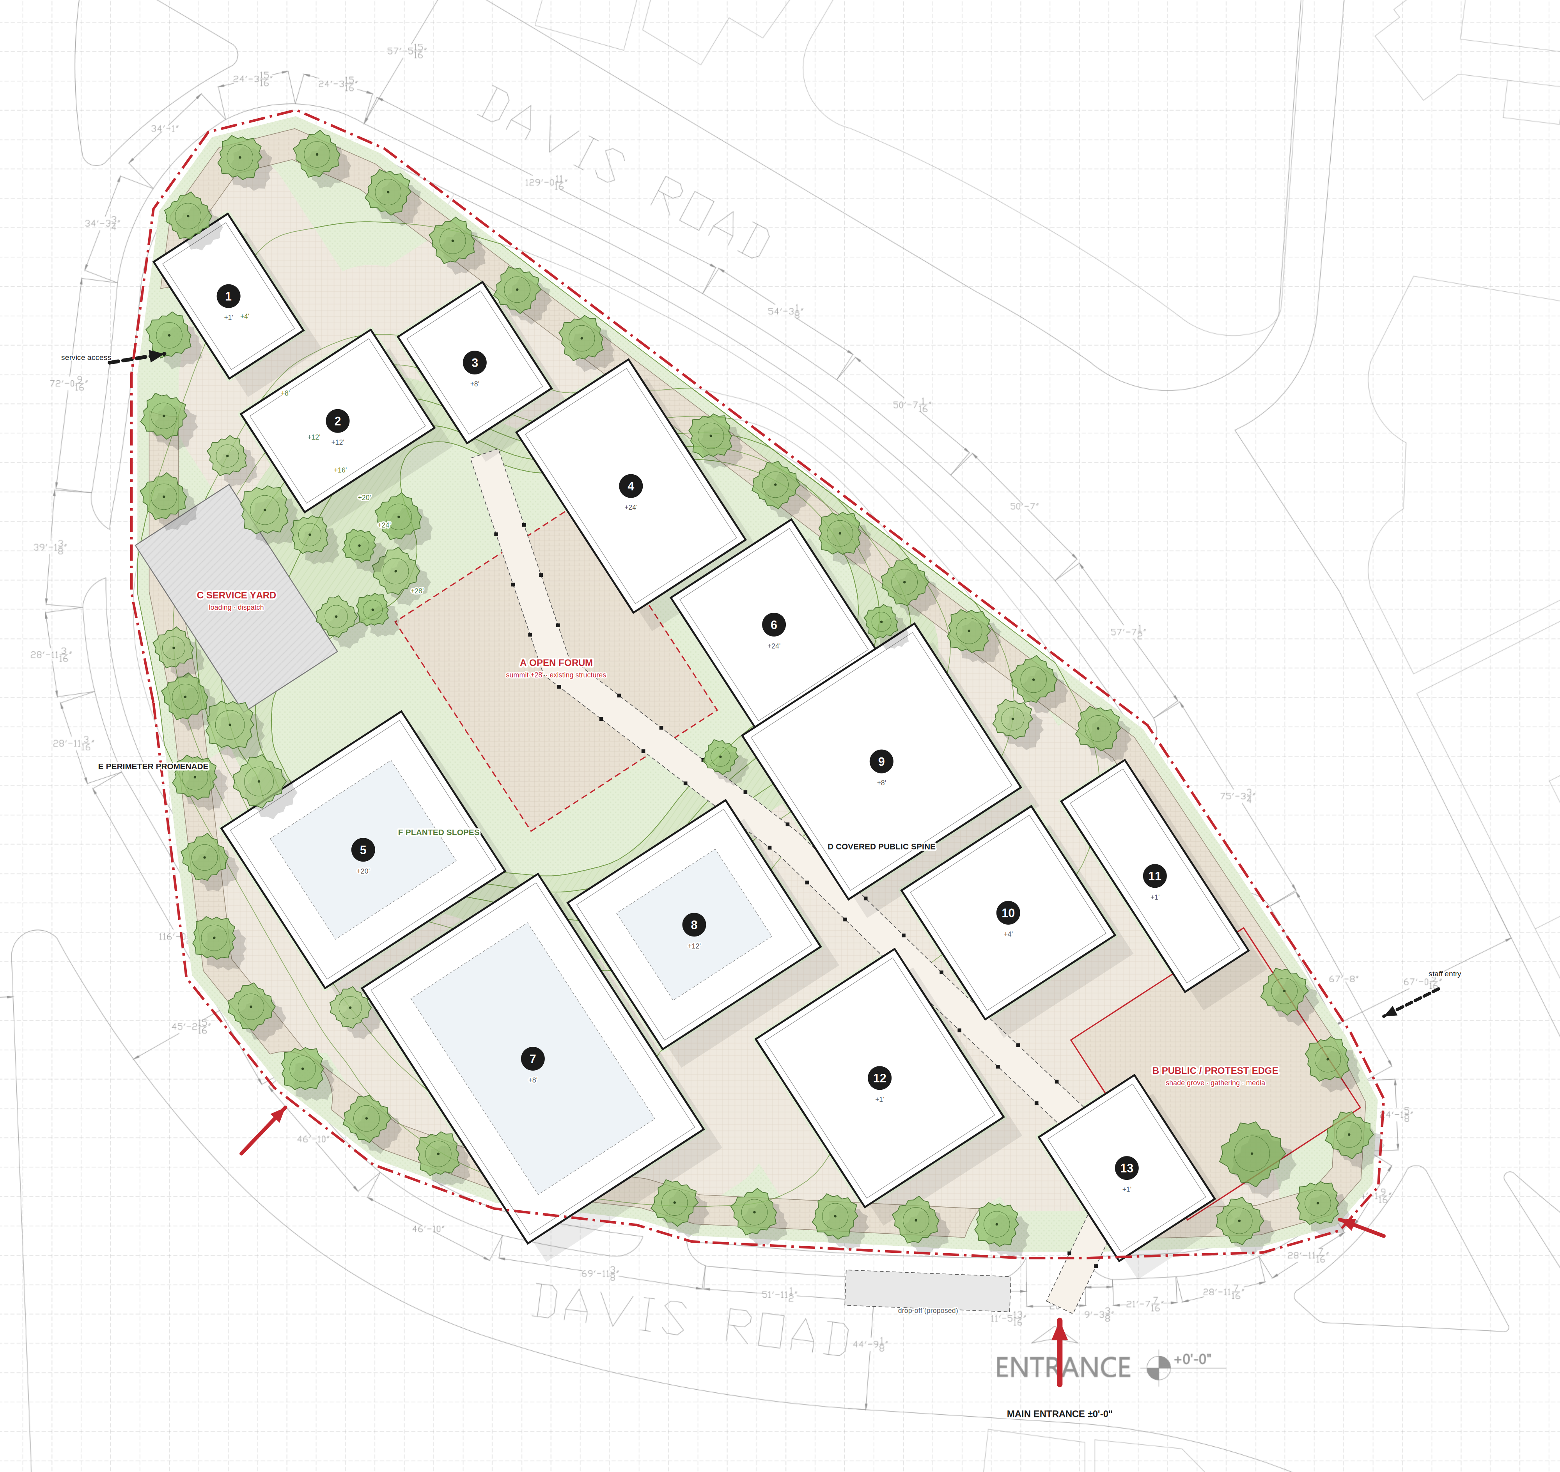
MASTER PLAN
The Contemporary Publishing House · Shimla Pahari, Lahore
0
25
50
75
100
feet · north not shown on survey
BUILDINGS
1
PRINT + DISPATCH (47' × 30')
2
ARCHIVE (40' × 53')
3
RESEARCH (43' × 34')
4
MEDIA + EDITORIAL (73' × 45')
5
AUDITORIUM (65' × 73')
6
WORKSHOPS + EDUCATION (53' × 49')
7
EXHIBITION · PRESS CONF. · FORUM HALL (103' × 71')
8
PUBLIC LIBRARY (59' × 64')
9
NEW PRESS CLUB (66' × 70')
10
GAMES + RECREATION (52' × 53')
11
ADMIN + STAFF ENTRY (77' × 26')
12
CAFE · CANTEEN · BOOKSHOP (68' × 56')
13
ENTRY PAVILION (50' × 39')
OPEN SPACES
A Open forum — summit +28', existing structures
B Public / protest edge — shade grove
C Service yard — loading, dispatch
D Covered public spine
E Perimeter promenade
F Planted slopes — no building
public entrances
service / staff
SITE DATA Site (traced) ≈ 104,706 ft² · built footprint ≈ 41,942 ft² (40%) · open / landscape ≈ 60%. Levels ±0' to +28' from survey; no regrading — buildings on slopes step or stand on piers. Old Press Club removed.

