Slide 1
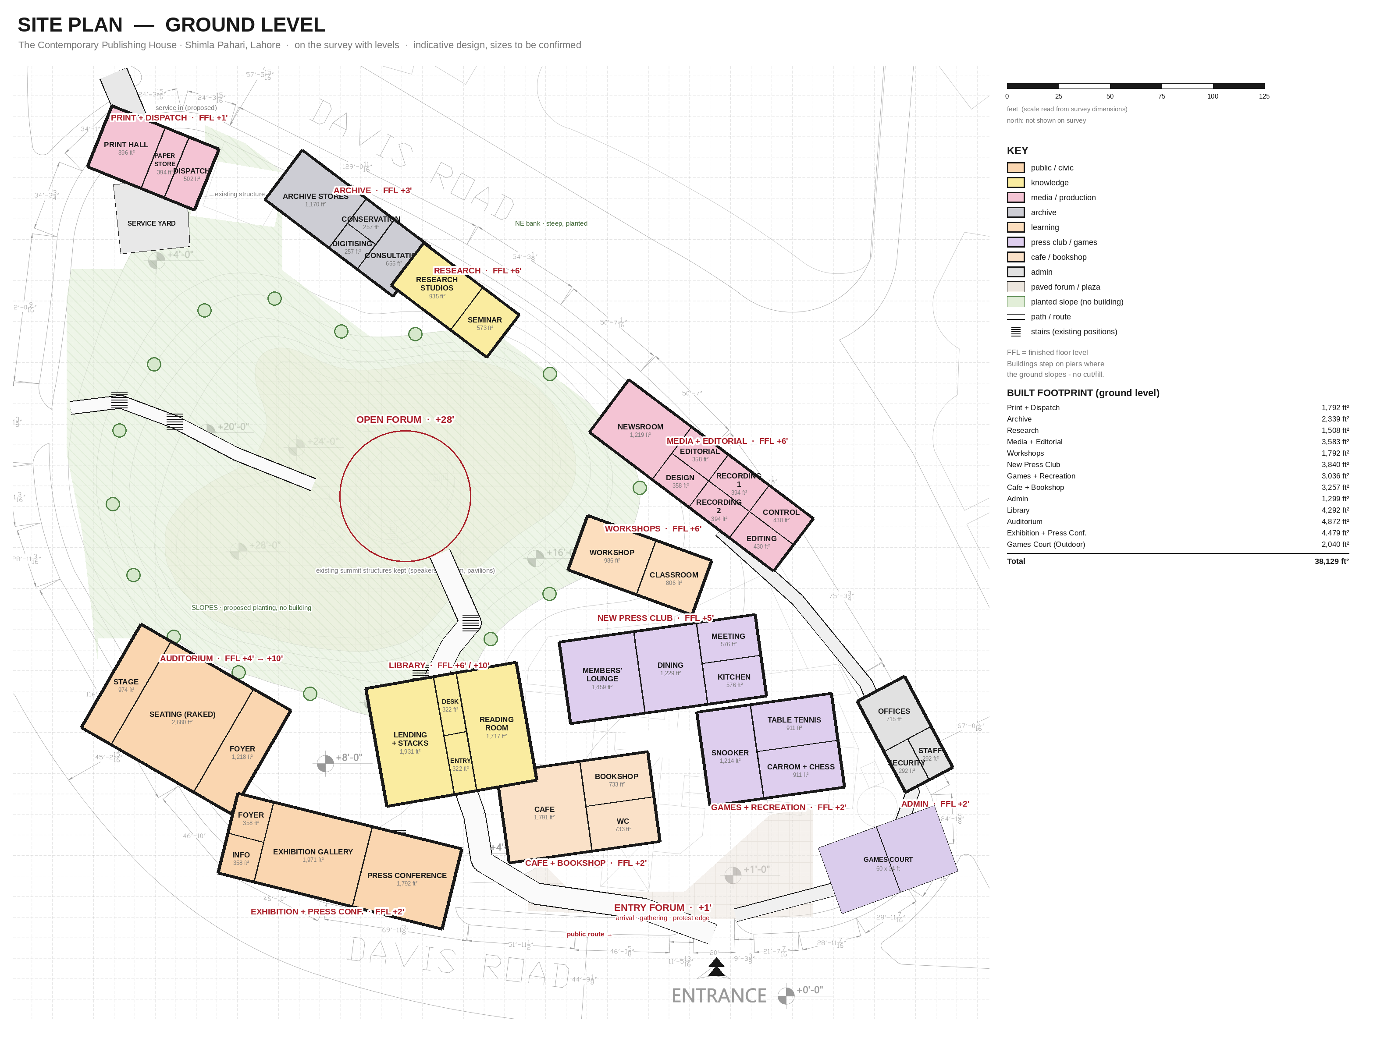

Slide 2
SITE PLAN — ROOM SCHEDULE (ground level)
Areas measured off the drawn plan (ft², gross, measured to wall centrelines). The handout gives no areas — these are my proposal, to test against a brief schedule.
BUILDING | ROOM | ft²
PRINT + DISPATCH | PRINT HALL | 896
 | PAPER STORE | 394
 | DISPATCH | 502
 | subtotal | 1,792
ARCHIVE | ARCHIVE STORES | 1,170
 | CONSERVATION | 257
 | DIGITISING | 257
 | CONSULTATION | 655
 | subtotal | 2,339
RESEARCH | RESEARCH STUDIOS | 935
 | SEMINAR | 573
 | subtotal | 1,508
MEDIA + EDITORIAL | NEWSROOM | 1,219
 | EDITORIAL | 358
 | DESIGN | 358
 | RECORDING 1 | 394
 | RECORDING 2 | 394
 | CONTROL | 430
 | EDITING | 430
 | subtotal | 3,583
WORKSHOPS | WORKSHOP | 986
 | CLASSROOM | 806
 | subtotal | 1,792
NEW PRESS CLUB | MEMBERS' LOUNGE | 1,459
 | DINING | 1,229
 | MEETING | 576
 | KITCHEN | 576
 | subtotal | 3,840
GAMES + RECREATION | SNOOKER | 1,214
 | TABLE TENNIS | 911
 | CARROM + CHESS | 911
 | subtotal | 3,036
BUILDING | ROOM | ft²
CAFE + BOOKSHOP | CAFE | 1,791
 | BOOKSHOP | 733
 | WC | 733
 | subtotal | 3,257
ADMIN | OFFICES | 715
 | STAFF | 292
 | SECURITY | 292
 | subtotal | 1,299
LIBRARY | LENDING + STACKS | 1,931
 | DESK | 322
 | ENTRY | 322
 | READING ROOM | 1,717
 | subtotal | 4,292
AUDITORIUM | STAGE | 974
 | SEATING (RAKED) | 2,680
 | FOYER | 1,218
 | subtotal | 4,872
EXHIBITION + PRESS CONF. | FOYER | 358
 | INFO | 358
 | EXHIBITION GALLERY | 1,971
 | PRESS CONFERENCE | 1,792
 | subtotal | 4,479
GAMES COURT (outdoor) | court | 2,040
 | subtotal | 2,040
TOTAL GROUND-LEVEL FOOTPRINT ≈ 38,129 ft² (≈36% of the traced site)

Slide 3
HOW THE PLAN MEETS THE GROUND
ELEMENT | FFL | HOW IT SITS
Entry forum · cafe · games · court · exhibition · admin | +1' to +2' | flat base — slab on grade, no fill
New press club | +5' | sits on the gentle rise N of the old club; one step up from the forum
Library | +6' / +10' | two floor plates stepping with the S slope; reading room on the upper step faces the summit
Auditorium | +4' → +10' | raked seating follows the existing slope; foyer at the low end, stage at the high end
Archive · research · media · workshops (NE bank) | +3' to +6' | long bars parallel to the contours; floor on piers where the bank drops to the road
Print + dispatch | +1' | flat NW pocket; own service yard off Davis Rd N (proposed access)
Slopes +12' to +28' | — | planted; existing stairs kept as the public route
Summit +28' | — | open forum around the existing structures; nothing new built
Open items: the survey has no north point; the service access, all building sizes and upper floors are proposals. Upper floors (e.g. second floors for research + media) are the next step.

