Slide 1
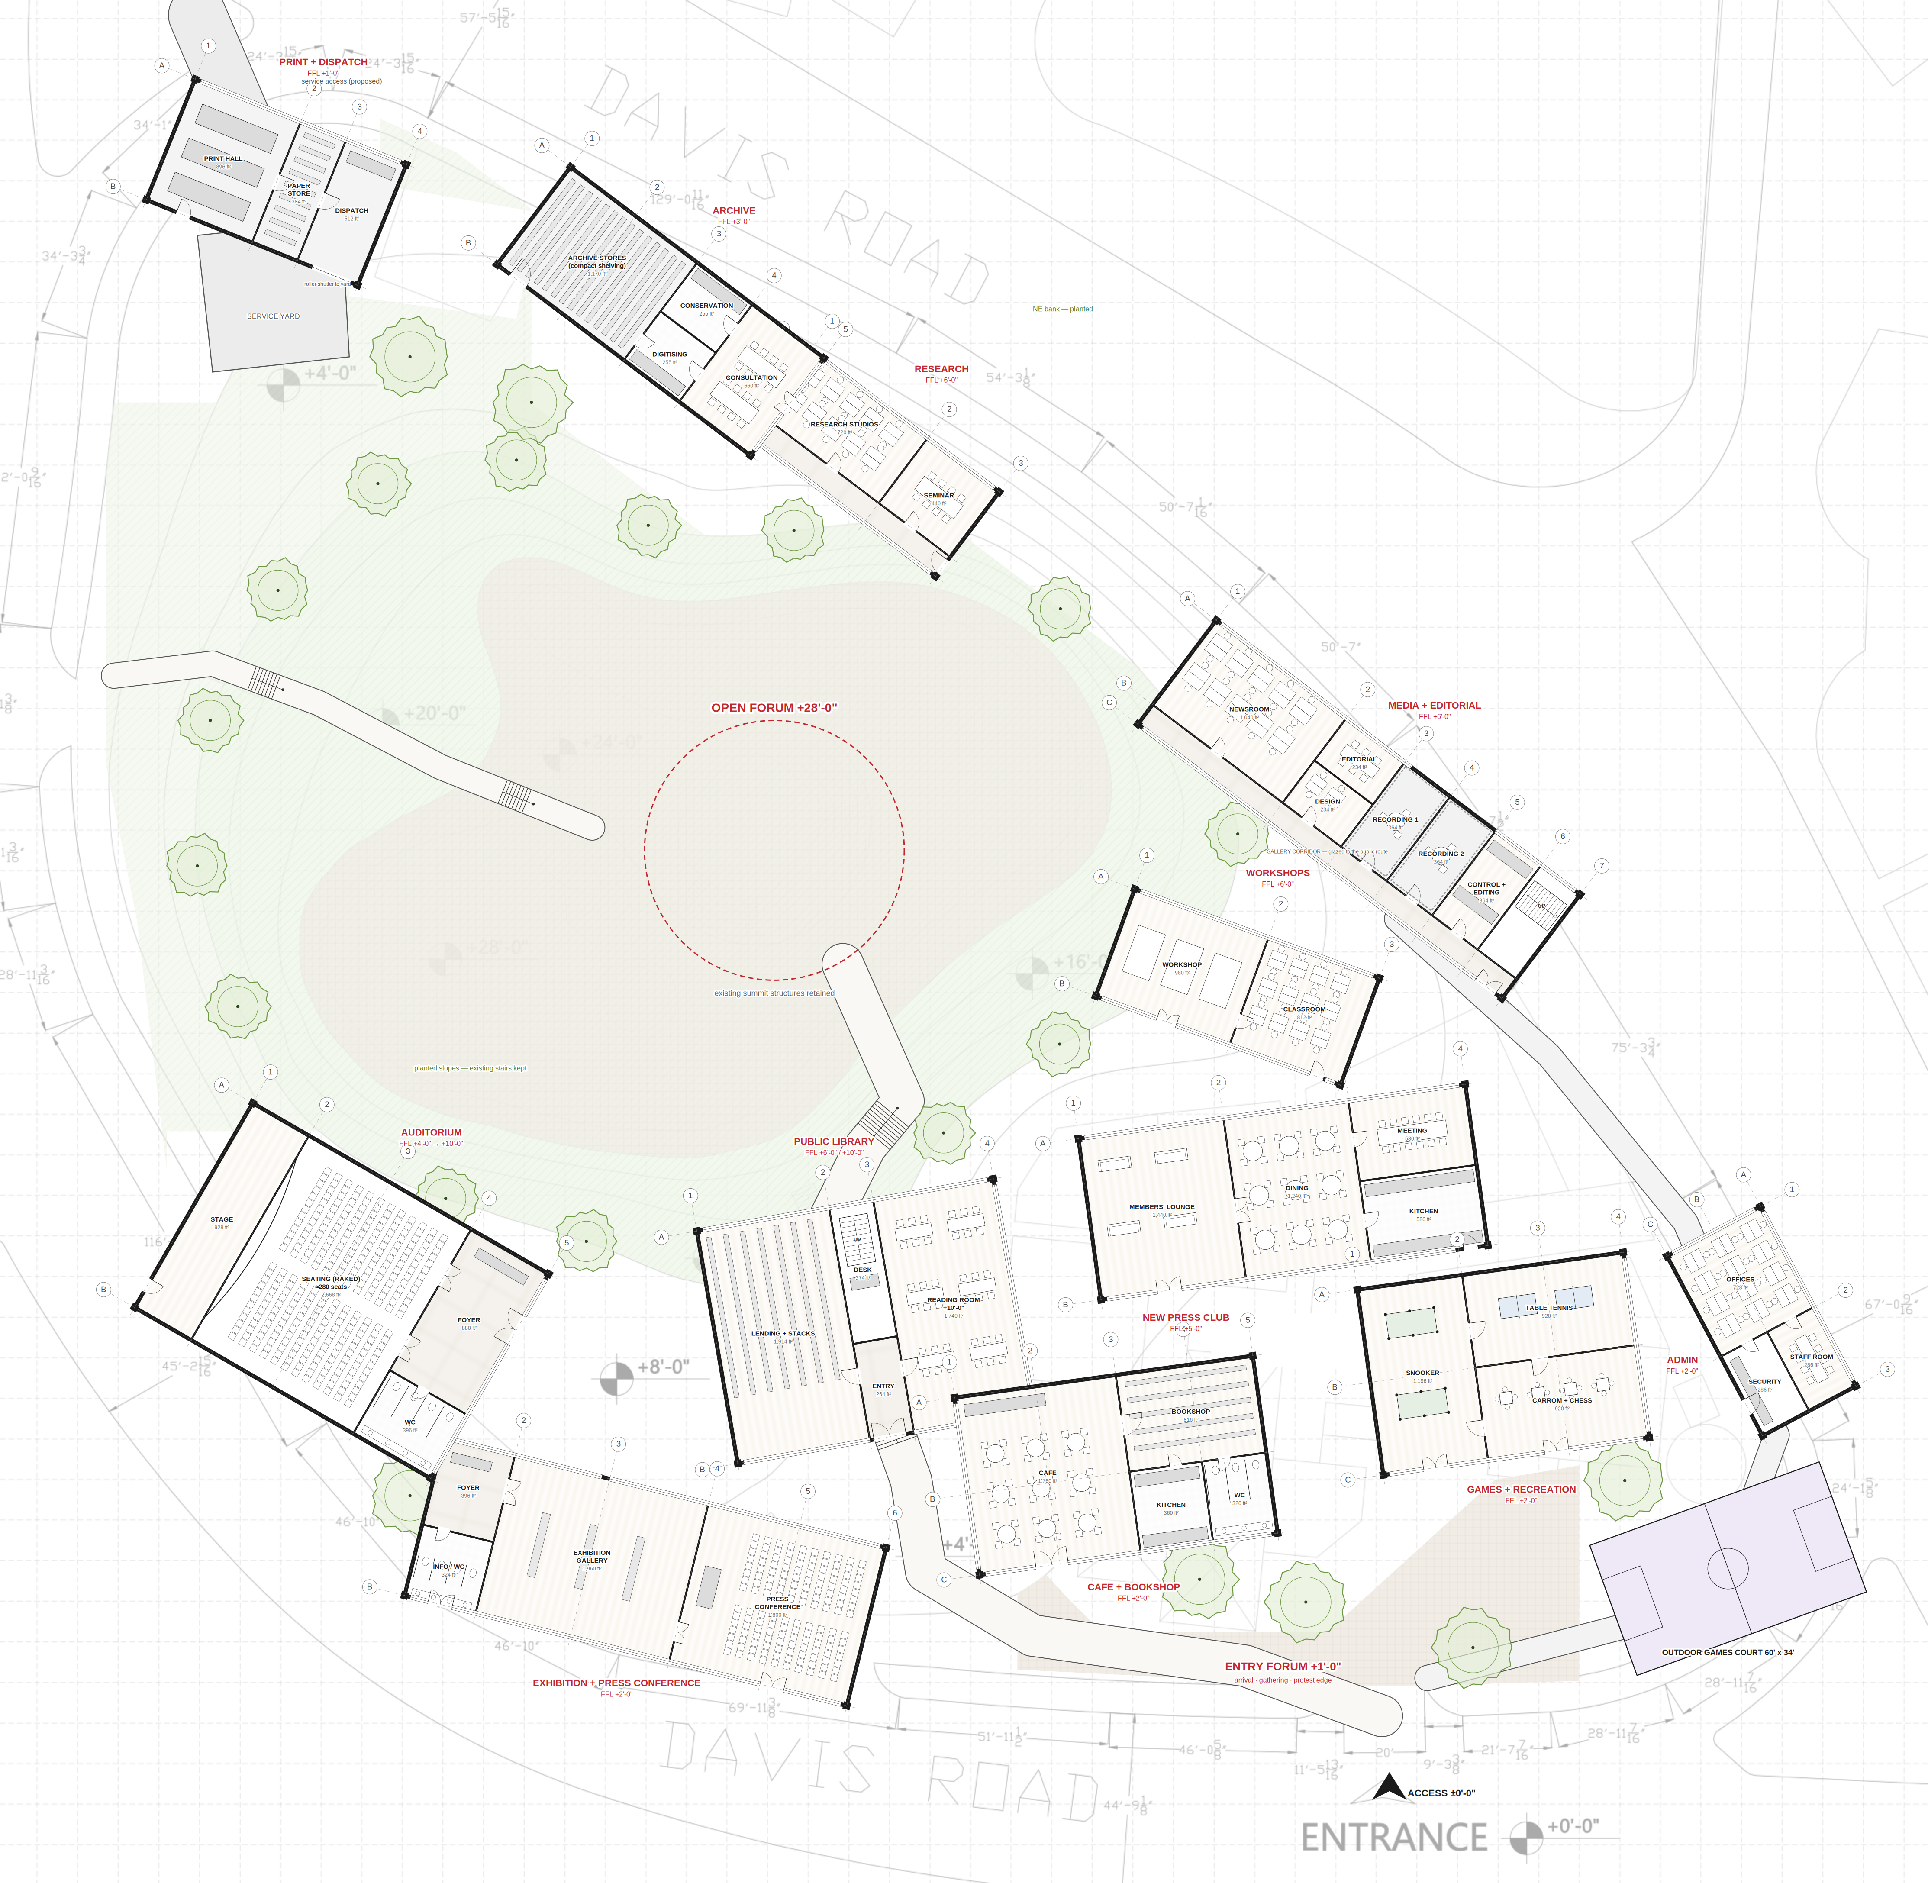
GROUND FLOOR PLAN — WHOLE SITE
The Contemporary Publishing House · Shimla Pahari, Lahore
0
25
50
75
100
feet · north not shown on survey
KEY
poché / wall
glazing (thin double line)
timber floor
tiled (wet areas)
paving / forum
planted slope
①②③ / Ⓐ Ⓑ structural grid per building
FFL finished floor level above the survey ±0'-0" at the entrance
Areas ft², measured off the drawing (proposal)
Base: Shimla Pahari survey (contours, levels, dimensions). Old Press Club removed. Building sizes, rooms, furniture and service access are design proposals.

Slide 2
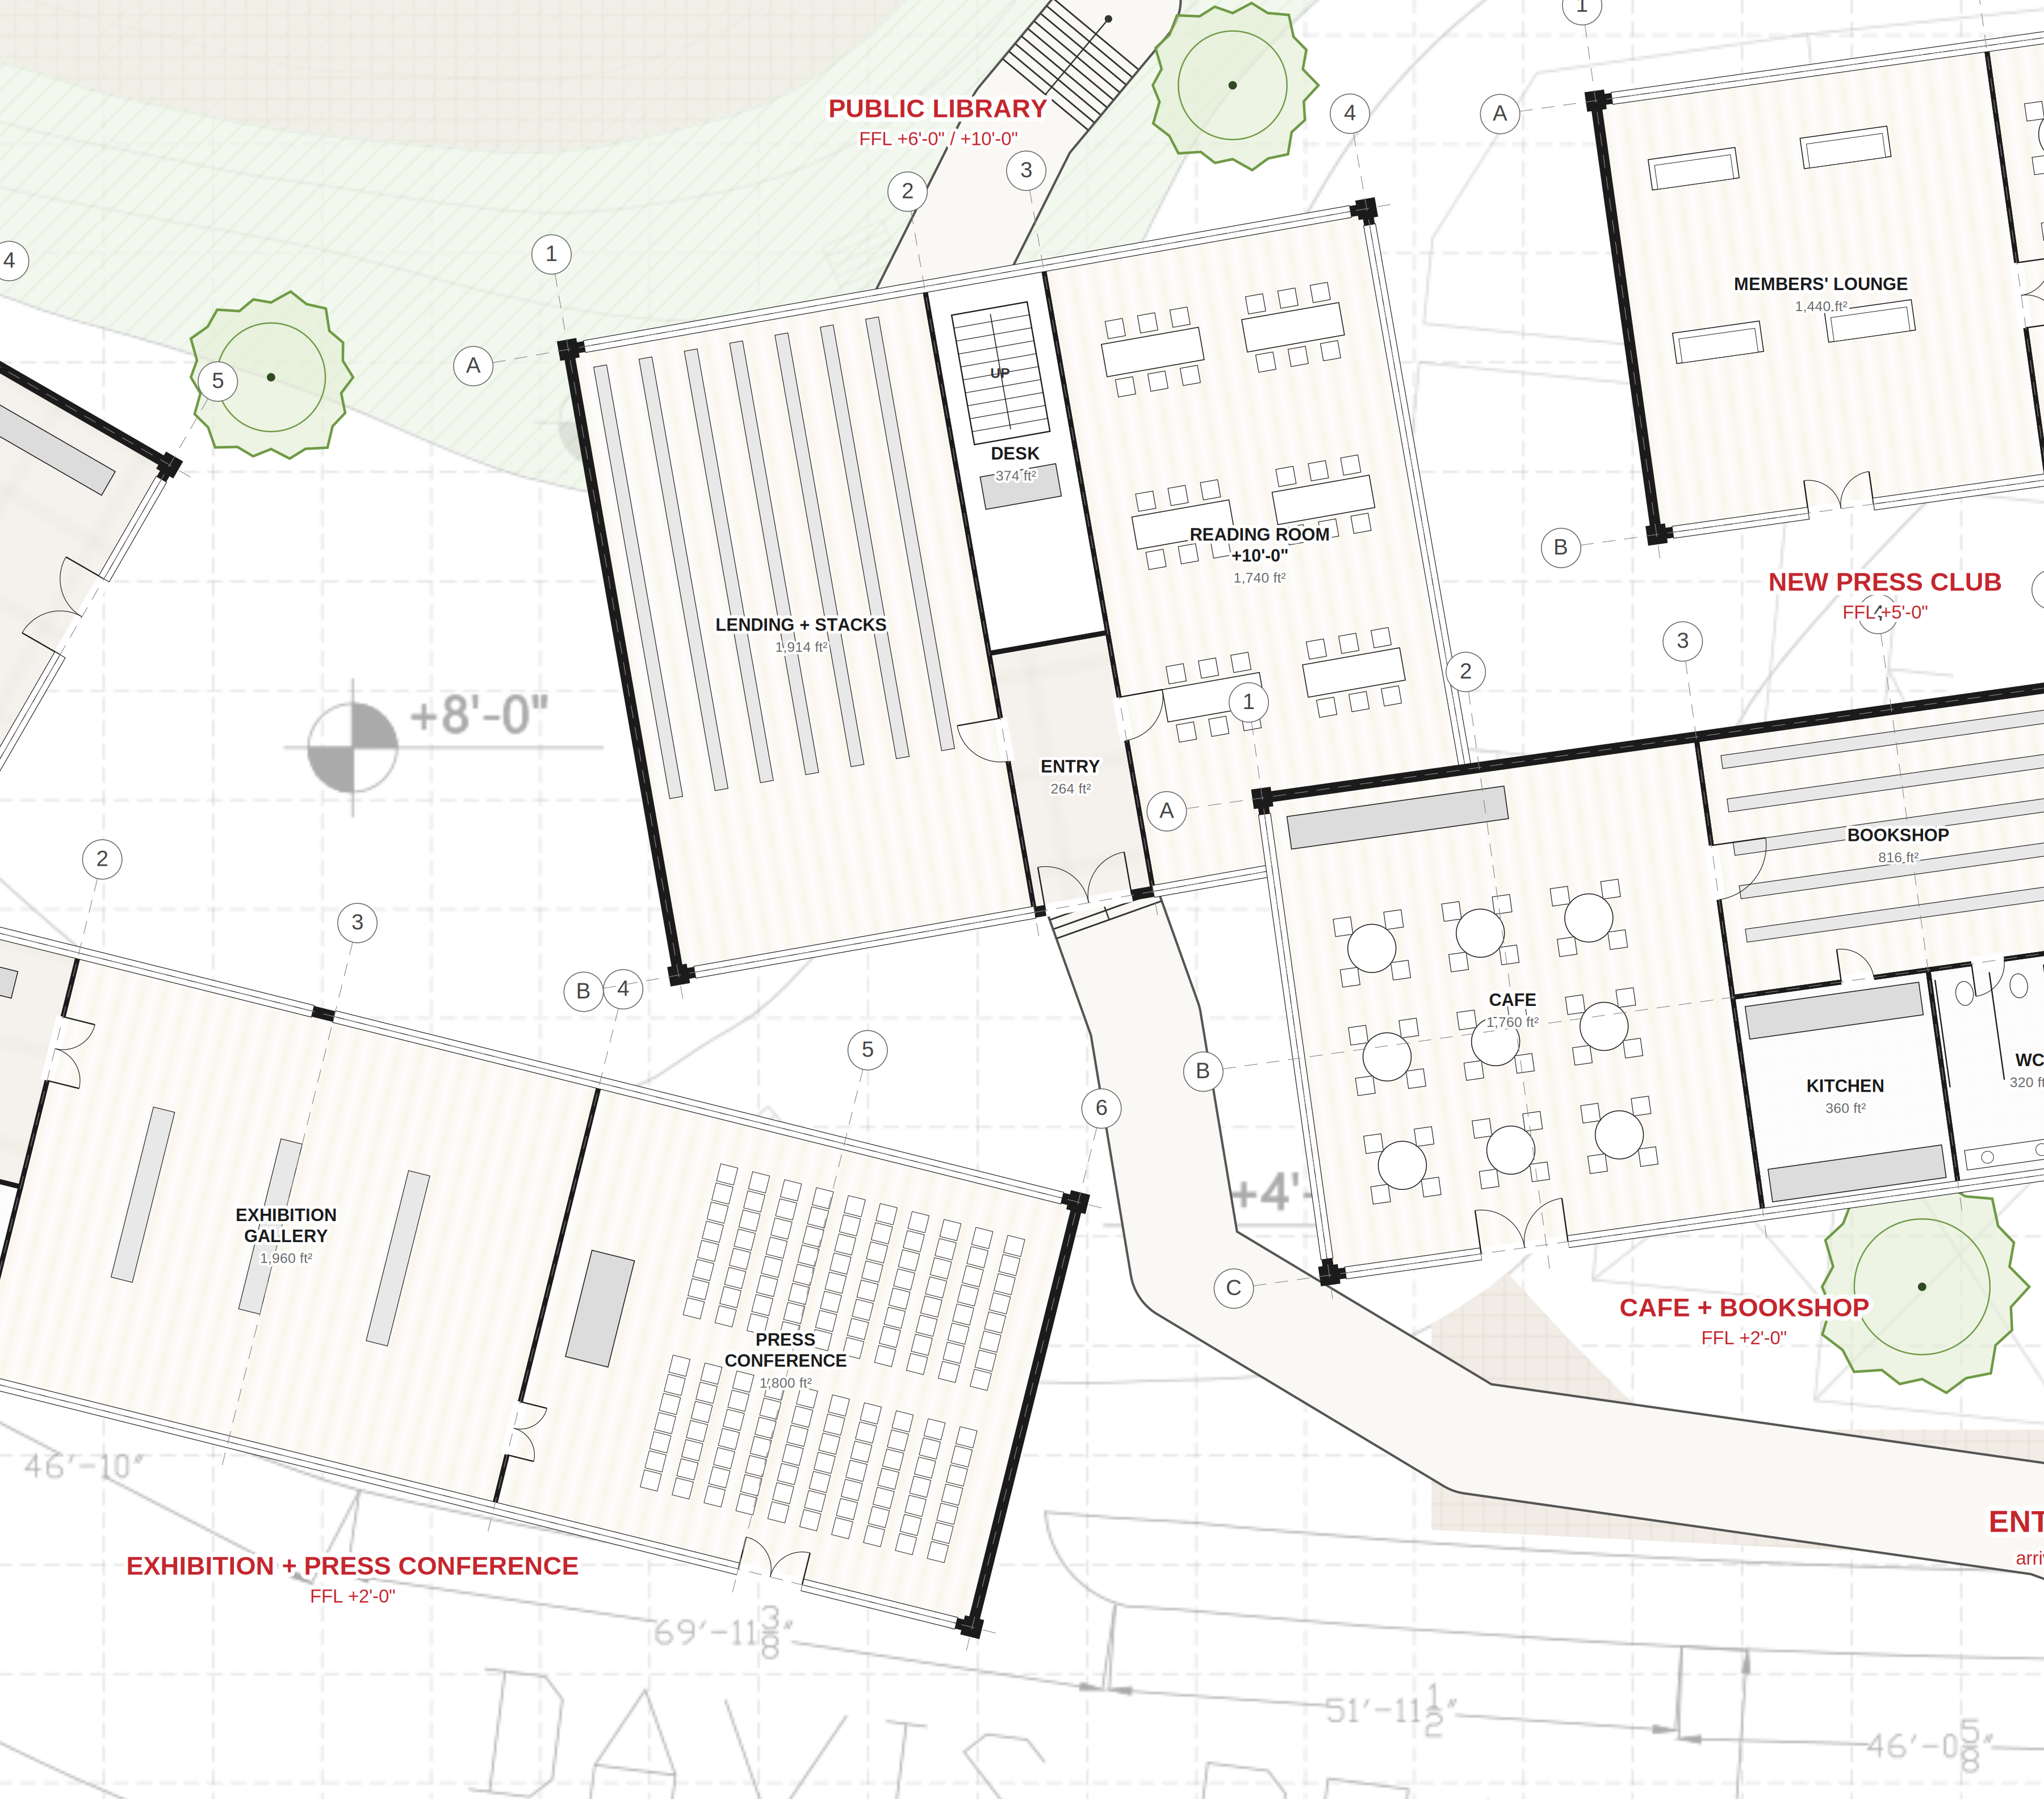
ENLARGED PLAN 1 — CIVIC FRONT: exhibition · press conference · library · cafe
The Contemporary Publishing House · Shimla Pahari, Lahore
0
10
20
30
40
feet · north not shown on survey
KEY
poché / wall
glazing (thin double line)
timber floor
tiled (wet areas)
paving / forum
planted slope
①②③ / Ⓐ Ⓑ structural grid per building
FFL finished floor level above the survey ±0'-0" at the entrance
Areas ft², measured off the drawing (proposal)
Base: Shimla Pahari survey (contours, levels, dimensions). Old Press Club removed. Building sizes, rooms, furniture and service access are design proposals.

Slide 3
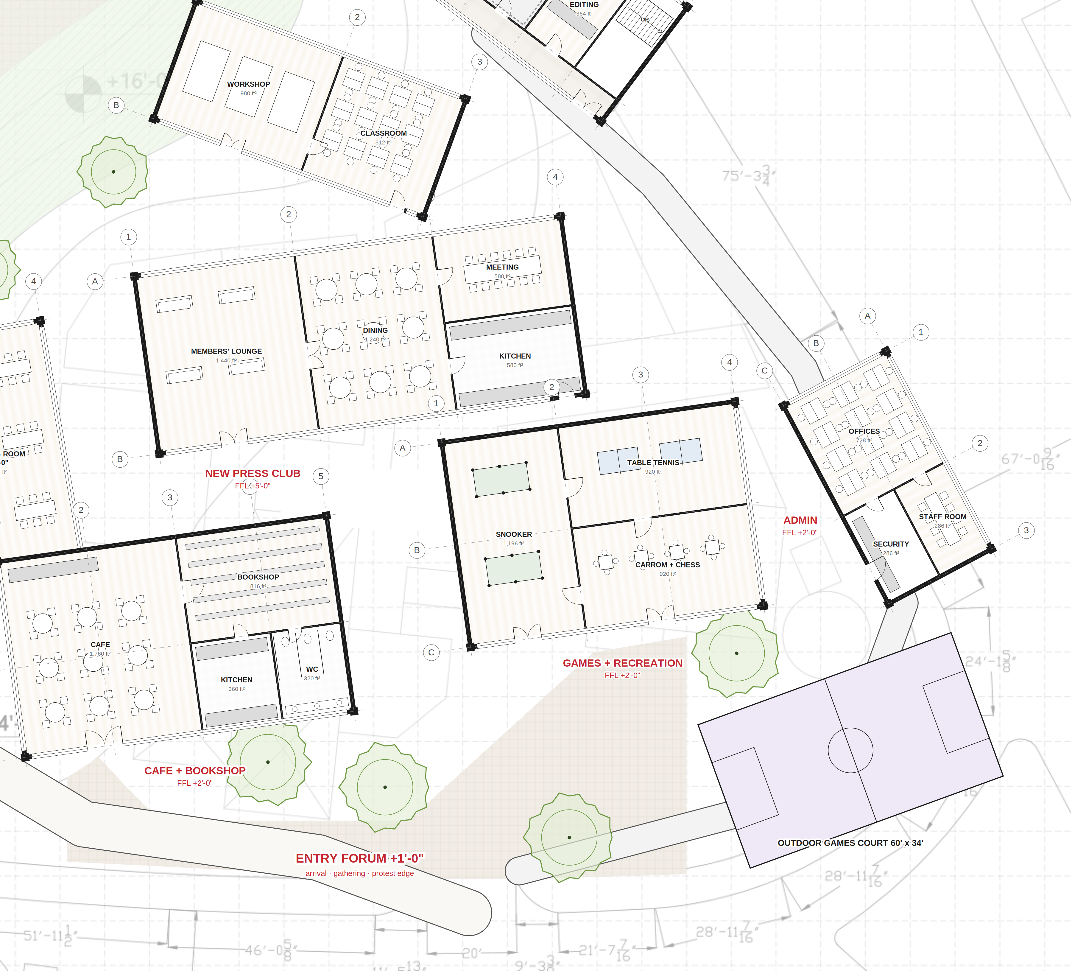
ENLARGED PLAN 2 — CLUB + RECREATION: new press club · games · admin · workshops · court
The Contemporary Publishing House · Shimla Pahari, Lahore
0
10
20
30
40
feet · north not shown on survey
KEY
poché / wall
glazing (thin double line)
timber floor
tiled (wet areas)
paving / forum
planted slope
①②③ / Ⓐ Ⓑ structural grid per building
FFL finished floor level above the survey ±0'-0" at the entrance
Areas ft², measured off the drawing (proposal)
Base: Shimla Pahari survey (contours, levels, dimensions). Old Press Club removed. Building sizes, rooms, furniture and service access are design proposals.

Slide 4
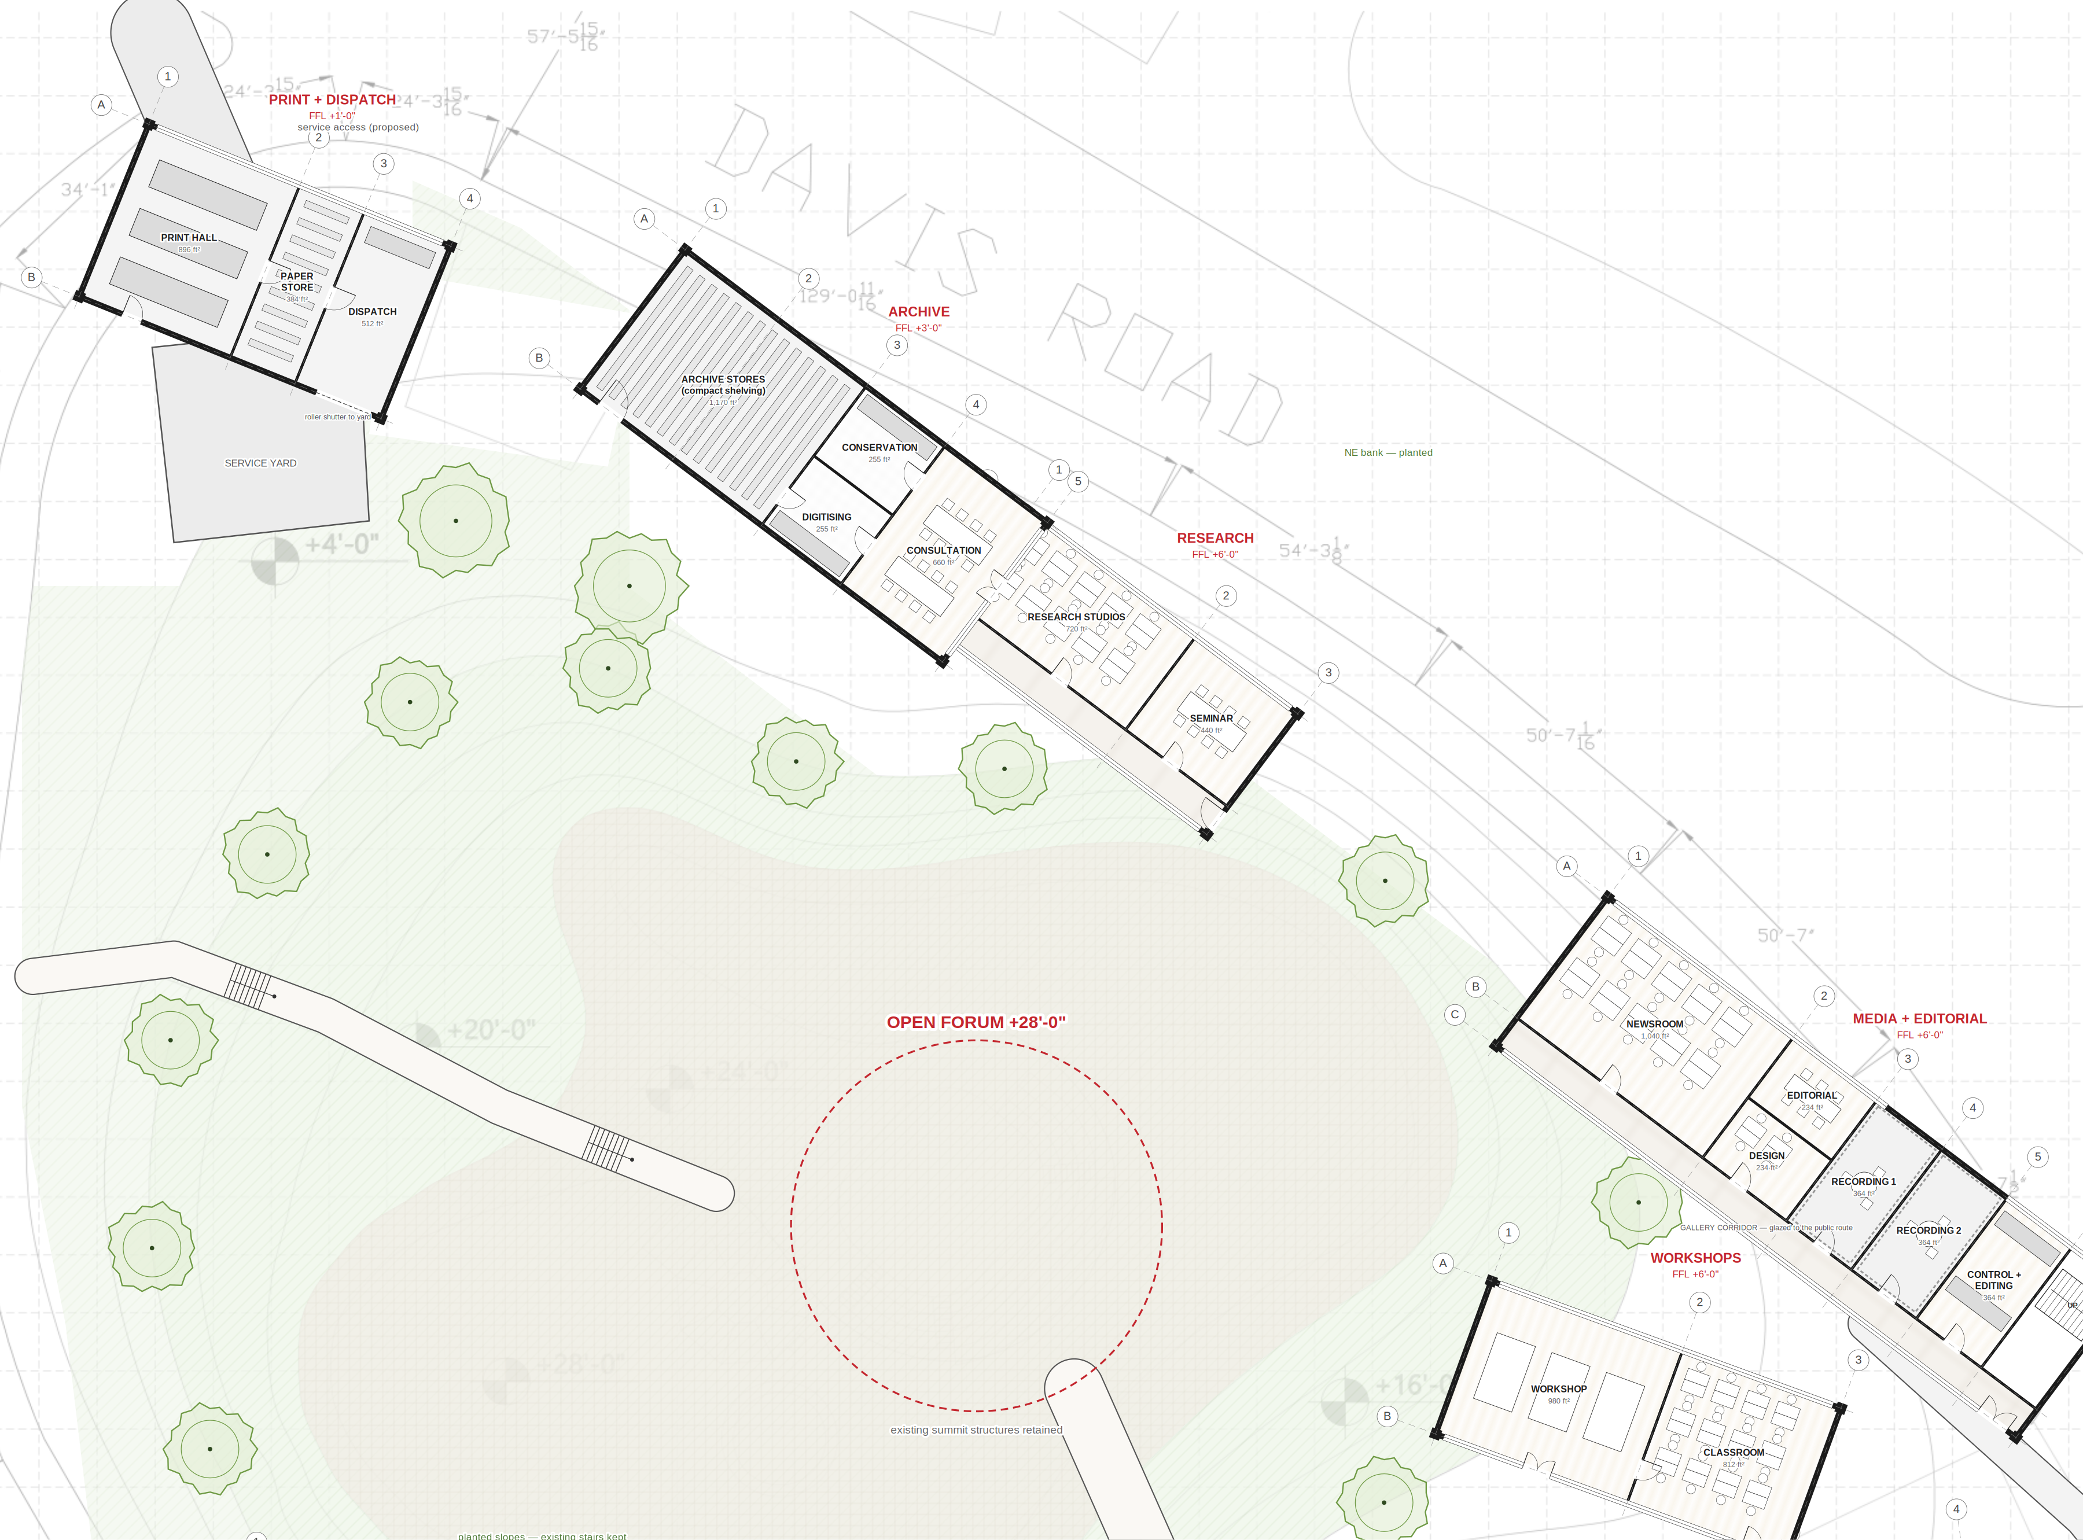
ENLARGED PLAN 3 — NE BANK: print · archive · research · media + editorial
The Contemporary Publishing House · Shimla Pahari, Lahore
0
10
20
30
40
feet · north not shown on survey
KEY
poché / wall
glazing (thin double line)
timber floor
tiled (wet areas)
paving / forum
planted slope
①②③ / Ⓐ Ⓑ structural grid per building
FFL finished floor level above the survey ±0'-0" at the entrance
Areas ft², measured off the drawing (proposal)
Base: Shimla Pahari survey (contours, levels, dimensions). Old Press Club removed. Building sizes, rooms, furniture and service access are design proposals.

