Slide 1
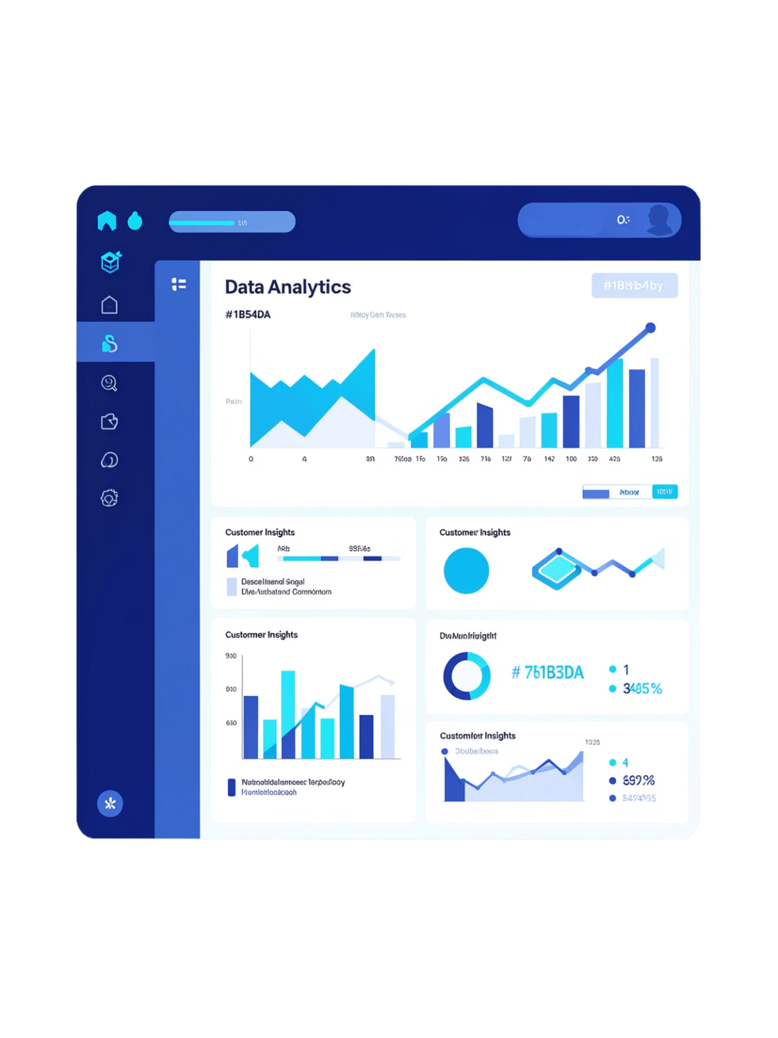
Customer Shopping Behavior Analysis
A complete data analysis project exploring spending patterns, customer segments, product preferences, and subscription behavior across 3,900 purchase records to support data-driven business decisions.

Slide 2
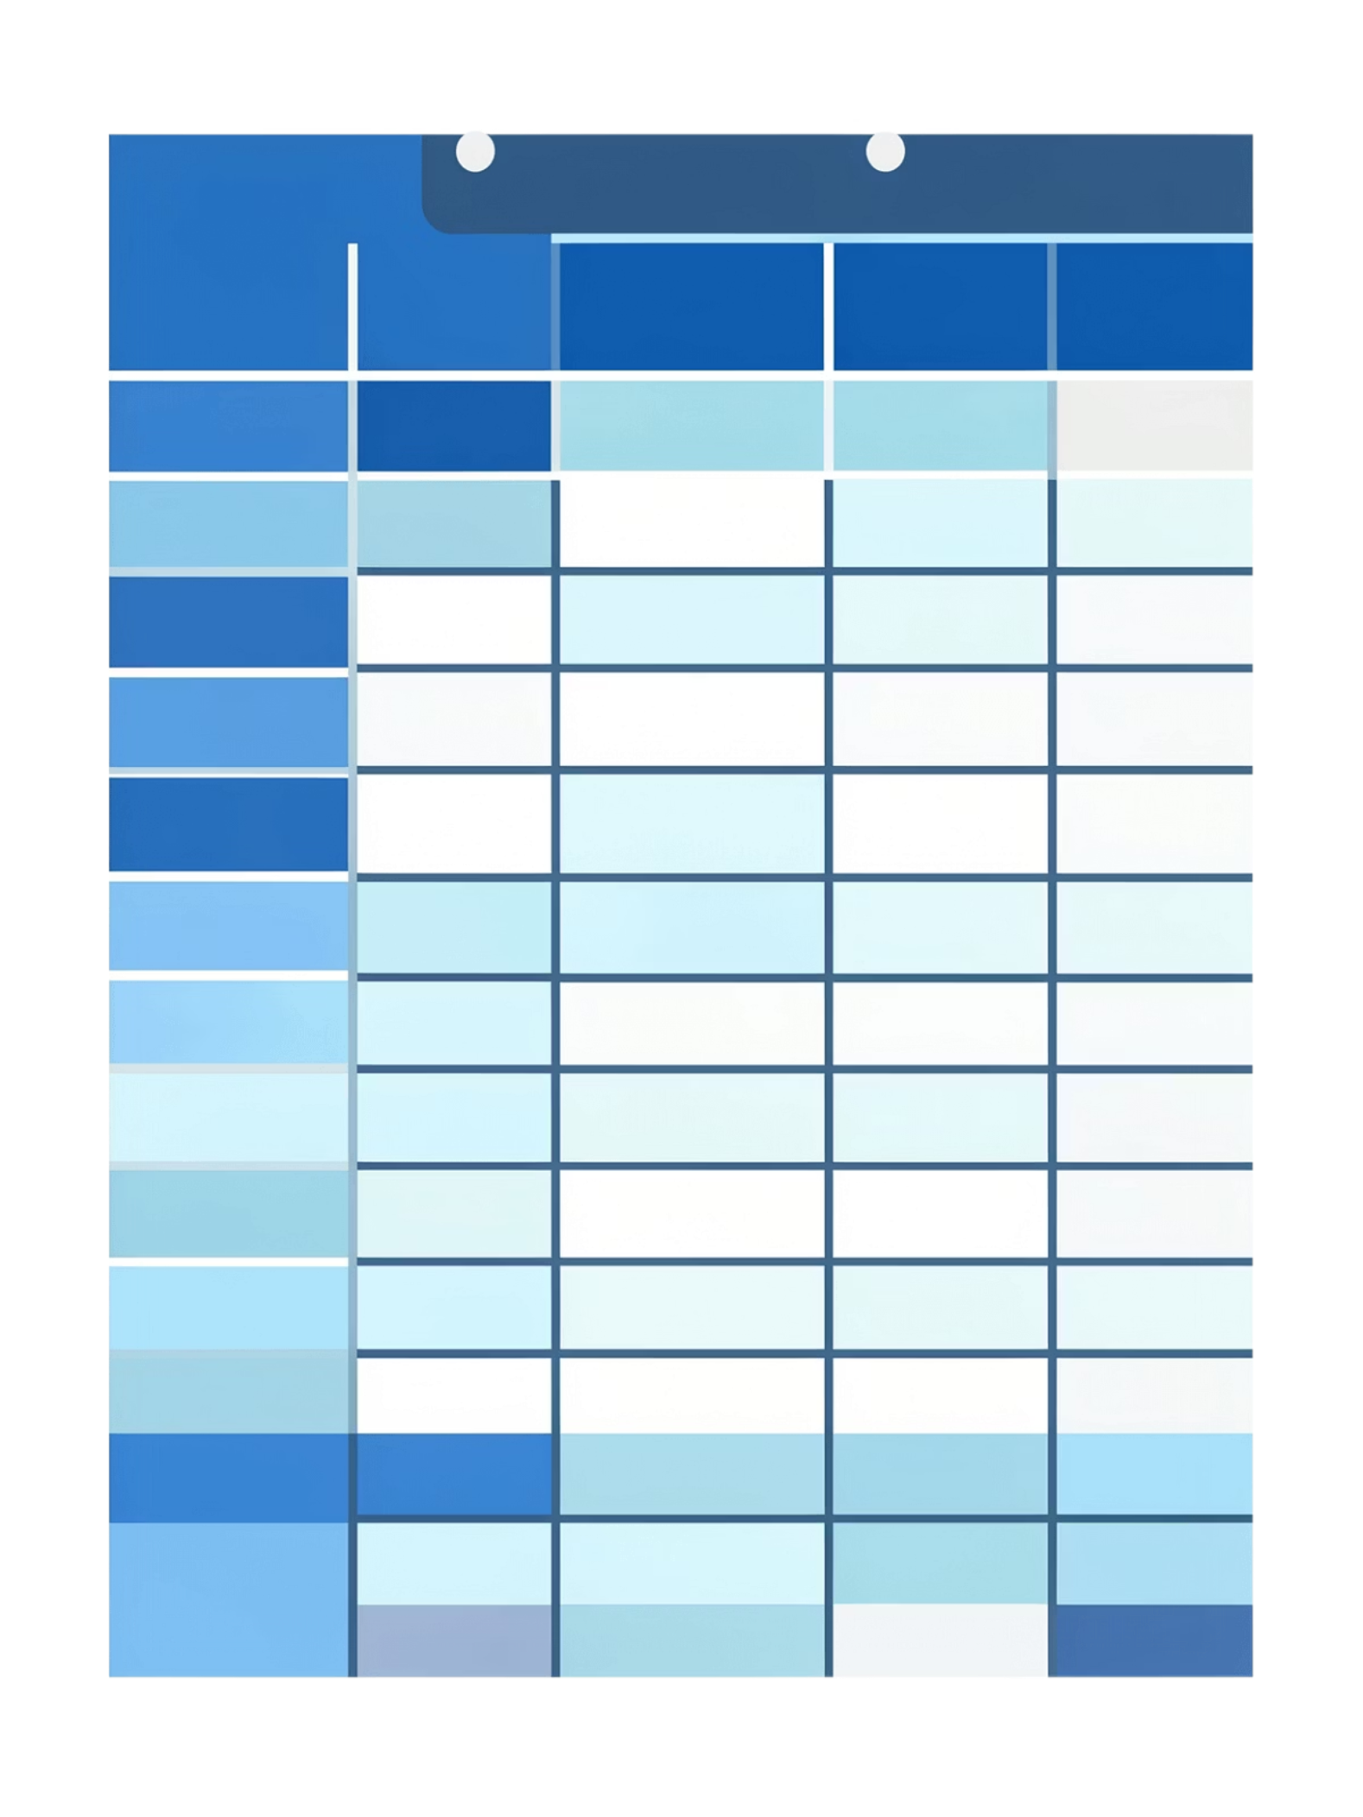

Dataset Overview
The dataset contains 3,900 purchase records across 18 columns, organized into three information groups:
Customer Info
Purchase Info
Age, Gender, Location, and Subscription Status
Item Purchased, Category, Purchase Amount, Season, Size, and Color
Shopping Behavior
Discount Applied, Payment Method, Frequency, Review Rating, and Shipping Type
37 missing values were found in the Review Rating column.

Slide 3


Data Preparation & Cleaning
Python & Pandas
Explored structure with df.info() and df.describe()
Replaced missing Review Ratings with category median
Standardized column names to snake_case
Created age_group and purchase_frequency_days features
Removed redundant promo_code_used column
Cleaned data was loaded into a PostgreSQL database for SQL analysis.

Slide 4

Revenue & Spending Patterns
Revenue by Gender
High-Spending Discount Users
Subscribers vs. Non-Subscribers
Male customers generated higher total revenue due to more purchase records, but average purchase amounts were relatively close between genders.
Customers using discounts still made purchases above the overall average, helping evaluate discount strategy effectiveness.
Non-subscribers generated more total revenue (larger group), but average purchase amounts were similar across both groups.

Slide 5
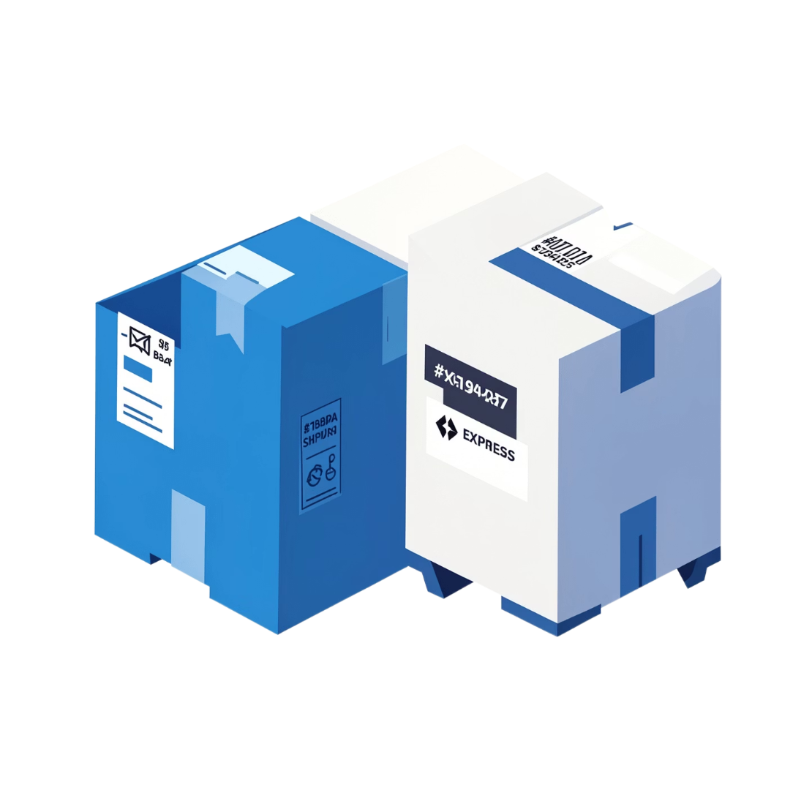
Shipping & Product Insights
Shipping Type Comparison
Express shipping purchases had a higher average purchase amount than Standard shipping — suggesting a link between premium shipping and higher spending.
Top Products by Rating
The top 5 highest-rated products were identified for potential inclusion in future marketing campaigns, as high ratings signal strong customer satisfaction.
Discount-Dependent Products
The 5 products with the highest percentage of discounted purchases were identified, revealing which items rely most on discounts to drive sales.

Slide 6
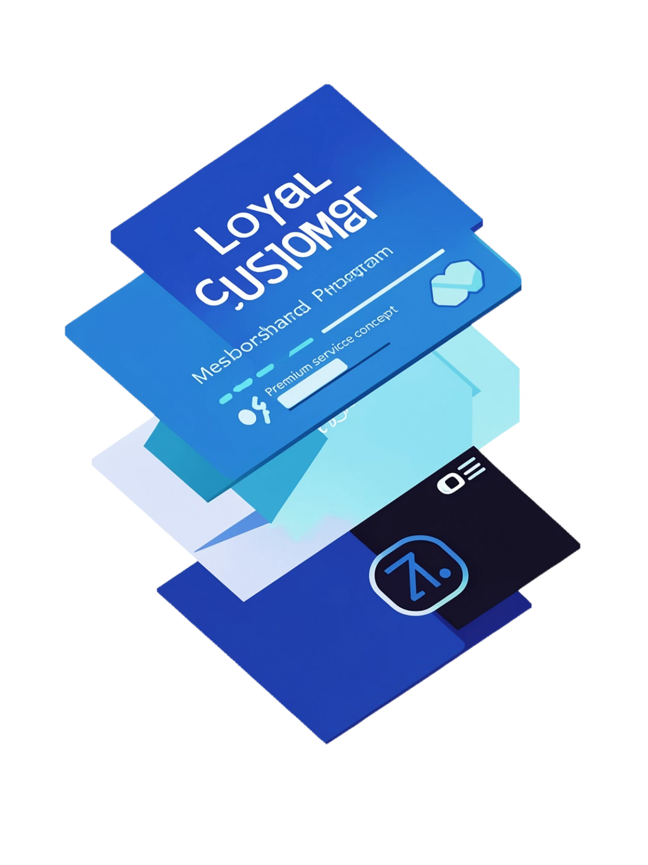
Customer Segmentation
Customers were divided into three segments based on previous purchase history:
New Customers
Returning Customers
Up to 5 previous purchases
More than 5, up to 10 previous purchases
Loyal Customers
More than 10 previous purchases — the largest segment, contributing a significant portion of total revenue

Slide 7
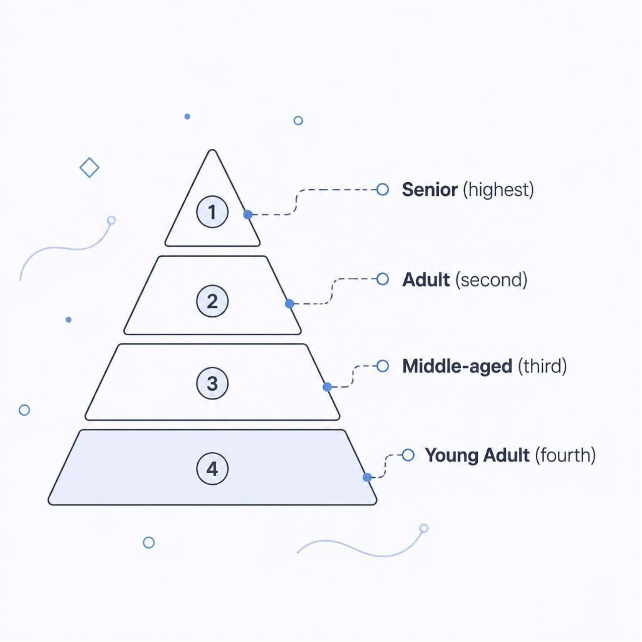
Repeat Buyers, Categories & Age Groups
Top Products per Category
Most purchased products were identified across Clothing, Footwear, Accessories, and Outerwear to improve product positioning and promotions.
Repeat Buyers & Subscriptions
Customers with 5+ purchases showed no significantly higher subscription rate vs. the overall base — purchase history alone may not explain subscription behavior.
Revenue by Age Group
The Senior group generated the highest revenue, followed by Adult and Middle-aged groups — useful for targeting marketing activities.

Slide 8






Key Findings
Gender Revenue
Express Shipping
Males drive higher total revenue; average spend is similar across genders.
Linked to higher average purchase amounts than Standard shipping.
Loyal Segment
Senior Age Group
Largest customer group, contributing significantly to total revenue.
Highest revenue-contributing age segment in the dataset.
Discount Variation
Subscription Behavior
Discount dependence differs by product, allowing tailored strategies.
Repeat buyers show no significantly higher subscription rate.

Slide 9
Business Recommendations
01
02
Enhance subscriptions with exclusive benefits, special offers, and loyalty rewards.
Build a loyalty program to reward repeat buyers and convert Returning customers to Loyal.
03
04
Review discount strategy — monitor high-dependency products to protect margins.
Promote top-rated products through marketing campaigns and recommendations.
05
06
Target high-revenue age groups and monitor campaign performance.
Evaluate Express shipping as a premium service to test its effect on spending.

Slide 10
Tools, Dashboard & Conclusion
Tools & Technologies
Conclusion
This project demonstrates a complete end-to-end analysis — from raw transactional data through cleaning, SQL analysis, and Power BI visualization.
Insights on customer spending, product ratings, discounts, subscriptions, shipping, loyalty, and age groups can directly support decisions on retention, promotions, and targeted marketing.
Python & Pandas
PostgreSQL & SQL
Loading, cleaning, feature engineering
Storage and business analysis
Power BI
Interactive dashboard & visualization

