Slide 1
Microservices
With Kubernetes

Slide 2
Why Microservices
1

Slide 3
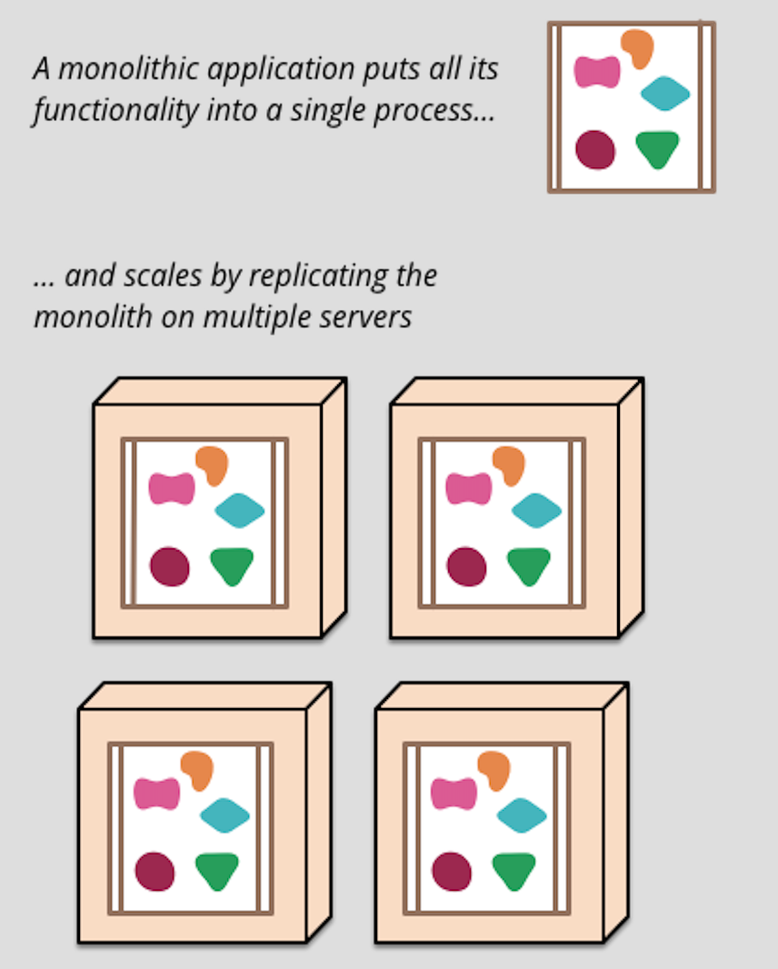
Monolithic Applications

Slide 4
Disadvantages of monolithic applications
Maintain huge code base
Larger monolithic application may be take longer start‑up time
Difficult to scale when different modules have conflicting resource requirements
Difficult to adopt new frameworks and languages

Slide 5
What are Microservices
2

Slide 6
A particular way of designing software applications as suites of independently deployable services
Highly maintainable and testable
Loosely coupled
Independently deployable
Communicate using lightweight protocols
State-less
Organized around business capabilities

Slide 7
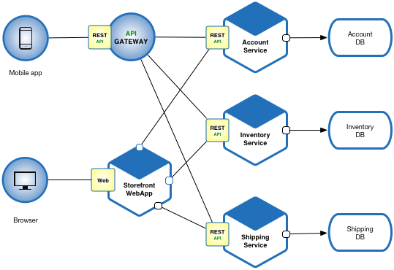
Notes:
Each service are independently deployble
Each one have own doan
We can use dedicated DB per each service, But when some requirments we may have to go with single centralized db
Here all services are exposed to external users through APIGateway.

Slide 8
How to implement Microservices
3

Slide 9
Topics
Container and Container Orchestration
Discovery and load balancing
Service resilience and Fault tolerance
API Gateway
Config Management
CI / CD
Demo

Slide 10
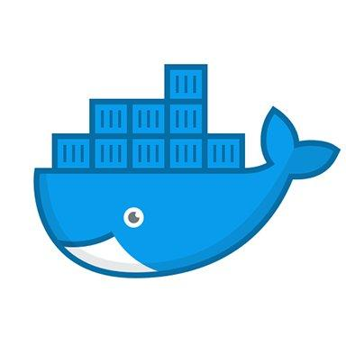
Container
Containers allow developers to make it possible to isolate applications into small, lightweight execution environments
.
Docker is a tool designed to make it easier to create, deploy, and run applications by using containers

Slide 11
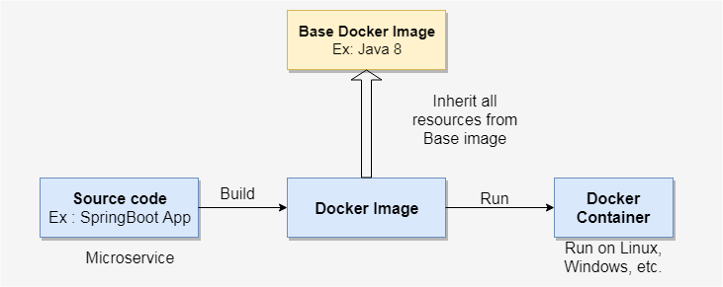
Docker Image Build Process

Slide 12
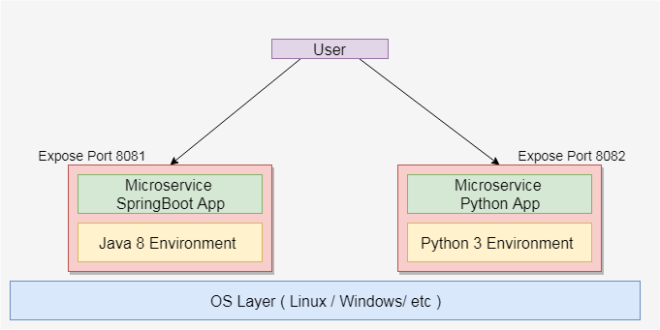
Docker Container Runtime

Slide 13
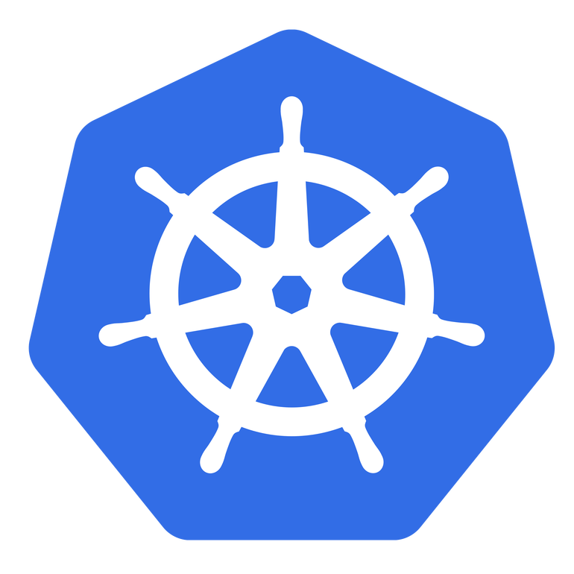
Container Orchestration
Container Orchestration allows developers to define how to coordinate and manage the containers.
Kubernetes is a tool for deploying and managing multi-container applications at scale

Slide 14
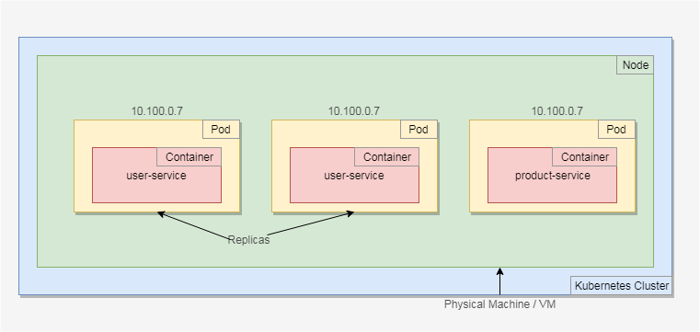
How containers are running inside the Kubernetes

Slide 15
Service Mesh
Layer to manage service-to-service communication

Slide 16
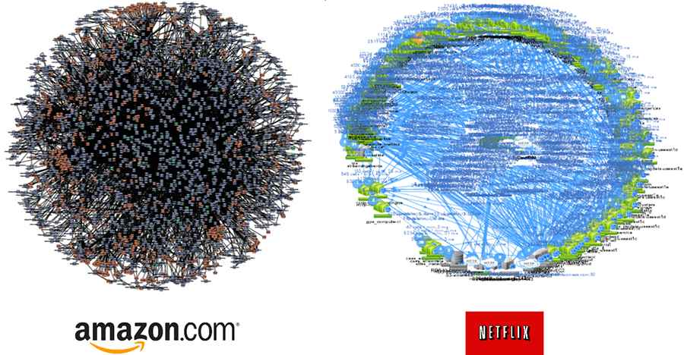
Service Mesh of Amazon and Netflix

Slide 17
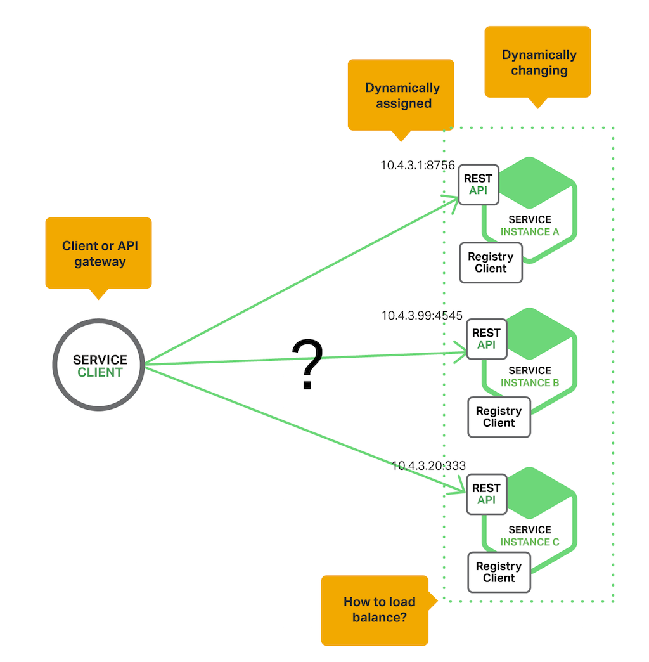
Discovery and load balancing
Why Discovery needs ?

Slide 18
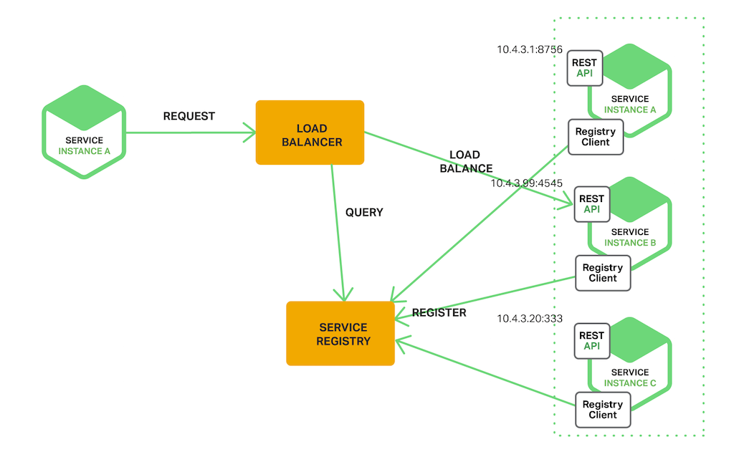
With Discovery Server

Slide 19
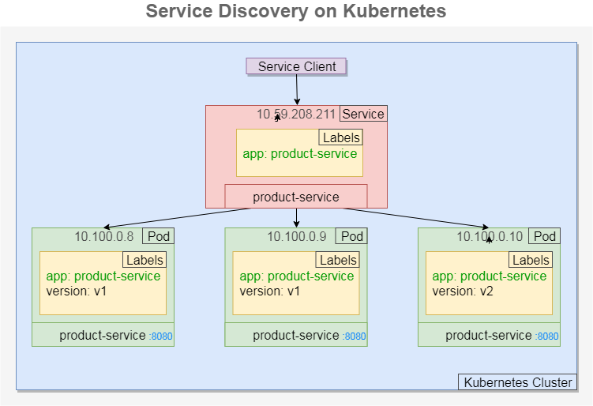
Notes:
Service is act as Load Blancer
It delegates request to perticular pod
Here to register Pod with the Service it use labling technique
In the service we menion what are the lebels , pods also have labels. Then the request are delegates to only mathing labels.

Slide 20
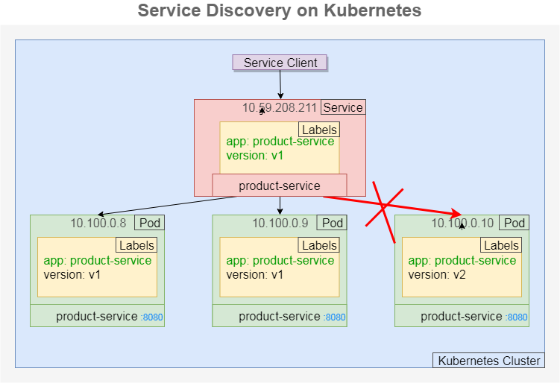
Notes:
This Service is supports only for app, version. Then request is pass onto these pod.

Slide 21
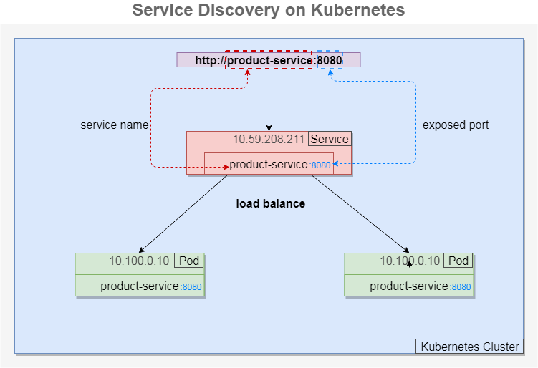

Slide 22
Service resilience and Fault tolerance
Why do you need to make service resilient?
A problem with Distributed applications is that they communicate over network – which is unreliable.
Hence you need to design your microservices in such a way that they are fault tolerant and handle failures gracefully.
Notes:
How continuasly functioning even in a faailiure situation
https://dotnetvibes.com/2018/08/06/making-your-microservices-resilient-and-fault-tolerant/

Slide 23
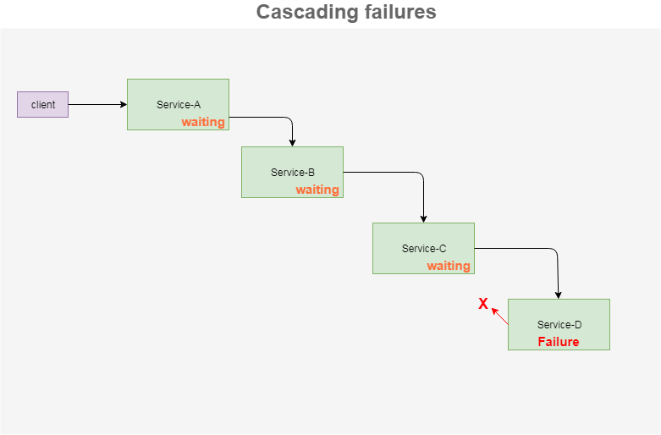

Slide 24
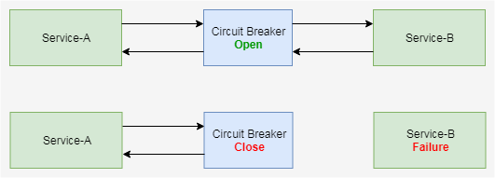
Circuit Breaker Pattern
If there are failures in the inter service communication, then you need to fail fast by opening the circuit.
So we return an exception immediately. The circuit is closed to allow normal functionality.

Slide 25
Circuit Breaker Implementation
Hystrix
Istio Circuit Breaker
Notes:
Istio is kubenetes service mesh technologies. It helps to implement Discover, FaultTolle etc , without changing any application code.
Hystrix is a java library. Istion can use with any application.
Its inject a proxy to the pod. Whole request are going through the proxy. The he handle the FaultTolle . We call SideCar proxy.

Slide 26
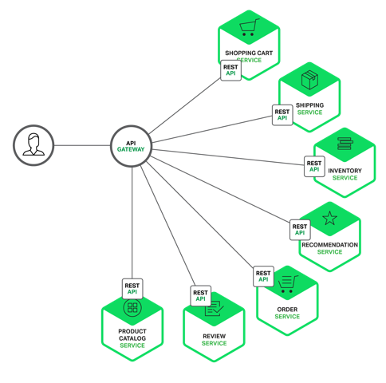
API Gateway
The entrypoint into the microservices based application from external API clients.
Notes:
How continuasly functioning even in a faailiure situation
https://dotnetvibes.com/2018/08/06/making-your-microservices-resilient-and-fault-tolerant/

Slide 27
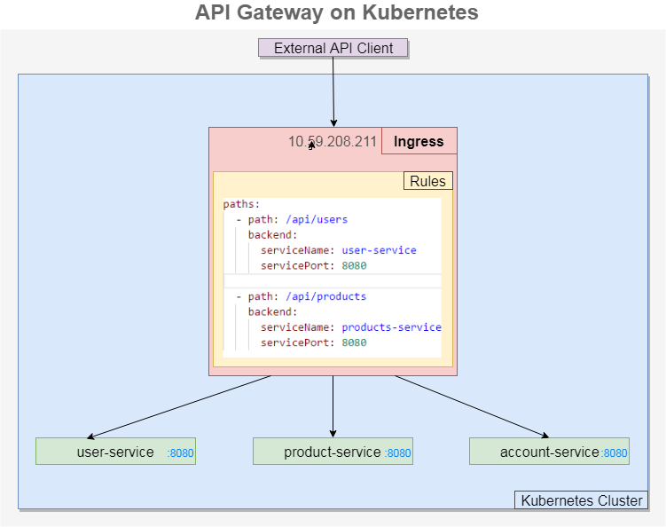
Notes:
How continuasly functioning even in a faailiure situation
https://dotnetvibes.com/2018/08/06/making-your-microservices-resilient-and-fault-tolerant/

Slide 28
Config Management
The standard ways manage configuration in microservices is to isolate the dependency to a separate config layer.
if we change a property for a microservice, it can reflect that on the fly without redeploying the microservice
Notes:
In a monolith there is one place where the property files are stored and when changes are needed, there is only one place that they need to be updated
In a microservice architecture, each microservice owns its own properties. This can result in duplication of a single property value across multiple microservices

Slide 29
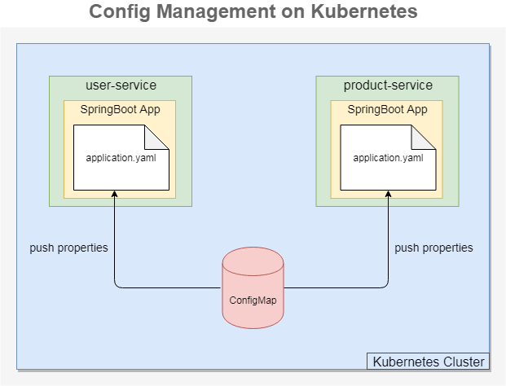

Slide 30
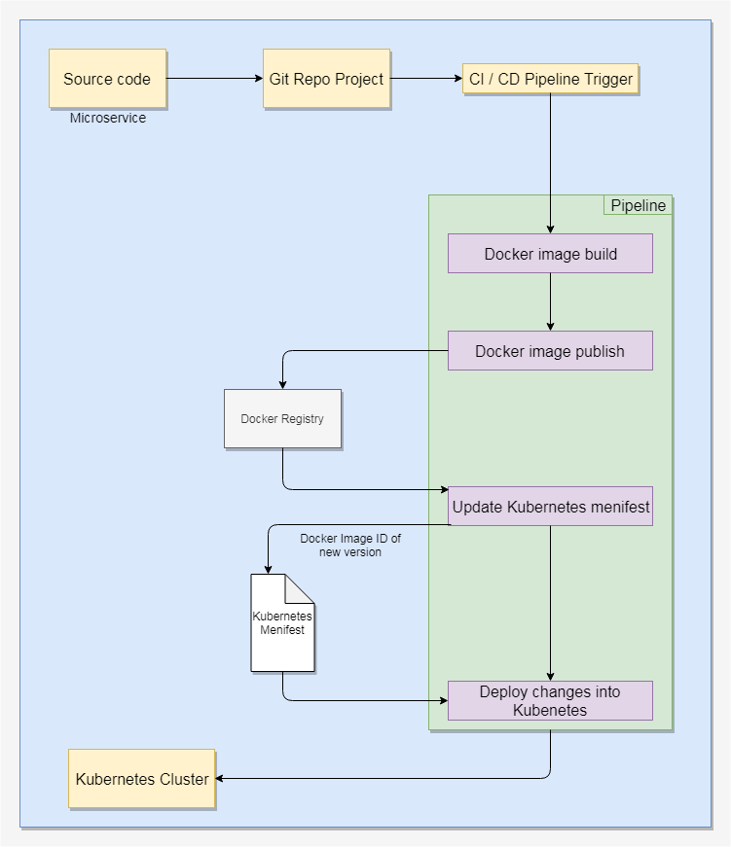
CI / CD
Notes:
In a monolith there is one place where the property files are stored and when changes are needed, there is only one place that they need to be updated
In a microservice architecture, each microservice owns its own properties. This can result in duplication of a single property value across multiple microservices

Slide 31
Demo
quebic-source/microservices-kubernetes-demo

Slide 32
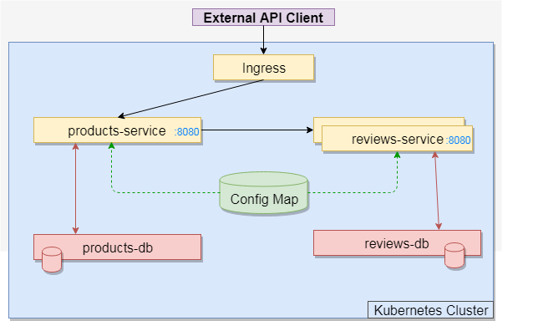

Slide 33
Additional Readings
Istio- Service Mesh Technology
Event-Driven Microservices
FaaS - Function as a Service

