Slide 1
Where to Stay Rio de Janeiro based on Data
Stacey Smith

Slide 2
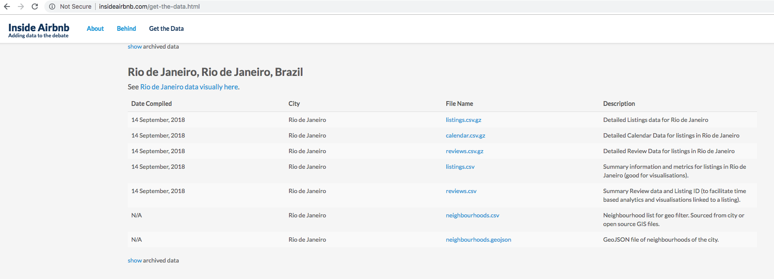
Slide Title

Slide 3
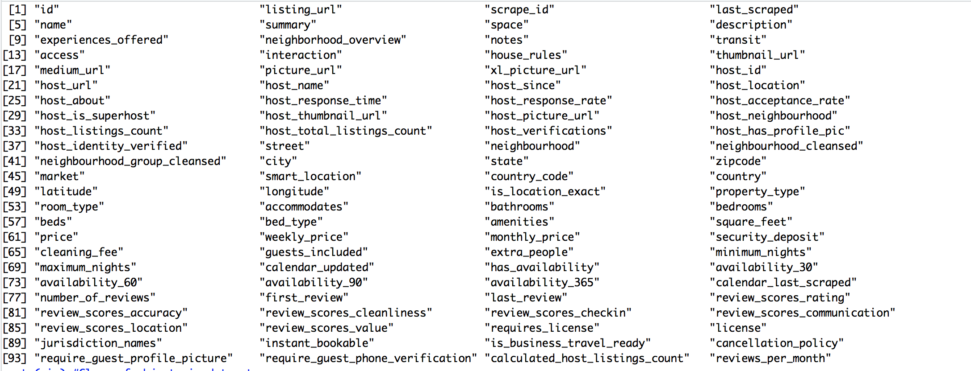
Column Names from Data Set

Slide 4
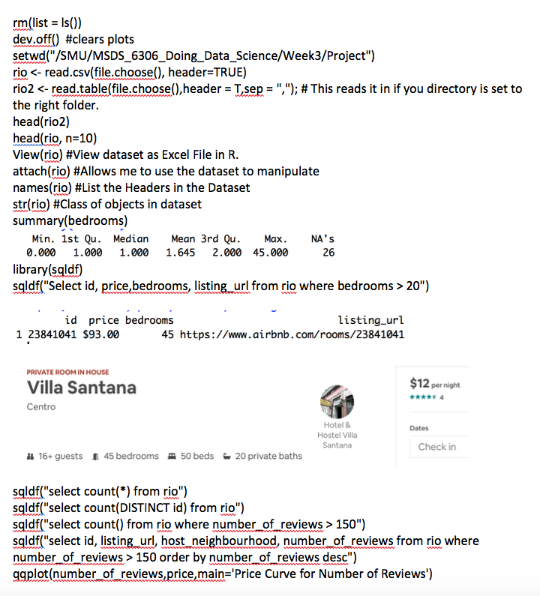

Slide 5
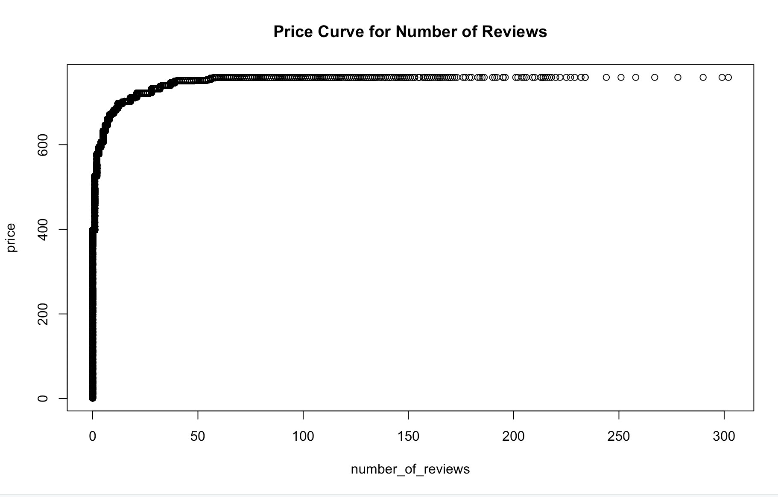

Slide 6
