Slide 1







Findings about Software Technology Trends
Teo Kwee Kim
16th June 2022

Slide 2



OUTLINE
Executive Summary
Introduction
Methodology
Results
Visualization – Charts
Dashboard
Discussion
Findings & Implications
Conclusion
Appendix

Slide 3

EXECUTIVE SUMMARY
Popular Programming Languages and Databases For Current vs. Future
Gender Gaps in Software Development Field
Technologies Gaps in Countries

Slide 4

INTRODUCTION
About:
Data analysis on Stack Overflow Developer Survey about the trends in developer's favorite technologies varied by countries and genders
Purpose:
What are the top programming languages in demand?
What are the top database skills in demand?
What are the popular IDEs?
Target Audience:
Software Developers, Software Engineering Manager/Lead, Human Resource

Slide 5

METHODOLOGY
1. Sources for Data Collection
The 2019 Stack Overflow Developer Survey Results
Github Job Postings
Annual Salary for Programming Languages
2. Data Cleaning
3. Data Mining and Analysis
4. Data Visualization
5. Presentation

Slide 6
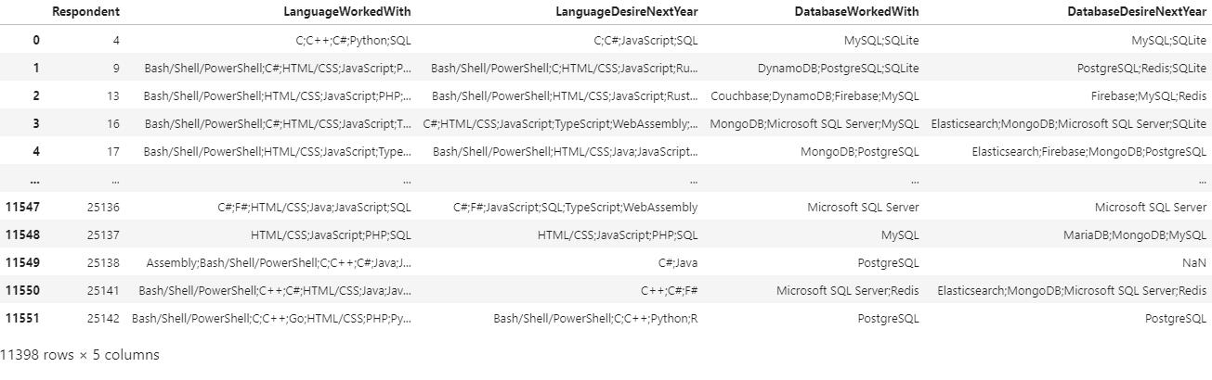
RESULTS
The gathered results are shown in the table below:

Slide 7
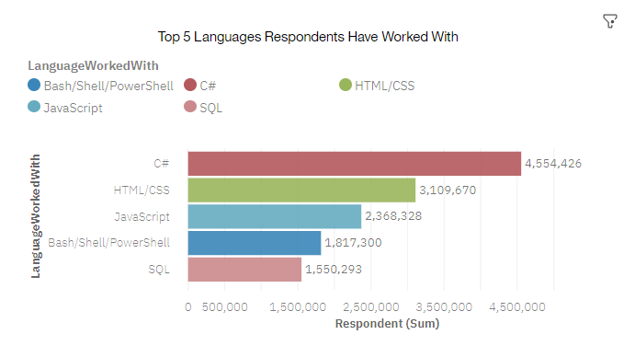
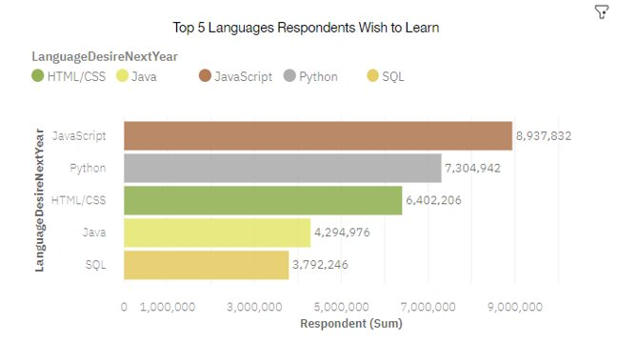
PROGRAMMING LANGUAGE TRENDS
Current Year
Next Year

Slide 8
PROGRAMMING LANGUAGE TRENDS - FINDINGS & IMPLICATIONS
Findings
C#, HTML/CSS and Javascript are the top 3 languages that software developers have worked with.
Python becomes one of the top preferred languages to be mastered in future.
Knowledge in SQL still high in demand for future.
Implications
Website development is still high in demand for future.
Python is the fastest-growing major programming language for Artificial intelligence / Machine learning fields.
Data analytics / big data fields would require expertise in SQL.

Slide 9
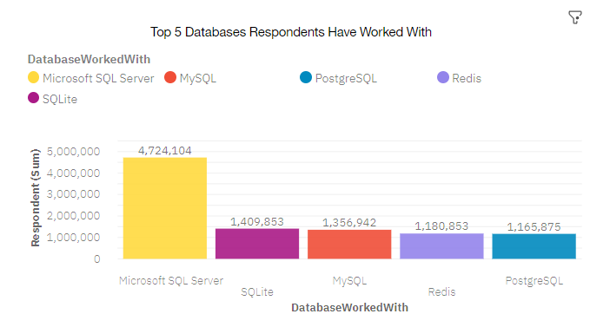
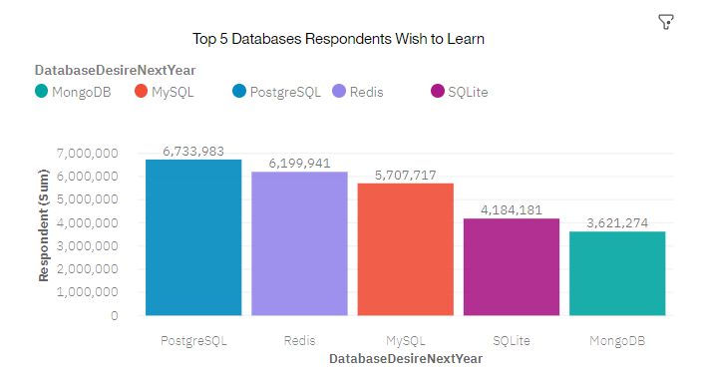
DATABASE TRENDS
Current Year
Next Year

Slide 10
DATABASE TRENDS - FINDINGS & IMPLICATIONS
Findings
PostgreSQL and Redis started rising this year.
Microsoft SQL Server is edged out from the list.
MongoDB is another upcoming favorite database.
Implications
Open source databases are preferable as they are highly efficient, especially with large databases.
PostgreSQL is preferred by companies compared to Microsoft SQL Server because it is a free open source object-relational database system.
MongoDB is rising as it is a NoSQL database which store big data of all kinds (structured/unstructured).

Slide 11

DASHBOARD
Dashboard link:
https://eu-de.dataplatform.cloud.ibm.com/dashboards/41485732-dca5-4393-bef3-0124bdae1286/view/5764e72e3c953df463cfcce4079a7a007c63225db7bbd100898c7b4908637997f0601294c8274a0fd8190630a6b9115dca

Slide 12
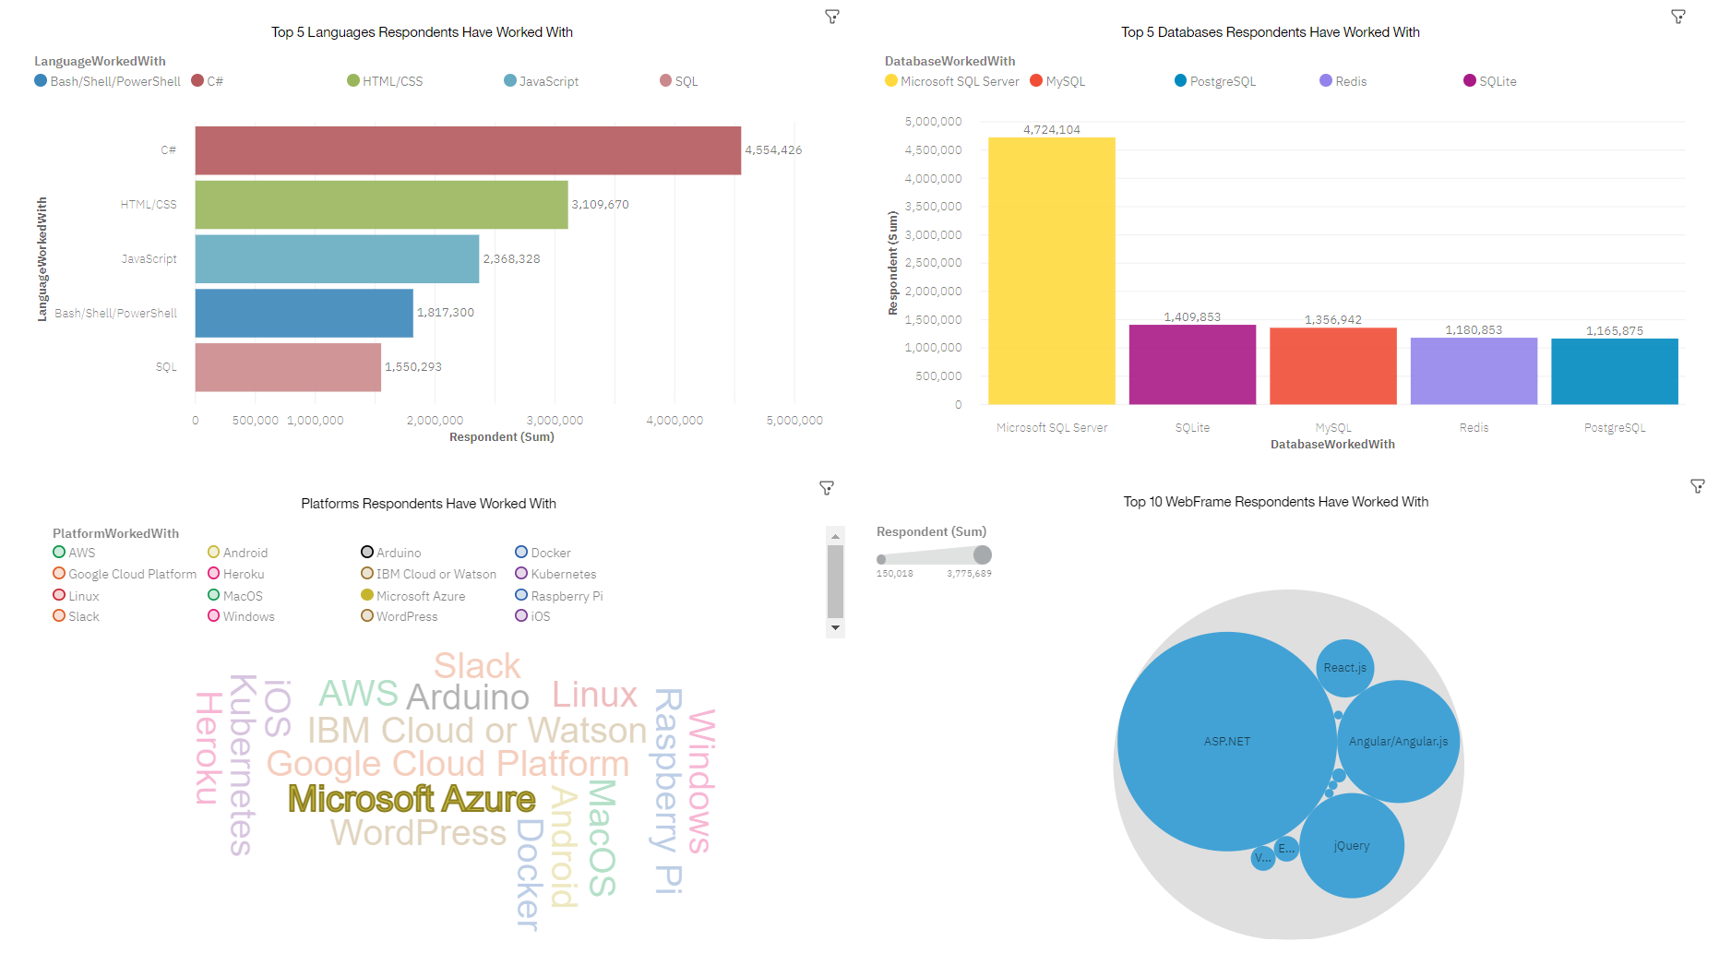
DASHBOARD TAB 1
Current Technology Used

Slide 13
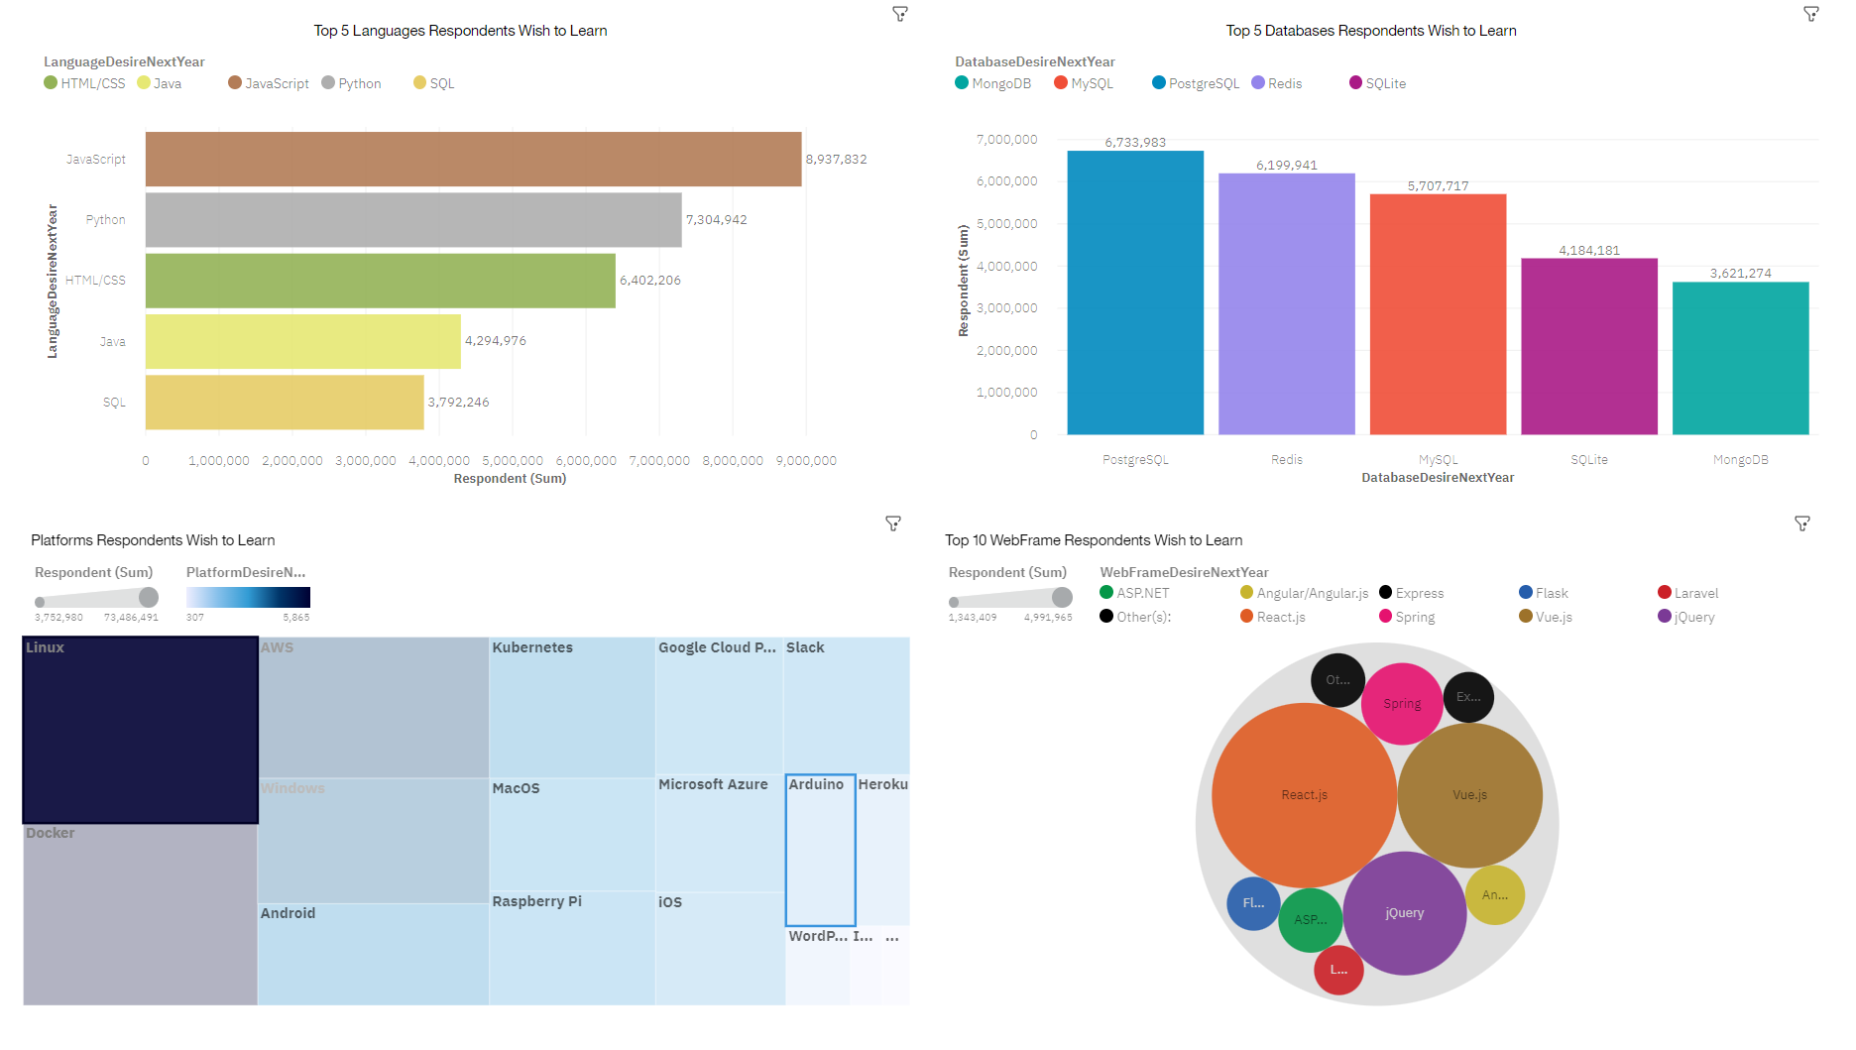
DASHBOARD TAB 2
Future Technology Used

Slide 14
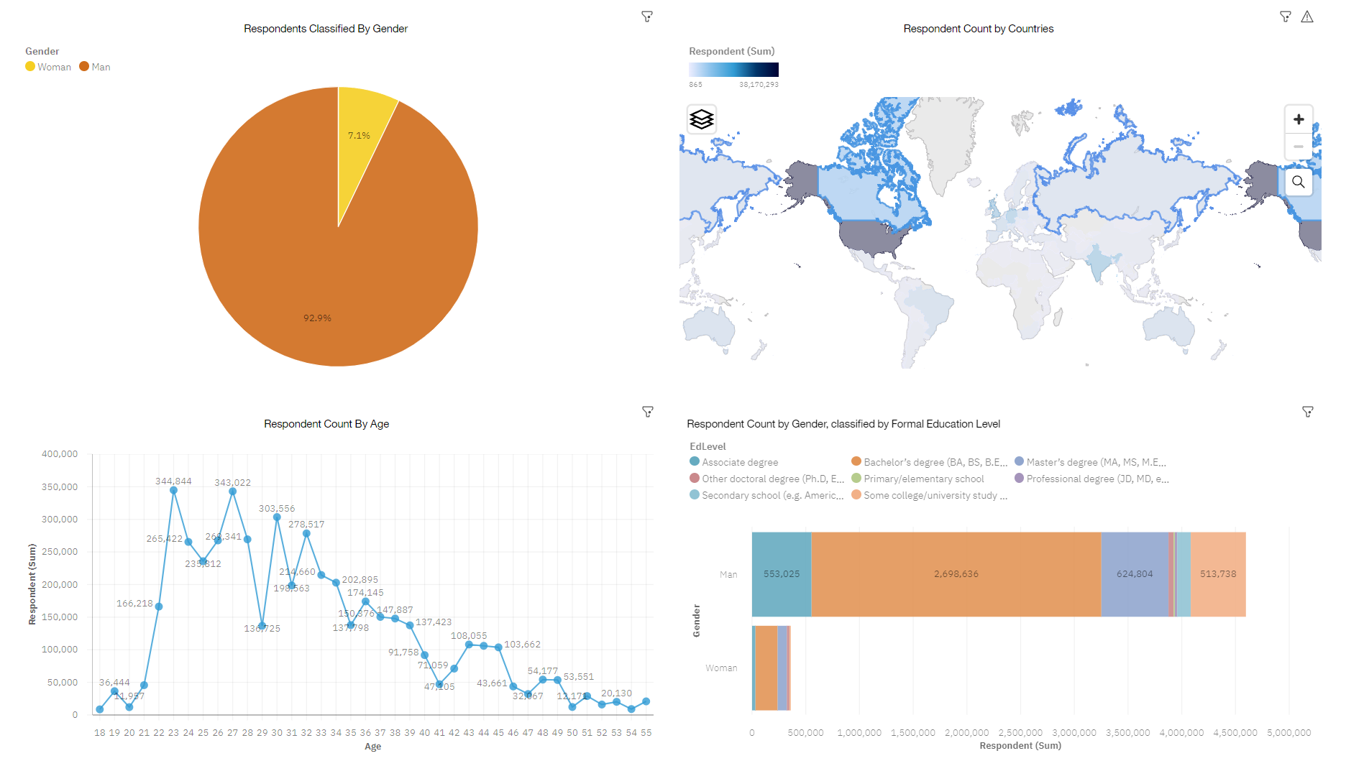
DASHBOARD TAB 3
Demographics

Slide 15
DISCUSSION
The demand for the required skills in software technology for upcoming jobs.
Increase women participation in software development fields.
Provide trainings to the existing software developers who wish to learn new technologies.
Enable more online courses for people who are interested to dive into software development or switch career.

Slide 16
OVERALL FINDINGS & IMPLICATIONS
Findings
Fast changing technologies introduced every year.
Many software technology expertise are from countries such as USA, India and Germany.
Gender gaps in technology jobs.
Many people started to learn programming since young eg. Age 16.
Implications
Companies need to adapt to new technologies rapidly.
More online courses or sharing need to be shared with other countries in order to create more software professionals.
Technology determines the direction of the future, and women need equal opportunity to shape that direction. Companies must ensure that sexism is avoided in the hiring process and in the workplace, and to continue building great initiatives to bridge the gender divide all over the world.
The current generation of children will need to be literate in technology in order to be competitive in the future job market as most jobs require the knowledge of basic IT skills.

Slide 17

CONCLUSION
Adapt to new technologies rapidly as there are fast changing technologies happen every year.
Enable more online resources for learning purposes all over the world.
Empower women pursuing software engineering roles.

Slide 18
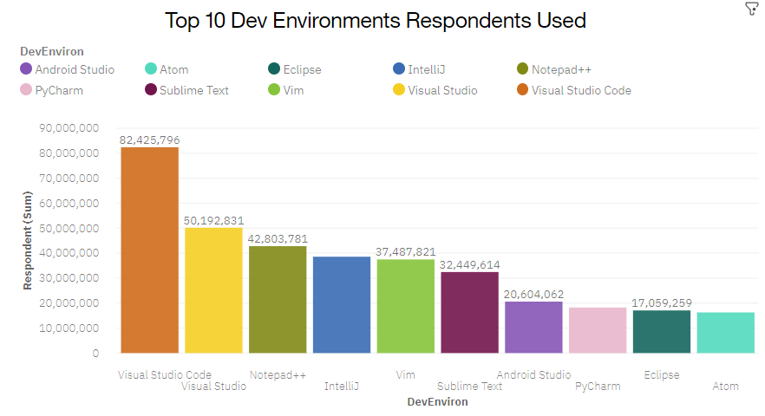

APPENDIX

Slide 19
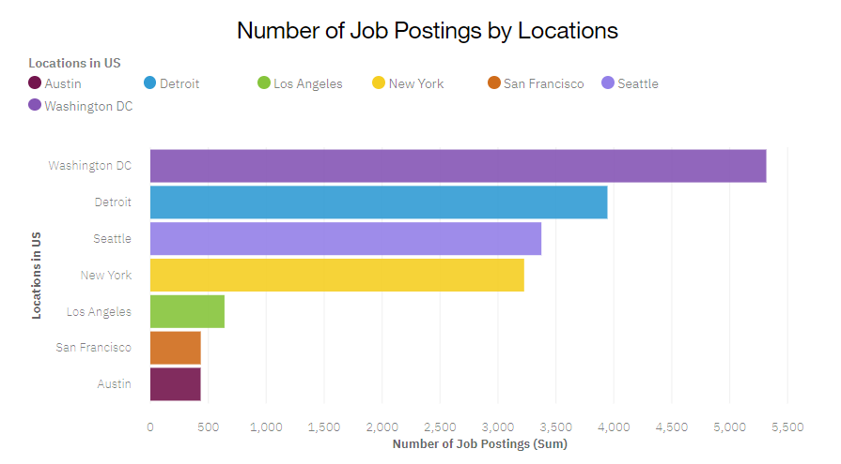
JOB POSTINGS
Number of Job Postings by Locations

Slide 20
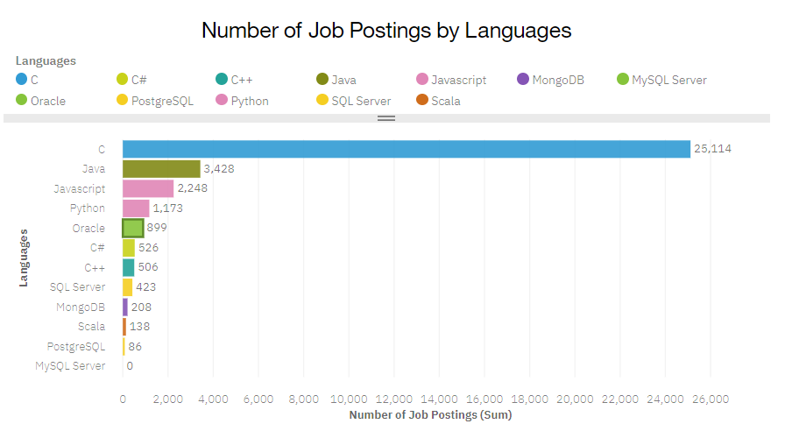
JOB POSTINGS
Number of Job Postings by Languages

Slide 21
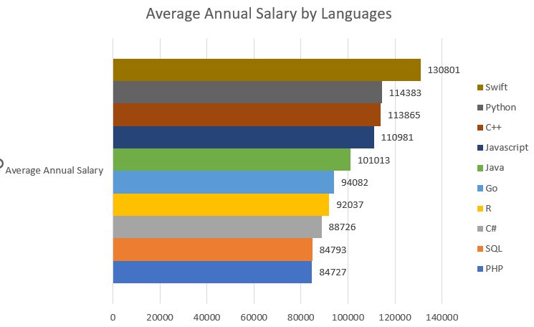
POPULAR LANGUAGES

