Slide 1
Encrypted Search versus simple frequency analysis
Alex Towell
queelius@gmail.com

Slide 2
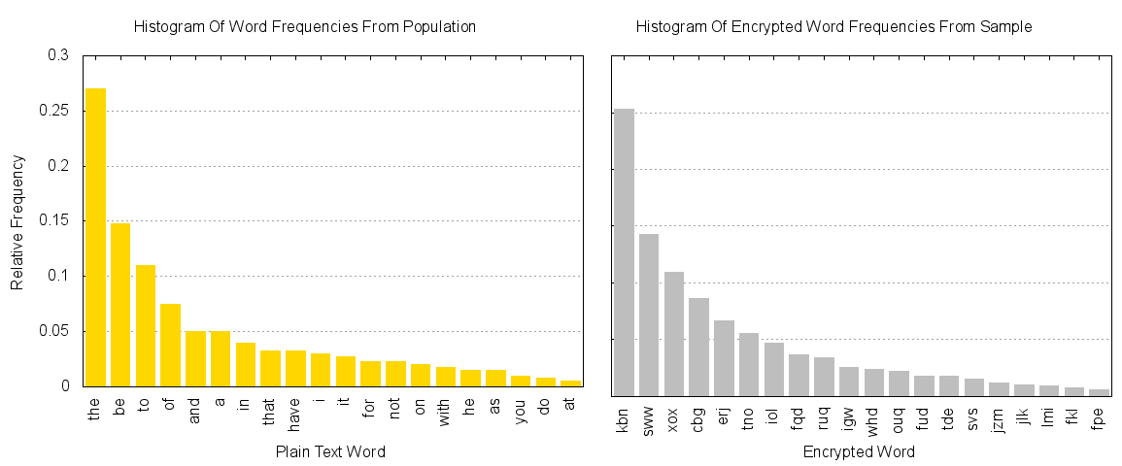
Plain text word distribution versus sample of encrypted words

Slide 3
How the adversary finds a good mapping
Talk about procedure of mapping encrypted terms to plain text terms

Slide 4
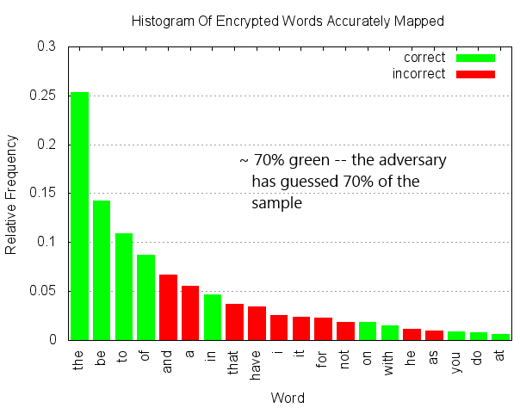
How do we measure adversary’s accuracy?
Adversary’s accuracy is the proportion of the sample mapped correctly
She was 70% accurate here
Accuracy depends on sample size -- larger sample, higher accuracy (up to a point)
100% accuracy unlikely since it closely follows a Zipf distribution
Most words are rare, with little difference in frequency to distinguish them
Even with an infinite sample size
Also, adversary is only estimating the true distribution
Notes:
Comment about uniform distribution – at that point, mapping is just a pure game of chance

Slide 5
What is considered to be a success for the attacker?
Clearly, the higher the accuracy, the better.
But even 25% accuracy compromises confidentiality
Would you be happy with someone only being able to read 25% of your journal

