Slide 1
Why Simple Hash Functions Work :
Exploiting the Entropy in a Data Stream
Michael Mitzenmacher
Salil Vadhan

Slide 2
How Collaborations Arise…
At a talk I was giving on Bloom filters...
  Salil: Your analysis assumes perfectly random hash functions. What do you use in your experiments?
  Michael: In practice, it works even with standard hash functions.
  Salil: Can you prove it?
  Michael: Um…

Slide 3
Question
Why do simple hash functions work?
  Simple = chosen from a pairwise (or k-wise) independent (or universal) family.
    Our results are actually more general.
  Work = perform just like random hash functions in most real-world experiments.
Motivation: Close the divide between theory and practice.

Slide 4
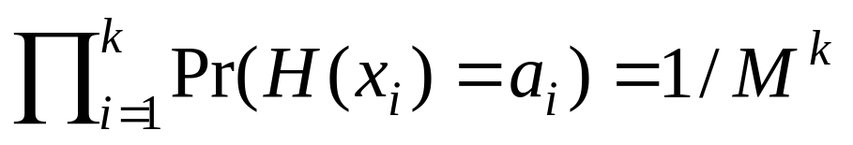
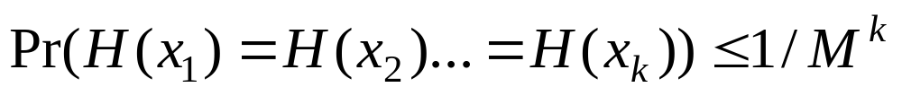
Universal Hash Families
Defined by Carter/Wegman
Family of hash functions Λ of form H:[N] → [M] is k-wise independent if when H is chosen randomly, for any x₁,x₂,…x_{k}, and any a₁,a₂,…a_{k},
Family is k-wise universal if

Slide 5
Applications
Potentially, wherever hashing is used
  Bloom Filters
  Power of Two Choices
  Linear Probing
  Cuckoo Hashing
  Many Others…

Slide 6
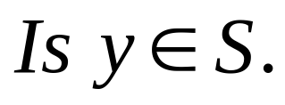
Review: Bloom Filters
Given a set S = {x₁,x₂,x₃,…x_{n}} on a universe U, want to answer queries of the form:
Bloom filter provides an answer in
  “Constant” time (time to hash).
  Small amount of space.
  But with some probability of being wrong.

Slide 7
Bloom Filters
Start with an m bit array, filled with 0s.
B
0
0
0
0
0
0
0
0
0
0
0
0
0
0
0
0
Hash each item x_{j} in S k times. If H_{i}(x_{j}) = a, set B[a] = 1.
B
0
1
0
0
1
0
1
0
0
1
1
1
0
1
1
0
To check if y is in S, check B at H_{i}(y). All k values must be 1.
B
0
1
0
0
1
0
1
0
0
1
1
1
0
1
1
0
Possible to have a false positive; all k values are 1, but y is not in S.
B
0
1
0
0
1
0
1
0
0
1
1
1
0
1
1
0
n items m = cn bits k hash functions

Slide 8
Power of Two Choices
Hashing n items into n buckets
  What is the maximum number of items, or load, of any bucket?
  Assume buckets chosen uniformly at random.
Well-known result:
  Θ(log n / log log n) maximum load w.h.p.
Suppose each ball can pick two bins independently and uniformly and choose the bin with less load.
  Maximum load is log log n / log 2 + Θ(1) w.h.p.
  With d ≥ 2 choices, max load is log log n / log d + Θ(1) w.h.p.

Slide 9
Power of Two Choices
Suppose each ball can pick two bins independently and uniformly and choose the bin with less load.
What is the maximum load now?
  log log n / log 2 + Θ(1) w.h.p.
What if we have d ≥ 2 choices?
  log log n / log d + Θ(1) w.h.p.

Slide 10
Linear Probing
Hash elements into an array.
If h(x) is already full, try h(x)+1,h(x)+2,… until empty spot is found, place x there.
Performance metric: expected lookup time.

Slide 11
Not Really a New Question
“The Power of Two Choices” = “Balanced Allocations.” Pairwise independent hash functions match theory for random hash functions on real data.
Bloom filters. Noted in 1980’s that pairwise independent hash functions match theory for random hash functions on real data.
But analysis depends on perfectly random hash functions.
  Or sophisticated, highly non-trivial hash functions.

Slide 12




Slide 13
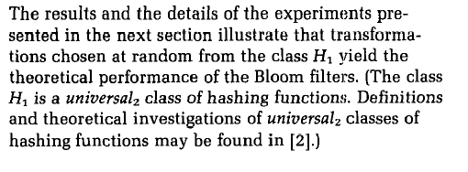

Slide 14
Worst Case : Simple Hash Functions Don’t Work!
Lower bounds show result cannot hold for “worst case” input.
There exist pairwise independent hash families, inputs for which Linear Probing performance is worse than random [PPR 07].
There exist k-wise independent hash families, inputs for which Bloom filter performance is provably worse than random.
Open for other problems.
Worst case does not match practice.

Slide 15
Bloom Filters
Start with an m bit array, filled with 0s.
B
0
0
0
0
0
0
0
0
0
0
0
0
0
0
0
0
Hash each item x_{j} in S k times. If H_{i}(x_{j}) = a, set B[a] = 1.
B
0
1
0
0
1
0
1
0
0
1
1
1
0
1
1
0
To check if y is in S, check B at H_{i}(y). All k values must be 1.
B
0
1
0
0
1
0
1
0
0
1
1
1
0
1
1
0
Possible to have a false positive; all k values are 1, but y is not in S.
B
0
1
0
0
1
0
1
0
0
1
1
1
0
1
1
0
n items m = cn bits k hash functions

Slide 16
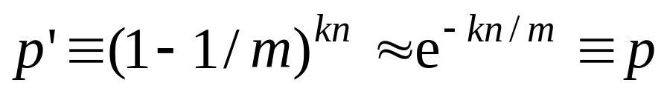
Example: Bloom Filter Analysis
Standard Bloom filter argument:
  Pr(specific bit of filter is 0) is
  If ρ is fraction of 0 bits in the filter then false positive probability is
Analysis depends on random hash function.

Slide 17
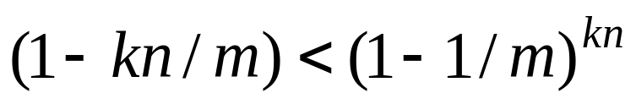
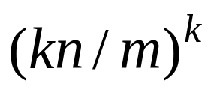
Pairwise Independent Analysis
Natural approach: use union bounds.
  Pr(specific bit of filter is 0) is at least
  False positive probability is bounded above by
  Implication: need more space for same false positive probability.
  Have lower bounds showing this is tight, and generalizes to higher k-wise independence.

Slide 18
Random Data?
Analysis usually trivial if data is independently, uniformly chosen over large universe.
  Then all hashes appear “perfectly random”.
Not a good model for real data.
Need intermediate model between worst-case, average case.

Slide 19
A Model for Data
Based on models of semi-random sources.
  [SV 84], [CG 85]
Data is a finite stream, modeled by a sequence of random variables X₁,X₂,…X_{T}.
Range of each variable is [N].
Each stream element has some entropy, conditioned on values of previous elements.
  Correlations possible.
  But each element has some unpredictability, even given the past.

Slide 20
Intuition
If each element has entropy, then extract the entropy to hash each element to near-uniform location.
Extractors should provide near-uniform behavior.

Slide 21
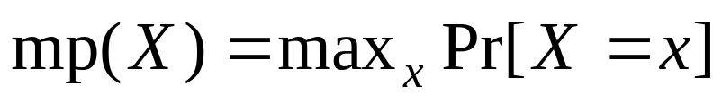

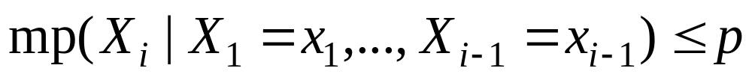
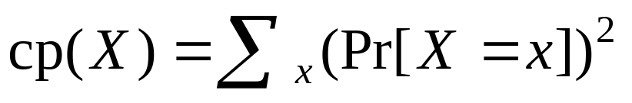

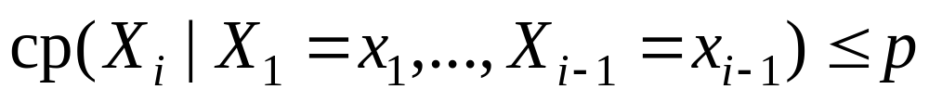
Notions of Entropy
max probability :
  min-entropy :
  block source with max probability p per block
collision probability :
  Renyi entropy :
  block source with coll probability p per block
These “entropies” within a factor of 2.
We use collision probability/Renyi entropy.

Slide 22
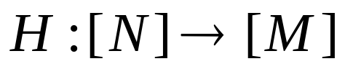
Leftover Hash Lemma
A “classical” result (from 1989).
Intuitive statement: If is chosen from a pairwise independent hash function, and X is a random variable with small collision probability, H(X) will be close to uniform.

Slide 23
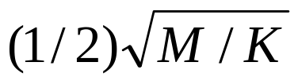
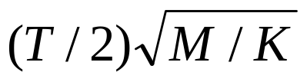
Leftover Hash Lemma
Specific statements for current setting.
  For 2-universal hash families.
Let be a random hash function from a 2-universal hash family Λ. If cp(X)< 1/K, then (H,H(X)) is -close to (H,U_{[M]}).
  Equivalently, if X has Renyi entropy at least log M + 2log(1/ε), then (H,H(X)) is ε-close to uniform.
Let be a random hash function from a 2-universal hash family. Given a block-source with coll prob 1/K per block, (H,H(X₁),.. H(X_{T})) is xxxxxxxxxx-close to (H,U_{[M]T}).
  Equivalently, if X has Renyi entropy at least log M + 2log(T/ε), then (H,H(X₁),.. H(X_{T})) is ε-close to uniform.

Slide 24
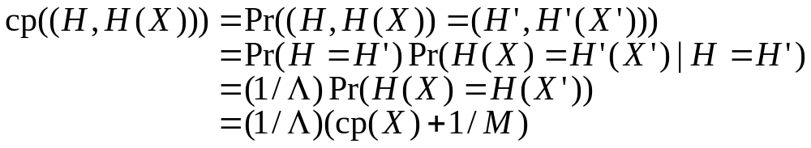
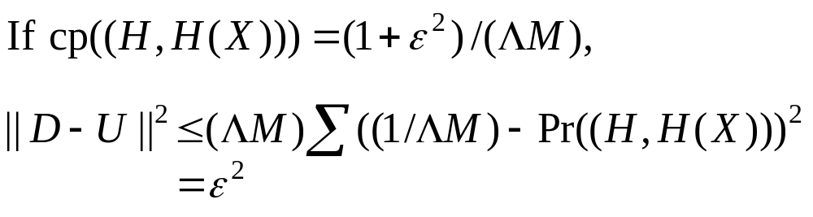
Proof of Leftover Hash Lemma
Step 1: cp( (H,H(X)) ) is small.
Step 2: Small cp implies close to uniform.

Slide 25

Close to Reasonable in Practice
Network flows classified by 5-tuples
  N = 2¹⁰⁴
Power of 2 choices: each flow gets 2 hash bucket values, placed in least loaded. Number buckets number items.
  T = 2¹⁶, M = 2³².
  For K = 2⁸⁰, get 2⁻⁹-close to uniform.
How much entropy does stream of flow-tuples have?
Similar results using Bloom filters with 2 hashes [KM 05], linear probing.

Slide 26
Theoretical Questions
How little entropy do we need?
Tradeoff between entropy and complexity of hash functions?

Slide 27
Improved Analysis [MV]
Can refine Leftover Hash Lemma style analysis for this setting.
Idea: think of result as a block source.
Let be a random hash function from a 2-universal hash family. Given a block-source with coll prob 1/K per block, (H(X₁),.. H(X_{T})) is ε-close to a block source with coll prob 1/M+T/(ε K) per block.

Slide 28
4-Wise Independence
Further improvements by using 4-wise independent families.
Let be a random hash function from a 4-wise independent hash family. Given a block-source with collision probability 1/K per block, (H(X₁),.. H(X_{T})) is ε-close to a block source with coll prob 1/M+(1+((2T)/(ε M))^{1/2})/K per block.
  Collision probability per block much tighter around 1/M.
4-wise independent possible for practice [TZ 04].

Slide 29
Proof Technique
Given bound on cp(X), derive bound on cp(H(X)) that holds with high probability over random H using Markov’s/Chebychev’s inequalities.
Union bound/induction argument to extend to block sources.
Tighter analyses?

Slide 30
Generality
Proofs utilize universal families. Is this necessary?
  Does not appear so.
Key point: bound cp(H(X)).
Can this be done for practical hash functions?
  Must think of hash function as randomly chosen from a certain family.

Slide 31
Reasonable in Practice
Power of 2 choices:
  T = 2¹⁶, M = 2³².
  Still need K > 2⁶⁴ for pairwise independent hash functions, but K < 2⁶⁴ for 4-wise independence.

Slide 32
Further Improvements
Vadhan and Chung [CV08] improved analysis for tight bounds on entropy needed.
Shave an additive log T over previous results.
Improvement comes from improved analysis of conditional probabilities, using Hellinger distance instead of statistical distance.

Slide 33
Open Problems
Tightening connection to practice.
  How to estimate relevant entropy of data streams?
  Performance/theory of real-world hash functions?
  Generalize model/analyses to additional realistic settings?
Block source data model.
  Other uses, implications?

Slide 34
[PPR] = Pagh, Pagh, Ruzic
[TZ] = Thorup, Zhang
[SV] = Santha, Vazirani
[CG] = Chor Goldreich
[BBR88] = Bennet-Brassard-Robert
[ILL] = Impagliazzo-Levin-Luby

