Slide 1
Codes, Bloom Filters, and Overlay Networks
Michael Mitzenmacher

Slide 2
Today...
Erasure codes
  Digital Fountain
Bloom Filters
  Summary Cache, Compressed Bloom Filters
Informed Content Delivery
  Combining the two…
Other Recent Work

Slide 3
Codes: High Level Idea
Everyone thinks of data as an ordered stream. I need packets 1-1,000.
Using codes, data is like water:
  You don’t care what drops you get.
  You don’t care if some spills.
  You just want enough to get through the pipe.
  I need 1,000 packets.

Slide 4

Erasure Codes
n
Message
Encoding Algorithm
cn
Encoding
Transmission
n
Received
Decoding Algorithm
n
Message

Slide 5
Application:
Trailer Distribution Problem
Millions of users want to download a new movie trailer.
32 megabyte file, at 56 Kbits/second.
Download takes around 75 minutes at full speed.

Slide 6
Point-to-Point Solution Features
Good
  Users can initiate the download at their discretion.
  Users can continue download seamlessly after temporary interruption.
  Moderate packet loss is not a problem.
Bad
  High server load.
  High network load.
  Doesn’t scale well (without more resources).

Slide 7
Broadcast Solution Features
Bad
  Users cannot initiate the download at their discretion.
  Users cannot continue download seamlessly after temporary interruption.
  Packet loss is a problem.
Good
  Low server load.
  Low network load.
  Does scale well.

Slide 8
A Coding Solution: Assumptions
We can take a file of n packets, and encode it into cn encoded packets.
From any set of n encoded packets, the original message can be decoded.

Slide 9
Coding Solution
5 hours
4 hours
Encoding
Copy 2
3 hours
Encoding
File
2 hours
Encoding
Copy 1
1 hour
User 1
Reception
User 2
Reception
0 hours
Transmission

Slide 10
Coding Solution Features
Users can initiate the download at their discretion.
Users can continue download seamlessly after temporary interruption.
Moderate packet loss is not a problem.
Low server load - simple protocol.
Does scale well.
Low network load.

Slide 11
So, Why Aren’t We Using This...
Encoding and decoding are slow for large files -- especially decoding.
So we need fast codes to use a coding scheme.
We may have to give something up for fast codes...

Slide 12
Performance Measures
Time Overhead
  The time to encode and decode expressed as a multiple of the encoding length.
Reception efficiency
  Ratio of packets in message to packets needed to decode. Optimal is 1.

Slide 13
Reception Efficiency
Optimal
  Can decode from any n words of encoding.
  Reception efficiency is 1.
Relaxation
  Decode from any (1+ε) n words of encoding
  Reception efficiency is 1/(1+ε).

Slide 14
Parameters of the Code
n
Message
cn
Encoding
(1+ε)n
Reception efficiency is 1/(1+ε)

Slide 15
Previous Work
Reception efficiency is 1.
  Standard Reed-Solomon
    Time overhead is number of redundant packets.
    Uses finite field operations.
  Fast Fourier-based
    Time overhead is ln² n field operations.
Reception efficiency is 1/(1+ε).
  Random mixed-length linear equations
    Time overhead is ln(1/ε)/ε.

Slide 16
Tornado Code Performance
Reception efficiency is 1/(1+ε).
Time overhead is ln(1/ε).
Simple, fast, and practical.

Slide 17
Codes: Other Applications?
Using codes, data is like water.
What more can you do with this idea?
Example --Parallel downloads: Get data from multiple sources, without the need for co-ordination.

Slide 18
Latest Improvements
Practical problem with Tornado code: encoding length
  Must decide a priori -- what is right?
  Encoding/decoding time/memory proportional to encoded length.
Luby transform:
  Encoding produced “on-the-fly” -- no encoding length.
  Encoding/decoding time/memory proportional to message length.

Slide 19
Coding Solution
5 hours
4 hours
3 hours
Encoding
File
2 hours
1 hour
User 1
Reception
User 2
Reception
0 hours
Transmission

Slide 20
Bloom Filters: High Level Idea
Everyone thinks they need to know exactly what everyone else has. Give me a list of what you have.
Lists are long and unwieldy.
Using Bloom filters, you can get small, approximate lists. Give me information so I can figure out what you have.

Slide 21
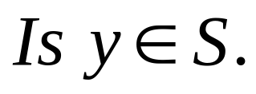
Lookup Problem
Given a set S = {x₁,x₂,x₃,…x_{n}} on a universe U, want to answer queries of the form:
Example: a set of URLs from the universe of all possible URL strings.
Bloom filter provides an answer in
  “Constant” time (time to hash).
  Small amount of space.
  But with some probability of being wrong.

Slide 22
Bloom Filters
Start with an m bit array, filled with 0s.
B
0
0
0
0
0
0
0
0
0
0
0
0
0
0
0
0
Hash each item x_{j} in S k times. If H_{i}(x_{j}) = a, set B[a] = 1.
B
0
1
0
0
1
0
1
0
0
1
1
1
0
1
1
0
To check if y is in S, check B at H_{i}(y). All k values must be 1.
B
0
1
0
0
1
0
1
0
0
1
1
1
0
1
1
0
Possible to have a false positive; all k values are 1, but y is not in S.
B
0
1
0
0
1
0
1
0
0
1
1
1
0
1
1
0

Slide 23
Errors
Assumption: We have good hash functions, look random.
Given m bits for filter and n elements, choose number k of hash functions to minimize false positives:
  Let
  Let
As k increases, more chances to find a 0, but more 1’s in the array.
Find optimal at k = (ln 2)m/n by calculus.

Slide 24
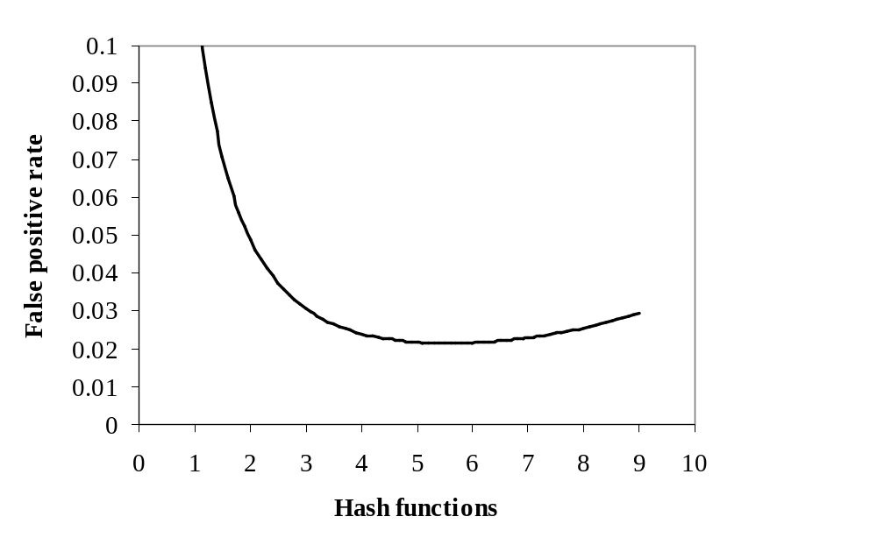
Example
m/n = 8
Opt k = 8 ln 2 = 5.45...

Slide 25

Bloom Filters: Distributed Systems
Send Bloom filters of URLs.
False positives do not hurt much.
  Get errors from cache changes anyway.
Web Cache 1
Web Cache 2
Web Cache 3
Web Cache 4
Web Cache 5
Web Cache 6

Slide 26
Tradeoffs
Three parameters.
  Size m/n : bits per item.
  Time k : number of hash functions.
  Error f : false positive probability.

Slide 27
Compression
Insight: Bloom filter is not just a data structure, it is also a message.
If the Bloom filter is a message, worthwhile to compress it.
Compressing bit vectors is easy.
  Arithmetic coding gets close to entropy.
Can Bloom filters be compressed?

Slide 28
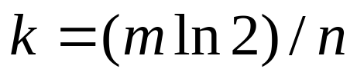
Optimization, then Compression
Optimize to minimize false positive.
At k = m (ln 2) /n, p = 1/2.
Bloom filter looks like a random string.
  Can’t compress it.
is optimal

Slide 29
Tradeoffs
With compression, four parameters.
  Compressed (transmission) size z/n : bits per item.
  Decompressed (stored) size m/n : bits per item.
  Time k : number of hash functions.
  Error f : false positive probability.

Slide 30
Does Compression Help?
Claim: transmission cost limiting factor.
  Updates happen frequently.
  Machine memory is cheap.
Can we reduce false positive rate by
  Increasing decompressed size (storage).
  Keeping transmission cost constant.

Slide 31
Errors: Compressed Filter
Assumption: optimal compressor, z = mH(p).
  H(p) is entropy function; optimally get H(p) compressed bits per original table bit.
  Arithmetic coding close to optimal.
Optimization: Given z bits for compressed filter and n elements, choose table size m and number of hash functions k to minimize f.
Optimal found by calculus.

Slide 32
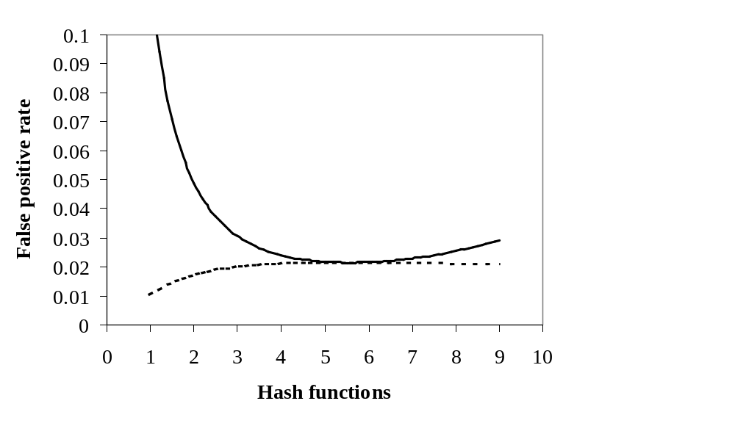
Example
Original
z/n = 8
Compressed

Slide 33
Results
At k = m (ln 2) /n, false positives are maximized with a compressed Bloom filter.
  Best case without compression is worst case with compression; compression always helps.
Side benefit: Use fewer hash functions with compression; possible speedup.

Slide 34
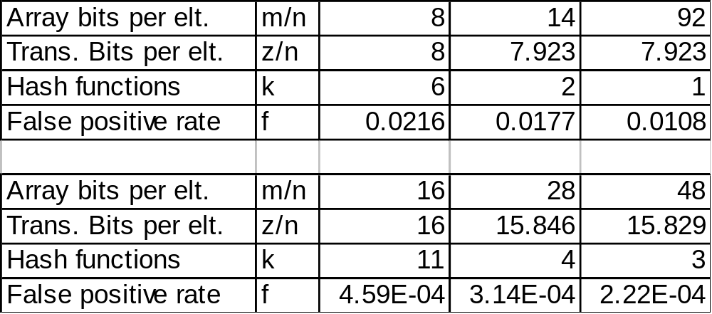
Examples
Examples for bounded transmission size.
  20-50% of false positive rate.
Simulations very close.
  Small overhead, variation in compression.

Slide 35
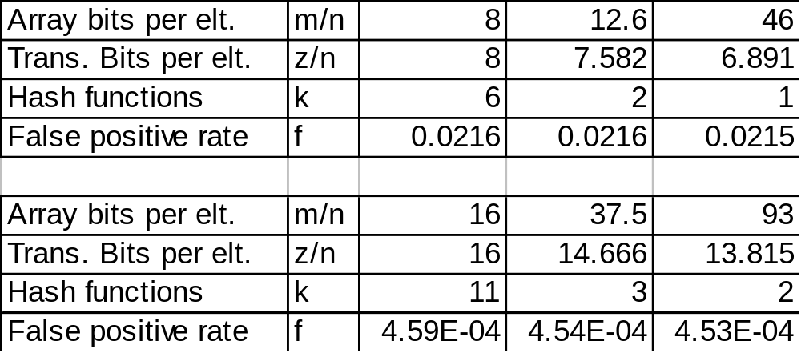
Examples
Examples with fixed false probability rate.
  5-15% compression for transmission size.
Matches simulations.

Slide 36
Bloom Filters: Other Applications?
Finding objects
  Oceanstore : Object Location
  Geographical Region Summary Service
Data summaries
  IP Traceback
Reconciliation methods
  Coming up...

Slide 37
Putting it all Together:
Informed Content Delivery on Overlay Networks
To appear in SIGCOMM 2002.
Joint work with John Byers, Jeff Considine, Stan Rost.

Slide 38
Informed Delivery: Basic Idea
Reliable multicast uses tree networks.
On an overlay/P2P network, there may be other bandwidth/communication paths available.
But I need coordination to use it wisely.

Slide 39
Application:
Movie Distribution Problem
Millions of users want to download a new movie.
  Or a CDN wants to populate thousands of servers with a new movie for those users.
Big file -- for people with lots of bandwidth.
People will being using P2P networks.

Slide 40
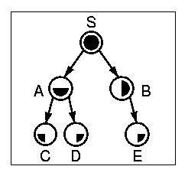
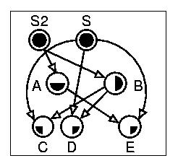
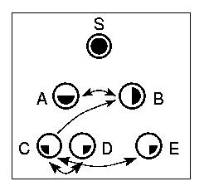
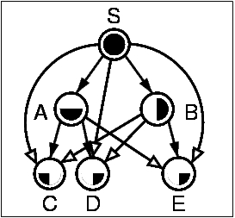
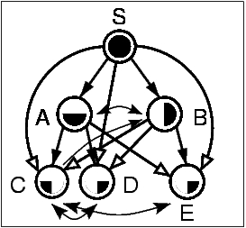
Motivating Example

Slide 41
Our Argument
In CDNs/P2Ps with ample bandwidth, performance will benefit from additional connections
  If intelligent in collaborating on how to utilize the bandwidth
Assuming a pair of end-systems has not received exactly the same content, it should reconcile the differences in received content

Slide 42
It’s a Mad, Mad, Mad World
Challenges
  Native Internet
    Asynchrony of connections, disconnections
    Heterogeneity of speed, loss rates
    Enormous client population
    Preemptable sessions
    Transience of hosts, routers and links
  Adaptive overlays
    In reconfiguring topologies, exacerbate some of the above

Slide 43
Environmental Fluidity Requires Flexible Content Paradigms
Expect frequent reconfiguration
  Need scalable migration, preemption support
Digital fountain to the rescue
  Stateless: servers can produce encoded continuously
  Time-invariant in memoryless encoding
  Tolerance to client differences
  Additivity of fountains

Slide 44
Environmental Fluidity Produces Opportunities
Opportunities for reconciliation
  Significant discrepancies between working sets of peers receiving identical content
    Receiver with higher transfer rate or having arrived earlier will have more content
    Receivers with uncorrelated losses will have gaps in different portions of their working sets
  Parallel downloads
  Ephemeral connections of adaptive overlay networks
Notes:
Of course, here we are assuming non-reliable delivery

Slide 45
Reconciliation Problem
With standard sequential ordering, reconciliation is not (necessarily) a problem.
Using coding, must reconcile over a potentially large, unordered universe of symbols (using Luby’s improved codes).
  How to reconcile peers with partial content in an informed manner?

Slide 46
Approximate Reconciliation with Bloom Filters
Send a (compressed) Bloom filter of encoding packets held.
Respondent can start sending encoding packets you do not have.
False positives not so important.
  Coding already gives redundancy.
  You want useful packets as quickly as possible.
Bloom filters require a small number of packet.

Slide 47
Additional Work
Coarse estimation of overlap in 1 packet.
  Using sampling.
  Using min-wise independent samples.
Approximate reconciliation trees.
  Enhanced data structure for when the number of discrepancies is small.
  Also based on Bloom filters.
Re-coding.
  Combining coded symbols.

Slide 48
Reconciliation:
Other Applications
Approximate vs. Exact Reconciliation
  Communication complexity.
Practical uses:
  Databases, handhelds, etc.

Slide 49
Public Relations:
Latest Research (1)
A Dynamic Model for File Sizes and Double Pareto Distributions
  A generative model that explains the empirically observed shape of file sizes in file systems.
  Lognormal body, Pareto tail.
  Combines multiplicative models from probability theory with random graph models similar to recent work on Web graphs.

Slide 50
Public Relations:
Latest Research (2)
Load Balancing with Memory
  Throw n balls into n bins.
  Randomly: maximum load is log n / log log n
  Best of 2 choices: log log n / log 2
Suppose you get to “remember” the best possibility from the last throw.
  1 Random choice, 1 memory: log log n / 2 log τ
  Queueing variations also analyzed.

Slide 51
Public Relations:
Latest Research (3)
Verification Codes
  Low-Density Parity-Check codes for large alphabets: e.g. 32-bit integers, and random errors.
  Simple, efficient codes.
    Linear time.
    Based on XORs.
  Performance: better than worst-case Reed-Solomon codes.
  Extended to additional error models (code scrambling).

Slide 52
Conclusions
I’m interested in network problems.
There are lots of interesting problems out there.
  New techniques, algorithms, data structures
  New analyses
  Finding the right way to apply known ideas
I’d love to work with MIT students, too.

