Slide 1
INSY 8311 • DATABASE DEVELOPMENT WITH PL/SQL
restaurant order and sales tracking system
STUDENT & ID
INSTRUCTOR
Name: Queen Ineza
ID: 29354
Eric Maniraguha
GITHUB REPOSITORY
https://github.com/queenineza18-boop/Queen_29354_restaurent

Slide 2

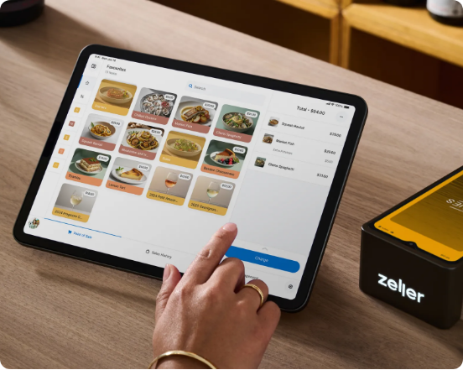
1. who is affected and why it matters
Who Is Affected
Restaurant owners, waitstaff, cashiers, and dining guests.
Why It Matters
Billing Errors: Handwritten tickets cause tax miscalculations.
Revenue Leakage: Unrecorded payments distort daily cash audits.
Slow Service: Delayed kitchen tickets frustrate peak-hour guests.

Slide 3
2. why you chose this project
Zero Bill Discrepancies
Peak-Hour Speed
Actionable Sales Insights
Automated subtotal, tax, and discount computation.
Instant order routing without paper bottlenecks.
Real-time visibility into top-selling menu items.

Slide 4
3. main three specific objectives
Develop an Oracle PL/SQL restaurant system automating orders, billing, payments, and sales reports.
01 • ORDER AUTOMATION
02 • EXACT BILLING
03 • SALES REPORTING
Validate menu availability before order capture.
Calculate taxes, totals, and split payments accurately.
Generate daily shift revenue summaries automatically.

Slide 5
4. existing solutions and their gaps
Paper Dockets & Basic Cash Registers
Database-Enforced Integrity
Manual Dockets: Lost tickets and illegible handwriting.
Atomic Billing: Triggers recalculate totals on every edit.
Standalone Tills: Lack itemized menu analytics.
Payment Guardrails: Blocks closing unpaid orders.
Cloud POS Suites: High monthly subscription fees.
Audit Security: Logs every voided item or discount.

Slide 6
5.dataset, link, size, a few sample records
4,200+
CC0 Public
GITHUB REPOSITORY
Order & Payment Records
Open Educational License
https://github.com/queenineza18-boop/Queen_29354_restaurent
Order_ID | Menu_Item | Qty | Total_Bill | Payment_Status
ORD-3012 | Grilled Tilapia Platter | 2 | $28.00 | Paid (Mobile Money)
ORD-3013 | Margherita Woodfire Pizza | 1 | $14.50 | Open (Dining)
ORD-3014 | Fresh Passion Juice | 3 | $10.50 | Paid (Card)

Slide 7
6. Proposed solution and innovation
LAYER 01 • CASHIER UI
LAYER 02 • CORE LOGIC
LAYER 03 • ANALYTICS
Python Streamlit POS
Oracle 21c PL/SQL
Live Sales Dashboard
Waitstaff place orders and record payments live.
Triggers compute taxes and block unpaid closures.
Tracks hourly revenue, peak tables, and top dishes.

Slide 8
7. main tables and how they relate
Table Name | Primary / Foreign Keys | Core Purpose
DINING_TABLES | PK: Table_ID | Table numbers, seating capacity, occupancy status
MENU_ITEMS | PK: Item_ID | Dish catalog, category, unit price, availability
ORDERS | PK: Order_ID • FK: Table_ID | Order timestamp, status, computed total bill
ORDER_DETAILS | PK: Detail_ID • FK: Order_ID, Item_ID | Ordered dish quantities and line-item subtotals
PAYMENTS | PK: Payment_ID • FK: Order_ID | Amount paid, payment method, receipt timestamp
SALES_AUDIT_LOG | PK: Audit_ID | Canceled orders, price overrides, denied closures

Slide 9
8. procedures, functions, cursors, triggers, packages, exceptions
Triggers: Auto-update ORDERS. Total_Bill on item changes and block unpaid closures.
Cursors: End-of-day cursor aggregates shift revenue by payment channel.
Procedures: RECORD_PAYMENT settles bills and frees DINING_TABLES atomically.
Packages: RESTAURANT_OPS_PKG groups all order, billing, and report modules.
Functions: CALC_FINAL_BILL computes item sums plus 18% VAT accurately.
Exceptions: Custom UNAVAILABLE_ITEM_ERR halts out-of-stock orders cleanly.

Slide 10
9. what I will demonstrate
1. Instant Bill Calculation
2. Interactive Cashier App
Live order updates recalculate totals and VAT immediately.
Streamlit interface calling Oracle PL/SQL procedures live.
3. Unpaid Closure Guard
4. Automated Shift Report
Database trigger blocks closing any unsettled table bill.
Daily revenue summary broken down by menu category.

Slide 11
10. Future improvements and limitations
LIMITATIONS
IMPROVEMENTS
Single Venue: Designed for one restaurant branch.
Kitchen Display System: Real-time prep queue screen.
No Raw Ingredients: Tracks finished dishes only.
QR Table Ordering: Direct guest mobile menu checkout.
Simulated Payments: Records payment status without gateway APIs.
Recipe Inventory: Auto-deduct raw pantry ingredients.

Slide 12
REFERENCE
Kaggle. (2025). Restaurant Orders and Sales Transactions Dataset. https://www.kaggle.com
Kimes, S. E., & Collier, J. E. (2022). How point-of-sale automation improves table turnover and billing accuracy. Cornell Hospitality Quarterly, 63(4), 485–498.
National Institute of Statistics of Rwanda. (2024). Hospitality and food service
sector performance report. Kigali, Rwanda.
Oracle Corporation. (2025). Oracle Database PL/SQL Language Reference (21c). Oracle Docs.
Singh, R., & Patel, M. (2023). Relational database normalization for hospitality sales auditing. International Journal of Database Management Systems, 15(1), 22–36.

