Slide 1
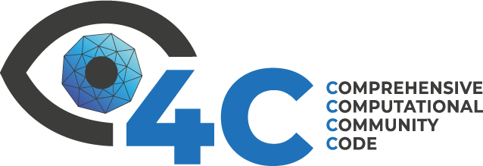

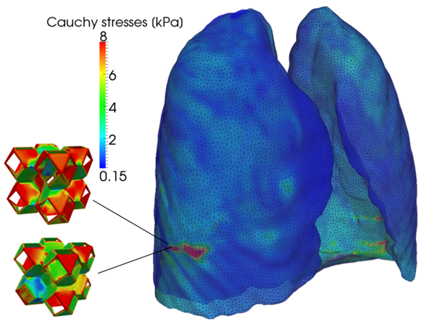

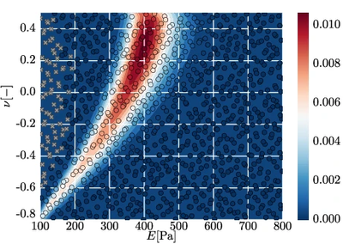

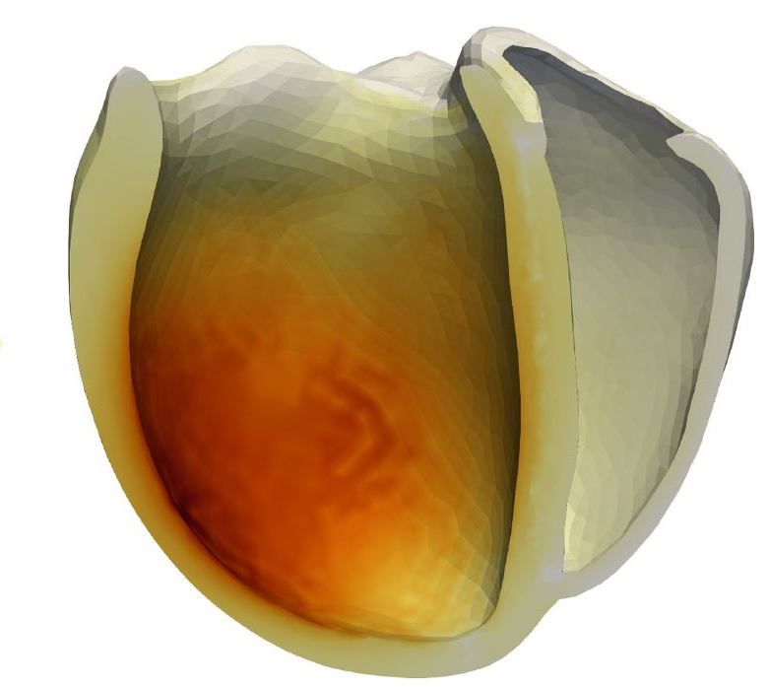





An open-source parallel multiphysics research code based on FEM, HDG, SPH & DEM
An open-source Python framework for solver-independent multi-query analyses of large-scale computational models.
[Lena Yoshihara, LNM, TUM]
github.com/4C-multiphysics/4C
github.com/queens-py/queens
Applications:
Parameter identification
Sensitivity analysis
Uncertainty quantification
Bayesian inverse analysis
[Amadeus M. Gebauer, LNM, TUM]
Biehler, J., Nitzler, J., Brandstaeter, S., Dinkel, M., Gravemeier, V., Haeusel, L. J., Rei, G. R., Willmann, H., Wirthl, B., & Wall, W. A. (2025). QUEENS: An Open-Source Python Framework for Solver-Independent Analyses of Large-Scale Computational Models. arXiv.2508.16316.

