Slide 1

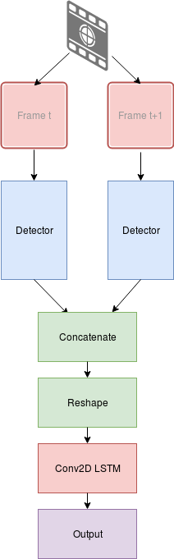
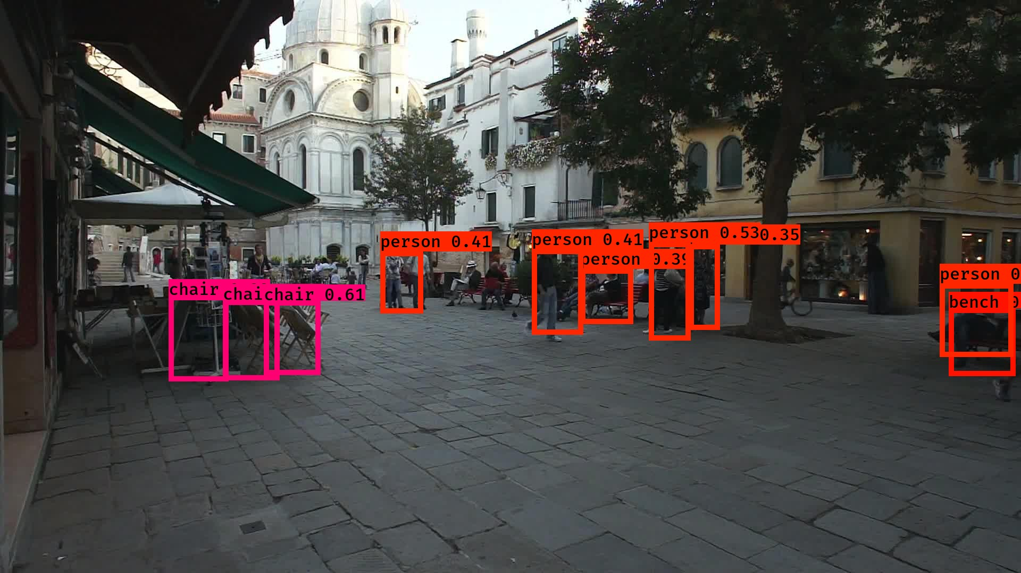
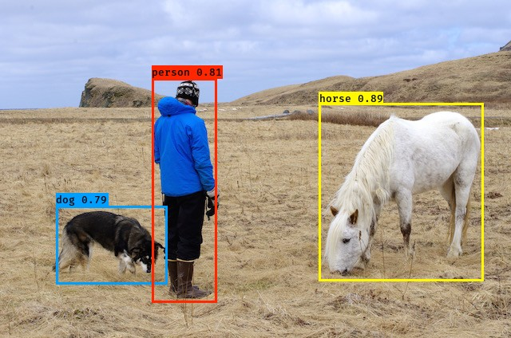
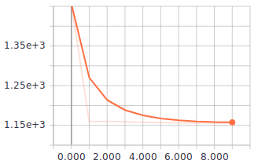
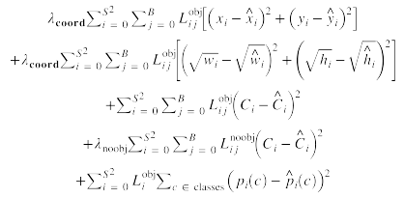
Tracking in Video Object Detection Using Neural Networks
2018
Mohammed Gasmallah
Supervisor: Dr. Farhana Zulkernine
School of Computing, Queen’s University
Background
Architecture
Data Summary
With the advent of increasingly large object detection libraries and the use of neural networks to perform object detection on images in real time speed, interesting problems are now being looked at with regards to the prediction of objects using object tracking networks. These networks can be used for a multitude of different problems such as pedestrian tracking, surveillance cameras, and other video analysis problems.
Two frames are fed to their own detectors and the output is concatenated and fed into a Conv2D LSTM layer.
- The dataset used for training/validation are the COCO and MOT 2017 object tracking dataset.
- MOT contains images from video and annotations marking bounding boxes and label.
- Images are resized into 608 x 608
- Network divides image into 19x19 grids and gives a confidence score for each class, in each anchor box, in each grid square.
Objectives
Apply a temporal convolutional layer to two detection networks in order to train an object tracker with spatio-temporal awareness.
Achieve similar object tracking mAP to other state-of-the-art trackers.
Review the use of SpatioTemporal awareness using a conv2D LSTM layer.
Future Works
Improve box output to use velocity instead of objective x, y coordinates.
Improve network to perform detection and tracking simultaneously.
Neural Networks
Inputs: Two images corresponding that are in sequence to one another from a video.
Output: A series of boxes containing x,y location of object with confidence score and class.
The novel element of this network is the use of a conv2D LSTM layer.
This is a convolutional layer composed entirely of LSTM nodes and allows for a recurrency of the input tensors.
Implementation
The training of the deep convolutional network was done using a custom loss function that uses Intersection over Union for loss evaluation and categorical cross entropy for classification.
Frames are fed in from the MOT 2017 object detection dataset.
Frame t and frame t+1 are paired while the expected output are boxes from frame t+2.
The training was performed using CAC high performance computing machines from the Frontenac cluster using a 24 core Intel Xeon CPU E5-2650 v4 @ 2.20Ghz.
References
- Redmon, J., & Farhadi, A. (2016). YOLO9000: Better, Faster, Stronger. University of Washington. https://doi.org/10.1109/CVPR.2017.690
-Lin, T. Y., Maire, M., Belongie, S., Hays, J., Perona, P., Ramanan, D., … Zitnick, C. L. (2014). Microsoft COCO: Common objects in context. Lecture Notes in Computer Science (Including Subseries Lecture Notes in Artificial Intelligence and Lecture Notes in Bioinformatics), 8693 LNCS(PART 5), 740–755. https://doi.org/10.1007/978-3-319-10602-1_48

