Slide 1
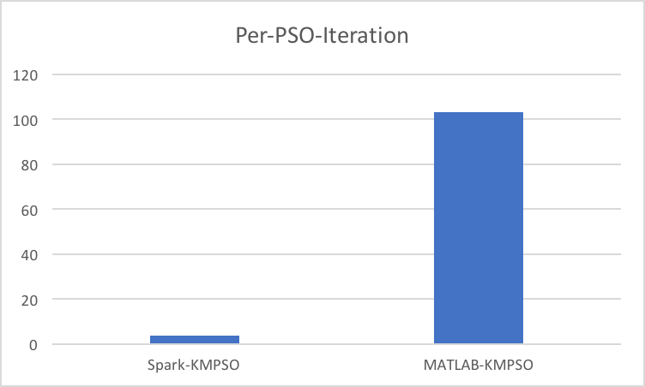
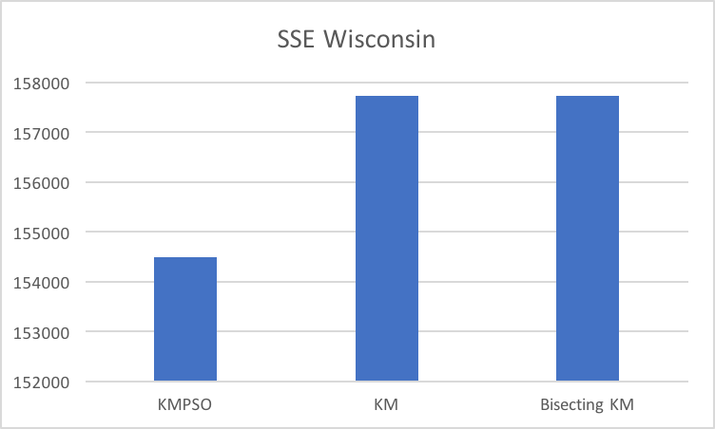
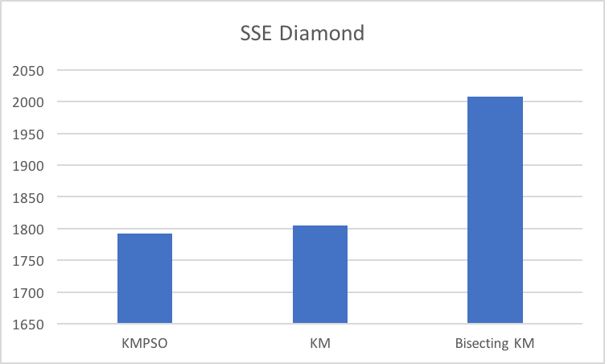
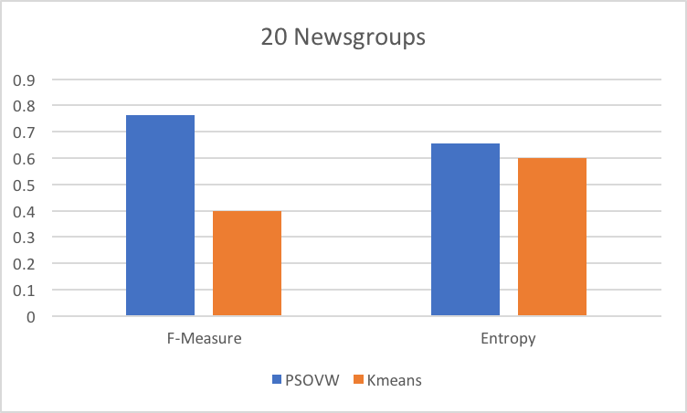
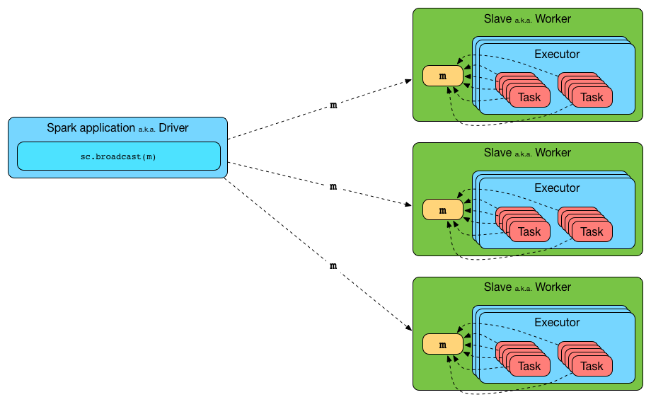
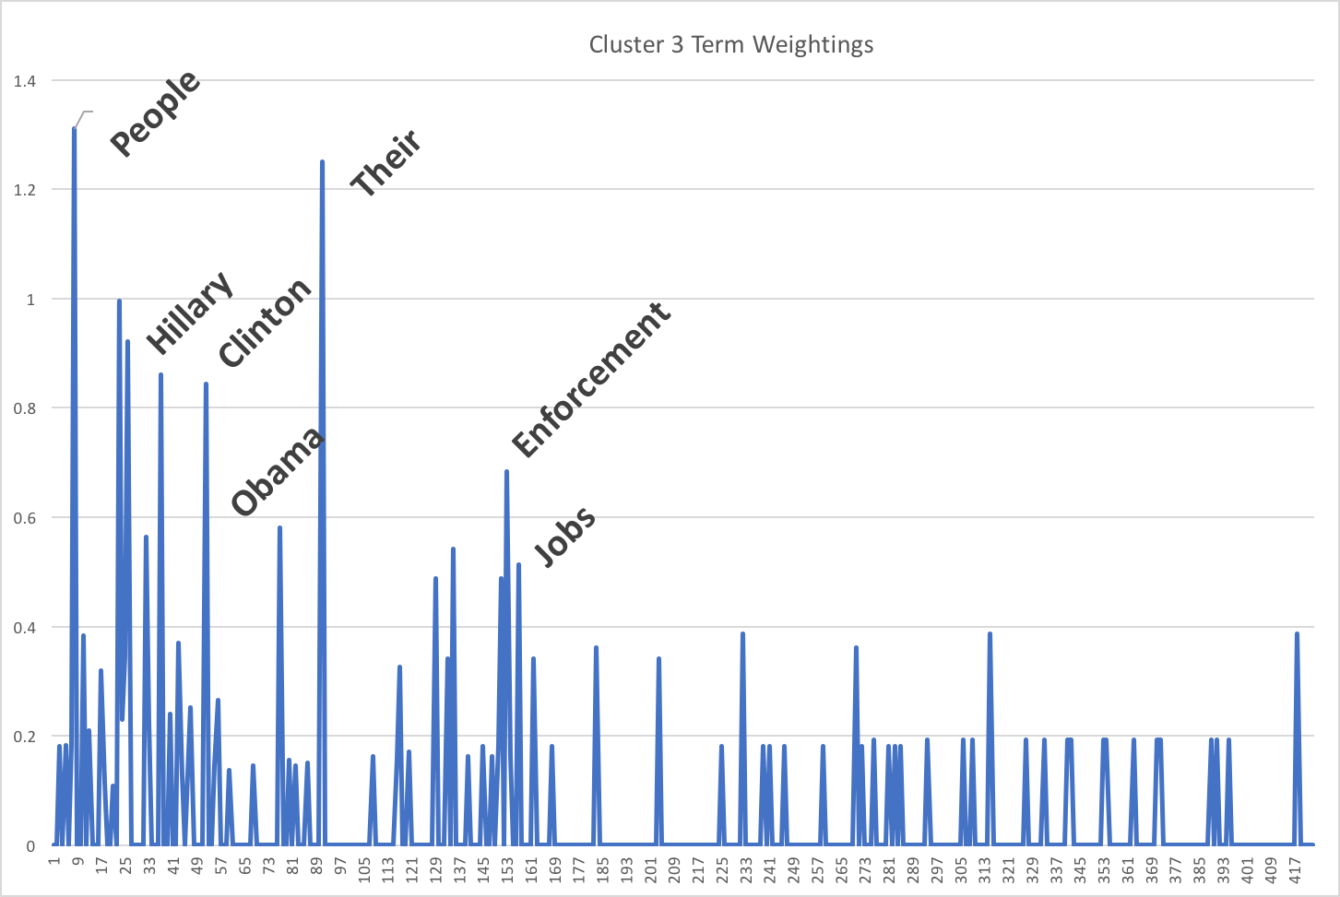
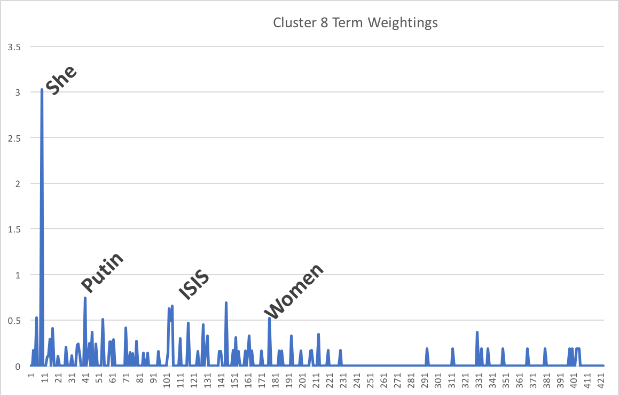
Implementation of a Particle Swarm Optimization Clustering Algorithm in Apache Spark for High Dimensional Data
Matthew Sherar & Dr. Farhana Zulkernine
CISC 500
Introduction
Clustering data is an important and common task in many data mining and machine learning applications. Particle Swarm Optimization (PSO) is an evolutionary optimization algorithm that is effective for clustering but is computationally expensive. Apache Spark is a powerful in-memory data processing engine but does not have PSO in its library.
Research Objective
Implement a hybrid K-Means PSO (KMPSO) algorithm in Apache Spark
Implement PSO-Variable Weighting for subspace clustering in Apache Spark
Evaluate the performance of KMPSO against standalone and Spark clustering algorithms
Evaluate PSOVW with text datasets
PSOVW Fitness Function:
Datasets
Name | Size | Type | Classes
Diamond | 3000x2 | artificial | 2
Forty | 3000x2 | artificial | 2
Wisconsin | 569x33 | real | 2
20Newsgroups | 400x5832 | text | 4
Presidential Debates | 253x423 | text | 8
Text Pre-processing
Stemming, tokenizing
Term-Frequency – Inverse Document Frequency
Why Spark?
Spark is a distributed data processing engine
Data stored in Resilient Distributed Databases (RDD’s)
Effective for iterative data processing due to in-memory and lazy, evaluation
Up to 100x faster than Hadoop’s MapReduce
Results
Why PSO?
PSO is an evolutionary algorithm based on social and cognitive behavior of flocking animals
Found to produce more compact clusters when used in clustering applications
Each particle represents a solution, with position (x) and velocity (v)
Comprehensive Learning PSO:
Future Work
Future work includes clustering text from medical domains, and to apply these algorithms for streaming data with Spark Streaming
Related Work
Lu, Y. et al.: Particle swarm optimizer for variable weighting in clustering high-dimensional data. Machine learning 82(1), 43–70 (2011)
Cui, X. et al.: Document clustering using particle swarm optimization. In: Swarm Intelligence Symposium, 2005. SIS 2005. Proceedings 2005 IEEE. pp. 185–191. IEEE (2005)

