Slide 1

HashLibrarian
Michael Sweeney

Slide 2
Basic Operation
Hash Individual Files
Hash Directories Recursively
Create Databases of Collected Hashes
Encrypt Databases
Generate HTML Reports

Slide 3
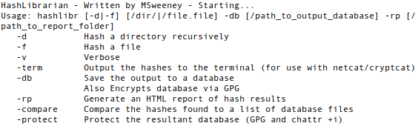
Options and Switches

Slide 4
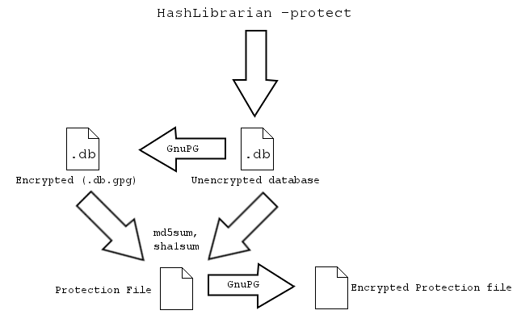
Encrypting Databases

Slide 5
Demonstration
Creating/Protecting Databases
Comparisons involving Protected Databases
HTML Reports

