Slide 1
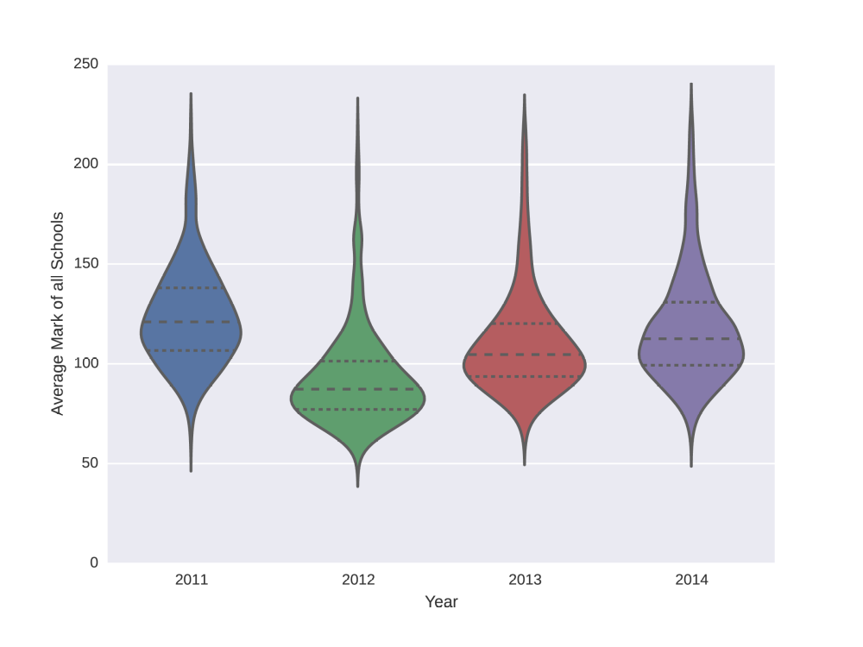
Performance of schools after doing the Workshops
First, we removed the effect of the yearly variation of the average school marks shown below.
Then, we calculated a performance score.

Slide 2
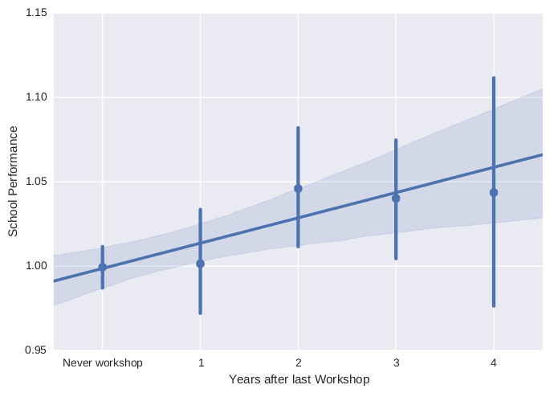
Performance of schools after doing the Workshops
This “performance” score is weighted over the mean marks of each year, so the mean performance of all schools is always 1 independently of the year.
Performance is better on the schools that participated in the workshops.
Teachers continue to improve years after taking the workshops!

