Slide 1
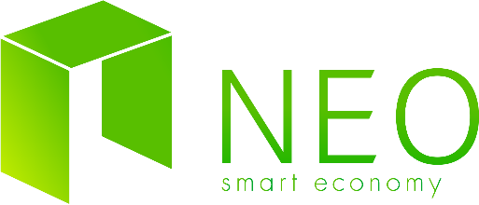
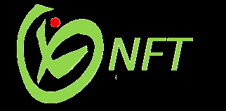
Breed & Brawl Crypto Game
Market Place
Contract Methods extension proposal
NEO Blockchain Hackathon
Berlin, Germany | 27. - 28. October 2018

Slide 2

ABOUT US
The team
Martin Ivanov — Pyhon, .Net dev, ML enthusiast
Anton Sotirov — Node.js, JavsScript dev, Enterpreneur
Bogdan Alov — Python, .Net dev, Devops

Slide 3
Aim: To introduce innovative ways of digital asset exchange

Slide 4
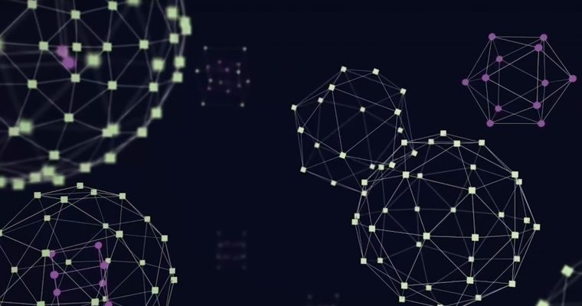
Potential of the blockchain technology
Development of the distributed ledger technology is a promising to bring the biggest revolution since the Internet in the information ages. Its potential applications are varied and its implications reach across numerous industries
As blockchain technology continues to be present in headlines, cryptocurrencies have potential to disrupt the financial industry but current applications are still limited.

Slide 5

PROBLEM
The average consumer doesn’t understand what a cryptocurrency is or why it matters, let alone how to safely and transparently auction or lend digital assets
The “cryptocurrency,” as a concept often goes over the head of the average consumer; they don’t understand the implications of blockchain technology beyond simple trading and investment. While it’s understandable that new developments will follow public interest to some degree, it may limit blockchain innovation in both the short and long term.
Many blockchain projects have limited their audiences to early investors or small groups of people with specialized in domain knowledge or interests.

Slide 6
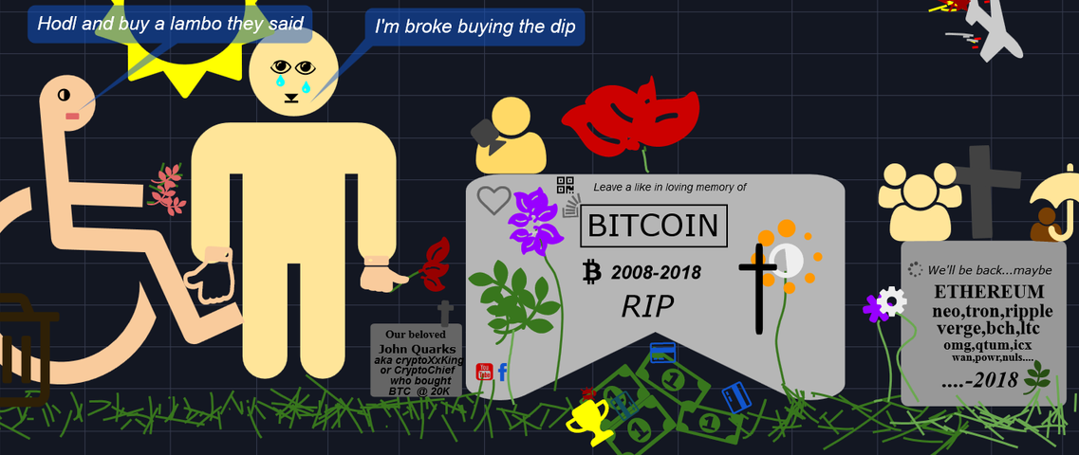
As a result 2018 was a dissapointing year for many crpyto enthusiasts...
And they are missing the point…
Source: https://www.tradingview.com/markets/cryptocurrencies/ideas/

Slide 7

SOLUTION
Only Software Developers could fully undestand the vast amount of applications of the blockchain concept idea and imagine the varied implications that reach across numerous industries
Introduce aplications of blockchain technology beyond simple trading and investment that are explanatory and exciting to explore
Present innovative solutions on the crpyto platforms such as unified markets and borrowing a digital assset
Provide a solution that is reusable in software development and SaS licencing

Slide 8
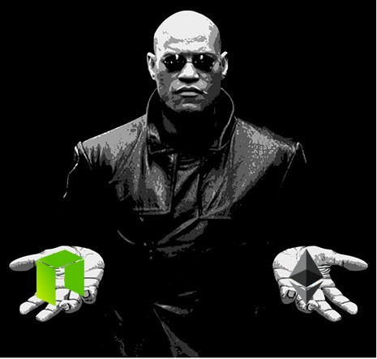
The Non-fungible Token Standard
A new idea has emerged in the form of a smart contract
„NFTs are required to track, exchange and enforce ownership of digital assets. A non-fungible token (NFT) can be thought of like a property deed - each one is unique and carries some non-mutable information. Other information, such as the owner of the property, can be changed. This allows for high value objects to be tokenized more effectively.“
Source: https://github.com/neo-project/proposals/pull/41/files
It is also available on the Etherium platform as ERC-721 with some limitations

Slide 9


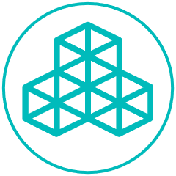
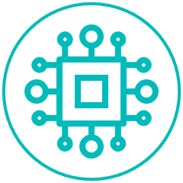
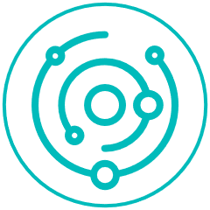
Our NEP
We aim to embrace the new token standart via a game because...
Demonstration of implicit mechanics
Education through gamification
Solid architecture
Contract free revenew model
ADD A FOOTER
MM.DD.20XX

Slide 10
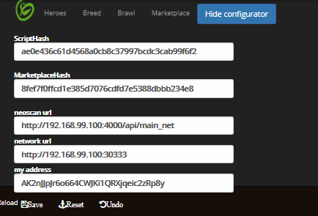

The game
Breed & Brawl

Slide 11
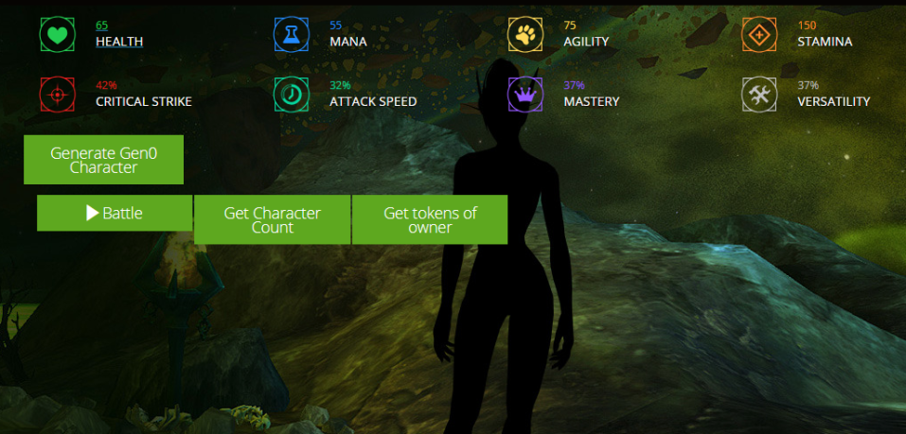
The game

Slide 12
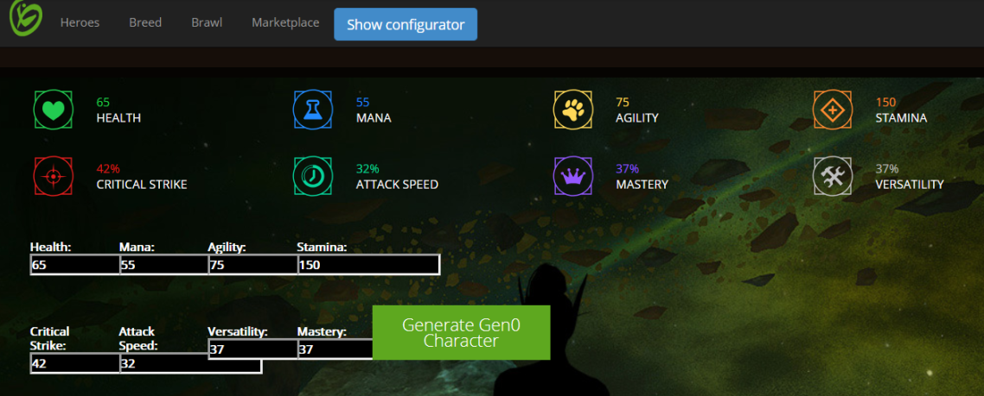
The game

Slide 13
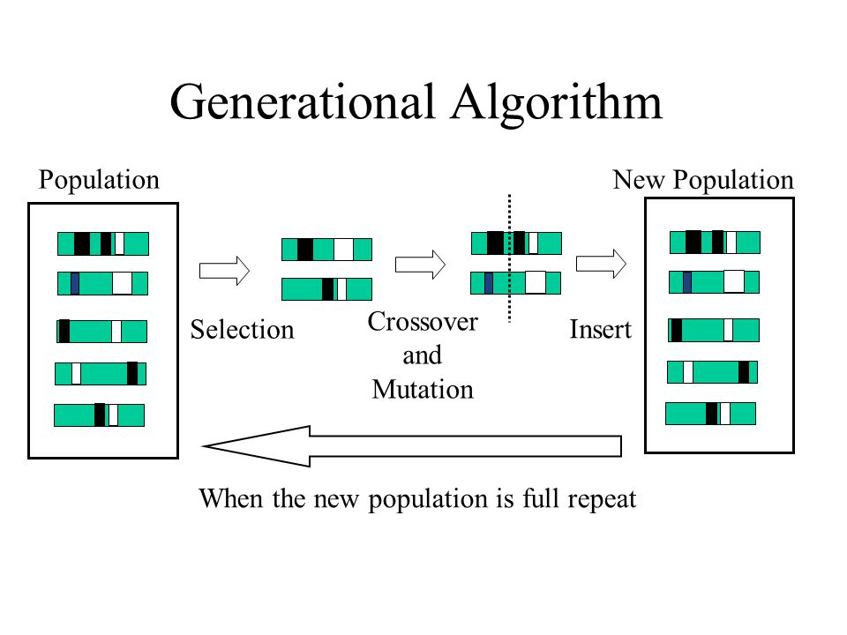
The game mechanics
Inspired by evolutionary computation

Slide 14
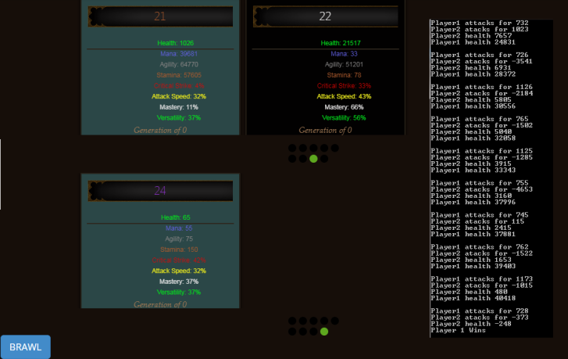
The game: Brawl

Slide 15
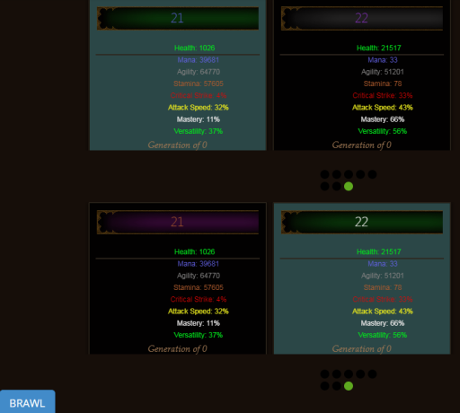
The Marketplace

Slide 16
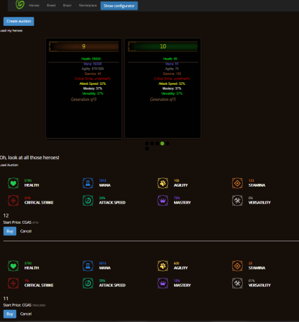
The Marketplace

Slide 17
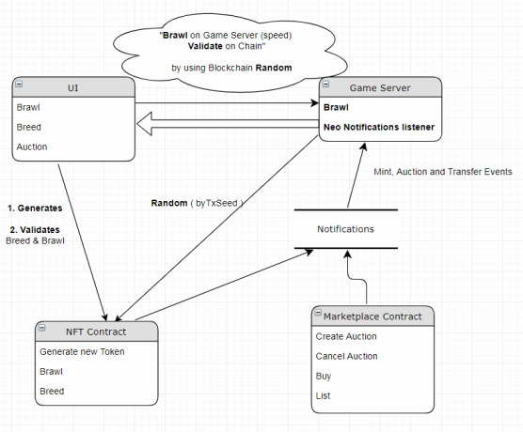
The Marketplace

Slide 18
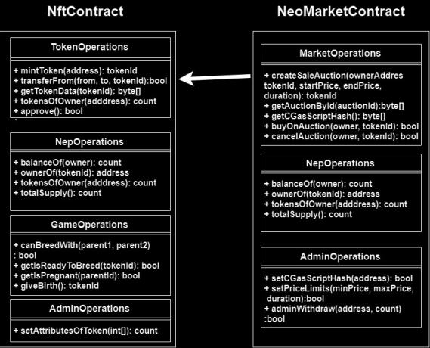
Contracts Overview

Slide 19
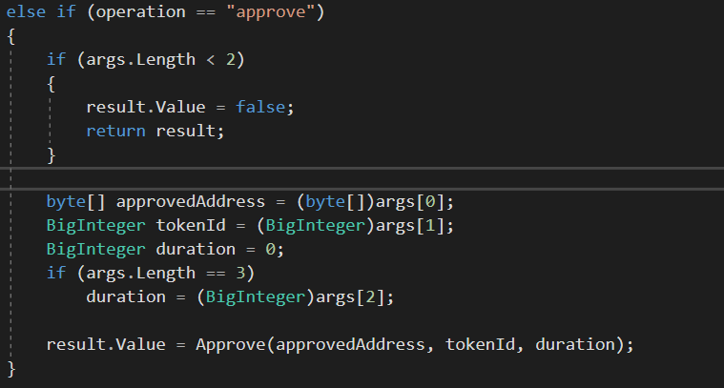
The NEP extended method

Slide 20
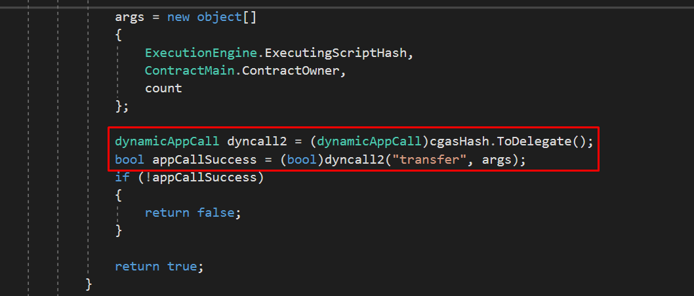
Contracts Overview

Slide 21
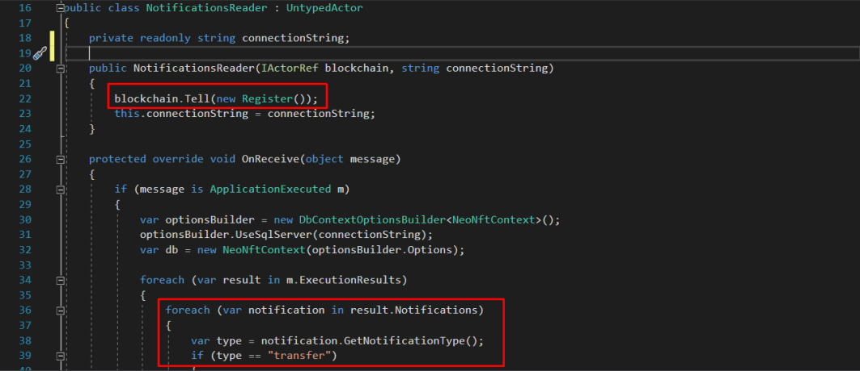
Contracts Overview

Slide 22
BUSINESS MODEL
We want to extend the usage of this model to digital assets such as software products.
1
2
3
Users deposit gas
Marketplace has a 1% fee
User create valuable assets playing the game or doing something online
ADD A FOOTER
MM.DD.20XX

Slide 23
COMPETITION
Limited competition in the crypto world. Although marketplaces exist in almost every game.

Slide 24
THANK YOU
For your attention!

