Slide 1
Virtual reality at the service of architecture

Slide 2
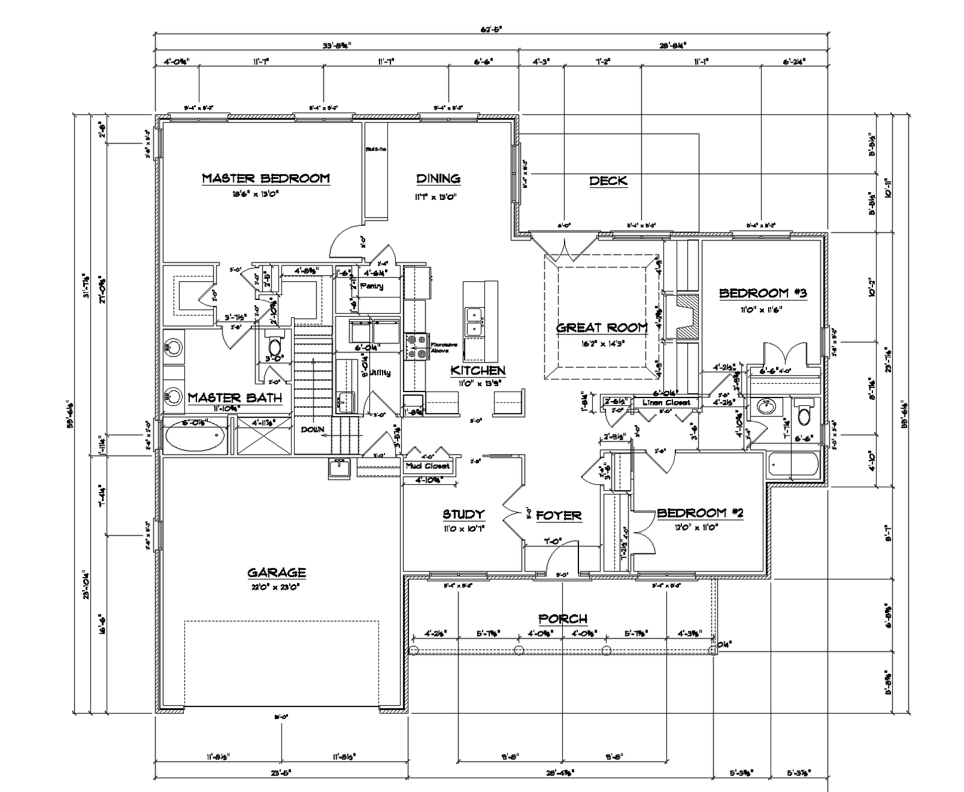
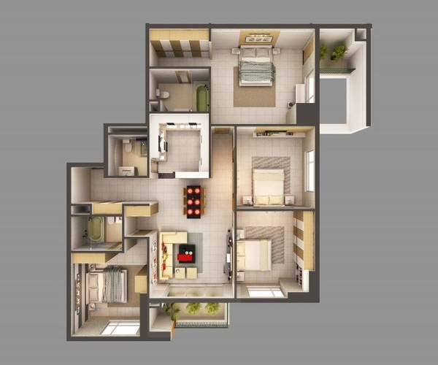
Virtual reality at the service of architecture

Slide 3
Virtual reality at the service of architecture
Two costs:
  Trying to explain your vision with unadapted tools.
  Final result not matching architect vision or client expectations.
“The mean direct and indirect costs for design errors were revealed to be 6.85 and 7.36% of contract value, respectively.”

Slide 4
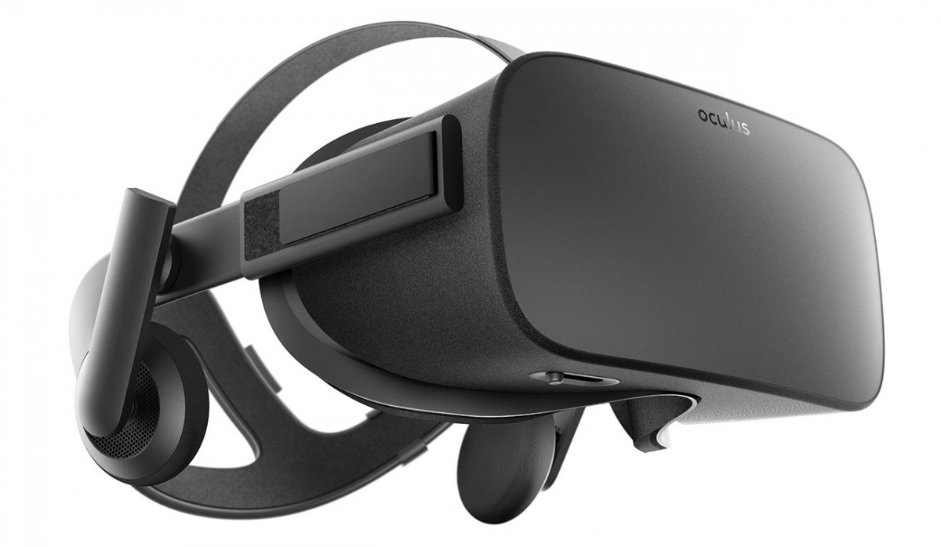
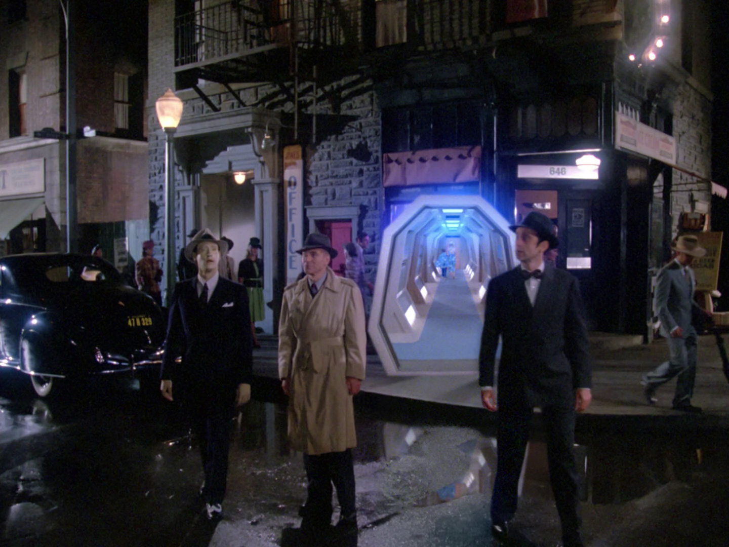
Virtual reality at the service of architecture
+
=

Slide 5

Virtual reality at the service of architecture
+
+
Control tool for the architect
Communication tool for the clients
And much more...

Slide 6
Virtual reality at the service of architecture
A very big market growing fast:
“The global (construction) market is forecast to grow 85% to $17.5 trillion (...) by 2030.”
“UK to spend US$6.2 trillion on construction cumulatively by 2030”

Slide 7
Thank you
Come to our stand for a demo!

