Slide 1
VR for Google Cardboard in Unity
Challenges and opportunities

Slide 2

Content
5 W's of VR (sort of...)
Cardboard and Unity
Must-know of VR
  Cybersickness
  UI
  Single button controller
Future of VR?
Cute kitten picture

Slide 3
5 W's of VR
What is VR?
Trick the user's senses into believing he is somewhere else.
"It's a trap!" Admiral Gial Ackbar

Slide 4
5 W's of VR
Where: which industries?
Mainly entertainment and education.
A whole new medium, very immersive.

Slide 5
5 W's of VR
Who can build VR experiences?
Everyone at a basic level.
Game designers and filmmakers. BUT many new factors to consider.

Slide 6
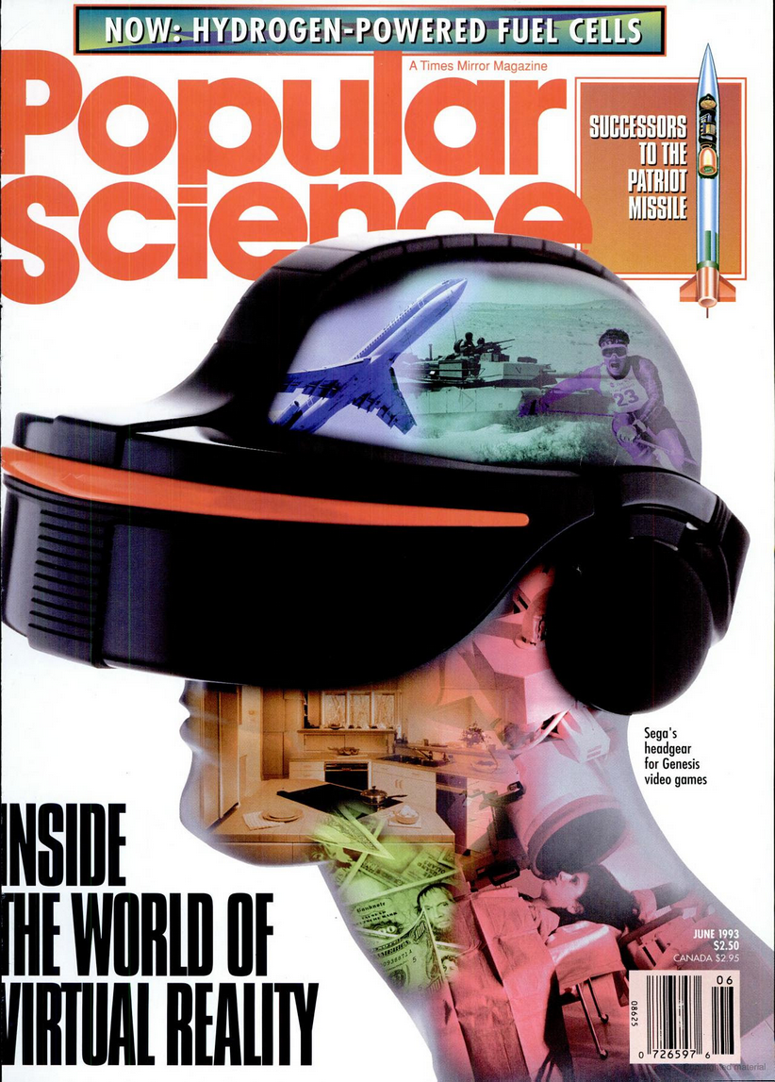
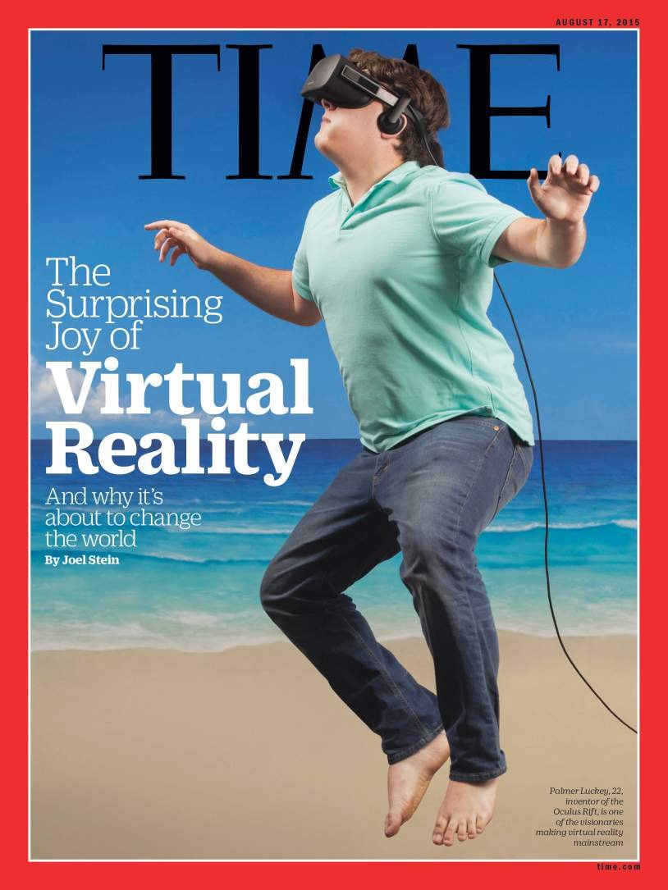
5 W's of VR
When VR?
25 years ago?
Now!
(with a LOT to come...)

Slide 7
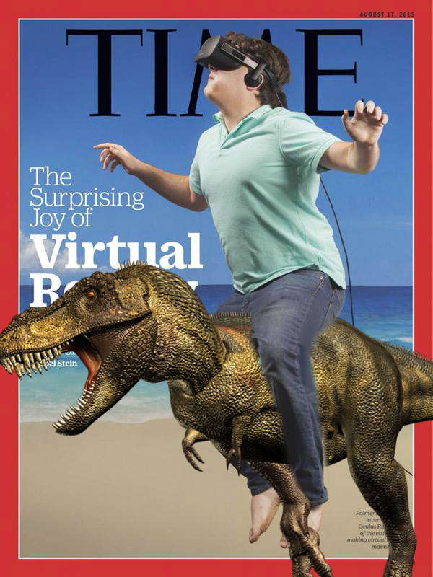
5 W's of VR
When VR?
25 years ago?
Now!
(with a LOT to come...)
And a lot cooler 😎

Slide 8
5 W's of VR
Why VR?
Because it's AWESOME!
...and opens new doors (to AWESOMENESS!)

Slide 9
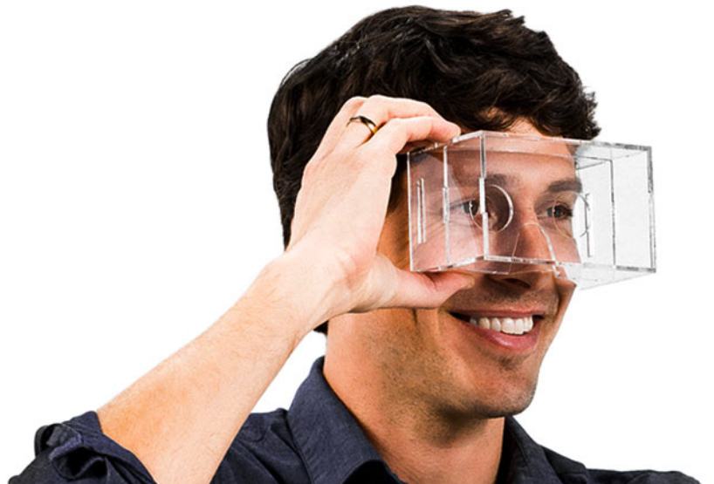

VR for Cardboard with Unity
Why Cardboard?
  Cheap => available for all
  Simple
  Good enough
Why Unity?
  Google made a Cardboard SDK for Unity
  It's Fun to use!
  It's powerful
  It's free (until you want to monetize your apps)

Slide 10
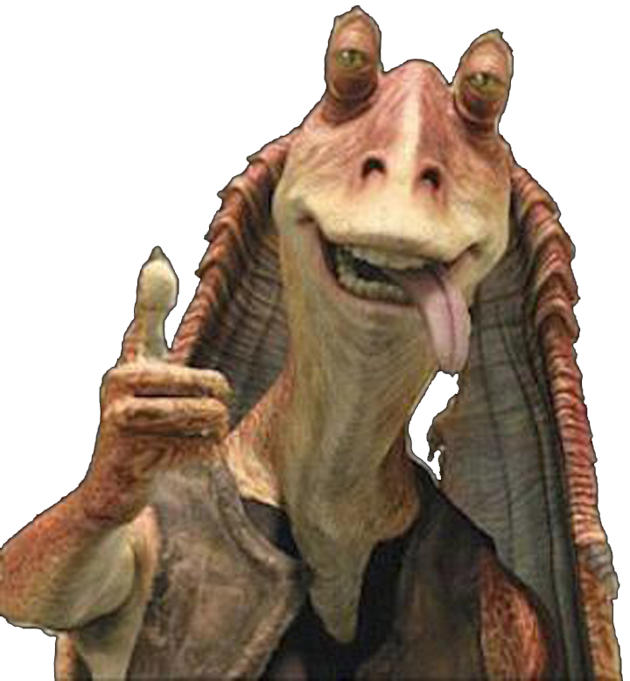



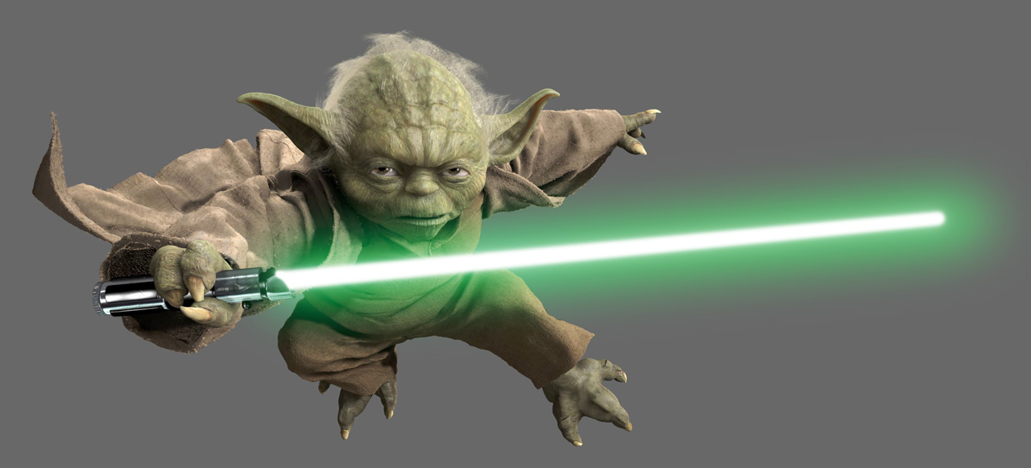
Before you start
Cybersickness
User interface
Single button controller

Slide 11
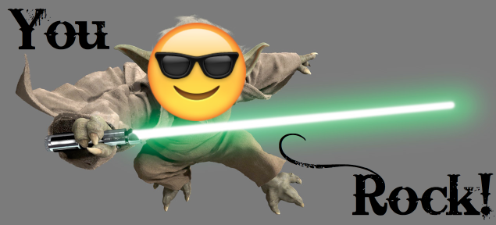
Before you start
Cybersickness
User interface
Single button controller

Slide 12
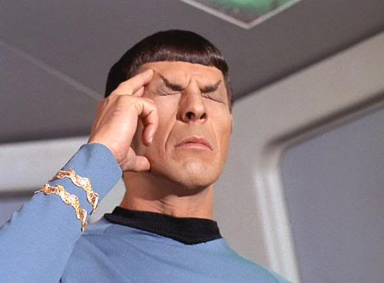
Before you start
Cybersickness
  Main danger for VR!
  Symptoms similar to motion sickness (seasick, airsick...)
  Caused by sensory conflicts
  Linked to the perception of self?

