Slide 1
Color palette
UCLouvain
#00204e
#5db4e6
#9cb7d4
Complementary
#4e2e00
#e68f5d
#d4b99c
Palette
#00204e
#9cb7d4
#8b687f
#f0c987
#b5dbab
#5db4e6

Slide 3
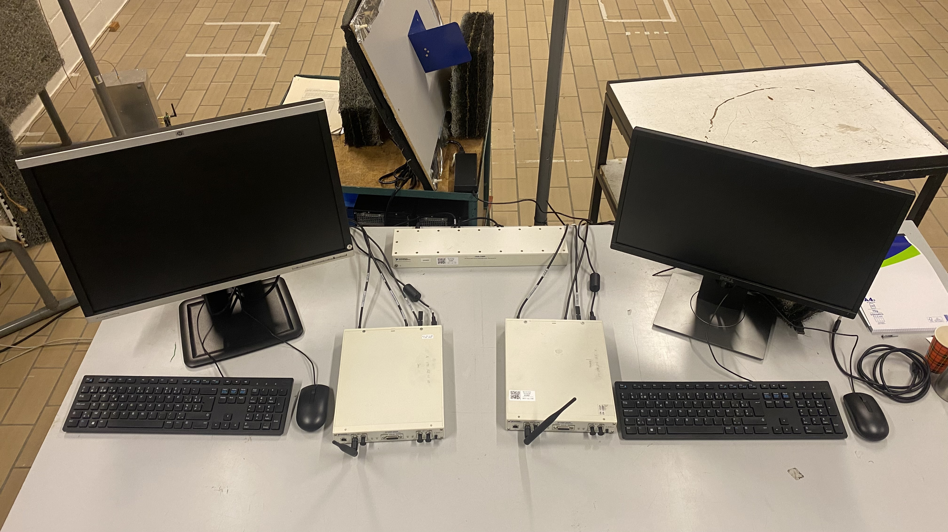
Transmission
Reception
— USRP — Computer — Clock

Slide 4
Input signal
Synchronization
OFDM demodulation
Delay/Doppler map creation
OFDM channel estimation
Channel equalization
Symbol/bit extraction
Radar specific
Common
Communication specific

Slide 5
Delay/Doppler map creation
Synchronization
OFDM demodulation
OFDM channel estimation
Input signal
Channel equalization
Symbol/bit extraction

Slide 6
Transport adapters
Radio interfaces
FPGA RFNoC image
Crossbar
Existing IP block
Existing IP block
Existing IP block
New IP block
New IP block

Slide 7



Transmission USRP
Clock
Reception USRP
Transmission PC
Reception PC

