Slide 1
TFE25-462: Meeting 8
Schmidl & Cox results, ToolChain, RFNoC & jury

Slide 2
Schmidl & Cox results

Slide 3
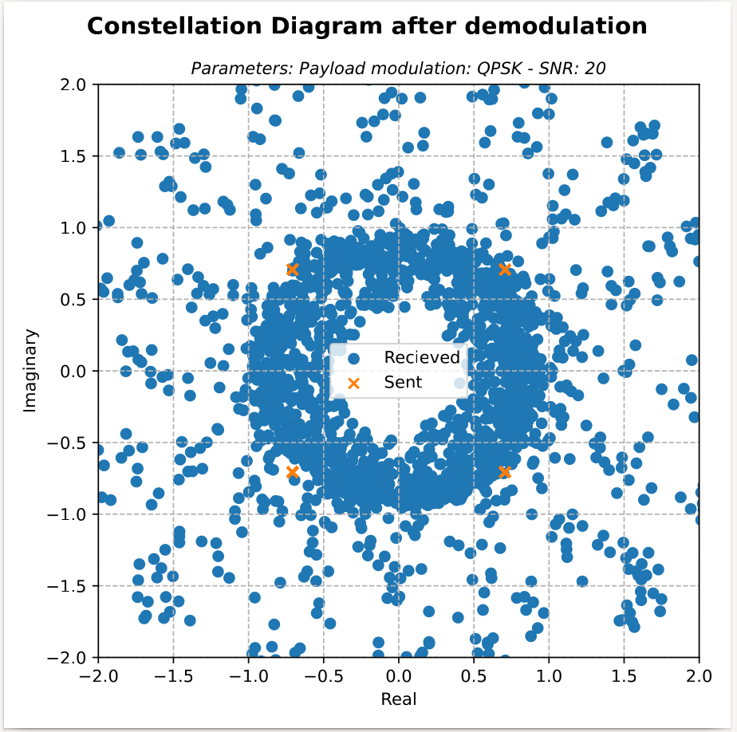
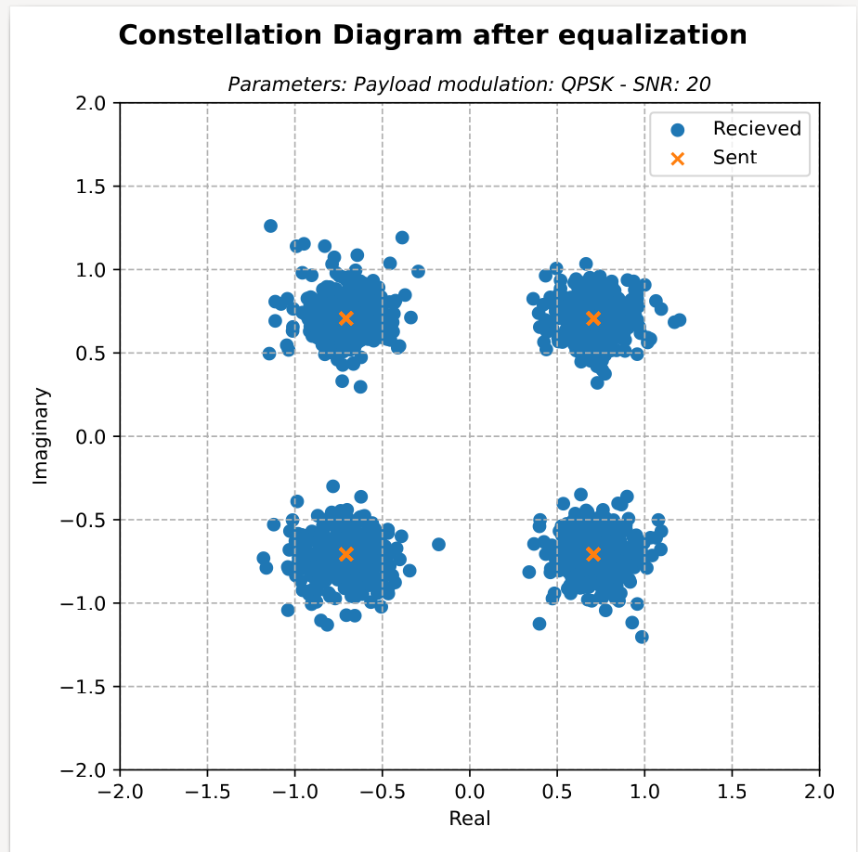
Schmidl & Cox
Verified by simulation

Slide 4
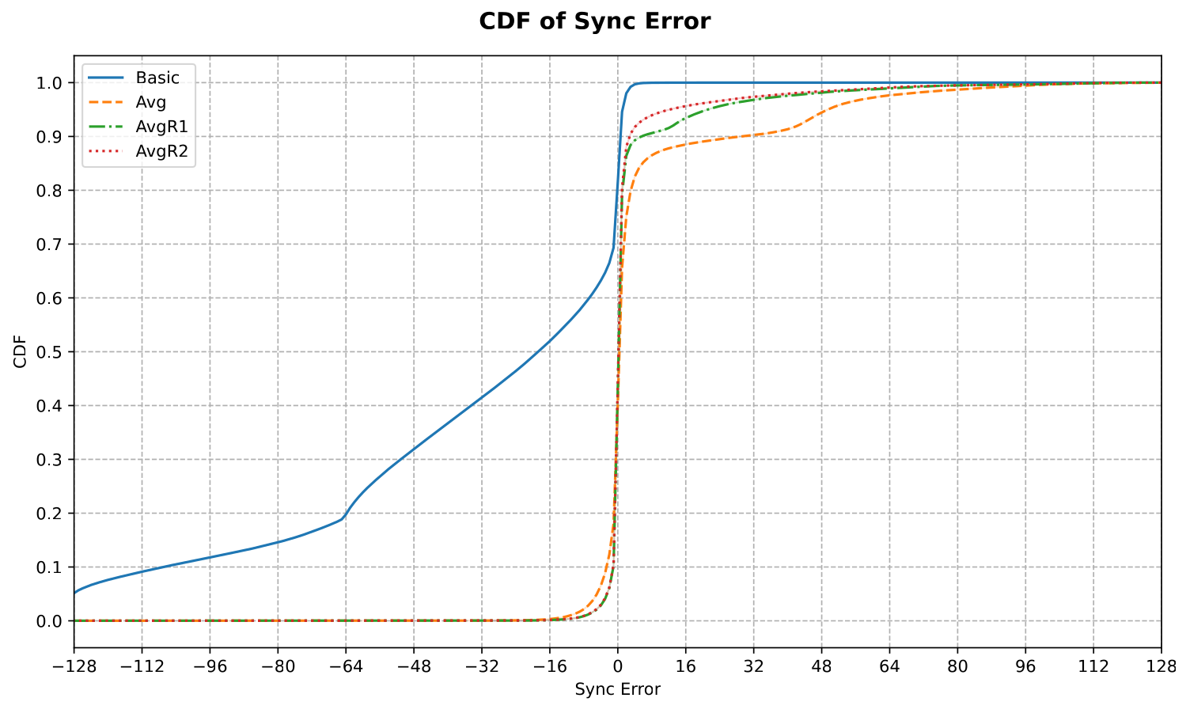
Schmidl & Cox
Verified by simulation

Slide 5
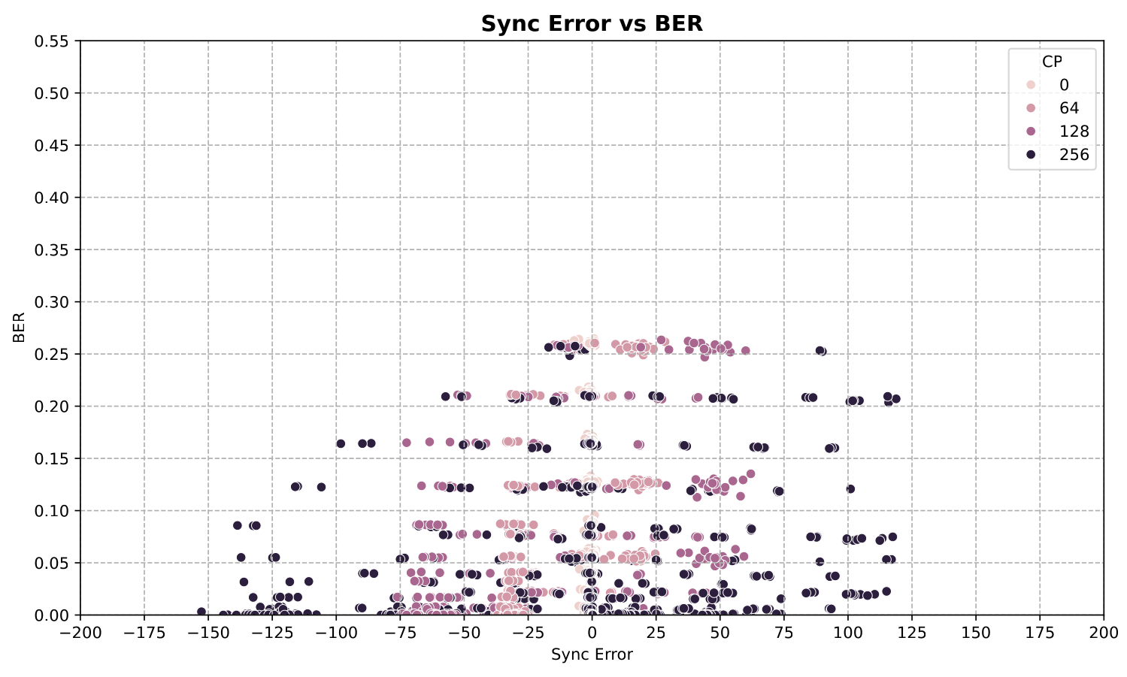
Schmidl & Cox : impact of parameters variation (CP) - only AVG algorithms

Slide 6
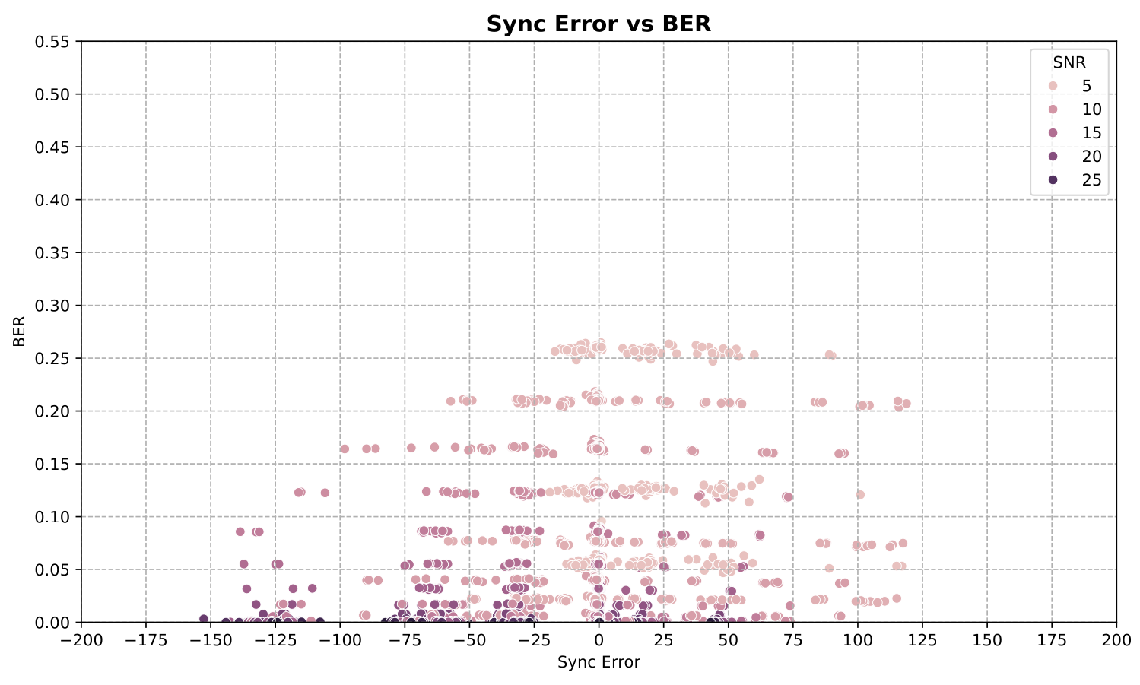
Schmidl & Cox : impact of parameters variation (SNR) - only AVG algorithms

Slide 7
Toolchain

Slide 8
Toolchain
UHD 4.8 (on VM & setup PC) - Development and IP + tool for RFNoC integration
Xilinx vivado 2021.1 (on VM & setup PC) - compilation
ModelSim 2020.4 (works wih 2021.1) (on VM only) - simulation
GNURadio (on VM & setup PC) - communication

Slide 9
RFNoC

Slide 10
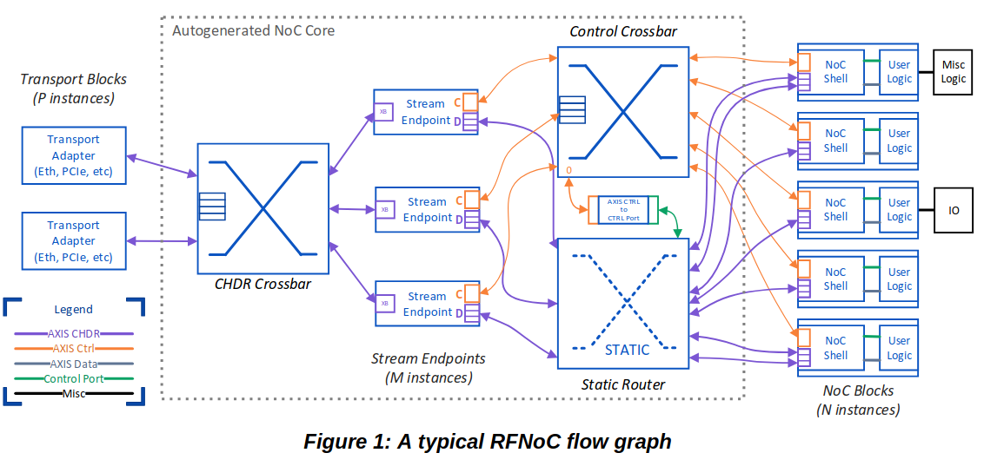
Typical flowgraph

Slide 11
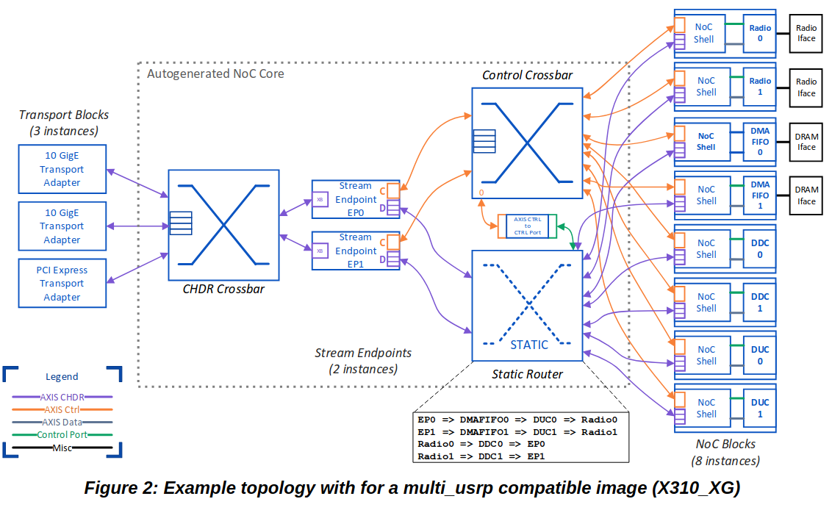
Current FPGA image

Slide 12
Goal
Divide the problem into blocks
Schmidl & Cox (R2)
AVG window
...
Implement those blocs as out of tree (OOT) modules
Help of existing IP
Existing implementation on RFNoC 3.15 LTS
TestBenches creation
Software control for UHD and GNU Radio
FPGA Image build

Slide 13
After presentation notes:
root mean square errror en fct du SNR pour un SNR fixé => Error en ordonnée MSE de synchro / SNR
CDF encore intéressant
BER en fct du SNR

