Slide 1
TFE25-462: Meeting 9
RFNoC detailed overview
Metric computation on FPGA
Jury composition and TFE title

Slide 2
RFNoC detailed overview - FPGA
RF Network-On-Chip

Slide 3
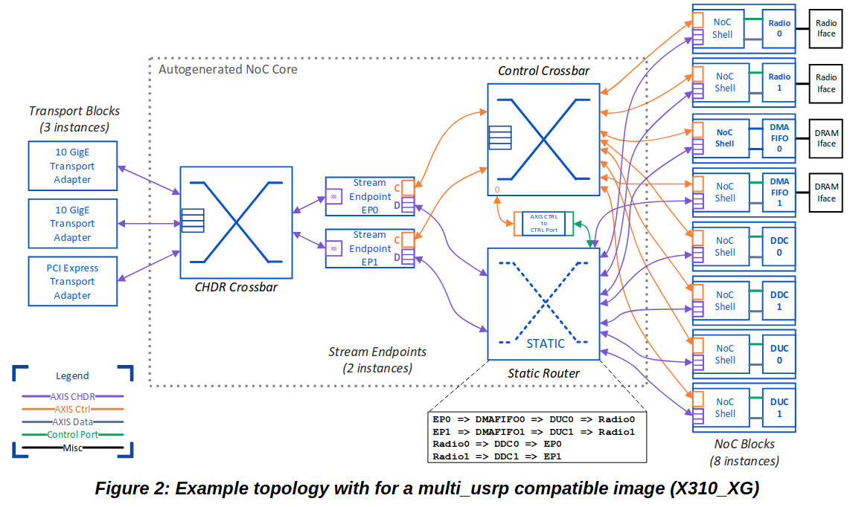
RFNoC flow graph
https://files.ettus.com/app_notes/RFNoC_Specification.pdf

Slide 4
Communication protocols - CHDR
CHDR (Condensed Hierarchical Datagram for RFNoC) is the protocol for data transfer in a RFNoC network
2 main types of packets
Data packets: transmitting arbitrary data between blocks
Control packets: memory-mapped transactions
Some internet only packets (stream status, stream command & management) => Not used
Block should parse CHDR packets, can done using NoC Shell
=> CHDR is parsed by the NoC shell, user logic must not interface with the protocol
==>CHDR is transparent for the user logic

Slide 5
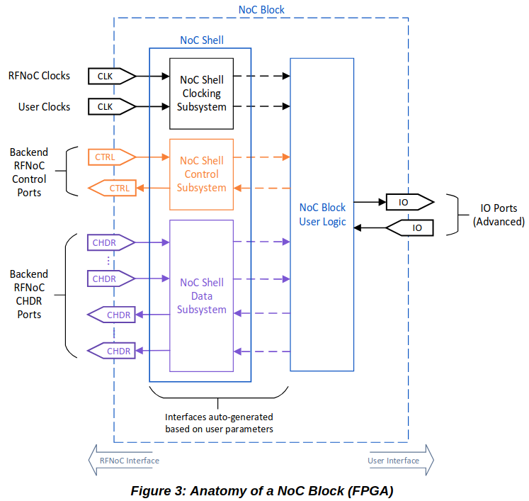
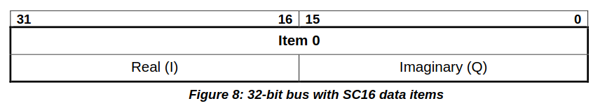
Anatomy of a NoC block (FPGA)
Control and Data interface are available in 2 formats:
low-level => user receive CHDR packet
simple => Noc Shell parse the packet
Control
Used to configure block, send commands, ...
Read, and write requests
Ex: change the value of the gain in the gain block
Data(also called payload)
Complex number representation
2 streams:
Context: additional information about payload (header, timestamp, metadata) Ex: number of items in payload, timestamp for execution...
Payload: items of data
https://files.ettus.com/app_notes/RFNoC_Specification.pdf

Slide 6
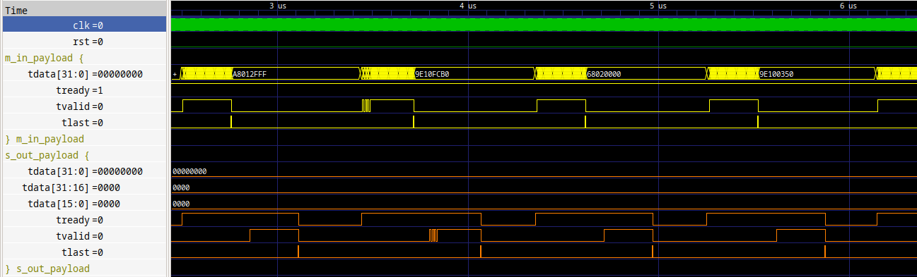
Payload packets on simple Data interface of the user logic

Slide 7
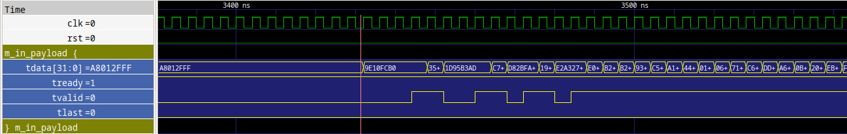
Communication protocols - AXI-Stream
Use AXI-Stream protocol for communication bus protocol
Handshake protocol
xVALID: driven by the source to inform destination that the payload on the channel is valid
xREADY: driven by the destination to notify that it is prepared to receive data
Note: xLast is not part of AXI => used for signaling last item of the CHDR Data packet.
EttusResearch provides a lot of modules for AXI-Stream computation
Xilinx provides IP for AXI-Stream computation

Slide 8
RFNoC detailed overview - UHD
Software side of UHD: how to communicate with the device and configuring routes ?

Slide 9
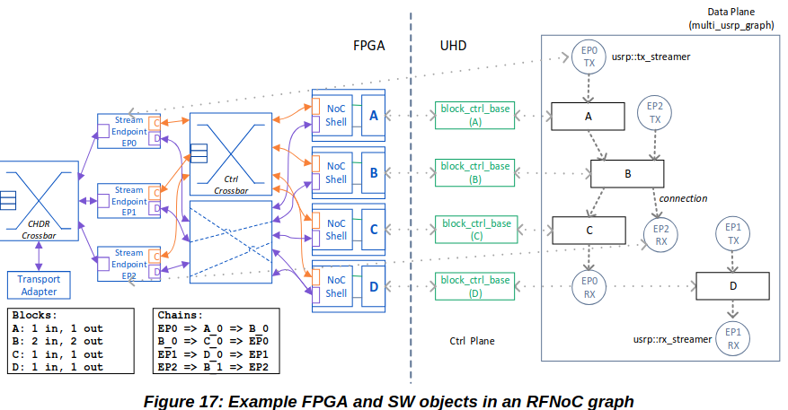
UHD Basics
Block controller: attached to each block, auto-discovered
Graph: topology of blocks (static and dynamic connection are reflected here)
Streamers: send/receive data to/from blocks in the FPGA
https://files.ettus.com/app_notes/RFNoC_Specification.pdf

Slide 10
Metric computation on FPGA

Slide 11
y
Metric computation: Block diagram
Split stream FIFO
P(d + 1) = P(d) + y(d) x y(d-L)* - y(d-L) x y(d-2L)*
R(d + 1) = R(d) + |y(d)|^2
- |y(d-L)|^2
Delay (L)
Complex to magnitude squared
Conjugate
Moving sum (Q)
Complex multiplication
>> 16 => divide by 2¹⁶
Clip complex (32 to 16 bits by component)
Complex multiplication
Moving sum (I)
Moving sum (Q)
Legend (signed int)
32 bits complex (16 bits I, 16 bits Q)
64 bits complex (32 bits I, 32 bits Q)
Complex to magnitude squared
Divider
16 bits integer
32 bits integer

Slide 12
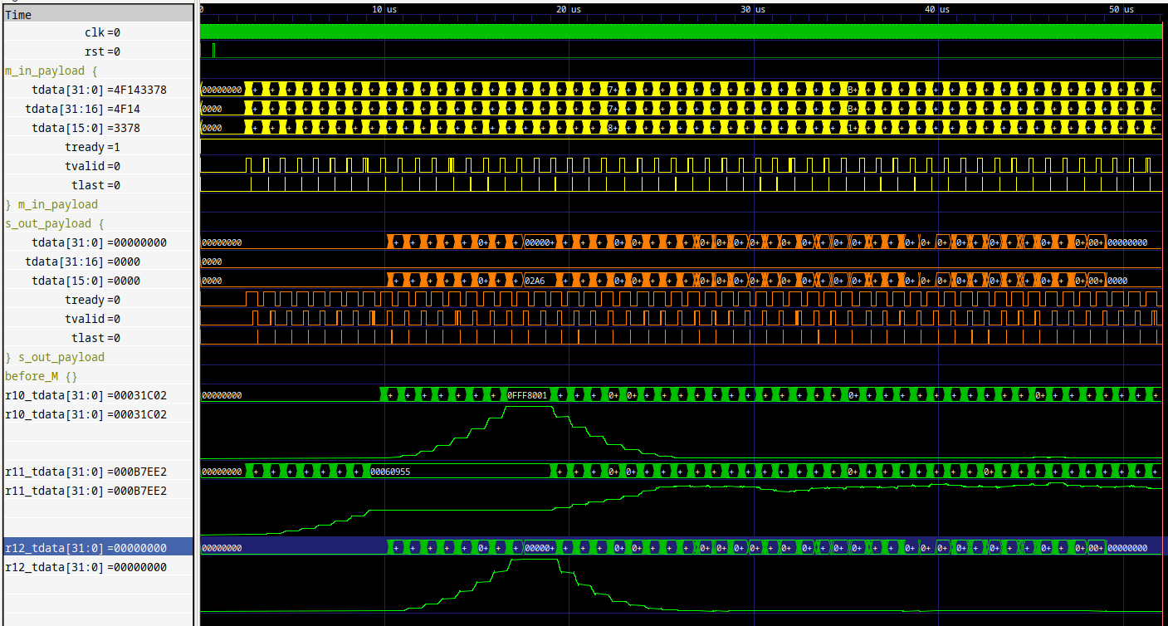
Metric computation: Results
in_tdata = y(d), out_tdata = r12 r10 = |P(d)|^2 r11 = (R(d))^2 r12 = M(d)

Slide 13
Jury composition and TFE title

Slide 14
Jury composition and TFE title
Previous TFE title: Integrated sensing and communication: a Wi-Fi 6 USRP-Based experimental setup
Poster title: Hardware Acceleration on FPGA of an Integrated Sensing and Communication OFDM Chain for a Wi-Fi 6 USRP-based Experimental Setup
final title: FPGA Acceleration of an USRP-based OFDM Chain for Integrated Sensing and Communication
Still Wi-Fi based ?
More about RFNoC / USRP ?

