Slide 1
Transport adapters
Radio interfaces
FPGA RFNoC image
Crossbar
Existing IP block
Existing IP block
Existing IP block
New IP block
New IP block

Slide 2
Input signal
Synchronization
OFDM demodulation
Delay/Doppler map creation
OFDM channel estimation
Channel equalization
Symbol/bit extracting
Radar specific
Common
Communication specific

Slide 3
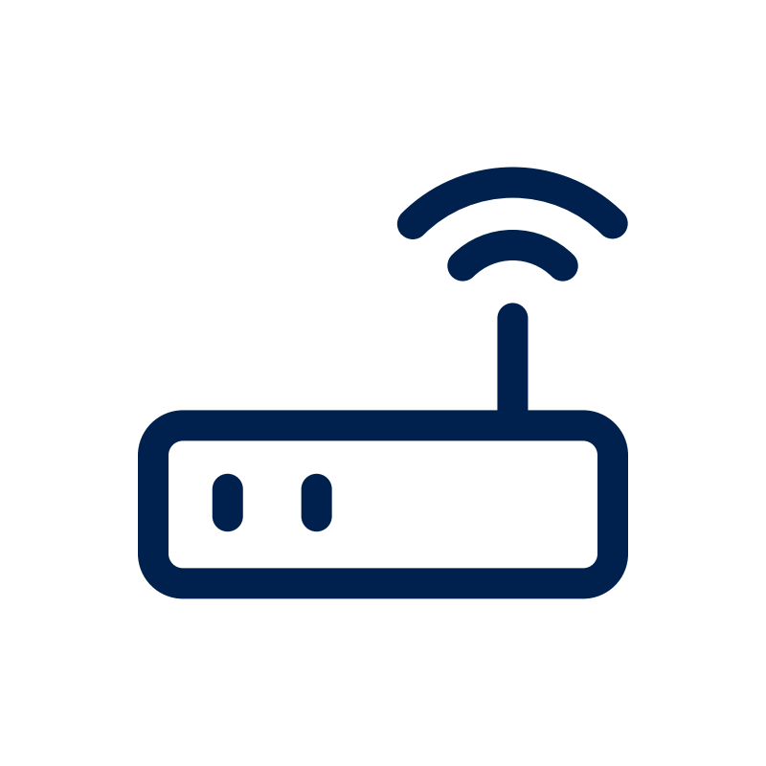
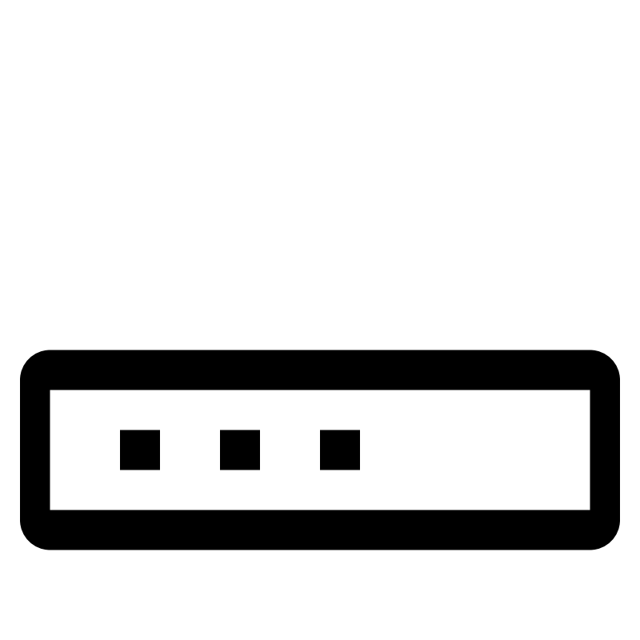

Transmission USRP
Clock
Reception USRP
Transmission PC
Reception PC

Slide 4

P | D | D | P | D | D | P
D | D | D | D | D | D | D
P | D | D | P | D | D | P
D | D | D | D | D | D | D
P | D | D | P | D | D | P
D | D | D | D | D | D | D
P | D | D | P | D | D | P
P | D | D | P | D | D | P
D | D | D | D | D | D | D
P | D | D | P | D | D | P
D | D | D | D | D | D | D
P | D | D | P | D | D | P
D | D | D | D | D | D | D
P | D | D | P | D | D | P
Transmission USRP
Reception USRP

Slide 5
Radar
Communication
ISAC
Pilots
Data
Pilots
Data
Channel
Channel
Channel
Data
— Known — Unknown

Slide 6
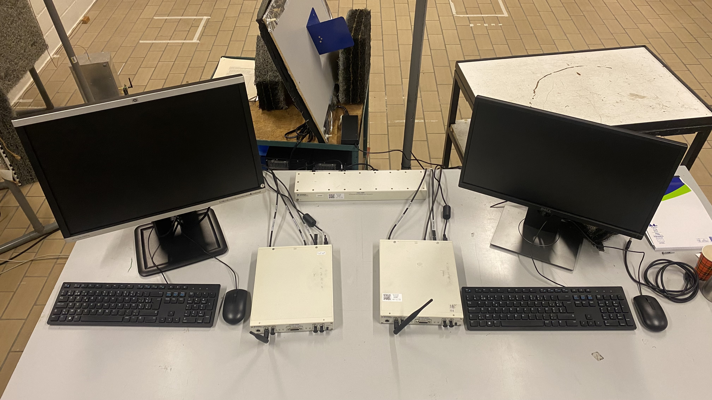
Transmission
Reception
— USRP — Computer — Clock

