Slide 1
Color palette
UCLouvain
#00204e
#5db4e6
#9cb7d4
Complementary
#4e2e00
#e68f5d
#d4b99c
Palette
#00204e
#9cb7d4
#8b687f
#f0c987
#b5dbab
#5db4e6
#f27474

Slide 2
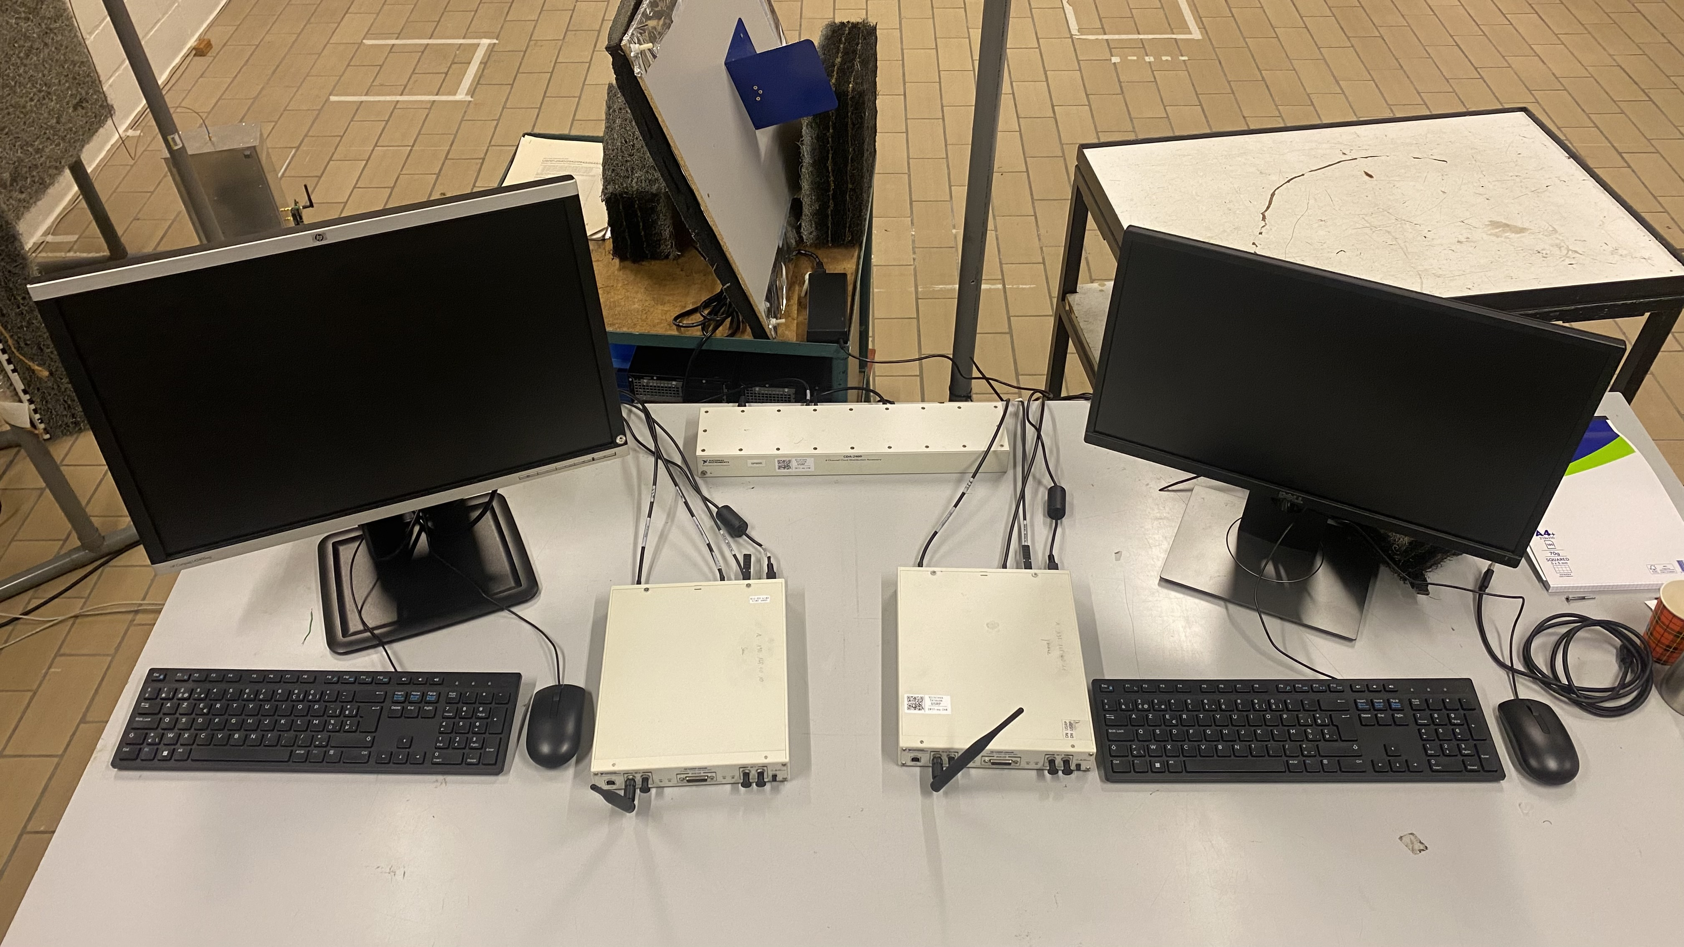
Clock
Transmission computer
USRP tx
USRP rx
Reception computer

Slide 3





OFDM
OFDM
Transmitter
Receiver (with FPGA)

Slide 4
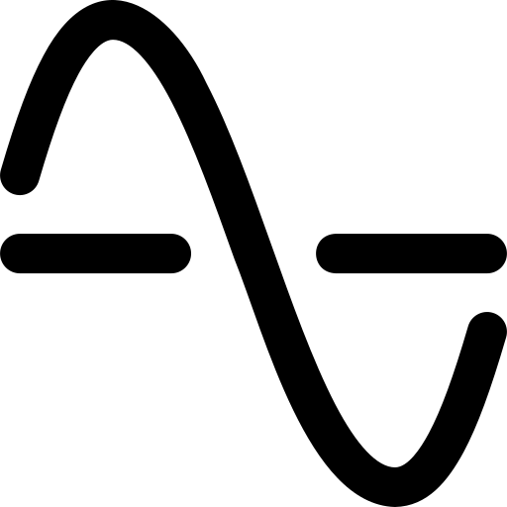
Hardware
Software
RADAR
Delay/Doppler
Speed & Distance
Synchronization
OFDM demodulation
OFDM channel estimation
Communication
Channel equalization
010110101

Slide 5
Transport adapters
Radio interfaces
FPGA RFNoC image
Crossbar
Existing IP block
Existing IP block
Existing IP block
New IP block
New IP block

Slide 6


Transmission USRP
Clock
Reception USRP
Transmission PC
Reception PC

