Slide 1


Slide 2



The Problem
Underpriced → Lost value
Overpriced → No buyers
Subjective valuations

Slide 3




Features
Price Prediction
Image Analysis
Fast Evaluation
User Friendly
Agent & homeowner flows
Accurate target price + confidence interval
Finish, space, condition detected automatically
Seconds per listing — instant decisions

Slide 4

Market Opportunity
Global Market
Transactions
$200T+ real estate asset class
Millions of apartment sales annually — large addressable market
AI Adoption
Rapid demand for automated valuation & visual analytics

Slide 5

How it works? The Magic of Multimodal Fusion
Computer Vision
Photos and images
Price Prediction
Multimodal Fusion
Text Processing
Final predicted price
Descriptions and reviews
Central Model
Tabular Data
Fusion and preprocessing
Features and metrics

Slide 6
What We Trained On? (Data Science)
Real data and strong metrics.
23,353
0.82
Listings
R² Score
Dataset size
Model quality
82%
18%
Explained variance
Residual error

Slide 7

How it works — One click to price
Input
Output
Photos • sq ft • rooms • location
Predicted price • Confidence

Slide 8

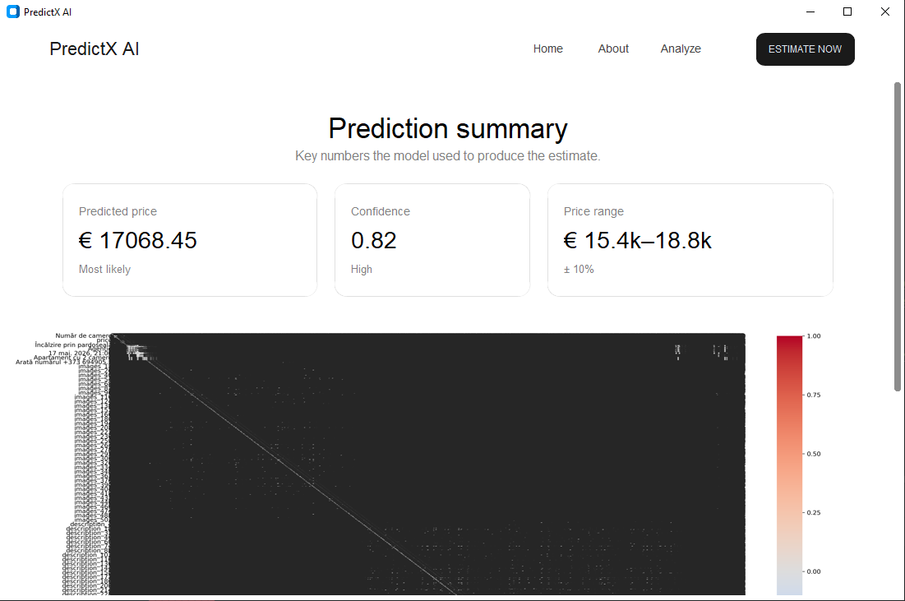
CustomTkinter Interface
Upload
Details
Price
Async
Real-time
Modern
Clean CustomTkinter design

Slide 9
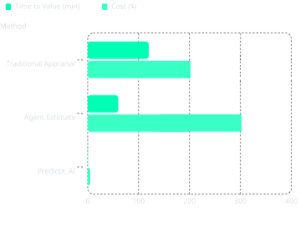
Competitive Advantage
Speed: immediate valuations
Cost: orders of magnitude cheaper
Scalability: API + batch processing
Consistency: model-based objectivity
Visuals: image-driven signals other tools lack
Clear gap vs legacy methods — product wins on unit economics.

Slide 10


Impact & Next Steps
Sellers: higher sale price, reduced time on market
Buyers: fair offers, confidence
Agencies: scale valuations, lower costs
Repo & demo: github.com/quentorix/PredictX_AI
PredictX_AI
The Future of Real Estate Valuation

Slide 11

AI Technology
Machine Learning
Computer Vision
Geospatial Data
Data Science

Slide 12

Upload Listing
Photos & Location
Feature Extraction
Price
One click input → multimodal AI → actionable price and confidence interval. Fast: seconds per listing.

