Slide 1


Speaker Recognition
Maik Riestock & Jonas Marquardt

Slide 2
Speaker Recognition
Identify person by the speech
Our task was:
Closed set speaker authentication on the Hyke speech database
Compare the results achieved (in terms of authentication performance) to results presented in [Reda2011]
A projection of the samples in your data set to the characters of ‘Doddingtons Zoo’ [Doddington1998]
Notes:
Close-set speaker…

Slide 3
Hyke Projekt [Reda2011]
Attendance tracking
- without trusted administrator on-side
Teacher in northwestern Indian
In past:
- camera based
- two photos per day (with timestamp)
- physically verified
Advantages of speaker recognition:
- cheap device
- no need of internet
Notes:
We used database
We compared our results

Slide 4
Processing chain
Feature Extraction
Data Acquisition
Preprocessing
Postprocessing
Classification & Comparison
Notes:
Proccessing chain aus der lectrure
Postprocessing eingefügt
Das ist unsere gliederung des projektes

Slide 5

Database from Hyke Projekt[Reda2011]
Speaker 83:
- Male: 48
- Female: 35
Recordings:
- mostly 5 recordings of each speaker
- total recordings: 415
- length between 5 and 35 seconds
- overall Size 100mb
- recorded with normal telephones
- natural environment
Source: http://www.azreda.org/audio.html
Notes:
Database from hyke projekt
Loss of Bandwidh
Not ever 5 recordings

Slide 6
Preprocessing
1. Step:
2. Step:
Male/Female
Overall
Train Set
For training of the classifiers
4 recordings each speaker
Test Set
For evaluation of the classifiers
1 recording of 10 seconds each speaker
Notes:
- 6 datasets as result

Slide 7
Feature Extraktion
Used the AMSL Audio Feature Extractor
- Divide recordings in small samples
- Delivers 593 Features each sample
Result:
All 415 recordings delivered around 18.000 samples
Notes:
Data rein ins tool und viele viele features raus

Slide 8
Post processing
Using Weka
- Deleted unhelpful Features
e.g. same value in all samples
- Deleted samples without speech
under usage of Amplitude
Approximately 50% of the Database was filtered
(Because it contains no speech)
Notes:
To improve data for classification
What is weka?

Slide 9
Classification
Using Weka
- Used all relevant classifier
- Used train set for training of the classifier
- Used test set for evaluation of the classifier
Best classifiers (correct classified):
 | IBK | RandomForest
Male | 58,5% | 41,8%
Female | 54,9% | 39,1%
mixed | 53,2% | 33,9%
Notes:
so we come to our classification
where we also used weka for our task of the closed set authentication
weka provides us a huge amount of possible classifier,
which we all tried and compare the results to find the best classifier
as the best classifier turned out the IBK and the RandomForest with the results shown in this table
these results say that we could match samples from one recording to the origin speaker with a probability of 56%
on first sight these results doesnt look particularly well, but we have to consider
that the classifier was able to distinguish one sample from over 80 other speaker with a 56% which is quite well
And more important is the fact that
the main task was not to match samples with speaker, the main task was to match recordings to speaker
due to the fact
we only used ONE recording each speaker in the test set
and only ONE speaker is speaking in the recording
we just need the majority of the sample to be classified right
lets just take a look of the results

Slide 10
Result of classification
Task: closed speaker recognition
- no rejection scheme
- no acceptance threshold
Only need:
- closest match, witch means the majority of samples
Result:
- 96,68 % correctly authenticated
Speaker is correct classified, if the majority of samples of one recording is correct classified
Notes:
To explain outr result
I want to draw attention to our task of closed set authentication
And how does this affect our work
…slides…
Result: no significant difference between the male/female set

Slide 11
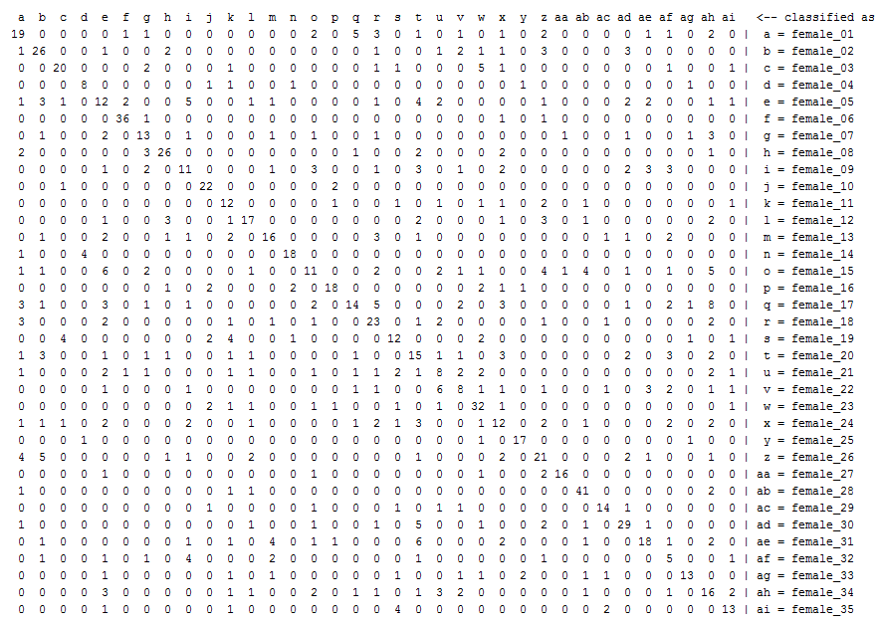
Covarianzmatrix
Notes:
here we see all samples
and where they were classified
we also see that the classification is result is good because the majority of the sample lie on the diagonal of the matrix
on a closer look we see that
some speaker were much harder to identified as other were almost all sample were right classified
we come to our last topic

Slide 12
Doddington Zoo
Sheeps: easily accepted by the system
Goats: exceptionally unsuccessful at being accepted
Lambs: exceptionally vulnerable to impersonation
Wolves: exceptionally successful at impersonation
character | percentage
Sheep | 93,36%
Goat | 3,32%
Lamp | 1,66%
Wolfs | 1,66%
Notes:
this is a thesis we already had in the lecture
but as a small reminder
they assume that every speaker can be assign to one of these animals
every animal represent a other charateristic of speaker
sheep, represent the most speaker
goats, where not much samples are right classified, speaker who could not authenticated are goats
lambs, where many wrong samples are assign to, need to look on the vertical
wolves, where a lot of samples are classifed to few other speaker
this categorization we did with all our speaker an come to the conclusion shows in this table
where we can see that the most are sheeps and easly to accepted by the system
and only 10% shown this unwanted feature

Slide 13
Conclusion
With:
Non optimal database
Good feature extraction tool
Good classification tool
Minimal post-processing
We accomplish:
96,68% authentication rate
Successfully projection of ‘Doddingtons Zoo’
Notes:
what did we learn about skeaper recognition in our project?
even with a non optimal database
but
with the right tools, feature extraction and classification
We could accomplish
A good result of 96.68% of right authentificated speakers

Slide 14
Sources
[Reda2011] Azarias Reda, Saurabh Panjwani and Edward Cutrell: Hyke: A Low-cost Remote Attendance Tracking System for Developing Regions. The 5th ACM Workshop on Networked Systems for Developing Regions (NSDR), 2011 [Doddington1998] George Doddington, Walter Liggett, Alvin Martin, Mark Przybocki and Douglas Reynolds: Sheep, Goats, Lambs and Wolves - A Statistical Analysis of Speaker Performance. In NIST 1998 Speaker Recognition Evaluation, Int. Conference on Spoken Language Processing, NIST, 1998. [Vielhauer2006] Claus Vielhauer: Biometric User Authentication for IT Security: From Fundamentals to Handwriting. Springer, Advances in Information Security, 2006. http://www.cs.waikato.ac.nz/ml/weka/ http://www.azreda.org/audio.html

Slide 15

Thank you for your attention!

