Slide 1
Our approach:
Classification of process models
Database with performance data of filter/detector categorized by process model class and fault activation
implementation:
All-In-One solution
Notes:
Idea was to support the user by finding a suiable detector/filter
Our approach to achieve that is
Implementation with the goal:
easiest possible for the user

Slide 2
Suggest and Design - Workflow
Idea:
Find a suitable detector/filter for my system
Requirement:
A process model
Knowledge about possible sensor faults
Notes:
This workflow represent our main idea behind our framework
Requirement:
As .slx

Slide 3
Step by step
1.Step: Select your process model
2.Step: Select a previously created fault configuration or create one
3.Step: Get a list of appropriate detectors and filters
4.Step: Design and export a chosen detector/filter
Notes:
1.step:
we set up simlength and stepsize
Use the default/chosen classify method to classify the process model
2.step:
Fault configuration are XML-Files which contain all informations about the faults that are injected
3.step:
With this informations our framework is now able the suggest detectors and filters
You get estimated values about the performance of the detectors and filters
4.step:

Slide 4
Assessing - Workflow
Idea:
Test an new detector/filter for my system
Requirement:
A process model
Knowledge about possible sensor faults
A detector or filter to test

Slide 5
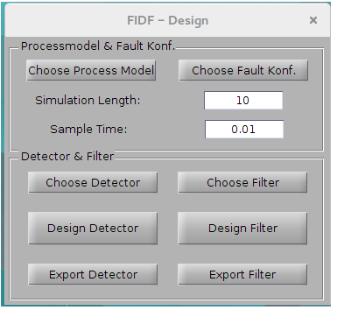
Step by step
1.Step:
Select your process model
2.Step:
Select a previously created fault configuration or create one
3.Step:
Get a list of appropriate detectors and filters
4.Step:
Design and export a chosen detector/filter

Slide 6
Live Demonstration

Slide 7
Zusammenfassung der Resultate

