Slide 1

CS 348 Lecture 11
DBMS Architecture Overview &
Physical Data Organization
  Semih Salihoğlu
  Feb 10th 2022

Slide 2
Welcome Back!

Slide 3
CS 348 Diagram
User/Administrator Perspective
Primary Database Management System Features
Data Model: Relational Model
High Level Query Language: Relational Algebra & SQL
Integrity Constraints
Indexes/Views
Transactions
Relational Database Design
E/R Models
Normal Forms
How To Program A DBMS (0.5-1 lecture)
Embedded vs Dynamic SQL
Frameworks
DBMS Architect/Implementer Perspective
Other (Last 1/2 Lectures)
Graph DBMSs
MapReduce: Distributed Data Processing Systems
Physical Record Design
Query Planning and Optimization
Indexes
Transactions

Slide 4
Announcements
Assignment 3:
  Out Feb 14th night (next Monday).
  Due Feb 15th midnight
No lecture on Tuesday (Feb 15th) to not distract you.

Slide 5
Outline For Today
High-level DBMS Architecture
Storage Manager and Physical File Organization Designs
  Physical Operators/Storage Interface
  Fundamental Property of Storage Devices & Potential Goals of Physical Design
  Row-oriented Physical Design
  Colum-oriented Physical Design
  Hybrid (PAX) Physical Design
  Designs for Variable-length Fields
  Designs for NULLs

Slide 6
Outline For Today
High-level DBMS Architecture
Storage Manager and Physical File Organization Designs
  Physical Operators/Storage Interface
  Fundamental Property of Storage Devices & Potential Goals of Physical Design
  Row-oriented Physical Design
  Colum-oriented Physical Design
  Hybrid (PAX) Physical Design
  Designs for Variable-length Fields
  Designs for NULLs

Slide 7
High-level DBMS Architecture Overview
Transformations of Query’s Structure
Text
An In-Memory Representation
Logical Plan
Physical Plan
Captures overall structure. Many details are system-specific.
Figure from Database Management Systems, Ramakrishnan & Gehrke 3rd edition

Slide 8
Example From GraphflowDB
SELECT cid
FROM Customer C, Order O, Product P
WHERE C.cid = O.cid AND O.pid = P.pid
AND P.name = BookA
Customer
cid | name
C1 | Alice Munro
… | …
Order
oid | cid | pid | price
O1 | C1 | P2 | $20
… | … | … | …
Product
pid | name
P1 | WatchB
… | …
Following example is a read-only query.
Updates & transactions require additional steps & system components

Slide 9
Overview of Compilation Steps
Text
AST
SELECT …
FROM …
WHERE…
Parser
Root
Binder
Normalizer
SELECT
…
TABLES
…
CON.
Customer
Product
=
Logical Plan
cid
5
Physical Plan Translator
Optimizer
Project
oid
Logical Plan Translator
Join
C.cid=O.cid
Physical Plan
Scan Tbl
Order
100 < price
Scan Tbl
Customer
cid=3
Project
$5
HashJoin
L.$2=R.$3
Filter
$2=5
IndexScan cust.mkd
Query Executor
RESULT
cid
…
IndexScan
order.mkd

Slide 10
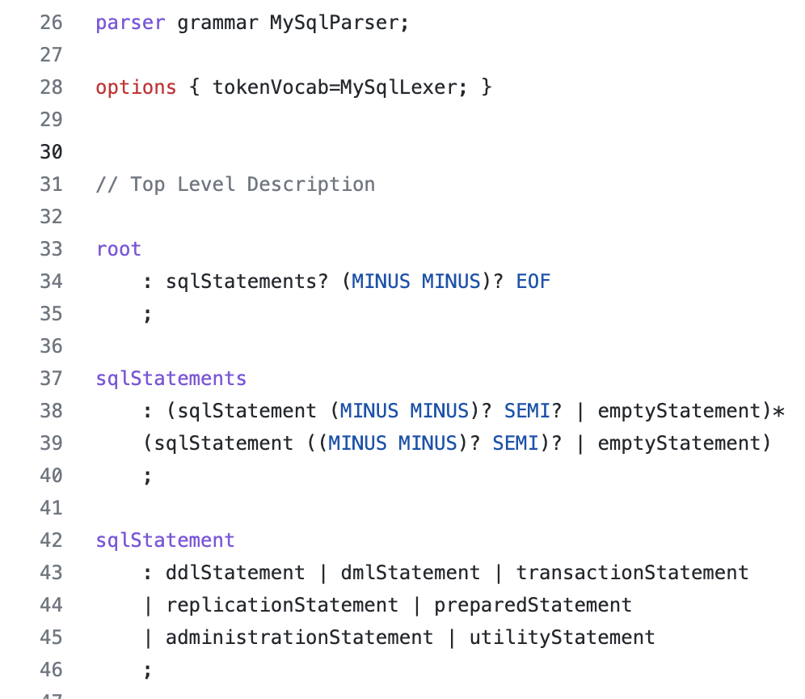
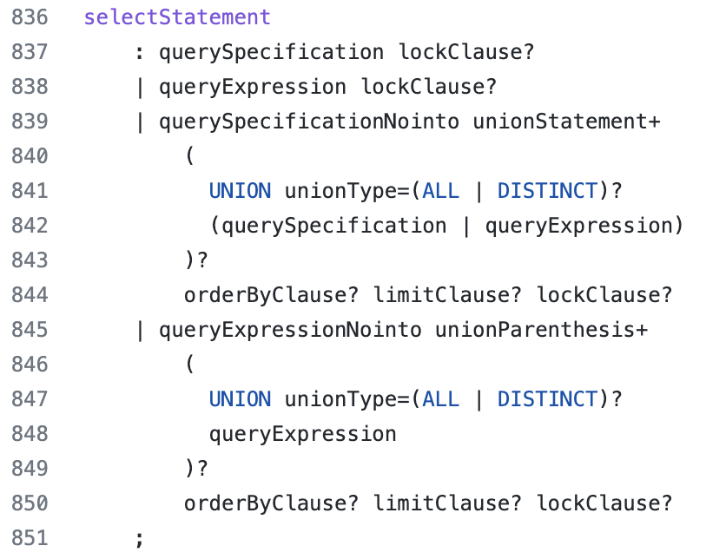
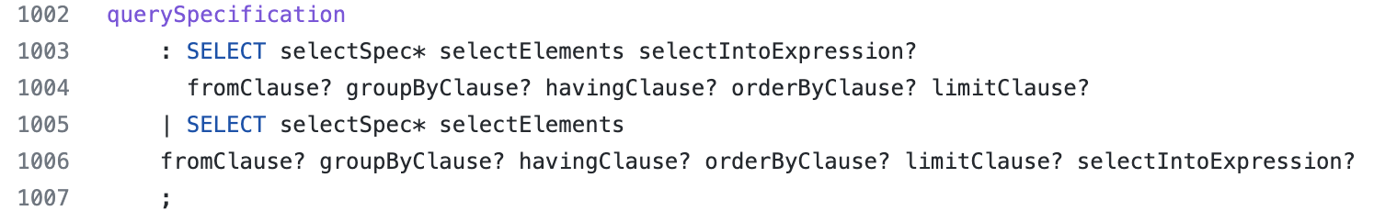
Parser
Parses text query into an abstract syntax tree based on SQL grammar
Ex: Snippets from MySQL’s SQL grammar

Slide 11
Parser
SELECT cid
FROM Customer C, Order O, Product P
WHERE C.cid = O.cid AND O.pid = P.pid
AND P.name = BookA
Root
SELECT
FIELDS
FROM
TABLES
WHERE
CONDITIONS
cid
Customer
Product
AND
Order
AND
=
=
=
P.name
`BookA`
C.cid
O.cid
O.pid
P.pid

Slide 12
Parser
Catches syntax errors
FROM Customer C, Order O, Product P
SELECT cid
WHERE C.cid = O.cid AND O.pid = P.pid
AND P.name = BookA
42601 syntax error at or near "from"

Slide 13
Overview of Compilation Steps
Text
AST
SELECT …
FROM …
WHERE…
Parser
Root
Binder
Normalizer
SELECT
…
TABLES
…
CON.
Customer
Product
=
Logical Plan
cid
5
Physical Plan Translator
Optimizer
Project
oid
Logical Plan Translator
Join
C.cid=O.cid
Physical Plan
Scan Tbl
Order
100 < price
Scan Tbl
Customer
cid=3
Project
$5
HashJoin
L.$2=R.$3
Filter
$2=5
IndexScan cust.mkd
Query Executor
RESULT
cid
…
IndexScan
order.mkd

Slide 14
Binder
Binds type information to columns and expressions
Uses a system component called Database Catalog
  Keeps “metadata” about database tables and indexes
  Ex Metadata: Column names and types, constraints, etc.

Slide 15
Binder
Root
SELECT
FIELDS
FROM
TABLES
WHERE
CONDITIONS
cid
int
Customer
Product
AND
Order
AND
=
=
=
P.Name
Product
String
`BookA`
Literal
String
C.cid
Cust.
int
O.cid
Order
int
O.Pid
Order
int
P.Pid
Product
int

Slide 16
Binder
Catches type errors
SELECT cid
FROM Customer C, Order O, Product P
WHERE C.cid AND O.pid = P.pid
AND P.name = BookA
42804 argument of WHERE must be type boolean, not type integer
SELECT cid
FROM Customer C, Order O, Product P
WHERE C.cid + false = O.cid AND O.pid = P.pid
AND P.name = BookA
42883 operator does not exist: integer + boolean

Slide 17
Overview of Compilation Steps
Text
AST
SELECT …
FROM …
WHERE…
Parser
Root
Binder
Normalizer
SELECT
…
TABLES
…
CON.
Customer
Product
=
Logical Plan
cid
5
Physical Plan Translator
Optimizer
Project
oid
Logical Plan Translator
Join
C.cid=O.cid
Physical Plan
Scan Tbl
Order
100 < price
Scan Tbl
Customer
cid=3
Project
$5
HashJoin
L.$2=R.$3
Filter
$2=5
IndexScan cust.mkd
Query Executor
RESULT
cid
…
IndexScan
order.mkd

Slide 18
Normalizer
Normalizes the ast according to several rules
Examples:
  Convert all comparisons to < or <=.
  Perform all constant arithmetic: 5 + 10 => 15
  Simplify bool expressions that are guaranteed to be true or false.
  Convert WHERE expression to Conjunctive Normal Form (ANDs of ORs)
  etc.
>
<
age
Customer
int
5
Literal
int
5
Literal
int
age
Customer
int

Slide 19
Overview of Compilation Steps
Text
AST
SELECT …
FROM …
WHERE…
Parser
Root
Binder
Normalizer
SELECT
…
TABLES
…
CON.
Customer
Product
=
Logical Plan
cid
5
Physical Plan Translator
Optimizer
Project
oid
Logical Plan Translator
Join
C.cid=O.cid
Physical Plan
Scan Tbl
Order
100 < price
Scan Tbl
Customer
cid=3
Project
$5
HashJoin
L.$2=R.$3
Filter
$2=5
IndexScan cust.mkd
Query Executor
RESULT
cid
…
IndexScan
order.mkd

Slide 20
Logical Plan Translator
Maps normalized ast or other in-memory representation to an initial (unoptimized) logical query plan
Logical Query Plan: Consists of “high-level” operators:
  Table Scan, Filter, Projection, Join, Group By-And Aggregate, etc.
  Many but not all operators are based on relational algebra but correspond to SQL clauses
  Some are not: e.g: LIMIT, SKIP, Order By, etc.

Slide 21
Logical Plan Translator
SELECT cid
FROM Customer C, Order O, Product P
WHERE C.cid = O.cid AND O.pid = P.pid
AND P.name = BookA
Project
cid
Filter
name=BookA
Join
C.cid=O.cid
Join
P.pid=O.pid
Scan Table
Customer
Scan Table
Product
Scan Table
Order

Slide 22
Overview of Compilation Steps
Text
AST
SELECT …
FROM …
WHERE…
Parser
Root
Binder
Normalizer
SELECT
…
TABLES
…
CON.
Customer
Product
=
Logical Plan
cid
5
Physical Plan Translator
Optimizer
Project
oid
Logical Plan Translator
Join
C.cid=O.cid
Physical Plan
Scan Tbl
Order
100 < price
Scan Tbl
Customer
cid=3
Project
$5
HashJoin
L.$2=R.$3
Filter
$2=5
IndexScan cust.mkd
Query Executor
RESULT
cid
…
IndexScan
order.mkd

Slide 23
Optimizer
Optimizes initial logical plan using a set of rules and estimated costs
Example Optimizations:
  Pushing filters down in the query plan
  Pushing projections down
  Changing the order of the joins
  Replacing sub-plans with views
  Identifying and reusing common sub-plans
  etc..

Slide 24
Example Optimization: Filter Pushdown
Project
cid
Project
cid
Filter
name=BookA
Join
P.pid=O.pid
Join
C.cid=O.cid
Join
P.pid=O.pid
Scan Table
Customer
Join
C.cid=O.cid
Filter
name=BookA
Scan Table
Product
Scan Table
Order
Scan Table
Order
Scan Table
Customer
Scan Table
Product

Slide 25
Overview of Compilation Steps
Text
AST
SELECT …
FROM …
WHERE…
Parser
Root
Binder
Normalizer
SELECT
…
TABLES
…
CON.
Customer
Product
=
Logical Plan
cid
5
Physical Plan Translator
Optimizer
Project
oid
Logical Plan Translator
Join
C.cid=O.cid
Physical Plan
Scan Tbl
Order
100 < price
Scan Tbl
Customer
cid=3
Project
$5
HashJoin
L.$2=R.$3
Filter
$2=5
IndexScan cust.mkd
Query Executor
RESULT
cid
…
IndexScan
order.mkd

Slide 26
Physical Plan Translator
Translates logical operators into physical operators
Logical operators: placeholders to describe the overall query processing algorithm
Physical operators: classes in the implementation language of DBMS (e.g. C++) that have functions that operate on in-memory tuples
Each logical op might be implemented with multiple physical ops
  Scan Table => FileScan or IndexFileScan
  Join => Hash Join, Merge Join, Index Nested Loop Join, etc.
Might implicitly do some optimizations

Slide 27
Physical Plan Translator
Project
cid
Project
cid
Join
P.pid=O.pid
HashJoin
L.$3=R.$3
Join
C.cid=O.cid
Filter
name=BookA
HashJoin
L.$3=R.2
Scan Table
Order
Scan Table
Customer
Scan Table
Product
name=BookA
IndexScan
Product
name=BookA
FileScan
Order
FileScan
Customer
Notes:
Talk about tuples flowing from leaves to root.

Slide 28
Overview of Compilation Steps
Text
AST
SELECT …
FROM …
WHERE…
Parser
Root
Binder
Normalizer
SELECT
…
TABLES
…
CON.
Customer
Product
=
Logical Plan
cid
5
Physical Plan Translator
Optimizer
Project
oid
Logical Plan Translator
Join
C.cid=O.cid
Physical Plan
Scan Tbl
Order
100 < price
Scan Tbl
Customer
cid=3
Project
$5
HashJoin
L.$2=R.$3
Filter
$2=5
IndexScan cust.mkd
Query Executor
RESULT
cid
…
IndexScan
order.mkd

Slide 29
Query Executor
Executes physical plans
Implements a task scheduling mechanism:
  Can have a threadpool of “workers”
  Workers execute physical plans in parallel and coordinate

Slide 30
Outline For Today
High-level DBMS Architecture
Storage Manager and Physical File Organization Designs
  Physical Operators/Storage Interface
  Fundamental Property of Storage Devices & Potential Goals of Physical Design
  Row-oriented Physical Design
  Colum-oriented Physical Design
  Hybrid (PAX) Physical Design
  Designs for Variable-length Fields
  Designs for NULLs

Slide 31
Persistent Data Storage
DBMSs store data persistently on durable storage devices
  Hard disks or flash disks or more recently non-volatile memory
  Hence our drawing of DBMSs as disks
But query processing is computation and all computation ultimately happens in memory.
Notes:
Recall physical operator

Slide 32

Physical Operator/Storage Interface
RDBMSs store data in table/index files on disk (indices next lecture)
Several physical operators access data in files
  Most importantly scans but sometimes also joins
Recall: Physical operators: classes in the implementation language of DBMS (e.g. C++) that have functions that operate on in-memory tuples
Memory
Project
cid
HashJoin
P.pid=O.pid
HashJoin
L.$3=R.2
FileScan
Order
FileScan
Customer
IndexScan
Product
name=BookA
File accesses happen via classes implemented in StorageManager component (aka FileManager, FileAccessMethods etc.)
Table files, index files
Disk
Notes:
Recall physical operator

Slide 33
Physical Operator/Storage Interface
Class ScanTable : public PhysicalOperator {
string tableFilename;
DBFileHandle* dbFH; // Interface to access storage
int nextRecordID;
// Assume parent operator has access to outTuple as well
Tuple* outTuple;
void init() {
dbFH = new DBFileHandle(tableFilename); // e.g., order.mkd
nextRecordID = 0;}
// each operator in the tree calls its child to get next Tuple
Tuple* getNextTuple() {
if (nextRecordId < dbFH.maxRecordID) {
dbFH.readRecord(&outTuple, nextRecordID);
nextRecordID++;
return &tuple;
}
}}
will show a sample pseudocode later

Slide 34
File Access Functions
Functions such as readRecord in DBFileHandle-like classes that form the operator/storage interface know about physical data organizations (and operators don’t):
  Record layout in files
  Page/Block layout of records in files
Other Possible operator/storage interface functions:
  readRecords(int beginRecordID, int endRecordID)
  readRecordsInNextPage(int pageID) (see next slide)
  etc…
Question 1: Why is there another unit of data called page/block?
Question 2: Potential goals of DBMS implementors when designing physical layouts?
Question 3: Common record and page layouts?

Slide 35
Outline For Today
High-level DBMS Architecture
Storage Manager and Physical File Organization Designs
  Physical Operators/Storage Interface
  Fundamental Property of Storage Devices & Potential Goals of Physical Design
  Row-oriented Physical Design
  Colum-oriented Physical Design
  Hybrid (PAX) Physical Design
  Designs for Variable-length Fields
  Designs for NULLs

Slide 36
Fundamental Property of Storage Devices
Random reads is slow! Sequential reads is fast!
Take this very seriously!
Holds for RAM, magnetic disks, or flash disks.
Examples: Read 1GB of 64bit ints randomly in RAM vs sequentially and you might get ~10x difference.
  Exercise: Test this and let me know the exact answer.
Worse diff. depending on read size in hard/flash disks (e.g. ~1000x)
Question 1: Why is there another unit of data called page/block?
Important Consequences:
  OS reads/writes data from/to disk in pages (e.g., 4K)
  DBMS should also read/write data in pages (multiple of OS page sizes, 4K, 8K, 12K etc. but not 2K)

Slide 37
Why Random Reads Are Slow on Disks?
Tracks
Platter
Platter
Spindle
Disk head
Disk arm
Platter
“Moving parts” are slow
Arm movement
Spindle rotation
Time To Read X bytes: Seek time + rotational delay + transfer time
~4-5ms each
1MB in ~3-4ms

Slide 38
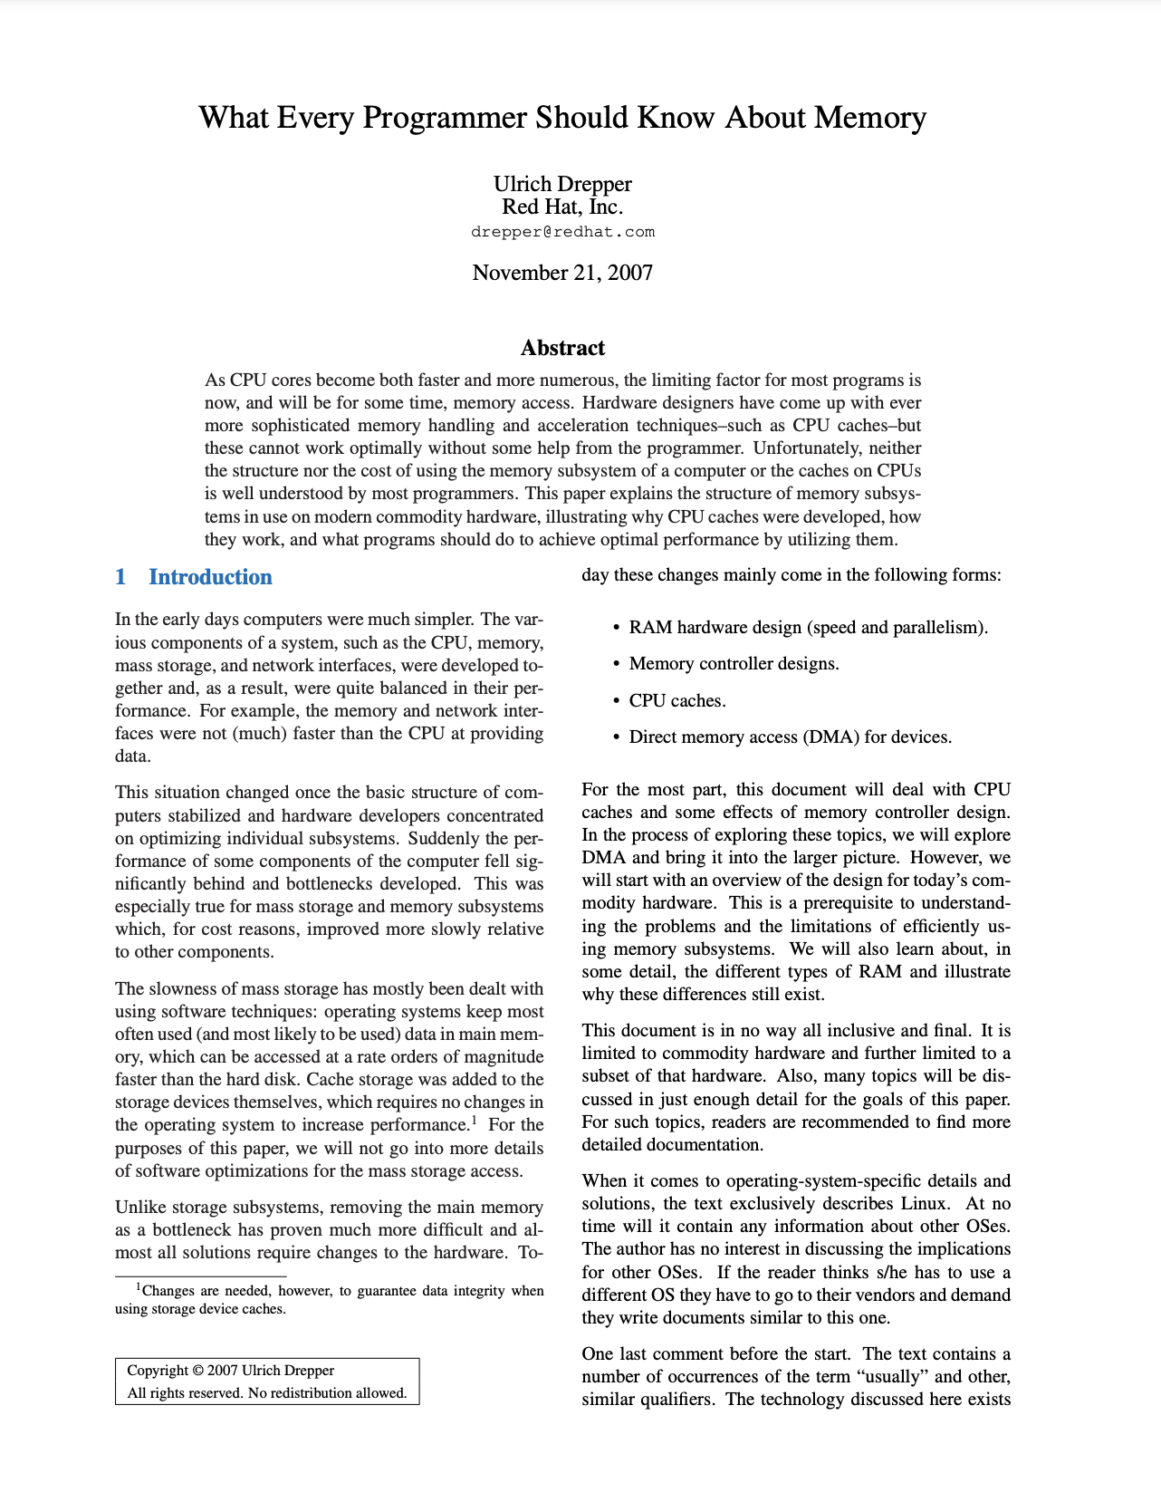
Why Random Reads Are Slow for RAM?
Fundamentally because of better CPU cache utilization, i.e., L1/L2 caches in modern CPUs

Slide 39
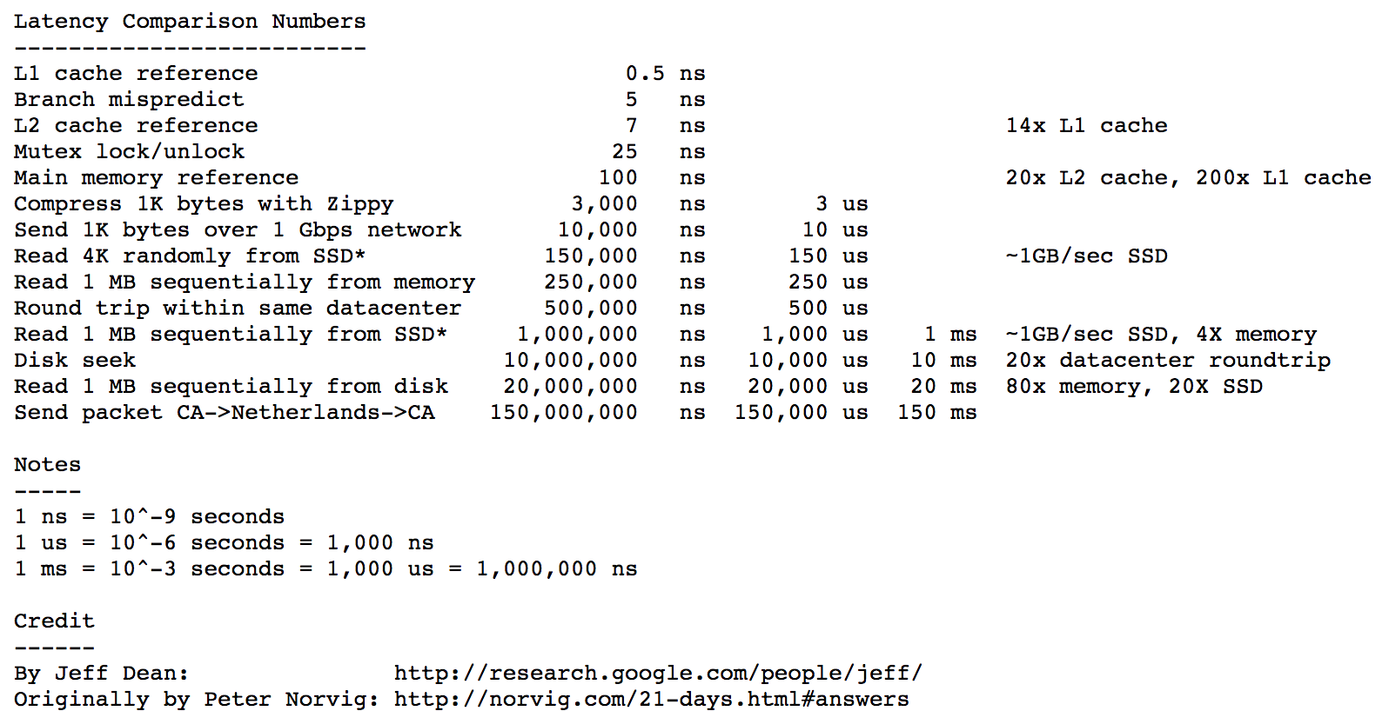
Latency Numbers Every Programmer Should Know

Slide 40
Q2: Potential Goals of Physical Data Design
Minimize I/O!
  Design files to pack records/columns into few number of pages
  Keep related data close in storage devices!
  Cache pages of data that is likely to be used
Maximize sequential reads from storage devices!
Simplicity/speed of accessing values
  E.g., don’t compress using a complex compression scheme
These are general guidelines and not necessarily independent.

Slide 41
Q3: Common Record and Page Layouts
Row-oriented
Column-oriented
Hybrid (PAX) Row & Column-oriented Fixed-length Values
Designs for Variable-length Values
Designs for NULL Values

Slide 42
Several Simplification Assumptions
Each field/column is of constant size
No compression
Assume files are broken into pages of size H (e.g., 4K)
Assume each field and entire rows of each table easily fit into a page << H (e.g., fields ~10s of bytes rows 100s of bytes)
  Assume each row takes T many bytes

Slide 43
Outline For Today
High-level DBMS Architecture
Storage Manager and Physical File Organization Designs
  Physical Operators/Storage Interface
  Fundamental Property of Storage Devices & Potential Goals of Physical Design
  Row-oriented Physical Design
  Colum-oriented Physical Design
  Hybrid (PAX) Physical Design
  Designs for Variable-length Fields
  Designs for NULLs

Slide 44
Row-Oriented N-ary Storage Model (NSM)
Each page contains ~ H/T many rows and all fields of each row
Customer
cid : int64 (8 bytes) | name : string (60 chars) | isGoldMember : bool (1 byte)
101 | Alice Munro\0\0\0….\0 | 1
201 | Carl Sagan\0\0\0…\0 | 0
103 | Bob \0\0\0….\0 | 1
… | … | …
(Example Disk Page, e.g., in file customer.mkd)
Note: because records are fixed length, can read any field with simple arithmetic (*not a consequence of NSM*)
  E.g: 5th records name field at offsets: 4*(8+60+1) + 8 = 284 to 344

Slide 45
Pros/Cons of NSM
Pro: Good for queries that access multiple or all fields of tuples
Con: If queries access a single field, e.g., counting numGoldMembers, “effective read size” can be small
  E.g. 1/69 bytes read is useful, in columnar storage you can do 69x less I/O to do the same count.
Con: For some workloads higher # I/O => lower (buffer) cache utilization (next slide)

Slide 46
Buffer Manager & Ex Op/Storage Interface Code
DBMSs have a buffer manager (BM) component that keeps a set of file pages in memory to reduce I/O.
Goal of BM: keep pages that are likely to be accessed in memory
  Implement a caching alg, e.g., Least-Recently Used (LRU)
class DatabaseFileHandle : {
string filename; // e.g., order.mkd
int tupleLen; // e.g., 69
BufferManager bm;
void readRecord(Tuple* outTuple, recordID) {
(pageIdx, offset)= calculatePageInfo(recordID)
Frame* frame = bm.pinPage(pageIdx);
memcpy(outTuple, frame>bytes[offset], tupleLen)
bm.unpin(frame); }}
Buffer Pool/Frames
RAM
P1
P3
P8
Disk File/Pages
P1
P2
P3
Disk
P4
P5
P6
P7
P8
P9
Pin: put disk page into buffer pool until further notice
  possibly evicts an existing page
Unpin: can now remove the page from buffer pool if needed
order.mkd

Slide 47
Column-Oriented Storage Design
One file for each field of table (~H/field-size rows worth of data):
101 | 201 | 103 | 330
Alice Munro\0\0….\0
1 | 0 | 1 | 0 | 0 | 0
… | … | … | …
Carl Sagan\0\0\0….\0
… | … | … | … | … | …
Bob \0\0\0….\0
cID.mkd
name.mkd
isGoldMember.mkd
Pros: Good for queries that access few columns
  Can reduce I/O significantly
  Better sequential reads when pages are in memory
Pros: Easier to apply compression because each page is very “homogenous”
Cons: Bad for queries that access all columns (1 I/O in row-oriented storage could be done with # cols I/O).
Select count(*)
from customer
where isGoldMember

Slide 48
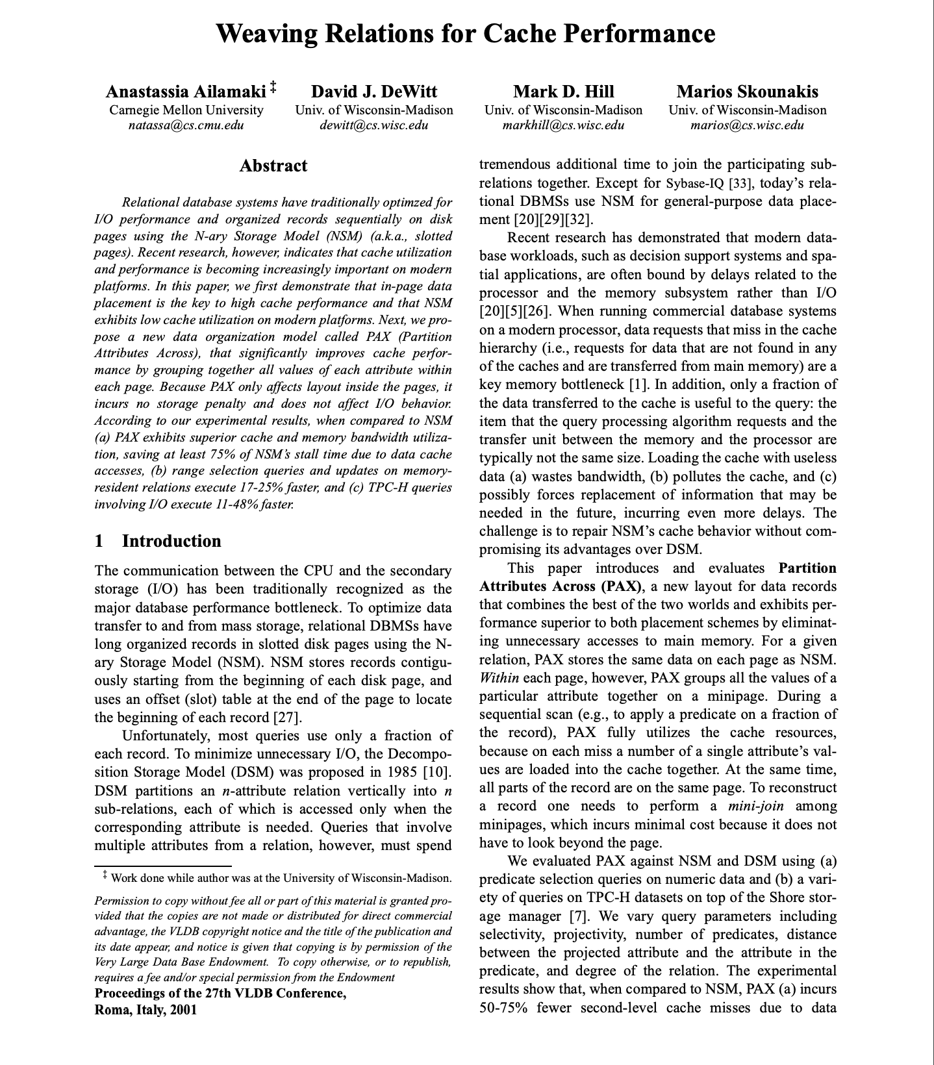
PAX Hybrid Storage Design
PAX: Partition Attributes Across (Ailamaki et al. VLDB 2001)
  All fields of a row in the same page
  But pages internally organized by columns
101 | 201 | 103 | 330 | … | …
Alice Munro\0\0….\0
Carl \0\0\0….\0
Bob \0\0\0….\0 | …
1 | 0 | 1 | 0 | 0 | 0 | … | …
customer.mkd
Better sequential reads for queries that read a single column
Gives the advantage of having all fields of a row in the same page
But still more I/O than pure columnar storage for some queries

Slide 49
Outline For Today
High-level DBMS Architecture
Storage Manager and Physical File Organization Designs
  Physical Operators/Storage Interface
  Fundamental Property of Storage Devices & Potential Goals of Physical Design
  Row-oriented Physical Design
  Colum-oriented Physical Design
  Hybrid (PAX) Physical Design
  Designs for Variable-length Fields
  Designs for NULLs

Slide 50
Variable-length Values
Pages are often more complex than examples in these slides
One complexity: variable-length fields
Assume row-oriented NSM storage
Approaches to encode var-length fields, e.g., var-len strings, in pages
  Delimiters
  Field Offsets
  Pointers to Overflow Pages
Both:
(i) put first fixed-len fields and then var-len fields when encoding each row
(ii) require storing page-level offset of each row

Slide 51
Delimiter Approach
Example Delimiter: \0 character
0
21
101 | 1 | Alice Munro\0
201 | 0 | Carl\0
35
48
103 | 1 | Bob\0
… | … | …
page-level offsets
0 | 21 | 35 | 48
customer.mkd
Why are page offsets at the end and fields in the beginning of pages?
  Can grow them separately without sliding data within pages.
Advantage of storing fixed-len fields and then var-len fields:
  Can read fixed-len fields w/ page-level offsets +arithmetic
  e.g., isGoldMember of rowID 2: offset[2] + 8 = 35+8=43.
  no need to scan over var-len fields

Slide 52
Field Offsets Approach
Suppose there is a second var-len field called address
Page structure stays same except each row would be encoded as:
offset of address
end of address
offset of name
0
8
9
11
13
15
26
101 | 1 | 15 | 26 | 44 | Alice Munro | Univ. Ave. Waterloo
cid
name
address
isGoldMember

Slide 53

Overflow Pages
Keep variable length fields, in particular strings, fixed length
Any overflow points to separate overflow pages
E.g., Strings in Graphflow (originally by Thomas Neumann)
  16 bytes fixed part with 2 possible cases
  Pro: original pages are simpler; Con: More I/O for reading large strings
4-byte
len
12-byte value
(w/ possible padding)
…
11 | Alice Munro\0
Case 1
Univ. Ave. Waterloo
…
8-byte
pointer to overflow pages
4-byte
len
4-char
prefix
19 | Univ | ptr
address.ovf
Case 2

Slide 54
NULL Values
Several possible approaches. E.g:
  Store special NULL values for each data type as regular values
    E.g.: -2^63 for 8-byte int
  Store NULL bits in the page
    Assume columnar storage and (fixed-len) name can be NULL
    1 means NULL 0 means NULL
  Other alternatives are possible
Alice Munro\0\0….\0
xxxxxxxxxxxxxxxxxxxx
arbitrary value
Bob \0\0\0….\0
0 | 1 | 0
NULL bits
name.mkd

Slide 55
Summary of Physical Data Design Alternatives
High-level: row-oriented vs columnar but row-oriented can be hybrid (PAX)
Variable-length fields and fields that can be NULL require more sophisticated design
For any physical design we showed, other alternatives are possible
In practice physical design is principled art!
Many tradeoff, choices, and complications exist:
  Deletions of tuples (can leave gaps in pages or shift tuples)
  Fields larger than page sizes
  Tuple versions (some systems, e.g., Postgres, support multiple version of tuples so users can keep track of how each record changed)
  Compression
  Some crazy ideas put rows from multiple tables into same pages
  Many other designs

