Slide 1

CS 348 Lecture 1
Course Overview & Organization
  Semih Salihoğlu
  Jan 6th, 2022

Slide 2
Outline For Today
Overview of DBMSs: 3 Major Contributions of the Field
  Set of DBMS Features for Applications
  Physical Data Independence/High-level Query Languages
  Transactions
Course Diagram & Administrative Information

Slide 3
Outline For Today
Overview of DBMSs: 3 Major Contributions of the Field
  Set of DBMS Features for Applications
  Physical Data Independence/High-level Query Languages
  Transactions
Course Diagram & Administrative Information

Slide 4
What is a Database Management System (DBMS)?
Applications
Queries/modifications
Answers/responses
DBMS
File system interface
OS
Storage system interface
Disk(s)

Slide 5
Main Set of DBMS Features
High-level Data Model and Query Language
Efficient access and processing of data
Scalability:
  Handling of Large Data, i.e., Out-of-memory Data
  10-100Ks of concurrent data access/sec
Safe access and processing of data:
  Maintenance of the integrity of the data upon updates
  Multi-User access to data (Concurrency)
  Fault tolerant storage of data

Slide 6
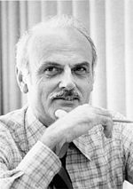
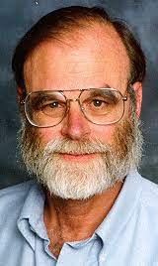
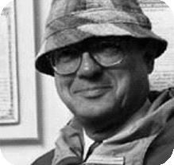
Main Contributions of the Field?
The System (Charles Bachmann)
High-level/Declarative Programming (Ted Codd)
  Ingredients: Relational Data Model & Algebra: A model based on set theory (so a formal mathematical theory)
  Provides ability to generate automatic efficient algorithms for many data processing tasks
Transactions (Jim Gray)
  Principles of concurrent data-manipulating app. development

Slide 7








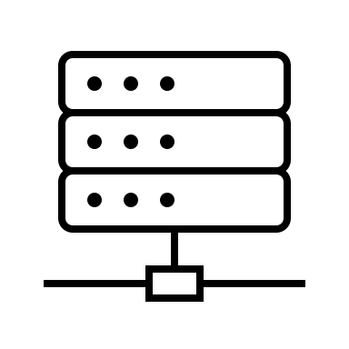
Why App Developers Need a DBMS?
Application: Order & Inventory Management in E-commerce
  E.g.: Amazon or Alibaba
Customers &
End Devices
Product
Shipments & Arrivals
Managers & Analytics Apps
App Software/
Servers
Storage Software Server & Device
Service Requirement
Thousands of requests/sec
Let’s simplify the design: assume a single server will accept requests from app software to keep track of and serve your records: orders, new products, etc.

Slide 8

Bad Idea: Write Storage Software in Java/C++
Possible Approach: Directly use the file system of the OS.
  E.g: one or more files for orders, customers, products etc.
Orders.txt
Customers.txt
Products.txt
Problem: Physical Record Design?
  Suppose you record: name, birthdate for each customer
  How many bytes for each fact?
    E.g.: Encoding of string names? Fixed or variable length?
  Many sub-problems: E.g.: How to quickly find a record?

Slide 9
PR1: Example Physical Record Designs (1)
Variable-length design
name-len (bytes) | name payload | birthdate (fixed 4 bytes)
11 | Alice Smith | 2001/09/08
19 | Alexander Desdemona | 2002/05/20
6 | Ali Jo | 1992/02/25
26 | Montgomery Cambridgeshire | 1992/02/25
… | … | …
… | … | …
… | … | …
Customers.txt
Fixed-length design
Overflow ptr | len | name (16 byte) | birthdate (4 bytes)
null | 11 | Alice Smith ---------- | 2001/09/08
ona | idgeshire | ….
0 | 19 | Alexander Desdem | 2002/05/20
… | … | ….
null | 19 | Ali Jo ------------------ | 1992/02/25
… | … | … | …
Customers.txt
Customer-overflow.txt

Slide 10
PR1: Example Physical Record Designs (2)
Chained Design: Maybe to keep in sorted alphabetical order
name-leng (bytes) | name payload | birthdate (fixes 4 bytes) | prev ptr | next ptr
r0 | 11 | Alice. | 2001/09/08 | r0 | r3
r1 | 19 | Alexander. | 2002/05/20 | null | r2
`
r2 | 6 | Ali Jo | 1992/02/25 | r1 | r0
r3 | 26 | Montgom. | 1992/02/25 | r0 | r7
r4 | … | … | … | … | …
r5 | … | … | … | … | …
Customers.txt
Takeaway 1: Many designs options & difficult for app developers!
Takeaway 2: Bytes not the right data abstraction to program apps.

Slide 11
PR2: Efficient Query/Analytics Algorithms
Managers Ask: Who are top paying customers?
  Task: Compute total sales by customer
  Assume in record layout every field is fixed length
  Problem: App developer needs to implement an algorithm.
Possible Algorithm 1:
file = open(“Orders.txt”)
HashTable ht;
for each line in file:
// some code to parse custID and price
if (ht.contains(custID))
ht.put(custID, ht.get(custID) + price)
else: ht.put(custID, price);
file.close();
O1 | Cust1 | BookA | $20
O2 | Cust2 | WatchA | $120
O3 | Cust1 | DiapersB | $30
O4 | Cust3 | MasksA | $15
… | … | … | …
… | … | … | …
Possible High-level Algorithm 2:
sort Orders.txt on CustID
orders of Cust_i are now consecutive
read sorted records sequentially
and sum prices for each C_i
Orders.txt
Which sorting algorithm to use?
Should one parallelize sorting? How?

Slide 12
PR2: Efficient Query/Analytics Algorithms
That is only for 1 question. There will be many questions:
  List of Orders that bought a product that cost > $500
  Last Order from Cust4?
  Who are closest co-purchasers of Cust4? (i.e., who bought the same item as Cust4, ordered by the #co-purchases.)
  Many many more (thousands) important business questions:
    For each question numerous possible algorithms and implementations.
Takeaway 1: Many algs & implementations. Difficult to choose. Takeaway 2: Writing an algorithm for each task won’t scale!

Slide 13
PR3: Scalability
Large-scale Data: Data > Memory
  E.g. Orders.txt grows to terabytes & does not fit in memory.
  Often the case for data-intensive applications
  Need ``External’’ algorithms, i.e., uses disk to scale
  Hard to write such algorithms. Challenge:
    Try implementing a good external sorting algorithm?
Scale to: 10K~100Ks of requests/sec
  Hard to write code that efficiently supports such workloads.
Takeaway: Hard and have nothing to do w/ the app logic!
App developers should focus on the app!

Slide 14
PR4: Integrity/Consistency of The Data (1)
Many ways data can be corrupted:
  Often: Wrong application logic or bugs in application
E.g: Checkout App’s “Checkout As Guest”
  Writes the Order record
  And the Customer record
  Assume Bob shops again
  (Bob, 1999/05/07) is duplicated!
O8 | Bob | TVA | $90
O7 | Bob | BookC | $17
Bob | 1999/05/07
Likely an inconsistency.
We’d want to enforce the invariant:
No duplicate cust records!
Orders.txt
Customers.txt
Products.txt

Slide 15
PR4: Integrity/Consistency of The Data (2)
E.g: Checkout App’s “Checkout As Guest”
  Writes the Order record
  But not the Customer record
  (Bob, 1999/05/07) is not in Customers.txt.
O7 | Bob | BookC | $17
X
Likely an inconsistency.
We’d want to enforce the invariant:
Every order’s cust record exists!
Orders.txt
Customers.txt
Products.txt
Another example momentarily in concurrency

Slide 16

PR5: Concurrency: Multiple Conflicting Requests
Alice & Bob concurrently order BookA: suppose 1 left in stock.
Product | NumInStock
… | …
BookA | 1
… | …
Buy_Product_Subroutine(string prodName):
(prod, numInStock) = readProduct(prodName)
if (numInStock > 0):
writeProduct((prod, numInStock - 1)
else throw(“Cannot buy product!”);
r: (A, 1)
r: (A,1)
r: (A,1)
r: (A,1)
w: (A, 0)
w:(A,0)
w:(A,0)
time
r: (A, 0)
r:(A,0)
w:(A,0)
No Book
No Book
✓
✓
X

Slide 17
Concurrency Questions
What is a correct/incorrect state upon concurrent updates?
  Theoretical formalism to explain these states: Serializability
What protocols/algorithms can ensure a correct state?
  Locking-based protocols
    Pessimistic: set of lock acquisitions to prevent bad state
  Optimistic protocols
    Detect bad state and recover from it
Set of guarantees that a DBMS should satisfy
  ACID guarantees: atomicity, consistency, isolation, durability

Slide 18


Concurrency Avoidance Ex: Global DB Lock
Alice and Bob order BookA
Bob
Alice
lock DB X Wait
lock DB ✓
r (A, 1)
time
w (A, 0)
release lock
lock DB ✓
Product | NumInStock
… | …
BookA | 1
BookB | 7
Safe but inefficient. Why?

Slide 19
Concurrency Avoidance Ex: Global DB Lock
Alice orders BookA, Bob orders BookB
Bob
Alice
lock DB X Wait
lock DB ✓
r (A, 1)
time
w (A, 0)
release lock
lock DB ✓
r (B, 7)
…
Product | NumInStock
… | …
BookA | 1
BookB | 7
Bob had no conflicts; so was “unnecessarily” blocked.

Slide 20

Concurrency Avoidance Ex: Record-level Lock
Alice, Bob as before want BookA, Carmen orders Book B
Bob
Alice
Carmen
…
lock: (A, 1) ✓
lock: (A, 1) X Wait
lock: (B, 7) ✓
r (A, 1)
r (B, 7)
time
w (A, 0)
w (B, 6)
 | Product | NumInStock
 | … | …
 | BookA | 1
 | BookB | 7

Slide 21
Concurrency Avoidance Ex: Record-level Lock
Alice, Bob as before want BookA, Carmen orders Book B
Bob
Alice
Carmen
…
lock: (A, 1) ✓
lock: (A, 1) X Wait
lock: (B, 7) ✓
r (A, 1)
r (B, 7)
time
w (A, 0)
w (B, 6)
release lock A
release lock B
lock: (A, 1) ✓
 | Product | NumInStock
 | … | …
 | BookA | 0
 | BookB | 6
Safe and achieves parallelism. What can go wrong?

Slide 22
Where There is Locking, There is Deadlocks!
Alice, Bob both order both BookA and BookB together
Bob
Alice
lock: (A, 1) ✓
lock: (B, 7) ✓
time
lock: (B, 7) X Wait
lock: (A, 1) X Wait
Deadlock!
 | Product | NumInStock
 | … | …
 | BookA | 1
 | BookB | 7
How can we detect & avoid deadlocks?

Slide 23

Failure & Recovery
What if your disk fails in the middle of an order?
What if your server software fails due to a bug?
What if there is a power outage in the machine storing files?
Product | NumInStock
… | …
BookA | 1
BookB | 7

Slide 24
Failure & Recovery
What if your disk fails in the middle of an order?
What if your server software fails due to a bug?
What if there is a power outage in the machine storing files?
Suppose Alice orders both BookA and BookB
w (A, 0)
Product | NumInStock
… | …
BookA | 1
BookB | 7

Slide 25
Failure & Recovery
What if your disk fails in the middle of an order?
What if your server software fails due to a bug?
What if there is a power outage in the machine storing files?
Suppose Alice orders both BookA and BookB
Before (B, 6) is written failure!
Inconsistent data state!
PR: How to recover from inconsistent state?
w (A, 0)
✓
Product | NumInStock
… | …
BookA | 0
BookB | 7
Product | NumInStock
… | …
BookA | 0
BookB | 6
X

Slide 26
Contributions of DBMSs To Computing
DBMSs provide solutions to all of the problems we identified!
Allows app developers to focus on the application logic.
Contribution 2
 | Problems | Solutions
1. | Physical record design and access to records | Data Model (Higher-level than bits/bytes)
2. | Efficiency | High Level Data Query/Manipulation Language: Automatic compilation of queries to efficient algs/query plans
3. | Scalability: 3.1: Large-scale data 3.2: Large # of requests | Persistent-disk-based data Scale to 10-100K requests/seconds
4. | Safe Concurrency | Transactions & ACID guarantees
5. | Other Safety Features: | Data Integrity and Failure Recovery
Contribution 3
Contribution 1: The System
IDS (1960s): First DBMS
  Had a data model and a primitive “query” language
  Had scalability for its era and integrity and recovery
  No transactions

Slide 27
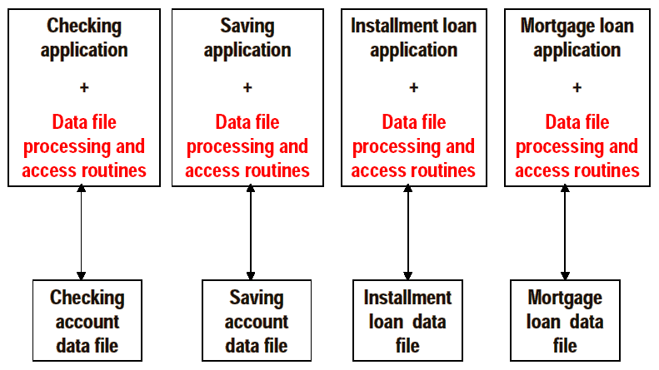
The Birth of DBMS (1)
From Hans-J. Schek’s VLDB 2000 slides

Slide 28
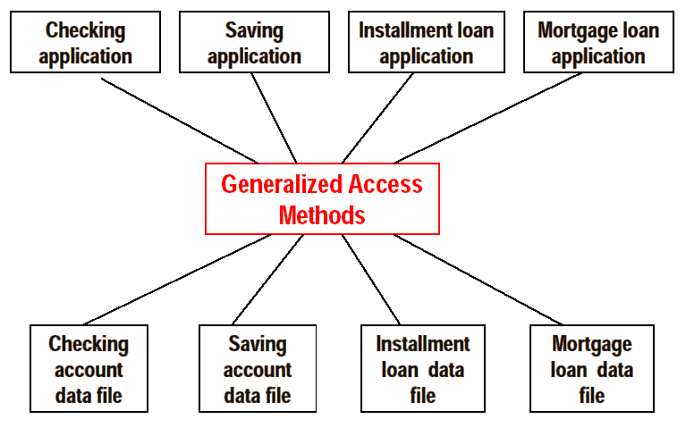
The Birth of DBMS (2)
From Hans-J. Schek’s VLDB 2000 slides

Slide 29
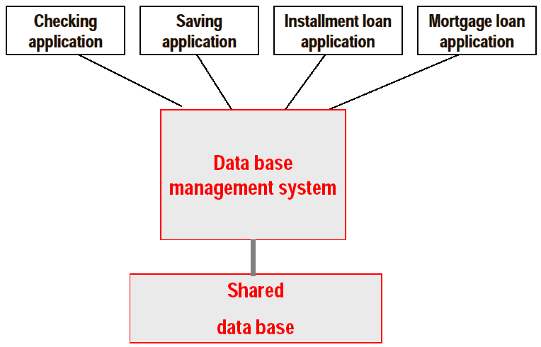
The Birth of DBMS (3)
DBMS is an excellent example of a successful abstraction!
From Hans-J. Schek’s VLDB 2000 slides

Slide 30
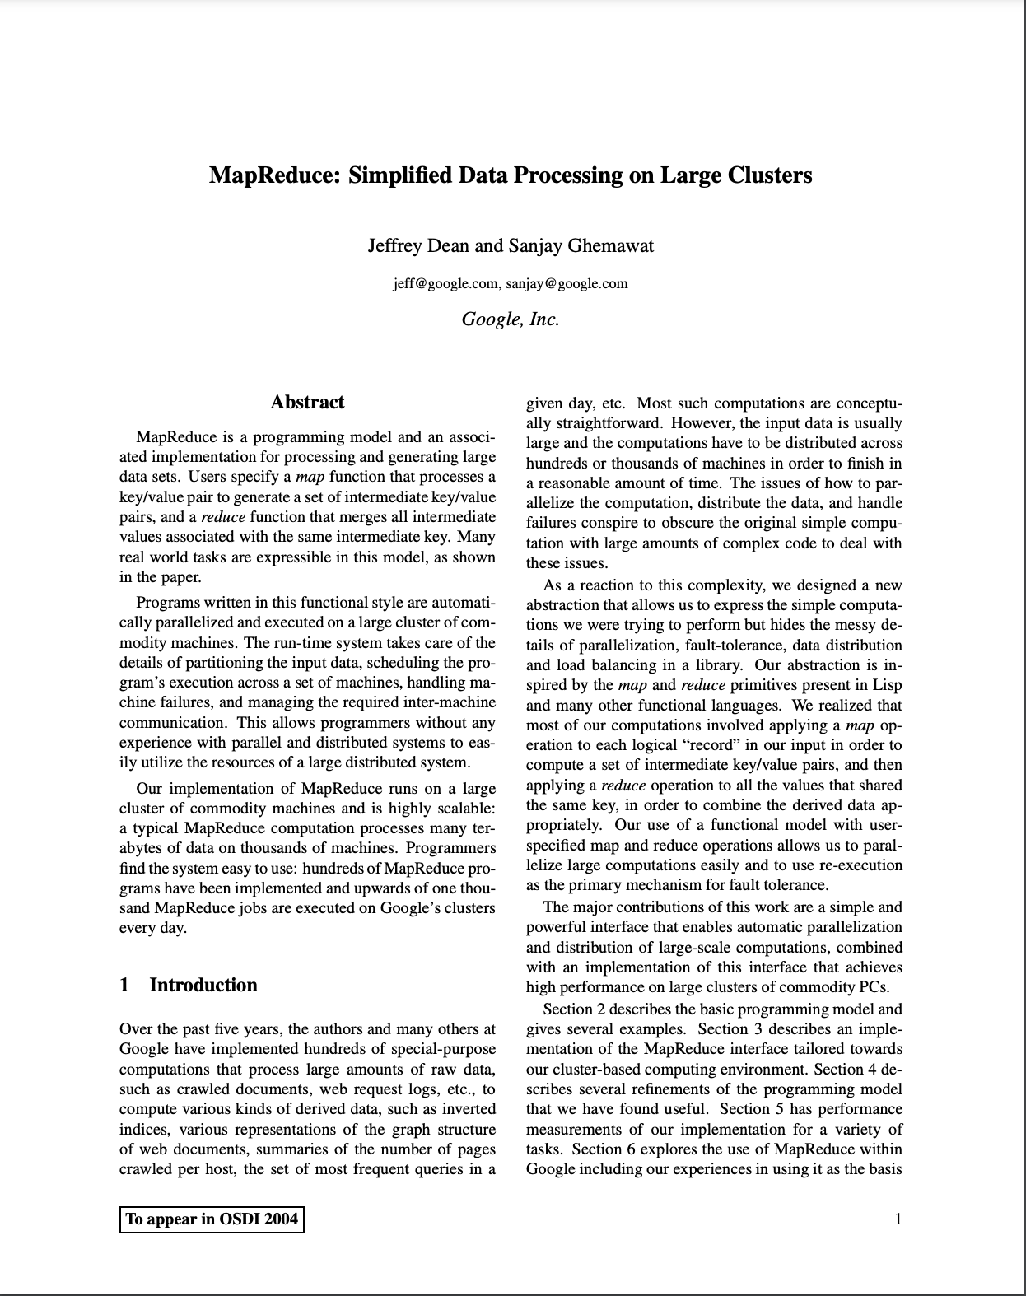
A Side Note on Spotting an Opportunity For New Systems or System Components
Sometimes (but not always) you spot that a new system/system component is needed by observing functionality duplication.
Ex 1: Map Reduce Large-Scale Dataflow System
  CS 451: Data-Intensive Distributed Computing
Over the past five years, the authors and many others at Google have implemented hundreds of special-purpose computations that process large amounts of raw data, such as crawled documents, web request logs, etc., to compute various kinds of derived data, such as inverted indices, various representations of the graph structure of web documents, summaries of the number of pages crawled per host, the set of most frequent queries in a given day, etc. Most such computations are conceptually straightforward. However, the input data is usually large and the computations have to be distributed across hundreds or thousands of machines in order to finish in a reasonable amount of time. The issues of how to parallelize the computation, distribute the data, and handle failures conspire to obscure the original simple computation with large amounts of complex code to deal with these issues.

Slide 31
The Birth of MapReduce (1)
Google Inverted Index Constructor
Google PageRank Computation
Google User
Dashboards
Code for:
Computation parallelization
across a cluster of machines
Distributing data files,
Custer failure recovery
Code for:
Computation parallelization
across a cluster of machines
Distributing data files,
Custer failure recovery
…
Code for:
Computation parallelization
across a cluster of machines
Distributing data files,
Custer failure recovery
…
…
…
…

Slide 32
The Birth of MapReduce (2)
Google Inverted Index Constructor
Google PageRank Computation
Google User
Dashboards
…
MapReduce System
Code for:
Computation parallelization
across a cluster of machines
Distributing data files,
Custer failure recovery
…

Slide 33
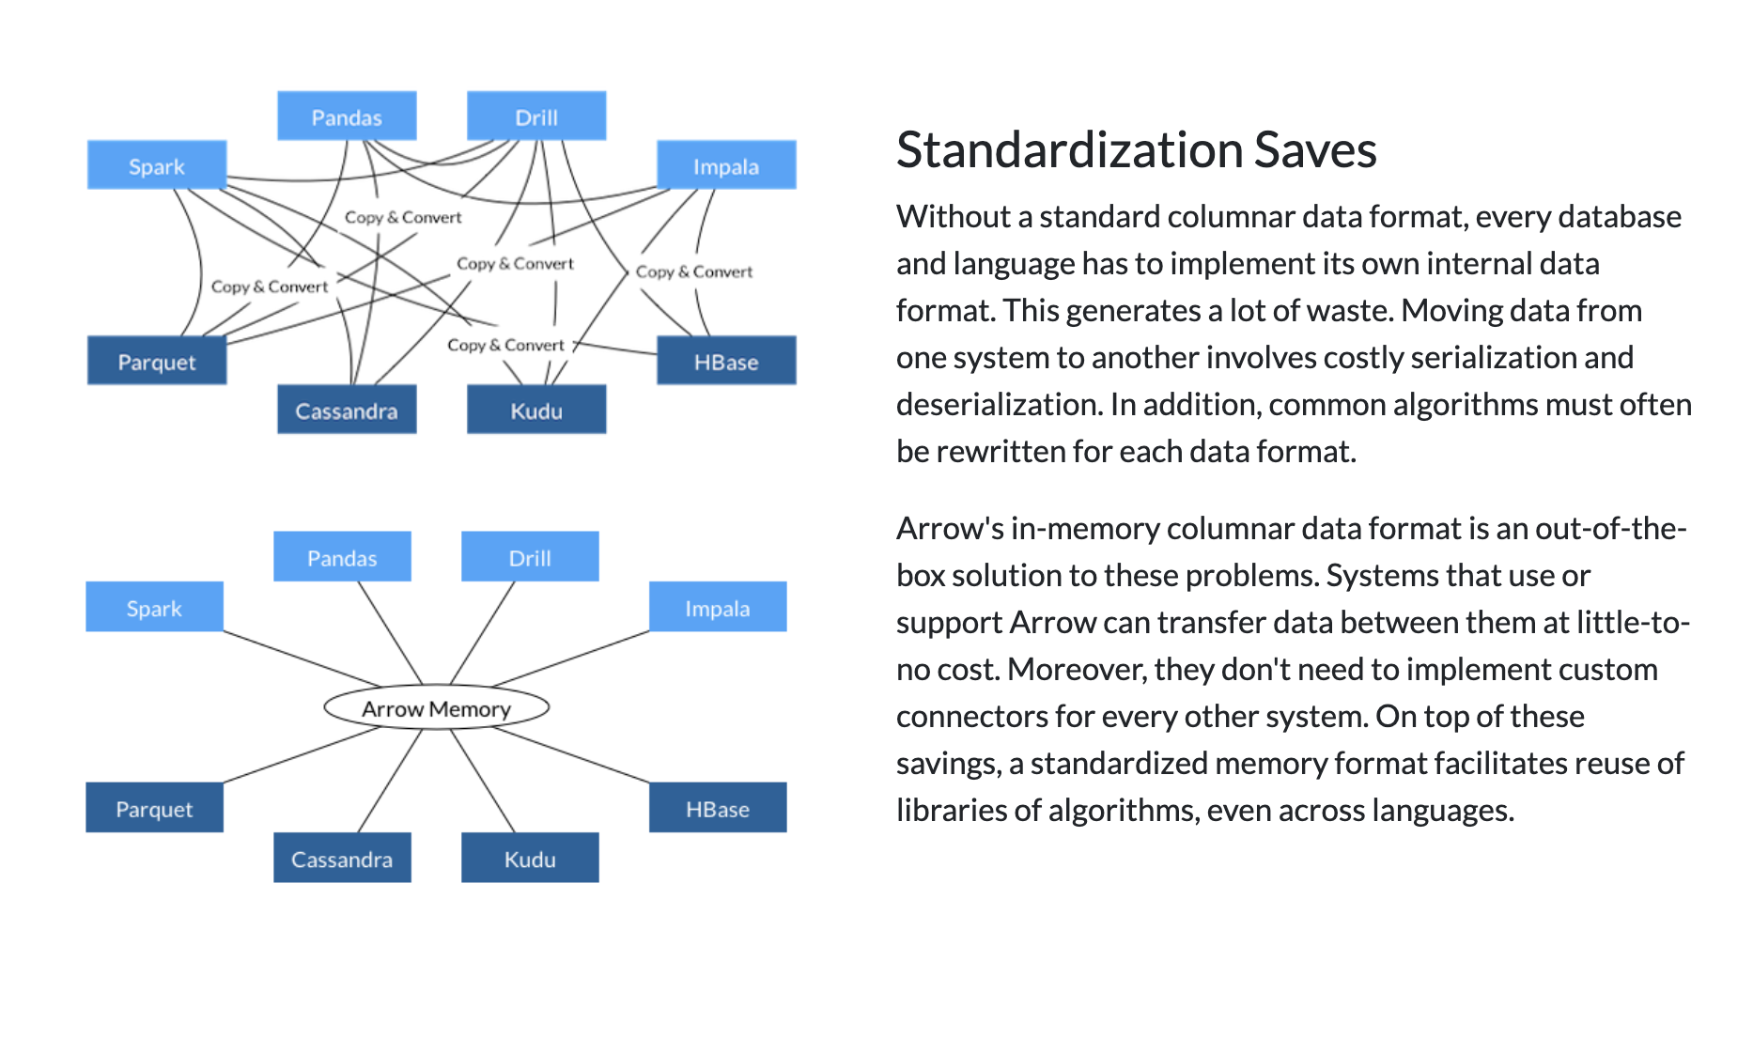
Another Recent Example: Apache Arrow
A New Columnar Data Format and Library for Data Science

Slide 34
Same Application Development W/ a DBMS
We will use a Relational DBMS (RDBMS) but can use other DBMSs too (e.g., a graph database management system)
  Ex: PostgreSQL, Oracle, MySQL, SAP HANA, Snowflake…

Slide 35
Data Modeling With an RDBMS (1)
Relational Model: Data is modeled as a set of tables
  Much higher-level abstraction than bits/bytes
Customers
name | birthday
Alice | 2001/09/08
Bob | 2002/05/20
… | …
Orders
oID | cust | product | price
O1 | 2001/09/08 | BookA | 20
O2 | 2002/05/20 | TVB | 100
… | … | … | …
Products
product | numInStock
BookA | 1
TVB | 78
… | …
Example SQL Command in an RDBMS:
CREATE TABLE Customers
name varchar(255),
birthdate DATE;
The RDBMS takes care of physical record design: Fixed-length/var-length, columnar, row, chained etc.
The physical record design is transparent to the developer, i.e. the developer does not need to know the design.

Slide 36
Data Modeling With an RDBMS (2)
Physical Data Independence:
  Throughout the lifetime of the app, the RDBMS can change the physical layout for performance or other reasons and the applications keep working because the design is transparent.
E.g:
  A new column can be added that changes the record design
  A compressed column can be uncompressed
Takeaway: A high-level data model delegates the responsibility of physical record design and access to these records to the DBMS

Slide 37
High-level Query Language (1)
Structured Query Language (SQL)
SQL is so high-level that it’s called a declarative language: i.e., one in which you can describe the output of the computation but not how to perform the computation.
Recall managers’ question: Who are top paying customers?
SELECT cust, sum(price) as sumPay
FROM Orders
ORDER BY sumPay DESC
Orders
oID | cust | product | price
No procedural description of how to group-by and aggregate: hash-based, sort-based, what sorting algorithm to use etc.

Slide 38
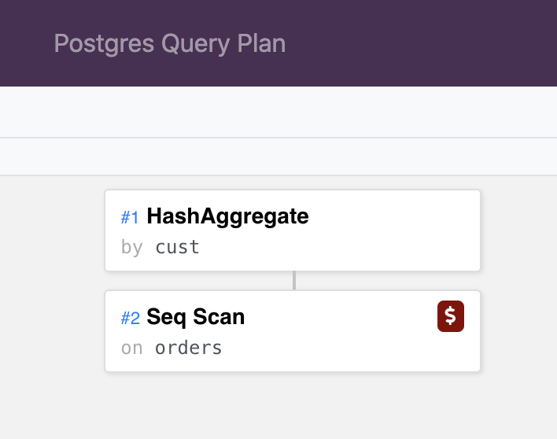
High-level Query Language (2)
RDBMS automatically generates an algorithm for the query:
  We call those algorithms query plans
SELECT cust, sum(price) as sumPay
FROM Orders
ORDER BY sumPay DESC
High-level QLs are perhaps the best examples of automatic programming
Takeaway: A high-level QL delegates the responsibility of finding an efficient algorithm for queries to the DBMS.
Other efficiency benefits: The DBMS will handle large data and automatically parallelize these algorithms.

Slide 39
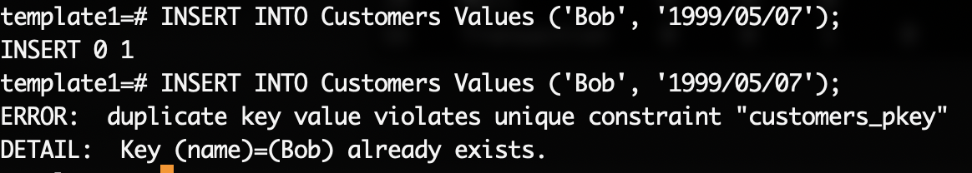
Integrity Constraints
Recall the bug in Checkout App’s “Checkout As Guest”:
  Writes the Customer record
  Assume Bob shops again
  (Bob, 1999/05/07) is duplicated!
In RDBMSs: add uniqueness constraints (Primary Key Constraints)
CREATE TABLE Customers (name varchar(255), birthdate DATE,
PRIMARY KEY (name));
Takeaway: DBMSs will enforce the constraint and maintain the data’s integrity at all times on behalf of the app!
Can enforce other integrity constraints (e.g., foreign key)

Slide 40
Concurrency When Using an RDBMS
Recall Alice & Bob concurrently ordering BookA:
Product | NumInStock
… | …
BookA | 1
… | …
Buy_Product_Subroutine(string prodName):
(prod, numInStock) = readProduct(prodName)
if (numInStock > 0):
writeProduct((prod, numInStock - 1)
else throw(“Cannot buy product!”);
r: (A, 1)
r: (A,1)
r: (A,1)
r: (A,1)
w: (A, 0)
w:(A,0)
w:(A,0)
time
r: (A, 0)
r:(A,0)
w:(A,0)
No Book
No Book
✓
✓
X

Slide 41
Concurrency When Using an RDBMS
Will ensure a correct end state
Will avoid any deadlocks
Will error for Alice or Bob
Take away: DBMS ensures safe concurrency.
(Simplified) SQL:
BEGIN TRANSACTION
UPDATE Products
SET numInStock = numInStock - 1
WHERE name = “BookA”
INSERT INTO Orders
VALUES (“Alice”, “BookA”, $20)
COMMIT
r: (A, 1)
r: (A,1)
r: (A,1)
r: (A,1)
w: (A, 0)
w:(A,0)
w:(A,0)
time
r: (A, 0)
r:(A,0)
w:(A,0)
✓
✓
X

Slide 42
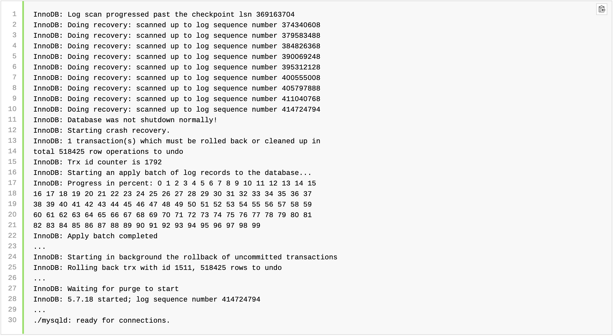
Backup and Recovery
Recall failure scenario: Alice orders both BookA and BookB
Suppose a power failure occurs and the DBMS fails in the middle of committing the transaction
r (A, 1)
w (A, 0)
Product | NumInStock
… | …
BookA | 0
BookB | 7
Product | NumInStock
… | …
BookA | 1
BookB | 7
X
✓

Slide 43
Summary
DBMS is an indispensable core system software to develop any application that stores, queries, or processes data.

Slide 44
Outline For Today
Overview of DBMSs: 3 Major Contributions of the Field
  Set of DBMS Features for Applications
  Physical Data Independence/High-level Query Languages
  Transactions
Course Diagram & Administrative Information

Slide 45
Key People When Developing Data-Intensive Applications
1: Application End Users
2. App Developers: DBMS Users
App Software/
Servers
3. DBMS Administrator: Person who maintains the DBMS when it serves multiple applications
4. DBMS Architect: Person who actually implements the DBMS
DBMS
Won’t differentiate between 2&3
  ~2/3rd from the perspective of app developers
  ~1/3rd on DBMS internals and architecture
Want to learn more about internals of DBMSs: CS 448

Slide 46
CS 348 Diagram
User/Administrator Perspective
Primary Database Management System Features
Data Model: Relational Model
High Level Query Language: Relational Algebra & SQL, Datalog
Integrity Constraints
Indexes/Views
Transactions
Relational Database Design
E/R Models
Normal Forms
How To Program A DBMS (0.5-1 lecture)
Embedded vs Dynamic SQL
Frameworks
DBMS Architect/Implementer Perspective
Other (Last 1/2 Lectures)
Graph DBMSs
MapReduce: Distributed Data Processing Systems
Physical Record Design
Query Planning and Optimization
Indexes
Transactions

Slide 47
Before/After CS 348
SAP, Oracle, Microsoft, IBM, Snowflake, Databricks, Neo4j, CockroachDB, GraphflowDB, …
SQL vs NoSQL?
RDBMs vs GDBMs vs Key-Value or Document Store?
….
Relational Model, SQL, Datalog
DB Design & Tuning
Transactions
DB Internal Architecture

Slide 48




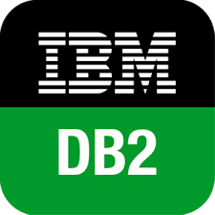







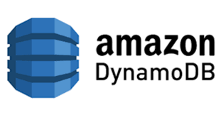
A Glimpse of Current DBMS Market
Hundreds of companies producing DBMSs: Many RDBMS/SQL, but also graph, RDF, Document DB, Key-value stores etc..
Not even including companies to tune, ingest, visualize etc..

Slide 49
What I Want You To Watch
Short Video On History of DBMSs by Computer History Museum (CHM)
Charles Bachmann’s Talk at CHM on Developing IDS
  IDS: The First DBMS in the world (developed around 1960-1964)
Jim Gray’s Interview on Microsoft Research on His Career & Projects
  This short video is his high-level overview of transactions & ACID
No Public Talk of Ted Codd I know of. If you ever find one let me know!

Slide 50

What I Want You To Never Forget
I have highlighted 3 main intellectual contributions and some of the key people behind those contributions
But as any field: the field is much bigger than these people
Excellent researchers and engineers continue to push the field forward
E.g: Patricia Selinger: core engineer in System R, first RDBMS prototype. Lead of first cost-based query optimizer.
E.g: Prof. Tamer Ozsu of UWaterloo DSG: key figure in distributed DBMSs
E.g: Ken Salem of UWaterloo DSG (co-inventor of disk-striping, which is the foundations of RAID disks)
Patricia Selinger
Tamer Ozsu
Ken Salem

Slide 51

Administrative Info (1)
Instructor: Semih Salihoglu (semih.salihoglu@uwaterloo.ca)
Planning for an online instead of a hybrid course
  School is officially online until Feb but expect a longer delay
  If we go in person, we *might* have an actual midterm and final.
  Plan for course organization aside from in-person lectures is same
OHs: Mondays 2:00pm-3:00pm over Zoom (see Piazza)
Unofficial Co-Instructor: Prof Xi He!
  Will use much of her material and her videos
TAs: Guy Coccimiglio, Glaucia Melo, Karl Knopf, Chang Liu, Amine, Mhedhbi
TA OHs: 2 hours on weeks assignments are due
Lectures: For online part: recorded and available on Learn
  If we are in-person, I will deliver in-person lectures

Slide 52
Administrative Info (2)
Learn: https://learn.uwaterloo.ca/d2l/home/761209
Piazza: https://piazza.com/class/kxhps7c94rj9r
  Unless urgent, we will wait for students to answer
  We will interfere when there is confusion
  Please be active! This our best forum for communication.

Slide 53
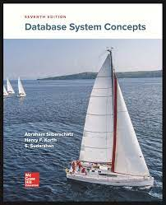
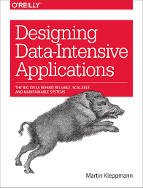
Administrative Info (3)
Textbook: Database System Concepts, Silberschatz et al., 7th edition
  “The library has electronic access only to the 2006 edition of “Database System Concepts by Silberschatz.” This access is through Hathi Trust which is emergency access. Access is restricted to one user and for one hour at a time.”
  (Rare) Optional: Designing Data Intensive Applications, Klepmann

Slide 54
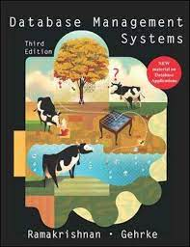
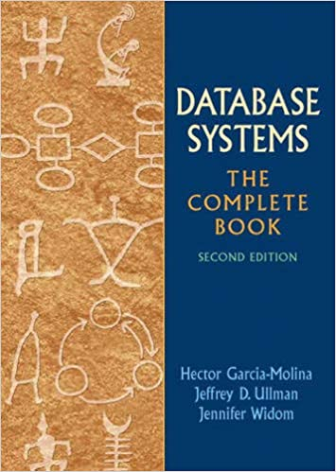
Administrative Info (3)
2 Other Main Textbooks in the Field

Slide 55
Administrative Info (4)
Workload & Mark Distribution
  4 assignments:
    ~3 will have programming questions.
    1 or 2 weeks (not guaranteed to be 2 weeks) to complete each.
    Submit through Crowdmark/Marmoset
    First one is out next Friday, Jan14th. Due Jan 28th.
  1 “Midterm Assignment”. You will have 1 day
  1 “Final Assignment”. You will have 1 day.
  Midterm & Final Assignments are comprehensive w/ different late policy
Late Policy: You have 2 extra days
  For 4 Assignments: Lose 5% for each additional day
  For Midterm and Final Assignments: Lose 15% for each additional day

Slide 56
Prerequisites
CS 240/240E is listed but not strictly necessary.
Programming in a standard language: TBA
General Interest in Software Systems, Data-Intensive Application Programming and Data Management/Processing Systems

