Slide 1
Intro to the Relational Model
Introduction to Database Management
CS348 Spring 2021

Slide 2
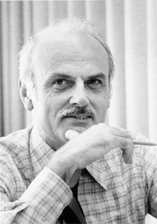
Edgar F. Codd (1923-2003)
Pilot in the Royal Air Force in WW2
Inventor of the relational model
and algebra while at IBM
Turing Award, 1981
http://en.wikipedia.org/wiki/File:Edgar_F_Codd.jpg

Slide 3
Outline
Part 1: Relational data model
Part 2: Relational algebra

Slide 4






Example for Relational data model
Group
User
gid | name
abc | Book Club
gov | Student Government
dps | Dead Putting Society
… | …
uid | name | age | pop
142 | Bart | 10 | 0.9
123 | Milhouse | 10 | 0.2
857 | Lisa | 8 | 0.7
456 | Ralph | 8 | 0.3
… | … | … | …
Member
uid | gid
142 | dps
123 | gov
857 | abc
857 | gov
456 | abc
456 | gov
… | …
relations (or tables)

Slide 5




Example for Relational data model
Group
User
gid | name
abc | Book Club
gov | Student Government
dps | Dead Putting Society
… | …
uid | name | age | pop
142 | Bart | 10 | 0.9
123 | Milhouse | 10 | 0.2
857 | Lisa | 8 | 0.7
456 | Ralph | 8 | 0.3
… | … | … | …
Member
uid | gid
142 | dps
123 | gov
857 | abc
857 | gov
456 | abc
456 | gov
… | …
attributes (or columns)

Slide 6










Example for Relational data model
Group
User
gid | name
abc | Book Club
gov | Student Government
dps | Dead Putting Society
… | …
uid | name | age | pop
142 | Bart | 10 | 0.9
123 | Milhouse | 10 | 0.2
857 | Lisa | 8 | 0.7
456 | Ralph | 8 | 0.3
… | … | … | …
Member
uid | gid
142 | dps
123 | gov
857 | abc
857 | gov
456 | abc
456 | gov
… | …
domain (or type)

Slide 7



Example for Relational data model
Group
User
gid | name
abc | Book Club
gov | Student Government
dps | Dead Putting Society
… | …
uid | name | age | pop
142 | Bart | 10 | 0.9
123 | Milhouse | 10 | 0.2
857 | Lisa | 8 | 0.7
456 | Ralph | 8 | 0.3
… | … | … | …
Member
uid | gid
142 | dps
123 | gov
857 | abc
857 | gov
456 | abc
456 | gov
… | …
tuples (or rows)
Duplicates are not allowed
Ordering of rows doesn’t matter
(even though output is
always in some order)

Slide 8
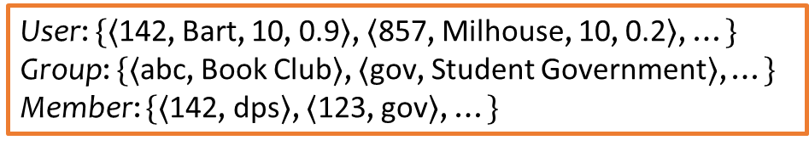
Example for Relational data model
Group
User
gid | name
abc | Book Club
gov | Student Government
dps | Dead Putting Society
… | …
uid | name | age | pop
142 | Bart | 10 | 0.9
123 | Milhouse | 10 | 0.2
857 | Lisa | 8 | 0.7
456 | Ralph | 8 | 0.3
… | … | … | …
Member
uid | gid
142 | dps
123 | gov
857 | abc
857 | gov
456 | abc
456 | gov
… | …
User: $\{〈$142, Bart, 10, 0.9$〉$, $〈$857, Milhouse, 10, 0.2$〉$, …$\}$
Group: $\{〈$abc, Book Club$〉$, $〈$gov, Student Government$〉$, …$\}$
Member: $\{〈$142, dps$〉$, $〈$123, gov$〉$, …$\}$

Slide 9
Relational data model
A database is a collection of relations (or tables)
Each relation has a set of attributes (or columns)
Each attribute has a name and a domain (or type)
  The domains are required to be atomic
Each relation contains a set of tuples (or rows)
  Each tuple has a value for each attribute of the relation
  Duplicate tuples are not allowed
    Two tuples are duplicates if they agree on all attributes
Simplicity is a virtue!

Slide 10
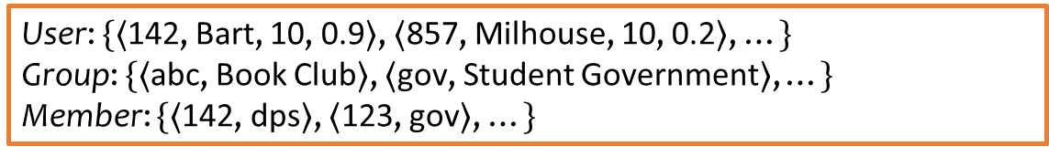
Schema vs. instance
Schema (metadata)
  Specifies the logical structure of data
  Is defined at setup time, rarely changes
Instance
  Represents the data content
  Changes rapidly, but always conforms to the schema
User (uid int, name string, age int, pop float)
Group (gid string, name string)
Member (uid int, gid string)
User: $\{〈$142, Bart, 10, 0.9$〉$, $〈$857, Milhouse, 10, 0.2$〉$, …$\}$
Group: $\{〈$abc, Book Club$〉$, $〈$gov, Student Government$〉$, …$\}$
Member: $\{〈$142, dps$〉$, $〈$123, gov$〉$, …$\}$

Slide 11



Integrity constraints
A set of rules that database instances should follow
Example:
  age cannot be negative
  uid should be unique in the User relation
  uid in Member must refer to a row in User
User (uid int, name string, age int, pop float)
Group (gid string, name string)
Member (uid int, gid string)
User: $\{〈$142, Bart, 10, 0.9$〉$, $〈$857, Milhouse, 10, 0.2$〉$, …$\}$
Group: $\{〈$abc, Book Club$〉$, $〈$gov, Student Government$〉$, …$\}$
Member: $\{〈$142, dps$〉$, $〈$123, gov$〉$, …$\}$

Slide 12
Integrity constraints
An instance is only valid if it satisfies all the integrity constraints.
Reasons to use constraints:
  Ensure data entry/modification respects to database design
  Protect data from bugs in applications

Slide 13
Types of integrity constraints
Tuple-level
  Domain restrictions, attribute comparisons, etc.
    E.g. age cannot be negative
Relation-level
  Key constraints (focus in this lecture)
    E.g. uid should be unique in the User relation
  Functional dependencies (Textbook, Ch. 7)
Database-level
  Referential integrity – foreign key (focus in this lecture)
    uid in Member must refer to a row in User with the same uid

Slide 14
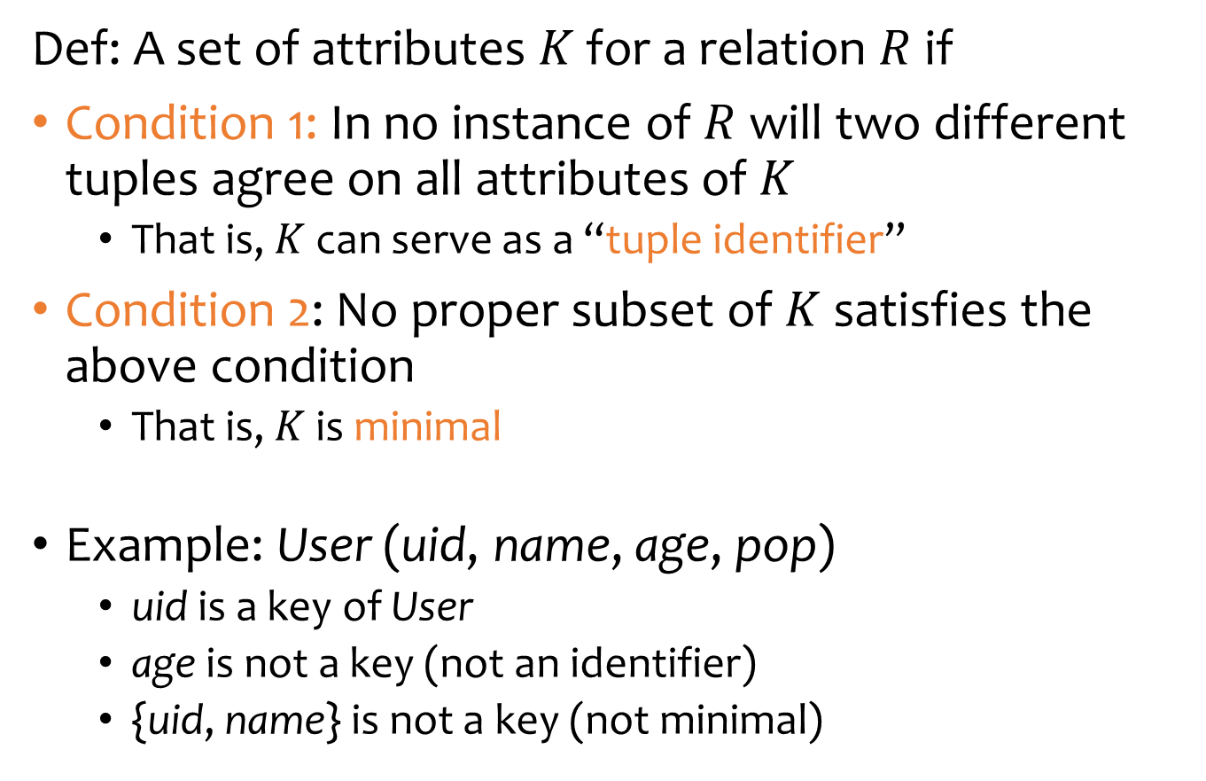
Key (Candidate Key)
Def: A set of attributes $K$ for a relation $R$ if
Condition 1: In no instance of $R$ will two different tuples agree on all attributes of $K$
  That is, $K$ can serve as a “tuple identifier”
Condition 2: No proper subset of $K$ satisfies the above condition
  That is, $K$ is minimal
Example: User (uid, name, age, pop)
  uid is a key of User
  age is not a key (not an identifier)
  {uid, name} is not a key (not minimal)
Satisfies only Condition 1
, but a superkey

Slide 15
Schema vs. instance
uid | name | age | pop
142 | Bart | 10 | 0.9
123 | Milhouse | 10 | 0.2
857 | Lisa | 8 | 0.7
456 | Ralph | 8 | 0.3
Is name a key of User?
  Yes? Seems reasonable for this instance
  No! User names are not unique in general
Key declarations are part of the schema

Slide 16
More examples of keys
Member
uid | gid
142 | dps
123 | gov
857 | abc
857 | gov
456 | abc
456 | gov
… | …
Member (uid, gid)
  {uid, gid}
  A key can contain multiple attributes
Address (street_address, city, state, zip)
  Key 1: {street_address, city, state}
  Key 2: {street_address, zip}
  A relation can have multiple keys!
Primary key: a designated candidate key in the schema declaration
  Underline all its attributes, e.g., Address (street_address, city, state, zip)

Slide 17
Use of keys
More constraints on data, fewer mistakes
Look up a row by its key value
  Many selection conditions are “key = value”
“Pointers” to other rows (often across tables)

Slide 18


“Pointers” to other rows
Foreign key: primary key of one relation appearing as attribute of another relation
Group
User
uid | name | age | pop
142 | Bart | 10 | 0.9
123 | Milhouse | 10 | 0.2
857 | Lisa | 8 | 0.7
456 | Ralph | 8 | 0.3
… | … | … | …
gid | name
abc | Book Club
gov | Student Government
dps | Dead Putting Society
… | …
Member
uid | gid
142 | dps
123 | gov
857 | abc
857 | gov
456 | abc
456 | gov
… | …

Slide 19
“Pointers” to other rows
Referential integrity: A tuple with a non-null value for a foreign key that does not match the primary key value of a tuple in the referenced relation is not allowed.
Member
uid | gid
142 | dps
123 | gov
857 | Xi
857 | gov
456 | abc
456 | gov
… | …
Group
gid | name
abc | Book Club
gov | Student Government
dps | Dead Putting Society

Slide 20
Outline
Part 1: Relational data model
  Data model
  Database schema
  Integrity constraints (keys)
  Languages
    Relational algebra (focus in this lecture)
    SQL (next lecture)
    Relational calculus (textbook, Ch. 27)
Part 2: Relational algebra

Slide 21
Relational algebra
A language for querying relational data
based on “operators”
RelOp
RelOp
Core operators:
  Selection, projection, cross product, union, difference, and renaming
Additional, derived operators:
  Join, natural join, intersection, etc.
Compose operators to make complex queries

Slide 22


Core operator 1: Selection
Example: Users with popularity higher than 0.5
$$σ_{pop>0.5}User$$
uid | name | age | pop
142 | Bart | 10 | 0.9
123 | Milhouse | 10 | 0.2
857 | Lisa | 8 | 0.7
456 | Ralph | 8 | 0.3
… | … | … | …
uid | name | age | pop
142 | Bart | 10 | 0.9
857 | Lisa | 8 | 0.7
… | … | … | …
$$σ_{pop>0.5}$$

Slide 23
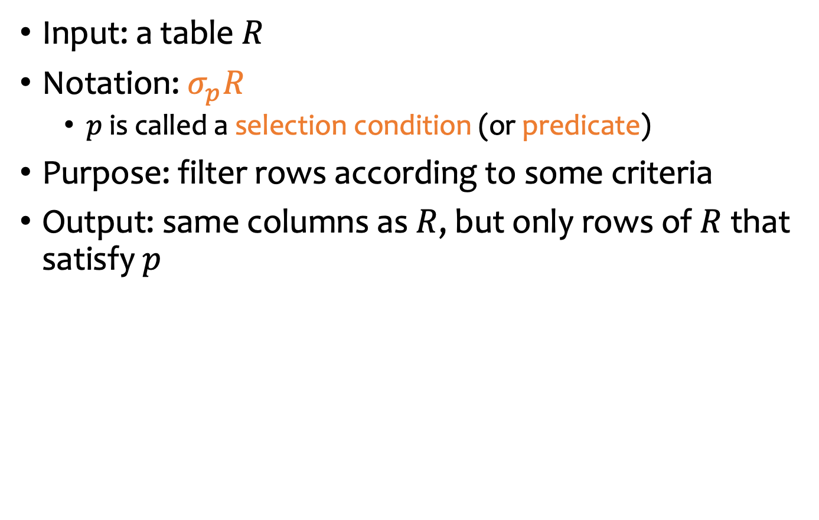
Core operator 1: Selection
Input: a table $R$
Notation: $σ_{p}R$
  $p$ is called a selection condition (or predicate)
Purpose: filter rows according to some criteria
Output: same columns as $R$, but only rows of $R$ that satisfy $p$

Slide 24
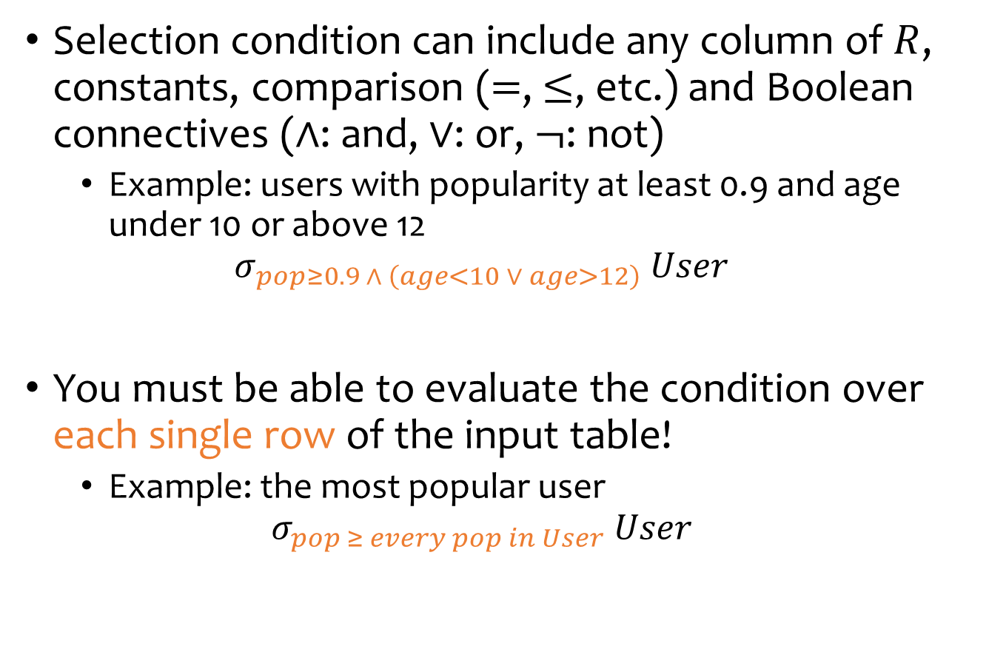
More on selection
Selection condition can include any column of $R$, constants, comparison ($=$, $≤$, etc.) and Boolean connectives ($∧$: and, $∨$: or, $¬$: not)
  Example: users with popularity at least 0.9 and age under 10 or above 12
  $$σ_{pop≥0.9 ∧ \left(age<10 ∨ age>12\right)} User$$
You must be able to evaluate the condition over each single row of the input table!
  Example: the most popular user
  $$σ_{pop ≥ every pop in User} User$$
WRONG!

Slide 25


Core operator 2: Projection
Example: IDs and names of all users
$$π_{uid,name} User$$
uid | name | age | pop
142 | Bart | 10 | 0.9
123 | Milhouse | 10 | 0.2
857 | Lisa | 8 | 0.7
456 | Ralph | 8 | 0.3
… | … | … | …
uid | name
142 | Bart
123 | Milhouse
857 | Lisa
456 | Ralph
… | …
$$π_{uid, name}$$

Slide 26

Core operator 2: Projection
Input: a table $R$
Notation: $π_{L}R$
  $L$ is a list of columns in $R$
Purpose: output chosen columns
Output: “same” rows, but only the columns in $L$

Slide 27


More on projection
Duplicate output rows are removed (by definition)
  Example: user ages
  $$π_{age} User$$
age
10
10
8
8
…
uid | name | age | pop
142 | Bart | 10 | 0.9
123 | Milhouse | 10 | 0.2
857 | Lisa | 8 | 0.7
456 | Ralph | 8 | 0.3
… | … | … | …
age
10
8
…
$$π_{age}$$

Slide 28






Core operator 3: Cross product
$$User×Member$$
uid | gid
123 | gov
857 | abc
857 | gov
uid | name | age | pop
123 | Milhouse | 10 | 0.2
857 | Lisa | 8 | 0.7
$$×$$
uid | name | age | pop | uid | gid
123 | Milhouse | 10 | 0.2 | 123 | gov
123 | Milhouse | 10 | 0.2 | 857 | abc
123 | Milhouse | 10 | 0.2 | 857 | gov
857 | Lisa | 8 | 0.7 | 123 | gov
857 | Lisa | 8 | 0.7 | 857 | abc
857 | Lisa | 8 | 0.7 | 857 | gov

Slide 29

Core operator 3: Cross product
Input: two tables $R$ and $S$
Natation: $R×S$
Purpose: pairs rows from two tables
Output: for each row $r$ in $R$ and each $s$ in $S$, output a row $rs$ (concatenation of $r$ and $s$)

Slide 30


A note a column ordering
Ordering of columns is unimportant as far as contents are concerned
So cross product is commutative, i.e., for any $R$ and $S$, $R×S=S×R$ (up to the ordering of columns)
uid | name | age | pop | uid | gid
123 | Milhouse | 10 | 0.2 | 123 | gov
123 | Milhouse | 10 | 0.2 | 857 | abc
123 | Milhouse | 10 | 0.2 | 857 | gov
857 | Lisa | 8 | 0.7 | 123 | gov
857 | Lisa | 8 | 0.7 | 857 | abc
857 | Lisa | 8 | 0.7 | 857 | gov
… | … | … | … | … | …
uid | gid | uid | name | age | pop
123 | gov | 123 | Milhouse | 10 | 0.2
857 | abc | 123 | Milhouse | 10 | 0.2
857 | gov | 123 | Milhouse | 10 | 0.2
123 | gov | 857 | Lisa | 8 | 0.7
857 | abc | 857 | Lisa | 8 | 0.7
857 | gov | 857 | Lisa | 8 | 0.7
… | … | … | … | … | …
$$=$$

Slide 31



Derived operator 1: Join
Info about users, plus IDs of their groups
$$User⋈_{User.uid=Member.uid}Member$$
uid | gid
123 | gov
857 | abc
857 | gov
… | …
uid | name | age | pop
123 | Milhouse | 10 | 0.2
857 | Lisa | 8 | 0.7
… | … | … | …
$$×$$
$$⋈_{\begin{aligned}User.uid= \\ Member.uid\end{aligned}}$$
$$⋈_{\begin{aligned}User.uid= \\ Member.uid\end{aligned}}$$
Prefix a column reference
with table name and “.” to
disambiguate identically named
columns from different tables
uid | name | age | pop | uid | gid
123 | Milhouse | 10 | 0.2 | 123 | gov
857 | Lisa | 8 | 0.7 | 857 | abc
857 | Lisa | 8 | 0.7 | 857 | gov
… | … | … | … | … | …
uid | name | age | pop | uid | gid
123 | Milhouse | 10 | 0.2 | 123 | gov
123 | Milhouse | 10 | 0.2 | 857 | abc
123 | Milhouse | 10 | 0.2 | 857 | gov
857 | Lisa | 8 | 0.7 | 123 | gov
857 | Lisa | 8 | 0.7 | 857 | abc
857 | Lisa | 8 | 0.7 | 857 | gov
… | … | … | … | … | …

Slide 32
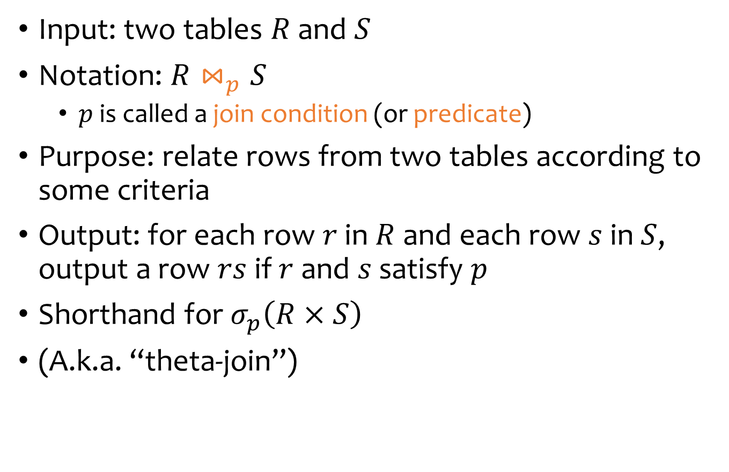
Derived operator 1: Join
Input: two tables $R$ and $S$
Notation: $R⋈_{p}S$
  $p$ is called a join condition (or predicate)
Purpose: relate rows from two tables according to some criteria
Output: for each row $r$ in $R$ and each row $s$ in $S$, output a row $rs$ if $r$ and $s$ satisfy $p$
Shorthand for $σ_{p}\left(R×S\right)$
(A.k.a. “theta-join”)

Slide 33



Derived operator 2: Natural join
$$User⋈Member$$
$$=π_{uid,name,age,pop,gid}\left(User⋈_{\begin{aligned}User.uid= \\ Member.uid\end{aligned}}Member\right)$$
uid | name | age | pop
123 | Milhouse | 10 | 0.2
857 | Lisa | 8 | 0.7
… | … | … | …
uid | gid
123 | gov
857 | abc
857 | gov
… | …
$$⋈$$
$$⋈$$
$$⋈_{\begin{aligned}User.uid= \\ Member.uid\end{aligned}}$$
uid | name | age | pop | uid | gid
123 | Milhouse | 10 | 0.2 | 123 | gov
857 | Lisa | 8 | 0.7 | 857 | abc
857 | Lisa | 8 | 0.7 | 857 | gov
… | … | … | … | … | …
uid | name | age | pop |  | gid
123 | Milhouse | 10 | 0.2 |  | gov
857 | Lisa | 8 | 0.7 |  | abc
857 | Lisa | 8 | 0.7 |  | gov
… | … | … | … |  | …

Slide 34
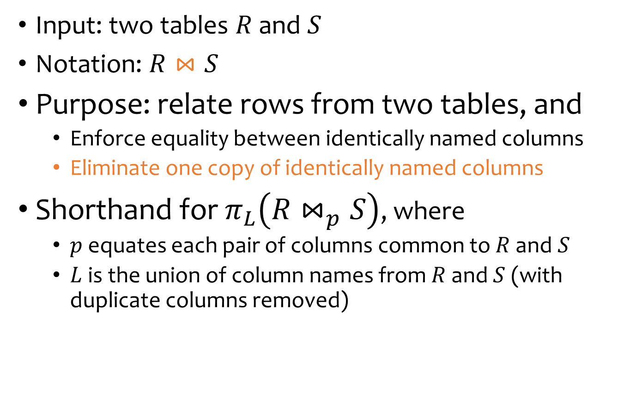
Derived operator 2: Natural join
Input: two tables $R$ and $S$
Notation: $R⋈S$
Purpose: relate rows from two tables, and
  Enforce equality between identically named columns
  Eliminate one copy of identically named columns
Shorthand for $π_{L}\left(R⋈_{p}S\right)$, where
  $p$ equates each pair of columns common to $R$ and $S$
  $L$ is the union of column names from $R$ and $S$ (with duplicate columns removed)

Slide 35

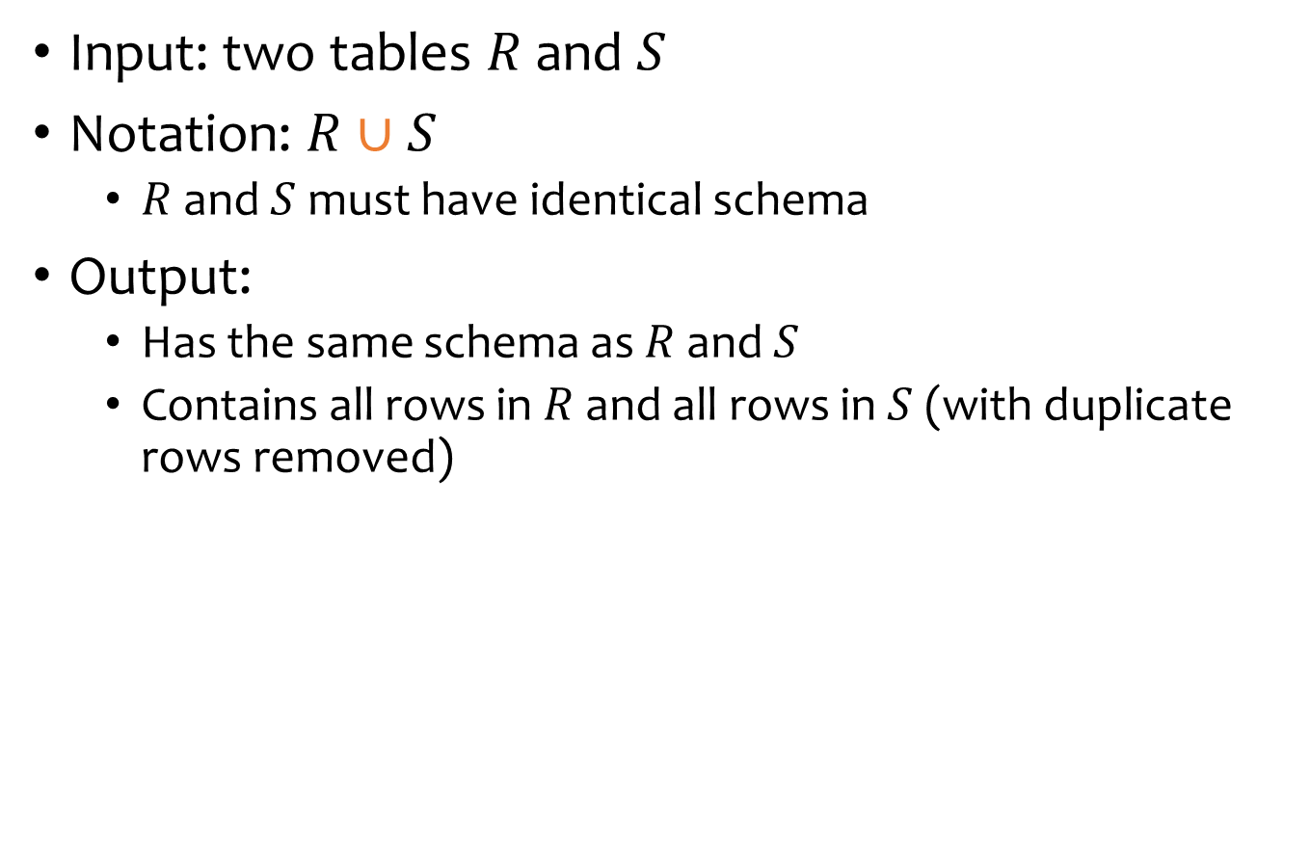
Core operator 4: Union
Input: two tables $R$ and $S$
Notation: $R∪S$
  $R$ and $S$ must have identical schema
Output:
  Has the same schema as $R$ and $S$
  Contains all rows in $R$ and all rows in $S$ (with duplicate rows removed)
uid | gid
123 | gov
857 | abc
uid | gid
123 | gov
901 | edf
uid | gid
123 | gov
857 | abc
901 | edf
$∪$ =

Slide 36


Core operator 5: Difference
Input: two tables $R$ and $S$
Notation: $R−S$
  $R$ and $S$ must have identical schema
Output:
  Has the same schema as $R$ and $S$
  Contains all rows in $R$ that are not in $S$
uid | gid
123 | gov
857 | abc
uid | gid
123 | gov
901 | edf
uid | gid
857 | abc
$−$ =

Slide 37

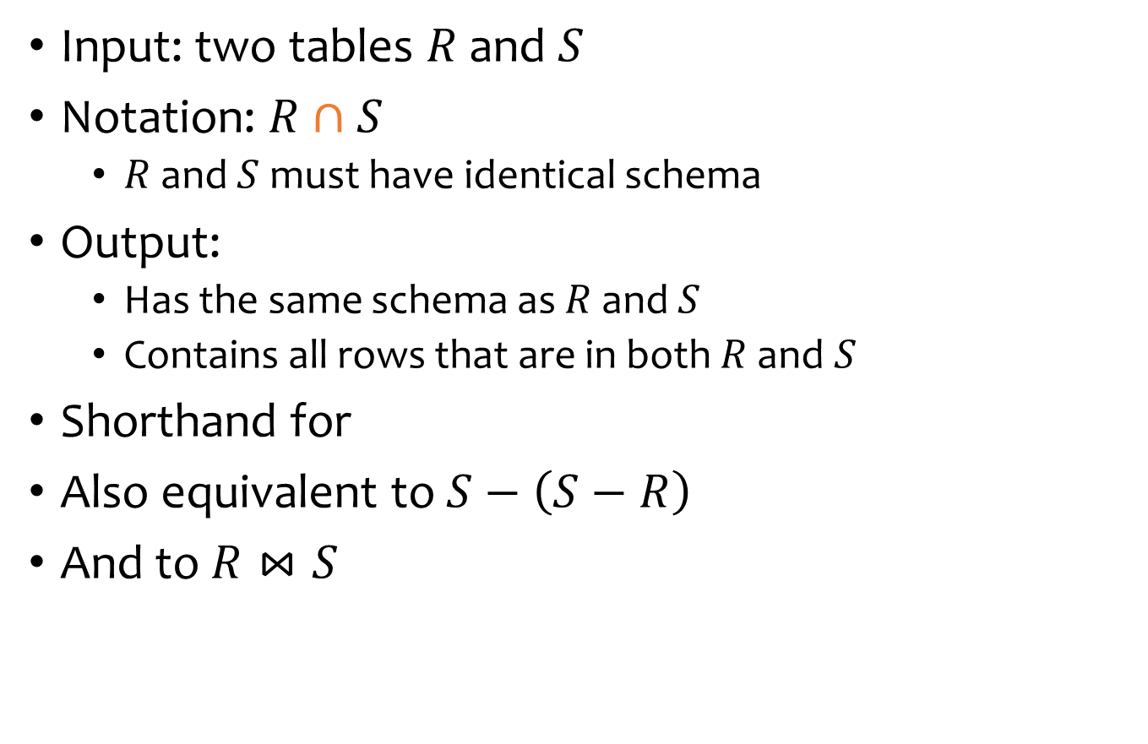
Derived operator 3: Intersection
Input: two tables $R$ and $S$
Notation: $R∩S$
  $R$ and $S$ must have identical schema
Output:
  Has the same schema as $R$ and $S$
  Contains all rows that are in both $R$ and $S$
Shorthand for
Also equivalent to $S−\left(S−R\right)$
And to $R⋈S$
$$R−\left(R−S\right)$$

Slide 38


Core operator 6: Renaming
Input: a table $R$
Notation: $ρ_{S} R$, $ρ_{\left(A_{1}→A_{1}^{′}, …\right)}R$, or $ρ_{S\left(A_{1}→A_{1}^{′},…\right)}R$
Purpose: “rename” a table and/or its columns
Output: a table with the same rows as $R$, but called differently
Member
M1
uid | gid
123 | gov
857 | abc
$$ρ_{M1\left(uid→ uid_{1},gid→ gid_{1}\right)}Member$$
uid1 | gid1
123 | gov
857 | abc

Slide 39
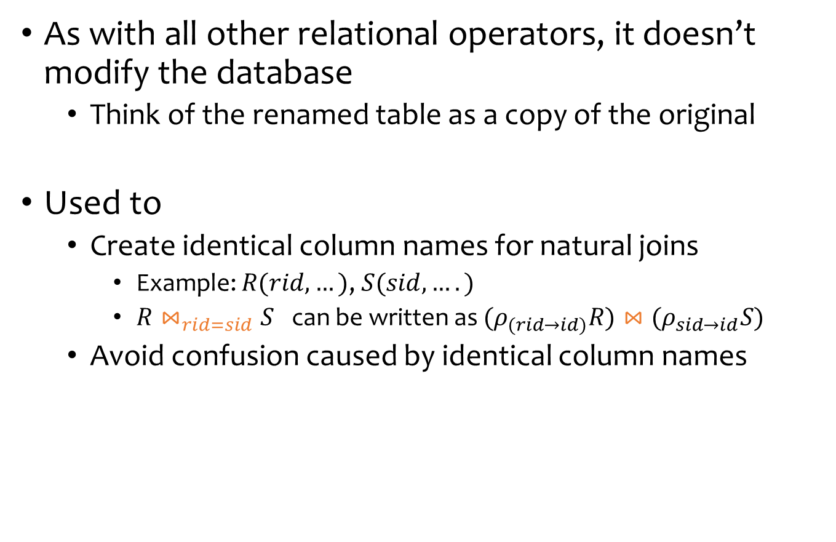
Core operator 6: Renaming
As with all other relational operators, it doesn’t modify the database
  Think of the renamed table as a copy of the original
Used to
  Create identical column names for natural joins
    Example: $R(rid, …)$, $S(sid, ….)$
    $R⋈_{rid=sid}S$ can be written as ${(ρ}_{(rid→id)}R)⋈(ρ_{sid→id}S)$
  Avoid confusion caused by identical column names

Slide 40


Core operator 6: Renaming
IDs of users who belong to at least two groups
$$Member⋈_{?}Member$$
uid | gid
100 | gov
100 | abc
200 | gov
uid | gid
100 | gov
100 | abc
200 | gov
$$⋈_{?}$$
uid | gid | uid | gid
100 | gov | 100 | gov
100 | gov | 100 | abc
100 | gov | 200 | gov
100 | abc | 100 | gov
100 | abc | 100 | abc
100 | abc | 200 | gov
200 | gov | 100 | gov
200 | gov | 100 | abc
200 | gov | 200 | gov
Condition 1: same uid
Condition 2: different gids

Slide 41
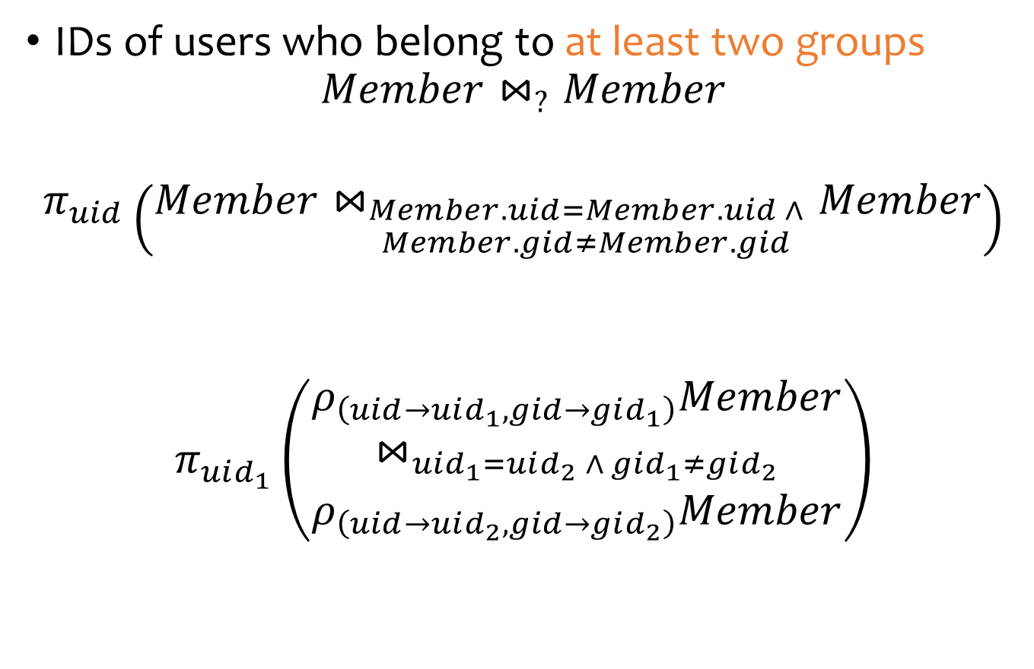
Renaming example
IDs of users who belong to at least two groups
$$Member⋈_{?}Member$$
$$π_{uid}\left(Member⋈_{\begin{aligned}Member.uid=Member.uid ∧ \\ Member.gid≠Member.gid\end{aligned}}Member\right)$$
$$π_{uid_{1}}\left(\begin{aligned}ρ_{\left(uid→uid_{1},gid→gid_{1}\right)}Member \\ ⋈_{uid_{1}=uid_{2} ∧ gid_{1}≠gid_{2}} \\ ρ_{\left(uid→uid_{2}, gid→gid_{2}\right)}Member\end{aligned}\right)$$
WRONG!

Slide 42
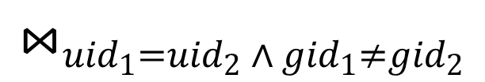


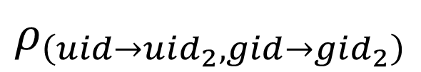
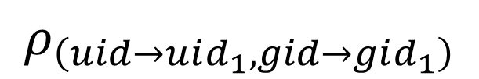
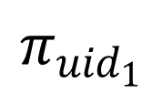
Expression tree notation
$$π_{uid_{1}}$$
$$⋈_{uid_{1}=uid_{2} ∧ gid_{1}≠gid_{2}}$$
$$ρ_{\left(uid→uid_{1},gid→gid_{1}\right)}$$
$$ρ_{\left(uid→uid_{2},gid→gid_{2}\right)}$$
$$Member$$
$$Member$$

Slide 43
Take-home Exercises
Exercise 1: IDs of groups who have at least 2 users?
Exercise 2: IDs of users who belong to at least three groups?

Slide 44
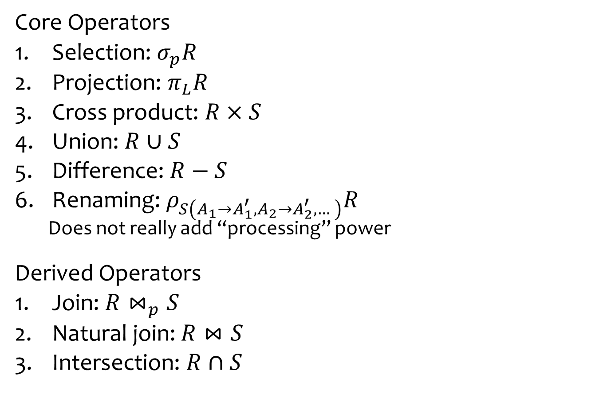
Summary of operators
Core Operators
Selection: $σ_{p}R$
Projection: $π_{L}R$
Cross product: $R×S$
Union: $R∪S$
Difference: $R−S$
Renaming: $ρ_{S\left(A_{1}→A_{1}^{′},A_{2}→A_{2}^{′},…\right)}R$
  Does not really add “processing” power
Derived Operators
Join: $R⋈_{p}S$
Natural join: $R⋈S$
Intersection: $R∩S$
Note: Only use these operators for assignments & quiz

Slide 45
More example
User (uid int, name string, age int, pop float)
Group (gid string, name string)
Member (uid int, gid string)
Names of users in Lisa’s groups
If you have a different solution and you are uncertain about it, you can post your solution on Piazza with the lecture number and slide number; or discuss it during office hours.

Slide 46











More example
User (uid int, name string, age int, pop float)
Group (gid string, name string)
Member (uid int, gid string)
Names of users in Lisa’s groups
Their names
$$π_{name}$$
Writing a query bottom-up:
$$⋈$$
Users in
Lisa’s groups
$$π_{uid}$$
$$User$$
$$⋈$$
Lisa’s groups
$$π_{gid}$$
$$Member$$
$$⋈$$
Who’s Lisa?
$$σ_{name="Lisa"}$$
$$Member$$
$$User$$

Slide 47
More example
User (uid int, name string, age int, pop float)
Group (gid string, name string)
Member (uid int, gid string)
IDs of groups that Lisa doesn’t belong to
Writing a query top-down:

Slide 48








More example
User (uid int, name string, age int, pop float)
Group (gid string, name string)
Member (uid int, gid string)
IDs of groups that Lisa doesn’t belong to
Writing a query top-down:
$$−$$
All group IDs
IDs of Lisa’s groups
$$π_{gid}$$
$$π_{gid}$$
$$Group$$
$$⋈$$
$$Member$$
$$σ_{name="Lisa"}$$
$$User$$

Slide 49
A trickier example
User (uid int, name string, age int, pop float)
Group (gid string, name string)
Member (uid int, gid string)
Who are the most popular?
  Who do NOT have the highest pop rating?
  Whose pop is lower than somebody else’s?

Slide 50





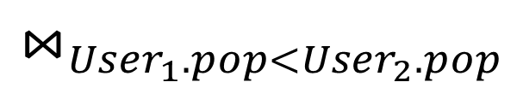




A trickier example
User (uid int, name string, age int, pop float)
Group (gid string, name string)
Member (uid int, gid string)
Who are the most popular?
  Who do NOT have the highest pop rating?
  Whose pop is lower than somebody else’s?
$$−$$
$$π_{uid}$$
$$π_{User_{1}.uid}$$
$$User$$
$$⋈_{User_{1}.pop<User_{2}.pop}$$
$$ρ_{User_{1}}$$
$$ρ_{User_{2}}$$
A deeper question:
When (and why) is “$−$” needed?
$$User$$
$$User$$

Slide 51




Non-monotone operators
RelOp
What happens
to the output?
Add more rows
to the input...
If some old output rows may become invalid, and need to be removed → the operator is non-monotone
Example: difference operator $R−S$
This old row becomes invalid because the new row added to S
uid | gid
123 | gov
857 | abc
uid | gid
123 | gov
901 | edf
uid | gid
857 | abc
$−$ =
857 | abc
$$R$$
$$S$$

Slide 52
Non-monotone operators
RelOp
What happens
to the output?
Add more rows
to the input...
If some old output rows may become invalid, and need to be removed → the operator is non-monotone
Otherwise (old output rows always remain “correct”) → the operator is monotone
This old row is always valid no matter what rows are added to R
uid | gid
123 | gov
857 | abc
uid | gid
123 | gov
901 | edf
uid | gid
857 | abc
$−$ =
189 | abc
189 | abc
$$R$$
$$S$$

Slide 53
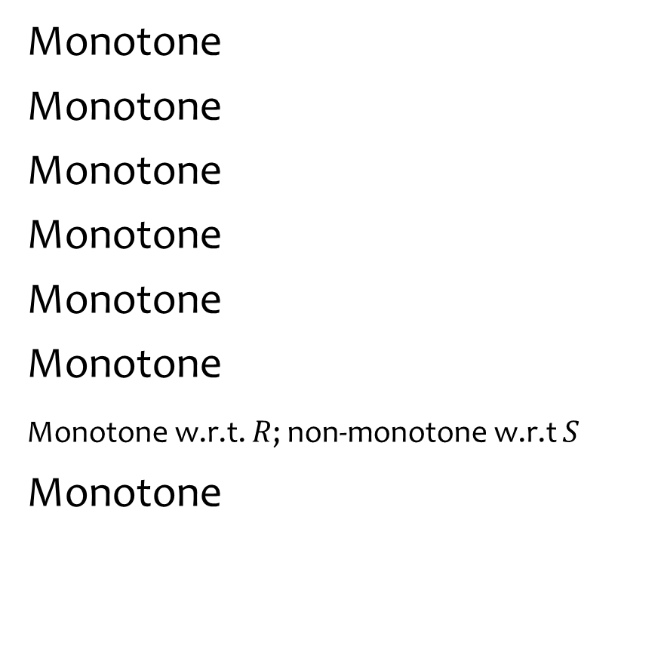
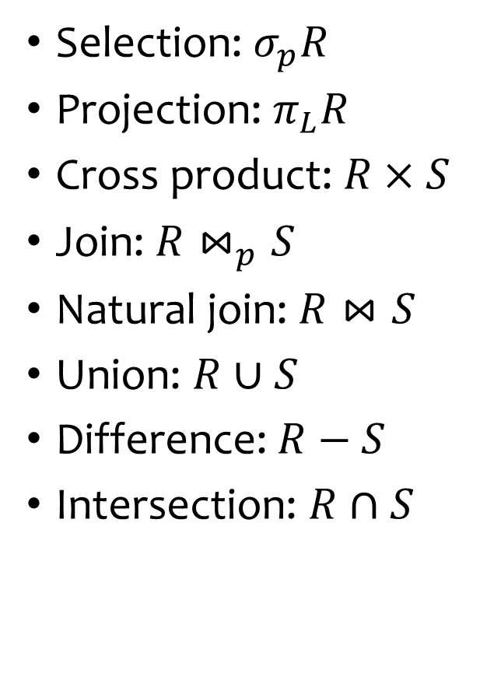
Classification of relational operators
Selection: $σ_{p}R$
Projection: $π_{L}R$
Cross product: $R×S$
Join: $R⋈_{p}S$
Natural join: $R⋈S$
Union: $R∪S$
Difference: $R−S$
Intersection: $R∩S$
Monotone
Monotone
Monotone
Monotone
Monotone
Monotone
Monotone w.r.t. $R$; non-monotone w.r.t $S$
Monotone

Slide 54

Why is “$−$” needed for “highest”?
Composition of monotone operators produces a monotone query
  Old output rows remain “correct” when more rows are added to the input
Is the “highest” query monotone? (slide 50)
  No!
  Current highest pop is 0.9
  Add another row with pop 0.91
  Old answer is invalidated
So it must use difference!

Slide 55
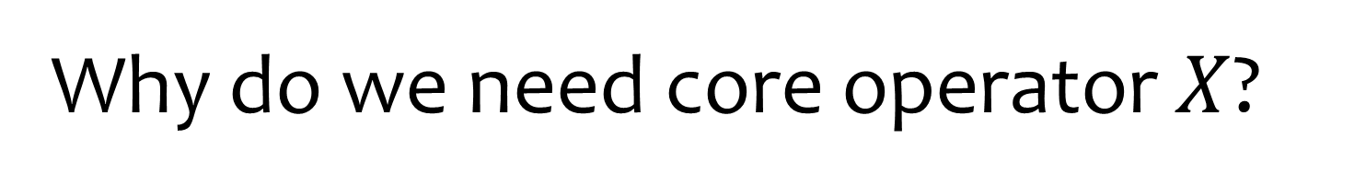
Why do we need core operator $X$?
Difference
  The only non-monotone operator
Projection
  The only operator that removes columns
Cross product
  The only operator that adds columns
Union
  ?
Selection
  ?

Slide 56
Extensions to relational algebra
Duplicate handling (“bag algebra”)
Grouping and aggregation
“Extension” (or “extended projection”) to allow new column values to be computed
All these will come up when we talk about SQL
But for now we will stick to standard relational algebra without these extensions

Slide 57
Why is r.a. a good query language?
Simple
  A small set of core operators
  Semantics are easy to grasp
Declarative?
  Yes, compared with older languages like CODASYL
  Though operators do look somewhat “procedural”
Complete?
  With respect to what?

Slide 58
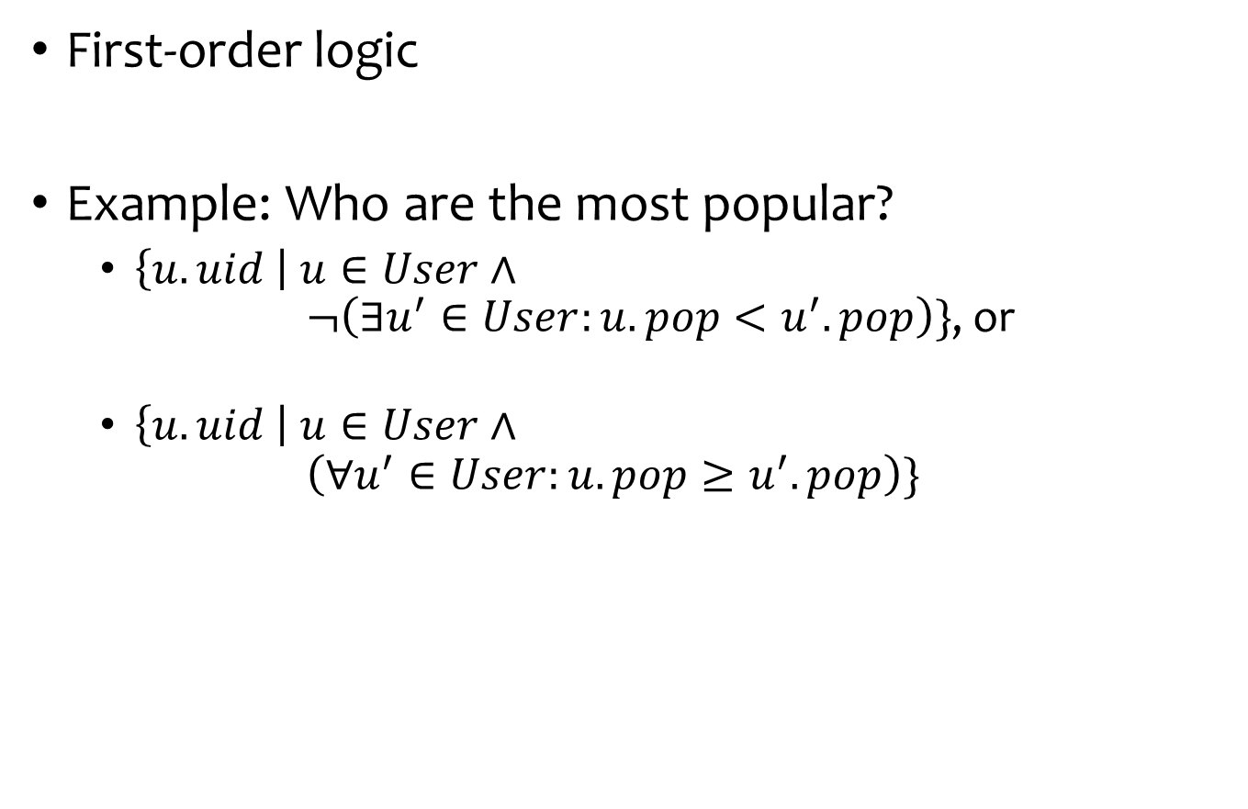
Relational calculus
User (uid int, name string, age int, pop float)
Group (gid string, name string)
Member (uid int, gid string)
First-order logic
Example: Who are the most popular?
  $\left\{u.uid \right| u∈User∧$
  $¬\left(∃u^{′}∈User:u.pop<u^{′}.pop\right)\}$, or
  $\left\{u.uid \right| u∈User∧$
  $\left(∀u^{′}∈User:u.pop≥u^{′}.pop\right)\}$

Slide 59
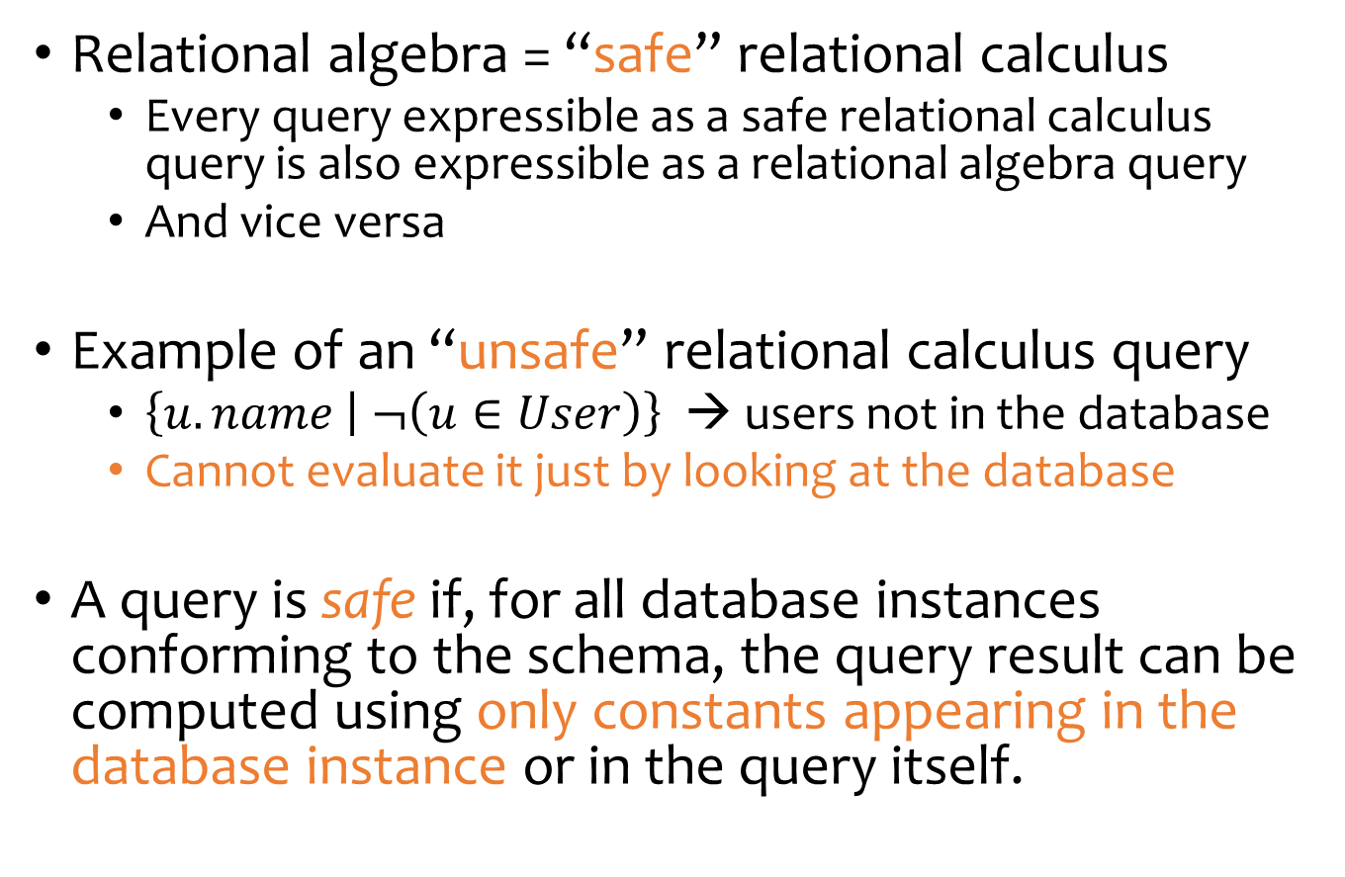
Relational calculus
Relational algebra = “safe” relational calculus
  Every query expressible as a safe relational calculus query is also expressible as a relational algebra query
  And vice versa
Example of an “unsafe” relational calculus query
  $\left\{u.name | ¬\left(u∈User\right)\right\}$ → users not in the database
  Cannot evaluate it just by looking at the database
A query is safe if, for all database instances conforming to the schema, the query result can be computed using only constants appearing in the database instance or in the query itself.

Slide 60
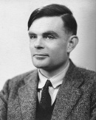
Turing machine
How does relational algebra compare with a Turing machine?
A conceptual device that can
execute any computer algorithm
Approximates what general-
purpose programming languages
can do
  E.g., Python, Java, C++, …
Alan Turing (1912-1954)
http://en.wikipedia.org/wiki/File:Alan_Turing_photo.jpg

Slide 61
Limits of relational algebra
Relational algebra has no recursion
  Example: given relation Friend(uid1, uid2), who can Bart reach in his social network with any number of hops?
    Writing this query in r.a. is impossible!
  So r.a. is not as powerful as general-purpose languages
But why not?
  Optimization becomes undecidable
  Simplicity is empowering
  Besides, you can always implement it at the application level, and recursion is added to SQL nevertheless!

Slide 62
Summary
Part 1: Relational data model
  Data model
  Database schema
  Integrity constraints (keys)
  Languages (relational algebra, relational calculus, SQL)
Part 2: Relational algebra – basic language
  Core operators & derived operators
  (how to write a query)
  V.s. relational calculus
  V.s. general programming language
What’s next?
  SQL – query language used in practice (4 lectures)

