Slide 1
SQL: Part I
Introduction to Database Management
CS348 Spring 2021

Slide 2

We know a bit more about you

Slide 3
Announcements (Tue. May 18)
Project details (note+video) are released on Learn
  Milestone 0 by May 24 (Mon), 11pm
    Form groups of 4-5 on Markus
    Submit report.pdf and code.zip to Markus
    Mainly for testing of the groups, not graded
Assignment #1 is released on Learn
  Part 1: general questions and r.a.
    Submit a a1part1.pdf to Markus
  Part 2: writing SQL on DB2 on school servers (try soon)
    Submit 1.sql, 2.sql, …,6.sql to Markus
  Due by May 31 (Mon), 11pm

Slide 4
SQL
SQL: Structured Query Language
  Pronounced “S-Q-L” or “sequel”
  The standard query language supported by most DBMS
A brief history
  IBM System R
  ANSI SQL86
  ANSI SQL89
  ANSI SQL92 (SQL2)
  ANSI SQL99 (SQL3)
  ANSI SQL 2003 (added OLAP, XML, etc.)
  ANSI SQL 2006 (added more XML)
  ANSI SQL 2008, …

Slide 5
SQL
Data-definition language (DDL): define/modify schemas, delete relations
Data-manipulation language (DML): query information, and insert/delete/modify tuples
Integrity constraints: specify constraints that the data stored in the database must satisfy
Intermediate/Advanced topics: (next week)
  E.g., triggers, views, indexes, programming, recursive queries
this
week

Slide 6

DDL
User (uid int, name string, age int, pop float)
Group (gid string, name string)
Member (uid int, gid string)
CREATE TABLE $\text{table}\text{_}\text{name}$
(…, $\text{column}\text{_}\text{nam}\text{e}$ $\text{column}\text{_}\text{typ}\text{e}$, …);
DROP TABLE $\text{table}\text{_}\text{name}$;
CREATE TABLE User(uid DECIMAL(3,0), name VARCHAR(30), age DECIMAL (2,0), pop DECIMAL(3,2));
CREATE TABLE Group (gid CHAR(10), name VARCHAR(100));
CREATE TABLE Member (uid DECIMAL (3,0), gid CHAR(10));
How does it work with MySQL?
DROP TABLE User;
DROP TABLE Group;
DROP TABLE Member;
-- everything from -- to the end of line is ignored.
-- SQL is insensitive to white space.
-- SQL is insensitive to case (e.g., ...CREATE... is
-- equivalent to ...create...).

Slide 7
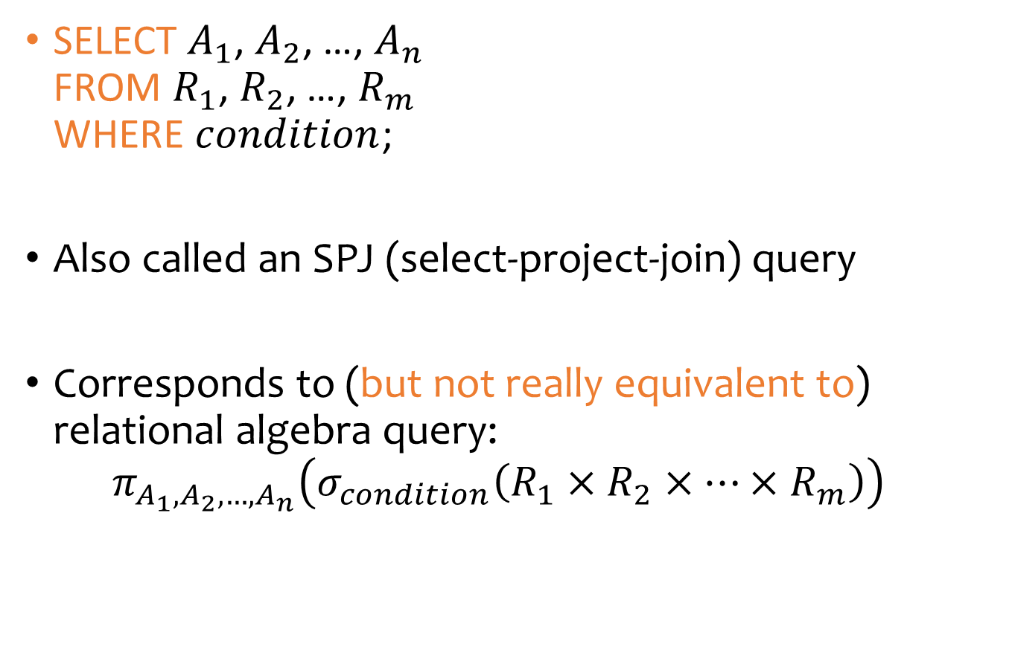
Basic queries for DML: SFW statement
SELECT $A_{1}$, $A_{2}$, …, $A_{n}$
FROM $R_{1}$, $R_{2}$, …, $R_{m}$
WHERE $condition$;
Also called an SPJ (select-project-join) query
Corresponds to (but not really equivalent to) relational algebra query:
$π_{A_{1},A_{2},…,A_{n}}\left(σ_{condition}\left(R_{1}×R_{2}×⋯×R_{m}\right)\right)$

Slide 8
Examples
User (uid int, name string, age int, pop float)
Group (gid string, name string)
Member (uid int, gid string)
List all rows in the User table
    * is a short hand for “all columns”
List name of users under 18 (selection, projection)
When was Lisa born?
  SELECT list can contain expressions
    Can also use built-in functions such as SUBSTR, ABS, etc.
  String literals (case sensitive) are enclosed in single quotes
SELECT * FROM User;
SELECT name FROM User where age <18;
SELECT 2021-age FROM User where name = ‘Lisa’;

Slide 9
Example: join
User (uid int, name string, age int, pop float)
Group (gid string, name string)
Member (uid int, gid string)
List ID’s and names of groups with a user whose name contains “Simpson”
SELECT Group.gid, Group.name
FROM User, Member, Group
WHERE User.uid = Member.uid
AND Member.gid = Group.gid
AND ….;

Slide 10
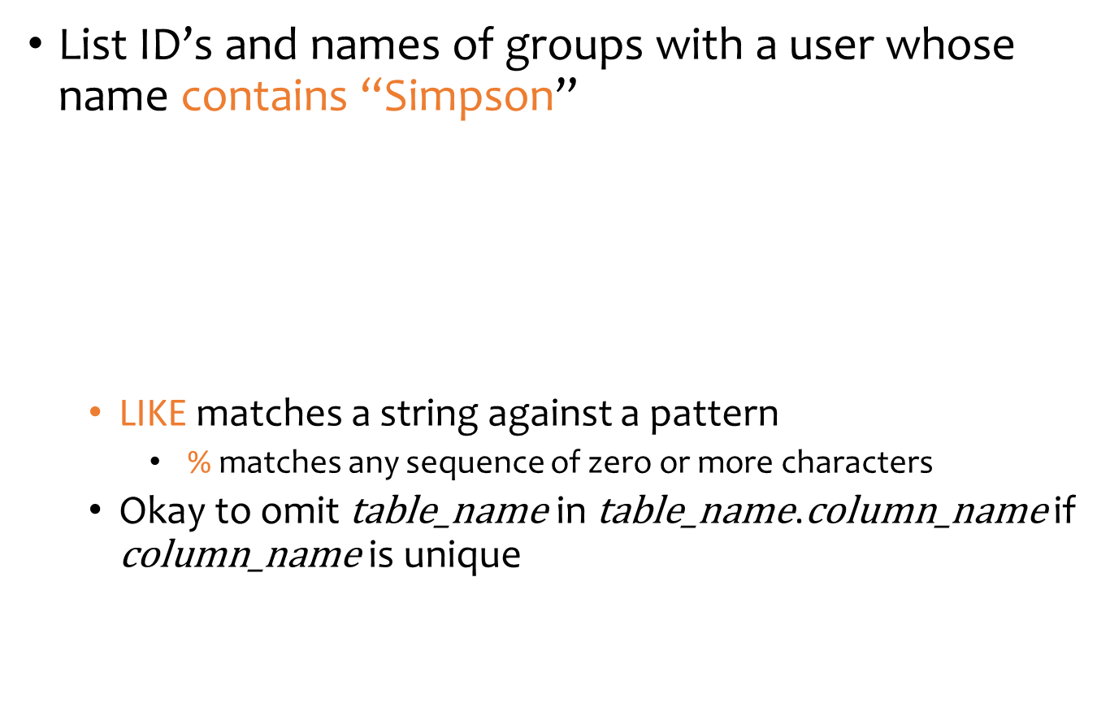
Example: join
User (uid int, name string, age int, pop float)
Group (gid string, name string)
Member (uid int, gid string)
List ID’s and names of groups with a user whose name contains “Simpson”
  LIKE matches a string against a pattern
    % matches any sequence of zero or more characters
  Okay to omit $\text{table}\text{_}\text{name}$ in $\text{table}\text{_}\text{name}$.$\text{column}\text{_}\text{name}$ if $\text{column}\text{_}\text{name}$ is unique
SELECT Group.gid, Group.name
FROM User, Member, Group
WHERE User.uid = Member.uid
AND Member.gid = Group.gid
AND User.name LIKE ‘%Simpson%’;

Slide 11
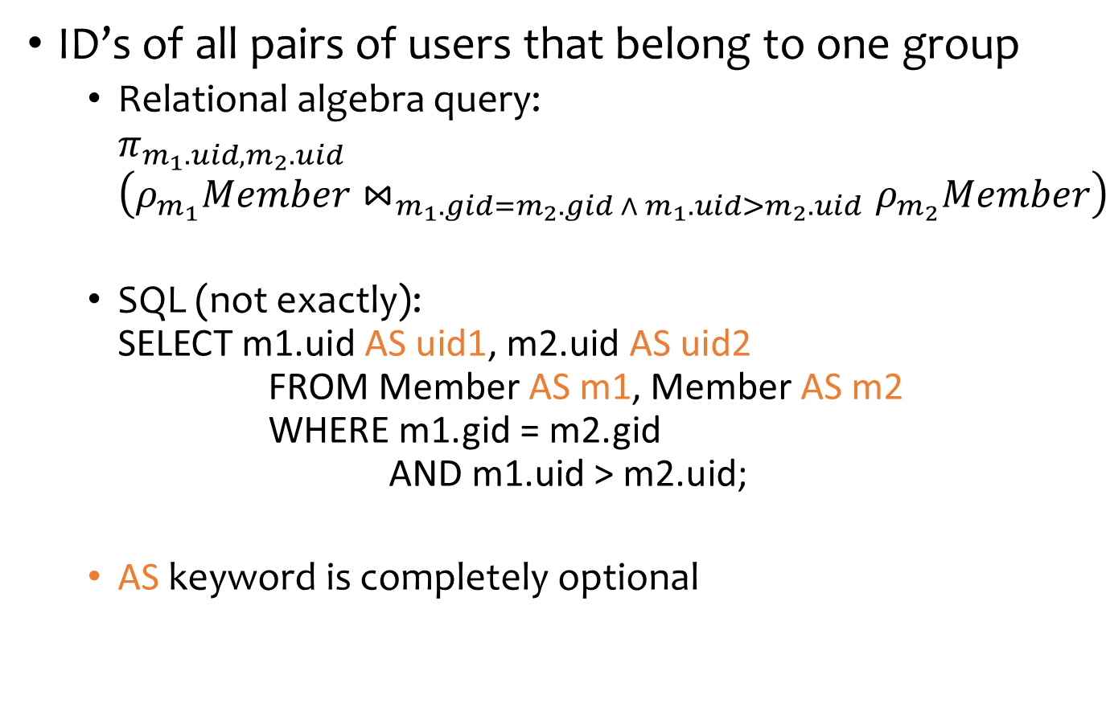
Example: rename
User (uid int, name string, age int, pop float)
Group (gid string, name string)
Member (uid int, gid string)
ID’s of all pairs of users that belong to one group
  Relational algebra query:
  $π_{m_{1}.uid,m_{2}.uid}$
  $\left(ρ_{m_{1}}Member⋈_{m_{1}.gid=m_{2}.gid ∧ m_{1}.uid>m_{2}.uid}ρ_{m_{2}}Member\right)$
  SQL (not exactly):
  SELECT m1.uid AS uid1, m2.uid AS uid2
  FROM Member AS m1, Member AS m2
  WHERE m1.gid = m2.gid
  AND m1.uid > m2.uid;
  AS keyword is completely optional
  SELECT m1.uid AS uid1, m2.uid AS uid2
  FROM Member AS m1, Member AS m2
  WHERE m1.gid = m2.gid
  AND m1.uid > m2.uid;

Slide 12
A more complicated example
Names of all groups that Lisa and Ralph are both in
Tip: Write the FROM clause first, then WHERE, and then SELECT
User (uid int, name string, age int, pop float)
Group (gid string, name string)
Member (uid int, gid string)

Slide 13
A more complicated example
Names of all groups that Lisa and Ralph are both in
  SELECT g.name
  FROM User u1, …, Member m1, …
  WHERE u1.name = 'Lisa' AND …
  AND u1.uid = m1.uid AND …
  AND …;
User (uid int, name string, age int, pop float)
Group (gid string, name string)
Member (uid int, gid string)

Slide 14
A more complicated example
Names of all groups that Lisa and Ralph are both in
  SELECT g.name
  FROM User u1, User u2, Member m1, Member m2, …
  WHERE u1.name = 'Lisa' AND u2.name = ‘Ralph’
  AND u1.uid = m1.uid AND u2.uid=m2.uid
  AND …;
User (uid int, name string, age int, pop float)
Group (gid string, name string)
Member (uid int, gid string)

Slide 15
A more complicated example
Names of all groups that Lisa and Ralph are both in
  SELECT g.name
  FROM User u1, User u2, Member m1, Member m2, Group g
  WHERE u1.name = 'Lisa' AND u2.name = ‘Ralph’
  AND u1.uid = m1.uid AND u2.uid=m2.uid
  AND m1.gid = g.gid AND m2.gid = g.gid;
User (uid int, name string, age int, pop float)
Group (gid string, name string)
Member (uid int, gid string)

Slide 16
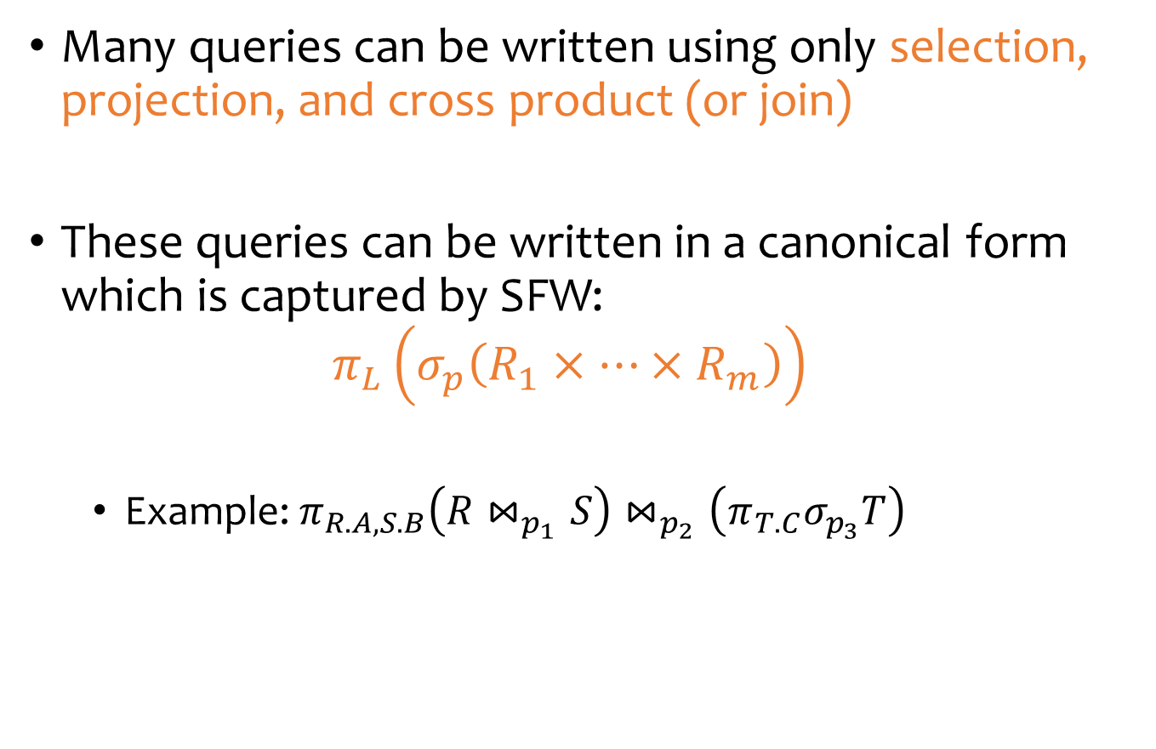
Why SFW statements?
Many queries can be written using only selection, projection, and cross product (or join)
These queries can be written in a canonical form which is captured by SFW:
$π_{L}\left(σ_{p}\left(R_{1}×⋯×R_{m}\right)\right)$
  Example: $π_{R.A, S.B}\left(R⋈_{p_{1}}S\right)⋈_{p_{2}}\left(π_{T.C}σ_{p_{3}}T\right)$
$$=π_{R.A,S.B,T.C}σ_{p_{1}∧p_{2}∧p_{3}}\left(R×S×T\right)$$

Slide 17

Set versus bag
User
age
10
8
…
uid | name | age | pop
142 | Bart | 10 | 0.9
123 | Milhouse | 10 | 0.2
857 | Lisa | 8 | 0.7
456 | Ralph | 8 | 0.3
… | … | … | …
$$π_{age}User$$
Set
No duplicates
Relational model and algebra use set semantics
SELECT age
FROM User;
age
10
10
8
8
…
Bag
Duplicates allowed
Number of duplicates is significant
SQL uses bag semantics by default

Slide 18

A case for bag semantics
Efficiency
  Saves time of eliminating duplicates
Which one is more useful?
  The first query just returns all possible user ages
  The second query returns the user age distribution
Besides, SQL provides the option of set semantics with DISTINCT keyword
SELECT age
FROM User;
$$π_{age}User$$

Slide 19
Forcing set semantics
ID’s of all pairs of users that belong to one group
  Say Lisa and Ralph are in both the book club and the student government, they id pairs will appear twice
  Remove duplicate (uid1, uid2) pairs from the output
  SELECT m1.uid AS uid1, m2.uid AS uid2
  FROM Member AS m1, Member AS m2
  WHERE m1.gid = m2.gid
  AND m1.uid > m2.uid;
  SELECT DISTINCT m1.uid AS uid1, m2.uid AS uid2
  FROM Member AS m1, Member AS m2
  WHERE m1.gid = m2.gid;
  AND m1.uid > m2.uid;

Slide 20
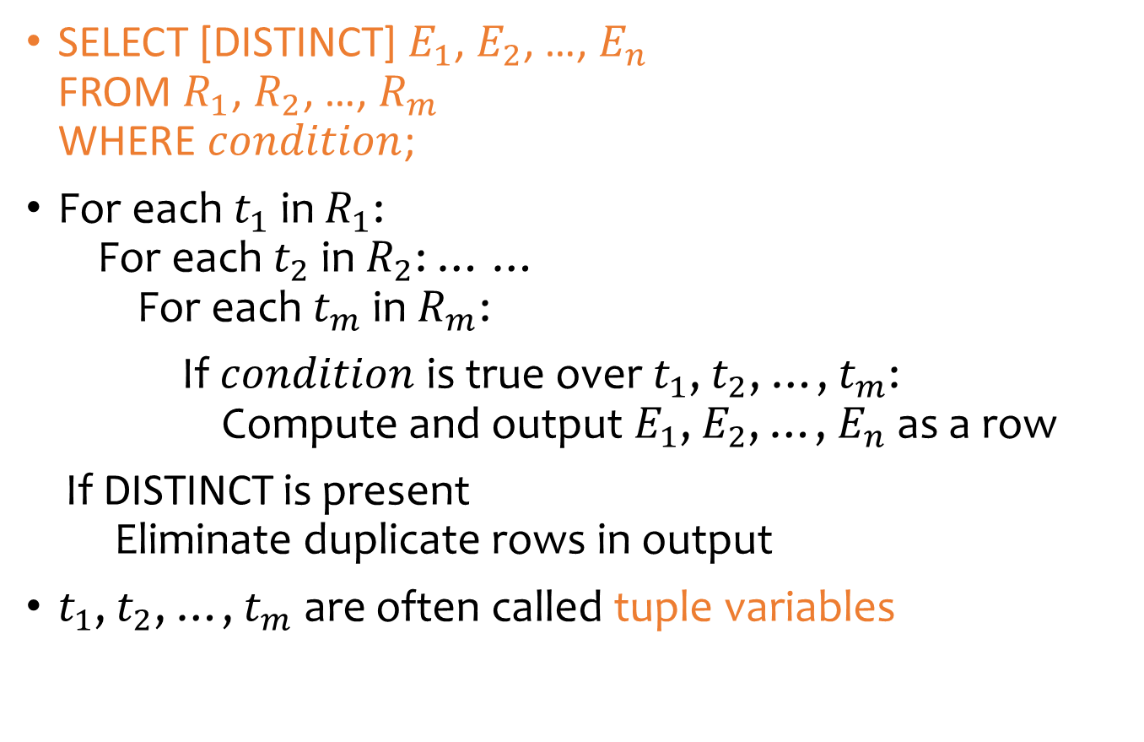
Semantics of SFW
SELECT [DISTINCT] $E_{1}$, $E_{2}$, …, $E_{n}$
FROM $R_{1}$, $R_{2}$, …, $R_{m}$
WHERE $condition$;
For each $t_{1}$ in $R_{1}$:
For each $t_{2}$ in $R_{2}$: … …
For each $t_{m}$ in $R_{m}$:
If $condition$ is true over $t_{1}$, $t_{2}$, …, $t_{m}$:
Compute and output $E_{1}$, $E_{2}$, …, $E_{n}$ as a row
If DISTINCT is present
Eliminate duplicate rows in output
$t_{1}$, $t_{2}$, …, $t_{m}$ are often called tuple variables

Slide 21

SQL set and bag operations
Set: UNION, EXCEPT, INTERSECT
  Exactly like set $∪$, $−$, and $∩$ in relational algebra
  Duplicates in input tables, if any, are first eliminated
  Duplicates in result are also eliminated (for UNION)
Bag1
Bag2
(SELECT * FROM Bag1)
UNION
(SELECT * FROM Bag2);
(SELECT * FROM Bag1)
EXCEPT
(SELECT * FROM Bag2);
(SELECT * FROM Bag1)
INTERSECT
(SELECT * FROM Bag2);
fruit
apple
apple
orange
fruit
orange
orange
orange
fruit
apple
orange
fruit
apple
fruit
orange

Slide 22

SQL set and bag operations
Set: UNION, EXCEPT, INTERSECT
  Exactly like set $∪$, $−$, and $∩$ in relational algebra
Bag: UNION ALL, EXCEPT ALL, INTERSECT ALL
  Think of each row as having an implicit count (the number of times it appears in the table)
(SELECT * FROM Bag1)
UNION ALL
(SELECT * FROM Bag2);
Bag1
Bag2
fruit
apple
apple
orange
apple
orange
orange
sum up the counts from two tables
fruit
apple
apple
orange
fruit
apple
orange
orange
apple: 2
orange:1
apple: 1
orange:2
apple: 3
orange:3

Slide 23
SQL set and bag operations
Set: UNION, EXCEPT, INTERSECT
  Exactly like set $∪$, $−$, and $∩$ in relational algebra
Bag: UNION ALL, EXCEPT ALL, INTERSECT ALL
  Think of each row as having an implicit count (the number of times it appears in the table)
(SELECT * FROM Bag1)
EXCEPT ALL
(SELECT * FROM Bag2);
Bag1
Bag2
proper-subtract the two counts
fruit
apple
apple
orange
fruit
apple
orange
orange
fruit
apple
apple: 2
orange:1
apple: 1
orange:2
apple: 1
orange:0

Slide 24
SQL set and bag operations
Set: UNION, EXCEPT, INTERSECT
  Exactly like set $∪$, $−$, and $∩$ in relational algebra
Bag: UNION ALL, EXCEPT ALL, INTERSECT ALL
  Think of each row as having an implicit count (the number of times it appears in the table)
(SELECT * FROM Bag1)
INTERSECT ALL
(SELECT * FROM Bag2);
Bag1
Bag2
take the minimum of the two counts
fruit
apple
apple
orange
fruit
apple
orange
orange
fruit
apple
orange
apple: 2
orange:1
apple: 1
orange:2
apple: 1
orange:1

Slide 25
Set versus bag operations
Poke (uid1, uid2, timestamp)
  uid1 poked uid2 at timestamp
Question: How do these two queries differ?
Q1:
(SELECT uid1 FROM Poke)
EXCEPT
(SELECT uid2 FROM Poke);
Q2:
(SELECT uid1 FROM Poke)
EXCEPT ALL
(SELECT uid2 FROM Poke);

Slide 26
Set versus bag operations
Poke (uid1, uid2, timestamp)
  uid1 poked uid2 at timestamp
Question: How do these two queries differ?
Q1:
(SELECT uid1 FROM Poke)
EXCEPT
(SELECT uid2 FROM Poke);
Q2:
(SELECT uid1 FROM Poke)
EXCEPT ALL
(SELECT uid2 FROM Poke);
Users who poked others but never got poked by others
Users who poked others more than others poked them

Slide 27
SQL features covered so far
SELECT-FROM-WHERE statements
Set and bag operations
Next: how to nest SQL queries

Slide 28
Table subqueries
Use query result as a table
  In set and bag operations, FROM clauses, etc.
Example: names of users who poked others more than others poked them
  SELECT DISTINCT name
  FROM User,
    (SELECT uid1 FROM Poke)
    EXCEPT ALL
    (SELECT uid2 FROM Poke) AS T
  WHERE User.uid = T.uid;

Slide 29
Scalar subqueries
A query that returns a single row can be used as a value in WHERE, SELECT, etc.
Example: users at the same age as Bart
When can this query go wrong?
  Return more than 1 row
  Return no rows
  SELECT *
  FROM User,
  WHERE age = (SELECT age
  FROM User
  WHERE name = ‘Bart’);

Slide 30

IN subqueries
$x$ IN ($subquery$) checks if $x$ is in the result of $subquery$
Example: users at the same age as (some) Bart
  SELECT *
  FROM User,
  WHERE age IN (SELECT age
  FROM User
  WHERE name = ‘Bart’);

Slide 31

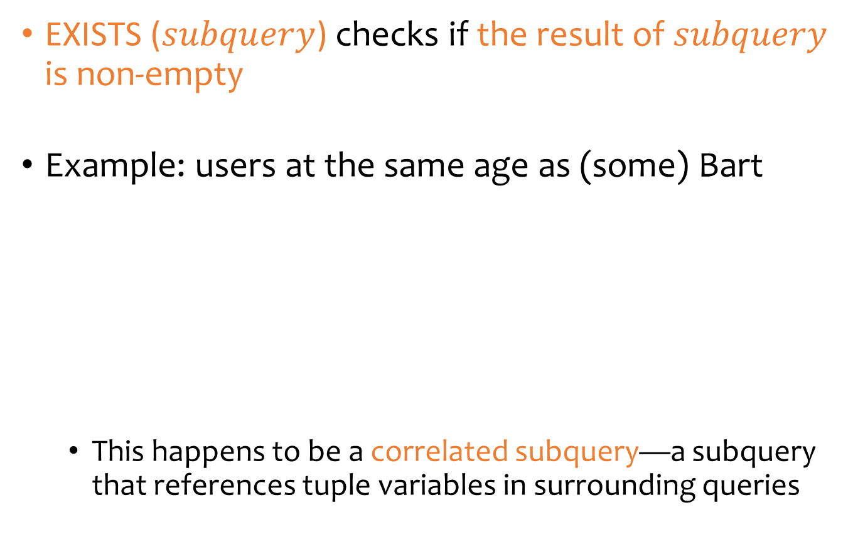
EXISTS subqueries
EXISTS ($subquery$) checks if the result of $subquery$ is non-empty
Example: users at the same age as (some) Bart
  This happens to be a correlated subquery—a subquery that references tuple variables in surrounding queries
  SELECT *
  FROM User AS u,
  WHERE EXISTS (SELECT * FROM User
  WHERE name = ‘Bart’
  AND age = u.age);

Slide 32

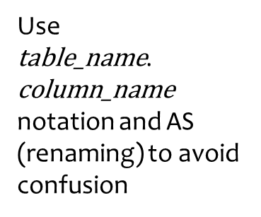
Another example
User (uid int, name string, age int, pop float)
Group (gid string, name string)
Member (uid int, gid string)
Users who join at least two groups
How to find which table a column belongs to?
  Start with the immediately surrounding query
  If not found, look in the one surrounding that; repeat if necessary
  SELECT * FROM User u
  WHERE EXISTS
  (SELECT * FROM Member m
  WHERE uid = u.uid
  AND EXISTS
  (SELECT * FROM Member
  WHERE uid = u.uid
  AND gid <> m.gid));
Use $\text{table}\text{_}\text{name}$.$\text{column}\text{_}\text{name}$ notation and AS (renaming) to avoid confusion

Slide 33
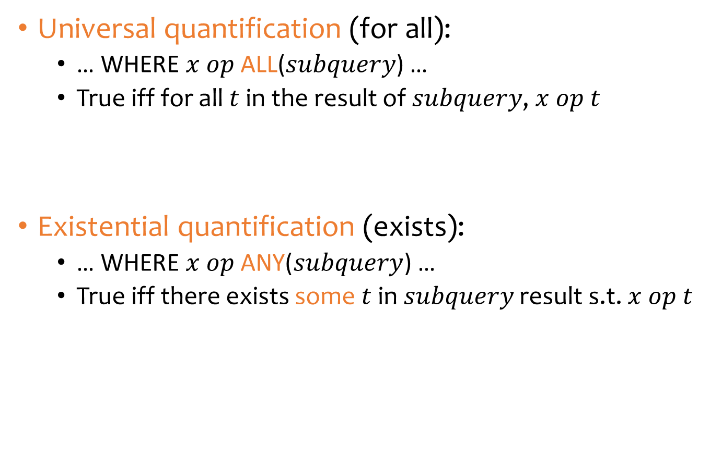
Quantified subqueries
Universal quantification (for all):
  … WHERE $x$ $op$ ALL($subquery$) …
  True iff for all $t$ in the result of $subquery$, $x op t$
Existential quantification (exists):
  … WHERE $x$ $op$ ANY($subquery$) …
  True iff there exists some $t$ in $subquery$ result s.t. $x op t$
  SELECT *
  FROM User
  WHERE pop >= ALL(SELECT pop FROM User);
  SELECT *
  FROM User
  WHERE NOT
  (pop < ANY(SELECT pop FROM User);

Slide 34
More ways to get the most popular
Which users are the most popular?
  Q1. SELECT *
  FROM User
  WHERE pop >= ALL(SELECT pop FROM User);
  Q2. SELECT *
  FROM User
  WHERE NOT
  (pop < ANY(SELECT pop FROM User);
EXISTS or IN?
  Q3. SELECT *
  FROM User AS u
  WHERE NOT [EXITS or IN?]
  (SELECT * FROM User
  WHERE pop > u.pop);
  Q4. SELECT * FROM User
  WHERE uid NOT [EXISTS or IN?]
  (SELECT u1.uid
  FROM User AS u1, User AS u2
  WHERE u1.pop < u2.pop);

Slide 35
SQL features covered so far
SELECT-FROM-WHERE statements
Set and bag operations
Subqueries
  Subqueries allow queries to be written in more declarative ways (recall the “most popular” query)
  But in many cases, they don’t add expressive power
Next: aggregation and grouping

Slide 36
Aggregates
Standard SQL aggregate functions: COUNT, SUM, AVG, MIN, MAX
Example: number of users under 18, and their average popularity
  COUNT(*) counts the number of rows
  SELECT COUNT(*), AVG(pop)
  FROM User
  WHERE age <18;

Slide 37
Aggregates with DISTINCT
Example: How many users are in some group?
  SELECT COUNT(*)
  FROM (SELECT DISTINCT uid FROM Member);
Is equivalent to
  SELECT COUNT(DISTINCT uid)
  FROM Member;

Slide 38

Grouping
SELECT … FROM … WHERE …
GROUP BY $\text{list}\text{_}\text{of}\text{_}\text{columns}$;
Example: compute average popularity for
each age group
  SELECT age, AVG(pop)
  FROM User
  GROUP BY age;

Slide 39
Example of computing GROUP BY
  SELECT age, AVG(pop) FROM User GROUP BY age;
uid | name | age | pop
142 | Bart | 10 | 0.9
857 | Lisa | 8 | 0.7
123 | Milhouse | 10 | 0.2
456 | Ralph | 8 | 0.3
Compute GROUP BY: group rows according to the values of GROUP BY columns
uid | name | age | pop
142 | Bart | 10 | 0.9
123 | Milhouse | 10 | 0.2
857 | Lisa | 8 | 0.7
456 | Ralph | 8 | 0.3
Compute SELECT
for each group
age | avg_pop
10 | 0.55
8 | 0.50

Slide 40
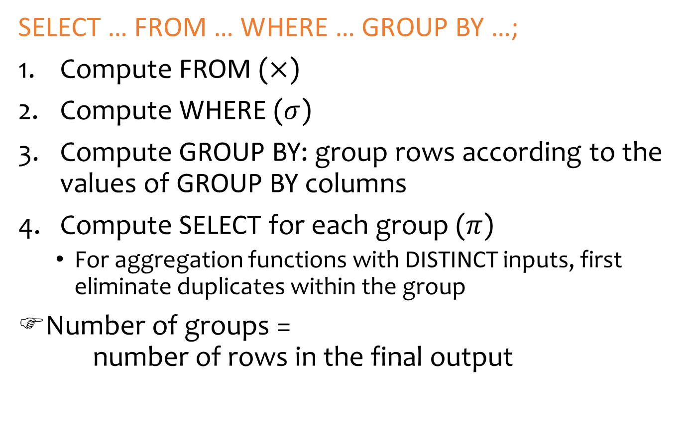
Semantics of GROUP BY
SELECT … FROM … WHERE … GROUP BY …;
Compute FROM ($×$)
Compute WHERE ($σ$)
Compute GROUP BY: group rows according to the values of GROUP BY columns
Compute SELECT for each group ($π$)
  For aggregation functions with DISTINCT inputs, first eliminate duplicates within the group
Number of groups =
number of rows in the final output

Slide 41
Aggregates with no GROUP BY
An aggregate query with no GROUP BY clause =
all rows go into one group
SELECT AVG(pop) FROM User;
  SELECT AVG(pop) FROM User;
Group all rows into one group
Aggregate over
the whole group
uid | name | age | pop
142 | Bart | 10 | 0.9
857 | Lisa | 8 | 0.7
123 | Milhouse | 10 | 0.2
456 | Ralph | 8 | 0.3
uid | name | age | pop
142 | Bart | 10 | 0.9
857 | Lisa | 8 | 0.7
123 | Milhouse | 10 | 0.2
456 | Ralph | 8 | 0.3
avg_pop
0.525

Slide 42
Restriction on SELECT
If a query uses aggregation/group by, then every column referenced in SELECT must be either
  Aggregated, or
  A GROUP BY column
Why?
This restriction ensures that any SELECT expression produces only one value for each group
  SELECT uid, age FROM User GROUP BY age;
WRONG!
  SELECT uid, MAX(pop) FROM User;
WRONG!

Slide 43
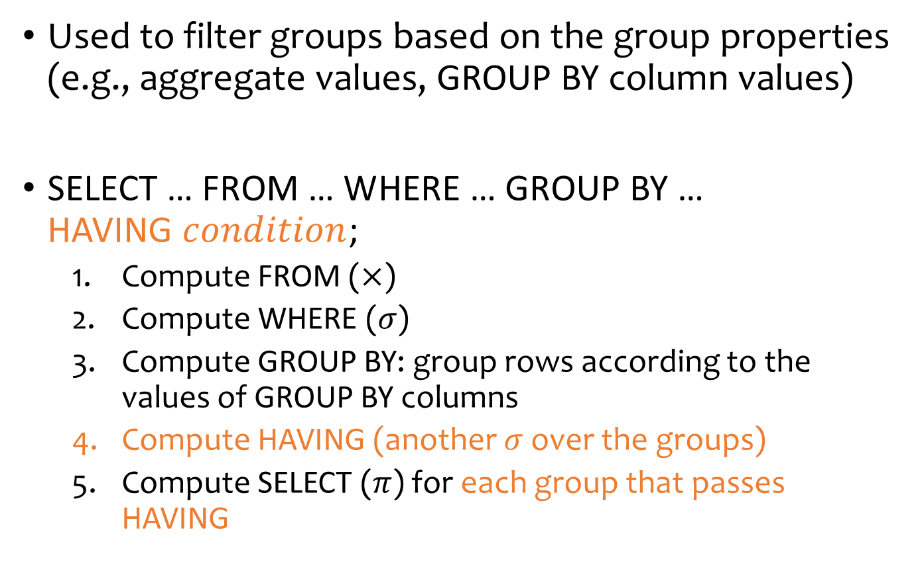
HAVING
Used to filter groups based on the group properties (e.g., aggregate values, GROUP BY column values)
SELECT … FROM … WHERE … GROUP BY …
HAVING $condition$;
  Compute FROM ($×$)
  Compute WHERE ($σ$)
  Compute GROUP BY: group rows according to the values of GROUP BY columns
  Compute HAVING (another $σ$ over the groups)
  Compute SELECT ($π$) for each group that passes HAVING

Slide 44
HAVING examples
List the average popularity for each age group with more than a hundred users
  Can be written using WHERE and table subqueries
SELECT age, AVG(pop)
FROM User
GROUP BY age
HAVING COUNT(*)>100;
SELECT T.age, T.apop
FROM (SELECT age, AVG(pop) AS apop, COUNT(*) AS gsize
FROM User GROUP BY age) AS T
WHERE T.gsize>100;

Slide 45
HAVING examples
Find average popularity for each age group over 10
  Can be written using WHERE without table subqueries
SELECT age, AVG(pop)
FROM User
GROUP BY age
HAVING age >10;
SELECT age, AVG(pop)
FROM User
WHERE age >10
GROUP BY age;

Slide 46
SQL features covered so far
SELECT-FROM-WHERE statements
Set and bag operations
Subqueries
Aggregation and grouping
  More expressive power than relational algebra
Next: ordering output rows

Slide 47
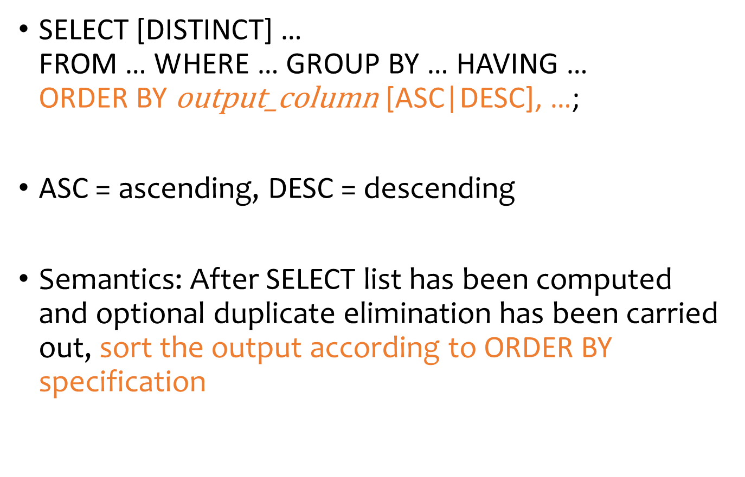
ORDER BY
SELECT [DISTINCT] …
FROM … WHERE … GROUP BY … HAVING …
ORDER BY $\text{output}\text{_}\text{column}$ [ASC|DESC], …;
ASC = ascending, DESC = descending
Semantics: After SELECT list has been computed and optional duplicate elimination has been carried out, sort the output according to ORDER BY specification

Slide 48
ORDER BY example
List all users, sort them by popularity (descending) and name (ascending)
  ASC is the default option
  Strictly speaking, only output columns can appear in ORDER BY clause (although some DBMS support more)
  Can use sequence numbers instead of names to refer to
  output columns: ORDER BY 4 DESC, 2;
SELECT uid, name, age, pop
FROM User
ORDER BY pop DESC, name;

Slide 49
SQL features covered so far
Query
  SELECT-FROM-WHERE statements
  Set/bag (DISTINCT, UNION/EXCEPT/INTERSECT (ALL))
  Subqueries (table, scalar, IN, EXISTS, ALL, ANY)
  Aggregation and grouping (GROUP BY, HAVING)
  Ordering (ORDER)
  Outerjoins (and Nulls)
Modification
  INSERT/DELETE/UPDATE
Constraints
Lecture 4

