Slide 1

CS 348 Lectures 13-14
Query Processing Architecture and Algorithms
  Semih Salihoğlu
  Mar 1st-3rd 2022

Slide 2
Announcements
Assignment 4:
  Out tonight.
  Due Mar 18th midnight
  Although the programming question is about query optimization (topic of next week) the question is completely self-contained, so you can start on it tonight.

Slide 3
Outline For Today
Wrap up Indices
DBMS Query Processing Architecture
Fundamental Query Processing Operators & Algorithms
  Assumptions
  Scan-based Operators
  Sort-based Operators
  Hashing-based Operators
  Algorithms Using Indices

Slide 4
Outline For Today
Wrap up Indices
DBMS Query Processing Architecture
Fundamental Query Processing Operators & Algorithms
  Assumptions
  Scan-based Operators
  Sort-based Operators
  Hashing-based Operators
  Algorithms Using Indices

Slide 5
Recap: 1+4 Index Designs From Last Lecture
Index-less “Insertion Sort”
Single-level Dense Index
Single-level Sparse Index with Overflows
Sparse Index pages
100, 123, 192, 200
901, 996
ID.idx
100, 108,
119, 121
123, 129,
…
192, 197,
…
200, 202,
…
901, 907,
…
996, 997,
…
students.mkd
107
Overflow block
Pros: Index size smaller than dense index
Con 1: Sparse Index can still become very large (GBs) for large tables.
Con 2: Overflows are not robust
Con 3: Can lead to empty pages (but less of an issue in practice)

Slide 6
Recap: 1+4 Index Designs From Last Lecture
Index-less “Insertion Sort”
Single-level Dense Index
Single-level Sparse Index with Overflows
Multi-level Indices with Overflows
Example: look up 197
100, 200, …, 901
Index blocks
100, 123, …, 192
200, …
…
901, …, 996
ID.idx
100, 108,
119, 121
123, 129,
…
192, 197,
…
200, 202,
…
901, 907,
…
996, 997,
…
…
…
…
students.mkd
107
Data blocks
Overflow block

Slide 7
Recap: 5th Approach: B/B+ Tree Indices
Multi-level sparse indices on a first level of pages that is either:
  actual relation pages (if clustered)
  dense index on the relation pages (works for clustered or unclustered)
  leaf level consists of chained pages
Forms a k-ary balanced tree
Instead of overflow pages uses splitting and merging of pages at any layer
100
Max fan-out: 4
30
120
150
180
pg1
pg2
pg3
pg4
pg5
pg6
11
30
35
100
101
110
120
130
150
156
179
180
200
3
5

Slide 8
How to Keep A Table Sorted?
Recall this key question
Recall further note on clustered indices and page order: “When a relation file has a clustered index, i.e., when pages are sorted, we do not necessarily need the pages to be sorted.”
100, 123, 192, 200
901, 996
ID.ind
100, 108,
119, 121
996, 997,
…
200, 202,
…
192, 197,
…
901, 907,
…
123, 129,
…
students.mkd
Data pages (original relation)

Slide 9
How to Keep A Table Sorted?
Recall this key question
Recall further note on clustered indices and page order.
Again assume leaf nodes are tuples
Many RDBMSs use “B+ tree files” to store the tables, i.e., entire file is a B+ tree index, with leaf nodes storing tuples (instead of pointers to tuples)
100, 901
100, 123, 192, 200
901, 996
students.mkd
100, 108,
119, 121
996, 997,
…
200, 202,
…
192, 197,
…
901, 907,
…
123, 129,
…
B+ tree file

Slide 10
Other Common Indices
2 Classes of Indices Overall
Tree-based: can do both lookups and range queries
  B/B+ Trees, R Trees, Radix Tree
Hash-based
  Can only do look ups. Cannot do range queries.
  In practice: handle collisions
Many other indices: bitmap indices, probabilistic indices, suffix arrays, GiST or Inverted Index for different applications and data types.
Hash Table
0 | Windel
1
2 | Sherri
3 | Martin
4
5 | Ralph, Bart
6
7 | Nelson
8 | Milhouse
9 | Terri
10 | Lisa
11 | Jessica
123 | Milhouse | 10
142 | Bart | 10
279 | Jessica | 10
345 | Martin | 8
456 | Ralph | 8
512 | Nelson | 10
679 | Sherri | 10
697 | Terri | 10
857 | Lisa | 8
912 | Windel | 8
997 | Jessica | 8
students.mkd

Slide 11
Using Indices In Practice

Slide 12
Using Indices In Practice (1)
Indices can be defined on one ore more attributes:
  CREATE INDEX NameIndex ON User(Lastname,Firstname);
  I.e., B+’s keys are (Lastname, Firstname) pairs and tuples are sorted first by LastName and then Firstname.
  This index would be useful for these queries:
select * from User where Lastname = ‘Smith’
select * from User where Lastname = ‘Smith’ and Firstname=‘John’
  But not this query:
select * from User where Firstname=‘John’
Many systems use indices by default on the primary key
Many systems use indices to implement UNIQUE constraints
  CREATE TABLE Students(
  studentID int,
  sinNumber varchar(16) UNIQUE
  PRIMARY KEY (studentID))
p 1
Will create 2 B+ indices:
on studentID;
2) on sinNumber

Slide 13
Using Indices In Practice (2)
Users only create indices. They do not refer to indices in queries.
Pro: Some user queries will get much faster
  B/c RDBMSs use indices during query evaluation
  Ex: IndexScan operators, or IndexMergeJoin (in Oracle) or IndexNestedLoopJoin etc.
Project
cid
Project
cid
p 1
Recall Plan Transformation during Query Optimization
Join
P.pid=O.pid
HashJoin
L.$3=R.$3
Join
C.cid=O.cid
Filter
name=BookA
HashJoin
L.$3=R.2
Scan Table
Order
Scan Table
Customer
Scan Table
Product
name=BookA
IndexScan
Product
name=BookA
FileScan
Order
FileScan
Customer

Slide 14
Using Indices In Practice (3)
Con: Updates will get slower because indices need to be maintained
Q: How should users pick indices given a workload W (i.e., the set of queries an application asks and their frequencies)
General Guideline:
  Profile slow queries. Check if they have =, <, ≤, >, ≥ predicates
SELECT * FROM R WHERE A = value;
SELECT * FROM R WHERE A = value AND B = 27;
  SELECT * FROM R, S WHERE R.A = S.C;
  SELECT * FROM S WHERE D > 50;
  E.g., above indices on R.A, R.A and R.B multicolumn, S.C, S.D are possible indices that can speed queries
  But one should weigh these benefits against slow downs due to updates
p 1
14

Slide 15
Using Indices In Practice (4)
Many RDBMSs have “Physical Design Advisor” (PDA) tool
Input: Database D (w/ existing indices), workload W
Output: A set of recommended indices
Internally PDA does a “what if” analysis:
  Uses Query Optimizer & inspects the estimated runtimes/costs of plans the system would use for queries in W with & without additional indices
p 1
can include updates
W = {<Q₁, f₁>,…, <Q_{k}, f_{k}>}
Query Optimizer
D = {R₁, …, R_{n}},
{Ind₁, …, Ind_{z}}
Ind_{z+1}?
Inspects the costs of these generated plans to recommend a set of indices to develop
Generate Plans for each Q_{i}
15

Slide 16
The Halloween Problem: An Interesting Note On Challenging Problems a DBMS has to solve
Story from the early days of System R:
  UPDATE Payroll
  SET salary = salary * 1.1
  WHERE salary >= 100000;
  There is a B⁺-tree index on Payroll(salary)
  The update never stopped (why?)
Why?
How could you try to solve this if you implemented System R.

Slide 17
Outline For Today
Wrap up Indices
DBMS Query Processing Architecture
Fundamental Query Processing Operators & Algorithms
  Assumptions
  Scan-based Operators
  Sort-based Operators
  Hashing-based Operators
  Algorithms Using Indices

Slide 18
Recall: Overview of Compilation Steps
Text
AST
SELECT …
FROM …
WHERE…
Parser
Root
Binder
Normalizer
SELECT
…
TABLES
…
CON.
Customer
Product
=
Logical Plan
cid
5
Physical Plan Translator
Optimizer
Project
oid
Logical Plan Translator
Join
C.cid=O.cid
Physical Plan
Scan Tbl
Order
100 < price
Scan Tbl
Customer
cid=3
Project
$5
HashJoin
L.$2=R.$3
Filter
$2=5
IndexScan cust.mkd
Query Executor
RESULT
cid
…
IndexScan
order.mkd

Slide 19
Query Processor of DBMSs
The component that executes a physical plan:
  A tree of operators that manipulate files and tuples to produce the output asked in a query.
  Operators implement core:
    data access methods
    query processing algorithms
Project
cid
HashJoin
P.pid=O.pid
SELECT cid
FROM Customer C, Order O, Product P
WHERE C.cid = O.cid AND O.pid = P.pid
AND P.name = BookA
HashJoin
L.cid=R.cid
FileScan
Order
FileScan
Customer
IndexScan
Product
name=BookA
Note: the more operators a system has, the larger set of query plans (i.e., algorithms) it can stich together to evaluate queries

Slide 20

(Simplified) Physical Plan Architecture
Tuples flow from leaves to root
Operators produce tables
  not necessarily in full; can be in pieces
Several designs exist. Most popular choices
  push vs pull (will not simulate)
  materialized vs pipelined
  iterator model (Volcano) vs
  block-at-a-time
Project
cid
O1 | C1 | P2 | $20 | Alice | BookA
… | … | … | … | … | …
HashJoin
P.pid=O.pid
O1 | C1 | P2 | $20 | Alice
… | …. | …. | … | ….
HashJoin
O.cid=C.cid
FileScan
Order
FileScan
Customer
IndexScan
Product
name=BookA
O1 | C1 | P2 | $20
O2 | C1 | P3 | $30
… | … | … | …
C1 | Alice
… | …
P1 | BookA
Table files, index files organized into pages/blocks
Disk

Slide 21
Materialized vs Pipelined (1)
Materialized: All ops are “blocking”, i.e. materialize all their inputs to disk or temp. memory buffers
Simple to implement
Earlier DBMSs adopted materialization but now obsolete
…
C1
C4
Project
cid
Filter
name=Alice
C1 | Alice
C4 | Alice
C1 | Alice
C2 | Carl
C3 | Bob
C4 | Alice
FileScan
Customer
Disk
tmp

Slide 22
Materialized vs Pipelined (2)
Pipelined: When possible, ops take 1 or more tuples-at-a-time, process, and pass to parent ops
More efficient (avoids temp file writing, reading)
Not always possible: e.g., ORDER BY
  to sort a table, cannot pipeline tuples. need to see all tuples before computing the order.
…
C4
C1
Project
cid
C1 | Alice
Filter
name=Alice
C4 | Alice
C1 | Alice
C2 | Carl
C3 | Bob
C4 | Alice
FileScan
Customer
Disk

Slide 23

Iterator Model vs Block-at-a-time
Iterator Model (by Goetz Graefe, 1990)
  Pull data from children “one tuple a a time”
  E.g.: PostgreSQL
Block-at-a-time:
  Pull data many, e.g., 1024, tuples at a time
  Better CPU utilization b/c
  fewer function calls
Project
cid
HashJoin
P.pid=O.pid
HashJoin
L.cid=R.cid
Goetz Graefe
FileScan
Order
FileScan
Customer
IndexScan
Product
name=BookA
Main architect of first version of MS SQL Server
Table files, index files organized into pages/blocks
Disk

Slide 24
Outline For Today
DBMS Query Processing Architecture
Fundamental Query Processing Operators & Algorithms
  Assumptions
  Scan-based Operators
  Sort-based Operators
  Hashing-based Operators
  Algorithms Using Indices

Slide 25
Costs of Query Processing Algorithms
In algorithm analysis often “runtime”, i.e., # CPU cycles is the metric
In DBMSs, most algs (but not all) are linear time or almost-linear time (i.e., with O(log(|R|)) factors) in terms of runtime.
Will use I/O cost to analyze the main algorithms because DBMSs are disk-based systems.
Disclaimer 1: Simplification to study the general behavior of algs
Disclaimer 2: All of the algs we describe are integrated in many systems and have scenarios when one is used over the other

Slide 26
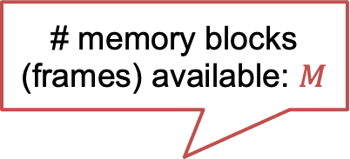
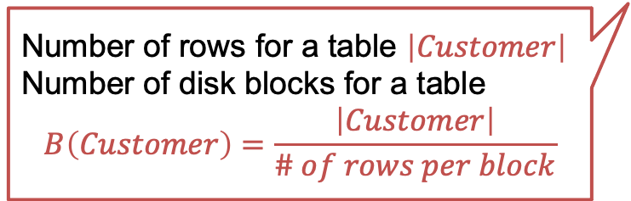
Setting
Given operator o processing 1 or 2 tables (e.g., scan or join)
Recall: o runs in memory
# memory blocks (frames) available: $M$
Memory
c1, c2
c3,c4
…
select * from Customer, Order where Customer.cid = Order.cid;
Disk
Cust
Order
c1
c2
…
o1
o2
…
Number of rows for a table $\left|Customer\right|$
Number of disk blocks for a table
$$B\left(Customer\right)=\frac{\left|Customer\right|}{\# of rows per block}$$
26

Slide 27
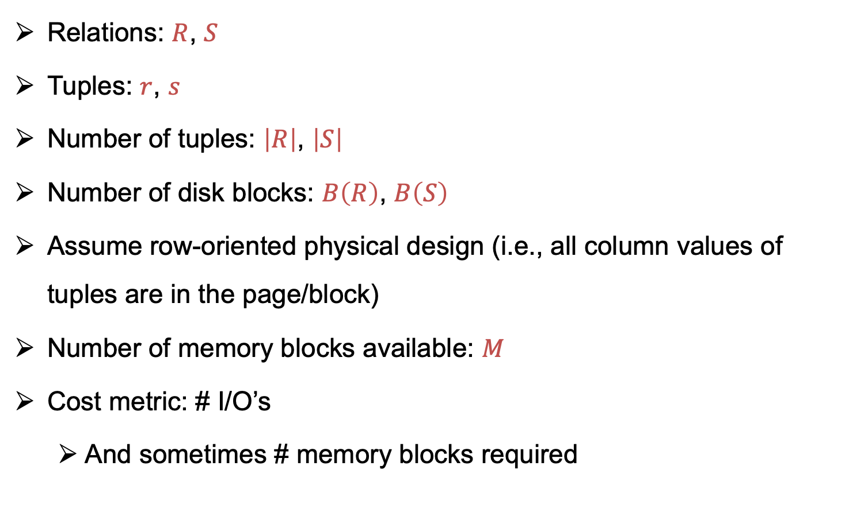
Notation
Relations: $R$, $S$
Tuples: $r$, $s$
Number of tuples: $\left|R\right|$, $\left|S\right|$
Number of disk blocks: $B\left(R\right)$, $B\left(S\right)$
Assume row-oriented physical design (i.e., all column values of tuples are in the page/block)
Number of memory blocks available: $M$
Cost metric: # I/O’s
  And sometimes # memory blocks required

Slide 28
Outline For Today
DBMS Query Processing Architecture
Fundamental Query Processing Operators & Algorithms
  Assumptions
  Scan-based Operators
  Sort-based Operators
  Hashing-based Operators
  Algorithms Using Indices

Slide 29
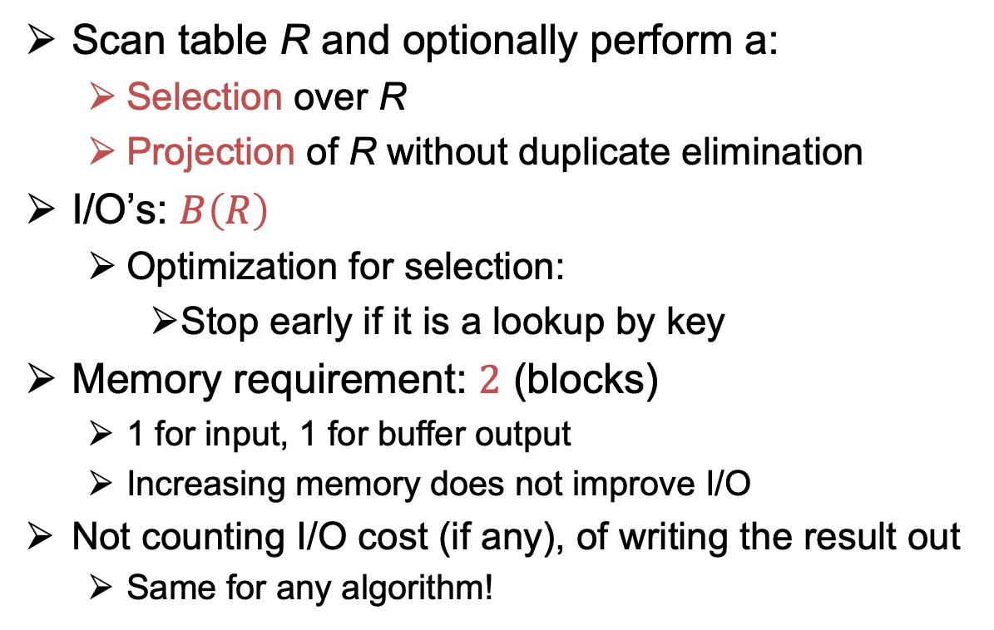
Table Scan Operators
Scan table R and optionally perform a:
  Selection over R
  Projection of R without duplicate elimination
I/O’s: $B\left(R\right)$
  Optimization for selection:
    Stop early if it is a lookup by key
Memory requirement: $2$ (blocks)
  1 for input, 1 for buffer output
  Increasing memory does not improve I/O
Not counting I/O cost (if any), of writing the result out
  Same for any algorithm!
Buffer output
Memory
r1 r2
1 for input
r1 r2
Disk
r1 r2
R
r3 r4
….

Slide 30
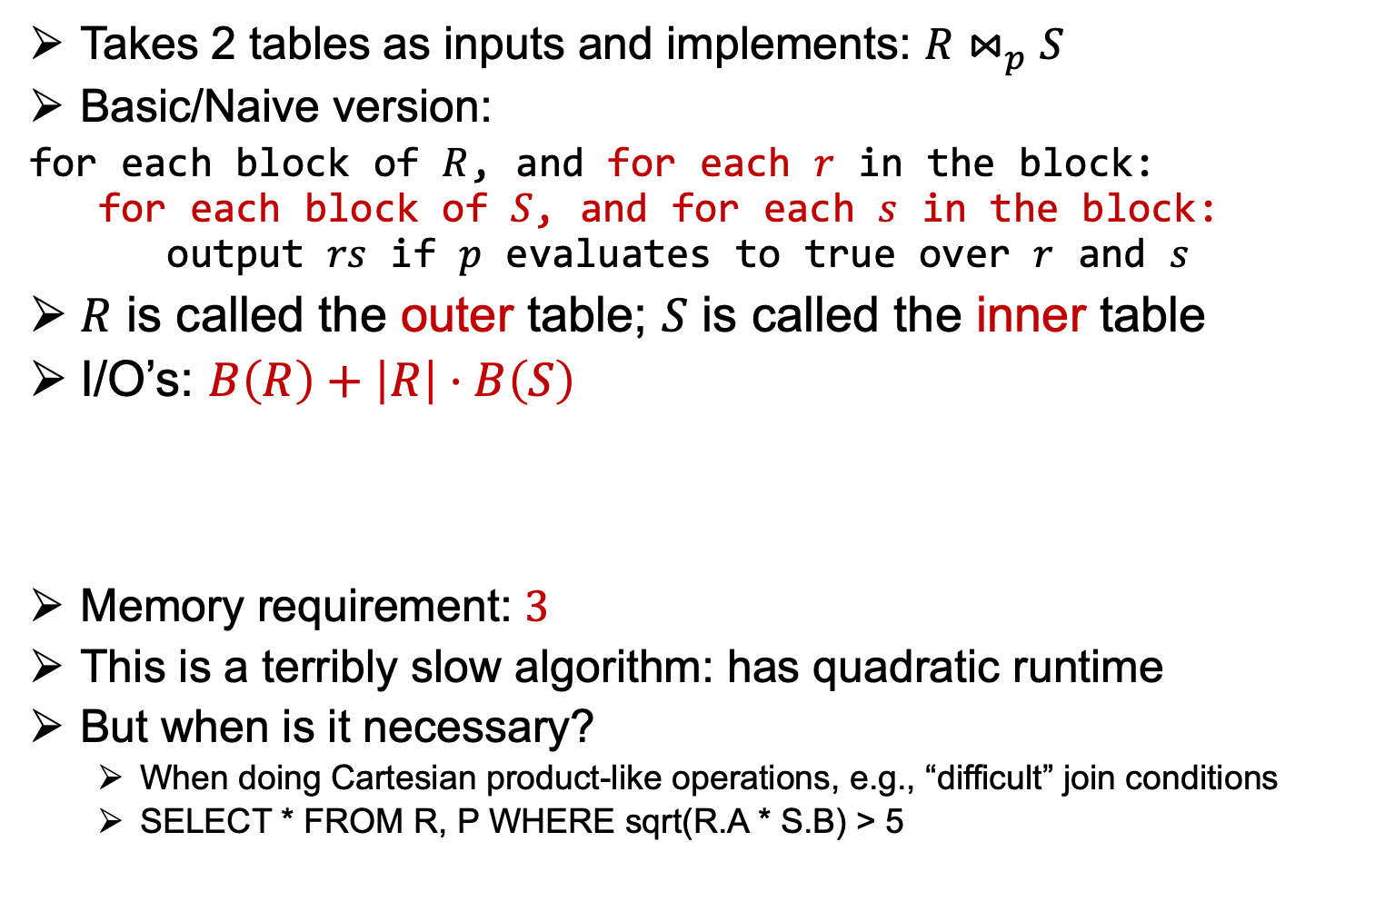
Nested-loop Join Operator
Takes 2 tables as inputs and implements: $R⋈_{p}S$
Basic/Naive version:
for each block of $R$, and for each $r$ in the block:
for each block of $S$, and for each $s$ in the block:
output $rs$ if $p$ evaluates to true over $r$ and $s$
$R$ is called the outer table; $S$ is called the inner table
I/O’s: $B\left(R\right)+\left|R\right|⋅B\left(S\right)$
Memory requirement: $3$
This is a terribly slow algorithm: has quadratic runtime
But when is it necessary?
  When doing Cartesian product-like operations, e.g., “difficult” join conditions
  SELECT * FROM R, P WHERE sqrt(R.A * S.B) > 5
Note: No other operation except table scan
Blocks of R are moved into memory only once
Blocks of S are moved into memory with |R| number of times

Slide 31
Simulation of Basic Nested-loop Join
1 block = 2 tuples, 3 blocks of memory
Disk
R
r1,r2
r3,r4
r1,r2
r1,r2
r1,r2
r1,r2
r1,r2
r1,r2
r3,r4
r3,r4
r3,r4
s1,s2
s3,s4
s5,s6
s1,s2
s3,s4
s5,s6
s1,s2
s3,s4
s5,s6
output
output
output
output
output
output
output
output
output
S
s1,s2
s3,s4
s5,s6
Time 1 2 3 4 5 6 7 8 9
Only compares (r1,s1), (r1,s2)
Number of I/O:
B(R) + |R| * B(S) = 2 blocks + 4 * 3 blocks = 14

Slide 32

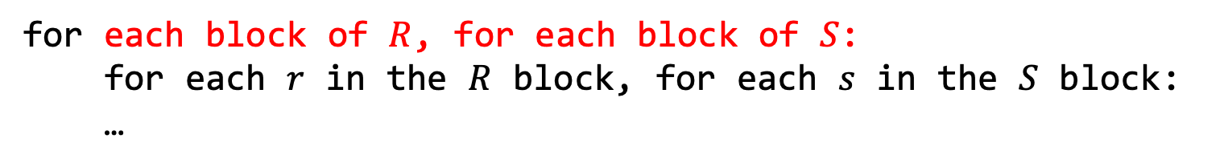
Block-Nested-loop join Operator
Improvement: block-based nested-loop join
for each block of $R$, for each block of $S$:
for each $r$ in the $R$ block, for each $s$ in the $S$ block:
…
I/O’s: $B\left(R\right)+B\left(R\right)⋅B\left(S\right)$
Memory requirement: same as before

Slide 33
Simulation of Block Nested-loop Join
1 block = 2 tuples, 3 blocks of memory
Disk
R
r1,r2
r3,r4
r1,r2
r1,r2
r1,r2
r3,r4
r3,r4
r3,r4
s1,s2
s3,s4
s5,s6
s1,s2
s3,s4
s5,s6
output
output
output
output
output
output
S
s1,s2
s3,s4
s5,s6
Time 1 2 3 4 5 6
Compares (r1,s1), (r2,s1), (r1,s2),(r2,s2)
Number of I/O:
B(R) + B(R)* B(S) = 2 blocks + 2 * 3 blocks = 8

Slide 34
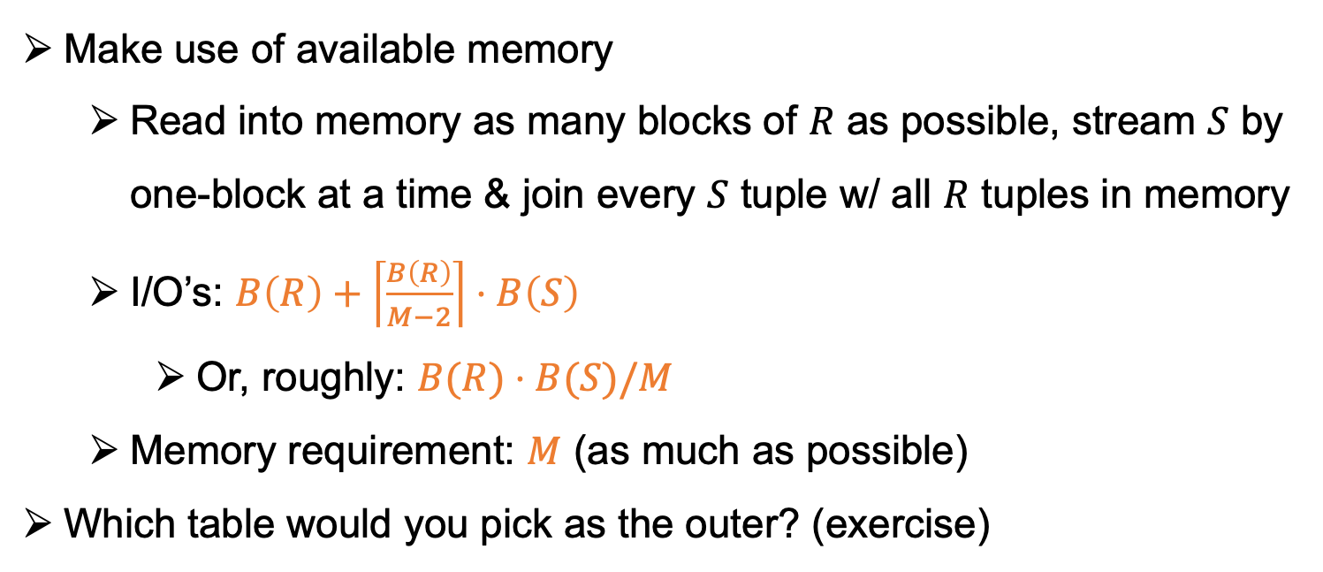
Improvement to Block Nested Loop Join
Make use of available memory
  Read into memory as many blocks of $R$ as possible, stream $S$ by one-block at a time & join every $S$ tuple w/ all $R$ tuples in memory
  I/O’s: $B\left(R\right)+\left\lceil \frac{B\left(R\right)}{M−2}\right\rceil ⋅B\left(S\right)$
    Or, roughly: $B(R)⋅B(S)/M$
  Memory requirement: $M$ (as much as possible)
Which table would you pick as the outer? (exercise)

Slide 35
Simulation After Improvement
1 block = 2 tuples, 4 blocks of memory
Disk
R
r1,r2
r3,r4
r1,r2
r1,r2
r1,r2
r3,r4
r3,r4
r3,r4
s1,s2
s3,s4
s5,s6
S
s1,s2
s3,s4
s5,s6
output
output
output
Time 1 2 3
Compares (r1,s1), (r2,s1), (r1,s2),(r2,s2), (r3,s1),(r3,s2),(r4,s1),(r4,s2)
Number of I/O:
  B(R) + B(R)/(M-2)* S(R) = 2 blocks + 1 * 3blocks = 5

Slide 36
Outline For Today
DBMS Query Processing Architecture
Fundamental Query Processing Operators & Algorithms
  Assumptions
  Scan-based Operators
  Sort-based Operators
  Hashing-based Operators
  Algorithms Using Indices

Slide 37
Two Core DBMS Operations
At a high-level majority of DBMS operators require: (1) sorting; or (2) hashing of input tables.
If you have a DBMS that has these core operators implemented in a very performant, robust, and scalable manner, you have a solid query processing foundation.
  Key point: Keep optimizing these core algorithms!

Slide 38
Sorting Under Limited Memory
A robust DBMS has solutions to the following problem:
Consider an operator o that needs to sort a table R, maybe a base table or an intermediate table (e.g., implementing ORDER BY clause)
Assume o is given M blocks of memory by system’s memory manager but M << B(R). (Not an infrequent scenario)
How can we sort if data does not fit into system’s memory?

Slide 39




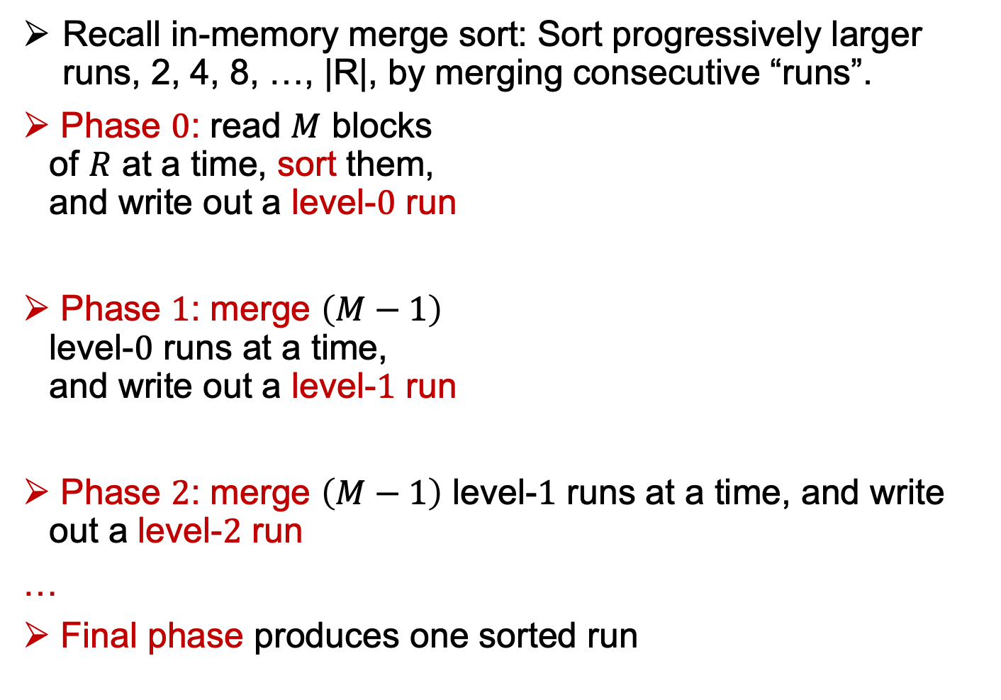

(External) Merge Sort Operator
Recall in-memory merge sort: Sort progressively larger runs, 2, 4, 8, …, |R|, by merging consecutive “runs”.
Phase $0$: read $M$ blocks
of $R$ at a time, sort them,
and write out a level-$0$ run
Phase $1$: merge $\left(M−1\right)$
level-$0$ runs at a time,
and write out a level-$1$ run
Phase $2$: merge $\left(M−1\right)$ level-$1$ runs at a time, and write out a level-$2$ run
…
Final phase produces one sorted run
Disk
$$R$$
…
Memory
Level-$0$
…
…
Level-$1$

Slide 40
Example
3 memory blocks available; each holds one number
Input: 1, 7, 4, 5, 2, 8, 9, 6, 3
Phase 0
Disk
Arrows indicate the blocks in memory
R: | 1 | 7 | 4 | 5 | 2 | 8 | 9 | 6 | 3

Slide 41
Example
3 memory blocks available; each holds one number
Input: 1, 7, 4, 5, 2, 8, 9, 6, 3
Phase 0
Disk
Arrows indicate the blocks in memory
R: | 1 | 7 | 4 | 5 | 2 | 8 | 9 | 6 | 3
1 | 4 | 7

Slide 42
Example
3 memory blocks available; each holds one number
Input: 1, 7, 4, 5, 2, 8, 9, 6, 3
Phase 0
Disk
Arrows indicate the blocks in memory
R: | 1 | 7 | 4 | 5 | 2 | 8 | 9 | 6 | 3
1 | 4 | 7

Slide 43
Example
3 memory blocks available; each holds one number
Input: 1, 7, 4, 5, 2, 8, 9, 6, 3
Phase 0
Disk
Arrows indicate the blocks in memory
R: | 1 | 7 | 4 | 5 | 2 | 8 | 9 | 6 | 3
1 | 4 | 7
2 | 5 | 8

Slide 44
Example
3 memory blocks available; each holds one number
Input: 1, 7, 4, 5, 2, 8, 9, 6, 3
Phase 0
Disk
Arrows indicate the blocks in memory
R: | 1 | 7 | 4 | 5 | 2 | 8 | 9 | 6 | 3
1 | 4 | 7
2 | 5 | 8

Slide 45
Example
3 memory blocks available; each holds one number
Input: 1, 7, 4, 5, 2, 8, 9, 6, 3
Phase 0
Disk
Arrows indicate the blocks in memory
R: | 1 | 7 | 4 | 5 | 2 | 8 | 9 | 6 | 3
1 | 4 | 7
2 | 5 | 8
3 | 6 | 9

Slide 46
Example
3 memory blocks available; each holds one number
Input: 1, 7, 4, 5, 2, 8, 9, 6, 3
Phase 0
Phase 1
Disk
Arrows indicate the blocks in memory
R: | 1 | 7 | 4 | 5 | 2 | 8 | 9 | 6 | 3
1 | 4 | 7
2 | 5 | 8
3 | 6 | 9

Slide 47
Example
3 memory blocks available; each holds one number
Input: 1, 7, 4, 5, 2, 8, 9, 6, 3
Phase 0
Phase 1
Disk
Arrows indicate the blocks in memory
R: | 1 | 7 | 4 | 5 | 2 | 8 | 9 | 6 | 3
1 | 4 | 7
2 | 5 | 8
3 | 6 | 9
1

Slide 48
Example
3 memory blocks available; each holds one number
Input: 1, 7, 4, 5, 2, 8, 9, 6, 3
Phase 0
Phase 1
Disk
Arrows indicate the blocks in memory
R: | 1 | 7 | 4 | 5 | 2 | 8 | 9 | 6 | 3
1 | 4 | 7
2 | 5 | 8
3 | 6 | 9
1

Slide 49
Example
3 memory blocks available; each holds one number
Input: 1, 7, 4, 5, 2, 8, 9, 6, 3
Phase 0
Phase 1
Disk
Arrows indicate the blocks in memory
R: | 1 | 7 | 4 | 5 | 2 | 8 | 9 | 6 | 3
1 | 4 | 7
2 | 5 | 8
3 | 6 | 9
1 | 2

Slide 50
Example
3 memory blocks available; each holds one number
Input: 1, 7, 4, 5, 2, 8, 9, 6, 3
Phase 0
Phase 1
Disk
Arrows indicate the blocks in memory
R: | 1 | 7 | 4 | 5 | 2 | 8 | 9 | 6 | 3
1 | 4 | 7
2 | 5 | 8
3 | 6 | 9
1 | 2

Slide 51
Example
3 memory blocks available; each holds one number
Input: 1, 7, 4, 5, 2, 8, 9, 6, 3
Phase 0
Phase 1
Disk
Arrows indicate the blocks in memory
R: | 1 | 7 | 4 | 5 | 2 | 8 | 9 | 6 | 3
1 | 4 | 7
2 | 5 | 8
3 | 6 | 9
1 | 2 | 4

Slide 52
Example
3 memory blocks available; each holds one number
Input: 1, 7, 4, 5, 2, 8, 9, 6, 3
Phase 0
Phase 1
Disk
Arrows indicate the blocks in memory
R: | 1 | 7 | 4 | 5 | 2 | 8 | 9 | 6 | 3
1 | 4 | 7
2 | 5 | 8
3 | 6 | 9
1 | 2 | 4

Slide 53
Example
3 memory blocks available; each holds one number
Input: 1, 7, 4, 5, 2, 8, 9, 6, 3
Phase 0
Phase 1
Disk
Arrows indicate the blocks in memory
R: | 1 | 7 | 4 | 5 | 2 | 8 | 9 | 6 | 3
1 | 4 | 7
2 | 5 | 8
3 | 6 | 9
1 | 2 | 4 | 5

Slide 54
Example
3 memory blocks available; each holds one number
Input: 1, 7, 4, 5, 2, 8, 9, 6, 3
Phase 0
Phase 1
Disk
Arrows indicate the blocks in memory
R: | 1 | 7 | 4 | 5 | 2 | 8 | 9 | 6 | 3
1 | 4 | 7
2 | 5 | 8
3 | 6 | 9
1 | 2 | 4 | 5

Slide 55
Example
3 memory blocks available; each holds one number
Input: 1, 7, 4, 5, 2, 8, 9, 6, 3
Phase 0
Phase 1
Disk
Arrows indicate the blocks in memory
R: | 1 | 7 | 4 | 5 | 2 | 8 | 9 | 6 | 3
1 | 4 | 7
2 | 5 | 8
3 | 6 | 9
1 | 2 | 4 | 5 | 7 | 8

Slide 56
Example
3 memory blocks available; each holds one number
Input: 1, 7, 4, 5, 2, 8, 9, 6, 3
Phase 0
Phase 1
Phase 2 (final)
Disk
Arrows indicate the blocks in memory
R: | 1 | 7 | 4 | 5 | 2 | 8 | 9 | 6 | 3
1 | 4 | 7
2 | 5 | 8
3 | 6 | 9
1 | 2 | 4 | 5 | 7 | 8
3 | 6 | 9

Slide 57
Example
3 memory blocks available; each holds one number
Input: 1, 7, 4, 5, 2, 8, 9, 6, 3
Phase 0
Phase 1
Phase 2 (final)
Disk
Arrows indicate the blocks in memory
R: | 1 | 7 | 4 | 5 | 2 | 8 | 9 | 6 | 3
1 | 4 | 7
2 | 5 | 8
3 | 6 | 9
1 | 2 | 4 | 5 | 7 | 8
3 | 6 | 9
1 | 2 | 3 | 4 | 5 | 6 | 7 | 8 | 9

Slide 58
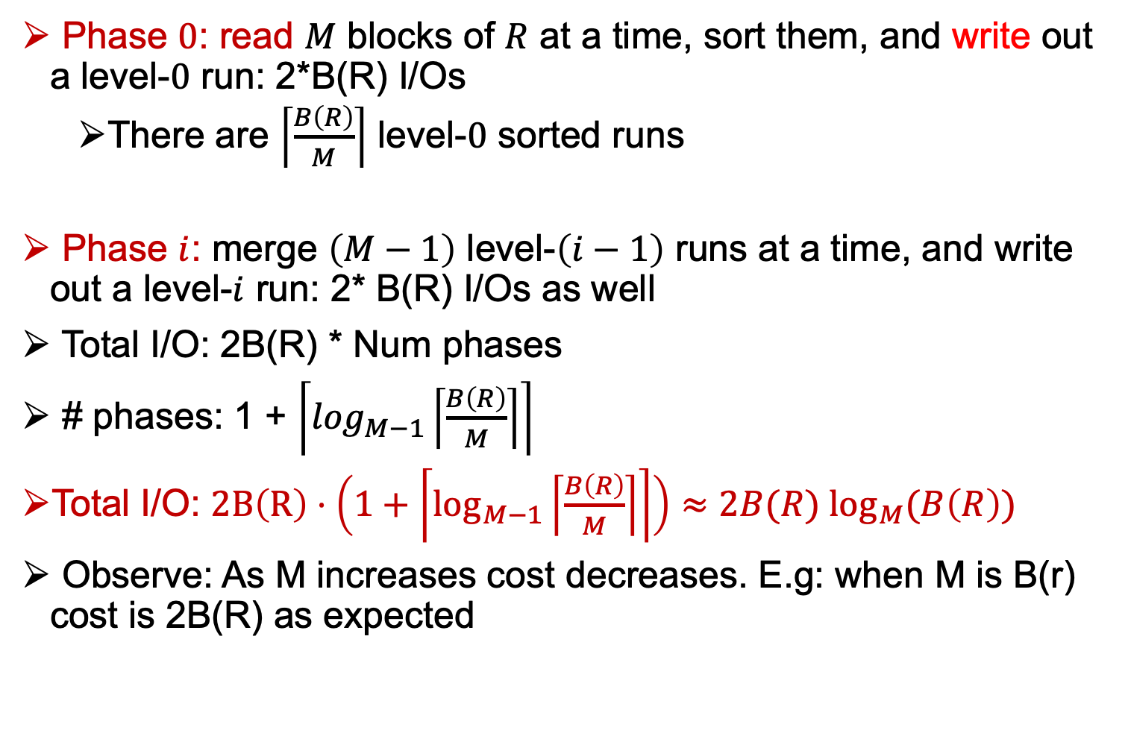
I/O Cost Analysis
Phase $0$: read $M$ blocks of $R$ at a time, sort them, and write out a level-$0$ run: 2*B(R) I/Os
  There are $\left\lceil \frac{B\left(R\right)}{M}\right\rceil$ level-$0$ sorted runs
Phase $i$: merge $\left(M−1\right)$ level-$\left(i−1\right)$ runs at a time, and write out a level-$i$ run: 2* B(R) I/Os as well
Total I/O: 2B(R) * Num phases
# phases: 1 + $\left\lceil \log_{M−1}\left\lceil \frac{B\left(R\right)}{M}\right\rceil \right\rceil$
Total I/O: $2B\left(R\right)⋅\left(1+\left\lceil \log_{M−1}\left\lceil \frac{B\left(R\right)}{M}\right\rceil \right\rceil \right)≈2B(R)$ $\log_{M}(B\left(R\right))$
Observe: As M increases cost decreases. E.g: when M is B(r) cost is 2B(R) as expected

Slide 59
Operators That Use Sorting
Pure Sort: e.g., ORDER BY
Set Union, Difference, Intersection, or Join or R and S (next slide): When the join condition is an equality condition e.g., R.A = S.B,
  All can be implemented by walking relations “in tandem” as in the merge step of merge sort.
Group-By-and-Aggregate: Exercise: Think about how you can implement group-by-and-aggregate with sorting?
DISTINCT (Related to group-by-and-aggregate)

Slide 60
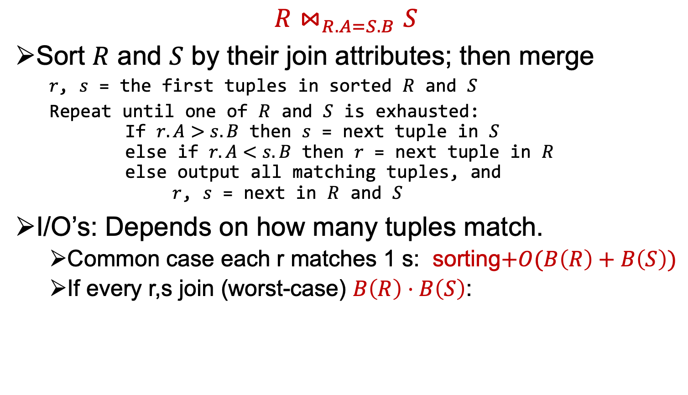
Sort-merge Join
$$R⋈_{R.A=S.B}S$$
Sort $R$ and $S$ by their join attributes; then merge
  $r$, $s$ = the first tuples in sorted $R$ and $S$
  Repeat until one of $R$ and $S$ is exhausted:
  If $r.A>s.B$ then $s$ = next tuple in $S$
  else if $r.A<s.B$ then $r$ = next tuple in $R$
  else output all matching tuples, and
  $r$, $s$ = next in $R$ and $S$
I/O’s: Depends on how many tuples match.
  Common case each r matches 1 s: sorting$+O(B\left(R\right)+B\left(S\right))$
  If every r,s join (worst-case) $B\left(R\right)⋅B\left(S\right)$:

Slide 61


Example
$R$: $S$: $R⋈_{R.A=S.B}S$:
$r_{1}.A=1$ $s_{1}.B=1$
$r_{2}.A=3$ $s_{2}.B=2$
$r_{3}.A=3$ $s_{3}.B=3$
$r_{4}.A=5$ $s_{4}.B=3$
$r_{5}.A=7$ $s_{5}.B=8$
$r_{6}.A=7$
$r_{7}.A=8$
$$r_{1}s_{1}$$

Slide 62
Example
$R$: $S$: $R⋈_{R.A=S.B}S$:
$r_{1}.A=1$ $s_{1}.B=1$
$r_{2}.A=3$ $s_{2}.B=2$
$r_{3}.A=3$ $s_{3}.B=3$
$r_{4}.A=5$ $s_{4}.B=3$
$r_{5}.A=7$ $s_{5}.B=8$
$r_{6}.A=7$
$r_{7}.A=8$
$$r_{1}s_{1}$$

Slide 63
Example
$R$: $S$: $R⋈_{R.A=S.B}S$:
$r_{1}.A=1$ $s_{1}.B=1$
$r_{2}.A=3$ $s_{2}.B=2$
$r_{3}.A=3$ $s_{3}.B=3$
$r_{4}.A=5$ $s_{4}.B=3$
$r_{5}.A=7$ $s_{5}.B=8$
$r_{6}.A=7$
$r_{7}.A=8$
$$r_{1}s_{1}$$

Slide 64
Example
$R$: $S$: $R⋈_{R.A=S.B}S$:
$r_{1}.A=1$ $s_{1}.B=1$
$r_{2}.A=3$ $s_{2}.B=2$
$r_{3}.A=3$ $s_{3}.B=3$
$r_{4}.A=5$ $s_{4}.B=3$
$r_{5}.A=7$ $s_{5}.B=8$
$r_{6}.A=7$
$r_{7}.A=8$
$$r_{1}s_{1}$$

Slide 65

Example
$R$: $S$: $R⋈_{R.A=S.B}S$:
$r_{1}.A=1$ $s_{1}.B=1$
$r_{2}.A=3$ $s_{2}.B=2$
$r_{3}.A=3$ $s_{3}.B=3$
$r_{4}.A=5$ $s_{4}.B=3$
$r_{5}.A=7$ $s_{5}.B=8$
$r_{6}.A=7$
$r_{7}.A=8$
$$r_{1}s_{1}$$
$$r_{2}s_{3}$$

Slide 66

Example
$R$: $S$: $R⋈_{R.A=S.B}S$:
$r_{1}.A=1$ $s_{1}.B=1$
$r_{2}.A=3$ $s_{2}.B=2$
$r_{3}.A=3$ $s_{3}.B=3$
$r_{4}.A=5$ $s_{4}.B=3$
$r_{5}.A=7$ $s_{5}.B=8$
$r_{6}.A=7$
$r_{7}.A=8$
$$r_{1}s_{1}$$
$$r_{2}s_{3}$$
$$r_{2}s_{4}$$

Slide 67
Example
$R$: $S$: $R⋈_{R.A=S.B}S$:
$r_{1}.A=1$ $s_{1}.B=1$
$r_{2}.A=3$ $s_{2}.B=2$
$r_{3}.A=3$ $s_{3}.B=3$
$r_{4}.A=5$ $s_{4}.B=3$
$r_{5}.A=7$ $s_{5}.B=8$
$r_{6}.A=7$
$r_{7}.A=8$
$$r_{1}s_{1}$$
$$r_{2}s_{3}$$
$$r_{2}s_{4}$$

Slide 68

Example
$R$: $S$: $R⋈_{R.A=S.B}S$:
$r_{1}.A=1$ $s_{1}.B=1$
$r_{2}.A=3$ $s_{2}.B=2$
$r_{3}.A=3$ $s_{3}.B=3$
$r_{4}.A=5$ $s_{4}.B=3$
$r_{5}.A=7$ $s_{5}.B=8$
$r_{6}.A=7$
$r_{7}.A=8$
$$r_{1}s_{1}$$
$$r_{2}s_{3}$$
$$r_{2}s_{4}$$
$$r_{3}s_{3}$$

Slide 69

Example
$R$: $S$: $R⋈_{R.A=S.B}S$:
$r_{1}.A=1$ $s_{1}.B=1$
$r_{2}.A=3$ $s_{2}.B=2$
$r_{3}.A=3$ $s_{3}.B=3$
$r_{4}.A=5$ $s_{4}.B=3$
$r_{5}.A=7$ $s_{5}.B=8$
$r_{6}.A=7$
$r_{7}.A=8$
$$r_{1}s_{1}$$
$$r_{2}s_{3}$$
$$r_{2}s_{4}$$
$$r_{3}s_{3}$$
$$r_{3}s_{4}$$

Slide 70
Example
$R$: $S$: $R⋈_{R.A=S.B}S$:
$r_{1}.A=1$ $s_{1}.B=1$
$r_{2}.A=3$ $s_{2}.B=2$
$r_{3}.A=3$ $s_{3}.B=3$
$r_{4}.A=5$ $s_{4}.B=3$
$r_{5}.A=7$ $s_{5}.B=8$
$r_{6}.A=7$
$r_{7}.A=8$
$$r_{1}s_{1}$$
$$r_{2}s_{3}$$
$$r_{2}s_{4}$$
$$r_{3}s_{3}$$
$$r_{3}s_{4}$$

Slide 71
Example
$R$: $S$: $R⋈_{R.A=S.B}S$:
$r_{1}.A=1$ $s_{1}.B=1$
$r_{2}.A=3$ $s_{2}.B=2$
$r_{3}.A=3$ $s_{3}.B=3$
$r_{4}.A=5$ $s_{4}.B=3$
$r_{5}.A=7$ $s_{5}.B=8$
$r_{6}.A=7$
$r_{7}.A=8$
$$r_{1}s_{1}$$
$$r_{2}s_{3}$$
$$r_{2}s_{4}$$
$$r_{3}s_{3}$$
$$r_{3}s_{4}$$

Slide 72
Example
$R$: $S$: $R⋈_{R.A=S.B}S$:
$r_{1}.A=1$ $s_{1}.B=1$
$r_{2}.A=3$ $s_{2}.B=2$
$r_{3}.A=3$ $s_{3}.B=3$
$r_{4}.A=5$ $s_{4}.B=3$
$r_{5}.A=7$ $s_{5}.B=8$
$r_{6}.A=7$
$r_{7}.A=8$
$$r_{1}s_{1}$$
$$r_{2}s_{3}$$
$$r_{2}s_{4}$$
$$r_{3}s_{3}$$
$$r_{3}s_{4}$$

Slide 73
Example
$R$: $S$: $R⋈_{R.A=S.B}S$:
$r_{1}.A=1$ $s_{1}.B=1$
$r_{2}.A=3$ $s_{2}.B=2$
$r_{3}.A=3$ $s_{3}.B=3$
$r_{4}.A=5$ $s_{4}.B=3$
$r_{5}.A=7$ $s_{5}.B=8$
$r_{6}.A=7$
$r_{7}.A=8$
$$r_{1}s_{1}$$
$$r_{2}s_{3}$$
$$r_{2}s_{4}$$
$$r_{3}s_{3}$$
$$r_{3}s_{4}$$

Slide 74
Example
$R$: $S$: $R⋈_{R.A=S.B}S$:
$r_{1}.A=1$ $s_{1}.B=1$
$r_{2}.A=3$ $s_{2}.B=2$
$r_{3}.A=3$ $s_{3}.B=3$
$r_{4}.A=5$ $s_{4}.B=3$
$r_{5}.A=7$ $s_{5}.B=8$
$r_{6}.A=7$
$r_{7}.A=8$
$$r_{1}s_{1}$$
$$r_{2}s_{3}$$
$$r_{2}s_{4}$$
$$r_{3}s_{3}$$
$$r_{3}s_{4}$$

Slide 75

Example
$R$: $S$: $R⋈_{R.A=S.B}S$:
$r_{1}.A=1$ $s_{1}.B=1$
$r_{2}.A=3$ $s_{2}.B=2$
$r_{3}.A=3$ $s_{3}.B=3$
$r_{4}.A=5$ $s_{4}.B=3$
$r_{5}.A=7$ $s_{5}.B=8$
$r_{6}.A=7$
$r_{7}.A=8$
$$r_{1}s_{1}$$
$$r_{2}s_{3}$$
$$r_{2}s_{4}$$
$$r_{3}s_{3}$$
$$r_{3}s_{4}$$
$$r_{7}s_{5}$$

Slide 76
Outline For Today
DBMS Query Processing Architecture
Fundamental Query Processing Operators & Algorithms
  Assumptions
  Scan-based Operators
  Sort-based Operators
  Hashing-based Operators
  Algorithms Using Indices

Slide 77
Hash Join
Consider an equality join, e.g., join of R(X, A) ⋈ S(B, Y) where A=B.
Let h be hash function hashing A or B values to 1, …, k
If r ∈ R and s ∈ S “join”, i.e., r[A] = s[B] then:
  h(r[A]) = h(s[B])
Question: Why is this a useful observation?
Answer: We can:
  partition R by hashing its tuples on A into R₁, …, R_{k}
  partition S by hashing its tuples on B into S₁, …, S_{k}
  where each partitions are (i) much smaller tables (e.g., they may fit in memory) & (ii) tuples in R_{i} can only join with tuples in S_{i}
If the join will be computed externally, i.e., using disk, hash join can be an efficient algorithm

Slide 78



Hash Join vs Nested Loop Join Pictorially
$R⋈_{R.A=S.B}S$
If $r.A$ and $s.B$ get hashed to different partitions, they don’t join
$$R$$
1
2
3
4
5
1
Nested-loop join
considers all slots
2
$$S$$
3
Hash join considers only
those along the diagonal!
4
5

Slide 79
(External) Hash Join Algorithm
let h be a hash function mapping A or B columns into 1, …, k
Pick k < M (why?)
Phase 1: partition R and S into k partitions using h
Phase 2:
for i = 1, …, k:
read R_{i} and S_{i} into memory and use in-memory hash-join alg.
(i.e., build a hash table of R_{i} and probe S_{i} tuples)
HashJoin
R.A = S.B
Q: Systems make the smaller (estimated) relation the build side? Why?
Quicker to build & search in hash table
Note: do not have to use any memory for probe side, e.g., can just stream S.
probe side
build side
S
R

Slide 80




Phase 1: Partitioning
Partition $R$ and $S$ according to the same hash function on their join attributes
Memory
Disk
$$R$$
…
…
k partitions of $R$
Same for $S$
Each partition takes ~ B(R)/k blocks

Slide 81



Phase 2: Probing
Read in R_{i}, stream in the corresponding partition S_{i} and join
  Typically use in-memory hash join: build a hash table of R_{i}
    often use a different hash function for in-memory hash join
Disk
Memory
load
…
$$R$$
partitions
…
stream
For each $S$ tuple,
probe and join
$$S$$
partitions
…

Slide 82
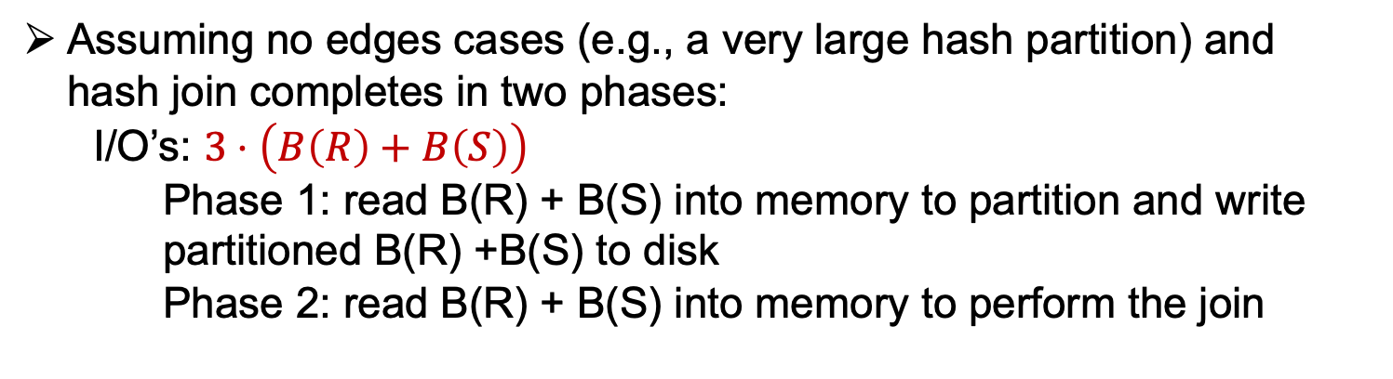
I/O Cost of Hash Join
Assuming no edges cases (e.g., a very large hash partition) and hash join completes in two phases:
  I/O’s: $3⋅\left(B\left(R\right)+B\left(S\right)\right)$
    Phase 1: read B(R) + B(S) into memory to partition and write partitioned B(R) +B(S) to disk
    Phase 2: read B(R) + B(S) into memory to perform the join

Slide 83
What if R_{i} Does Not Fit In Memory
Read it back in and partition it again!
Note however, in the worst-case all A or B values could be the same and one simply cannot generate useful partitions.
Systems either fail in such cases or fall back to alternative slower solutions

Slide 84
Outline For Today
DBMS Query Processing Architecture
Fundamental Query Processing Operators & Algorithms
  Assumptions
  Scan-based Operators
  Sort-based Operators
  Hashing-based Operators
  Algorithms Using Indices

Slide 85
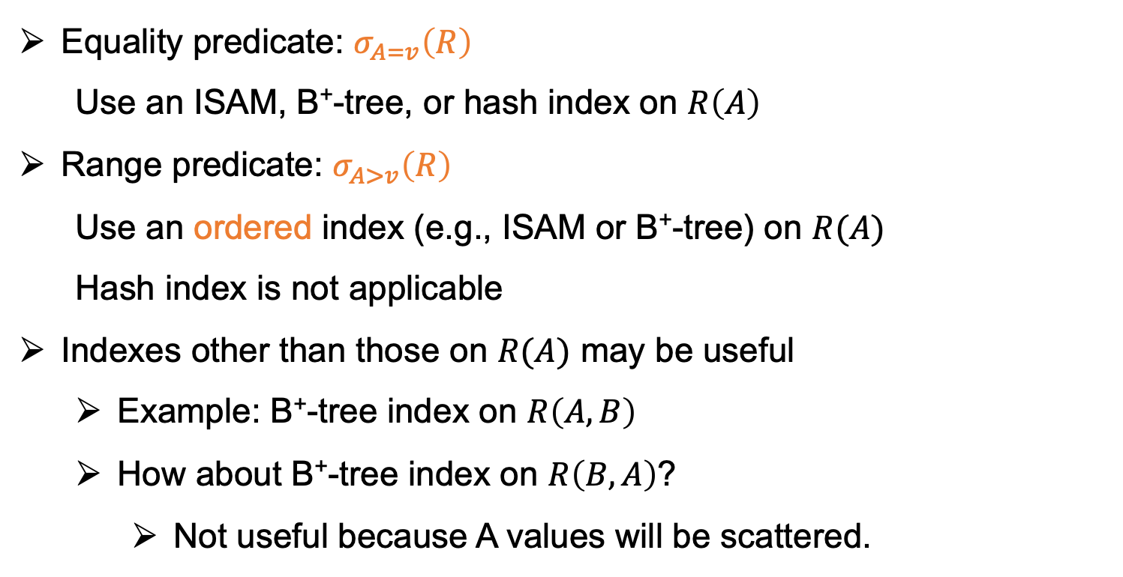
Selection Using Index
Equality predicate: $σ_{A=v}\left(R\right)$
  Use an ISAM, B⁺-tree, or hash index on $R\left(A\right)$
Range predicate: $σ_{A>v}\left(R\right)$
  Use an ordered index (e.g., ISAM or B⁺-tree) on $R(A)$
  Hash index is not applicable
Indexes other than those on $R(A)$ may be useful
  Example: B⁺-tree index on $R\left(A,B\right)$
  How about B⁺-tree index on $R\left(B, A\right)$?
    Not useful because A values will be scattered.

Slide 86
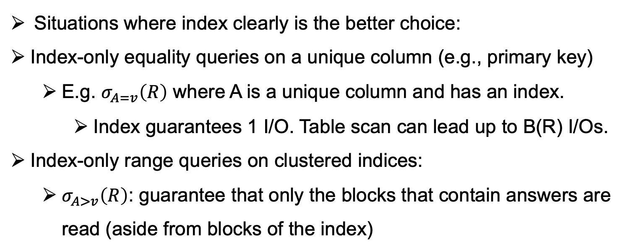
Index vs Table Scan (1)
Situations where index clearly is the better choice:
Index-only equality queries on a unique column (e.g., primary key)
  E.g. $σ_{A=v}\left(R\right)$ where A is a unique column and has an index.
    Index guarantees 1 I/O. Table scan can lead up to B(R) I/Os.
Index-only range queries on clustered indices:
  $σ_{A>v}\left(R\right)$: guarantee that only the blocks that contain answers are read (aside from blocks of the index)

Slide 87
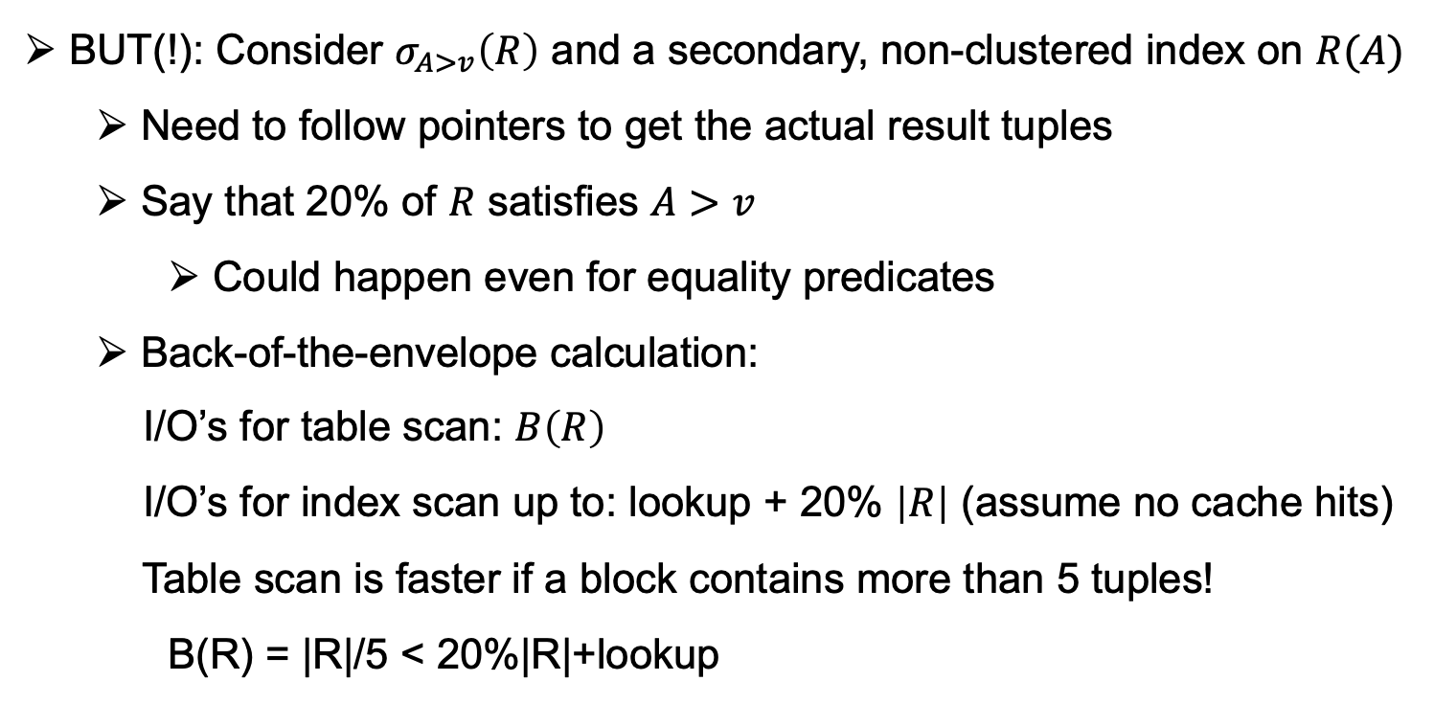
Index vs Table Scan (2)
BUT(!): Consider $σ_{A>v}\left(R\right)$ and a secondary, non-clustered index on $R(A)$
  Need to follow pointers to get the actual result tuples
  Say that 20% of $R$ satisfies $A>v$
    Could happen even for equality predicates
  Back-of-the-envelope calculation:
  I/O’s for table scan: $B\left(R\right)$
  I/O’s for index scan up to: lookup + 20% $\left|R\right|$ (assume no cache hits)
  Table scan is faster if a block contains more than 5 tuples!
    B(R) = |R|/5 < 20%|R|+lookup
Systems should not do this to be safe. Table scan might be slow but its slowness is bounded by B(R) and not a function of R.

Slide 88
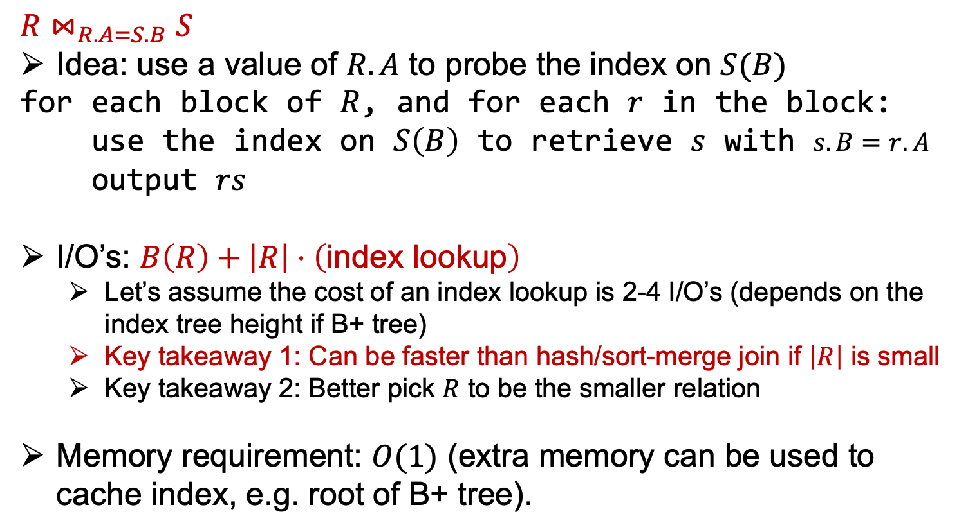
Index Nested-loop Join
$$R⋈_{R.A=S.B}S$$
Idea: use a value of $R.A$ to probe the index on $S(B)$
for each block of $R$, and for each $r$ in the block:
use the index on $S\left(B\right)$ to retrieve $s$ with $s.B=r.A$
output $rs$
I/O’s: $B\left(R\right)+\left|R\right|⋅\left(\text{index} \text{lookup}\right)$
  Let’s assume the cost of an index lookup is 2-4 I/O’s (depends on the index tree height if B+ tree)
  Key takeaway 1: Can be faster than hash/sort-merge join if $\left|R\right|$ is small
  Key takeaway 2: Better pick $R$ to be the smaller relation
Memory requirement: $O(1)$ (extra memory can be used to cache index, e.g. root of B+ tree).

Slide 89
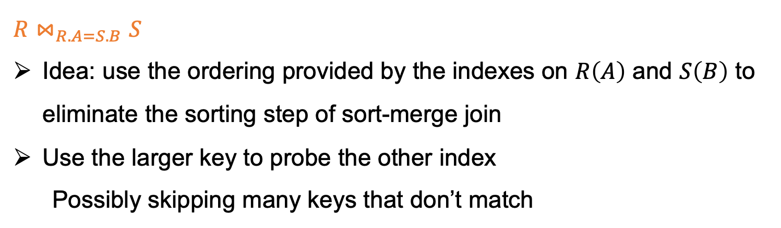
Zig-zag Join Using Ordered Indexes
$$R⋈_{R.A=S.B}S$$
Idea: use the ordering provided by the indexes on $R\left(A\right)$ and $S\left(B\right)$ to eliminate the sorting step of sort-merge join
Use the larger key to probe the other index
Possibly skipping many keys that don’t match

Slide 90


Zig-zag Join Using Ordered Indexes
$$R⋈_{R.A=S.B}S$$
Idea: use the ordering provided by the indexes on $R\left(A\right)$ and $S\left(B\right)$ to eliminate the sorting step of sort-merge join
Use the larger key to probe the other index
Possibly skipping many keys that don’t match
B⁺-tree on $R\left(A\right)$
1 2 3 4 7 9 18
1 7 9 11 12 17 19
B⁺-tree on $S\left(B\right)$

Slide 91
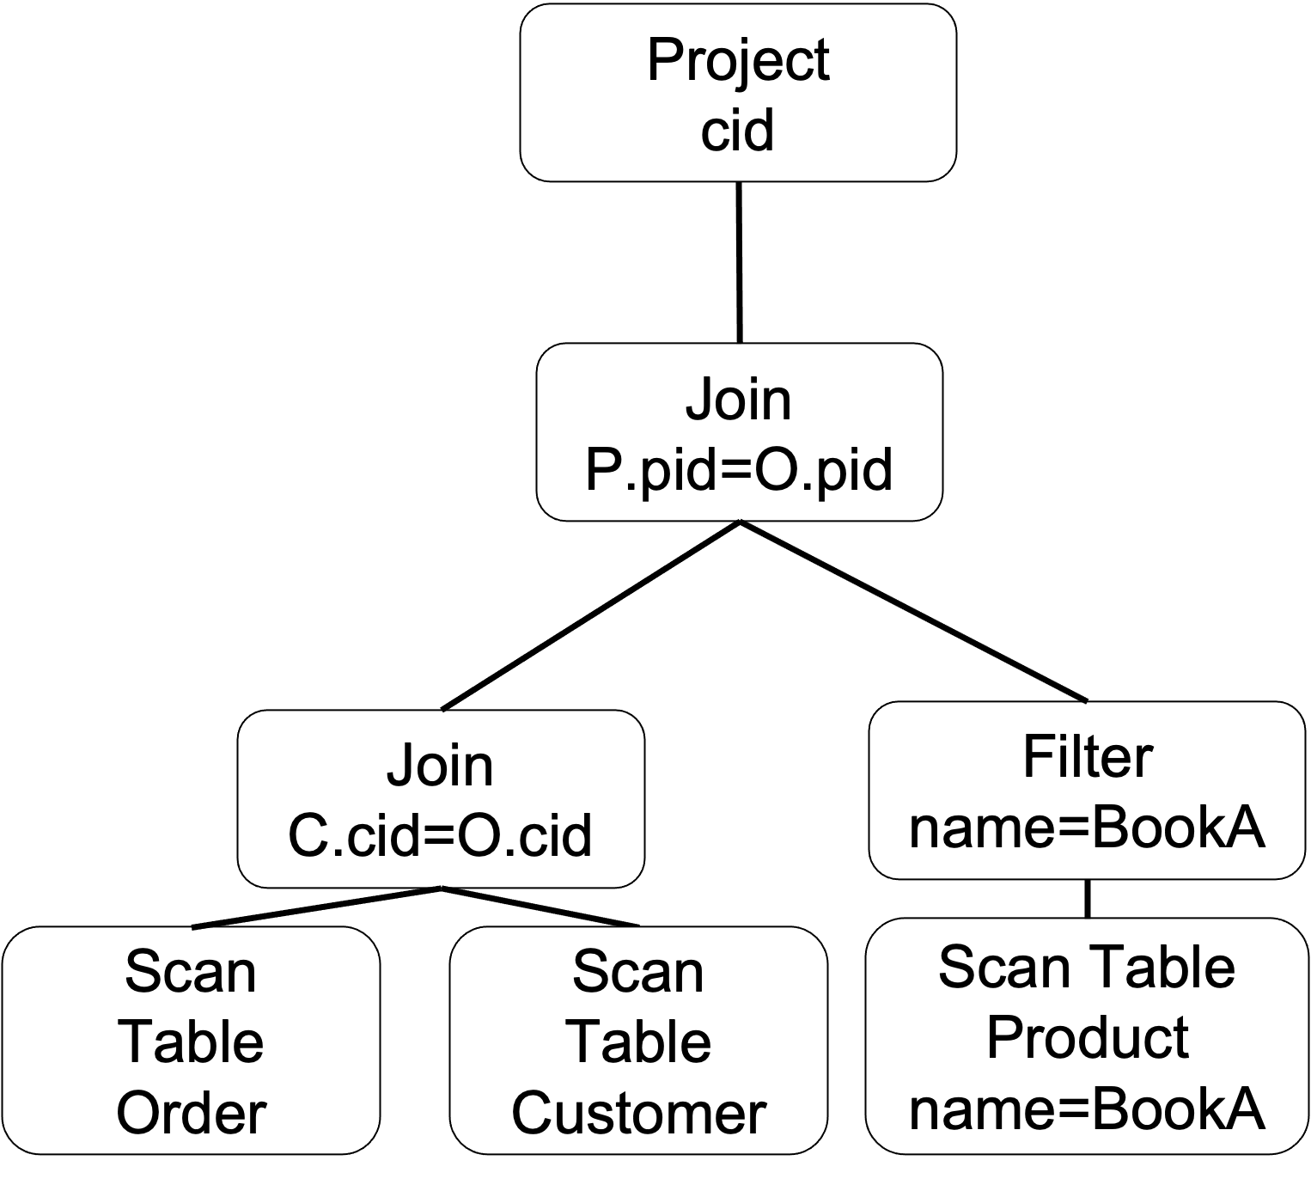
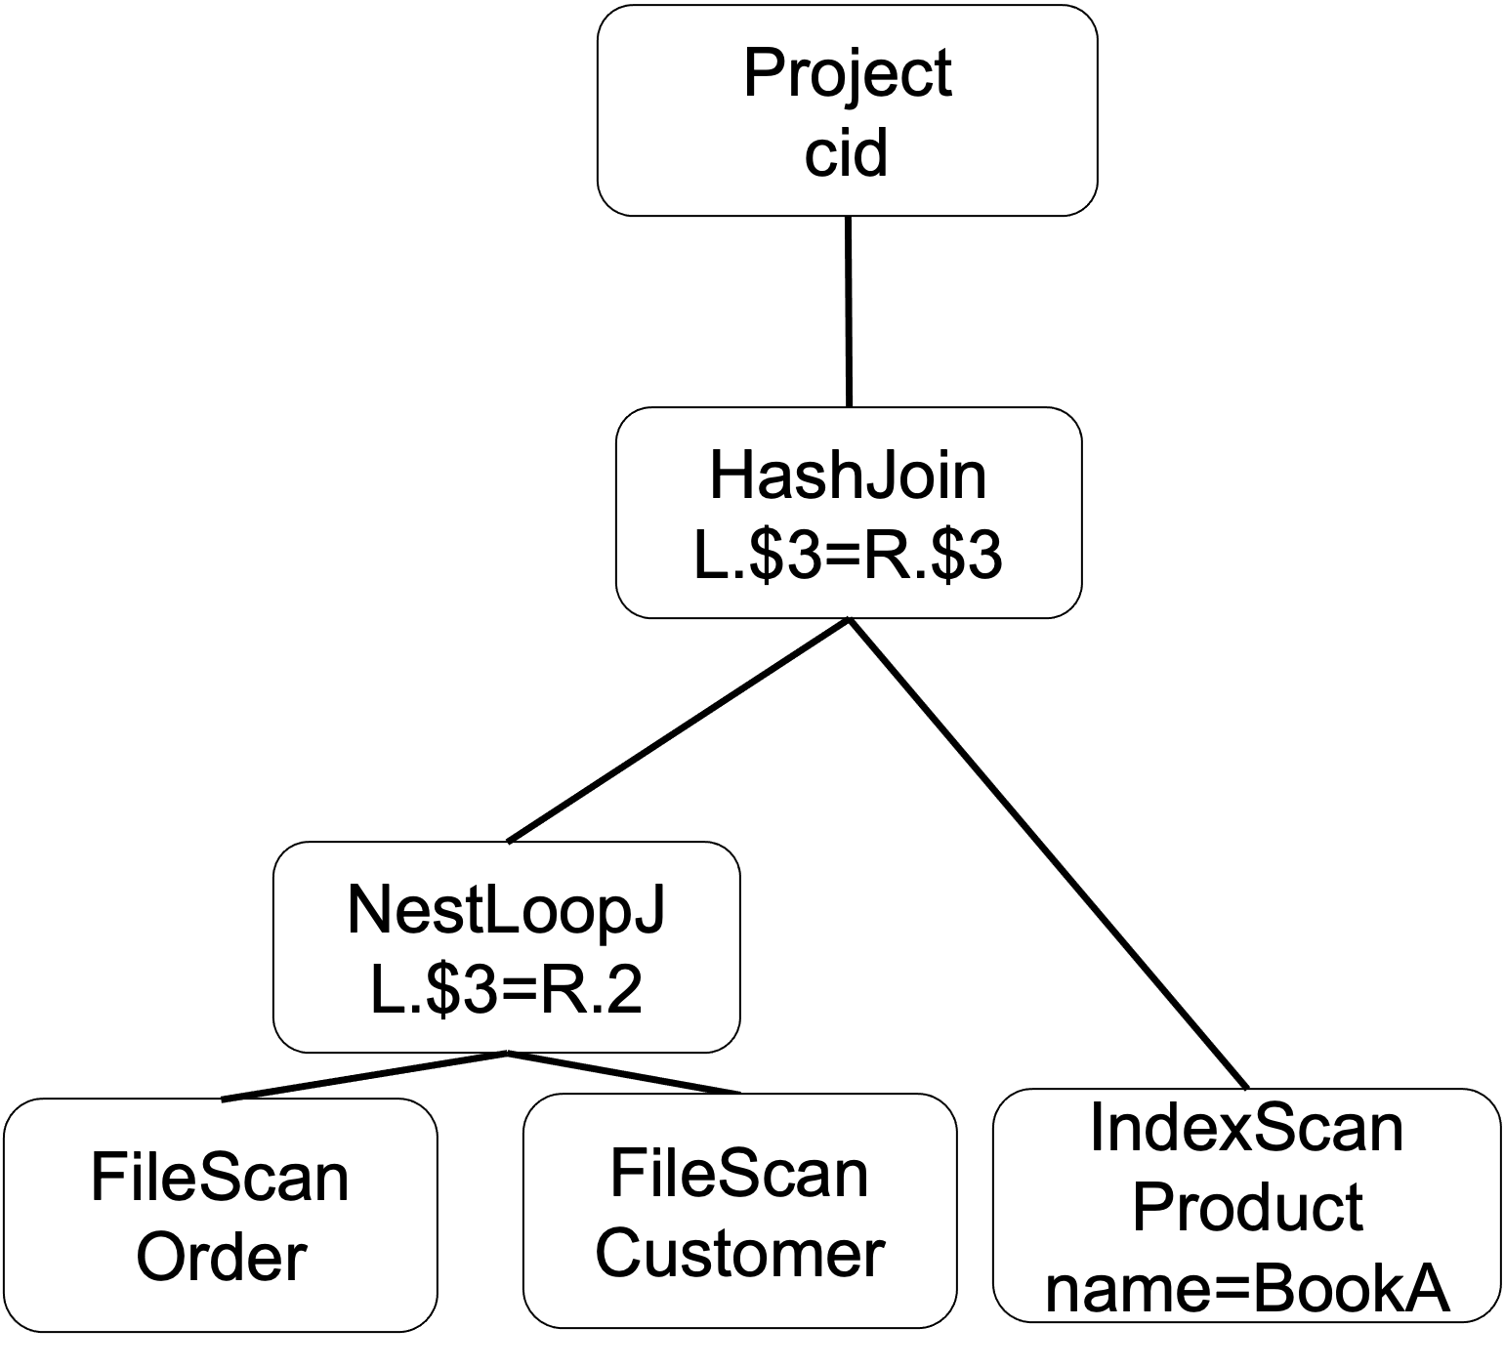

Note on Role of (I/O) Costs Of Operators For Picking Physical Plans
Some systems use estimated I/O costs of core ops to pick how to translate logical to physical plans, i.e., logical-physical plan translation is a cost-based optimization:
Logical Plan
Physical Plan 1
(cost = C1)
Physical Plan 2
(cost = C2)

Slide 92
Note on Role of (I/O) Costs Of Operators For Picking Physical Plans
Some systems use estimated I/O costs of core ops to pick how to translate logical to physical plans, i.e., logical-physical plan translation is a cost-based optimization:
  Enumerate different physical plan translations
  Estimate the cost of each physical plan
  Pick the minimum cost estimated plan
  Next lecture on cost-based optimization at logical plan picking level
Others pick physical operators in a rule-based manner, so the I/O costs are there to determine these rules.
  Always make scans IndexScans if possible
  All equality joins should be HashJoins except if the tables are already sorted, in which case use SortMerge Join.
  All other types of joins should be NesteLoopJoins etc.

