Slide 1

CS 348 Lecture 12
Physical Data Organization Finish & Indices
  Semih Salihoğlu
  Feb 17th 2022

Slide 2
Announcements
Assignment 3 past but still have until tomorrow midnight:
Reading week: No lectures or OHs next week.

Slide 3
Outline For Today
Recap & Finish Physical File Organization Designs
  Row-oriented Physical Design (Recap)
  Colum-oriented Physical Design
  Hybrid (PAX) Physical Design
  Designs for Variable-length Fields
  Designs for NULLs
Database Indices
  5 Index Designs in Increasing Level of Robustness
  Using Indices In Practice

Slide 4
Outline For Today
Recap & Finish Physical File Organization Designs
  Row-oriented Physical Design (Recap)
  Colum-oriented Physical Design
  Hybrid (PAX) Physical Design
  Designs for Variable-length Fields
  Designs for NULLs
Database Indices
  5 Index Designs in Increasing Level of Robustness
  Using Indices In Practice

Slide 5
Recall Potential Goals of Physical Data Design
Minimize I/O!
  Design files to pack records/columns into few number of pages
  Keep related data close in storage devices!
  Cache pages of data that is likely to be used
Maximize sequential reads from storage devices!
Simplicity/speed of accessing values
  E.g., don’t compress using a complex compression scheme
These are general guidelines and not necessarily independent.

Slide 6
Common Record and Page Layouts
Row-oriented
Column-oriented
Hybrid (PAX) Row & Column-oriented Fixed-length Values
Designs for Variable-length Values
Designs for NULL Values

Slide 7
Recap: Row-Oriented NSM Design
Each page contains ~ H/T many rows and all fields of each row
Customer
cid : int64 (8 bytes) | name : string (60 chars) | isGoldMember : bool (1 byte)
101 | Alice Munro\0\0\0….\0 | 1
201 | Carl Sagan\0\0\0…\0 | 0
103 | Bob \0\0\0….\0 | 1
… | … | …
(Example Disk Page, e.g., in file customer.mkd)
Note: because records are fixed length, can read any field with simple arithmetic (*not a consequence of NSM*)
  E.g: 5th records name field at offsets: 4*(8+60+1) + 8 = 284 to 344

Slide 8
Recap: Pros/Cons of NSM
Pro: Good for queries that access multiple or all fields of tuples
Con: If queries access a single field, e.g., counting numGoldMembers, “effective read size” can be small
  E.g. 1/69 bytes read is useful, in columnar storage you can do 69x less I/O to do the same count.
Con: For some workloads higher # I/O => lower (buffer) cache utilization (next slide)

Slide 9
Recap: Buffer Manager & Ex Op/Storage Interface
DBMSs have a buffer manager (BM) component that keeps a set of file pages in memory to reduce I/O.
Goal of BM: keep pages that are likely to be accessed in memory
  Implement a caching alg, e.g., Least-Recently Used (LRU)
class DatabaseFileHandle : {
string filename; // e.g., order.mkd
int tupleLen; // e.g., 69
BufferManager bm;
void readRecord(Tuple* outTuple, recordID) {
(pageIdx, offset)= calculatePageInfo(recordID)
Frame* frame = bm.pinPage(pageIdx);
memcpy(outTuple, frame>bytes[offset], tupleLen)
bm.unpin(frame); }}
Buffer Pool/Frames
RAM
P1
P3
P8
Disk File/Pages
P1
P2
P3
Disk
P4
P5
P6
P7
P8
P9
Pin: put disk page into buffer pool until further notice
  possibly evicts an existing page
Unpin: can now remove the page from buffer pool if needed
order.mkd

Slide 10
Column-Oriented Storage Design
One file for each field of table (~H/field-size rows worth of data):
101 | 201 | 103 | 330
Alice Munro\0\0….\0
1 | 0 | 1 | 0 | 0 | 0
… | … | … | …
Carl Sagan\0\0\0….\0
… | … | … | … | … | …
Bob \0\0\0….\0
cID.mkd
name.mkd
isGoldMember.mkd
Pros: Good for queries that access few columns
  Can reduce I/O significantly
  Better sequential reads when pages are in memory
Pros: Easier to apply compression because each page is very “homogenous”
Cons: Bad for queries that access all columns (1 I/O in row-oriented storage could be done with # cols I/O).
Select count(*)
from customer
where isGoldMember

Slide 11
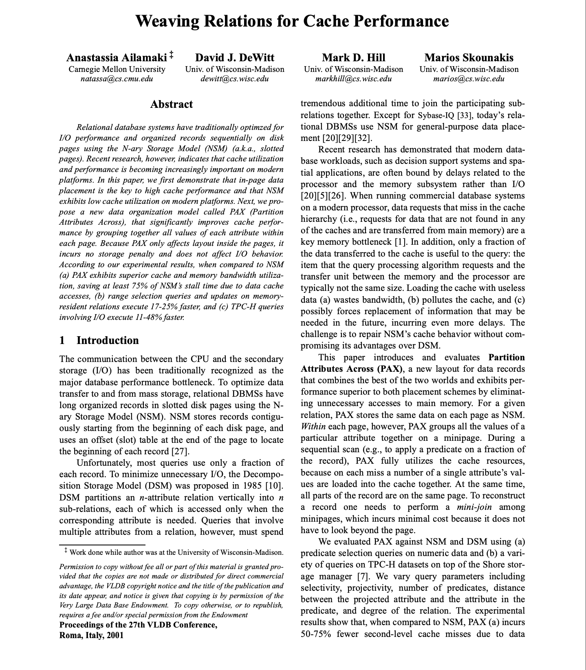
PAX Hybrid Storage Design
PAX: Partition Attributes Across (Ailamaki et al. VLDB 2001)
  All fields of a row in the same page
  But pages internally organized by columns
101 | 201 | 103 | 330 | … | …
Alice Munro\0\0….\0
Carl \0\0\0….\0
Bob \0\0\0….\0 | …
1 | 0 | 1 | 0 | 0 | 0 | … | …
customer.mkd
Better sequential reads for queries that read a single column
Gives the advantage of having all fields of a row in the same page
But still more I/O than pure columnar storage for some queries

Slide 12
Outline For Today
High-level DBMS Architecture
Storage Manager and Physical File Organization Designs
  Physical Operators/Storage Interface
  Fundamental Property of Storage Devices & Potential Goals of Physical Design
  Row-oriented Physical Design
  Colum-oriented Physical Design
  Hybrid (PAX) Physical Design
  Designs for Variable-length Fields
  Designs for NULLs

Slide 13
Variable-length Values
Pages are often more complex than examples in these slides
One complexity: variable-length fields
Assume row-oriented NSM storage
Approaches to encode var-length fields, e.g., var-len strings, in pages
  Delimiters
  Field Offsets
  Pointers to Overflow Pages
Both:
(i) put first fixed-len fields and then var-len fields when encoding each row
(ii) require storing page-level offset of each row

Slide 14
Delimiter Approach
Example Delimiter: \0 character
0
21
101 | 1 | Alice Munro\0
201 | 0 | Carl\0
35
48
103 | 1 | Bob\0
… | … | …
page-level offsets
0 | 21 | 35 | 48
customer.mkd
Why are page offsets at the end and fields in the beginning of pages?
  Can grow them separately without sliding data within pages.
Advantage of storing fixed-len fields and then var-len fields:
  Can read fixed-len fields w/ page-level offsets +arithmetic
  e.g., isGoldMember of rowID 2: offset[2] + 8 = 35+8=43.
  no need to scan over var-len fields

Slide 15
Field Offsets Approach
Suppose there is a second var-len field called address
Page structure stays same except each row would be encoded as:
offset of address
end of address
offset of name
0
8
9
11
13
15
26
101 | 1 | 15 | 26 | 44 | Alice Munro | Univ. Ave. Waterloo
cid
name
address
isGoldMember

Slide 16

Overflow Pages
Keep variable length fields, in particular strings, fixed length
Any overflow points to separate overflow pages
E.g., Strings in Graphflow (originally by Thomas Neumann)
  16 bytes fixed part with 2 possible cases
  Pro: original pages are simpler; Con: More I/O for reading large strings
4-byte
len
12-byte value
(w/ possible padding)
…
11 | Alice Munro\0
Case 1
Univ. Ave. Waterloo
…
8-byte
pointer to overflow pages
4-byte
len
4-char
prefix
19 | Univ | ptr
address.ovf
Case 2

Slide 17
NULL Values
Several possible approaches. E.g:
  Store special NULL values for each data type as regular values
    E.g.: -2^63 for 8-byte int
  Store NULL bits in the page
    Assume columnar storage and (fixed-len) name can be NULL
    1 means NULL 0 means NULL
  Other alternatives may be possible
Alice Munro\0\0….\0
xxxxxxxxxxxxxxxxxxxx
arbitrary value
Bob \0\0\0….\0
0 | 1 | 0
NULL bits
name.mkd

Slide 18
Summary of Physical Data Design Alternatives
High-level: row-oriented vs columnar but row-oriented can be hybrid (PAX)
Variable-length fields and fields that can be NULL require more sophisticated design
For any physical design we showed, other alternatives are possible
In practice physical design is principled art!
Many tradeoff, choices, and complications exist:
  Deletions of tuples (can leave gaps in pages or shift tuples)
  Fields larger than page sizes
  Tuple versions (some systems, e.g., Postgres, support multiple version of tuples so users can keep track of how each record changed)
  Compression
  Some crazy ideas put rows from multiple tables into same pages
  Many other designs

Slide 19
Outline For Today
Recap & Finish Physical File Organization Designs
  Row-oriented Physical Design (Recap)
  Colum-oriented Physical Design
  Hybrid (PAX) Physical Design
  Designs for Variable-length Fields
  Designs for NULLs
Database Indices
  5 Index Designs in Increasing Level of Robustness
  Using Indices In Practice

Slide 20
Functionality of Indices (1)
Indices are the primary mechanism to
  retrieve records quickly
  search records in sort order
SELECT * FROM Students WHERE ID = 912;
SELECT * FROM Students WHERE ID > 100;
Default way to find records:: sequential scans
  Read each page and each record
  Can be very slow for large tables
  If a file sorted on some columns:
    Can now do binary search
    Key Question: How to do this efficiently?
ID | name | mark
123 | Milhouse | 10
142 | Bart | 10
279 | Jessica | 10
345 | Martin | 8
page 1
456 | Ralph | 8
512 | Nelson | 10
679 | Sherri | 10
697 | Terri | 10
page 2
857 | Lisa | 8
912 | Windel | 8
997 | Jessica | 8
page 3
…
… | … | …
… | … | …
… | … | …
page k
students.mkd

Slide 21
Functionality of Indices (2)
Indices: are persistent data structures that are stored along with table files that allow fast search.
An example of a simple index: can be much smaller than the original table.
123 | Milhouse | 10
142 | Bart | 10
279 | Jessica | 10
345 | Martin | 8
 | Bart
 | Jessica
 | Lisa
 | Martin
 | Milhouse
 | Nelson
 | Ralph
 | Sherri
 | Terri
 | Windel
456 | Ralph | 8
512 | Nelson | 10
679 | Sherri | 10
697 | Terri | 10
857 | Lisa | 8
912 | Windel | 8
997 | Jessica | 8
name.ind
students.mkd

Slide 22
Naïve Approach for Keeping a Table Sorted
Sorting: primary technique to find things & data quickly!
Once a file is sorted, we can do binary search on the pages of the file.
How to keep a relation file in sorted order (e.g., students.mkd)?
Assume a sequence of insertions. 2 records/page. Sort on ID
Simple/naïve approach: Shift-based (index-less) sorting
p 1

Slide 23
Naïve Approach for Keeping a Table Sorted
Next Insertion
PAGES
857 | Lisa | 8
p 1

Slide 24
Naïve Approach for Keeping a Table Sorted
Next Insertion
PAGES
512 | Nelson | 10
279 | Jessica | 10
857 | Lisa | 8
857 | Lisa | 8
pg 1
pg 1
p 1

Slide 25
Naïve Approach for Keeping a Table Sorted
Next Insertion
PAGES
279 | Jessica | 10
279 | Jessica | 10
857 | Lisa | 8
512 | Nelson | 10
857 | Lisa | 8
pg 1
pg 1
p 1

Slide 26
Naïve Approach for Keeping a Table Sorted
Next Insertion
PAGES
912 | Windel | 8
279 | Jessica | 10
512 | Nelson | 10
pg 1
857 | Lisa | 8
pg 2
p 1

Slide 27
Naïve Approach for Keeping a Table Sorted
Next Insertion
PAGES
345 | Martin | 8
279 | Jessica | 10
512 | Nelson | 10
pg 1
857 | Lisa | 8
912 | Windel | 8
pg 2
p 1

Slide 28
Naïve Approach for Keeping a Table Sorted
Next Insertion
PAGES
697 | Terri | 10
279 | Jessica | 10
345 | Martin | 8
pg 1
512 | Nelson | 10
857 | Lisa | 8
pg 2
912 | Windel | 8
pg 3
p 1

Slide 29
Naïve Approach for Keeping a Table Sorted
Next Insertion
PAGES
123 | Milhouse | 10
279 | Jessica | 10
345 | Martin | 8
pg 1
512 | Nelson | 10
697 | Terri | 10
pg 2
857 | Lisa | 8
912 | Windel | 8
pg 3
p 1

Slide 30
Naïve Approach for Keeping a Table Sorted
Next Insertion
PAGES
123 | Milhouse | 10
279 | Jessica | 10
pg 1
345 | Martin | 8
512 | Nelson | 10
pg 2
697 | Terri | 10
857 | Lisa | 8
pg 3
p 1
912 | Windel | 8
pg 4
Pro: Very simple to implement
Con: Each insertion could require up to 2xb many I/Os (to read and right pages) if the table has b pages.
  Will not scale. Not practical.

Slide 31
2nd Approach: Single-level Dense Index
Lookup: find the record in index & follow pointer (page & offset)
If index file is disk-based:
  Con: Same problem as naïve solution
  Pro: But at a smaller scale b/c the index is smaller (a projection).
If index is in memory:
  Pro: Optimal I/O. Only store the record in the relation file but no sorting (called unclustered index)
  Con: Index cannot get very large.
123 | Milhouse | 10
142 | Bart | 10
279 | Jessica | 10
345 | Martin | 8
 | Bart
 | Jessica
 | Lisa
 | Martin
 | Milhouse
 | Nelson
 | Ralph
 | Sherri
 | Terri
 | Windel
456 | Ralph | 8
512 | Nelson | 10
679 | Sherri | 10
697 | Terri | 10
p 1
857 | Lisa | 8
912 | Windel | 8
997 | Jessica | 8
name.idx
students.mkd

Slide 32
3rd Approach: Single-level Sparse Index w/ Overflows
Suppose the sort column keys have a relatively stable domain and the table is not expected to grow significantly.
Can do an initial sort upon data ingestion and keep a sparse-index
Below: Just showing the sort column not entire rows
Lookup: Find page, follow pointer, scan page (& overflow pages (soon))
Sparse Index pages
100, 123, 192, 200
901, 996
ID.ind
100, 108,
119, 121
123, 129,
…
192, 197,
…
200, 202,
…
901, 907,
…
996, 997,
…
students.mkd
pg1
pg2
pg3
pg4
pg5
pg6
Need the data pages sorted (called clustered index)
Advantage over dense index: much smaller (can be a few orders of magn.)
Insertions require chaining & deletions can lead to empty pages (soon)

Slide 33
Note on Clustered Indices
When a relation file has a clustered index, i.e., when pages are sorted, we do not necessarily need the pages to be sorted.
If a file has b pages, as long as we can recover the full sort order with b I/Os (ignoring I/Os to read the sparse index), we get similar benefits
Below design will have similar performance as previous slide if we read pages sequentially through sparse index
100, 123, 192, 200
901, 996
ID.ind
100, 108,
119, 121
996, 997,
…
200, 202,
…
192, 197,
…
901, 907,
…
123, 129,
…
students.mkd
pg1
pg2
pg3
pg4
pg5
pg6

Slide 34
3rd Approach: Single-level Sparse Index w/ Overflows
Handing Insertions
Example: insert tuple with key 107
Example: delete tuple with key 129
Sparse Index pages
100, 123, 192, 200
901, 996
ID.idx
100, 108,
119, 121
123, 129,
…
192, 197,
…
200, 202,
…
901, 907,
…
996, 997,
…
students.mkd
107
Data pages (original relation)
Overflow block
Overflow chains and empty data blocks degrade performance
  If there is significant data distribution skew: records can go into one long chain, so lookups require scanning all data in worst-case.

Slide 35
3rd Approach: Single-level Sparse Index w/ Overflows
Pros: Index size smaller than dense index (1 key/ptr in index per page), so can be larger
Cons:
  Can still become very large (GBs) for large tables.
  Need overflows, which is not robust, if table grows significantly over time (e.g., most pages can become overflows, leading to large scans)
  Can lead to empty pages (but less of an issue in practice)
Address w/ multi-level indices
Address w/ splitting/merging
Sparse Index pages
100, 123, 192, 200
901, 996
ID.idx
100, 108,
119, 121
123, 129,
…
192, 197,
…
200, 202,
…
901, 907,
…
996, 997,
…
students.mkd
107
Overflow block

Slide 36
4th Approach: Multi-level Indices
If an index is too large, can put other layers of sparse indices on the index
Forms a tree and allows the system to keep higher-level indices in memory
  Cand do depth-1 many I/Os in lookups (ignoring overflows)
Example: look up 197
100, 200, …, 901
Index blocks
100, 123, …, 192
200, …
…
901, …, 996
ID.idx
100, 108,
119, 121
123, 129,
…
192, 197,
…
200, 202,
…
901, 907,
…
996, 997,
…
…
…
…
students.mkd
107
Data blocks
Overflow block

Slide 37
5th Approach: B/B+ Tree Indices
Multi-level sparse indices on a first level of pages that is either:
  actual relation pages (if clustered)
  dense index on the relation pages (works for clustered or unclustered)
  leaf level consists of chained pages
Forms a k-ary balanced tree
Instead of overflow pages uses splitting and merging of pages at any layer
100
Max fan-out: 4
30
120
150
180
pg1
pg2
pg3
pg4
pg5
pg6
11
30
35
100
101
110
120
130
150
156
179
180
200
3
5

Slide 38

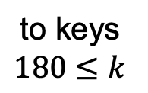
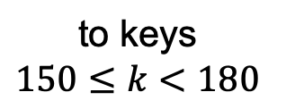
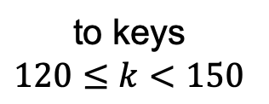
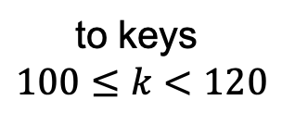
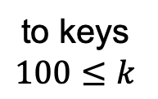
Sample B⁺-tree Nodes
to keys
$$100≤k$$
Max fan-out: 4
Non-leaf
120
150
180
to keys
$$100≤k<120$$
to keys
$$120≤k<150$$
to keys
$$150≤k<180$$
to keys
$$180≤k$$
Leaf
120
130
to next leaf node in sequence
to records with these $k$ values;
or, store records directly in leaves

Slide 39
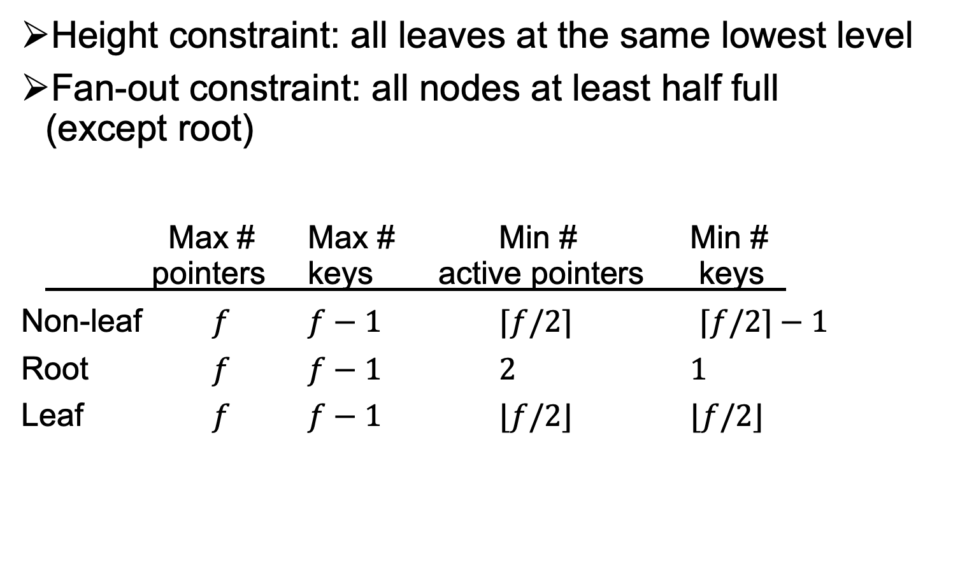
B⁺-tree Balancing Properties
Height constraint: all leaves at the same lowest level
Fan-out constraint: all nodes at least half full
(except root)
Max # Max # Min # Min #
pointers keys active pointers keys
Non-leaf $f$ $f−1$ $⌈f/2⌉$ $⌈f/2⌉−1$
Root $f$ $f−1$ $2$ $1$
Leaf $f$ $f−1$ $⌊f/2⌋$ $⌊f/2⌋$

Slide 40
Lookups
SELECT * FROM R WHERE k = 179;
SELECT * FROM R WHERE k = 32;
100
Max fan-out: 4
30
120
150
180
Not found
179
11
30
35
100
101
110
120
130
150
156
179
180
200
3
5

Slide 41
Range Query
SELECT * FROM R WHERE k > 32 AND k < 179;
100
Max fan-out: 4
30
120
150
180
Look up 32…
100
101
120
130
150
156
179
180
200
100
101
110
120
130
150
156
11
30
35
110
3
5
35
And follow next-leaf pointers until you hit upper bound

Slide 42
Insertion
Insert a record with search key value 32
100
Max fan-out: 4
30
Look up where the
inserted key
should go…
120
150
180
32
100
101
120
130
150
156
179
180
200
3
5
11
30
35
110
And insert it right there

Slide 43
Another Insertion Example
Insert a record with search key value 152
100
Max fan-out: 4
120
150
180
152
100
101
110
120
130
150
156
179
180
200
Node is already full!

Slide 44
Node Splitting
100
Max fan-out: 4
Now this node
becomes full!
120
150
180
156
Need to add to parent node a pointer
to the newly created node
100
101
110
120
130
150
152
156
179
180
200

Slide 45
More Node Splitting
100
156
Max fan-out: 4
Need to add to parent node a pointer
to the newly created node
120
150
180
100
101
110
120
130
150
152
156
179
180
200
In the worst case, node splitting can “propagate” all the way up to the root of the tree (not illustrated here)
  Splitting the root introduces a new root of fan-out 2 and causes the tree to grow “up” by one level (this is why roots can have < f/2-1 keys)

Slide 46
Deletions
Delete a record with search key value 130
100
Max fan-out: 4
Look up the key
to be deleted…
120
150
180
If a sibling has more
than enough keys,
steal one!
100
101
110
120
130
150
156
179
180
200
And delete it
Node is too empty!

Slide 47
Stealing From a Sibling Node
100
Max fan-out: 4
156
Need to fix the key
in the least common ancestor
of the affected nodes
120
150
180
100
101
110
120
150
156
179
180
200
If you are hacker, encourage you to implement the deletion subroutine of an external B+ tree. Quite challenging!

Slide 48
Another Deletion Example
Delete a record with search key value 179
100
Max fan-out: 4
120
156
180
100
101
110
120
150
156
179
180
200
Cannot steal from siblings
Then merge (coalesce) with a sibling!

Slide 49
Merging
100
Max fan-out: 4
Remember to delete the
appropriate key from parent
120
156
180
100
101
110
120
150
156
180
200
Deletion can “propagate” all the way up to the root of the tree (not illustrated here)
  When the root becomes empty, the tree “shrinks” by one level

Slide 50
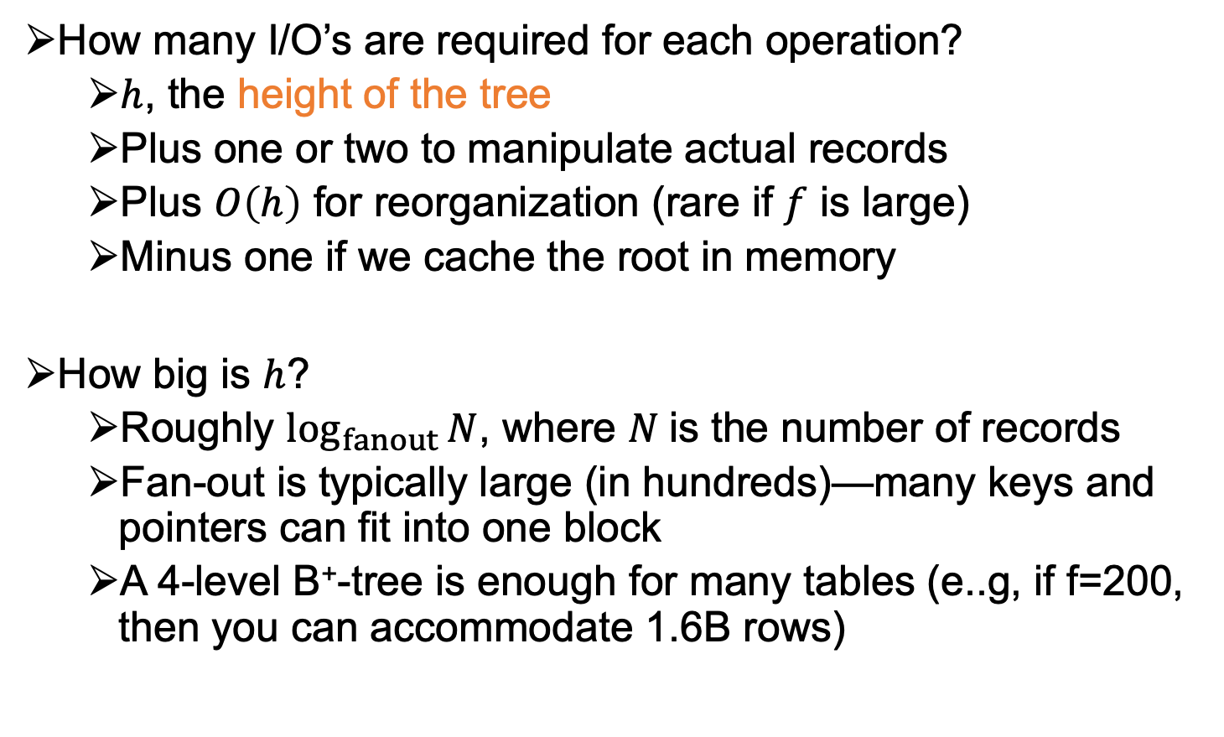
Performance analysis of B⁺-tree
How many I/O’s are required for each operation?
  $h$, the height of the tree
  Plus one or two to manipulate actual records
  Plus $O\left(h\right)$ for reorganization (rare if $f$ is large)
  Minus one if we cache the root in memory
How big is $h$?
  Roughly $\log_{fanout}{N}$, where $N$is the number of records
  Fan-out is typically large (in hundreds)—many keys and pointers can fit into one block
  A 4-level B⁺-tree is enough for many tables (e..g, if f=200, then you can accommodate 1.6B rows)

Slide 51
How to Keep A Table Sorted?
Recall this key question
Recall further note on clustered indices and page order.
100, 123, 192, 200
901, 996
ID.ind
100, 108,
119, 121
996, 997,
…
200, 202,
…
192, 197,
…
901, 907,
…
123, 129,
…
students.mkd
Data pages (original relation)

Slide 52
How to Keep A Table Sorted?
Recall this key question
Recall further note on clustered indices and page order.
Again assume leaf nodes are tuples
Many RDBMSs use “B+ tree files” to store the tables, i.e., entire file is a B+ tree index, with leaf nodes storing tuples (instead of pointers to tuples)
100, 901
100, 123, 192, 200
901, 996
students.mkd
100, 108,
119, 121
996, 997,
…
200, 202,
…
192, 197,
…
901, 907,
…
123, 129,
…
B+ tree file

Slide 53
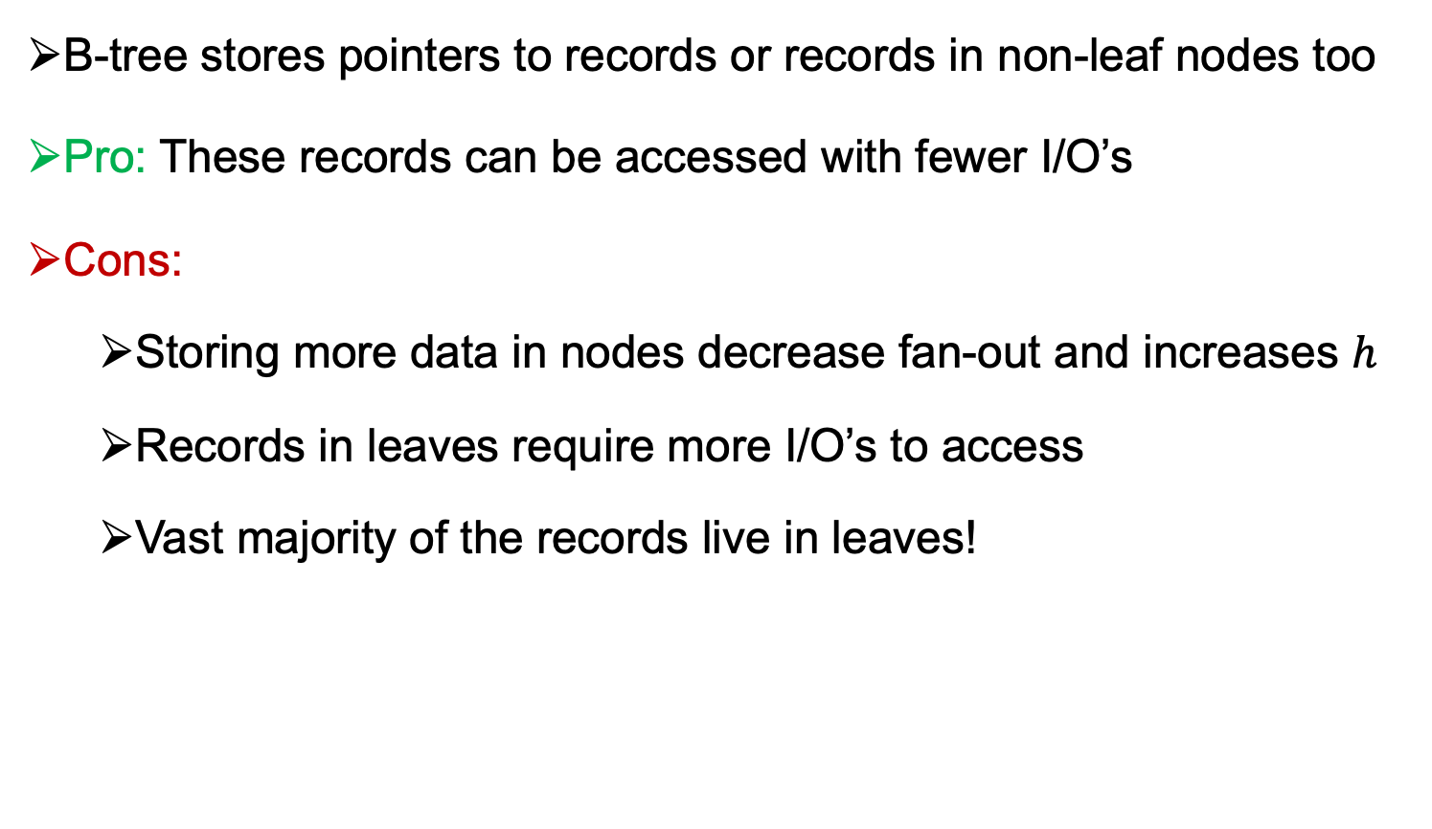
Difference Between B and B+ Tree
B-tree stores pointers to records or records in non-leaf nodes too
Pro: These records can be accessed with fewer I/O’s
Cons:
  Storing more data in nodes decrease fan-out and increases $h$
  Records in leaves require more I/O’s to access
  Vast majority of the records live in leaves!

Slide 54
What Does B Stand For?
No one really knows!
But Edward M. McCreight, co-inventor with Rudolf Bayer, has a video that says:
  They never resolved what B is but they had in mind:
  Boeing, Bayer, and Balance

Slide 55
Other Common Indices
2 Classes of Indices Overall
Tree-based: can do both lookups and range queries
  B/B+ Trees, R Trees, Radix Tree
Hash-based
  Can only do look ups. Cannot do range queries.
  In practice: handle collisions
Many other indices: bitmap indices, probabilistic indices, suffix arrays, GiST or Inverted Index for different applications and data types.
Hash Table
0 | Windel
1
2 | Sherri
3 | Martin
4
5 | Ralph, Bart
6
7 | Nelson
8 | Milhouse
9 | Terri
10 | Lisa
11 | Jessica
123 | Milhouse | 10
142 | Bart | 10
279 | Jessica | 10
345 | Martin | 8
456 | Ralph | 8
512 | Nelson | 10
679 | Sherri | 10
697 | Terri | 10
857 | Lisa | 8
912 | Windel | 8
997 | Jessica | 8
students.mkd

Slide 56
Outline For Today
Recap & Finish Physical File Organization Designs
  Row-oriented Physical Design (Recap)
  Colum-oriented Physical Design
  Hybrid (PAX) Physical Design
  Designs for Variable-length Fields
  Designs for NULLs
Database Indices
  5 Index Designs in Increasing Level of Robustness
  Using Indices In Practice

Slide 57
Using Indices In Practice (1)
Indices can be defined on one ore more attributes:
  CREATE INDEX NameIndex ON User(Lastname,Firstname);
  I.e., B+’s keys are (Lastname, Firstname) pairs and tuples are sorted first by LastName and then Firstname.
  This index would be useful for these queries:
select * from User where Lastname = ‘Smith’
select * from User where Lastname = ‘Smith’ and Firstname=‘John’
  But not this query:
select * from User where Firstname=‘John’
Many systems use indices by default on the primary key
Many systems use indices to implement UNIQUE constraints
  CREATE TABLE Students(
  studentID int,
  sinNumber varchar(16) UNIQUE
  PRIMARY KEY (studentID))
p 1
Will create 2 B+ indices:
on studentID;
2) on sinNumber

Slide 58
Using Indices In Practice (2)
Users only create indices. They do not refer to indices in queries.
Pro: Some user queries will get much faster
  B/c RDBMSs use indices during query evaluation
  Ex: IndexScan operators, or IndexMergeJoin (in Oracle) or IndexNestedLoopJoin etc.
Project
cid
Project
cid
p 1
Recall Plan Transformation during Query Optimization
Join
P.pid=O.pid
HashJoin
L.$3=R.$3
Join
C.cid=O.cid
Filter
name=BookA
HashJoin
L.$3=R.2
Scan Table
Order
Scan Table
Customer
Scan Table
Product
name=BookA
IndexScan
Product
name=BookA
FileScan
Order
FileScan
Customer

Slide 59
Using Indices In Practice (3)
Con: Updates will get slower because indices need to be maintained
Q: How should users pick indices given a workload W (i.e., the set of queries an application asks and their frequencies)
General Guideline:
  Profile slow queries. Check if they have =, <, ≤, >, ≥ predicates
SELECT * FROM R WHERE A = value;
SELECT * FROM R WHERE A = value AND B = 27;
  SELECT * FROM R, S WHERE R.A = S.C;
  SELECT * FROM S WHERE D > 50;
  E.g., above indices on R.A, R.A and R.B multicolumn, S.C, S.D are possible indices that can speed queries
  But one should weigh these benefits against slow downs due to updates
p 1
59

Slide 60
Using Indices In Practice (4)
Many RDBMSs have “Physical Design Advisor” (PDA) tool
Input: Database D (w/ existing indices), workload W
Output: A set of recommended indices
Internally PDA does a “what if” analysis:
  Uses Query Optimizer & inspects the estimated runtimes/costs of plans the system would use for queries in W with & without additional indices
p 1
can include updates
W = {<Q₁, f₁>,…, <Q_{k}, f_{k}>}
Query Optimizer
D = {R₁, …, R_{n}},
{Ind₁, …, Ind_{z}}
Ind_{z+1}?
Inspects the costs of these generated plans to recommend a set of indices to develop
Generate Plans for each Q_{i}
60

Slide 61
The Halloween Problem: An Interesting Note On Challenging Problems a DBMS has to solve
Story from the early days of System R:
  UPDATE Payroll
  SET salary = salary * 1.1
  WHERE salary >= 100000;
  There is a B⁺-tree index on Payroll(salary)
  The update never stopped (why?)
Why?
How could you try to solve this if you implemented System R.

