Slide 1

CS 348: Lecture 20
Acknowledgements & Beyond CS 348
  Semih Salihoğlu
  March 29, 2022

Slide 2
Announcements
A5 due on April 1st midnight
A6 will be released on April 4th midnight (you have 24 hrs)
  Cumulative
  Expect Relational Algebra Question
  Expect SQL Question
  Expect a Processing or Optimization Question
  Expect a Transaction Question
  But other topics will be covered too
  Length will be fair

Slide 3
Outline
Courses/Topics Beyond 348
GraphflowDB: Graph Database Management Systems
MapReduce

Slide 4
Outline
Courses/Topics Beyond 348
GraphflowDB: Graph Database Management Systems
MapReduce

Slide 5
CS 348 Diagram
User/Administrator Perspective
Primary Database Management System Features
Data Model: Relational Model
High Level Query Language: Relational Algebra & SQL
Integrity Constraints
Indexes/Views
Transactions
Relational Database Design
E/R Models
Normal Forms
How To Program A DBMS (0.5-1 lecture)
Embedded vs Dynamic SQL
Frameworks
DBMS Architect/Implementer Perspective
Other (Last 1/2 Lectures)
Graph DBMSs
MapReduce: Distributed Data Processing Systems
Physical Record Design
Query Planning and Optimization
Indexes
Transactions

Slide 6
Before/After CS 348
SAP, Oracle, Microsoft, IBM, Snowflake, Databricks, Neo4j, CockroachDB, GraphflowDB, …
SQL vs NoSQL?
RDBMs vs GDBMs vs Key-Value or Document Store?
….
Relational Model, SQL
DB Design & Tuning
Transactions
DB Internal Architecture

Slide 7
Beyond CS 348
CS 448: Database Systems Implementation
  Design and implementation of core DBMS components:
    Data layout, disk-based data structures, indexing, query processing algorithms, query optimization, transactional concurrency control, logging and recovery.
CS 451: Data-Intensive Distributed Computing
  How to scale data-intensive computations (e.g., petabyte scale)
  Big data stack, e.g., Spark, Storm, Hadoop
  Text, graphs, data mining, machine learning systems software
Interested in research on data processing and management systems?
  Reach out to me and DSG faculty for research positions.

Slide 8
Outline
Courses/Topics Beyond 348
GraphflowDB: Graph Database Management Systems
MapReduce

Slide 9
Graphs vs Tables?
Never Ending Dichotomy in Data Models
Two of the most natural data structures to model
enterprise application data
Relation X
Entity B
Entity A
… | … | …
… | … | …
… | … | …
… | … | …
Entity B
… | …
… | …
… | …
… | …
Relation X
… | … | …
… | … | …
… | … | …
… | … | …
Entity A
Relation Y
Entity C
Other data structures
  Arrays/Matrices: images, videos, locations, etc.
  Documents
  Lists (earlier)

Slide 10





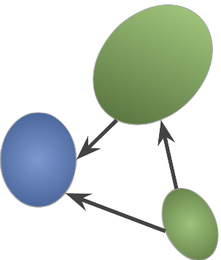
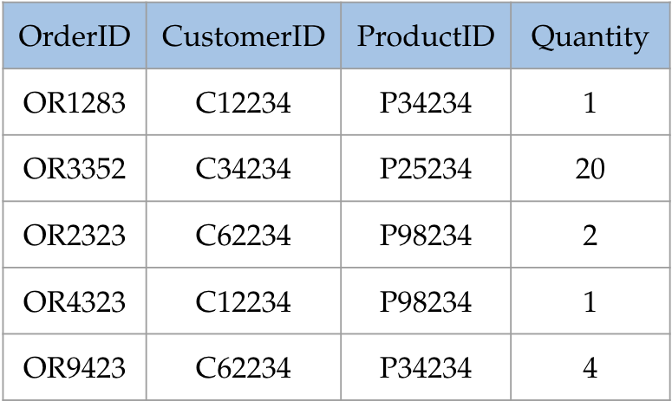




Key Takeaway: Dual View of Enterprise Data
Graphs, tables, or arrays don’t exist in real world
Real events/facts that enterprises store as records
More interesting question: When is one model more appropriate than another?

Slide 11










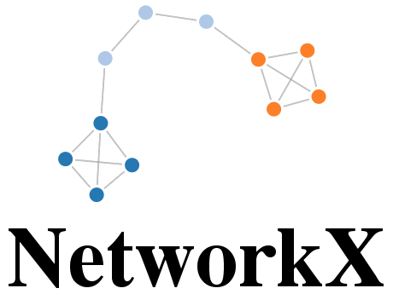

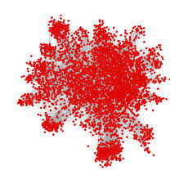




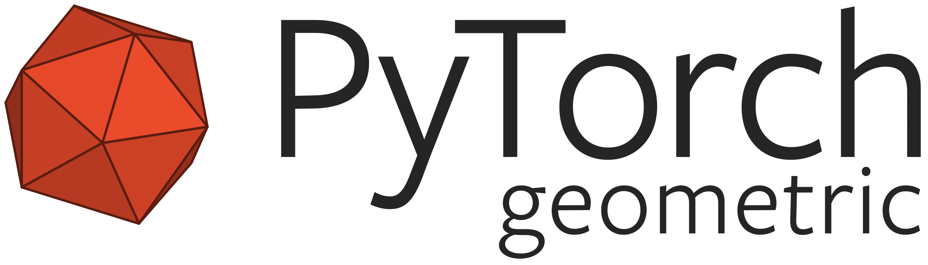

Graph Processing Systems
Graph DB Management Systems
RDF Systems
Graph Analytics Systems
Graph Visualization Software
GPS

Slide 12
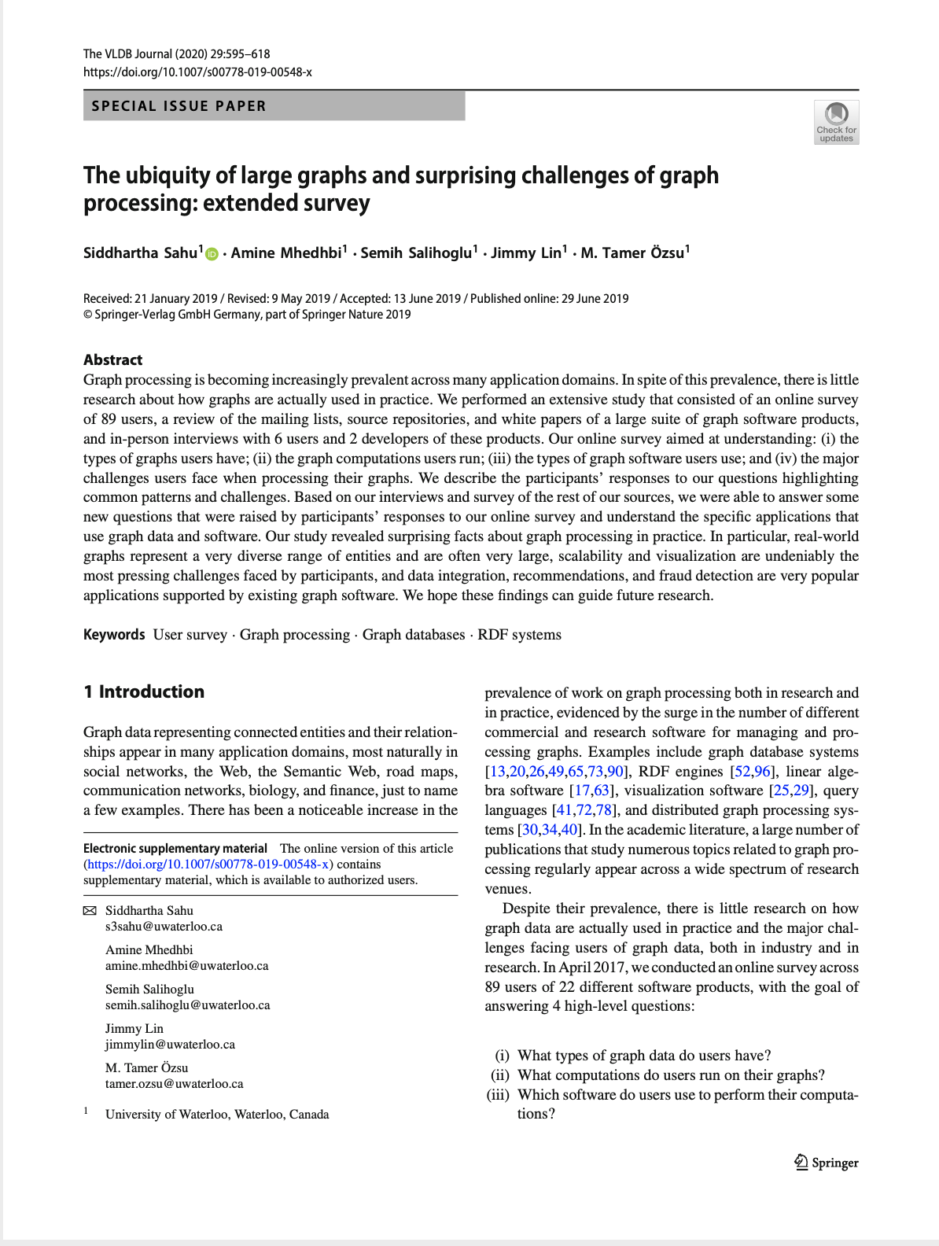
How Are Graphs and Graph Systems Used In Practice?
A User Survey
Sahu et. al. VLDBJ 2019
Q1: Graph Data?
Q2: Graph Computations?
Q3: Graph Software?
Q4: Main Challenges?
Q5: Applications?

Slide 13
Graph Database Management Systems Overview
Read-optimized database management systems designed for read-heavy workloads with large many-to-many (n-n) joins
Data Model
Query Language
System
Labeled Graph
Graph-specific SQL
Storage: Graph-specific
name:Alice
MATCH a->b->c,c->a
WHERE a.age > 30
RETURN (a,b).amount
1
1 | 2 | 3 | 4
amount: 700
amount: 700
2
3
4
1
4
5
3
2
amount: 700
Query Processor: Fast traversals, i.e., nested index loop joins
name: Carol
name:Bob

Slide 14
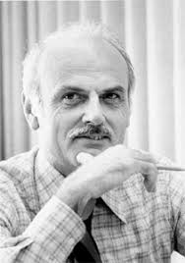
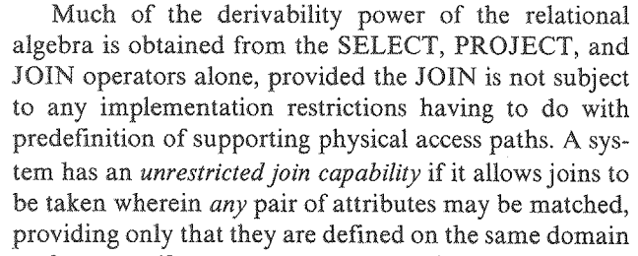
Differences Between Native GDBMSs vs RDBMSs (1)
Pre-defined/Pointer-based joins vs Value-based Joins
Network Model (1960s)
IDS: First DBMS in history
Relational Model (1970s)
Charles Bachman
Ted Codd
… but also the reason GDBMSs can be very fast at those joins.

Slide 15
Differences Between Native GDBMSs vs RDBMSs (2)
Pre-defined/Pointer-based joins (access paths)
Semi-structured data model
  No fixed schema
Better support for variable-length recursive join queries
“Give me all direct or indirect possible sources of money flow into Alice’s account from Canada.”
MATCH a-[:Transfer*]->b
WHERE a.location=Canada AND b.owner=Alice
  Can be done in recursive SQL but harder

Slide 16
Example Semi-structured Datasets (1)
Application: Question Answering over knowledge bases: encyclopedic facts about real-world entities
  Also called “Knowledge Graphs”
Often too complex to structure: cannot have a fixed schema
Consider encoding all facts about Canadian Universities
University of Waterloo vs York University
Different faculty structures
Different department structures
Different cirricula
Cannot tabulate this information. Need a flexible model.
school
Pure Math
faculty
Math
course
CS 341
school
UWaterloo
CS
faculty
course
CS 348
Humanities

Slide 17
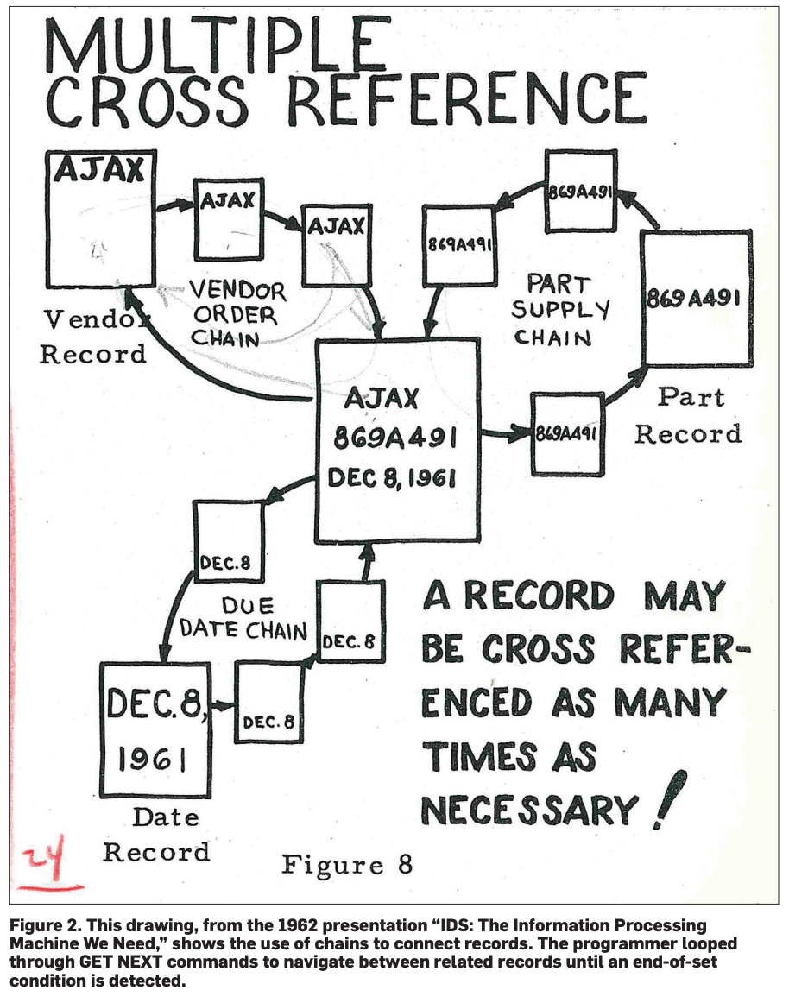
Links & a 1962 Drawing of IDS’s Network Model
Haigh’s Paper on the Birth of DBs and IDS (2006): "A Veritable Bucket of Facts”: Origins of the Data Base Management System
Bachman’s Turing Award Lecture (1973): Programmer As a Navigator
Bachman’s Talk (2002) at Computer History Museum
Codd’s Turing Award Lecture (1981): Relational Database: A Practical Foundation for Productivity

Slide 18
In-memory Graph DBMS: Property graph model & openCypher
Two primary features:
  Very fast n-n joins:
  Scalability: compressed, in-memory columnar storage
GraphflowDB | RDBMS Literature
List-based, Factorized Query Processor | Factorized DBs
Multiway intersection-based joins | WCO joins
A+ Indexes: Flexible Adjacency List Indexes | Materialized Views

Slide 19
Flat Block-based Processing In Read-optimized RDBMSs
Columnar RDBMSs, e.g., Vectorwise, MonetDB, Vertica
Optimized for OLAP workloads (online analytical processing)
  Read-heavy but joins are not n-n, and aggregation-heavy
Operators process a block of flat tuples at-a-time in for loops.
SELECT dep, avg(age)
FROM Employee E
WHERE age > 30
GroupBy & Aggregate
key: dep, aggr: avg(age)
Scan Employees: age > 30, dep
dep | age | fmask
IT | 25
Sales | 29
HR | 34
HR | 35
Sales | 46
dep | age | fmask
IT | 25 | 0
Sales | 29
HR | 34
HR | 35
Sales | 46
dep | age | fmask
IT | 25 | 0
Sales | 29 | 0
HR | 34
HR | 35
Sales | 46
dep | age | fmask
IT | 25 | 0
Sales | 29 | 0
HR | 34 | 1
HR | 35
Sales | 46
dep | age | fmask
IT | 25 | 0
Sales | 29 | 0
HR | 34 | 1
HR | 35 | 1
Sales | 46
dep | age | fmask
IT | 25 | 0
Sales | 29 | 0
HR | 34 | 1
HR | 35 | 1
Sales | 46 | 1
Employee
eID | age | dep
3121 | 25 | IT
2431 | 29 | Sales
1113 | 34 | HR
5110 | 35 | HR
9926 | 46 | Sales
dep | age
IT | 25
Sales | 29
HR | 34
HR | 35
Sales | 46
Block-based: Good CPU utilization
Flat Tuples: Not optimized for n-n joins

Slide 20
Value Repetitions When Performing n-n Joins
MATCH
WHERE b.owner=‘Liz’ AND
a.cntr=‘US’ AND c.cntr=‘CAN’
a
b
c
U₁
C₁
…
…
L₁
…
…
U₁₀₀
C₁₀₀
…
…
L₂
…
…
Scan (b)
owner=Liz
Extend (a)
Extend (c)
U₁₉₉
C₁₉₉
b | owner | fmask
L₁ | Liz | 1
L₂ | Liz | 1
U₁ | Ken | 0
… | … | …
U₁₉₉ | Bob | 0
b | owner | a | c | fmask
L₁ | Liz | U₁ | C₁ | 1
L₁ | Liz | U₁ | C₂ | 1
 | … | … | … | …
L₁ | Liz | U₁ | C₁₀₀ | 1
L₁ | Liz | U₂ | C₁ | 1
L₁ | Liz | U₂ | C₂ | 1
… | … | … | … | …
L₁ | Liz | U₂ | C₁₀₀ | 1
Repetition happens b/c 1 group of vectors represent a block of flat tuples

Slide 21
F-Representation-based Processor (1)
Flat Representation
F-Representation
b | owner | a | c
L₁ | Liz | U₁ | C₁
 | … | … | …
L₁ | Liz | U₁ | C₁₀₀
L₂ | Liz | U₁₀₀ | C₁₀₀
… | … | … | …
L₂ | Liz | U₁₉₉ | C₁₀₀
b, owner |  | a |  | c
{L₁, Liz} | X | {U_{1,}…, U₁₀₀} | X | {C₁, …, C₁₀₀}
U
{L₂, Liz} | X | {U_{100,}…, U₁₉₉} | X | {C₁₀₀, …, C₁₉₉}
2x(100+100) tuples
2x(100x100) tuples
Factorizing arbitrary relations is NP-hard
But: outputs of a query Q can be factorized by analyzing the conditional independence of the variables in Q
  E.g. in , once b is fixed, a and c are independent
a
b
c
Multiple List Groups: Represent intermediate tuples in multiple vector groups
Olteanu et. al. Factorized Databases, SIGMOD Record, 2016

Slide 22
F-Representation-based Processor (2)
MATCH
WHERE b.owner=‘Liz’ AND
a.cntr=‘US’ AND c.cntr=‘CAN’
U₁
C₁
a
b
c
…
…
L₁
…
…
U₁₀₀
C₁₀₀
…
…
L₂
…
…
U₁₉₉
C₁₉₉
Scan (b)
owner=Liz
Extend (a)
Extend (c)
List Group 1
List Group 2
List Group 3
b | owner | fmask
L₁ | Liz | 1
L₂ | Liz | 1
U₁ | Ken | 0
… | … | …
U₁₉₉ | Bob | 0
a | fmask
U₁ | 1
U₂ | 1
… | …
U₁₀₀ | 1
c | fmask
C₁ | 1
C₂ | 1
… | …
C₁₀₀ | 1
a | fmask
U₁₀₀ | 1
U₁₀₁ | 1
… | …
U₁₉₉ | 1
c | fmask
C₁₀₀ | 1
C₁₀₁ | 1
… | …
C₁₉₉ | 1
c | fmask
curIdx = -1
curIdx = -1
curIdx = 1
curIdx = 2
curIdx = -1

Slide 23
F-Representation-based Processor (3)
Microbenchmark: 1-, 2-, 3-hop path queries
  FILTER: last edge have a predicate, e.g.:
  COUNT: counts the number of paths
LDBC Soc. Network Benchmark scale 100 (1.7B edges), Flickr (33M edges)
GF-Flat vs GF-FRep
e₁
e₂
MATCH WHERE e2.date > 2021-03
a
b
c
 | LDBC100 |  |  |  |  |  | FLICKR
 | FILTER |  |  | COUNT(*) |  |  | FILTER |  |  | COUNT(*)
 | 1h | 2h | 3h | 1h | 2h | 3h | 1h | 2h | 3h | 1h | 2h | 3h
Flat | 0.02 | 1.4 | 40.0 | 0.02 | 0.3 | 6.9 | 0.03 | 1.3 | 14.8 | 0.03 | 0.5 | 4.1
FRep | 0.01 3.2x | 0.1 12.7x | 6.9 15.2x | 0.01 3.2x | 0.02 12.8x | 0.4 19.4x | 0.01 2.7x | 0.1 13.7x | 1.2 12.4x | 0.02 2.1x | 0.02 21.4x | 0.05 80.6x
runtimes in seconds
Also large differences with 3 baseline commercial systems (see paper)
Integrating Column-Oriented Storage and Query Proc. Techniques Into GDBMSs, Gupta et al., arXiv 2021

Slide 24
Further Value Repetitions
MATCH
WHERE a.cntr=‘US’ & e.cntr=‘CAN’
D₁
a
b
c
d
C₁
B₁
D₂
A₁
C₂
B₂
D₃
Most compact output: relevant subgraph
C₃
A₂
B₃
D₄
Scan (a)
cntr=`US’
Extend (b)
Extend (c)
Extend (d)
C₄
D₅
LG1
LG2
LG3
LG4
a |  | b |  | c |  | d
…
{A₁} | X | {B₁} | X | {C₂} | X | {D₂, D₃}
{A₁} | X | {B₂} | X | {C₂} | X | {D₂, D₃}
{A₁} | X | {B₂} | X | {C₃} | X | {D₃, D₄}
{A₂} | X | {B₂} | X | {C₂} | X | {D₃, D₄}
{A₂} | X | {B₂} | X | {C₃} | X | {D₃, D₄}
…
F-Representation

Slide 25
Further Value Repetitions
MATCH
WHERE a.cntr=‘US’ & e.cntr=‘CAD’
D₁
a
b
c
d
C₁
B₁
D₂
A₁
C₂
B₂
D₃
Most compact output: relevant subgraph
C₃
A₂
B₃
D₄
Scan (a)
cntr=`US’
Extend (b)
Extend (c)
Extend (d)
C₄
D₅
LG1
LG2
LG3
LG4
a |  | b |  | c |  | d
…
{A₁} | X | {B₁} | X | {C₂} | X | {D₂, D₃}
{A₁} | X | {B₂} | X | {C₂} | X | {D₂, D₃}
{A₁} | X | {B₂} | X | {C₃} | X | {D₃, D₄}
{A₂} | X | {B₂} | X | {C₂} | X | {D₃, D₄}
{A₂} | X | {B₂} | X | {C₃} | X | {D₃, D₄}
…
F-Representation

Slide 26
Further Value Repetitions
MATCH
WHERE a.cntr=‘US’ & e.cntr=‘CAD’
D₁
a
b
c
d
C₁
B₁
D₂
A₁
C₂
B₂
D₃
Most compact output: relevant subgraph
C₃
A₂
B₃
D₄
Scan (a)
cntr=`US’
Extend (b)
Extend (c)
Extend (d)
C₄
D₅
LG1
LG2
LG3
LG4
a |  | b |  | c |  | d
…
{A₁} | X | {B₁} | X | {C₂} | X | {D₂, D₃}
{A₁} | X | {B₂} | X | {C₂} | X | {D₂, D₃}
{A₁} | X | {B₂} | X | {C₃} | X | {D₃, D₄}
{A₂} | X | {B₂} | X | {C₂} | X | {D₃, D₄}
{A₂} | X | {B₂} | X | {C₃} | X | {D₃, D₄}
…
F-Representation

Slide 27
Further Value Repetitions
MATCH
WHERE a.cntr=‘US’ & e.cntr=‘CAD’
D₁
a
b
c
d
C₁
B₁
D₂
A₁
C₂
B₂
D₃
Most compact output: relevant subgraph
C₃
A₂
B₃
D₄
Scan (a)
cntr=`US’
Extend (b)
Extend (c)
Extend (d)
C₄
D₅
LG1
LG2
LG3
LG4
a |  | b |  | c |  | d
…
{A₁} | X | {B₁} | X | {C₂} | X | {D₂, D₃}
{A₁} | X | {B₂} | X | {C₂} | X | {D₂, D₃}
{A₁} | X | {B₂} | X | {C₃} | X | {D₃, D₄}
{A₂} | X | {B₂} | X | {C₂} | X | {D₃, D₄}
{A₂} | X | {B₂} | X | {C₃} | X | {D₃, D₄}
…
F-Representation

Slide 28
Further Value Repetitions
MATCH
WHERE a.cntr=‘US’ & e.cntr=‘CAD’
D₁
a
b
c
d
C₁
B₁
D₂
A₁
C₂
B₂
D₃
Most compact output: relevant subgraph
C₃
A₂
B₃
D₄
Scan (a)
cntr=`US’
Extend (b)
Extend (c)
Extend (d)
C₄
D₅
LG1
LG2
LG3
LG4
a |  | b |  | c |  | d
…
{A₁} | X | {B₁} | X | {C₂} | X | {D₂, D₃}
{A₁} | X | {B₂} | X | {C₂} | X | {D₂, D₃}
{A₁} | X | {B₂} | X | {C₃} | X | {D₃, D₄}
{A₂} | X | {B₂} | X | {C₂} | X | {D₃, D₄}
{A₂} | X | {B₂} | X | {C₃} | X | {D₃, D₄}
…
F-representations do not capture such repetitions
Need to group tuples into sets and point to them
F-Representation

Slide 29
D-Representations [Olteanu et al., TODS 2015]
D₁
C₁
B₁
D₂
A₁
C₂
B₂
D₃
C₃
A₂
B₃
D₄
C₄
D₅
F-Representation
D-Representation
a |  | b |  | c |  | d
…
{A₁} | X | {B₁} | X | {C₂} | X | {D₂, D₃}
{A₁} | X | {B₂} | X | {C₂} | X | {D₂, D₃}
{A₁} | X | {B₂} | X | {C₃} | X | {D₃, D₄}
{A₂} | X | {B₂} | X | {C₂} | X | {D₃, D₄}
{A₂} | X | {B₂} | X | {C₃} | X | {D₃, D₄}
…
Expr | c |  | d
DN_{C1} | {C₁} | X | {D₁, D₂}
DN_{C2} | {C₂} | X | {D₂, D₃}
DN_{C3} | {C₃} | X | {D₃, D₄}
DN_{C4} | {C₄} | X | {D₄, D₅}
Expr | b |  | {c, d}
DN_{B1} | {B₁} | X | {DN_{C1}, DN_{C2}}
DN_{B2} | {B₂} | X | {DN_{C2}, DN_{C3}}
DN_{B3} | {B₃} | X | {DN_{C3}, DN_{C4}}
a |  | {b, c, d}
{A₁} | X | {DN_{B1}, DN_{B2}}
{A₂} | X | {DN_{B2}, DN_{B3}}

Slide 30
D-Representation-based Processor (1)
MATCH
WHERE a.cntr=‘US’ & e.cntr=‘CAD’
a
b
c
d
Scan (a)
cntr=`US’
Extend (b)
Extend (c)
Extend (d)
DGroup (d by c)
DGroup (c by b)
Sink
Expr | b |  | {c, d}
DN_{B1} | {B₁} | X | {DN_{C1}, DN_{C2}}
DN_{B2} | {B₂} | X | {DN_{C2}, DN_{C3}}
DN_{B3} | {B₃} | X | {DN_{C3}, DN_{C4}}
DGroup: Constructs and puts D-reps into shared caches with join operators
DAG style plans: operator to skip sub-plans when there is a cache hit
Every other operator is list-based, so operates on blocks

Slide 31
D-Representation-based Processor (2)
LDBC Social Network Benchmark, Scale factor 10, 176M edges
Ex:
GF-FRep vs GF-DRep
MATCH
WHERE a.name=‘Alice’ & e₄.date > 2021-03
Knows
Knows
memberOf
e₄:contains
a:Per
b:Per
c:Per
d:For
e:Post
 | IC1 | IC2 | IC3 | IC4 | IC5 | IC6 | IC7 | IC8 | IC9 | IC10
GF-FRep | 7.1 | 6.5 | 80.4 | 0.36 | 188.0 | 21.0 | 0.17 | 0.05 | 181.5 | 0.85
GF-DRep | 0.2 30.0x | 3.0 2.2x | 5.2 15.3x | 0.40 0.9x | 5.8 32.1x | 0.9 23.0x | 0.17 1.0x | 0.07 0.7x | 9.7 18.7x | 0.21 4.1x
runtimes in seconds

Slide 32
Outline
Courses/Topics Beyond 348
GraphflowDB: Graph Database Management Systems
MapReduce

Slide 33
Google’s Large-scale Applications
Many applications processing very large data: (in Petabytes)
Ex: Trillions of web pages, ad clicks, queries, videos, images
construct web graph
summarize pages per host
Host | # Pages
cnn.com | 1300
yahoo.com | 4845
uwaterloo.ca | 762
techcrunch.com | 2582
… | …

Slide 34
Google’s Large-scale Applications
word | Pages
trudeau | cbc.ca, nytimes.com, wikipedia.org, …
apple | apple.com, farming.ca, …
computer | ibm.com, wikipedia.org,…
… | …
inverted index
user | clicks
user1 | cbc.ca
user1 | techcrunch.com
user2 | wikipedia.com
user3 | uwaterloo.ca
user3 | abc.ca
… | …
clustering “similar” users
(recommendation)
Many others: Ad clicks, videos, images, internal machine logs, etc…

Slide 35
Google’s Problem
Need 100s/1000s machines to process such large data.
Cluster
X
User code
User code
User code
Data
Data
…
Data
Machine 1
Machine 2
M 1K
But: Writing distributed code is very difficult! Need code for:
  Partitioning data.
  Parallelizing computation.
  Coordinating the progress.
Communication of machines.
Dealing with machine failures!
Others: load-balancing, etc.
All much more complex than the simple application logic!
  E.g: Take each web doc. & spit out an edge for each hyperlink

Slide 36
“Law of Large-Scale Distributed Systems”
Law of Hardware: Like humans, hardwares live & die
Consider a super reliable machine: Mean-time-btw-failure: 30 years
  At any day prob. failure: ~1/10000
  Consider a distributed system running on 10000 machines
  Q: Prob a machine will die at any day?
  A: 64%
  **Fact of Life: Machines will fail frequently at large-scale.**

Slide 37
Google’s Previous Solution
Special-purpose distributed program for each application.
Problem: Not scalable
  Difficult for many engineers to write parallel code
  Development speed: Thousands lines for simple applications.
  Code repetition for common tasks:
    Data Partitioning
    Code parallelizing, Fault-tolerance etc.

Slide 38
Google’s New Solution: MapReduce
Distr. Data Processing System with 3 fundamental properties:
  Transparent Parallelism
    i.e: User-code parallelization & data partitioning automatically done by the system
  Transparent Fault-tolerance
    i.e: Recovery from failures is automatic
  A Simple Programming API
    map() & reduce()

Slide 39

MapReduce Overview
Cluster
r₁
<k₁, v₁>
Out₁
Mapper
Machine₁
map()
<k₁, v₂>
<k₁, {v₁, v₂}>
Reducer
Machine₁
o₁
r₂
map()
o₂
r₃
map()
<k₂, v₂>
reduce()
<k_{p}, v₄>
Out₂
Mapper
Machine₂
r₄
map()
<k₂, {v₂, v₅, …, v_{m}}>
o₃
r₅
map()
Reducer
Machine₂
o₄
r₆
map()
<k_{p}, v₅>
reduce()
o₅
…
<k₂, v_{m-1}>
…
…
<k_{p}, v_{m-2}>
r_{m-2}
map()
<k_{p}, v_{m}>
Out_{p}
Mapper
Machine_{k}
r_{m-1}
<k_{p}, {v₁, v₄, …, v_{m-2}}>
Reducer
Machine_{p}
o_{t-1}
r_{m}
map()
map()
reduce()
o_{t}
map() function
reduce() function

Slide 40
Example 1: Word Count
Mapper Machine₁
Reducer Machine₁
apple
bob
map()
<apple, 1>
<apple, {1, 1, … ,1}>
map()
apple | 100
<bob, 1>
reduce()
Reducer Machine₂
Mapper Machine₂
<bob, 1>
map()
<bob, {1, 1, … ,1}>
bob | 70
bob
carol
map()
<carol, 1>
reduce()
<apple, 1>
…
…
Reducer Machine_{p}
Mapper Machine_{k}
<cat, {1, 1, … ,1}>
apple
cat
map()
<cat, 1>
cat | 30
reduce()
map()
map(String word) → <word, 1>
reduce(String word, List<Integer> ones): → <word, sum(ones)>

Slide 41
Example 2: Reversing Web-Link Graph
Mapper Machine₁
Reducer Machine₁
<cnn, uw>
<uw, {cnn}>
map()
uw | {cnn}
reduce()
uw.ca
<cbc, uw>
Reducer Machine₂
Mapper Machine₂
<cbc, cnn>
<cbc, {uw, cnn}>
cbc | {uw, cnn}
map()
reduce()
<twitter, cnn>
cnn.com
…
…
Reducer Machine_{p}
Mapper Machine_{k}
<twitter, {cnn, times}>
twitter | {cnn, times}
map()
<twitter, times>
reduce()
times.com
map(Doc srcDoc) → for (link dstLink in srcDoc): <dstLink, srcDoc.link>
reduce(String target, List<Long> srcs): → <target, srcs>

Slide 42
More Detailed Architecture
Worker 2
coordinates: workers
for progress, fault recovery, synchrn.
Worker 1
Worker 3
Master
Input₁
Input₂
Input₃
Distributed Storage (E.g., Distr. File System, Distr. Database)

Slide 43
More Detailed Architecture
Map Stage
(1st Superstep)
Worker 2
map()
Input₂
int-data₁
int-data₃
map()
map()
Input₁
int-data₂
Input₃
int-data₁
int-data₃
coordinates: workers
for progress, fault recovery, synchrn.
int-data₂
Worker 1
Worker 3
Master
Input₁
Input₂
Input₃
Distributed Storage (E.g., Distr. File System, Distr. Database)

Slide 44
More Detailed Architecture
Shuffle Stage
(1st Superstep)
Worker 2
int-data₁
int-data₃
int-data₂
int-data₁
int-data₃
coordinates: workers
for progress, fault recovery, synchrn.
int-data₂
Worker 1
Worker 3
Master
Input₁
Input₂
Input₃
Distributed Storage (E.g., Distr. File System, Distr. Database)

Slide 45
More Detailed Architecture
Reduce Stage
(2nd superstep)
Worker 2
reduce()
int-data₂
int-data₁
int-data₂
int-data₃
reduce()
reduce()
int-data₁
int-data₂
int-data₃
int-data₁
int-data₁
int-data₃
coordinates: workers
for progress, fault recovery, synchrn.
int-data₃
int-data₂
Worker 1
Worker 3
Master
Input₁
Input₂
Input₃
Distributed Storage (E.g., Distr. File System, Distr. Database)
Out₁
Out₂
Out₃

Slide 46
More Detailed Architecture
End of Computation
Worker 2
coordinates: workers
for progress, fault recovery, synchrn.
Worker 1
Worker 3
Master
Input₁
Input₂
Input₃
Distributed Storage (E.g., Distr. File System, Distr. Database)
Out₁
Out₂
Out₃

Slide 47

Acknowledgements
Prof Xi He!
All TAs: Guy Coccimiglio, Amine Mhedhbi, Karl Knopf, Chang Liu, Glaucia Melo, Jessica Saini
Sylvie Davies

Slide 48
Thank you!

