Slide 1
SQL: Part II
Introduction to Database Management
CS348 Spring 2021

Slide 2
Basic SQL features
Query
  SELECT-FROM-WHERE statements
  Set/bag (DISTINCT, UNION/EXCEPT/INTERSECT (ALL))
  Subqueries (table, scalar, IN, EXISTS, ALL, ANY)
  Aggregation and grouping (GROUP BY, HAVING)
  Ordering (ORDER)
  Outerjoins (and Nulls)
Modification
  INSERT/DELETE/UPDATE
Constraints
Lecture 4

Slide 3
Incomplete information
Example: User (uid, name, age, pop)
Value unknown
  We do not know Nelson’s age
Value not applicable
  Suppose pop is based on interactions with others on our social networking site
  Nelson is new to our site; what is his pop?

Slide 4
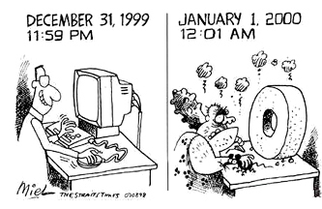

Solution 1
Dedicate a value from each domain (type)
  pop cannot be $−1$, so use $−1$ as a special value to indicate a missing or invalid pop
  Perhaps the value is not
  as special as you think!
    the Y2K bug
Incorrect answers
SELECT AVG(pop) FROM User;
SELECT AVG(pop) FROM User WHERE pop <> -1;
Complicated
http://www.90s411.com/images/y2k-cartoon.jpg

Slide 5
Solution 2
A valid-bit for every column
  User (uid,
  name, name_is_valid,
  age, age_is_valid,
  pop, pop_is_valid)
  Complicates schema and queries
SELECT AVG(pop) FROM User WHERE pop_is_valid;

Slide 6
Solution 3
Decompose the table; missing row = missing value
  UserName (uid, name)
  UserAge (uid, age)
  UserPop (uid, pop)
  UserID (uid)
Conceptually the cleanest solution
Still complicates schema and queries
  How to get all information about users in a table?
  Natural join doesn’t work!

Slide 7

SQL’s solution
A special value NULL
  For every domain
  Special rules for dealing with NULL’s
Example: User (uid, name, age, pop)
  $\left\langle \text{789, “}\text{Nelson}\text{”, }\text{NULL}\text{,} \text{NULL}\right\rangle$

Slide 8
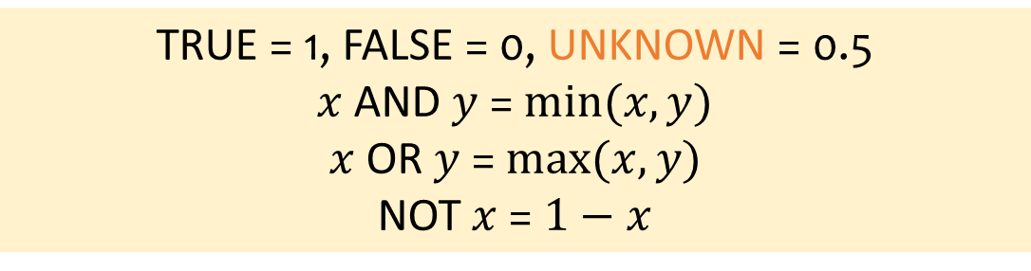
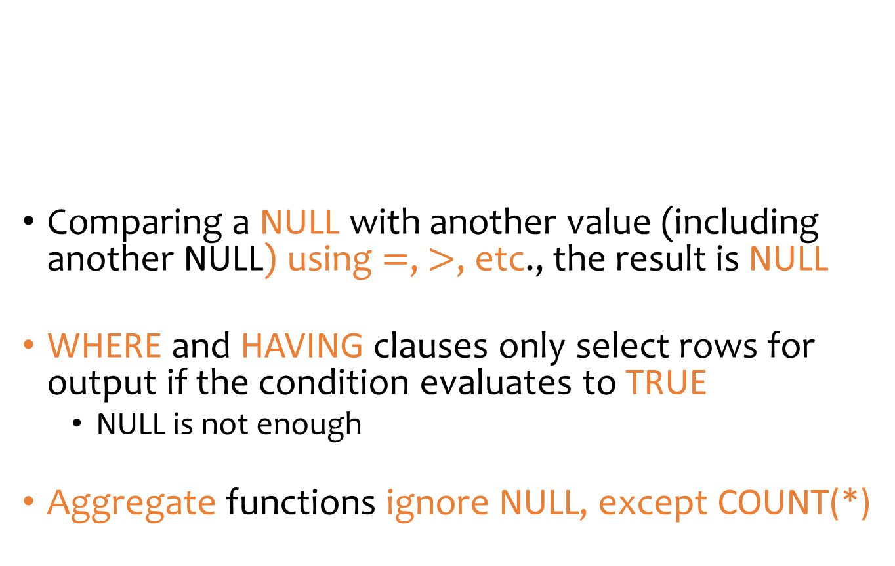
Three-valued logic
TRUE = 1, FALSE = 0, UNKNOWN = 0.5
$x$ AND $y$ = $min⁡(x, y)$
$x$ OR $y$ = $max⁡(x, y)$
NOT $x$ = $1−x$
Comparing a NULL with another value (including another NULL) using $=$, $>$, etc., the result is NULL
WHERE and HAVING clauses only select rows for output if the condition evaluates to TRUE
  NULL is not enough
Aggregate functions ignore NULL, except COUNT(*)

Slide 9
Unfortunate consequences
Q1a = Q1b?
Q2a = Q2b?
Be careful: NULL breaks many equivalences
Q1a. SELECT AVG(pop) FROM User;
Q1b. SELECT SUM(pop)/COUNT(*) FROM User;
Q2a. SELECT * FROM User;
Q2b SELECT * FROM User WHERE pop=pop;

Slide 10
Another problem
Example: Who has NULL pop values?
SQL introduced special, built-in predicates
IS NULL and IS NOT NULL
SELECT * FROM User WHERE pop = NULL;
Does not work!
(SELEC * FROM User)
EXCEPT ALL
(SELECT * FROM USER WHERE pop=pop);
Works, but ugly
SELECT * FROM User WHERE pop IS NULL;

Slide 11
Outerjoin motivation
Example: a master group membership list
What if a group is empty?
It may be reasonable for the master list to include empty groups as well
  For these groups, uid and uname columns would be NULL
  SELECT g.gid, g.name AS gname,
  u.uid, u.name AS uname
  FROM Group g, Member m, User u
  WHERE g.gid = m.gid AND m.uid = u.uid;

Slide 12

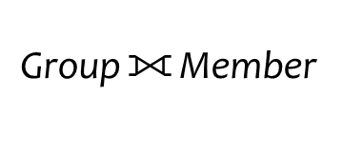
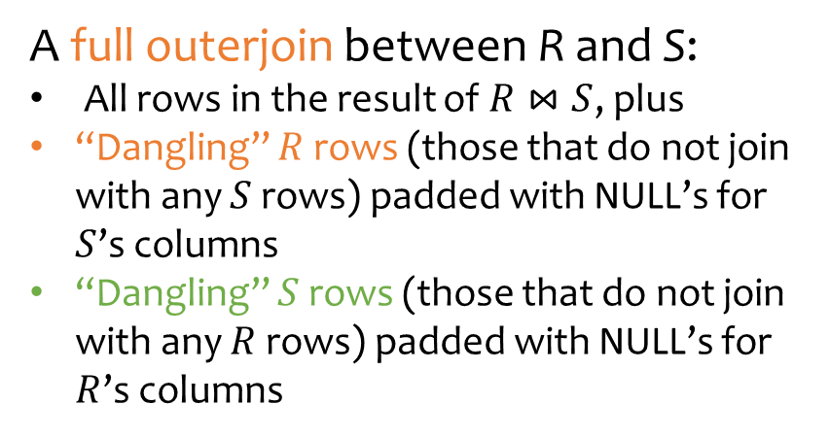

Outerjoin examples
gid | name | uid
abc | Book Club | 857
gov | Student Government | 123
gov | Student Government | 857
dps | Dead Putting Society | 142
$$\text{Group}⟗{\text{Member}}$$
Group
gid | name
abc | Book Club
gov | Student Government
dps | Dead Putting Society
nuk | United Nuclear Workers
nuk | United Nuclear Workers | NULL
foo | NULL | 789
A full outerjoin between R and S:
All rows in the result of $R⋈S$, plus
“Dangling” $R$ rows (those that do not join with any $S$ rows) padded with NULL’s for $S$’s columns
“Dangling” $S$ rows (those that do not join with any $R$ rows) padded with NULL’s for $R$’s columns
Member
uid | gid
142 | dps
123 | gov
857 | abc
857 | gov
789 | foo

Slide 13
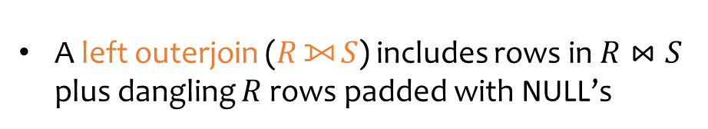
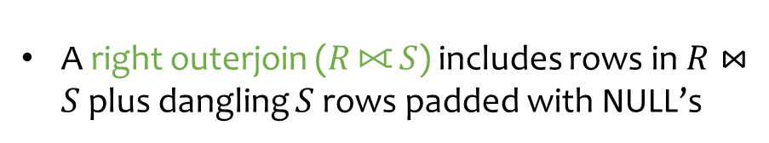
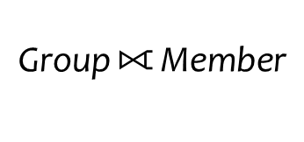
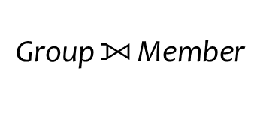
Outerjoin examples
gid | name | uid
abc | Book Club | 857
gov | Student Government | 123
gov | Student Government | 857
dps | Dead Putting Society | 142
nuk | United Nuclear Workers | NULL
$$\text{Group}⟕{\text{Member}}$$
Group
gid | name
abc | Book Club
gov | Student Government
dps | Dead Putting Society
nuk | United Nuclear Workers
A left outerjoin ($R⟕{S}$) includes rows in $R⋈S$ plus dangling $R$ rows padded with NULL’s
gid | name | uid
abc | Book Club | 857
gov | Student Government | 123
gov | Student Government | 857
dps | Dead Putting Society | 142
foo | NULL | 789
$$\text{Group}⟖{\text{Member}}$$
Member
uid | gid
142 | dps
123 | gov
857 | abc
857 | gov
789 | foo
A right outerjoin ($R⟖{S}$) includes rows in $R⋈S$ plus dangling $S$ rows padded with NULL’s

Slide 14
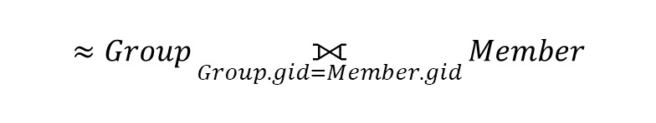
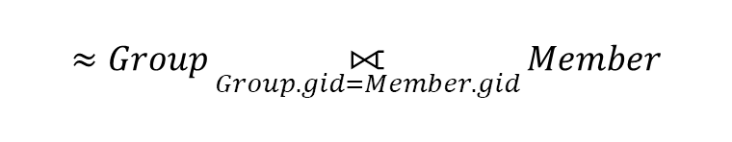
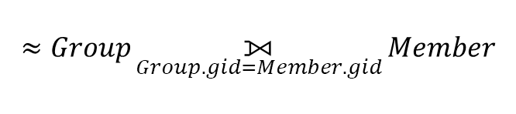
Outerjoin syntax
A similar construct exists for regular (“inner”) joins:
For natural joins, add keyword NATURAL; don’t use ON
SELECT * FROM Group LEFT OUTER JOIN Member
ON Group.gid = Member.gid;
$$≈Group⟕_{Group.gid=Member.gid}{Member}$$
SELECT * FROM Group RIGHT OUTER JOIN Member
ON Group.gid = Member.gid;
$$≈Group⟖_{Group.gid=Member.gid}{Member}$$
SELECT * FROM Group FULL OUTER JOIN Member
ON Group.gid = Member.gid;
$$≈Group⟗_{Group.gid=Member.gid}{Member}$$
SELECT * FROM Group JOIN Member ON Group.gid = Member.gid;
SELECT * FROM Group NATURAL JOIN Member;

Slide 15
SQL features covered so far
SELECT-FROM-WHERE statements
Set and bag operations
Table expressions, subqueries
Aggregation and grouping
Ordering
NULL’s and outerjoins
Next: data modification statements, constraints

Slide 16
INSERT
Insert one row
  User 789 joins Dead Putting Society
Insert the result of a query
  Everybody joins Dead Putting Society!
  INSERT INTO Member VALUES (789, 'dps');
  INSERT INTO Member
  (SELECT uid, 'dps' FROM User
  WHERE uid NOT IN (SELECT uid
  FROM Member
  WHERE gid = 'dps'));

Slide 17
DELETE
Delete everything from a table
Delete according to a WHERE condition
  Example: User 789 leaves Dead Putting Society
  Example: Users under age 18 must be removed from United Nuclear Workers
  DELETE FROM Member;
  DELETE FROM Member WHERE uid=789 AND gid=‘dps’;
  DELETE FROM Member
  WHERE uid IN (SELECT uid FROM User WHERE age < 18)
  AND gid = 'nuk';

Slide 18
UPDATE
Example: User 142 changes name to “Barney”
Example: We are all popular!
  But won’t update of every row causes average pop to change?
  Subquery is always computed over the old table
  UPDATE User
  SET name = 'Barney’
  WHERE uid = 142;
  UPDATE User
  SET pop = (SELECT AVG(pop) FROM User);

Slide 19
Constraints
Restrictions on allowable data in a database
  In addition to the simple structure and type restrictions imposed by the table definitions
Why use constraints?
  Protect data integrity (catch errors)
  Tell the DBMS about the data (so it can optimize better)
Declared as part of the schema and enforced by the DBMS

Slide 20
Types of SQL constraints
NOT NULL
Key
Referential integrity (foreign key)
General assertion
Tuple- and attribute-based CHECK’s

Slide 21
NOT NULL constraint examples
CREATE TABLE User
(uid DECIMAL(3,0) NOT NULL,
name VARCHAR(30) NOT NULL,
twitterid VARCHAR(15) NOT NULL,
age DECIMAL (2,0),
pop DECIMAL(3,2));
CREATE TABLE Group
(gid CHAR(10) NOT NULL,
name VARCHAR(100) NOT NULL);
CREATE TABLE Member
(uid DECIMAL(3,0) NOT NULL,
gid CHAR(10) NOT NULL);

Slide 22
Key declaration examples
CREATE TABLE User
(uid DECIMAL(3,0) NOT NULL PRIMARY KEY,
name VARCHAR(30) NOT NULL,
twitterid VARCHAR(15) NOT NULL UNIQUE,
age DECIMAL (2,0),
pop DECIMAL(3,2));
At most one primary key per table
Any number of UNIQUE keys per table
CREATE TABLE Group
(gid CHAR(10) NOT NULL PRIMARY KEY,
name VARCHAR(100) NOT NULL);
This form is required for multi-attribute keys
CREATE TABLE Member
(uid DECIMAL(3,0) NOT NULL,
gid CHAR(10) NOT NULL,
PRIMARY KEY(uid,gid));
Incorrect!
CREATE TABLE Member
(uid DECIMAL(3,0) NOT NULL PRIMARY KEY,
gid CHAR(10) NOT NULL PRIMARY KEY,

Slide 23
Referential integrity example
If an uid appears in Member, it must appear in User
  Member.uid references User.uid
If a gid appears in Member, it must appear in Group
  Member.gid references Group.gid
That is, no “dangling pointers”
User
Member
Group
uid | name | …
142 | Bart | …
123 | Milhouse | …
857 | Lisa | …
456 | Ralph | …
789 | Nelson | …
… | … | …
uid | gid
142 | dps
123 | gov
857 | abc
857 | gov
456 | abc
456 | gov
… | …
gid | name
abc | …
gov | …
dps | …
… | …

Slide 24


Referential integrity in SQL
Referenced column(s) must be PRIMARY KEY
Referencing column(s) form a FOREIGN KEY
Example
CREATE TABLE Member
(uid DECIMAL(3,0) NOT NULL REFERENCES User(uid),
gid CHAR(10) NOT NULL,
PRIMARY KEY(uid,gid),
FOREIGN KEY (gid) REFERENCES Group(gid));
This form is required for multi-attribute foreign keys
CREATE TABLE MemberBenefits
(…..
FOREIGN KEY (uid,gid) REFERENCES Member(uid,gid));

Slide 25
Enforcing referential integrity
Example: Member.uid references User.uid
Insert or update a Member row so it refers to a non-existent uid
  Reject
User
Member
uid | name | …
142 | Bart | …
123 | Milhouse | …
857 | Lisa | …
456 | Ralph | …
789 | Nelson | …
… | … | …
uid | gid
142 | dps
123 | gov
857 | abc
857 | gov
456 | abc
456 | gov
000 | gov
Reject

Slide 26
Enforcing referential integrity
Example: Member.uid references User.uid
Delete or update a User row whose uid is referenced by some Member row
  Multiple Options (in SQL)
CREATE TABLE Member
(uid DECIMAL(3,0) NOT NULL REFERENCES User(uid)
ON DELETE CASCADE,
…..);
User
Member
uid | name | …
142 | Bart | …
123 | Milhouse | …
857 | Lisa | …
456 | Ralph | …
789 | Nelson | …
… | … | …
uid | gid
142 | dps
123 | gov
857 | abc
857 | gov
456 | abc
456 | gov
… | ….
Option 1: Reject
Option 2: Cascade
(ripple changes to all referring rows)

Slide 27
Enforcing referential integrity
Example: Member.uid references User.uid
Delete or update a User row whose uid is referenced by some Member row
  Multiple Options (in SQL)
CREATE TABLE Member
(uid DECIMAL(3,0) NOT NULL REFERENCES User(uid)
ON DELETE SET NULL,
…..);
User
Member
uid | name | …
142 | Bart | …
123 | Milhouse | …
857 | Lisa | …
456 | Ralph | …
789 | Nelson | …
… | … | …
uid | gid
142 | dps
123 | gov
857 | abc
857 | gov
NULL | abc
NULL | gov
… | ….
Option 3: Set NULL
(set all references to NULL)

Slide 28
Deferred constraint checking
  CREATE TABLE Dept
  (name CHAR(20) NOT NULL PRIMARY KEY,
  chair CHAR(30) NOT NULL
  REFERENCES Prof(name));
Example:
  The first INSERT will always violate a constraint!
Deferred constraint checking is necessary
  Check only at the end of a transaction
  Allowed in SQL as an option
Curious how the schema was created in the first place?
  ALTER TABLE ADD CONSTRAINT (read the manual!)
  CREATE TABLE Prof
  (name CHAR(30) NOT NULL PRIMARY KEY,
  dept CHAR(20) NOT NULL
  REFERENCES Dept(name));

Slide 29
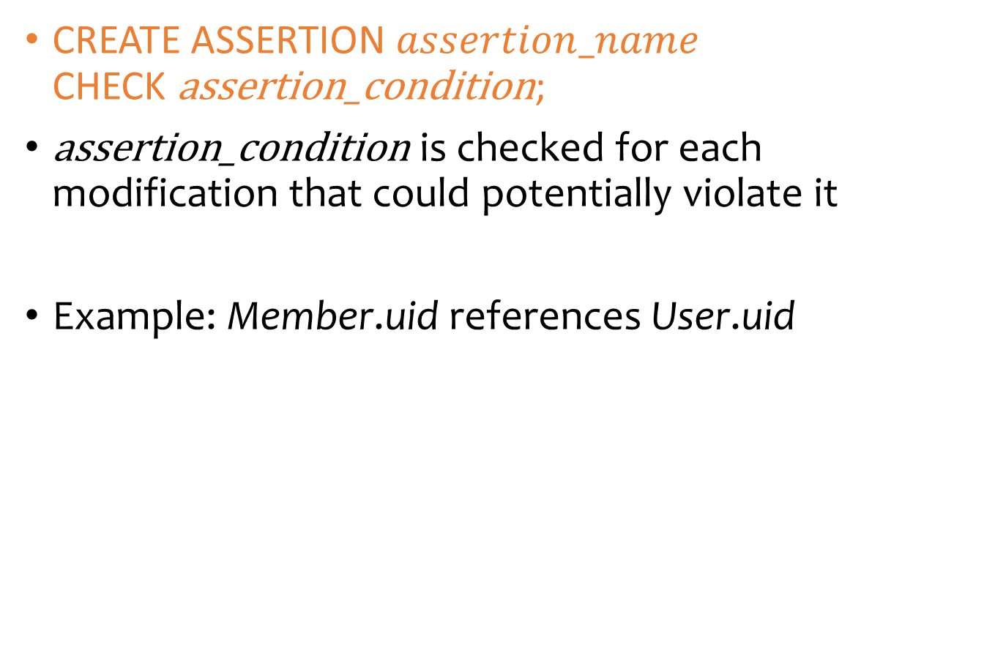
General assertion
CREATE ASSERTION $assertion_name$
CHECK $\text{assertion}\text{_}\text{condition}$;
$\text{assertion}\text{_}\text{condition}$ is checked for each modification that could potentially violate it
Example: Member.uid references User.uid
  CREATE ASSERTION MemberUserRefIntegrity
  CHECK (NOT EXISTS
  (SELECT * FROM Member
  WHERE uid NOT IN
  (SELECT uid FROM User)));

Slide 30
Tuple- and attribute-based CHECK’s
Associated with a single table
Only checked when a tuple/attribute is inserted/updated
  Reject if condition evaluates to FALSE
  TRUE and UNKNOWN are fine
Examples:
  CREATE TABLE User(...
  age INTEGER CHECK(age IS NULL OR age > 0),
  ...);
Exercise Question:
How does it differ from a referential integrity constraint (slides 26-27)?
  CREATE TABLE Member
  (uid INTEGER NOT NULL,
  CHECK(uid IN (SELECT uid FROM User)),
  ...);

Slide 31
SQL features covered so far
Query
  SELECT-FROM-WHERE statements
  Set and bag operations
  Table expressions, subqueries
  Aggregation and grouping
  Ordering
  Outerjoins (and NULL)
Modification
  INSERT/DELETE/UPDATE
Constraints
Next: triggers, views, indexes

