Slide 1
SQL:
Triggers, Views, Indexes
Introduction to Database Management
CS348 Spring 2021

Slide 2
Announcements (Tue., May 25)
Milestone 0 - Project groups are formed by tonight!
  Questions are welcome on Piazza
  Watch out for updates
Assignment #1 due next Mon (May 31, 11pm)
  Servers:
    ubuntu2004-002.student.cs.uwaterloo.ca
    ubuntu2004-004.student.cs.uwaterloo.ca
  Setup db2 environment:
    $ source ~cs348/public/db2profile

Slide 3
SQL
Basic SQL (queries, modifications, and constraints)
Intermediate SQL
  Triggers
  Views
  Indexes
Advanced SQL
  Programming
  Recursive queries
this
week

Slide 4
Still remember “referential integrity”?
Example: Member.uid references User.uid
Delete or update a User row whose uid is referenced by some Member row
  Multiple Options (in SQL)
CREATE TABLE Member
(uid DECIMAL(3,0) NOT NULL REFERENCES User(uid)
ON DELETE CASCADE,
…..);
User
Member
uid | name | …
142 | Bart | …
123 | Milhouse | …
857 | Lisa | …
456 | Ralph | …
789 | Nelson | …
… | … | …
uid | gid
142 | dps
123 | gov
857 | abc
857 | gov
456 | abc
456 | gov
… | ….
Option 1: Reject
Option 2: Cascade
(ripple changes to all referring rows)

Slide 5
Can we generalize it?
Delete/update a User row
Event
Some user’s popularity is updated
Whether its uid is referenced by some Member row
Condition
Whether the user is a member of “S group” and pop drops below 0.5
Yes: reject/delete cascade/null
Action
Yes: kick that user out of S group
Referential constraints
Data Monitoring

Slide 6
Triggers
A trigger is an event-condition-action (ECA) rule
  When event occurs, test condition; if condition is satisfied, execute action
CREATE TRIGGER PickySGroup
AFTER UPDATE OF pop ON User
REFERENCING NEW ROW AS newUser
FOR EACH ROW
WHEN (newUser.pop < 0.5)
AND (newUser.uid IN (SELECT uid
FROM Member
WHERE gid = ‘sgroup'))
DELETE FROM Member
WHERE uid = newUser.uid AND gid = ‘sgroup';
Event
Transition variable
Condition
Action

Slide 7
Trigger option 1 – possible events
Possible events include:
  INSERT ON table; DELETE ON table; UPDATE [OF column] ON table
CREATE TRIGGER PickySGroup
AFTER UPDATE OF pop ON User
REFERENCING NEW ROW AS newUser
FOR EACH ROW
WHEN (newUser.pop < 0.5)
AND (newUser.uid IN (SELECT uid
FROM Member
WHERE gid = ‘sgroup'))
DELETE FROM Member
WHERE uid = newUser.uid AND gid = ‘sgroup';
Event
Condition
Action

Slide 8
Trigger option 2 – timing
Timing—action can be executed:
  AFTER or BEFORE the triggering event
  INSTEAD OF the triggering event on views (more later)
CREATE TRIGGER NoFountainOfYouth
BEFORE UPDATE OF age ON User
REFERENCING OLD ROW AS o, NEW ROW AS n
FOR EACH ROW
WHEN (n.age < o.age)
SET n.age = o.age;
Event
Condition
Action

Slide 9

Trigger option 3 – granularity
Granularity—trigger can be activated:
  FOR EACH ROW modified
CREATE TRIGGER PickySGroup
AFTER UPDATE OF pop ON User
REFERENCING NEW ROW AS newUser
FOR EACH ROW
WHEN (newUser.pop < 0.5)
AND (newUser.uid IN (SELECT uid
FROM Member
WHERE gid = ‘sgroup'))
DELETE FROM Member
WHERE uid = newUser.uid AND gid = ‘sgroup';
Event
Condition
Action

Slide 10
Trigger option 3 – granularity
Granularity—trigger can be activated:
  FOR EACH ROW modified
  FOR EACH STATEMENT that performs modification
CREATE TRIGGER PickySGroup2
AFTER UPDATE OF pop ON User
REFERENCING NEW TABLE AS newUsers
FOR EACH STATEMENT
DELETE FROM Member
WHERE gid = ‘sgroup’
AND uid IN (SELECT uid
FROM newUsers
WHERE pop < 0.5);
Event
Transition table: contains all the affected rows
Condition & Action

Slide 11
Trigger option 3 – granularity
Granularity—trigger can be activated:
  FOR EACH ROW modified
  FOR EACH STATEMENT that performs modification
CREATE TRIGGER PickySGroup2
AFTER UPDATE OF pop ON User
REFERENCING NEW TABLE AS newUsers
FOR EACH STATEMENT
DELETE FROM Member
WHERE gid = ‘sgroup’
AND uid IN (SELECT uid
FROM newUsers
WHERE pop < 0.5);
Transition table: contains all the affected rows
Only can be used with AFTER triggers

Slide 12
Transition variables/tables
OLD ROW: the modified row before the triggering event
NEW ROW: the modified row after the triggering event
OLD TABLE: a hypothetical read-only table containing all rows to be modified before the triggering event
NEW TABLE: a hypothetical table containing all modified rows after the triggering event
AFTER Trigger BEFORE Trigger
Event | Row | Statement
Delete | old r; old t | old t
Insert | new r; new t | new t
Update | old/new r; old/new t | old/new t
Event | Row | Statement
Update | old/new r | -
Insert | new r | -
Delete | old r | -

Slide 13
Statement- vs. row-level triggers
Simple row-level triggers are easier to implement
  Statement-level triggers: require significant amount of state to be maintained in OLD TABLE and NEW TABLE
Exercise 1: However, can you think of a case when a row-level trigger may be less efficient?
Exercise 2: Certain triggers are only possible at statement level. Can you think of an example?

Slide 14
System issues
Recursive firing of triggers
  Action of one trigger causes another trigger to fire
  Can get into an infinite loop
Interaction with constraints (tricky to get right!)
  When to check if a triggering event violates constraints?
    After a BEFORE trigger
    Before an AFTER trigger
    (based on db2, other DBMS may differ)
Be best avoided when alternatives exist

Slide 15
SQL features covered so far
Basic SQL
Intermediate SQL
  Triggers
  Views

Slide 16
Views
A view is like a “virtual” table
  Defined by a query, which describes how to compute the view contents on the fly
  Stored by DBMS instead of view contents
  Can be used in queries just like a regular table
CREATE VIEW SGroup AS
SELECT * FROM User
WHERE uid IN (SELECT uid
FROM Member
WHERE gid = ‘sgroup');
SELECT AVG(pop)
FROM (SELECT * FROM User
WHERE uid IN
(SELECT uid FROM Member
WHERE gid = 'jes'))
AS SGroup;
Base tables
  SELECT AVG(pop) FROM SGroup;
  SELECT MIN(pop) FROM SGroup;
DROP VIEW SGroup;
  SELECT … FROM SGroup;

Slide 17
Why use views?
To hide complexity from users
To hide data from users
Logical data independence
To provide a uniform interface for different implementations or sources

Slide 18
Modifying views
Does it even make sense, since views are virtual?
It does make sense if we want users to really see views as tables
Goal: modify the base tables such that the modification would appear to have been accomplished on the view

Slide 19
A simple case
CREATE VIEW UserPop AS
SELECT uid, pop FROM User;
DELETE FROM UserPop WHERE uid = 123;
translates to:
DELETE FROM User WHERE uid = 123;

Slide 20
An impossible case
No matter what we do on User, the inserted row will not be in PopularUser
CREATE VIEW PopularUser AS
SELECT uid, pop FROM User
WHERE pop >= 0.8;
INSERT INTO PopularUser VALUES(987, 0.3);

Slide 21
A case with too many possibilities
Set everybody’s pop to 0.5?
Adjust everybody’s pop by the same amount?
Just lower one user’s pop?
CREATE VIEW AveragePop(pop) AS
SELECT AVG(pop) FROM User;
Renamed column
UPDATE AveragePop SET pop = 0.5;

Slide 22
SQL92 updateable views
More or less just single-table selection queries
  No join
  No aggregation
  No subqueries
Arguably somewhat restrictive
Still might get it wrong in some cases
  See the slide titled “An impossible case” (slide 20)
  Adding WITH CHECK OPTION to the end of the view definition will make DBMS reject such modifications

Slide 23
INSTEAD OF triggers for views
CREATE VIEW AveragePop(pop) AS
SELECT AVG(pop) FROM User;
What does this trigger do?
CREATE TRIGGER AdjustAveragePop
INSTEAD OF UPDATE ON AveragePop
REFERENCING OLD ROW AS o,
NEW ROW AS n
FOR EACH ROW
UPDATE User
SET pop = pop + (n.pop-o.pop);
UPDATE AveragePop SET pop = 0.5;

Slide 24
INSTEAD OF triggers for views
CREATE VIEW AveragePop(pop) AS
SELECT AVG(pop) FROM User;
What does this trigger do?
CREATE TRIGGER AdjustAveragePop
INSTEAD OF UPDATE ON AveragePop
REFERENCING OLD ROW AS o,
NEW ROW AS n
FOR EACH ROW
UPDATE User
SET pop = pop + (n.pop-o.pop);
0.5
User
0.4
… | pop | …
 | 0.4
 | 0.4
 | 0.6
 | 0.3
+0.1
+0.1
+0.1
UPDATE AveragePop SET pop = 0.5;
+0.1

Slide 25
SQL features covered so far
Basic SQL
Intermediate SQL
  Triggers
  Views
  Indexes

Slide 26
Motivating examples of using indexes
SELECT * FROM User WHERE name = 'Bart';
  Can we go “directly” to rows with name='Bart’ instead of scanning the entire table?
  → index on User.name
  Can we find relevant Member rows “directly”?
  → index on Member.gid or (gid, uid)
  For each relevant Member row, can we “directly” look up User rows with matching uid
  → index on User.uid
SELECT * FROM User, Member
WHERE User.uid = Member.uid AND Member.gid = ‘sgroup';

Slide 27
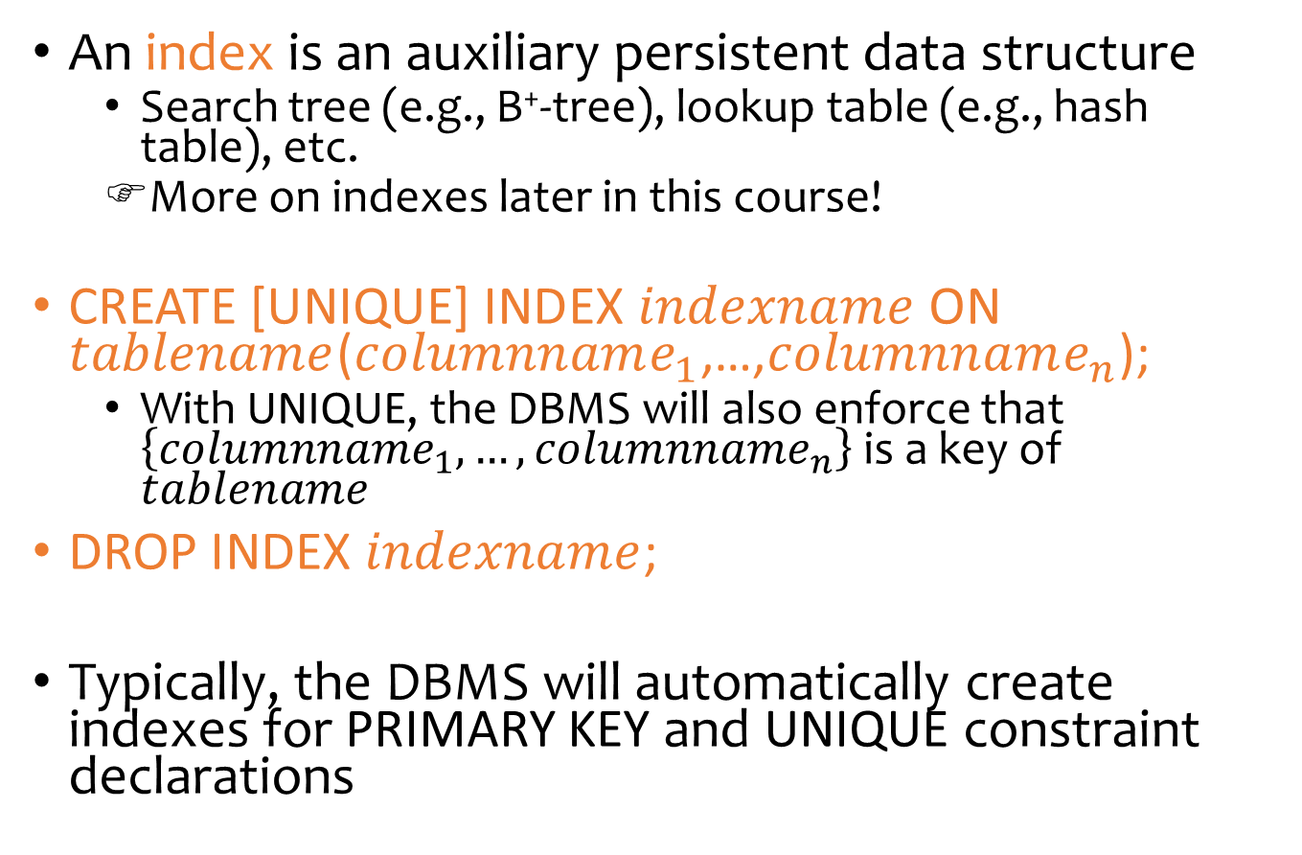
Indexes
An index is an auxiliary persistent data structure
  Search tree (e.g., B⁺-tree), lookup table (e.g., hash table), etc.
  More on indexes later in this course!
CREATE [UNIQUE] INDEX $indexname$ ON $tablename$($columnname_{1}$,…,$columnname_{n}$);
  With UNIQUE, the DBMS will also enforce that $\left\{columnname_{1},…,columnname_{n}\right\}$ is a key of $tablename$
DROP INDEX $indexname$;
Typically, the DBMS will automatically create indexes for PRIMARY KEY and UNIQUE constraint declarations

Slide 28
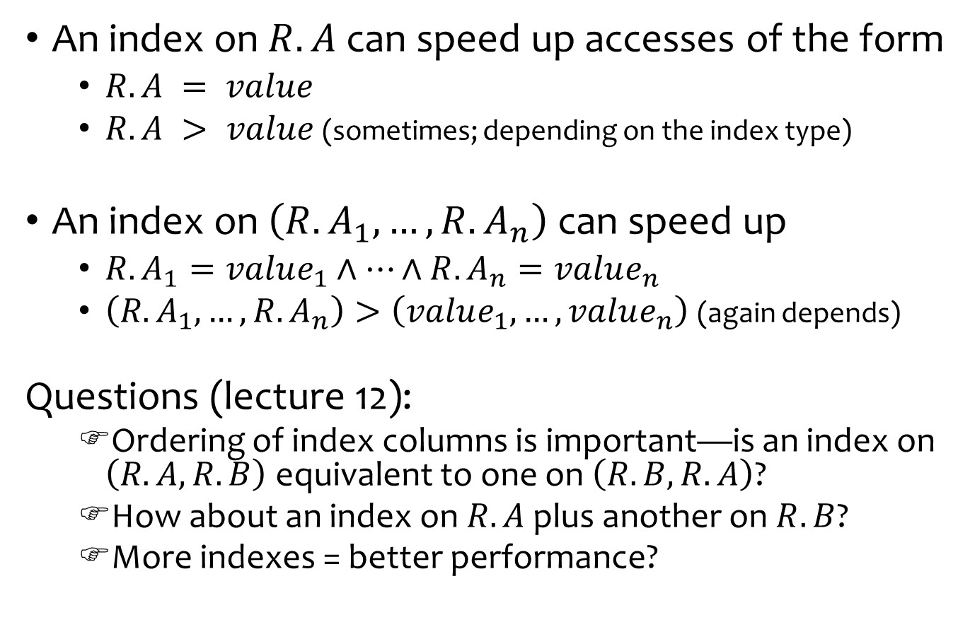
Indexes
An index on $R.A$ can speed up accesses of the form
  $R.A = value$
  $R.A > value$ (sometimes; depending on the index type)
An index on $\left(R.A_{1},…, R.A_{n}\right)$ can speed up
  $R.A_{1}=value_{1}∧…∧R.A_{n}=value_{n}$
  $\left(R.A_{1},…,R.A_{n}\right)>\left(value_{1},…,value_{n}\right)$ (again depends)
Questions (lecture 12):
  Ordering of index columns is important—is an index on $\left(R.A,R.B\right)$ equivalent to one on $\left(R.B, R.A\right)$?
  How about an index on $R.A$ plus another on $R.B$?
  More indexes = better performance?

Slide 29
SQL features covered so far
Basic & Intermediate SQL
Query
Modification
Constraints
Triggers
Views
Indexes
Next: Recursion, programming

