Slide 1

CS 348 Lectures 7-8
Database Design Theory:
Theory of Normal Forms
  Semih Salihoğlu
  Sep 30th-Oct 5 2021

Slide 2
Lectures on Relational Algebra & SQL (1)
Main SQL clauses for querying and data manipulation
  Founded on relational algebra
Constraints: Primary Keys, Foreign Keys, Not NULL, General Assertions and CHECKs
Triggers
Views
  Primary ways to get different abstractions on data
  When materialized also a way to achieve performance
Indexes
  Fast access to some data
Achieve Integrity of Database
***
Ease of Programming
***
**Performance**

Slide 3
Lectures on Relational Algebra & SQL (2)
Recursion: Can be considered a weak point for SQL
  Not an elegant way to express recursive computations
  E.g.: Try to express finding shortest paths in a graph
  GraphDB query languages: better but minor additional support
  Datalog: (I think) better declarative logic-based language for recursive programming
    Some DBMSs implement it. Good for coffee/OH chat
Example Datalog Program
Parent(A, B) is an external relation w/ tuples (e.g., (Alice, Bob))
Ancestor(X, Y) :- parent(X, Y)
Ancestor(X, Y) :- parent(X, Z), ancestor(Z, Y)
There are alg. (e.g., “semi-naïve datalog algorithm”) that can find “fixed point” states of any set of Datalog rules

Slide 4
Lectures on Relational Algebra & SQL (3)
SQL Programming Interfaces
  SLQ programming is almost always through a programming language (PL) or framework.
  Frameworks (e.g., Ruby on Rails) give basic functionality with no explicit SQL coding
  For somewhat complex apps, need direct SQL through a PL

Slide 5
Lectures on Relational Algebra & SQL (4)
Primary Takeaway:
SQL is very high-level and a very different style of programming data processing tasks than standard procedural PLs.
Little needs to be known algorithmically to perform tasks.

Slide 6
Next 2 Lectures: Relational Database Design Theory
Theory of Normal Forms (TNF): Given a set of constraints about the real-world facts that an app will store, how can we formally separate “good” and ”bad” relational db schemas?
Design 1
Design 2
InstDep | Dep
iID | name | salary | depName | bldng | budget
111 | Alice | 5000 | CS | DC | 20000
222 | Bob | 4000 | Physics | PHY | 30000
333 | Carl | 5200 | CS | DC | 20000
444 | Diana | 5500 | CS | DC | 20000
… | … | … | … | … | …
Inst | Dep
iID | name | salary | depName
111 | Alice | 5000 | CS
222 | Bob | 4000 | Physics
… | … | …. | …
Dep
depName | bldng | budget
CS | DC | 20000
Physics | PHY | 30000
If given a depName: (bldng, budget)
is unique, i.e., determined,
Design 1, intuitively, is a bad design with redundancy.
Goal of TNF: make the above intuition formal.

Slide 7
Following 2 Lectures: Entity/Relationship (ER) Model
Often users do not directly design relational tables
ER Model: An even higher-level data model
Close to object-oriented programming
  In turn is close to modeling data as a graph
  How complex dbs are modeled in practice
    Analogous to programming frameworks

Slide 8
Following 2 Lectures: Entity/Relationship (ER) Model
time
number
name
Trains
LocalTrainStops
Stations
engineer
address
ISA
ISA
LocalTrains
LocalStations
ExpressTrains
ExpressStations
time
ExpressTrainStops
Many DBMSs provide an actual E/R Schema Designer. Can be done manually for small/medium-size db schemas.
ER-to-Relational Mapper
R1
A_{1,1} | … | A_{1,m1}
… | … | …
R2
A_{2,1} | … | A_{2,m2}
… | … | …
Rn
A_{n,1} | … | A_{n,mn}
… | … | …
…
Upshot: Does not guarantee good designs as in TNF.
Still need to ensure final relations adhere to the principles of TNF

Slide 9
Outline For Today
Application Constraints and Decompositions
Functional Dependencies
Boyce-Codd Normal Form (BCNF) & BCNF Decomposition Alg.
Dependency Preservation and 3rd Normal Form
Multi-valued Dependencies and 4th Normal Form
Short Note on Other Applications of Factorization

Slide 10
Outline For Today
Application Constraints and Decompositions
Functional Dependencies
Boyce-Codd Normal Form (BCNF) & BCNF Decomposition Alg.
Dependency Preservation and 3rd Normal Form
Multi-valued Dependencies and 4th Normal Form
Short Note on Other Applications of Factorization

Slide 11




Application Constraints
Consider a simple university DB:
Independent of stored data: there will be external app. constraints. E.g:
  Each instructor has 1 name, salary, and department
  Each department has 1 building
  Each student can have 1 advisor from each department
  Instructor i’s set of addresses are independent of the departments of i
High-level idea: A “good” DB makes such constraints explicit
Instructors
Departments
Courses
Students

Slide 12
Application Constraints
Instructors: iIDs, names, salaries, departments (w/ unique iIDs)
Departments: names, building, budget (w/ unique names)
Constraint 1: Each instructor has 1 name, salary, and department
Constraint 2: Each department has 1 building and 1 associated budget
Possible Design: 1 large table InstDep with one row for each instructor
b/c iID is key
✓
X
b/c depName is not key
InstDep | Dep
iID | name | salary | depName | bldng | budget
111 | Alice | 5000 | CS | DC | 20000
222 | Bob | 4000 | Physics | PHY | 30000
333 | Carl | 5200 | CS | DC | 20000
444 | Diana | 5500 | CS | DC | 20000
… | … | … | … | … | …
Problem: redundant data replication. (CS, DC, 20000) repeated k times if there are k instructors in CS.

Slide 13
Problems of Redundancy
InstDep | Dep
iID | name | salary | depName | bldng | budget
111 | Alice | 5000 | CS | DC | 20000
222 | Bob | 4000 | Physics | PHY | 30000
333 | Carl | 5200 | CS | DC | 20000
444 | Diana | 5500 | CS | DC | 20000
… | … | … | … | … | …
Harder to keep db consistent when facts are stored multiple times. E.g:
If CS’s building changed to E4 => need to update 3 rows
Suppose Bob is the only instructor in Physics and retires (a delete):
  Deletion of Bob’s tuple: Physics department, which might exist, is deleted unless extra work is done
If new department (w/out yet an instructor) is added: new row w/ NULLs

Slide 14
Redundancy Is Determined By App. Constraints
Courses: cID, term, iID, capacity
Course |  | Dep
cID | term | iID | capacity
CS348 | F21 | Semih | 100
CS341 | F21 | Lap Chi | 80
CS348 | S21 | Xi | 100
CS348 | W20 | Xi | 100
CS350 | W19 | Salem | 130
Unclear if this is redundant or not. Depends on external app constraint:
If courses have 1 associated capacity (independent of term): Redundant
O.w repetition may be necessary and reflects similarity across entities.

Slide 15
Redundancy Is Determined By App. Constraints
Courses: cID, term, iID, capacity
Course |  | Dep
cID | term | iID | capacity
CS348 | F21 | Semih | 100
CS341 | F21 | Lap Chi | 80
CS348 | S21 | Xi | 100
CS348 | W20 | Xi | 100
CS350 | W19 | Salem | 130
CS348 | W22 | David | 200
Unclear if this is redundant or not. Depends on external app constraint:
If courses have 1 associated capacity (independent of term): Redundant
O.w repetition may be necessary and reflects similarity across entities.
Takeaway: Constraints are external to the db/app and need to be inputs in a db design theory.

Slide 16
Solution To Redundancy: Decompositions
InstDep | Dep
iID | name | salary | depName | bldng | budget
111 | Alice | 5000 | CS | DC | 20000
222 | Bob | 4000 | Physics | PHY | 30000
333 | Carl | 5200 | CS | DC | 20000
444 | Diana | 5500 | CS | DC | 20000
Inst | Dep
iID | name | salary | depName
111 | Alice | 5000 | CS
222 | Bob | 4000 | Physics
333 | Carl | 5200 | CS
444 | Diana | 5500 | CS
Dep
depName | bldng | budget
CS | DC | 20000
Physics | PHY | 30000

Slide 17
Desiderata for Decompositions (1)
D1 (Lossless): If R is decomposed into R1 and R2, then:
R = R1 ⋈ R2
Lossless-ness achieved by decomposing on an appropriate key
Inst | Dep
iID | name | salary | depName
111 | Alice | 5000 | CS
222 | Bob | 4000 | Physics
333 | Carl | 5200 | CS
444 | Diana | 5500 | CS
Dep
depName | bldng | budget
CS | DC | 20000
Physics | PHY | 30000
⋈
RESULT | Dep
iID | name | salary | depName | bldng | budget
111 | Alice | 5000 | CS | DC | 20000
222 | Bob | 4000 | Physics | PHY | 30000
333 | Carl | 5200 | CS | DC | 20000
444 | Diana | 5500 | CS | DC | 20000
InstDep | Dep
iID | name | salary | depName | bldng | budget
111 | Alice | 5000 | CS | DC | 20000
222 | Bob | 4000 | Physics | PHY | 30000
333 | Carl | 5200 | CS | DC | 20000
444 | Diana | 5500 | CS | DC | 20000
=

Slide 18
Example Lossy Decomposition
InstDep | Dep
ID | name | salary | depName | bldng | budget
111 | Alice | 5000 | CS | DC | 20000
222 | Bob | 4000 | Physics | PHY | 30000
333 | Carl | 5200 | CS | DC | 20000
444 | Diana | 5500 | CS | DC | 20000
ID
111
222
333
444
name
Alice
Bob
Carl
Diana
salary
5000
4000
5200
5500
depName
CS
Physics
bldng
DC
PHY
budget
20000
30000
⋈
⋈
⋈
⋈
⋈
RESULT | Dep
ID | name | salary | depName | bldng | budget
111 | Alice | 5000 | CS | DC | 20000
111 | Bob | 5200 | CS | PHY | 30000
… | … | … | … | … | …
X
Can’t tell what’s fact and what’s not.

Slide 19
Desiderata for Decompositions (2)
D2 (Locality of Constraints): If the app had a constraint C, we would prefer to check C in a single relation
Will discuss more in 3rd Normal Form. Stay tuned.

Slide 20
Outline For Today
Application Constraints and Decompositions
Functional Dependencies
Boyce-Codd Normal Form (BCNF) & BCNF Decomposition Alg.
Dependency Preservation and 3rd Normal Form
Multi-valued Dependencies and 4th Normal Form
Short Note on Other Applications of Factorization

Slide 21
Functional Dependencies (FDs): Generalized Uniqueness Constraints
Informally: Let X, Y be sets of attributes. A functional dependency X → Y holds if for each possible value of attributes X there is only 1 possible value Y value. I.e. X “determines” Y uniquely (independent of other values in a tuple).
Formally: Let t[A] be a tuple t’s projection on attributes A
Dfn: Let X, Y be sets of attributes. An fd X → Y holds in a relation R, if given t₁ and t₂ ∈ R s.t. t₁[X] = t₂[X], then t₁[Y] = t₂[Y] holds.

Slide 22
Example FDs
Captures generalized uniqueness constraints (beyond keys):
InstDep | Dep
iID | name | salary | depName | bldng | budget
111 | Alice | 5000 | CS | DC | 20000
222 | Bob | 4000 | Physics | PHY | 30000
333 | Carl | 5200 | CS | DC | 20000
444 | Diana | 5500 | CS | DC | 20000
… | … | … | … | … | …
Constraint 1: Each iID has 1 name and salary
  iID → name, salary
Constraint 2: Each depName has 1 building & 1 associated budget
  depName → bldng, budget
Key constraints: Each iID, depName is unique in InstDep
  iID, depName → name, salary, bldgn, budget

Slide 23
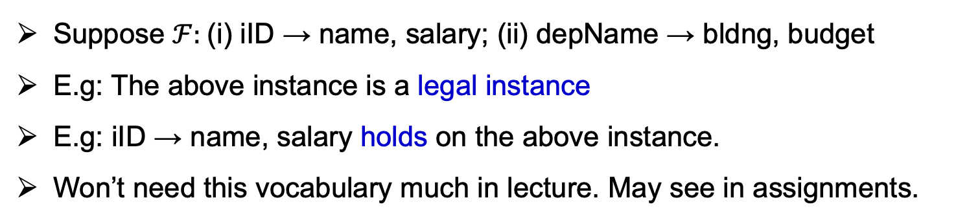
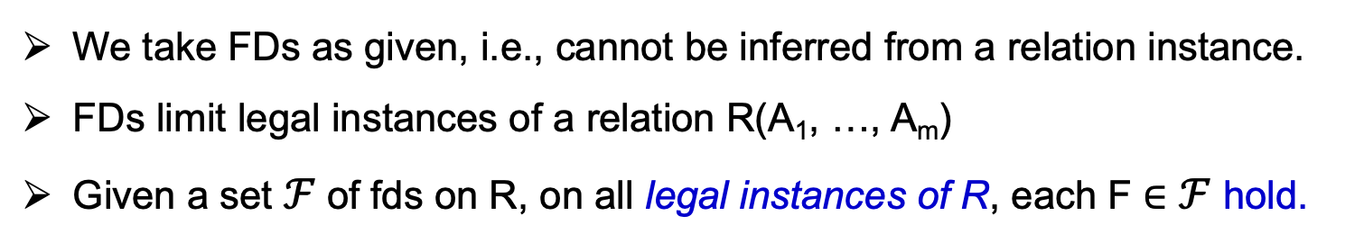
Some FD Vocabulary
We take FDs as given, i.e., cannot be inferred from a relation instance.
FDs limit legal instances of a relation R(A₁, …, A_{m})
Given a set $ℱ$of fds on R, on all legal instances of R, each F ∈ $ℱ$ hold.
InstDep | Dep
iID | name | salary | depName | bldng | budget
111 | Alice | 5000 | CS | DC | 20000
111 | Alice | 5000 | Biology | BIO | 50000
222 | Bob | 4000 | Physics | PHY | 30000
333 | Carl | 5200 | CS | DC | 20000
444 | Diana | 5500 | CS | DC | 20000
Suppose $ℱ:$(i) iID → name, salary; (ii) depName → bldng, budget
E.g: The above instance is a legal instance
E.g: iID → name, salary holds on the above instance.
Won’t need this vocabulary much in lecture. May see in assignments.

Slide 24
Implied FDs: Armstrong’s Axioms
A set of fds can imply other fds via 3 intuitive rules: Armstrong’s Axioms
Reflexivity: If Y⊆ X, then X → Y (trivially)
  iID, name → iID
  English: Each iID and name value takes a unique iID value
Augmentation: if X → Y, then XZ → YZ (trivially)
  If iID → salary then iID, bldng → salary, bldng
  English: if each iID takes a unique salary value, then each (iID, bldng) value pair takes a unique (salary, bldng) value
InstDep | Dep
iID | name | salary | depName | bldng | budget
111 | Alice | 5000 | CS | DC | 20000
222 | Bob | 4000 | Physics | PHY | 30000
333 | Carl | 5200 | CS | DC | 20000
… | … | … | … | … | …

Slide 25
Implied FDs: Armstrong’s Axioms
3. Transitivity: if X → Y and Y → Z, then X → Z
  Suppose each instructor can be in a single department and each dep has a single budget
  FD1: iID → depName FD2: depName → budget, then
  iID → budget
  English: If each iID value takes a unique depName value, which in turn takes a unique budget value, then each iID value takes a unique budget value.
InstDep | Dep
iID | name | salary | depName | bldng | budget
111 | Alice | 5000 | CS | DC | 20000
222 | Bob | 4000 | Physics | PHY | 30000
333 | Carl | 5200 | CS | DC | 20000
… | … | … | … | … | …

Slide 26
Other Rules Implied by Armstrong’s Axioms
Decomposition: If X → YZ, then X → Y and X → Z
  Proof:
  X → YZ
  YZ → Y (by reflexivity)
  X → Y (by transitivity)
Union: If X → Y and X → Z then X → YZ (Prove as exercise)
Pseudo-transitivity: If X → Y and YZ → T then XZ→ T (Prove as exercise)

Slide 27
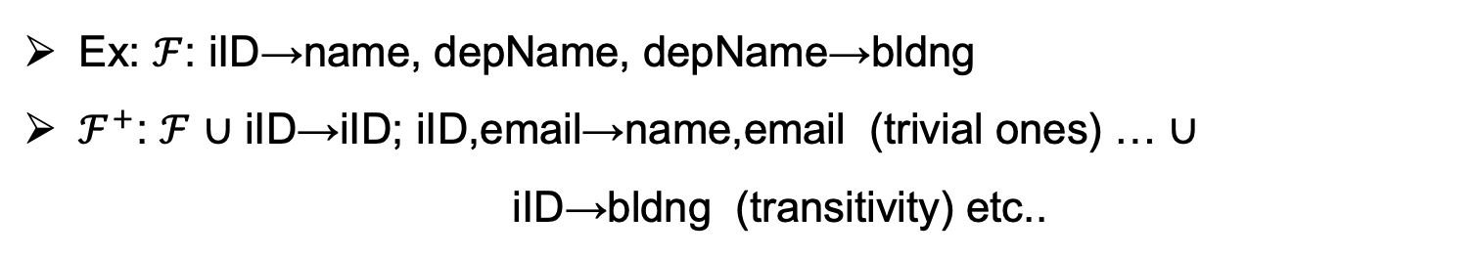
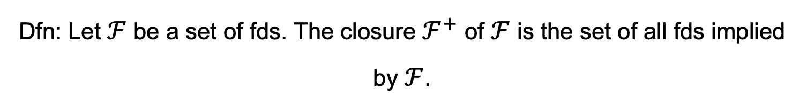
$ℱ^{+}:$Closure of $ℱ$
Dfn: Let $ℱ$ be a set of fds. The closure $ℱ^{+}$ of $ℱ$ is the set of all fds implied by $ℱ$.
Ex: $ℱ$: iID→name, depName, depName→bldng
$ℱ^{+}$: $ℱ$ ∪ iID→iID; iID,email→name,email (trivial ones) … ∪
iID→bldng (transitivity) etc..
InstDep | Dep
iID | name | email | depName | bldng
111 | Alice | alice@gmail | CS | DC
111 | Alice | alice@hotmail | CS | DC
222 | Bob | bob@gmail | Physics | PHY
222 | Bob | bob@hotmail | Physics | PHY
333 | Carl | carl@gmail | CS | DC
… | … | … | … | …

Slide 28
Exercise Showing an FD is in $ℱ^{+}$
Consider an Inst_Proj relation of instructors and their research projects
InstProj | Dep
iID | name | projID | projName | projDep | hours | funds
(i) iID → name; (ii) projID → projName, projDep;
(iii) iID, projID → hours; (iv) projDep, hours → funds;
Prove iID, projID → funds
iID, projID → hours (by fd iii)
projID → projName, projDep (by fd ii)
iID, projID → hours, projName, projDep (by pseudo-transitivity of 1 & 2)
iID, projID → funds (by transitivity of 3, and fd iv) (+ decomposition)

Slide 29
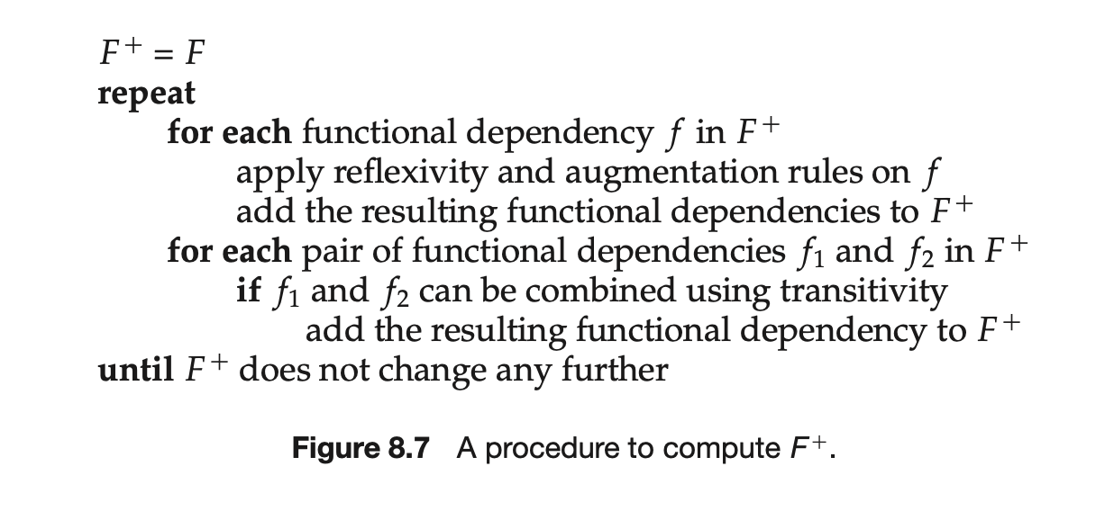
How To Compute $ℱ^{+}$ from $ℱ$

Slide 30
Outline For Today
Application Constraints and Decompositions
Functional Dependencies
Boyce-Codd Normal Form (BCNF) & BCNF Decomposition Alg.
Dependency Preservation and 3rd Normal Form
Multi-valued Dependencies and 4th Normal Form
Short Note on Other Applications of Factorization

Slide 31
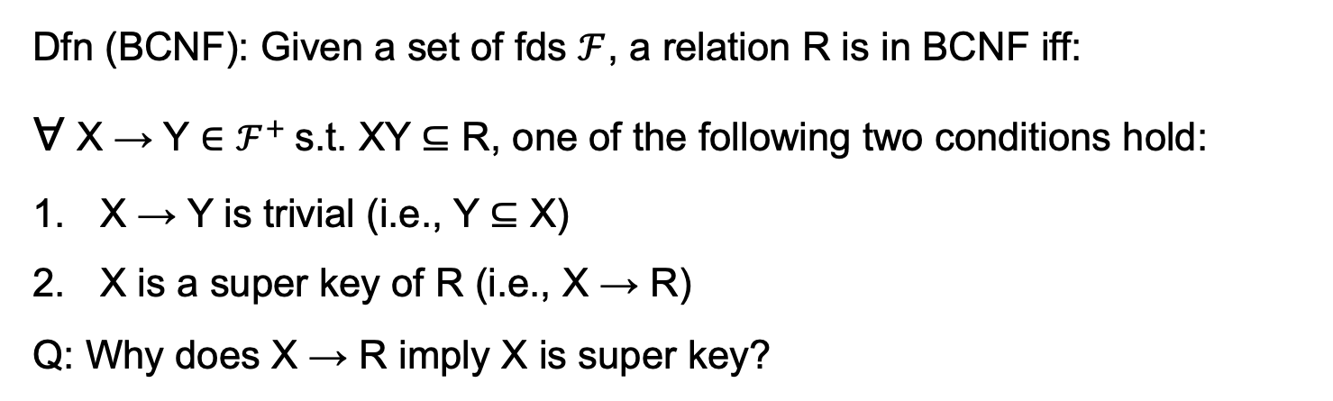
Boyce-Codd Normal Form (BCNF)
Dfn (BCNF): Given a set of fds $ℱ$, a relation R is in BCNF iff:
∀ X → Y ∈ $ℱ^{+}$s.t. XY ⊆ R, one of the following two conditions hold:
X → Y is trivial (i.e., Y ⊆ X)
X is a super key of R (i.e., X → R)
Q: Why does X → R imply X is super key?

Slide 32

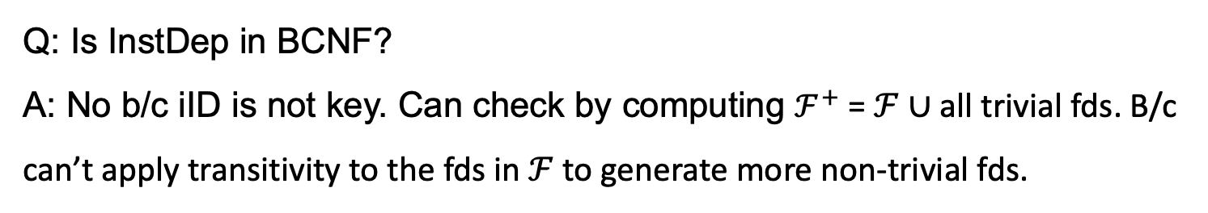
Example Relations in BCNF and not in BCNF (1)
Note we only need to look at the schema of R and $ℱ^{+}$
As before suppose $ℱ:$(i) iID→name,salary; (ii) depName→bldng,budget
InstDep | Dep
iID | name | salary | depName | bldng | budget
Q: Is InstDep in BCNF?
A: No b/c iID is not key. Can check by computing $ℱ^{+}$ = $ℱ$ ∪ all trivial fds. B/c can’t apply transitivity to the fds in $ℱ$ to generate more non-trivial fds.

Slide 33
Example Relations in BCNF and not in BCNF (2)
As before suppose $ℱ:$(i) iID→name,salary; (ii) depName→bldng,budget
R1 | Dep
iID | name | salary | depName
R2
depName | bldng | budget
Q: Is R1 in BCNF?
A: No b/c iID is still not key.
Q: Is R2 in BCNF?
A: Yes b/c depName is key.
R3 | Dep
iID | name | salary
R4
iID | depName
R2
depName | bldng | budget
Q: Is R3 in BCNF?
A: Yes
Q: Is R4 in BCNF?
A: Yes b/c no non-trivial FDs

Slide 34
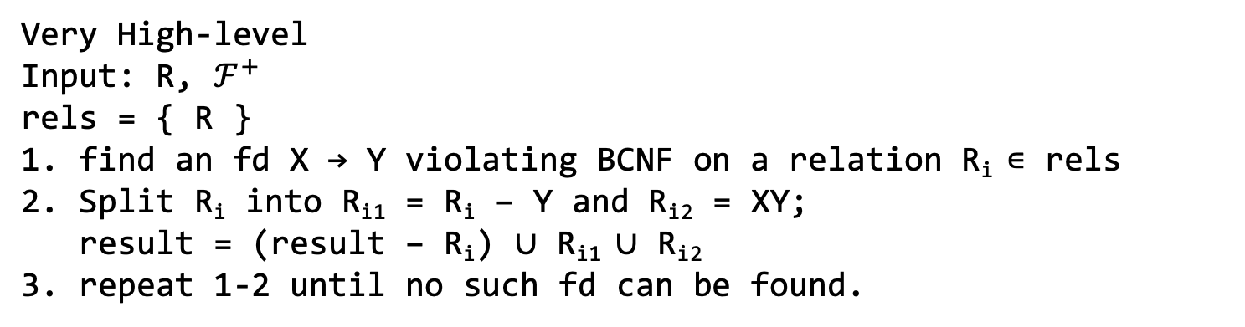
Greedy BCNF Decomposition Algorithm (1)
Very High-level
Input: R, $ℱ^{+}$
rels = { R }
1. find an fd X → Y violating BCNF on a relation R_{i} ∊ rels
2. Split R_{i} into R_{i1} = R_{i} – Y and R_{i2} = XY;
result = (result – R_{i}) ∪ R_{i1} ∪ R_{i2}
3. repeat 1-2 until no such fd can be found.
Several properties of the alg (won’t formally prove):
Always returns a set of relations R₁, …, R_{k} s.t. R_{j} is in BCNF and this is a lossless decomposition of R, i.e., R₁ ⋈ … R_{j} = R.
The output is *not* unique. (Exercise: show a simple example with a relation and two fds to demonstrate this)
Is lossless (Why? Stay tuned.)

Slide 35
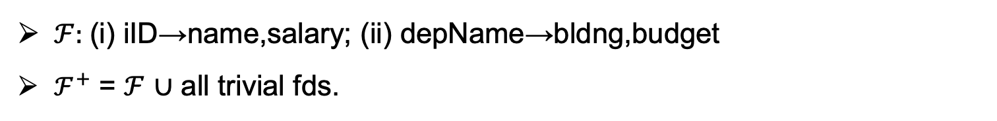
Greedy BCNF Decomposition Algorithm (2)
$ℱ:$(i) iID→name,salary; (ii) depName→bldng,budget
$ℱ^{+}$ = $ℱ$ ∪ all trivial fds.
InstDep | Dep
iID | name | salary | depName | bldng | budget
use: depName→bldng,budget
R1 | Dep
iID | name | salary | depName
R2
depName | bldng | budget
use: iID→name,salary
R3 | Dep
iID | name | salary
R4
iID | depName

Slide 36

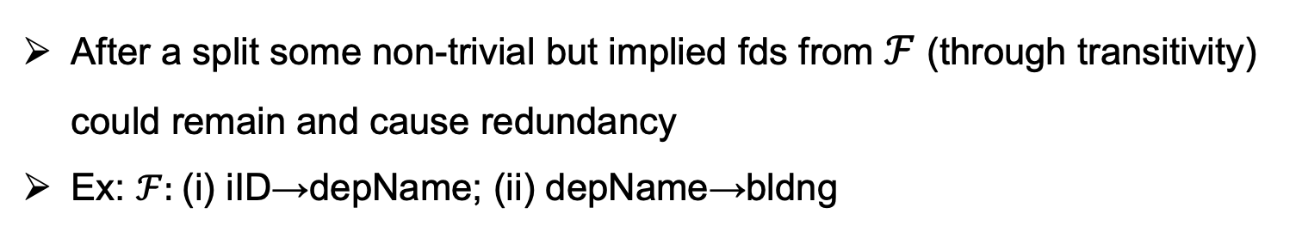
Why Do We Consider $ℱ^{+}$ instead of $ℱ$?
After a split some non-trivial but implied fds from $ℱ$ (through transitivity) could remain and cause redundancy
Ex: $ℱ:$(i) iID→depName; (ii) depName→bldng
InstDep
iID | email | depName | bldng
111 | a@gmail | CS | DC
111 | a@hotmail | CS | DC
use: iID→depName
iID | depName
111 | CS
iID | email | bldng
111 | a@gmail | DC
111 | a@hotmail | DC
still repetition
need: iID→bldg ∈ $ℱ^{+}$
iID | bldng
111 | DC
iID | email
111 | a@gmail
111 | a@hotmail

Slide 37
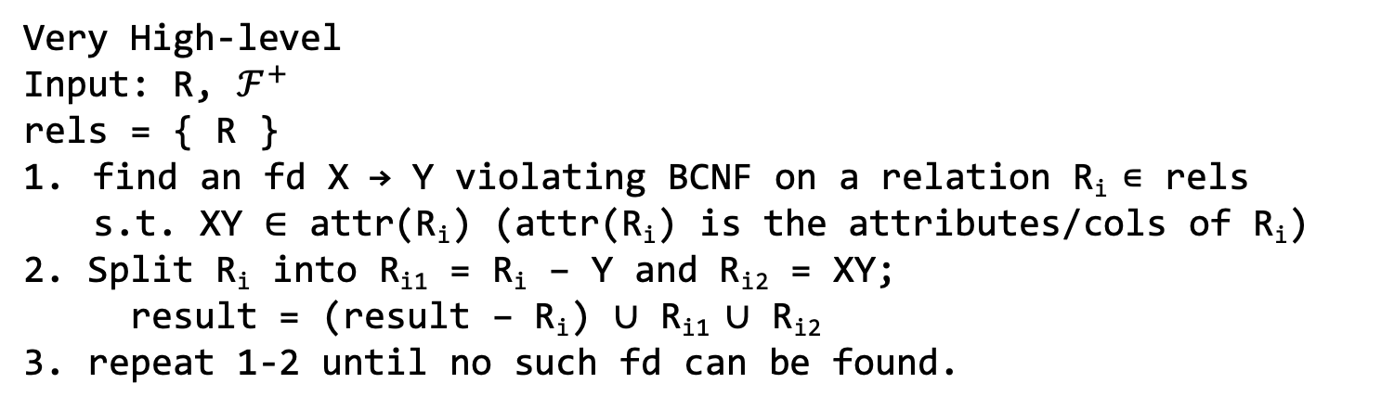
Why is BCNF A Lossless Decomposition? (1)
Very High-level
Input: R, $ℱ^{+}$
rels = { R }
find an fd X → Y violating BCNF on a relation R_{i} ∊ rels
  s.t. XY ∈ attr(R_{i}) (attr(R_{i}) is the attributes/cols of R_{i})
2. Split R_{i} into R_{i1} = R_{i} – Y and R_{i2} = XY;
result = (result – R_{i}) ∪ R_{i1} ∪ R_{i2}
3. repeat 1-2 until no such fd can be found.
By construction of the algorithm, X, which are the join attributes or R_{i1} and R_{i2}, i.e., R_{i1} ∩ R_{i2}, is a key in one of the split relations.
Since it’s a key, the join is 1-1:
  i.e., each tuple t in R_{i1} will join with 1 tuple t’ in R_{i2}.

Slide 38
Why is BCNF A Lossless Decomposition? (2)
InstDep | Dep
iID | name | salary | depName | bldng | budget
111 | Alice | 5000 | CS | DC | 20000
222 | Bob | 4000 | Physics | PHY | 30000
333 | Carl | 5200 | CS | DC | 20000
444 | Diana | 5500 | CS | DC | 20000
555 | Ed | 2500 | Physics | DC | 20000
use: depName→bldng,budget
R1 | Dep
iID | name | salary | depName
111 | Alice | 5000 | CS
222 | Bob | 4000 | Physics
333 | Carl | 5200 | CS
444 | Diana | 5500 | CS
555 | Ed | 2500 | Physics
R2
depName | bldng | budget
CS | DC | 20000
Physics | PHY | 30000
Since CS is key in R2, each R1 tuple can join with only 1 R2 tuple.

Slide 39
Why is BCNF Decomp Alg. *Not* “Depend. Preserving”?
Decomposing on non-trivial fd₁ can “break” a non-trivial fd₂
Ex: fd₁: iID → depName: an instructor belongs to 1 dep
fd₂: sID, depName → iID: a student has 1 advisor from each dep.
DeptAdvisor
sID | iID | depName
s1 | 111 | CS
s1 | 555 | Physics
s2 | 111 | CS
Note: Not in BCNF. Why?
use: iID → depName
R1
sID | iID
s1 | 111
s1 | 555
s2 | 111
R2
iID | depName
111 | CS
555 | Physics
Can no longer check fd₂ in a single relation. Need to join R1 and R2.

Slide 40
Outline For Today
Application Constraints and Decompositions
Functional Dependencies
Boyce-Codd Normal Form (BCNF) & BCNF Decomposition Alg.
Dependency Preservation and 3rd Normal Form
Multi-valued Dependencies and 4th Normal Form
Short Note on Other Applications of Factorization

Slide 41
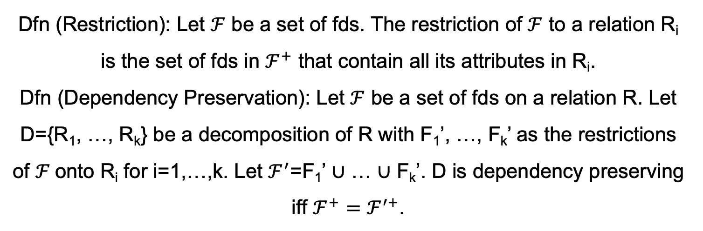
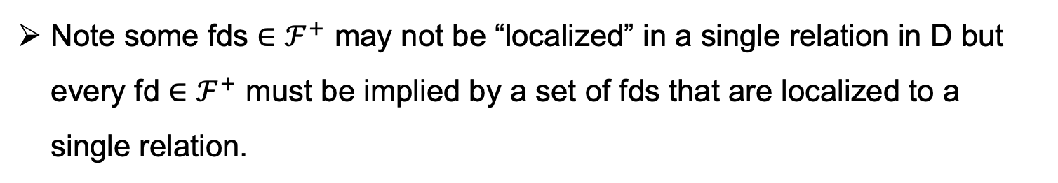
Dependency Preservation (1)
Dfn (Restriction): Let $ℱ$ be a set of fds. The restriction of $ℱ$ to a relation R_{i} is the set of fds in $ℱ^{+}$ that contain all its attributes in R_{i}.
Dfn (Dependency Preservation): Let $ℱ$ be a set of fds on a relation R. Let D={R₁, …, R_{k}} be a decomposition of R with F₁’, …, F_{k}’ as the restrictions of $ℱ$onto R_{i} for i=1,…,k. Let $ℱ^{′}$=F₁’ ∪ … ∪ F_{k}’. D is dependency preserving iff ${ℱ^{+}=ℱ}^{′+}$.
Note some fds ∈ $ℱ^{+}$ may not be “localized” in a single relation in D but every fd ∈ $ℱ^{+}$ must be implied by a set of fds that are localized to a single relation.

Slide 42
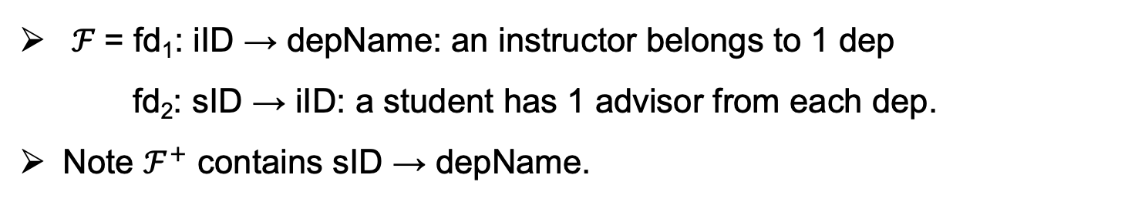
Dependency Preservation (2)
$ℱ$= fd₁: iID → depName: an instructor belongs to 1 dep
fd₂: sID → iID: a student has 1 advisor from each dep.
Note $ℱ^{+}$ contains sID → depName.
DeptAdvisor
sID | iID | depName
use: iID → depName
R1
sID | iID
R2
iID | depName
Cannot check sID → depName in a single relation but that’s OK.
We can still check it without any joins:
  fd₁: iID → depName can be checked in R2
  fd₂: sID → iID can be checked in R1
  fd₁ and fd₂ imply sID → depName

Slide 43
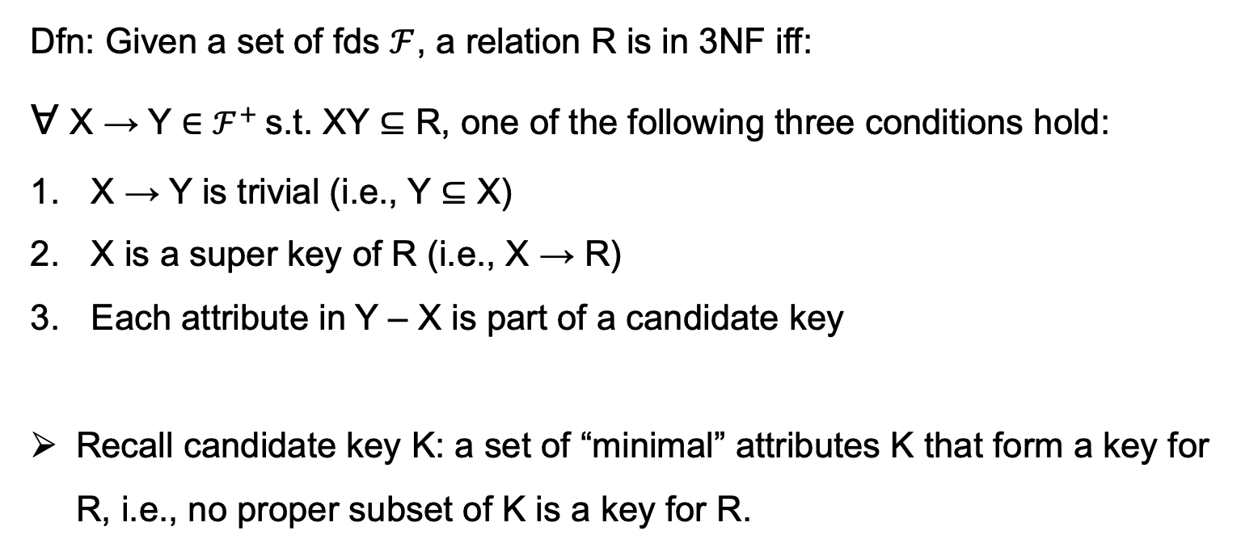
3rd Normal Form (3NF): Relaxation of BCNF To Allow Some “Reasonable” Redundancy
Dfn: Given a set of fds $ℱ$, a relation R is in 3NF iff:
∀ X → Y ∈ $ℱ^{+}$s.t. XY ⊆ R, one of the following three conditions hold:
X → Y is trivial (i.e., Y ⊆ X)
X is a super key of R (i.e., X → R)
Each attribute in Y – X is part of a candidate key
Recall candidate key K: a set of “minimal” attributes K that form a key for R, i.e., no proper subset of K is a key for R.

Slide 44
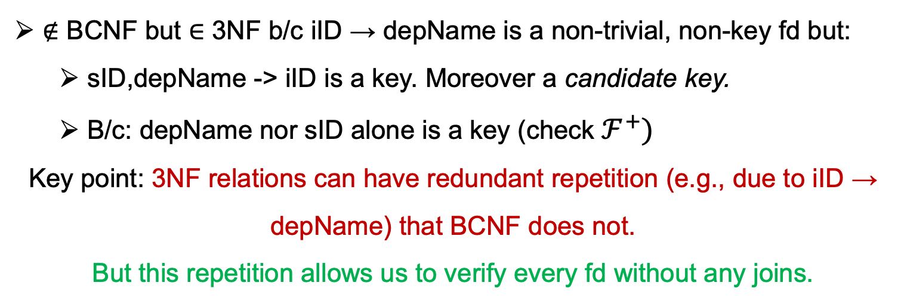
3NF Example
Recall non-BCNF example:
  fd₁: iID → depName: an instructor belongs to 1 dep
fd₂: sID, depName → iID: a student has 1 advisor from each dep.
DeptAdvisor
sID | iID | depName
s1 | 111 | CS
s1 | 555 | Physics
s2 | 111 | CS
∉ BCNF but ∈ 3NF b/c iID → depName is a non-trivial, non-key fd but:
  sID,depName -> iID is a key. Moreover a candidate key.
  B/c: depName nor sID alone is a key (check $ℱ^{+})$
Key point: 3NF relations can have redundant repetition (e.g., due to iID → depName) that BCNF does not.
But this repetition allows us to verify every fd without any joins.

Slide 45
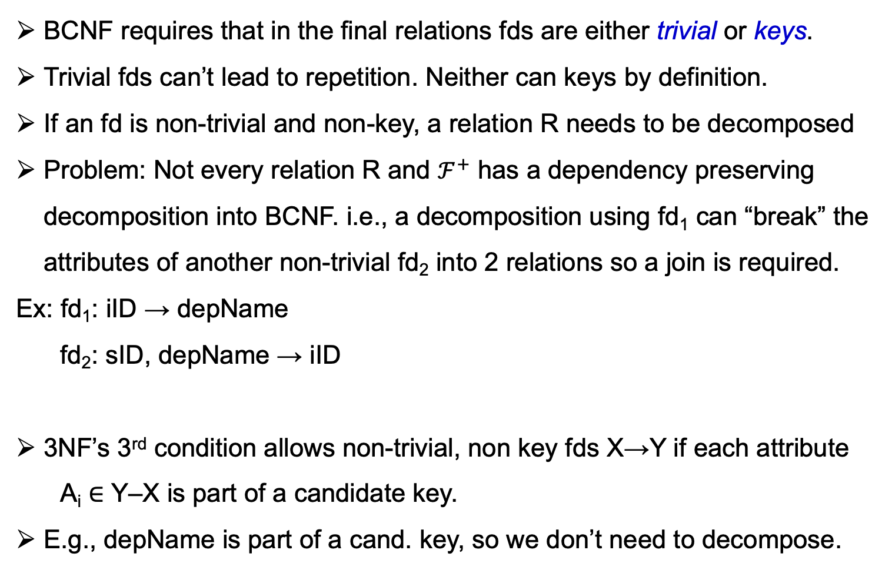
Intuition Behind 3rd Rule in 3NF (1)
BCNF requires that in the final relations fds are either trivial or keys.
Trivial fds can’t lead to repetition. Neither can keys by definition.
If an fd is non-trivial and non-key, a relation R needs to be decomposed
Problem: Not every relation R and $ℱ^{+}$ has a dependency preserving decomposition into BCNF. i.e., a decomposition using fd₁ can “break” the attributes of another non-trivial fd₂ into 2 relations so a join is required.
Ex: fd₁: iID → depName
fd₂: sID, depName → iID
3NF’s 3rd condition allows non-trivial, non key fds X→Y if each attribute
A_{i} ∈ Y–X is part of a candidate key.
E.g., depName is part of a cand. key, so we don’t need to decompose.
DeptAdvisor
sID | iID | depName
R1
sID | iID
R2
iID | depName

Slide 46
Intuition Behind 3rd Rule in 3NF (2)
Question: Why does the 3rd condition guarantee every relation has a dependency preserving decomposition?
3rd cond: fd*: X → Y is OK if each A_{i} ∈ Y – X is part of a candidate key.
High-level Intuition: Y – X are the “repeated” values due to fd*.
Let A_{i} ∈ Y – X. If A_{i} is part of a candidate key in the relation R, then:
∃ an fd_{ck}: Z, A_{i} → R. So if we decompose according to fd*:
R will split, so we need a join to check fd_{ck}.
The 3rd rule allows us to not split in these cases.
Note: This is not a proof.
A simpler proof for Question: study a 3NF decomposition alg. (next slide) and observe that it is dependency preserving by construction and is guaranteed to output relations in 3NF.

Slide 47
3NF and BCNF Venn Diagram
Every relation in BCNF is in 3NF but not vice versa.
3NF
BCNF

Slide 48

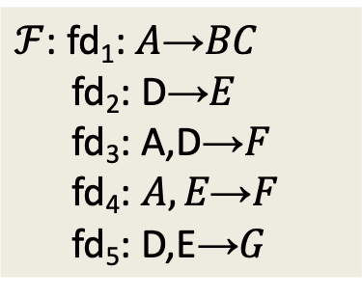
3NF Bottom-Up Decomp. Alg (1):
Minimal/Canonical Covers
A set of FDs $ℱ$ is minimal if:
  Every right-hand side of a FD in $ℱ$ is a single attribute
  For no $X\text{→}A$ is the set $ℱ−\{X\text{→}A\}$ equivalent to $ℱ$, i.e., Let $ℱ^{′ }=ℱ−\left\{X\text{→}A\right\}$, then ${ℱ^{′+ }=ℱ}^{+}$.
  For no $X\text{→}B$ and $Z$ a proper subset of $X$ is the set
  $(ℱ−\left\{X\text{→}B\right\})∪\left\{Z\text{→}B\right\}$ equivalent to $ℱ$
Ex: R(A, B, C, D, E, F, G)
$ℱ$: fd₁: $A\text{→}BC$
fd₂: D→$E$
fd₃: A,D$\text{→}F$
fd₄: $A, E\text{→}F$
fd₅: D,E→$G$
Fails Condition 1
Fails Condition 2: e.g., fd₂ and fd₄ imply fd₃
Fails Condition 3: difficult to directly see, but you can try that having instead fd₅: D→G has the same closure, i.e., is the same set of fds.

Slide 49
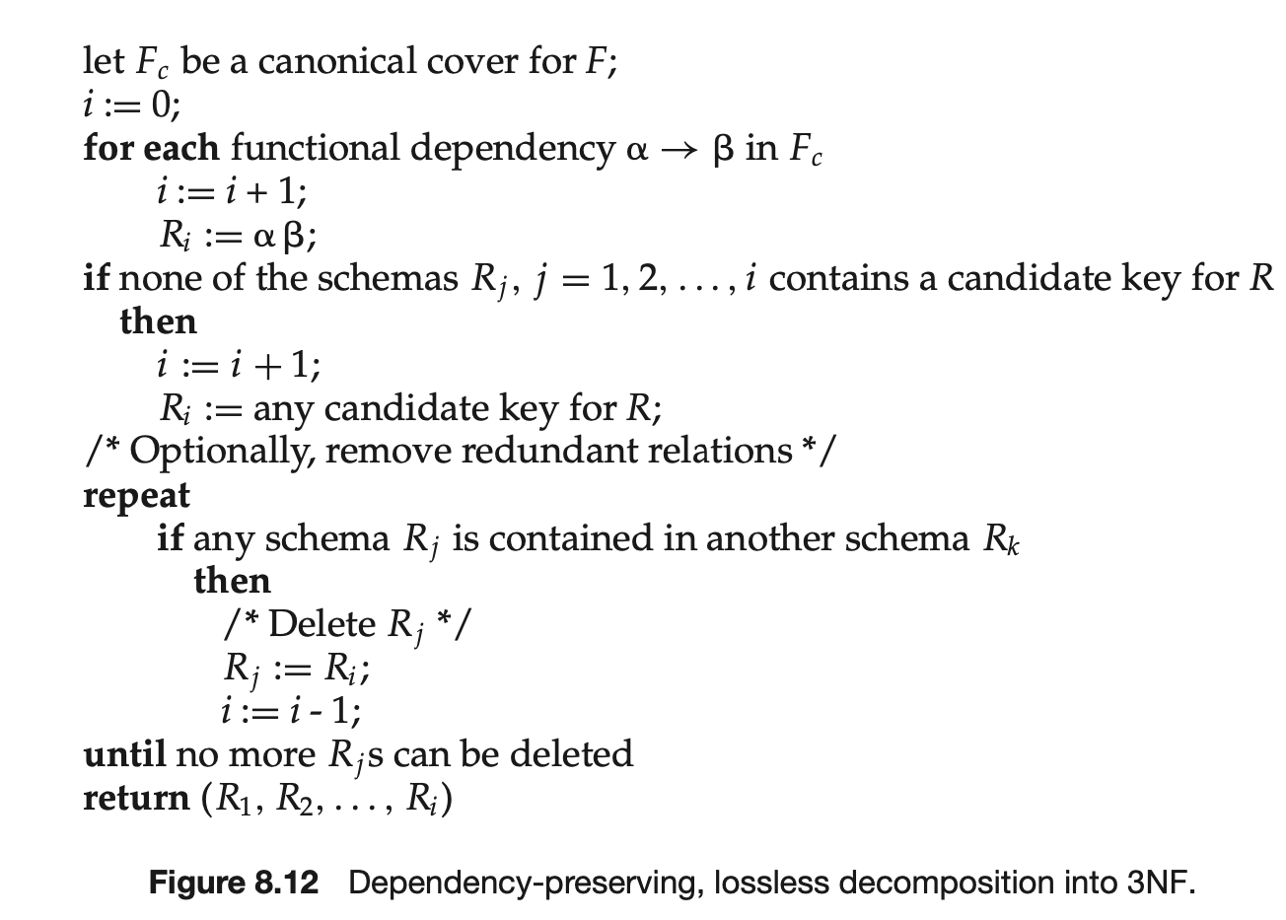
3NF Bottom-Up Decomp. Alg (2)

Slide 50
Outline For Today
Application Constraints and Decompositions
Functional Dependencies
Boyce-Codd Normal Form (BCNF) & BCNF Decomposition Alg.
Dependency Preservation and 3rd Normal Form
Multi-valued Dependencies and 4th Normal Form
Short Note on Other Applications of Factorization

Slide 51
Restatement of FDs: Conditional Independence Among Attribute Sets (1)
Recall the informal dfn of FDs: Let X, Y be sets of attributes. A functional dependency X → Y holds if for each possible value of attributes X there is only 1 possible value Y value. I.e. X “determines” Y uniquely (independent of other values in a tuple).
Equivalently: Let “RST= R- (X ∪ Y). X → Y means given a set of X values (x₁, …, x_{k}):
  Y values of tuples w/ (x₁, …, x_{k}): are independent of values in RST.
  And there is only 1 set of Y values.

Slide 52
Restatement of FDs: Conditional Independence Among Attribute Sets (2)
Let “RST= R- (X ∪ Y). X → Y means given a set of X values (x₁, …, x_{k}):
  Y values of tuples w/ (x₁, …, x_{k}): are independent of values in RST.
  And there is only 1 set of Y values.
InstDep | Dep
iID | name | salary | depName | bldng | budget
111 | Alice | 5000 | CS | DC | 20000
222 | Bob | 4000 | Physics | PHY | 30000
333 | Carl | 5200 | CS | DC | 20000
444 | Diana | 5500 | CS | DC | 20000
Ex: depName → bldng, budget
  RST: iID, name, salary

Slide 53
Multivalued Dependencies (MVDs): Generalized Conditional Independence Constraints
MVDs remove uniqueness constraint: given X, Y is independent of RST.
Dfn (MVD): Let X, Y be sets of attributes. An MVD X ↠ Y holds in R,
if given t₁ and t₂ ∈ R s.t. t₁[X] = t₂[X] and t₁[Y] ≠ t₂[Y],
then ∃ t_{3,} t₄ s.t:
t₁[X] = t₂[X] = t₃[X] = t₄[X]
t₃[Y] = t₁[Y] and t₃[RST] = t₂[RST]
t₄[Y] = t₂[Y] and t₄[RST] = t₁[RST]
 | X | Y | RST
t₁ | x* | y₁ | rst₁
t₂ | x* | y₂ | rst₂
… | … | … | …

Slide 54
Multivalued Dependencies (MVDs): Generalized Conditional Independence Constraints
MVDs remove uniqueness constraint: given X, Y is independent of RST.
Dfn (MVD): Let X, Y be sets of attributes. An MVD X ↠ Y holds in R,
if given t₁ and t₂ ∈ R s.t. t₁[X] = t₂[X] and t₁[Y] ≠ t₂[Y],
then ∃ t_{3,} t₄ s.t:
t₁[X] = t₂[X] = t₃[X] = t₄[X]
t₃[Y] = t₁[Y] and t₃[RST] = t₂[RST]
t₄[Y] = t₂[Y] and t₄[RST] = t₁[RST]
 | X | Y | RST
t₁ | x* | y₁ | rst₁
t₂ | x* | y₂ | rst₂
t₃ | x* | y₁ | rst₂
t₄ | x* | y₂ | rst₁

Slide 55
Multivalued Dependencies (MVDs): Generalized Conditional Independence Constraints
Example Constraint: given an instructor i, i’s emails are independent of the departments and buildings of these departments (but not unique).
  iID ↠ email
InstDep | Dep
iID | name | email | depName | bldng
111 | Alice | alice@gmail | CS | DC
111 | Alice | alice@hotmail | CS | DC
111 | Alice | alice@uw.ca | Physics | PHY
222 | Bob | bob@hotmail | Physics | PHY
333 | Carl | carl@gmail | CS | DC
… | … | … | … | …
Let x* be a set of values for X attributes (possibly > 1)
for any X values , R contains exactly: {x*} X {𝚷_{Y}(𝞂_{X=x*}(R)} X {𝚷_{RST}(𝞂_{X=x*}(R)}
Cartesian Product

Slide 56
Multivalued Dependencies (MVDs): Generalized Conditional Independence Constraints
Example Constraint: given an instructor i, i’s emails are independent of the departments and buildings of these departments (but not unique).
  iID ↠ email
InstDep | Dep
iID | name | email | depName | bldng
111 | Alice | alice@gmail | CS | DC
111 | Alice | alice@hotmail | CS | DC
111 | Alice | alice@uw.ca | Physics | PHY
222 | Bob | bob@hotmail | Physics | PHY
333 | Carl | carl@gmail | CS | DC
111 | Alice | alice@uw.ca | CS | DC
111 | Alice | alice@gmail | Physics | PHY
111 | Alice | alice@hotmail | Physics | PHY
Let x* be a set of values for X attributes (possibly > 1)
for any X values , R contains exactly: {x*} X {𝚷_{Y}(𝞂_{X=x*}(R)} X {𝚷_{RST}(𝞂_{X=x*}(R)}
Cartesian Product
Note: ∈ BCNF b/c InstDep has no non-trivial, non-key fds. Yet has repetition.

Slide 57
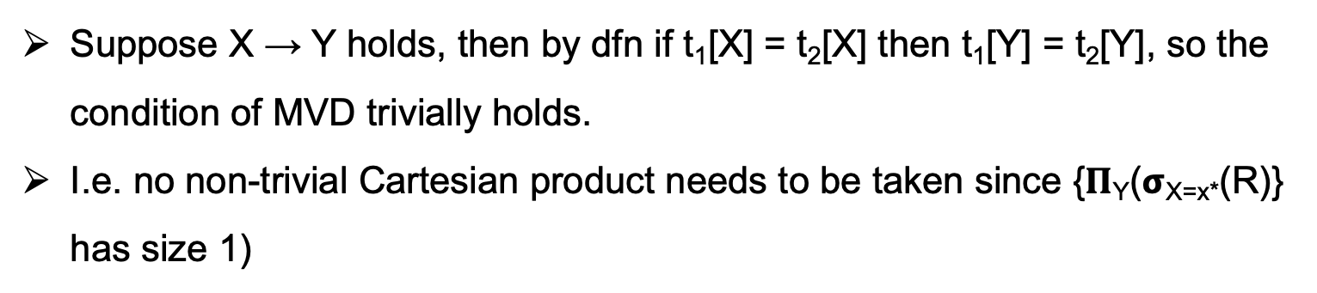
FDs are Specialized MVDs
More formal way to see FDs are specialized MDs (i.e., other than the informal definition that says MDs remove the uniqueness constraints)
Dfn (MVD): Let X, Y be sets of attributes. An MVD X ↠ Y holds in a relation R, if given t₁ and t₂ ∈ R s.t. t₁[X] = t₂[X] and t₁[Y] ≠ t₂[Y], then ∃ t_{3,} t₄ s.t:
t₁[X] = t₂[X] = t₃[X] = t₄[X]
t₃[Y] = t₁[Y] and t₃[RST] = t₂[RST]
t₄[Y] = t₂[Y] and t₄[RST] = t₁[RST]
Suppose X $\text{→}$ Y holds, then by dfn if t₁[X] = t₂[X] then t₁[Y] = t₂[Y], so the condition of MVD trivially holds.
I.e. no non-trivial Cartesian product needs to be taken since {𝚷_{Y}(𝞂_{X=x*}(R)} has size 1)

Slide 58
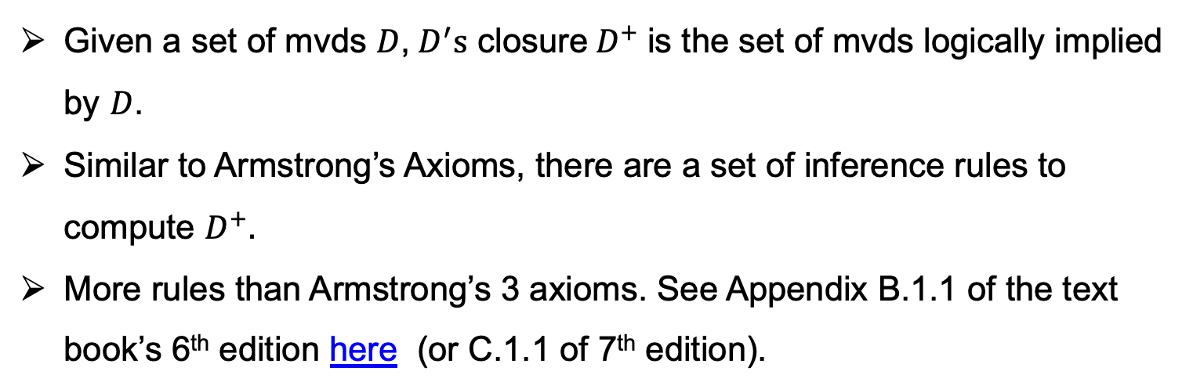
Closure of MVDs
Given a set of mvds $D$, $D^{′}s$ closure$D^{+}$is the set of mvds logically implied by $D$.
Similar to Armstrong’s Axioms, there are a set of inference rules to compute $D^{+}.$
More rules than Armstrong’s 3 axioms. See Appendix B.1.1 of the text book’s 6th edition here (or C.1.1 of 7th edition).

Slide 59
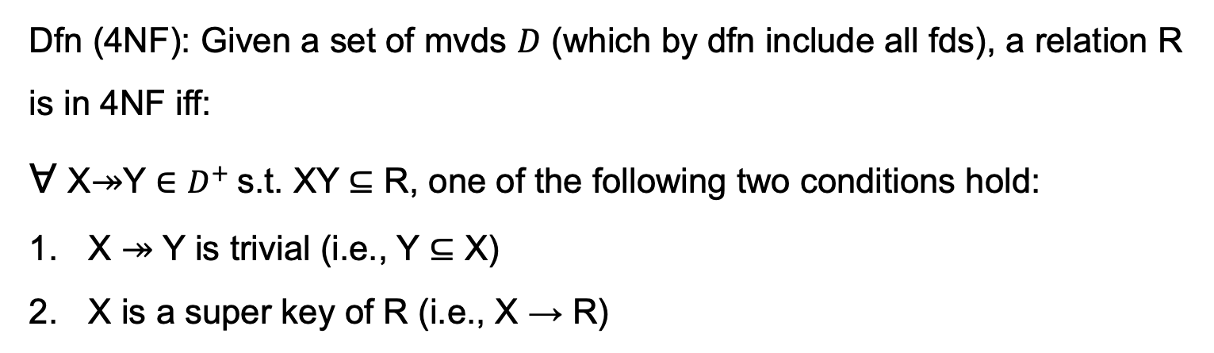
4NF: Avoiding All Repetition Due to MVDs
Dfn (4NF): Given a set of mvds $D$ (which by dfn include all fds), a relation R is in 4NF iff:
∀ X↠Y ∈ $D^{+}$s.t. XY ⊆ R, one of the following two conditions hold:
X ↠ Y is trivial (i.e., Y ⊆ X)
X is a super key of R (i.e., X → R)

Slide 60
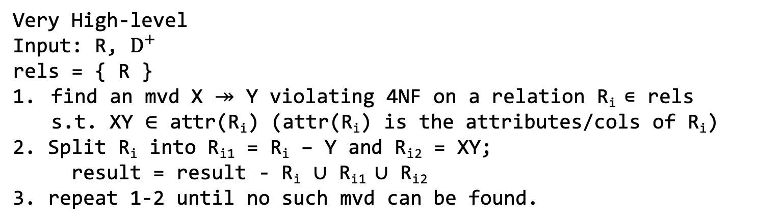
4th Normal Form Decomposition Algorithm
Simply replace FDs in the BCNF Decomposition Alg with MVDs
Very High-level
Input: R, $D^{+}$
rels = { R }
find an mvd X ↠ Y violating 4NF on a relation R_{i} ∊ rels
  s.t. XY ∈ attr(R_{i}) (attr(R_{i}) is the attributes/cols of R_{i})
2. Split R_{i} into R_{i1} = R_{i} – Y and R_{i2} = XY;
result = result - R_{i} ∪ R_{i1} ∪ R_{i2}
3. repeat 1-2 until no such mvd can be found.

Slide 61
4NF Decomposition Example
InstDep | Dep
iID | name | email | depName | bldng
111 | Alice | alice@gmail | CS | DC
111 | Alice | alice@hotmail | CS | DC
111 | Alice | alice@uw.ca | Physics | PHY
222 | Bob | bob@hotmail | Physics | PHY
333 | Carl | carl@gmail | CS | DC
111 | Alice | alice@uw.ca | CS | DC
111 | Alice | alice@gmail | Physics | PHY
111 | Alice | alice@hotmail | Physics | PHY
  iID ↠ email
R2
iID | email
111 | alice@gmail
111 | alice@hotmail
111 | alice@uw.ca
222 | bob@hotmail
333 | carl@gmail
R1 | Dep
iID | name | depName | bldng
111 | Alice | CS | DC
111 | Alice | Physics | PHY
222 | Bob | Physics | PHY
333 | Carl | CS | DC

Slide 62
Venn Diagram of Normal Forms
Every relation in 4NF is in BCNF but not vice versa (see previous slide).
3NF
BCNF
4NF

Slide 63
Enforcing FDs/MVDs in Practice
Key constraints are specialized fds that RDBMSs can enforce
But no direct support in RDBMSs for general FDs and MVDs.
But can use table level CHECKs and triggers to enforce these
There is also little support for specifying fds/mvds and decomposing relations in practice.
Users manually decompose relations if they observe repetition in design
But TNF is very useful when thinking about application constraints and their implications for redundancy
Try to target relations in 4NF or BCNF in practice. Often many natural designs are already in these forms.

Slide 64
Summary
Theory of Normal Forms (TNF): Given a specification of the real-world facts that an app will store, how can we formally separate “good” and ”bad” relational db schemas?
Ultimate Goal: Remove redundancy/repetition in design by factoring out ”conditionally” independent parts.
Redundancy depends on app constraints. Same exact relation can sometimes be redundant or not depending on app constraints.
FDs: Generalized Uniqueness Constraints
BCNF: Using FDs and the schema of R, can formally state whether R has redundant repetition due to uniqueness constraints.
3NF: Allows some redundancy to “localize” checking of fds to 1 relation
4NF: Most strict. Also does not allow repetition due to non-unique conditional independence relationships.

Slide 65
Outline For Today
Application Constraints and Decompositions
Functional Dependencies
Boyce-Codd Normal Form (BCNF) & BCNF Decomposition Alg.
Dependency Preservation and 3rd Normal Form
Multi-valued Dependencies and 4th Normal Form
Short Note on Other Applications of Factorization

Slide 66
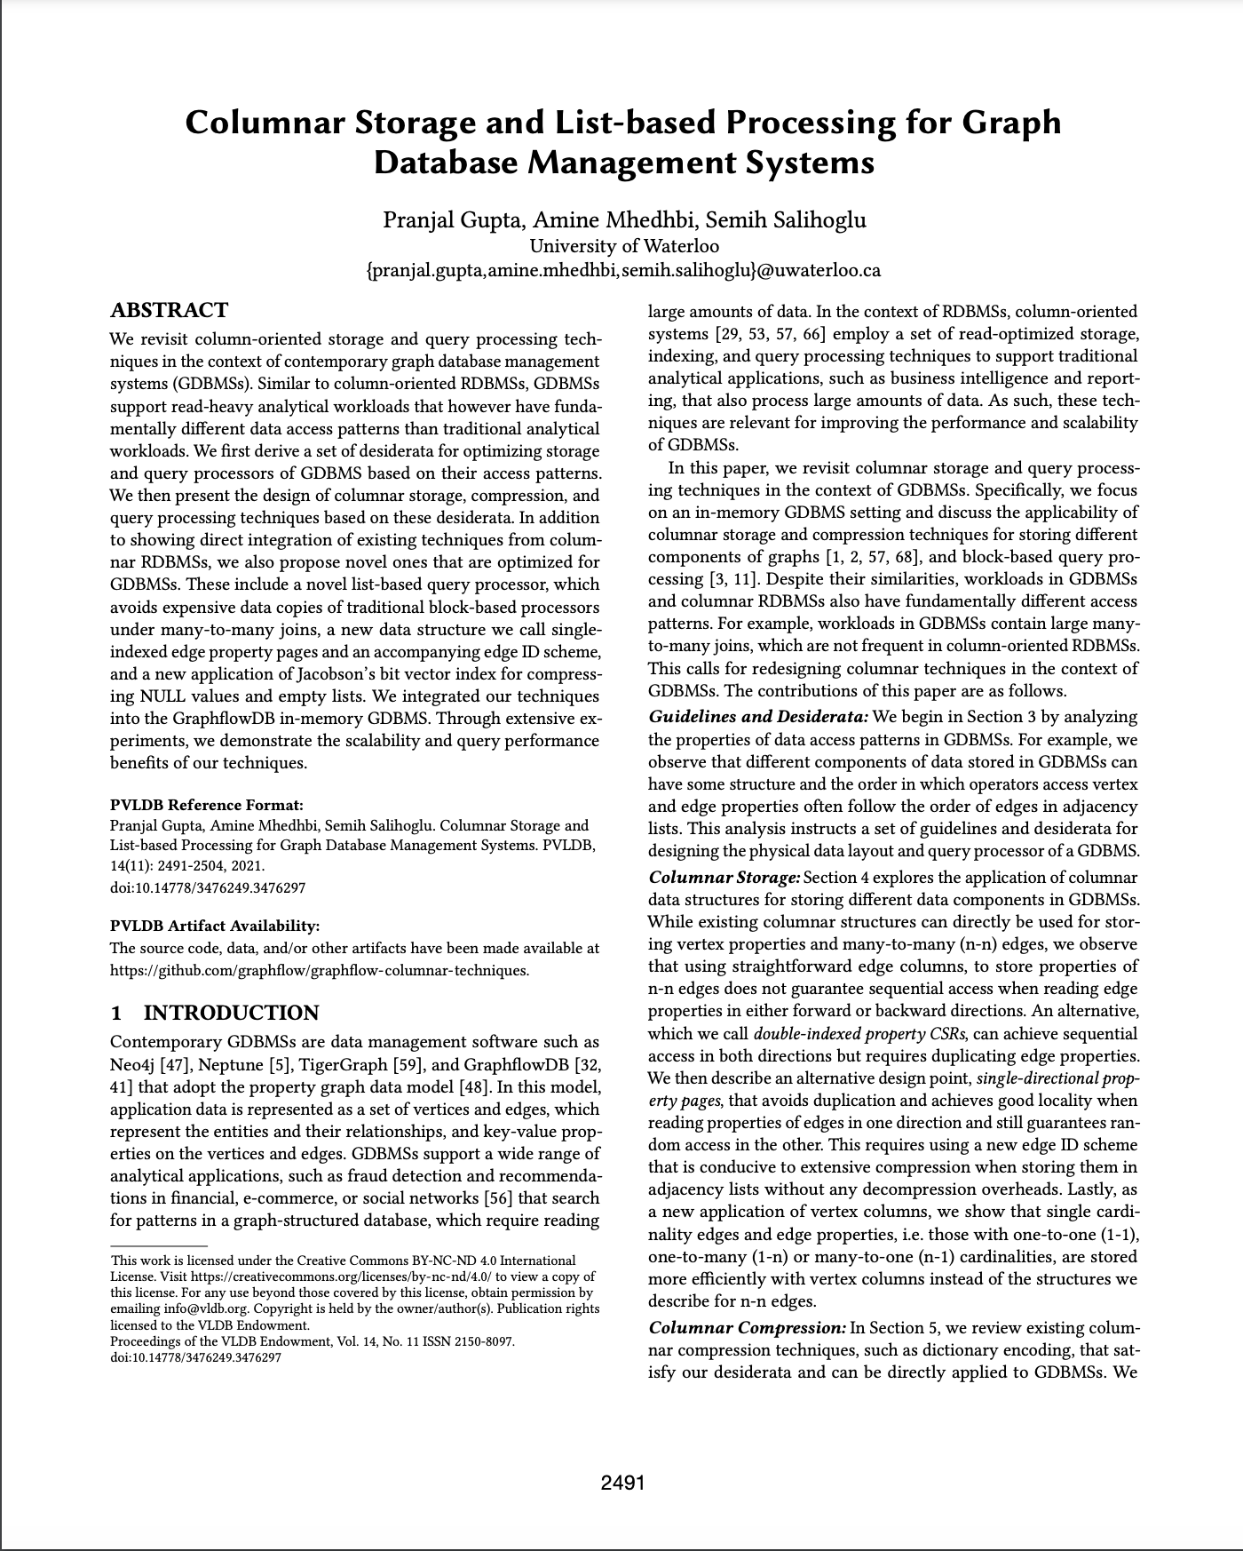
Normal Form Decompositions Are Examples of Factorization
Factorization: General set of techniques to represent relations in lossless compressed format.
NF Decompositions: application of factorization in db schema design.
Can also be applied in storage or even query processing.
Something my research group is actively working on.
VLDB 2021 [Gupta, Mhedhbi, Salihoglu]

Slide 67
Factorization At Physical Record Storage
Factorization: Consider a set of records for financial transactions.
U₁
C₁
…
…
L₁
…
…
U₁₀₀
C₁₀₀
Transfer
From | To
U₁ | L₁
U₂ | L₁
… | …
U₁₀₀ | L₁
L₁ | C₁
… | …
L₁ | C₁₀₀
Transfer
From X To | To
{U₁, U₂, …, U₁₀₀} | {L₁}
{L₁} | {C₁, C₂, …, C₁₀₀}
Factorized representation (f-rep)
Flat tuple representation (standard)
Dan Olteanu, Factorized Databases, 2016, SIGMOD Record

Slide 68
Factorization During Query Processing
SELECT *
FROM Transfer T1, Transfer T2
WHERE T1.To = T2.From
T1.To | T2.From | T2.To
U₁ | L₁ | C₁
… | … | …
U₁₀₀ | L₁ | C₁
… | …
U₁₀₀ | L₁ | C₁₀₀
100 x 100 tuples
Standard query processing over flat tuples
Join
Scan
Scan
From | To
U₁ | L₁
… | …
L₁ | C₁₀₀
From | To
U₁ | L₁
… | …
L₁ | C₁₀₀

Slide 69
Factorization During Query Processing
SELECT *
FROM Transfer T1, Transfer T2
WHERE T1.To = T2.From
T1.To | T2.From | T2.To
{U₁, …, U₁₀₀} | {L₁} | {C₁, …, C₁₀₀}
1 tuple with 200 values
Factorized query processing
Join
Scan
Scan
From | To
U₁ | L₁
… | …
L₁ | C₁₀₀
From | To
U₁ | L₁
… | …
L₁ | C₁₀₀
Many interesting questions about how to architect a factorized query processor: e.g.: how to detect from a given query when the intermediate results can be factorized.

