Slide 1
Relational Database Design using E/R
Introduction to Database Management
CS348 Spring 2021

Slide 2
Announcements (Tue. June 01)
Assignments (no work in this week), but in Week 5
  Release assignment 1 grade and partial solution
  Release assignment 2
Teams are formed. Please find your TA’s information on MarkUs
  Start working on your project
  Milestone 1 is due soon (< 2 weeks)
Start early ☺

Slide 3


Motivating Example
I want to have a registrar’s database. Can you help?
I know how to use SQL now!
It has these requirements …
Zero or more sections of a course are offered each term. Courses have names and numbers. In each term, the sections of each course are numbered starting with 1.
Most course sections are taught on-site, but a few
are taught at off-site locations.
Students have student numbers and names. Each course section is taught by a professor. A professor may teach more than one section in a term, but if a professor teaches more than one section in a term, they are always sections of the same course. Some professors do not teach every term.
Up to 50 students may be registered for a course section. Sections with 5 or fewer students are cancelled.
A student receives a mark for each course in which they are enrolled. Each student has a cumulative grade point average (GPA) which is calculated from all course marks the student has received.
What tables do you want me to create?
What are the primary keys, constraints, queries, …..?
We still need to learn about database design ☺

Slide 4
Database Design
Step 1: Understand the real-world domain being modeled
Specify it using a database design model
  E.g., Entity/Relationship (E/R) model, Object Definition Language (ODL), UML (Unified Modeling Language)
Step 2: Translate specification to the data model of DBMS
  Relational, XML, object-oriented, etc.
→ Create DBMS schema
Conceptual Design
Conceptual Schema
(E/R model)
Logical Design
Logical Schema
(Relational model)

Slide 5
Database Design
Entity-Relationship (E/R) model
Translating E/R to relational schema
Relational design principles
this
week

Slide 6
But what about ORM?
Automatic object-relational mappers are made popular by rapid Web development frameworks
But you still need designer discretion in all but simple cases
Each language/library has its own syntax for creating schema and for querying/modifying data
  Quirks and limitations cause portability problems
  They are not necessarily easier to learn than SQL

Slide 7
Entity-relationship (E/R) model
Historically and still very popular
Primarily a design model—not directly implemented by DBMS
Designs represented by E/R diagrams
  We use the style of E/R diagram covered by the textbook book; there are other styles/extensions
  Very similar to UML diagrams

Slide 8
E/R basics
Entity: a “thing,” like an object
Entity set: a collection of things of the same type, like a relation of tuples or a class of objects
  Represented as a rectangle
Relationship: an association among entities
Relationship set: a set of relationships of the same type (among same entity sets)
  Represented as a diamond
Attributes: properties of entities or relationships, like attributes of tuples or objects
  Represented as ovals

Slide 9
An example E/R diagram
Users are members of groups
A key of an entity set is represented by underlining all attributes in the key
  A key is a set of attributes whose values can belong to at most one entity in an entity set—like a key of a relation
uid
gid
Users
IsMemberOf
Groups
name
name

Slide 10
Attributes of relationships
Example: a user belongs to a group since a particular date
Where do the dates go?
  With Users?
    But a user can join multiple groups on different dates
  With Groups?
    But different users can join the same group on different dates
  With IsMemberOf!
uid
gid
Users
IsMemberOf
Groups
name
name
fromDate

Slide 11
More on relationships
There could be multiple relationship sets between the same entity sets
  Example: Users IsMemberOf Groups; Users Likes Groups
In a relationship set, each relationship is uniquely identified by the entities it connects
  Example: Between Bart and “Dead Putting Society”, there can be at most one IsMemberOf relationship and at most one Likes relationship
uid
gid
Users
IsMemberOf
Groups
name
name
Likes

Slide 12
More on relationships
There could be multiple relationship sets between the same entity sets
  Example: Users IsMemberOf Groups; Users Likes Groups
In a relationship set, each relationship is uniquely identified by the entities it connects
  Example: Between Bart and “Dead Putting Society”, there can be at most one IsMemberOf relationship and at most one Likes relationship
  What if Bart joins DPS, leaves, and rejoins? How can we modify the design to capture historical membership information?
    Make an entity set of MembershipRecords

Slide 13





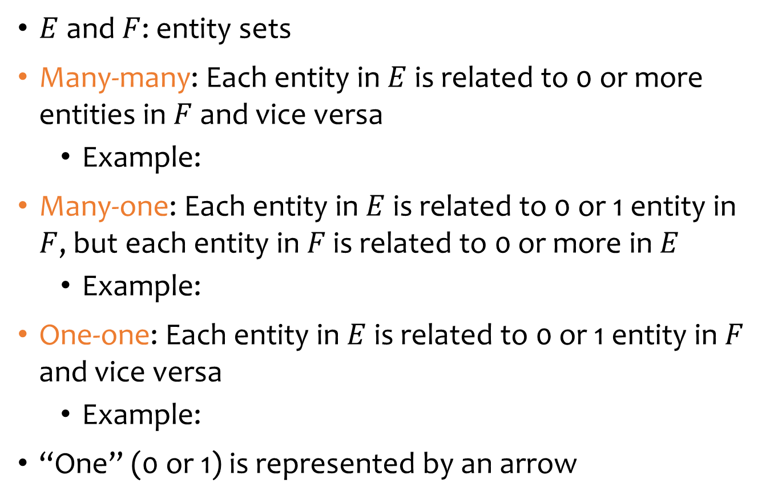

Multiplicity of relationships
$E$ and $F$: entity sets
Many-many: Each entity in $E$ is related to 0 or more entities in $F$ and vice versa
  Example:
Many-one: Each entity in $E$ is related to 0 or 1 entity in $F$, but each entity in $F$ is related to 0 or more in $E$
  Example:
One-one: Each entity in $E$ is related to 0 or 1 entity in $F$ and vice versa
  Example:
“One” (0 or 1) is represented by an arrow
Users
IsMemberOf
Groups
$$E$$
$$F$$
Groups
IsOwnedBy
Users
$$E$$
$$F$$
Users
IsLinkedTo
TwitterUsers
$$E$$
$$F$$

Slide 14
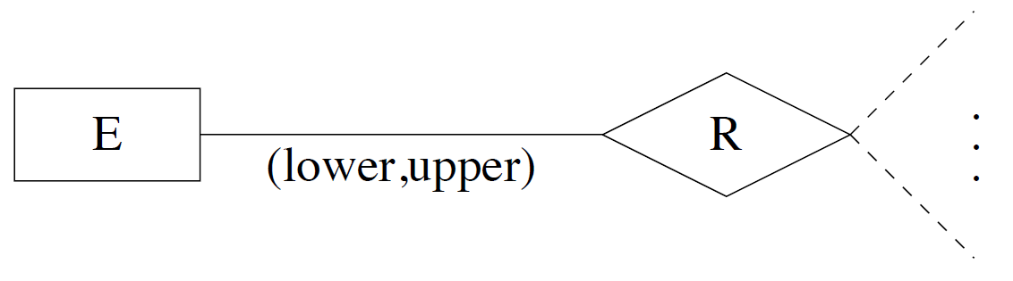
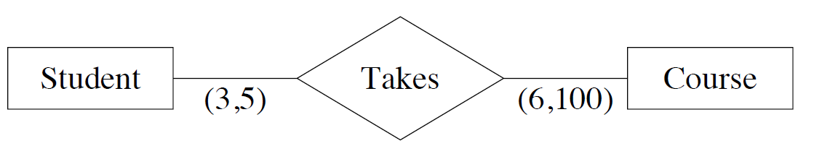
General cardinality constraints
General cardinality constraints determine lower and upper bounds on the number of relationships of a given relationship set in which a component entity may participate
Example:

Slide 15
Roles in relationships
An entity set may participate more than once in a relationship set
May need to label edges to distinguish roles
Examples
  Users may be parents of others; label needed
  Users may be friends of each other; label not needed
parent
IsFriendOf
Users
IsParentOf
child

Slide 16
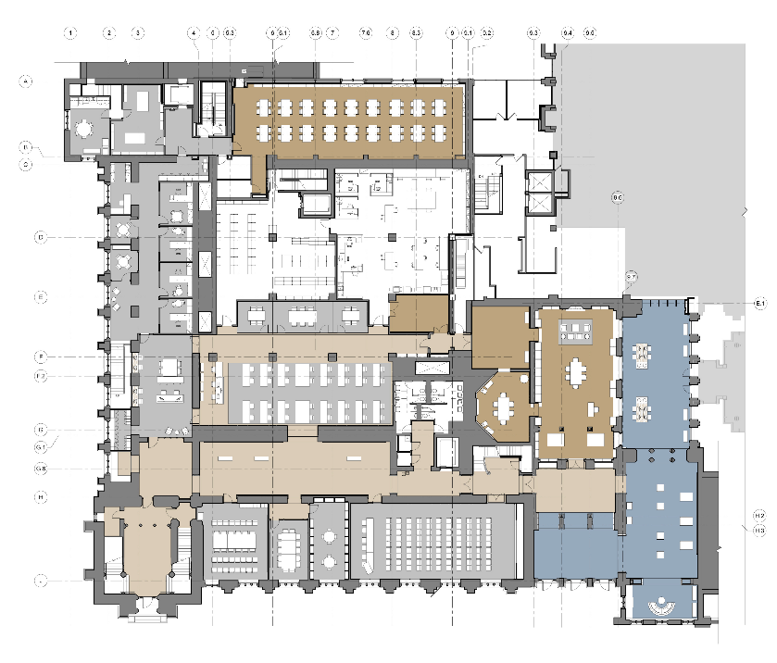
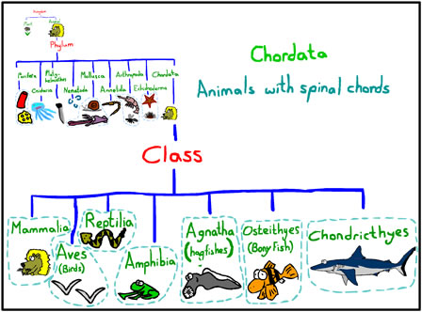
Next: two special relationships
… is part of/belongs to …
… is a kind of …
http://blogs.library.duke.edu/renovation/files/2012/08/Rubenstein-Library-First-Floor-Floorplan.jpg
http://www.sharky-jones.com/Sharkyjones/Artwork/taxonomy%20artwork/Class1.jpg

Slide 17
Weak entity sets
If entity E is existence dependent on entity F, then
  F is a dominant entity
  E is a subordinate entity
  Example: Rooms inside Buildings are partly identified by Buildings’ name
Weak entity set: containing subordinate entities
  Drawn as a double rectangle
  The relationship sets are called supporting
  relationship sets, drawn as double diamonds
  A weak entity set must have a many-to-one or
  one-to-one relationship to a distinct entity set
Strong entity set: containing no subordinate entities
Buildings
Implies (1,1)
In
Rooms

Slide 18
Weak entity set examples
Key: (Rnumber, building.name)
Seats in rooms in building
Attributes of weak entity sets only form key relative to a given dominant entity → discriminator (dotted underline)
Primary key of a weak entity set: discriminator + primary key of entity set for dominant entities
Rnumber
name
Rooms
In
Buildings
capacity
year
In
Key: ?
Snumber
Discriminator of a weak entity set: set of attributes that distinguish subordinate entities of the set, for a particular dominant entity
Seats
L/R?

Slide 19
ISA relationships
Similar to the idea of subclasses in object-oriented programming: subclass = special case, fewer entities, and possibly more properties
  Represented as a triangle (direction is important)
Example: paid users are users, but they also get avatars (yay!)
uid
gid
Users
IsMemberOf
Groups
name
name
ISA
fromDate
avatar
PaidUsers
Automatically “inherits” key, attributes, relationships

Slide 20
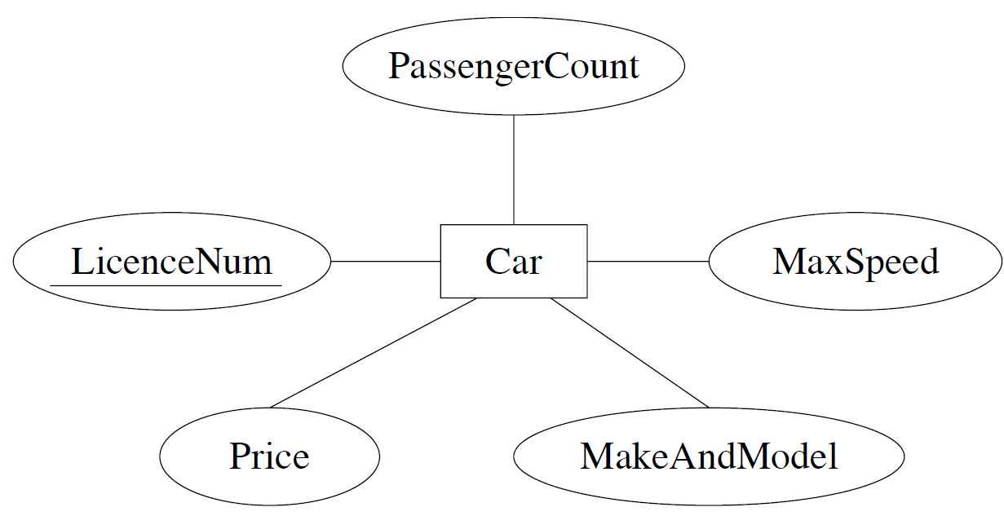
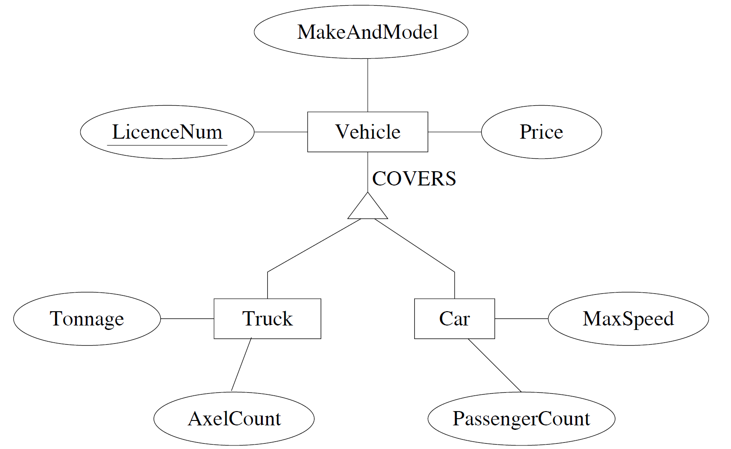
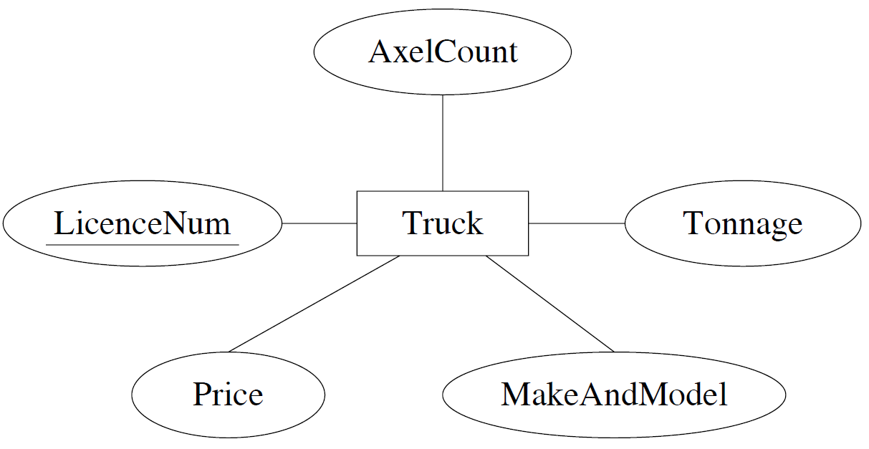
Other extensions to E/R models
Generalization: several entity sets can be abstracted by a more general entity set
  Example: “ a vehicle abstracts the notion of a car and a truck”

Slide 21
Other extensions to E/R models
Specialized entity sets are usually disjoint but can be declared to have entities in common
By default, specialized entity sets are disjoint.
  Example: We may decide that nothing is both a car and a truck.
  However, we can declare them to overlap (to accommodate utility vehicles, perhaps).
OVERLAPS

Slide 22
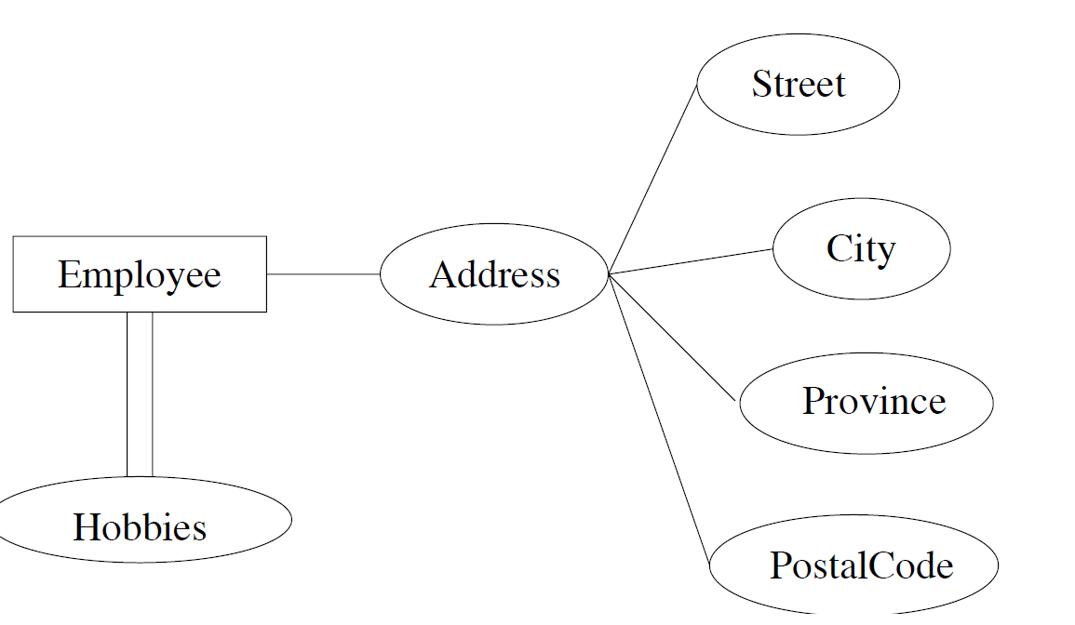
Other extensions to E/R models
Structured attributes:
  Composite attributes: composed of fixed number of other attributes
    E.g. Address
  Multi-valued attributes: attributes that are set-valued
    e.g. Hobbies (double edges)

Slide 23
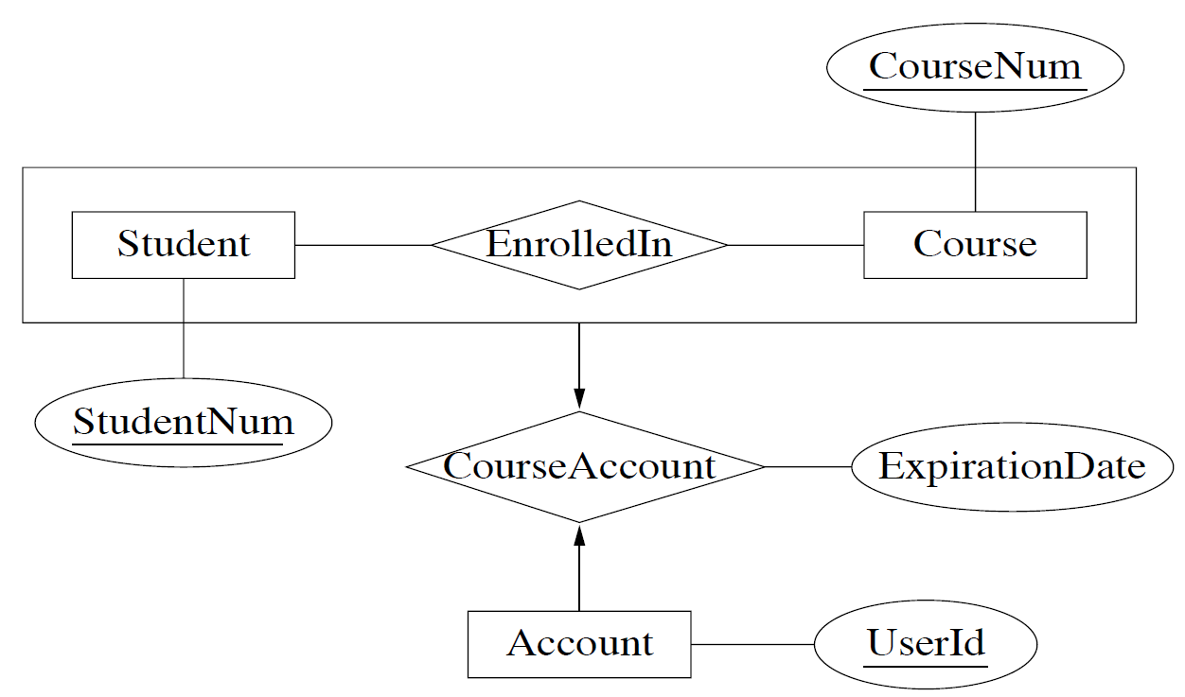






Other extensions to E/R models
Aggregation: relationships can be viewed as high-level entities
Example: “accounts are assigned to a given student enrollment”

Slide 24
Summary of E/R concepts
Entity sets
  Keys
  Weak entity sets
Relationship sets
  Attributes of relationships
  Multiplicity
  Roles
  Supporting relationships (related to weak entity)
  ISA relationships
Other extensions:
  Generalization
  Structured attributes
  Aggregation

Slide 25
Designing an E/R schema
Usually many ways to design an E-R schema
Points to consider
  use attribute or entity set?
  use entity set or relationship set?
  degrees of relationships?
  extended features?

Slide 26
Attributes or Entity Sets?
Example: How to model employees’ phones?
Rules of thumb:
  Is it a separate object?
  Do we maintain information about it?
  Can several of its kind belong to a single entity?
  Does it make sense to delete such an object?
  Can it be missing from some of the entity set’s entities?
  Can it be shared by different entities?
→ An affirmative answer to any of the above suggests a new entity set.
PhoneNumber
Employees
Employees
owns
Phones

Slide 27
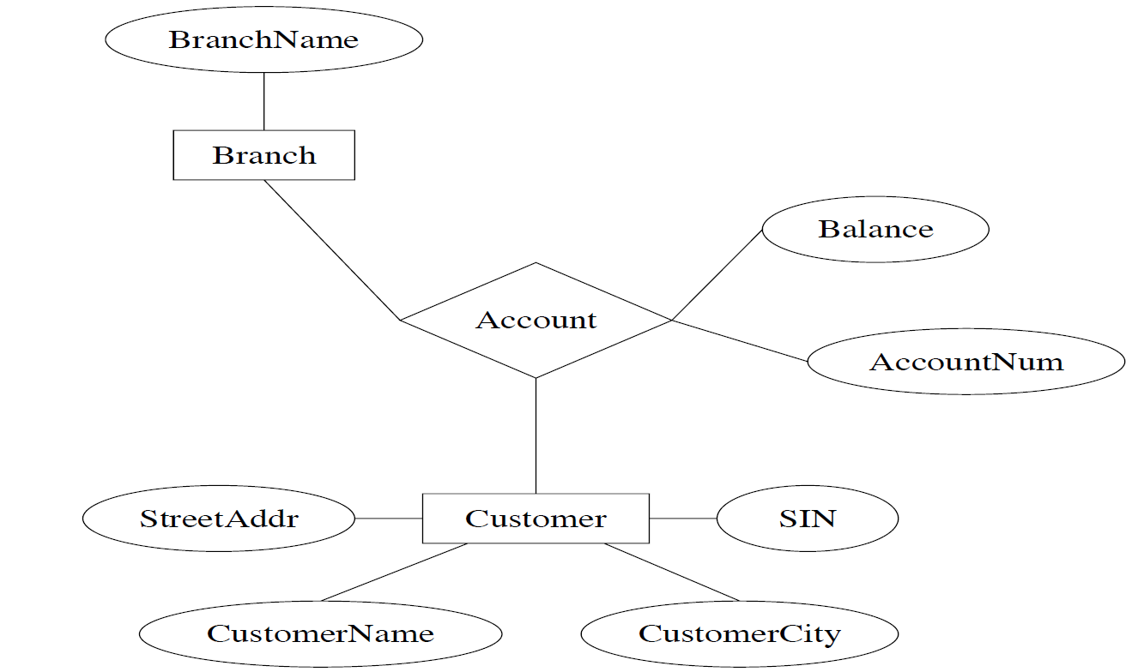
Entity Sets or Relationships?
Instead of representing accounts as entities, we could represent them as relationships
relationships

Slide 28
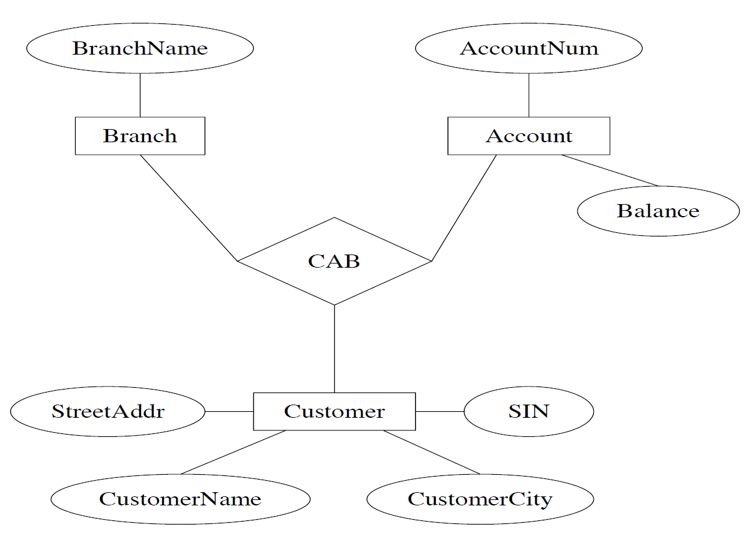
Binary vs. N-ary Relationships?
3-ary relationships

Slide 29
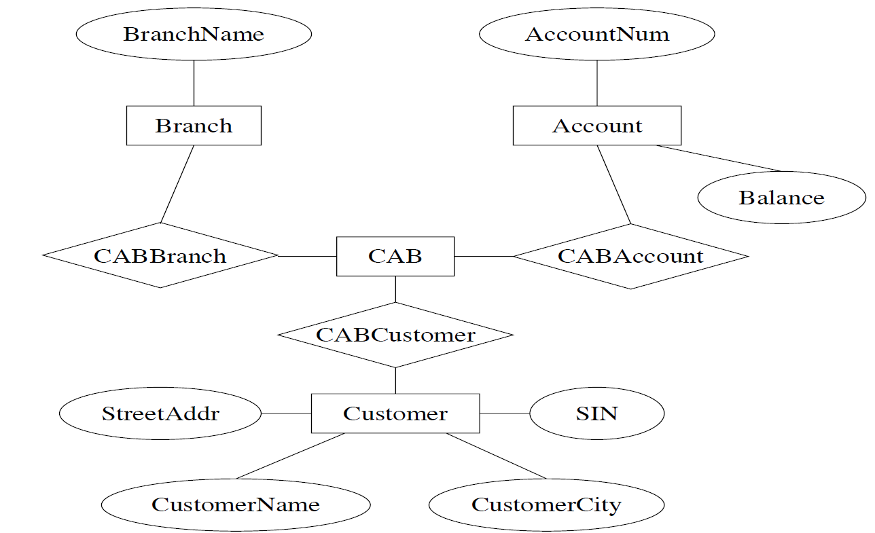
Binary vs. N-ary Relationships (cont’d)
We can always represent a relationship on n entity sets with n binary relationships

Slide 30
A simple methodology
Recognize entity sets
Recognize relationship sets and participating entity sets
Recognize attributes of entity and relationship sets
Define relationship types and existence dependencies
Define general cardinality constraints, keys and discriminators
Draw diagram
For each step, maintain a log of assumptions motivating the choices, and of restrictions imposed by the choices

Slide 31

Case study 1
Design a database representing cities, counties, and states
  For states, record name and capital (city)
  For counties, record name, area, and location (state)
  For cities, record name, population, and location (county and state)
Assume the following:
  Names of states are unique
  Names of counties are only unique within a state
  Names of cities are only unique within a county
  A city is always located in a single county
  A county is always located in a single state
What are the entity sets, relationship sets, and their attributes? What are the types of relationships and cardinality constraints, keys, discriminators?

Slide 32
Case study 1
Design a database representing cities, counties, and states
  For states, record name and capital (city)
  For counties, record name, area, and location (state)
  For cities, record name, population, and location (county and state)
Assume the following:
  Names of states are unique
  Names of counties are only unique within a state
  Names of cities are only unique within a county
  A city is always located in a single county
  A county is always located in a single state
Cities
What are my entity sets? (slide 26)
Counties
States

Slide 33
Case study 1
Design a database representing cities, counties, and states
  For states, record name and capital (city)
  For counties, record name, area, and location (state)
  For cities, record name, population, and location (county and state)
Assume the following:
  Names of states are unique
  Names of counties are only unique within a state
  Names of cities are only unique within a county
  A city is always located in a single county
  A county is always located in a single state
Cities
What are my relationship sets?
In
In
States
Counties

Slide 34
Case study 1
Design a database representing cities, counties, and states
  For states, record name and capital (city)
  For counties, record name, area, and location (state)
  For cities, record name, population, and location (county and state)
Assume the following:
  Names of states are unique
  Names of counties are only unique within a state
  Names of cities are only unique within a county
  A city is always located in a single county
  A county is always located in a single state
Add attributes!
name
Cities
population
IsCapitalOf
In
name
In
States
name
area
Counties

Slide 35
Case study 1
Design a database representing cities, counties, and states
  For states, record name and capital (city)
  For counties, record name, area, and location (state)
  For cities, record name, population, and location (county and state)
Assume the following:
  Names of states are unique
  Names of counties are only unique within a state
  Names of cities are only unique within a county
  A city is always located in a single county
  A county is always located in a single state
Relationship types?
name
Cities
population
IsCapitalOf
In
name
In
States
name
area
Counties

Slide 36
Case study 1
Design a database representing cities, counties, and states
  For states, record name and capital (city)
  For counties, record name, area, and location (state)
  For cities, record name, population, and location (county and state)
Assume the following:
  Names of states are unique
  Names of counties are only unique within a state
  Names of cities are only unique within a county
  A city is always located in a single county
  A county is always located in a single state
Cardinality constraints of relationship sets?
name
Cities
population
IsCapitalOf
In
name
In
States
name
area
Counties

Slide 37
Case study 1
Design a database representing cities, counties, and states
  For states, record name and capital (city)
  For counties, record name, area, and location (state)
  For cities, record name, population, and location (county and state)
Assume the following:
  Names of states are unique
  Names of counties are only unique within a state
  Names of cities are only unique within a county
  A city is always located in a single county
  A county is always located in a single state
Keys, discriminator of entity sets?
name
Cities
population
IsCapitalOf
In
name
In
States
name
area
Counties

Slide 38
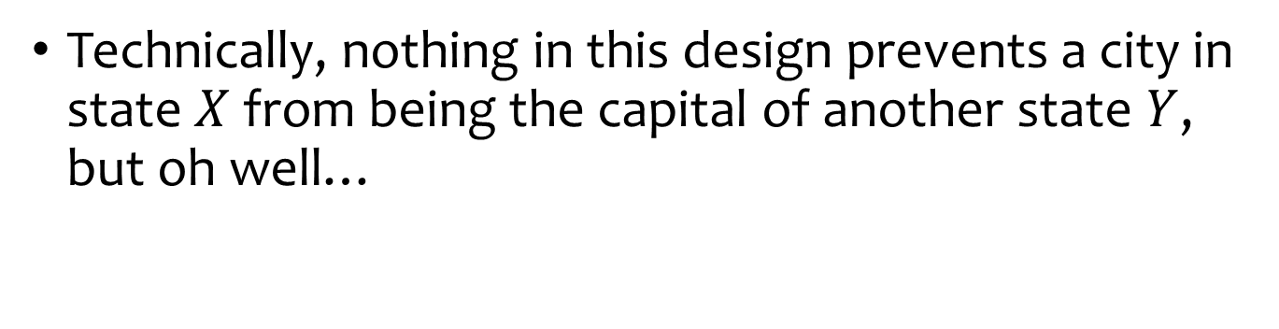
Case study 1: final design
name
Cities
population
In
IsCapitalOf
name
Counties
In
States
name
area
Technically, nothing in this design prevents a city in state $X$ from being the capital of another state $Y$, but oh well…

Slide 39
Case study 1: why not good?
name
name
Cities
In
States
population
capital
county_name
county_area
County area information is repeated for every city in the county
  Redundancy is bad (why?)
State capital should really be a city
  Should “reference” entities through explicit relationships

Slide 40
Case study 2
Design a database consistent with the following:
  A station has a unique name and an address, and is either an express station or a local station
  A train has a unique number and an engineer, and is either an express train or a local train
  A local train can stop at any station
  An express train only stops at express stations
  A train can stop at a station for any number of times during a day
  Train schedules are the same everyday
What are the entity sets, relationship sets, and their attributes? What are the types of relationships and cardinality constraints, keys, discriminators?

Slide 41
Case study 2: first design
Design a database consistent with the following:
A station has a unique name and an address, and is either an express station or a local station
A train has a unique number and an engineer, and is either an express train or a local train
A local train can stop at any station
An express train only stops at express stations
A train can stop at a station for any number of times during a day
Train schedules are the same everyday
Why not good?
Unintended constraint: A train can stop at a station only ONCE during a day! (slide 12)
number
name
engineer
Trains
StopsAt
Stations
address
E/L?
Cannot prevent express trains from stopping at any local stations
E/L?
time

Slide 42
Case study 2: second design
number
name
Trains
Stations
engineer
address
ISA
ISA
LocalTrains
LocalStations
ExpressTrains
ExpressStations
A station has a unique name and an address, and is either an express station or a local station
A train has a unique number and an engineer, and is either an express train or a local train
…..

Slide 43
Case study 2: second design
time
number
name
Trains
LocalTrainStops
Stations
engineer
address
ISA
ISA
LocalTrains
LocalStations
ExpressTrains
ExpressStations
time
ExpressTrainStops
…
A local train can stop at any station
An express train only stops at express stations
A train can stop at a station for any number of times during a day
…

Slide 44
Case study 2: second design
time
number
name
Trains
LocalTrainStops
Stations
engineer
address
ISA
ISA
LocalTrains
LocalStations
ExpressTrains
ExpressStations
time
No double-diamonds here
because train number + time
uniquely determine a stop
ExpressTrainStops
Is the extra complexity worth it?

Slide 45
Case study 3 (Exercise)
A Registrar’s Database:
  Zero or more sections of a course are offered each term. Courses have names and numbers. In each term, the sections of each course are numbered starting with 1.
  Most course sections are taught on-site, but a few are taught at off-site locations.
  Students have student numbers and names.
  Each course section is taught by a professor. A professor may teach more than one section in a term, but if a professor teaches more than one section in a term, they are always sections of the same course. Some professors do not teach every term.
  Up to 50 students may be registered for a course section. Sections with 5 or fewer students are cancelled.
  A student receives a mark for each course in which they are enrolled. Each student has a cumulative grade point average (GPA) which is calculated from all course marks the student has received.

Slide 46

Try it (5 mins)

Slide 47

What is your solution?

Slide 48









Case study 3 (Exercise)
A Registrar’s Database:
  Zero or more sections of a course are offered each term. Courses have names and numbers. In each term, the sections of each course are numbered starting with 1.
  Most course sections are taught on-site, but a few are taught at off-site locations.
  Students have student numbers and names.
  Each course section is taught by a professor. A professor may teach more than one section in a term, but if a professor teaches more than one section in a term, they are always sections of the same course. Some professors do not teach every term.
  Up to 50 students may be registered for a course section. Sections with 5 or fewer students are cancelled.
  A student receives a mark for each course in which they are enrolled. Each student has a cumulative grade point average (GPA) which is calculated from all course marks the student has received.

Slide 49



Case study 3 (Exercise)
A Registrar’s Database:
  Zero or more sections of a course are offered each term. Courses have names and numbers. In each term, the sections of each course are numbered starting with 1.
  Most course sections are taught on-site, but a few are taught at off-site locations.
  Students have student numbers and names.
  Each course section is taught by a professor. A professor may teach more than one section in a term, but if a professor teaches more than one section in a term, they are always sections of the same course. Some professors do not teach every term.
  Up to 50 students may be registered for a course section. Sections with 5 or fewer students are cancelled.
  A student receives a mark for each course in which they are enrolled. Each student has a cumulative grade point average (GPA) which is calculated from all course marks the student has received.

Slide 50
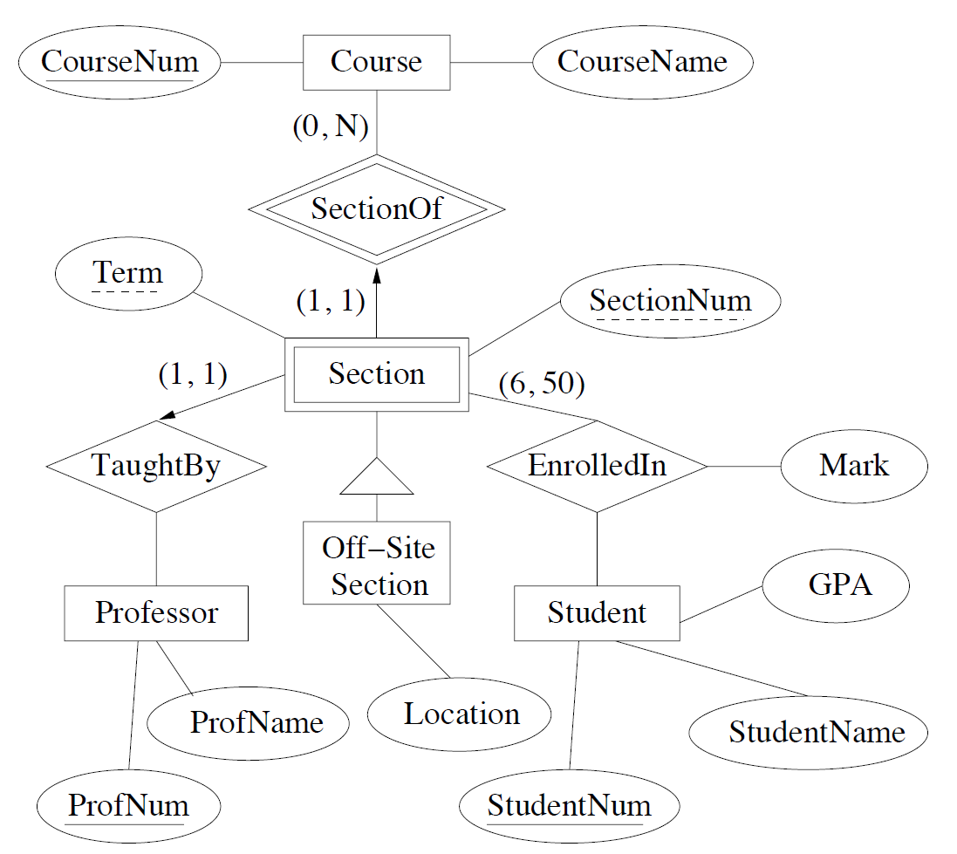
Case study 3 (Exercise) cont.

Slide 51
Case study 3 (Exercise) cont.
Optional, but good to state
Assume it is unique
(0,*)
Assume (term,sectionNum) is unique given the courseNum
Question: can we place “term” as an attribute of Course?
Zero or more sections of a course are offered each term. Courses have names and numbers. In each term, the sections of each course are numbered starting with 1.

Slide 52

Case study 3 (Exercise) cont.
(0,*)
Most course sections are taught on-site, but a few are taught at off-site locations.

Slide 53
Case study 3 (Exercise) cont.
(0,*)
(1,1)
(0,*)
Each course section is taught by a professor. A professor may teach more than one section in a term, but if a professor teaches more than one section in a term, they are always sections of the same course. Some professors do not teach every term.

Slide 54
Case study 3 (Exercise) cont.
(0,*)
(1,1)
Can “Professor” be an attribute of Section?
(0,*)
Each course section is taught by a professor. A professor may teach more than one section in a term, but if a professor teaches more than one section in a term, they are always sections of the same course. Some professors do not teach every term.

Slide 55
Case study 3 (Exercise) cont.
(0,*)
(6,50)
(0,*)
(0,*)
Up to 50 students may be registered for a course section. Sections with 5 or fewer students are cancelled.

Slide 56
Case study 3 (Exercise) cont.
Can “EnrolledIn” be a relationship set between Course and Student instead?
(0,*)
No, we may not be able to specify “(6,50)”
(0,*)
(0,*)
We did not capture this requirement
A student receives a mark for each course in which they are enrolled. Each student has a cumulative grade point average (GPA) which is calculated from all course marks the student has received.

Slide 57
Case study 3: possible solution
Assume it is unique
(0,*)
Assume (term,sectionNum) is unique given the courseNum
We did not capture this requirement
A student receives a mark for each course in which they are enrolled. Each student has a cumulative grade point average (GPA) which is calculated from all course marks the student has received.

Slide 58
What you have learned so far
Entity-Relationship (E/R) model
Next: Translating E/R to relational schema
Rnumber
name
Rooms
In
Buildings
capacity
year
In
Building (name, year)
Room (building_name, room_number, capacity)
Seat (building_name, room_number, seat_number, left_or_right)
Snumber
Seats
L/R?

