Slide 1
Relational Database Design:
E/R-Relational Translation
Introduction to Database Management
CS348 Spring 2021

Slide 2
E/R Model
E/R Concepts
E/R Schema Design
Next: Translating E/R to relational schema
Rnumber
name
Rooms
In
Buildings
capacity
year
In
Building (name, year)
Room (building_name, room_number, capacity)
Seat (building_name, room_number, seat_number, left_or_right)
Snumber
Seats
L/R?

Slide 3

Translating entity sets
An entity set translates directly to a table
  Attributes $→$ columns
  Key attributes $→$ key columns
uid
gid
Users
IsMemberOf
Groups
name
name
fromDate
User (uid, name)
Group (gid, name)

Slide 4
Translating weak entity sets
Remember the “borrowed” key attributes
Watch out for attribute name conflicts
Rnumber
name
Rooms
In
Buildings
capacity
year
In
Snumber
Seats
Building (name, year)
L/R?
Room (building_name, room_number, capacity)
Seat (building_name, room_number, seat_number, left_or_right)

Slide 5

Translating relationship sets
A relationship set translates to a table
  Keys of connected entity sets $→$ columns
  Attributes of the relationship set (if any) $→$ columns
  Multiplicity of the relationship set determines the key of the table
uid
gid
Users
IsMemberOf
Groups
name
name
fromDate
Member (uid, gid, fromDate)

Slide 6
More examples
parent
Users
IsParentOf
Parent (parent_uid, child_uid)
child

Slide 7
Translating double diamonds?
No need to translate because the relationship is implicit in the weak entity set’s translation
number
name
Rooms
In
Buildings
capacity
year
In
RoomInBuilding
(room_building_name, room_number,
building_name)
number
Seats
is subsumed by
Room (building_name, room_number, capacity)
L/R?

Slide 8


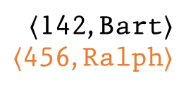

Translating subclasses & ISA: approach 1
Entity-in-all-superclasses approach (“E/R style”)
  An entity is represented in the table for each subclass to which it belongs
  A table includes only the attributes directly attached to the corresponding entity set, plus the inherited key
uid
gid
Users
IsMemberOf
Groups
name
name
ISA
fromDate
avatar
PaidUsers
Group (gid, name)
User (uid, name)
Member (uid, gid, from_date)
$〈$142, Bart$〉$
$〈$456, Ralph$〉$
$$∈$$
$〈$456, ☺$〉$
PaidUser (uid, avatar)
$$∈$$

Slide 9



Translating subclasses & ISA: approach 2
Entity-in-most-specific-class approach (“OO style”)
  An entity is only represented in one table (the most specific entity set to which the entity belongs)
  A table includes the attributes attached to the corresponding entity set, plus all inherited attributes
uid
gid
Users
IsMemberOf
Groups
name
name
ISA
fromDate
avatar
PaidUsers
Group (gid, name)
User (uid, name)
Member (uid, gid, from_date)
PaidUser (uid, name, avatar)
$〈$142, Bart$〉$
$$∈$$
$〈$456, Ralph, ☺$〉$
$$∈$$

Slide 10

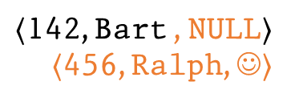
Translating subclasses & ISA: approach 3
All-entities-in-one-table approach (“NULL style”)
  One relation for the root entity set, with all attributes found in the network of subclasses
    (plus a “type” attribute when needed)
  Use a special NULL value in columns that are not relevant for a particular entity
uid
gid
Users
IsMemberOf
Groups
name
name
ISA
fromDate
avatar
PaidUsers
Group (gid, name)
User (uid, name)
Member (uid, gid, from_date)
Group (gid, name)
User (uid, name, avatar)
Member (uid, gid, from_date)
$〈$142, Bart , NULL$〉$
$〈$456, Ralph, ☺$〉$
$$∈$$

Slide 11
Comparison of three approaches
Entity-in-all-superclasses
  User (uid, name), PaidUser (uid, avatar)
  Pro:
  Con:
Entity-in-most-specific-class
  User (uid, name), PaidUser (uid, name, avatar)
  Pro:
  Con:
All-entities-in-one-table
  User (uid, [type, ]name, avatar)
  Pro:
  Con:
All users are found in one table
Attributes of paid users are scattered in different tables
All attributes of paid users are found in one table
Users are scattered in different tables
Everything is in one table
Lots of NULL’s; complicated if class hierarchy is complex

Slide 12
A complete example
time
number
name
Trains
LocalTrainStops
Stations
engineer
address
ISA
ISA
LocalTrains
LocalStations
ExpressTrains
ExpressStations
time
ExpressTrainStops

Slide 13
A complete example
time
number
name
Trains
LocalTrainStops
Stations
engineer
address
ISA
ISA
LocalTrains
LocalStations
ExpressTrains
ExpressStations
time
Train (number, engineer)
LocalTrain (number)
ExpressTrain (number)
ExpressTrainStops
merge
LocalTrainStop (local_train_number, time)
Station (name, address)
LocalStation (name)
ExpressStation (name)
LocalTrainStopsAtStation (local_train_number, time, station_name)
ExpressTrainStop (express_train_number, time)
merge
ExpressTrainStopsAtStation (express_train_number, time,
express_station_name)

Slide 14
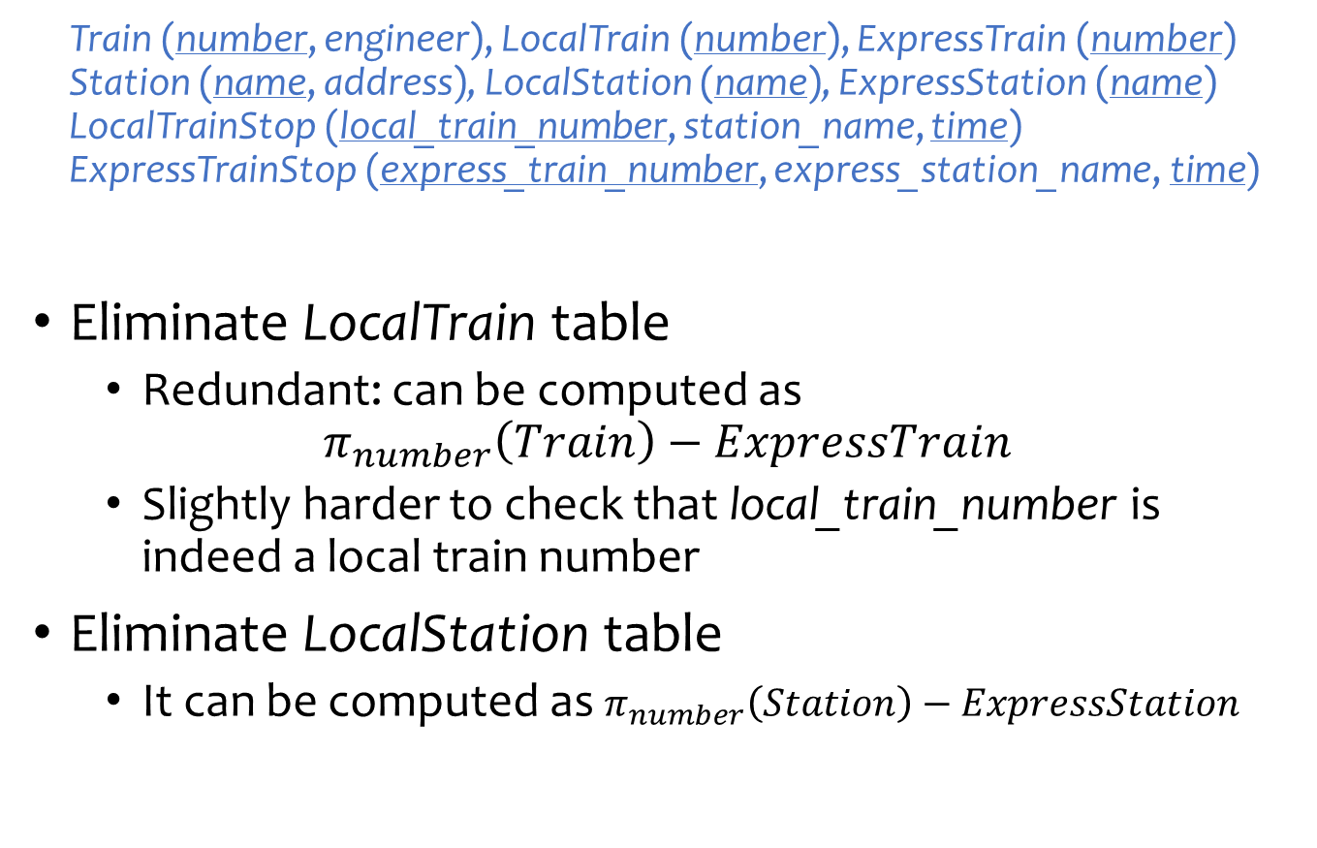
Simplifications and refinements
Train (number, engineer), LocalTrain (number), ExpressTrain (number)
Station (name, address), LocalStation (name), ExpressStation (name)
LocalTrainStop (local_train_number, station_name, time)
ExpressTrainStop (express_train_number, express_station_name, time)
Eliminate LocalTrain table
  Redundant: can be computed as
  $π_{number}\left(Train\right)−ExpressTrain$
  Slightly harder to check that local_train_number is indeed a local train number
Eliminate LocalStation table
  It can be computed as $π_{number}\left(Station\right)−ExpressStation$

Slide 15
An alternative design
Train (number, engineer, type)
Station (name, address, type)
TrainStop (train_number, station_name, time)
Encode the type of train/station as a column rather than creating subclasses
What about the following constraints?
  Type must be either “local” or “express”
  Express trains only stop at express stations
  They can be expressed/declared explicitly as database constraints in SQL
  Arguably a better design because it is simpler!

Slide 16

Design principles
KISS
  Keep It Simple, Stupid
Avoid redundancy
Capture essential constraints, but don’t introduce unnecessary restrictions
Use your common sense
  Warning: mechanical translation procedures given in this lecture are no substitute for your own judgment
POOR DESIGN!
http://ungenius.files.wordpress.com/2010/03/thehomer.jpg

Slide 17
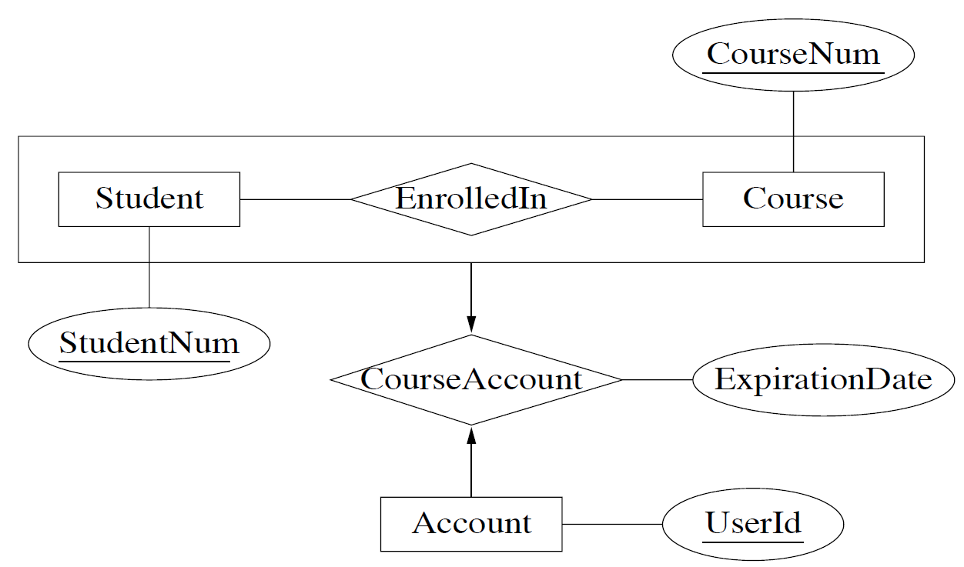
More examples
Representing aggregation
  Tabular representation of aggregation of R =
  tabular representation for relationship set R
  To represent relationship set involving aggregation of R, treat the aggregation like an entity set whose primary key is the primary key of the table for R
Student (StudentNum)
Couse(CourseNum)
Account(UserID)
  EnrolledIn(StudentNum,CouseNum)
  CouseAccount(UserId, StudentNum, CourseNum, ExpirationDate)

Slide 18
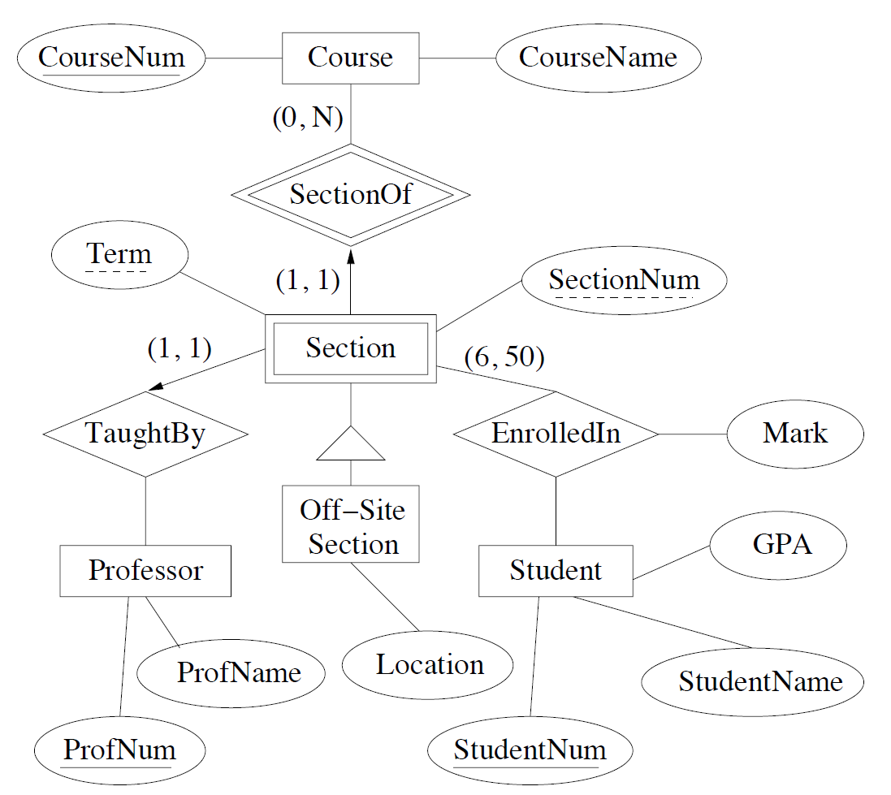
More examples (Exercise)
ER Diagram
Relational Schema
?

Slide 19
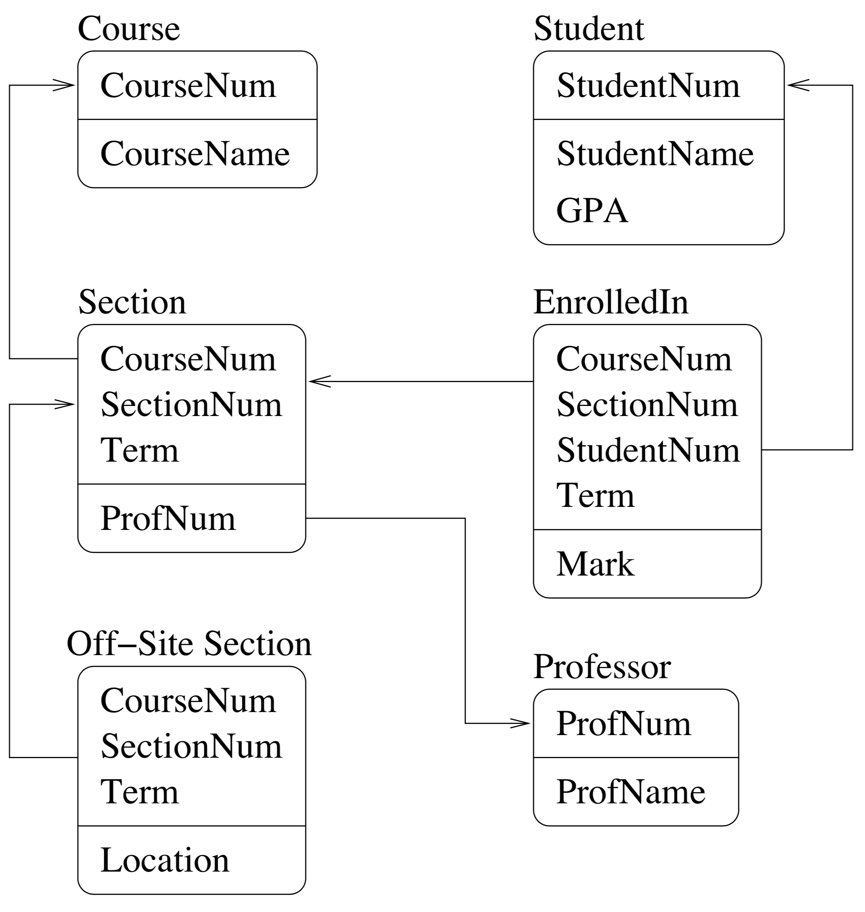
More examples
ER Diagram
Relational Diagram

Slide 20
More examples
ER Diagram
Relational DDL Commands
CREATE TABLE Course
(CourseNum INTEGER PRIMARY KEY,
CourseName CHAR(50));
CREATE TABLE Student
(StudentNum INTEGER PRIMARY KEY,
StudentName CHAR(50),
GPA FLOAT);
CREATE TABLE Professor
(ProfNum INTEGER PRIMARY KEY,
ProfName CHAR(50));
CREATE TABLE Section
(CourseNum INTEGER NOT NULL REFERENCES Course(CourseNum),
SectionNum INTEGER NOT NULL,
Term INTEGER NOT NULL,
PRIMARY KEY(CourseNum, SectionNum, Term),
ProfNum INTEGER NOT NULL REFERENCES Professor(ProfNum));
CREATE TABLE Off-SiteSection
(CourseNum INTEGER NOT NULL,
SectionNum INTEGER NOT NULL,
Term INTEGER NOT NULL,
FOREIGN KEY(CouseNum,SectionNum,Term) REFERENCES
Section(CouseNum,SectionNum,Term),
Location CHAR(50));
CREATE TABLE EnrolledIn
(CourseNum INTEGER NOT NULL,
SectionNum INTEGER NOT NULL,
Term INTEGER NOT NULL,
StudentNum INTEGER NOT NULL REFERENCES Student(StudentNum),
FOREIGN KEY(CouseNum,SectionNum,Term) REFERENCES
Section(CouseNum,SectionNum,Term),
Primary Key(CouseNum,SectionNum,Term,StudentNum),
Mark INTEGER);

Slide 21
Database Design
Entity-Relationship (E/R) model
Translating E/R to relational schema
Next week: Relational design principles

Slide 22
Clarifications
June 03, 2022

Slide 23
(slide 5) Translating relationship sets
A relationship set translates to a table
  Keys of connected entity sets $→$ columns
  Attributes of the relationship set (if any) $→$ columns
  Multiplicity of the relationship set determines the key of the table
uid
gid
Users
IsMemberOf
Groups
name
name
fromDate
Member (uid, gid, fromDate)
If we can deduce the general cardinality constraint (0,1) for a component entity set E, then take the primary key attributes for E
Otherwise, choose primary key attributes of each component entity

Slide 24
(Slide 17) More examples
Representing aggregation
  Tabular representation of aggregation of R =
  tabular representation for relationship set R
  To represent relationship set involving aggregation of R, treat the aggregation like an entity set whose primary key is the primary key of the table for R
Student (StudentNum)
Couse(CourseNum)
Account(UserID)
  EnrolledIn(StudentNum,CouseNum)
  CouseAccount(UserId, StudentNum, CourseNum, ExpirationDate)
One-to-one relationships → We can simply take UserId or (StudentNum, CourseNum) as the eky

