Slide 1

CS 348 Lectures 15-16
Query Optimization
  Semih Salihoğlu
  Nov 9-11 2021

Slide 2
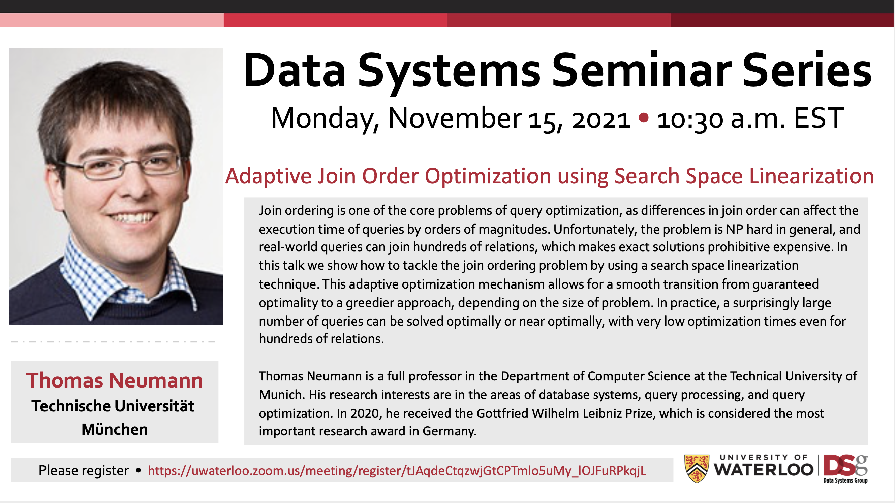
Announcements
Prof. Thomas Neumann DSG Seminar (Don’t miss!)
  Nov 15th at 10:30am
  Register here
  Send me an email if you want to join the student meeting

Slide 3
Recall: Overview of Compilation Steps
Text
AST
SELECT …
FROM …
WHERE…
Parser
Root
Binder
Normalizer
SELECT
…
TABLES
…
CON.
Customer
Product
=
Logical Plan
cid
5
Physical Plan Translator
Optimizer
Project
oid
Logical Plan Translator
Join
C.cid=O.cid
Physical Plan
Scan Tbl
Order
100 < price
Scan Tbl
Customer
cid=3
Project
$5
HashJoin
L.$2=R.$3
Filter
$2=5
IndexScan cust.mkd
Query Executor
RESULT
cid
…
IndexScan
order.mkd

Slide 4
Outline For Today
Goal of Query Optimization and Overview of Techniques
Cost-based Optimization Principles & Cardinality Estimation
Cost-based DP Logical Join Plan Optimizer
Rule-based Optimizations/Transformations
Final Remarks on Query Optimization & Query Processing

Slide 5
Outline For Today
Goal of Query Optimization and Overview of Techniques
Cost-based Optimization Principles & Cardinality Estimation
Cost-based DP Logical Join Plan Optimizer
Rule-based Optimizations/Transformations
Final Remarks on Query Optimization & Query Processing

Slide 6
Goal of Query Optimization (1)
Recall ultimately a physical plan executes to answer a query
Given a query Q, many equivalent physical plans exist:
  Many equivalent logical plans exist
SELECT cid
FROM Customer C, Order O, Product P
WHERE C.cid = O.cid AND O.pid = P.pid
AND P.name = BookA
Logical Plans:
Project
cid
Project
cid
Project
cid
L₁
L₂
L₃
Join
P.pid=O.pid
Filter
name=BookA
Filter
name=BookA
Join
C.cid=O.cid
Join
P.pid=O.pid
Filter
name=BookA
Join
P.pid=O.pid
Scan
Customer
Join
C.cid=O.cid
Scan
Product
Join
C.cid=O.cid
Scan
Product
Scan
Product
Scan
Order
Scan
Order
Scan
Customer
Scan
Order
Scan
Customer

Slide 7
Goal of Query Optimization (1)
Recall ultimately a physical plan executes to answer a query
Given a query Q, many equivalent physical plans exist:
  Many equivalent logical plans exist
  Each logical plan can have many equivalent physical plans.
SELECT cid
FROM Customer C, Order O, Product P
WHERE C.cid = O.cid AND O.pid = P.pid
AND P.name = BookA
Physical Plans:
Project
cid
Project
cid
P_{1,1}
Filter
name=BookA
P_{1,2}
Filter
name=BookA
HashJoin
C.cid=O.cid
HashJoin
C.cid=O.cid
MergeJoin
P.pid=O.pid
HashJoin
P.pid=O.pid
Scan
Customer
Scan
Customer
Sort(pid)
Sort(pid)
Scan
Product
Scan
Order
Scan
Product
Scan
Order

Slide 8
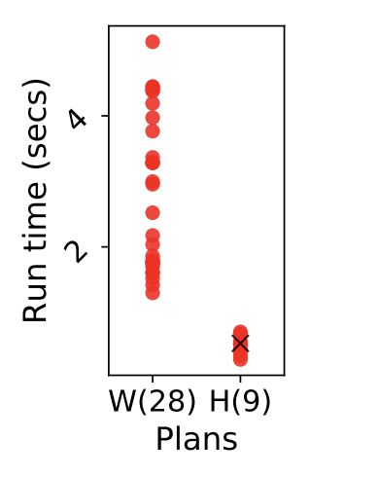
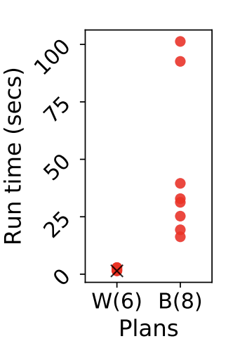
Goal of Query Optimization (2)
Ultimately: Given Q, pick the “best” physical plan for Q:
  Best: often means fastest, could mean “cheapest”
DBMS developers are more humble:
  Pick a reasonably good plan. Do not pick a very bad plan!
  Example plan spectrum of join-heavy queries
Don’t pick these!
Pick one of these!
Mhedhbi, Salihoglu, Optimizing Subgraph Queries by Combining Binary and Worst-Case Optimal Joins, VLDB 2019

Slide 9
Overview of Query Opt. Techniques
Enumerate a logical plan space (often enumerates all join orders)
  L₁, L₂, …, L_{k}
For one or more of L_{i}, (optionally) enumerate a physical plan space:
P_{i,1}, P_{i,2}, …, P_{i,t}
3. Pick the best P_{i,1}
Options for steps 1 & 2:
Rule-based
Cost-based
Hybrid rule/cost-based
(extended) relational algebraic expressions
A common approach:
  Step 1 is cost-based or hybrid
  Step 2 is rule-based

Slide 10
Outline For Today
Goal of Query Optimization and Overview of Techniques
Cost-based Optimization Principles & Cardinality Estimation
Cost-based DP Logical Join Plan Optimizer
Rule-based Optimizations/Transformations
Final Remarks on Query Optimization & Query Processing

Slide 11
Cost-based Optimization Principles
System R (’70s): First prototype relational DBMS from IBM
Project
cid
Project
cid
Filter
name=BookA
Filter
name=BookA
Patricia Selinger
Join
C.cid=O.cid
Join
P.pid=O.pid
Join
P.pid=O.pid
Scan
Customer
Join
C.cid=O.cid
Scan
Product
Scan
Product
Scan
Order
Scan
Order
Scan
Customer
Give each enumerated log/phy plan, e.g., L_{i}, a Cost(L_{i}) = c_{i}
Cost is the estimate of the system for how good/bad L_{i} is.
Pick min cost plan
Access Path Selection in a Relational Database Management, Selinger et al. 1979, SIGMOD

Slide 12
Cost-based Optimization Principles (1)
Naturally: cost definition is broken into costs of operators.
  i.e: Cost(L_{i}) = ∑_{j} cost(o_{j} ∈ L_{i})
Example cost metrics or components:
  # I/Os a plan will make
  # tuples that will pass through operators
  # runtime of algorithm o_{j} is running
    e.g., nested loop join of R, S: |R|*|S|
  Combination of above
For any reasonable metric:
  Need to estimate cardinality, i.e., size, of tuples o_{j} will process
Project
cid
Filter
name=BookA
Join
C.cid=O.cid
Join
P.pid=O.pid
Scan
Customer
Scan
Product
Scan
Order
The (notorious) cardinality estimation problem!

Slide 13
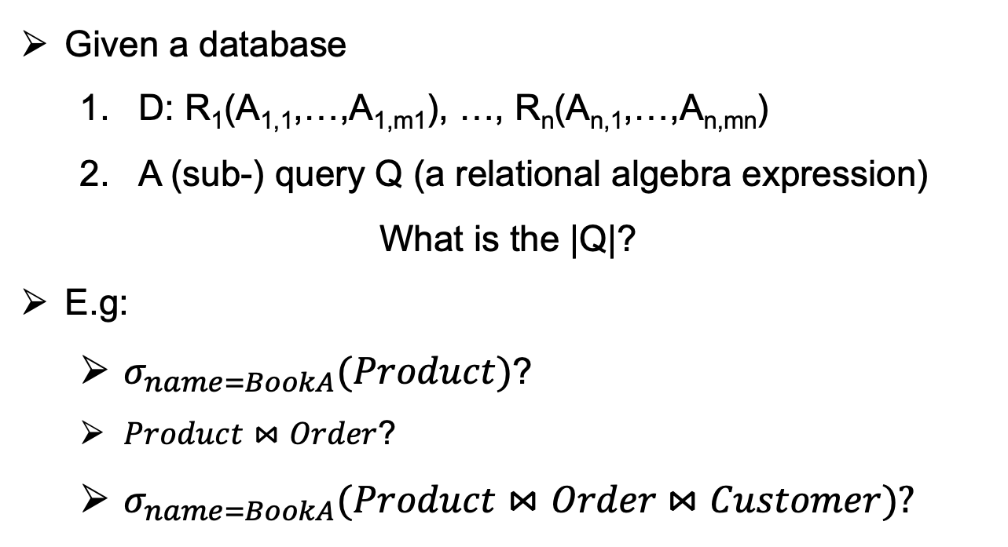
Cardinality Estimation
Given a database
  D: R₁(A_{1,1},…,A_{1,m1}), …, R_{n}(A_{n,1},…,A_{n,mn})
  A (sub-) query Q (a relational algebra expression)
What is the |Q|?
E.g:
  $σ_{name=BookA}(Product)$?
  $Product⋈Order$?
  $σ_{name=BookA}(Product⋈Order$ $⋈Customer$)?
Project
cid
Filter
name=BookA
Join
C.cid=O.cid
Join
P.pid=O.pid
Scan
Customer
Scan
Product
Scan
Order

Slide 14
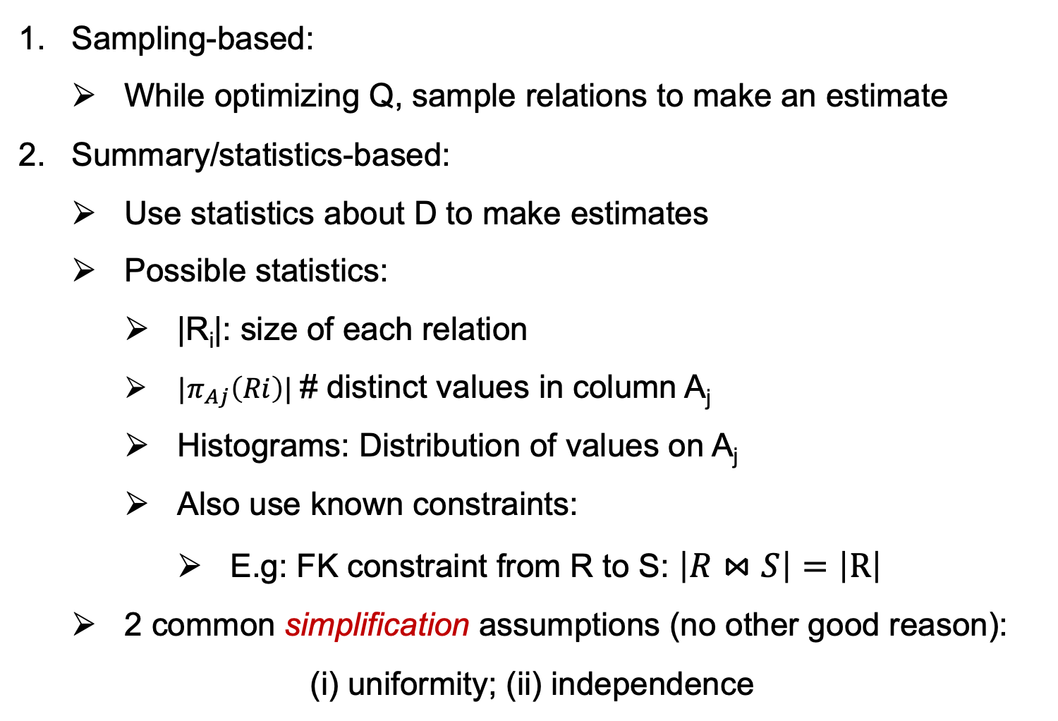
2 High-level Card. Estimation Techniques
Sampling-based:
  While optimizing Q, sample relations to make an estimate
Summary/statistics-based:
  Use statistics about D to make estimates
  Possible statistics:
    |R_{i}|: size of each relation
    ${|π}_{Aj}\left(Ri\right)|$# distinct values in column A_{j}
    Histograms: Distribution of values on A_{j}
    Also use known constraints:
      E.g: FK constraint from R to S: $\left|R⋈S\right|=\left|R\right|$
  2 common simplification assumptions (no other good reason):
(i) uniformity; (ii) independence
>20
<10
[10-20]
Histogram on R_{i}(A_{j})

Slide 15
Example Statistics-based Estimation Techniques

Slide 16
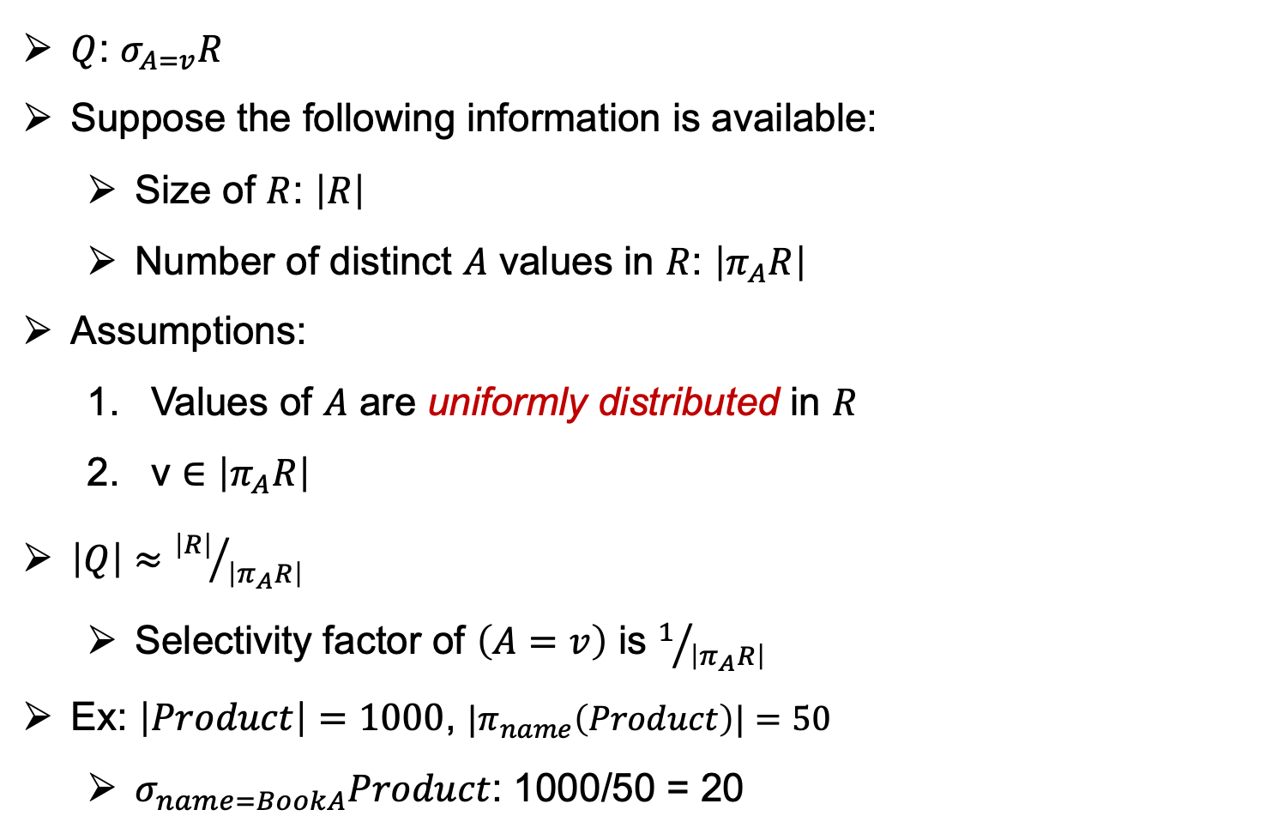
Selections with Equality Predicates
$Q$: $σ_{A=v}R$
Suppose the following information is available:
  Size of $R$: $\left|R\right|$
  Number of distinct $A$ values in $R$: $\left|π_{A}R\right|$
Assumptions:
  Values of $A$ are uniformly distributed in $R$
  v ∈ $\left|π_{A}R\right|$
$\left|Q\right|≈{\left|R\right|}/{\left|π_{A}R\right|}$
  Selectivity factor of $\left(A=v\right)$ is $1/{\left|π_{A}R\right|}$
Ex: $\left|Product\right|=1000$, ${|π}_{name}\left(Product\right)|=50$
  $σ_{name=BookA}Product$: 1000/50 = 20
wild assumption, often doesn’t hold
fair assumption, often holds (b/c users search things they put in the db)

Slide 17
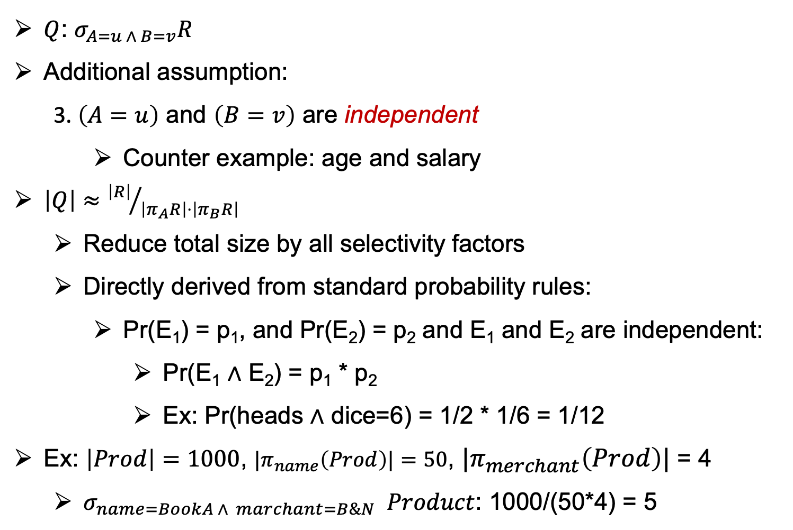
Conjunctive Predicates
$Q$: $σ_{A=u ∧ B=v}R$
Additional assumption:
  3. $\left(A=u\right)$ and $\left(B=v\right)$ are independent
    Counter example: age and salary
$\left|Q\right|≈{\left|R\right|}/{\left|π_{A}R\right|⋅\left|π_{B}R\right|}$
  Reduce total size by all selectivity factors
  Directly derived from standard probability rules:
    Pr(E₁) = p₁, and Pr(E₂) = p₂ and E₁ and E₂ are independent:
      Pr(E₁ ∧ E₂) = p₁ * p₂
      Ex: Pr(heads ∧ dice=6) = 1/2 * 1/6 = 1/12
Ex: $\left|Prod\right|=1000$, ${|π}_{name}\left(Prod\right)|=50$, ${|π}_{merchant}\left(Prod\right)|$ = 4
  $σ_{name=BookA ∧ marchant=B\&N} Product$: 1000/(50*4) = 5

Slide 18
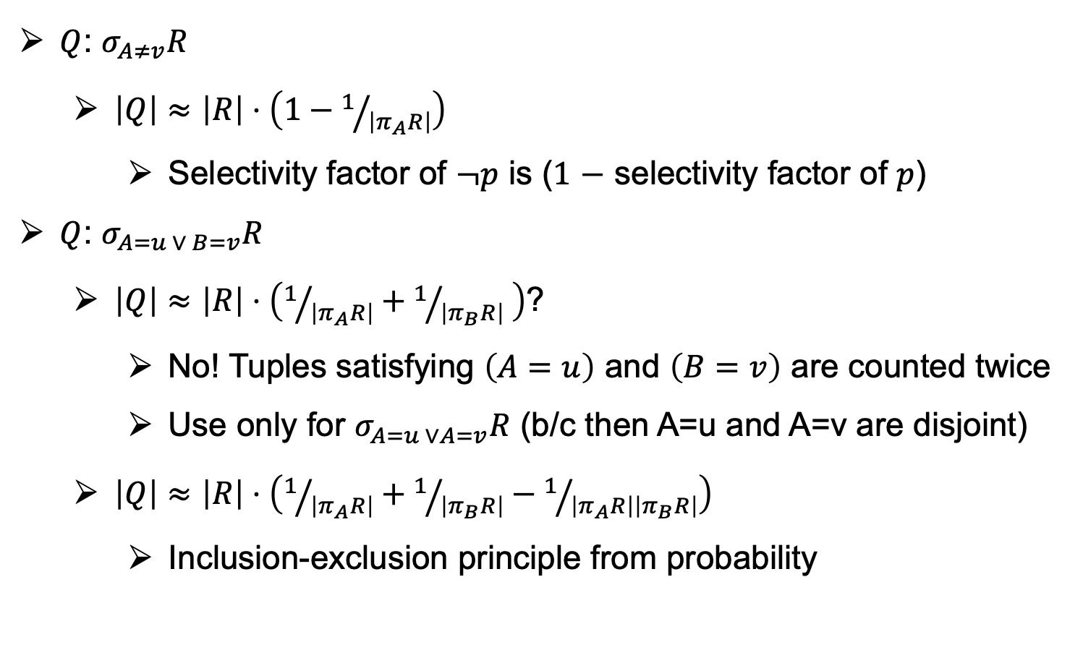
Negated and Disjunctive Predicates
$Q$: $σ_{A≠v}R$
  $\left|Q\right|≈\left|R\right|⋅\left(1−1/{\left|π_{A}R\right|}\right)$
    Selectivity factor of $¬p$ is ($1$ $−$ selectivity factor of $p$)
$Q$: $σ_{A=u ∨ B=v}R$
  $\left|Q\right|≈\left|R\right|⋅\left(1/{\left|π_{A}R\right|}+1/{\left|π_{B}R\right|} \right)$?
    No! Tuples satisfying $\left(A=u\right)$ and $\left(B=v\right)$ are counted twice
    Use only for $σ_{A=u ∨A=v}R$ (b/c then A=u and A=v are disjoint)
  $\left|Q\right|≈\left|R\right|⋅\left(1/{\left|π_{A}R\right|}+1/{\left|π_{B}R\right|}−1/{\left|π_{A}R\right|\left|π_{B}R\right|}\right)$
    Inclusion-exclusion principle from probability
A=u
B=v
A=u ∧ B=v

Slide 19
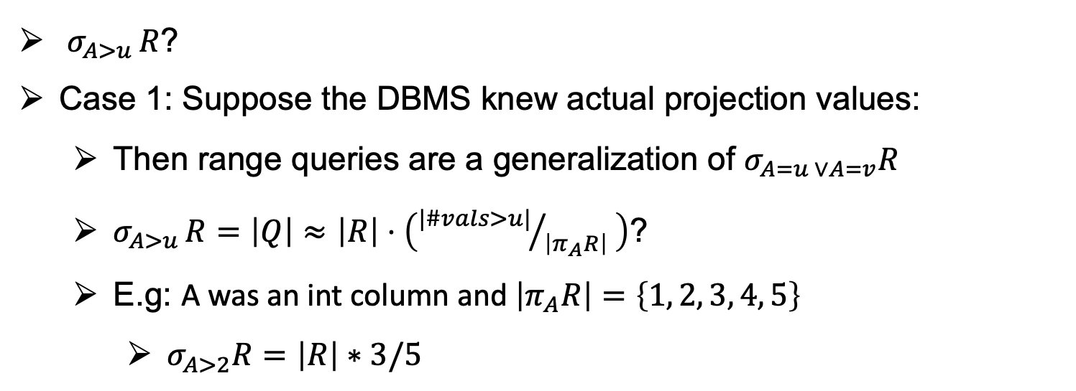
Range Predicates
$σ_{A>u }R$?
Case 1: Suppose the DBMS knew actual projection values:
  Then range queries are a generalization of $σ_{A=u ∨A=v}R$
  $σ_{A>u }R=\left|Q\right|≈\left|R\right|⋅\left({|\#vals>u|}/{\left|π_{A}R\right|} \right)\text{?}$
  E.g: A was an int column and $\left|π_{A}R\right|=\left\{1, 2, 3, 4, 5\right\}$
    $σ_{A>2}R=\left|R\right|∗3/5$

Slide 20
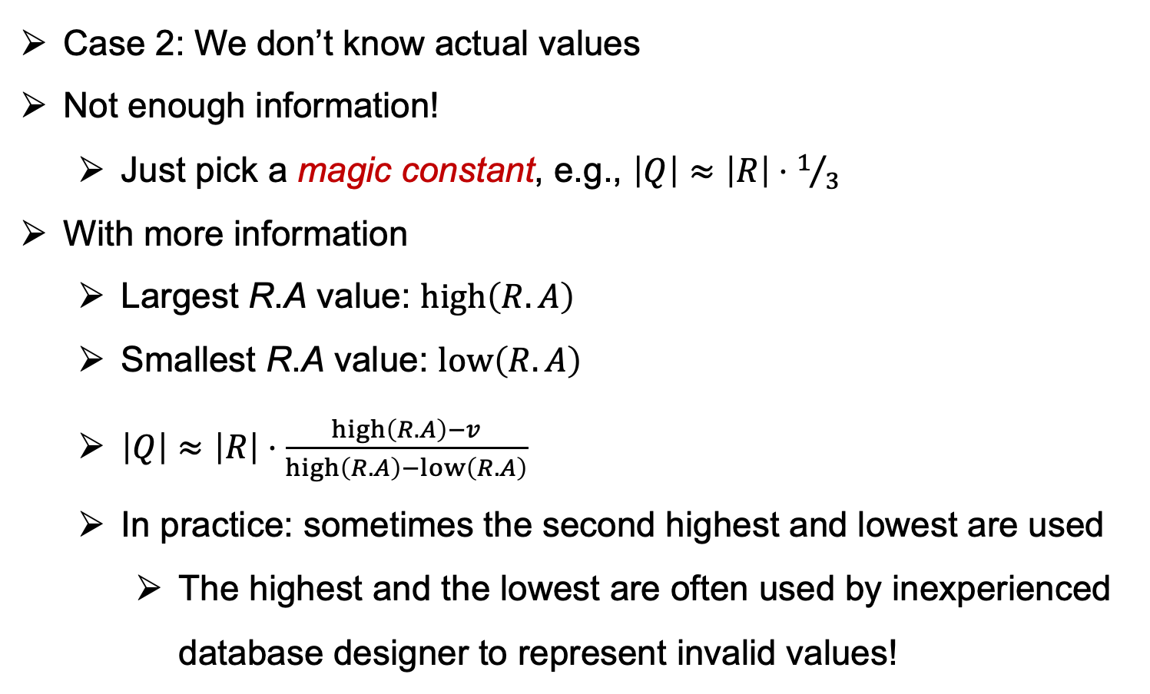


Case 2 of Range Predicates
Case 2: We don’t know actual values
Not enough information!
  Just pick a magic constant, e.g., $\left|Q\right|≈\left|R\right|⋅1/3$
With more information
  Largest R.A value: $high\left(R.A\right)$
  Smallest R.A value: $low\left(R.A\right)$
  $\left|Q\right|≈\left|R\right|⋅\frac{high\left(R.A\right)−v}{high\left(R.A\right)−low\left(R.A\right)}$
  In practice: sometimes the second highest and lowest are used
    The highest and the lowest are often used by inexperienced database designer to represent invalid values!
$$high\left(R.A\right)−low(R.A)$$
low |  | v |  | high
$$high\left(R.A\right)−v$$

Slide 21
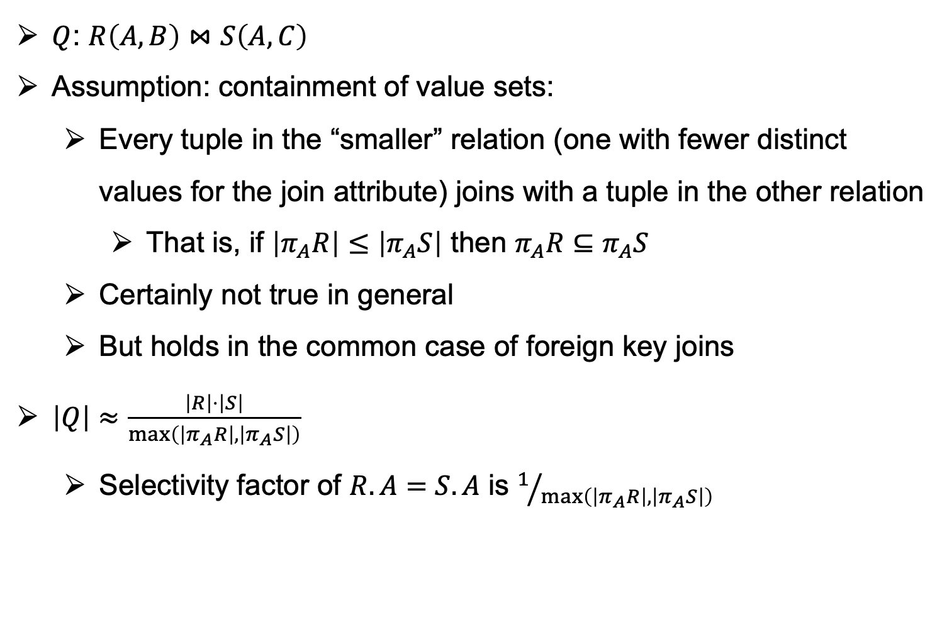
Equi-Join of Two Relations (1)
$Q$: $R\left(A, B\right)⋈S\left(A, C\right)$
Assumption: containment of value sets:
  Every tuple in the “smaller” relation (one with fewer distinct values for the join attribute) joins with a tuple in the other relation
    That is, if $\left|π_{A}R\right|≤\left|π_{A}S\right|$ then $π_{A}R⊆π_{A}S$
  Certainly not true in general
  But holds in the common case of foreign key joins
$\left|Q\right|≈\frac{\left|R\right|⋅\left|S\right|}{\max\left(\left|π_{A}R\right|,\left|π_{A}S\right|\right)}$
  Selectivity factor of $R.A=S.A$ is $1/{\max\left(\left|π_{A}R\right|,\left|π_{A}S\right|\right)}$

Slide 22

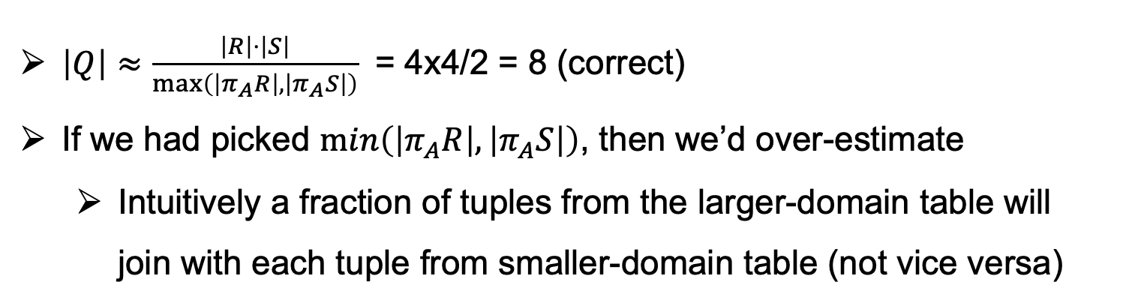

Equi-Join of Two Relations (2)
Example:
R
S
A | B
a₁ | b₁
a₁ | b₂
a₁ | b₃
a₁ | b₄
A | C
a₁ | c₁
a₁ | c₂
a₂ | c₃
a₂ | c₄
$$π_{A}R=\{\text{a}\text{1}\}$$
$$π_{A}S=\{\text{a}\text{1},\text{a}\text{2}\}$$
$\left|Q\right|≈\frac{\left|R\right|⋅\left|S\right|}{\max\left(\left|π_{A}R\right|,\left|π_{A}S\right|\right)}$ = 4x4/2 = 8 (correct)
If we had picked $\min\left(\left|π_{A}R\right|,\left|π_{A}S\right|\right)$, then we’d over-estimate
  Intuitively a fraction of tuples from the larger-domain table will join with each tuple from smaller-domain table (not vice versa)

Slide 23
Other Estimations Techniques
Using similar ideas, we can estimate the size of projection, duplicate elimination, union, difference, aggregation (with grouping)
Lots of assumptions and very rough estimation
  Accurate estimate is not needed
  Maybe okay if we overestimate or underestimate consistently
In practice: Very very difficult but very important for the optimizer.
  B/c: ultimate goal is to help estimate costs of operators & plans
  If we badly underestimate an expression => may lead to bad plans

Slide 24
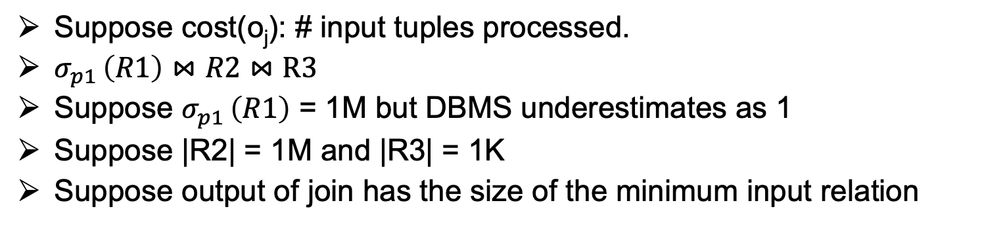
Example Poor Optimizer Choice
Suppose cost(o_{j}): # input tuples processed.
$σ_{p1 }\left(R1\right)⋈\left.R2\right.$ $⋈R3$
Suppose $σ_{p1 }\left(R1\right)$ = 1M but DBMS underestimates as 1
Suppose |R2| = 1M and |R3| = 1K
Suppose output of join has the size of the minimum input relation
Estimated Cost: 2
(ignoring in relations)
Estimated Cost: 1001
✓
1
1
Join
Join
1
1K
Join
R3
Join
R1
1K
1
R1
R2
R2
R3
1M
1K
1
1M

Slide 25
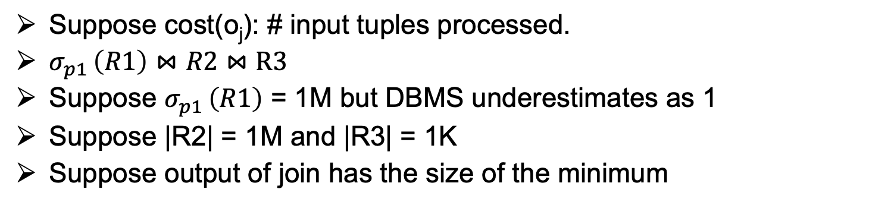
Example Poor Optimizer Choice
Suppose cost(o_{j}): # input tuples processed.
$σ_{p1 }\left(R1\right)⋈\left.R2\right.$ $⋈R3$
Suppose $σ_{p1 }\left(R1\right)$ = 1M but DBMS underestimates as 1
Suppose |R2| = 1M and |R3| = 1K
Suppose output of join has the size of the minimum
Actual Cost: 1M + 1K
Actual Cost: 2K
✓
1K
1K
Join
Join
1M
1K
Join
R3
Join
R1
1K
1M
R1
R2
R2
R3
1M
1K
1M
1M

Slide 26
Outline For Today
Goal of Query Optimization and Overview of Techniques
Cost-based Optimization Principles & Cardinality Estimation
Cost-based DP Logical Join Plan Optimizer
Rule-based Optimizations/Transformations
Final Remarks on Query Optimization & Query Processing

Slide 27
Widely Adopted Join Order Optimizer
Recall:
Enumerate a logical plan space (often enumerates all join orders)
  L₁, L₂, …, L_{k}
A widely used optimization algorithm is to use dynamic programming:
Consider a join only query:
      SELECT *
      FROM R1 NATURAL JOIN R2 NATURAL JOIN … NATURAL JOIN Rn
Q = R1 ⋈ R2 ⋈ … ⋈ Rn
Note not-necessarily a ``chain’’ query. It could be in any form, e.g:
  R1(A, B) ⋈ R2(B, C) ⋈ R3(C, A) ⋈ R4(A, B, C)

Slide 28
Plan Space
In its most general form Plan Space=All possible join plan ``trees’’
In practice: If possible you’d avoid plans that do Cartesian Products
Thought experiment: What does optimal tree L* look like?
Join
Join
Join
X
Join
Q-X
Join
Q-X
Join
Y
X-Y
X-Y
Z
Q-X-Z
Y

Slide 29
Optimal Sub-Join Tree Structure in L*
In L*: What can we say about the sub-tree L^{X} starting from X?
Must be the best plan for the sub-query Q^{X}= ⋈_{∀Ri ∈ X} Ri
  E:g: red-box must be the best plan for R1 ⋈ R2 ⋈ R5 (o.w. just replace L^{X} with the best plan for Q^{X}: L^{X*}.
Therefore can use dynamic programming algorithm to find join order.
Join
Join
Join
Join
X
Q-X
Join
R5
R3
R4
R1
R2

Slide 30
Cost-based DP Join Plan Optimizer
Input Q: R1 ⋈ R2 ⋈ … ⋈ Rn
Output Optimal Join Plan P:
OptPlans[]: a map that takes a sub-query Q_{t} and stores the already computed optimal plan:
for int t = 2 ... n // size of sub-queries
for each Q_{t} ⊆ Q with t relations
P*_{Qt}: // best plan found so far
for each ``split’’ X, Q_{t} – X:
P*_{x} = OptPlans[X]; P*_{Qt-X} = OptPlans[Q_{t}-X];
P_{Qt}: P*_{x} ⋈ P*_{Qt-X}; // Possible plan when split as X and Q_{t}-X
P*_{Qt} = min cost of P*_{Qt}, P_{Qt}
OptPlans[Q_{t}] = P*_{Qt}
Optimization 1:
can enumerate over sub-queries that are ``connected’’ to avoid Cartesian Products
Optimization 2:
enumerate only if
X and Q_{t}–X have common attributes; otherwise the possible plan would Cartesian product
where cardinality estimation of Q_{t} would happen

Slide 31
Example Chain-based Join Optimizer (A4)
A4: specialized version of DP Join Optimizer on ``chain queries``:
Q: R₀(A₀, A₁) ⋈ R₁(A₁, A₂) ⋈ … ⋈ R_{n-1}(A_{n-1}, A_{n})
Opt 1: Do not need to enumerate any dis-connected sub-query:
  Q_{t1}: R₀(A₀, A₁) ⋈ R₂(A₂, A₃) ⋈ R₆(A₆, A₇)
  Q_{t2}: R₁(A₁, A₂) ⋈ R₂(A₂, A₃) ⋈ R₃(A₃, A₄)
  Enumerate plans only for “consecutive”: R_{i} ⋈ R_{i+1} ⋈ … ⋈ R_{j}
  Enumerate only j-i``split points’’ for each k: i…j-1:
    R_{i} ⋈ R_{i+1}⋈… ⋈R_{k} and R_{k+1} ⋈ R_{k+2}⋈… ⋈R_{j}
X No common attributes
R₀
R₂
R₆
A₀ A₁ A₂ A₃ A₆ A₇
R₁
R₂
R₃
✓
A₁ A₂ A₃ A₄

Slide 32
Simulation
Opt Plans for 1-size sub-queries R_{i}:
Opt Plan:
R_{i}
cost: |R_{i}|
Opt Plans for 2-size sub-queries R_{i} ⋈ R_{i+1}:
Opt Plan:
Join
R_{i}
R_{i+1}
cost: c*_{i,i+1}
…
Opt Plans for 3-size sub-queries
(using 1- and 2-size
opt. plans):
Opt Plan:
Join
Opt Plan:
Join
Join
R₂
R₃
Join
R₃
R₄
R₅
R₄
cost: c*_{2,3,4}
cost: c*_{3,4,5}

Slide 33
Simulation
When computing plans for a 4-size sub-query: e.g., R₂ ⋈ R₃ ⋈ R₄ ⋈ R₅:
Opt Plan:
Join
Opt Plan:
Join
Opt Plan:
Join
Opt Plan:
Join
R₂
R₃
R₃
R₄
Join
R₂
R₃
Join
cost: c*_{2,3}
cost: c*_{3,4}
R₃
R₄
R₅
R₄
Opt Plan:
Join
cost: c*_{2,3,4}
cost: c*_{3,4,5}
R₄
R₅
cost: c*_{4,5}
Join
Join
possible plans:
Join
Join
Join
R₅
R₂
R₃
Join
Join
Join
Join
R₂
R₅
R₄
R₂
R₃
R₄
R₅
R₃
R₄
R₂ as the split point
R₃ as the split point
R₄ as the split point
if left/right child matters compare 2x more plans
Notes:
Note that each join order is 1 plan. So the DP algorithm enumerates a set of logical plans.

Slide 34
Outline For Today
Goal of Query Optimization and Overview of Techniques
Cost-based Optimization Principles & Cardinality Estimation
Cost-based DP Logical Join Plan Optimizer
Rule-based Optimizations/Transformations
Final Remarks on Query Optimization & Query Processing

Slide 35
Rule-based Transformations
DP-based join optimizer algorithm only considered join-only queries
What if there was a selection, projection, group-by aggregate etc?
When possible we consider them as we enumerate plans but often in a rule-based manner

Slide 36
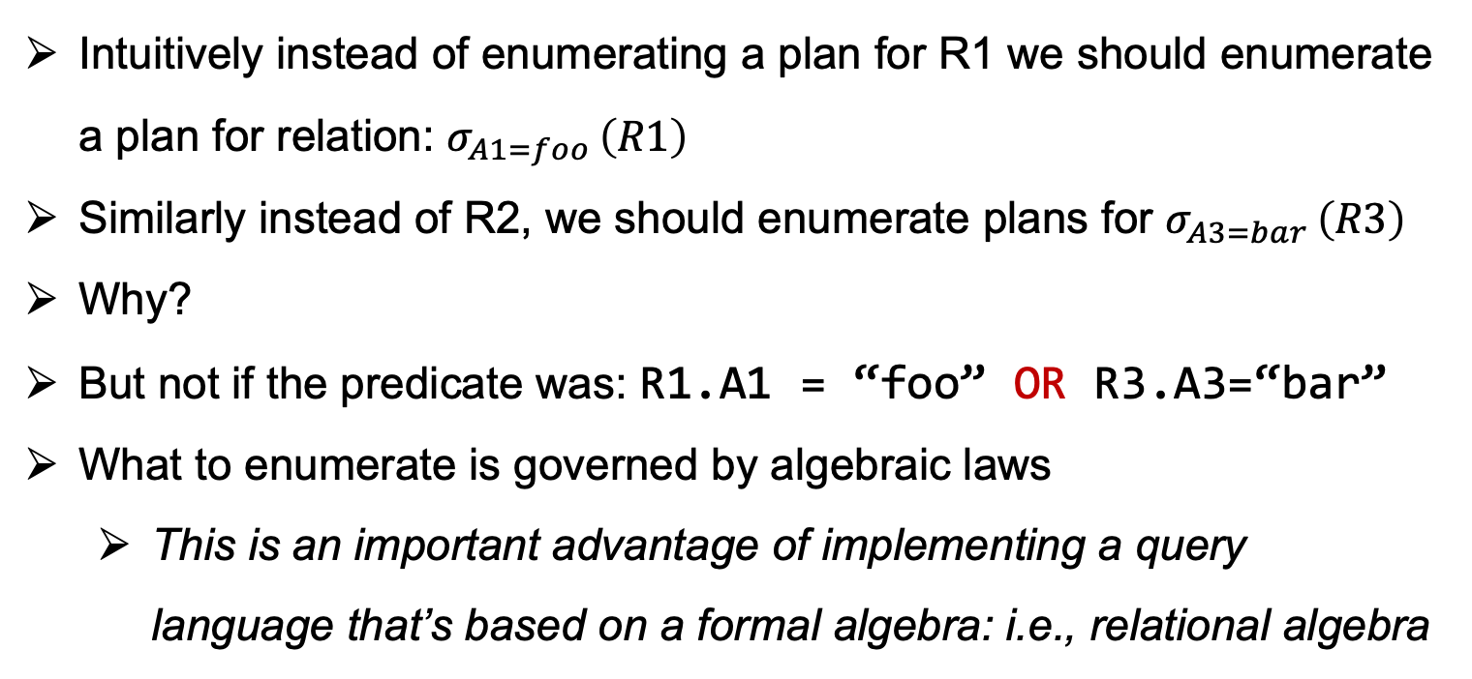
Example (1)
SELECT *
FROM R1 NATURAL JOIN R2 NATURAL JOIN R3 NATURAL JOIN R4
WHERE R1.A1 = “foo” AND R3.A3=“bar”
Intuitively instead of enumerating a plan for R1 we should enumerate a plan for relation: $σ_{A1=foo }\left(R1\right)$
Similarly instead of R2, we should enumerate plans for $σ_{A3=bar }\left(R3\right)$
Why?
But not if the predicate was: R1.A1 = “foo” OR R3.A3=“bar”
What to enumerate is governed by algebraic laws
  This is an important advantage of implementing a query language that’s based on a formal algebra: i.e., relational algebra

Slide 37
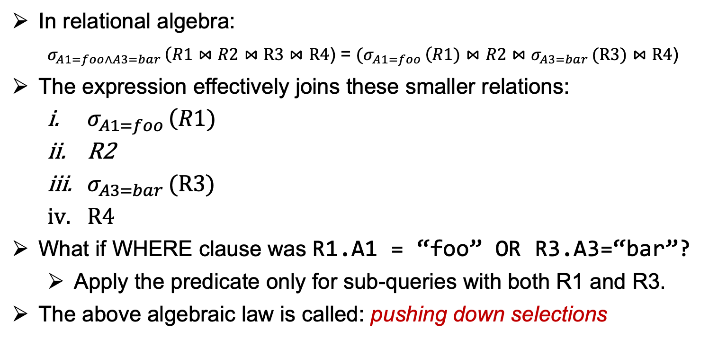
Example (2)
SELECT *
FROM R1 NATURAL JOIN R2 NATURAL JOIN R3 NATURAL JOIN R4
WHERE R1.A1 = “foo” AND R3.A3=“bar”
In relational algebra:
$σ_{A1=foo∧A3=bar }\left(R1\right.⋈\left.R2\right.$ $⋈R3⋈R4$) = ${(σ}_{A1=foo }\left(R1)\right.⋈\left.R2\right.$ $⋈σ_{A3=bar }(R3)⋈R4$)
The expression effectively joins these smaller relations:
  $σ_{A1=foo }\left(R1)\right.$
  R2
  $σ_{A3=bar }(R3)$
  $R4$
What if WHERE clause was R1.A1 = “foo” OR R3.A3=“bar”?
  Apply the predicate only for sub-queries with both R1 and R3.
The above algebraic law is called: pushing down selections

Slide 38
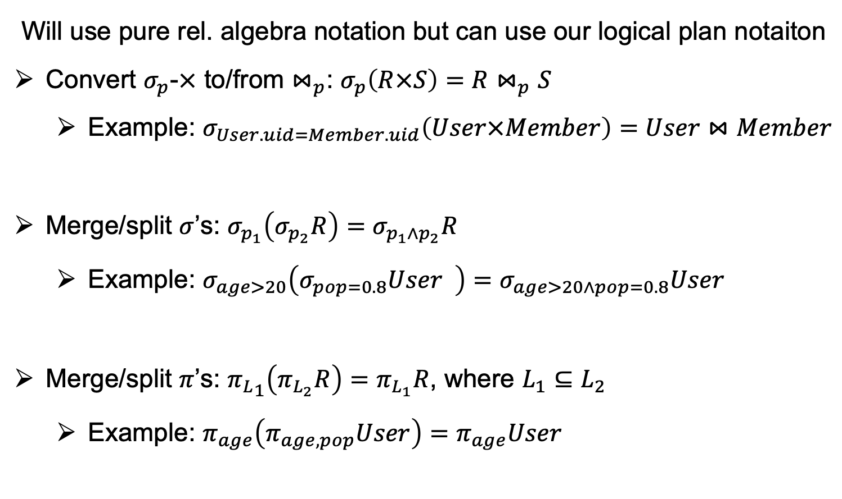
Ex Algebraic Transformation Rules (1)
Will use pure rel. algebra notation but can use our logical plan notaiton
Convert $σ_{p}$-$×$ to/from $⋈_{p}$: $σ_{p}\left(R×S\right)=R⋈_{p}S$
  Example: $σ_{User.uid=Member.uid}\left(User×Member\right)=User⋈Member$
Merge/split $σ$’s: $σ_{p_{1}}\left(σ_{p_{2}}R\right)=σ_{p_{1}∧p_{2}}R$
  Example: $σ_{age>20}\left(σ_{pop=0.8}User \right)=σ_{age>20∧pop=0.8}User$
Merge/split $π$’s: ${π_{L}}_{1}\left(π_{L_{2}}R\right)=π_{L_{1}}R$, where $L_{1}⊆L_{2}$
  Example: $π_{age}\left(π_{age,pop}User\right)=π_{age}User$

Slide 39

Example In Logical Plan Notation
Merge/split $σ$’s: $σ_{p_{1}}\left(σ_{p_{2}}R\right)=σ_{p_{1}∧p_{2}}R$
  Example:$σ_{age>20}\left(σ_{pop=0.8}User \right)=σ_{age>20∧pop=0.8}User$
…
…
Filter
pop>0.8
…
…
Filter
age>20 ∧ pop>0.8
Filter
age>20
User
User

Slide 40
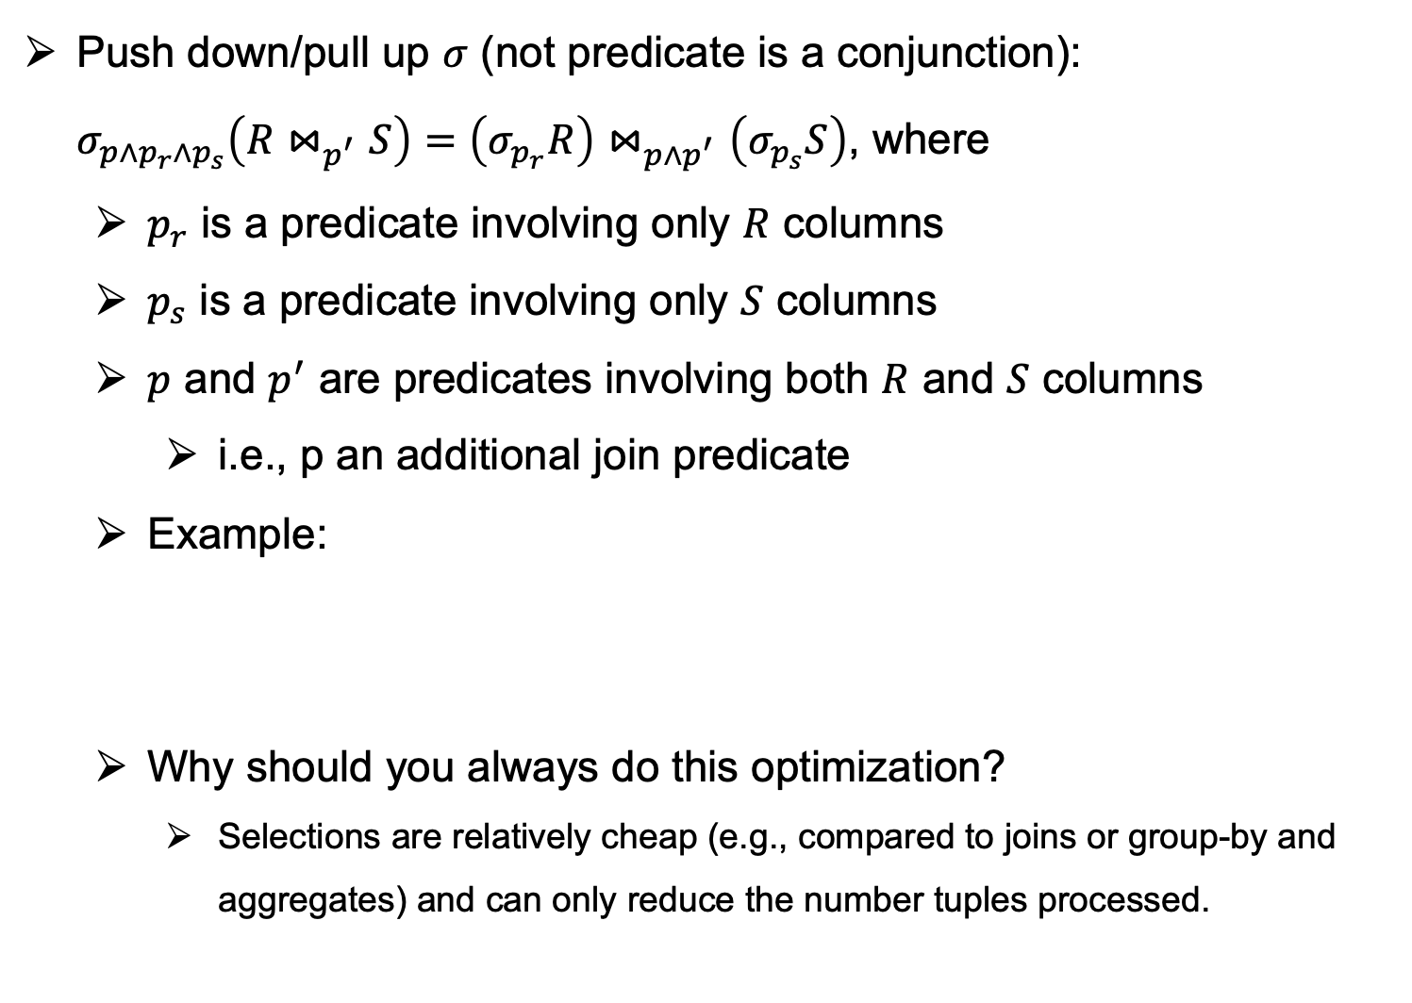
Ex Algebraic Transformation Rules (2)
Push down/pull up $σ$ (not predicate is a conjunction):
$σ_{p∧p_{r}∧p_{s}}\left(R⋈_{p^{′}}S\right)=\left(σ_{p_{r}}R\right)⋈_{p∧p^{′}}\left(σ_{p_{s}}S\right)$, where
  $p_{r}$ is a predicate involving only $R$ columns
  $p_{s}$ is a predicate involving only $S$ columns
  $p$ and $p^{′}$ are predicates involving both $R$ and $S$ columns
    i.e., p an additional join predicate
  Example:
  Why should you always do this optimization?
    Selections are relatively cheap (e.g., compared to joins or group-by and aggregates) and can only reduce the number tuples processed.
  $$σ_{U1. name=U2.name∧U1.pop>0.8∧U2.pop>0.8}\left(ρ_{U1}User⋈_{U1.uid≠U2.uid }ρ_{U2}User\right) \\ ={σ_{pop>0.8}(ρ}_{U1}User)⋈_{U1.uid≠U2.uid,U1.name=U2.name }{(σ_{pop>0.8}(ρ}_{U2}User))$$

Slide 41
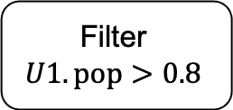
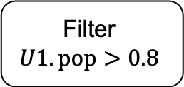
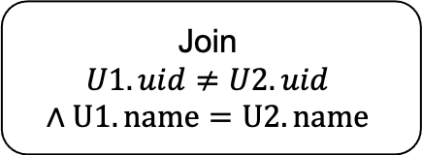
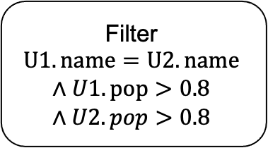

Example In Logical Plan Notation
  $$σ_{U1. name=U2.name∧U1.pop>0.8∧U2.pop>0.8}\left(ρ_{U1}User⋈_{U1.uid≠U2.uid }ρ_{U2}User\right) \\ ={σ_{pop>0.8}(ρ}_{U1}User)⋈_{U1.uid≠U2.uid,U1.name=U2.name }{(σ_{pop>0.8}(ρ}_{U2}User))$$
…
…
Filter
$$U1. name=U2.name$$
$$∧U1.pop>0.8$$
$$∧U2.pop>0.8$$
…
Join
$$U1.uid≠U2.uid$$
$$∧U1. name=U2.name$$
…
Join
$$U1.uid≠U2.uid$$
Filter
$$U1.pop>0.8$$
Filter
$$U1.pop>0.8$$
U1
U2
U1
U2

Slide 42
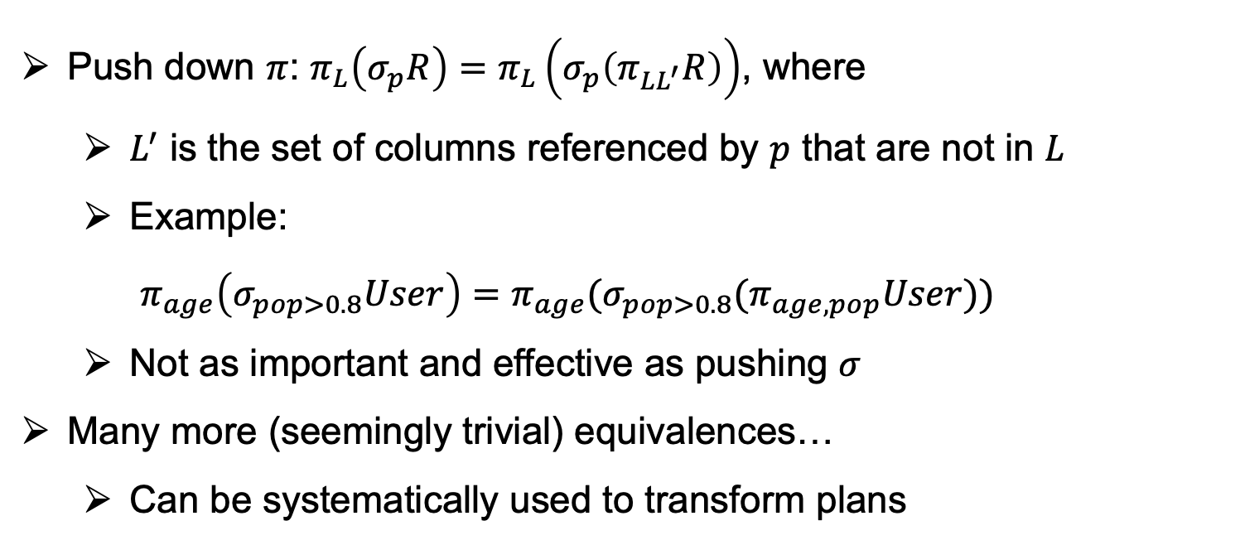
Ex Algebraic Transformation Rules (3)
Push down $π$: $π_{L}\left(σ_{p}R\right)=π_{L}\left(σ_{p}\left(π_{LL^{′}}R\right)\right)$, where
  $L^{′}$ is the set of columns referenced by $p$ that are not in $L$
  Example:
  $π_{age}\left(σ_{pop>0.8}User\right)={π_{age}(σ_{pop>0.8}(π}_{age,pop}User))$
  Not as important and effective as pushing $σ$
Many more (seemingly trivial) equivalences…
  Can be systematically used to transform plans

Slide 43
Outline For Today
Goal of Query Optimization and Overview of Techniques
Cost-based Optimization Principles & Cardinality Estimation
Cost-based DP Logical Join Plan Optimizer
Rule-based Optimizations/Transformations
Final Remarks on Query Optimization & Query Processing

Slide 44
Final Remarks (1)
Query Optimizer and Cardinality Estimator: Brain of the DBMS
  Ultimate Goal: Pick a reasonable plan (i.e,. one processing few tuples)
Query Processor and Storage: Skeleton
  They do actual data searching and computation
Several insights have emerged over the years in DBMS literature:
  Cost model is not very critical: keep a simple model (e.g., # tuples)
  Cardinality estimation: matters a lot
  But! Extremely difficult to integrate a good estimator. Always a hack with wild unrealistic assumptions here and there to make it implementable: magic constants, uniformity assumptions, independence assumptions etc.
My advice: Optimizer is important but keep it simple.
  Do not be complacent on the query processor and storage! Work very hard on these and optimize relentlessly!
Query Optimization Through the Looking Glass, and What We Found Running the Join Order Benchmark, Leis et al., VLDBJ, 2018

Slide 45
Final Remarks (2)
CS 448: Database Systems Implementation
  Gets into many more details about the internals of query processing and optimization and other DBMS components!
  A4’s programming question is meant to give you a glimpse of CS 448 assignments.
Query Optimization Through the Looking Glass, and What We Found Running the Join Order Benchmark, Leis et al., VLDBJ, 2018

