Slide 1

CS 348 Lecture 18
Transactions II
  Semih Salihoğlu
  Nov 18 2021

Slide 2
Outline For Today
Serializability:
  Execution Histories
  Conflict Equivalence
  Checking For Serializability
System’s Perspective
(and more next lecture)

Slide 3
Outline For Today
Serializability:
  Execution Histories
  Conflict Equivalence
  Checking For Serializability

Slide 4
Goals of Execution History Model &
Conflict Equivalences
Concurrency is achieved by interleaving operations across trxs.
Q: Does an interleaving correspond to a serializable execution?
Execution history model and conflict equivalences is a formal method to answer this question.
Trx 1
Trx 2
r:(…,$20)
r:(…, $20)
time
w:(…,$25)
w:(…,$30)
Notes:
I’m not a big fan of repeatable read

Slide 5
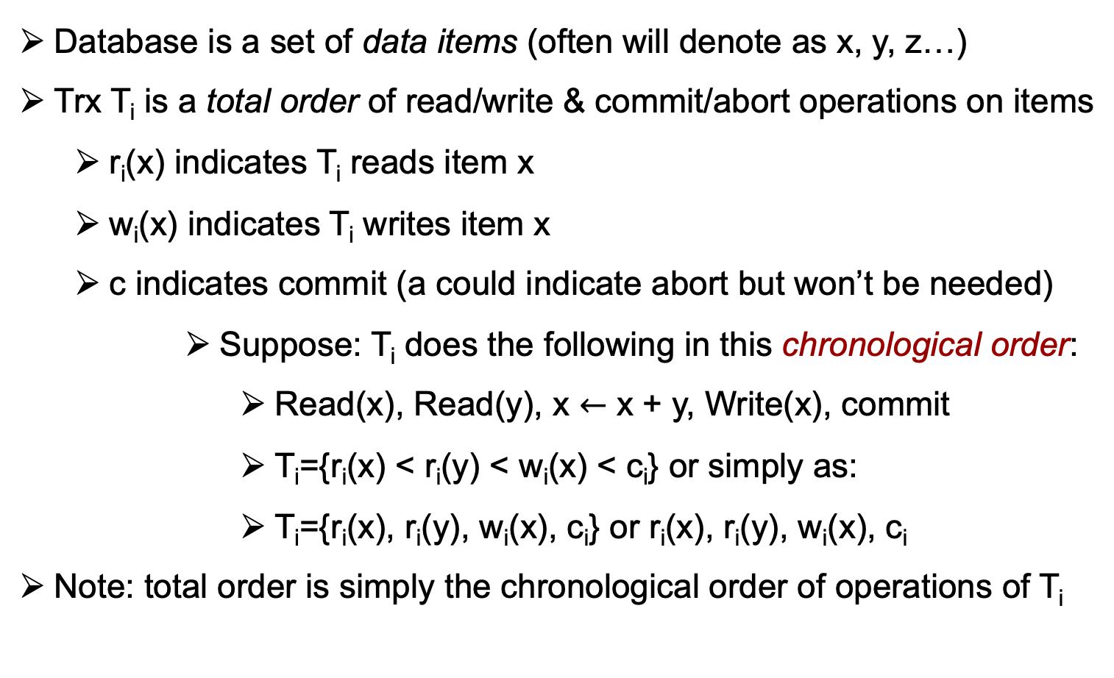
Representing Single Transactions
Database is a set of data items (often will denote as x, y, z…)
Trx T_{i} is a total order of read/write & commit/abort operations on items
  r_{i}(x) indicates T_{i} reads item x
  w_{i}(x) indicates T_{i} writes item x
  c indicates commit (a could indicate abort but won’t be needed)
      Suppose: T_{i} does the following in this chronological order:
        Read(x), Read(y), x $←$ x + y, Write(x), commit
        T_{i}={r_{i}(x) < r_{i}(y) < w_{i}(x) < c_{i}} or simply as:
        T_{i}={r_{i}(x), r_{i}(y), w_{i}(x), c_{i}} or r_{i}(x), r_{i}(y), w_{i}(x), c_{i}
Note: total order is simply the chronological order of operations of T_{i}

Slide 6
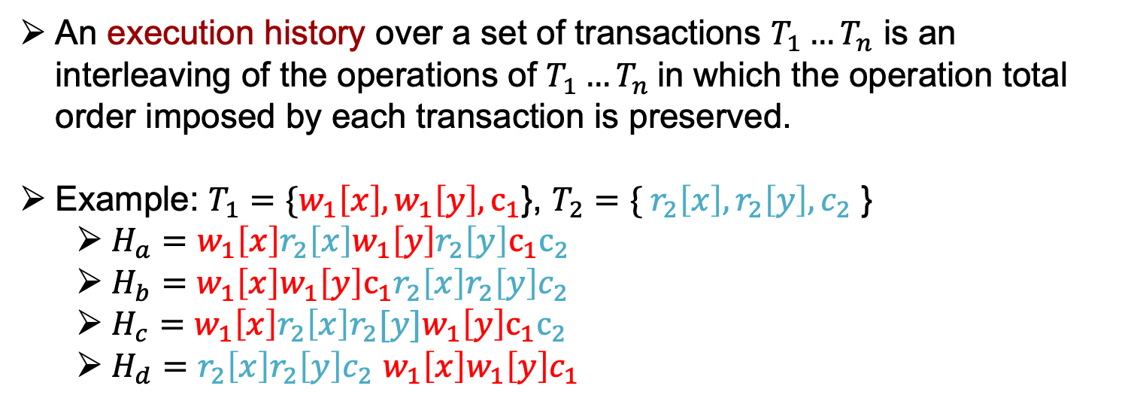
Execution Histories
An execution history over a set of transactions $T_{1}…T_{n}$ is an interleaving of the operations of $T_{1}…T_{n}$in which the operation total order imposed by each transaction is preserved.
Example: $T_{1}=\{w_{1}\left[x\right], w_{1}\left[y\right],c_{1}$}, $T_{2}=\{ {r_{2}\left[x\right], r}_{2}\left[y\right],c_{2}$ }
  $H_{a}=w_{1}\left[x\right]r_{2}\left[x\right]w_{1}\left[y\right]r_{2}\left[y\right]c_{1}c_{2}$
  $H_{b}=w_{1}\left[x\right]w_{1}\left[y\right]{c_{1}r_{2}\left[x\right]r}_{2}\left[y\right]c_{2}$
  $H_{c}=w_{1}\left[x\right]r_{2}\left[x\right]r_{2}[y]w_{1}\left[y\right]c_{1}c_{2}$
  $H_{d}={r_{2}\left[x\right]r}_{2}\left[y\right]c_{2}$ $w_{1}\left[x\right]w_{1}\left[y\right]c_{1}$

Slide 7

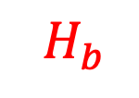
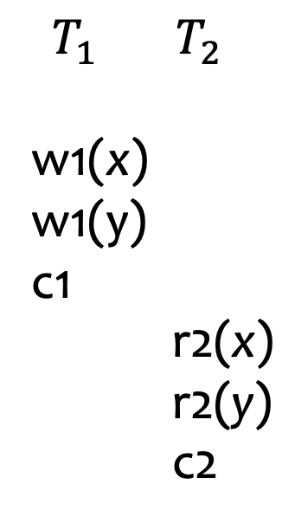
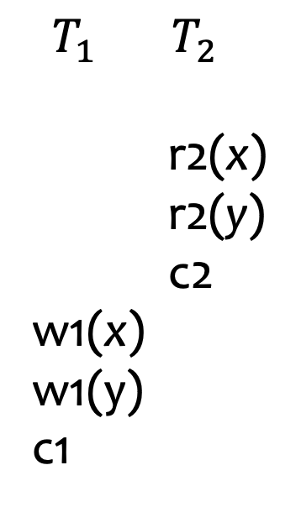

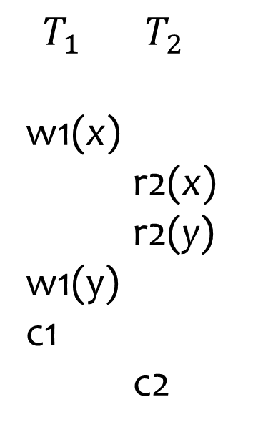
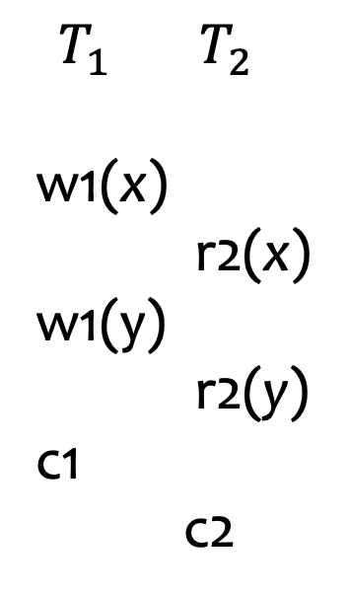
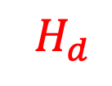
Examples for Valid Execution History
$T_{1}=\{w_{1}\left[x\right], w_{1}\left[y\right],c_{1}$}, $T_{2}=\{ {r_{2}\left[x\right], r}_{2}\left[y\right],c_{2}$ }
$T_{1}$ $T_{2}$
w1(x)
r2(x)
w1(y)
r2(y)
c1
c2
$T_{1}$ $T_{2}$
w1(x)
w1(y)
c1
r2(x)
r2(y)
c2
$T_{1}$ $T_{2}$
w1(x)
r2(x)
r2(y)
w1(y)
c1
c2
$T_{1}$ $T_{2}$
r2(x)
r2(y)
c2
w1(x)
w1(y)
c1
time
$$H_{a}$$
$${ H}_{b}$$
$$H_{c}$$
${ H}_{d}$

Slide 8
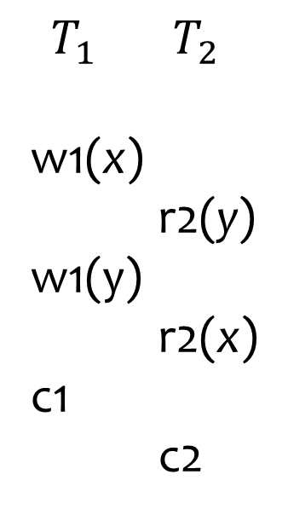
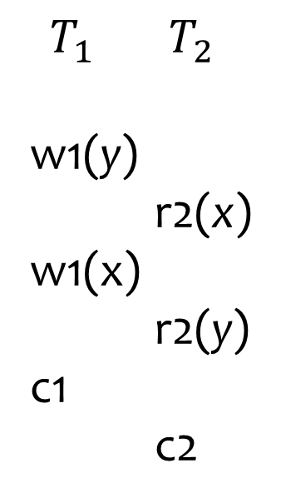
Examples for Invalid Execution History
$T_{1}=\{w_{1}\left[x\right], w_{1}\left[y\right],c_{1}$}, $T_{2}=\{ {r_{2}\left[x\right], r}_{2}\left[y\right],c_{2}$ }
$T_{1}$ $T_{2}$
w1(y)
r2(x)
w1(x)
r2(y)
c1
c2
$T_{1}$ $T_{2}$
w1(x)
r2(y)
w1(y)
r2(x)
c1
c2
Incorrect orders

Slide 9

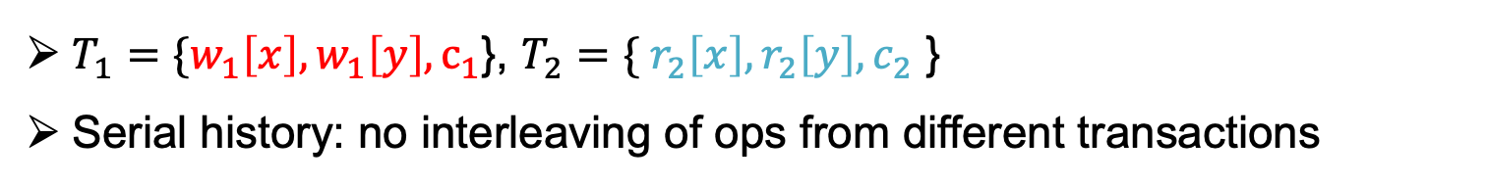
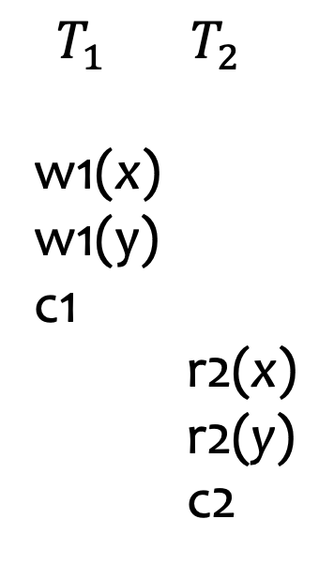
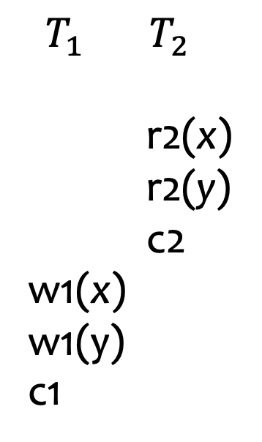
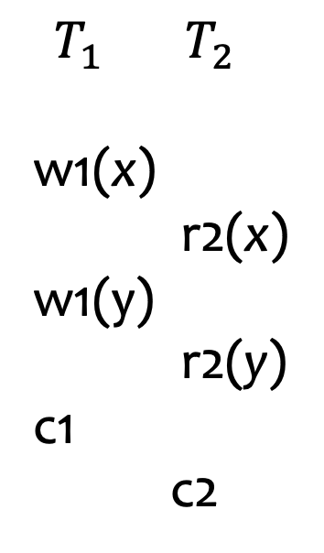
Serial Execution Histories
$T_{1}=\{w_{1}\left[x\right], w_{1}\left[y\right],c_{1}$}, $T_{2}=\{ {r_{2}\left[x\right], r}_{2}\left[y\right],c_{2}$ }
Serial history: no interleaving of ops from different transactions
$T_{1}$ $T_{2}$
w1(x)
r2(x)
w1(y)
r2(y)
c1
c2
$T_{1}$ $T_{2}$
w1(x)
w1(y)
c1
r2(x)
r2(y)
c2
$T_{1}$ $T_{2}$
w1(x)
r2(x)
r2(y)
w1(y)
c1
c2
$T_{1}$ $T_{2}$
r2(x)
r2(y)
c2
w1(x)
w1(y)
c1
$H_{a} { H}_{b}$ $H_{c}$ ${ H}_{d}$

Slide 10
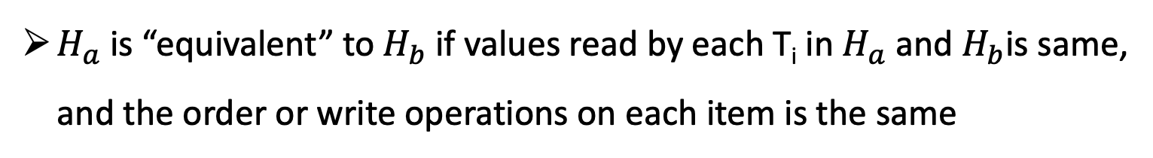
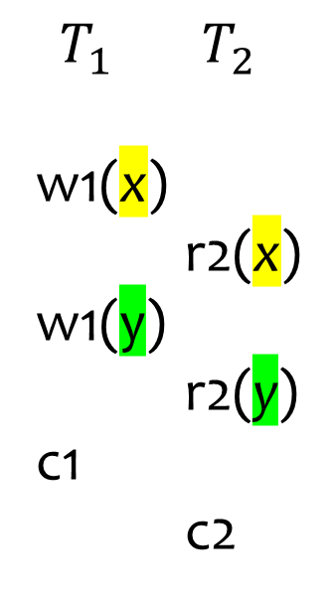
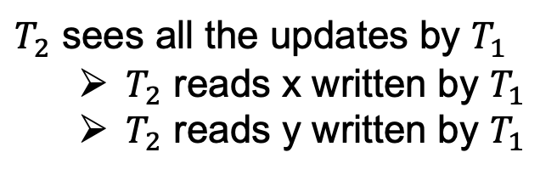
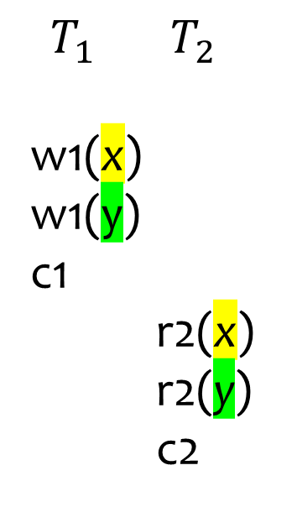
Equivalent Histories
$H_{a}$ is “equivalent” to $H_{b}$ if values read by each T_{i} in $H_{a}$ and $H_{b}$is same, and the order or write operations on each item is the same
$T_{1}$ $T_{2}$
w1(x)
r2(x)
w1(y)
r2(y)
c1
c2
$T_{1}$ $T_{2}$
w1(x)
w1(y)
c1
r2(x)
r2(y)
c2
Write 4
Write 4
$T_{2}$ sees all the updates by $T_{1}$
  $T_{2}$ reads x written by $T_{1}$
  $T_{2}$ reads y written by $T_{1}$
Write 5
Write 5
Read 4
Read 4
Read 5
Read 5
x=3, y=1 (before T1 and T2)
$$H_{a} { H}_{b}$$

Slide 11
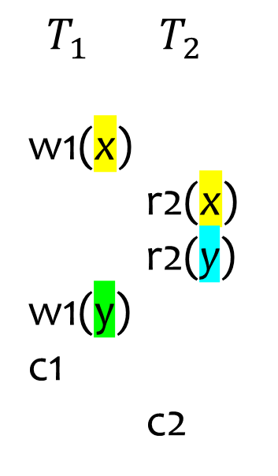
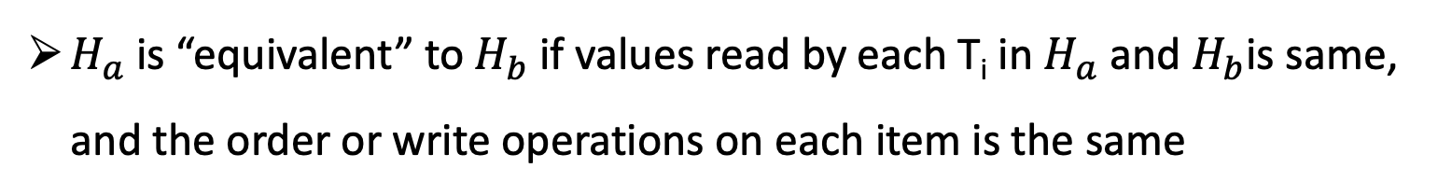


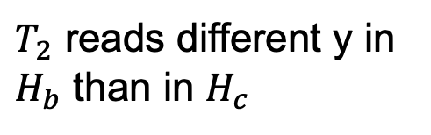
Example Non-equivalent Histories
$H_{a}$ is “equivalent” to $H_{b}$ if values read by each T_{i} in $H_{a}$ and $H_{b}$is same, and the order or write operations on each item is the same
$T_{1}$ $T_{2}$
w1(x)
w1(y)
c1
r2(x)
r2(y)
c2
$T_{1}$ $T_{2}$
w1(x)
r2(x)
r2(y)
w1(y)
c1
c2
Write 4
Write 4
$T_{2}$ reads different y in $H_{b}$ than in $H_{c}$
Write 5
Read 4
Read 4
Write 5
Read 1
Read 5
x=3, y=1 (before T1 and T2)
${ H}_{b}$ $H_{c}$

Slide 12
Outline For Today
Serializability:
  Execution Histories
  Conflict Equivalence
  Checking For Serializability

Slide 13
Conflict Equivalence
Dfn: Two operations conflict if:
  they belong to different transactions,
  they operate on the same object, and at least one of the operations is a write
  2 types of conflicts: (1) Read-Write and (2) Write-Write
Dfn: Two histories are (conflict) equivalent if
  they are over the same set of transactions, and
  the ordering of each pair of conflicting operations is the same in each history

Slide 14
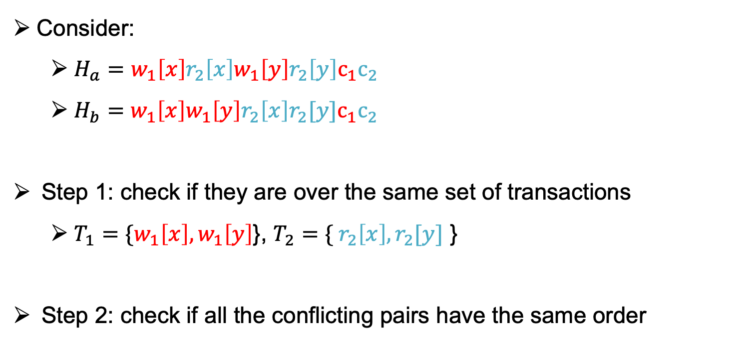
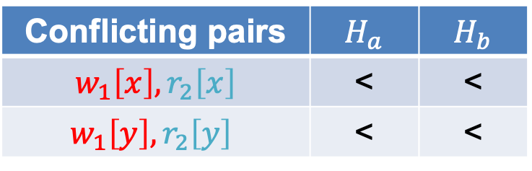
Example 1
Consider:
  $H_{a}=w_{1}\left[x\right]r_{2}\left[x\right]w_{1}\left[y\right]r_{2}\left[y\right]c_{1}c_{2}$
  $H_{b}=w_{1}\left[x\right]w_{1}\left[y\right]{r_{2}\left[x\right]r}_{2}[y]c_{1}c_{2}$
Step 1: check if they are over the same set of transactions
  $T_{1}=\{w_{1}\left[x\right], w_{1}\left[y\right]$}, $T_{2}=\{ {r_{2}\left[x\right], r}_{2}[y]$ }
Step 2: check if all the conflicting pairs have the same order
Conflicting pairs | $$H_{a}$$ | $$H_{b}$$
$$w_{1}\left[x\right],r_{2}\left[x\right]$$ | < | <
$$w_{1}\left[y\right],r_{2}\left[y\right]$$ | < | <

Slide 15
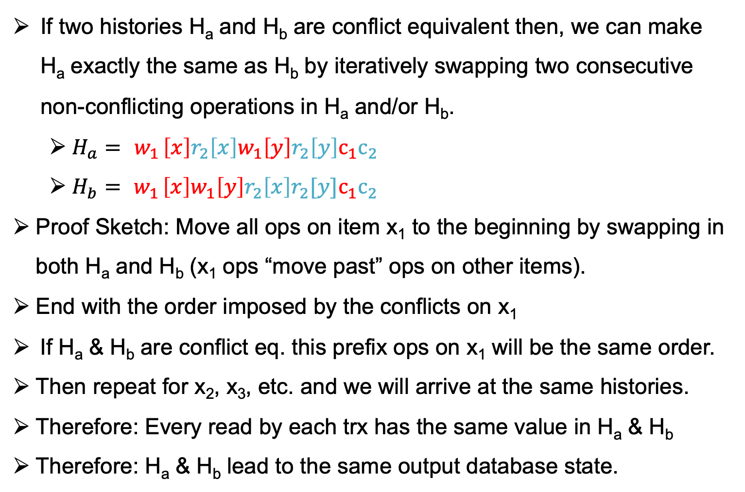

Motivation & Intuition For Conflict Equivalence
If two histories H_{a} and H_{b} are conflict equivalent then, we can make H_{a} exactly the same as H_{b} by iteratively swapping two consecutive non-conflicting operations in H_{a} and/or H_{b}.
  $H_{a}={ w}_{1}\left[x\right]r_{2}\left[x\right]w_{1}\left[y\right]r_{2}\left[y\right]c_{1}c_{2}$
  $H_{b}={ w}_{1}\left[x\right]w_{1}\left[y\right]{r_{2}\left[x\right]r}_{2}[y]c_{1}c_{2}$
Proof Sketch: Move all ops on item x₁ to the beginning by swapping in both H_{a} and H_{b} (x₁ ops “move past” ops on other items).
End with the order imposed by the conflicts on x₁
If H_{a} & H_{b} are conflict eq. this prefix ops on x₁ will be the same order.
Then repeat for x₂, x₃, etc. and we will arrive at the same histories.
Therefore: Every read by each trx has the same value in H_{a} & H_{b}
Therefore: H_{a} & H_{b} lead to the same output database state.
=> ${H′}_{a}=w_{1}\left[x\right]{w_{1}\left[y\right]r_{2}[x]r}_{2}\left[y\right]c_{1}c_{2}$

Slide 16
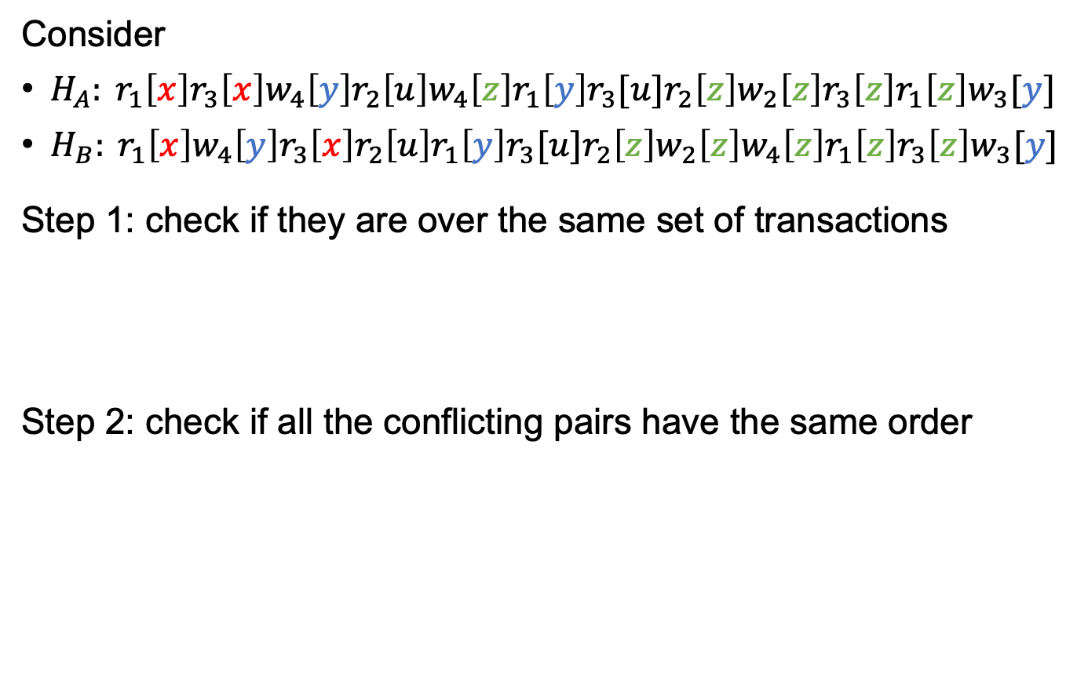
Example 2
Consider
$H_{A}: r_{1}\left[x\right]r_{3}\left[x\right]w_{4}\left[y\right]r_{2}\left[u\right]w_{4}\left[z\right]r_{1}\left[y\right]r_{3}[u]r_{2}\left[z\right]w_{2}\left[z\right]r_{3}\left[z\right]r_{1}\left[z\right]w_{3}[y]$
$H_{B}: r_{1}\left[x\right]w_{4}\left[y\right]r_{3}\left[x\right]r_{2}\left[u\right]r_{1}\left[y\right]r_{3}[u]r_{2}\left[z\right]w_{2}\left[z\right]w_{4}\left[z\right]r_{1}\left[z\right]r_{3}\left[z\right]w_{3}[y]$
Step 1: check if they are over the same set of transactions
Step 2: check if all the conflicting pairs have the same order

Slide 17
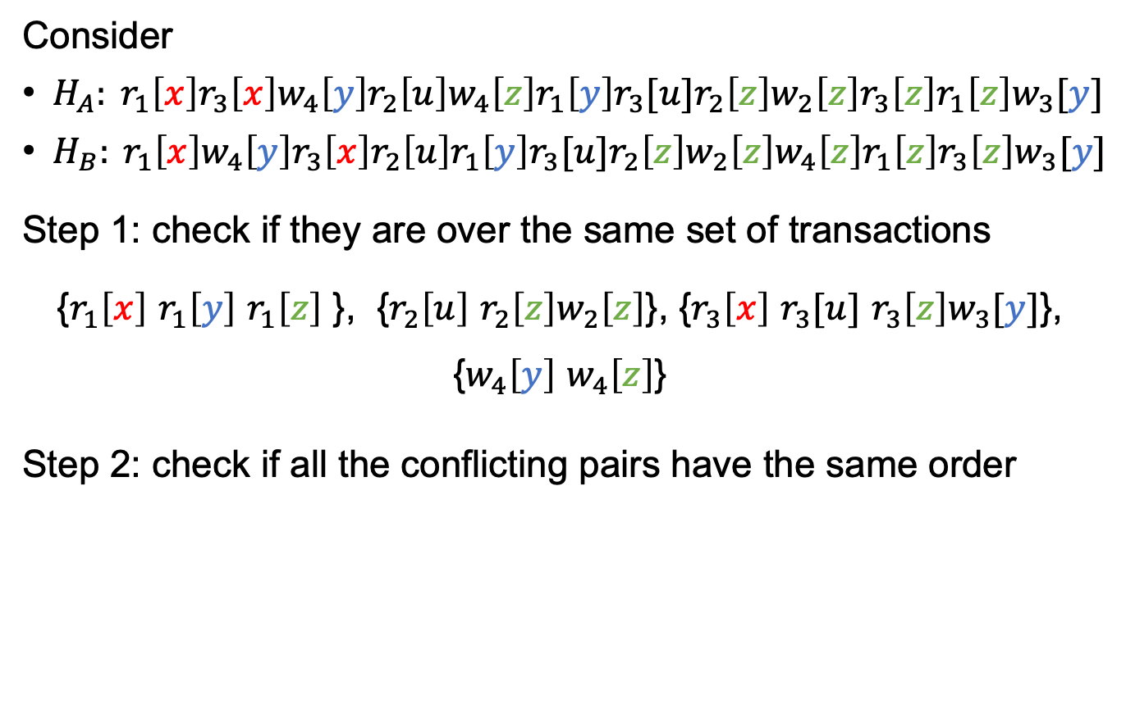
Example 2
Consider
$H_{A}: r_{1}\left[x\right]r_{3}\left[x\right]w_{4}\left[y\right]r_{2}\left[u\right]w_{4}\left[z\right]r_{1}\left[y\right]r_{3}[u]r_{2}\left[z\right]w_{2}\left[z\right]r_{3}\left[z\right]r_{1}\left[z\right]w_{3}[y]$
$H_{B}: r_{1}\left[x\right]w_{4}\left[y\right]r_{3}\left[x\right]r_{2}\left[u\right]r_{1}\left[y\right]r_{3}[u]r_{2}\left[z\right]w_{2}\left[z\right]w_{4}\left[z\right]r_{1}\left[z\right]r_{3}\left[z\right]w_{3}[y]$
Step 1: check if they are over the same set of transactions
{$r_{1}\left[x\right]$ $r_{1}\left[y\right]$ $r_{1}\left[z\right]$ }, {$r_{2}\left[u\right]$ $r_{2}\left[z\right]w_{2}\left[z\right]$}, {$r_{3}\left[x\right]$ $r_{3}[u]$ $r_{3}\left[z\right]w_{3}[y]$}, {$w_{4}\left[y\right]$ $w_{4}\left[z\right]$}
Step 2: check if all the conflicting pairs have the same order

Slide 18
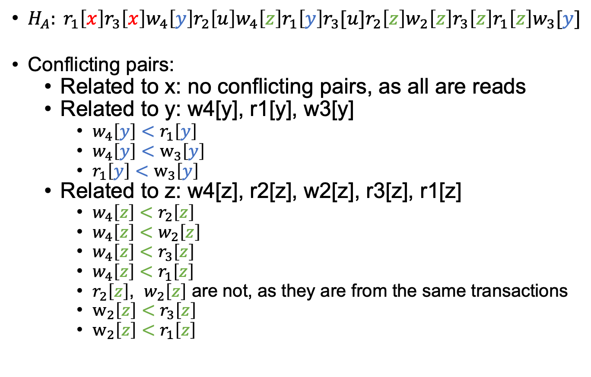
Identify All Conflicting Pairs
$H_{A}: r_{1}\left[x\right]r_{3}\left[x\right]w_{4}\left[y\right]r_{2}\left[u\right]w_{4}\left[z\right]r_{1}\left[y\right]r_{3}[u]r_{2}\left[z\right]w_{2}\left[z\right]r_{3}\left[z\right]r_{1}\left[z\right]w_{3}[y]$
Conflicting pairs:
  Related to x: no conflicting pairs, as all are reads
  Related to y: w4[y], r1[y], w3[y]
    $w_{4}\left[y\right]<$ $r_{1}\left[y\right]$
    $w_{4}\left[y\right]<$ $w_{3}\left[y\right]$
    $r_{1}\left[y\right]$ $<$ $w_{3}\left[y\right]$
  Related to z: w4[z], r2[z], w2[z], r3[z], r1[z]
    $w_{4}\left[z\right]$ $<$ $r_{2}\left[z\right]$
    $w_{4}\left[z\right]$ $<$ $w_{2}\left[z\right]$
    $w_{4}\left[z\right]$ $<$ $r_{3}\left[z\right]$
    $w_{4}\left[z\right]$ $<$ $r_{1}\left[z\right]$
    $r_{2}\left[z\right]$, $w_{2}\left[z\right]$ are not, as they are from the same transactions
    $w_{2}\left[z\right]$ $<$ $r_{3}\left[z\right]$
    $w_{2}\left[z\right]$ $<$ $r_{1}\left[z\right]$

Slide 19
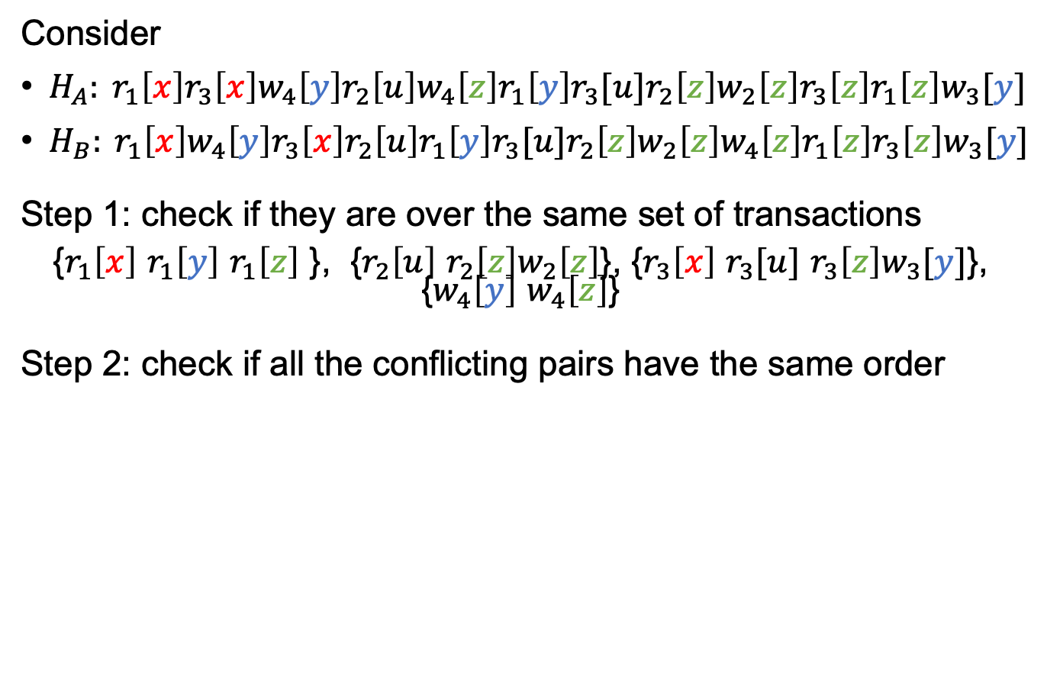
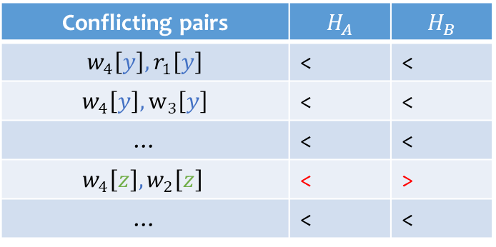
Example 2
Consider
$H_{A}: r_{1}\left[x\right]r_{3}\left[x\right]w_{4}\left[y\right]r_{2}\left[u\right]w_{4}\left[z\right]r_{1}\left[y\right]r_{3}[u]r_{2}\left[z\right]w_{2}\left[z\right]r_{3}\left[z\right]r_{1}\left[z\right]w_{3}[y]$
$H_{B}: r_{1}\left[x\right]w_{4}\left[y\right]r_{3}\left[x\right]r_{2}\left[u\right]r_{1}\left[y\right]r_{3}[u]r_{2}\left[z\right]w_{2}\left[z\right]w_{4}\left[z\right]r_{1}\left[z\right]r_{3}\left[z\right]w_{3}[y]$
Step 1: check if they are over the same set of transactions
{$r_{1}\left[x\right]$ $r_{1}\left[y\right]$ $r_{1}\left[z\right]$ }, {$r_{2}\left[u\right]$ $r_{2}\left[z\right]w_{2}\left[z\right]$}, {$r_{3}\left[x\right]$ $r_{3}[u]$ $r_{3}\left[z\right]w_{3}[y]$}, {$w_{4}\left[y\right]$ $w_{4}\left[z\right]$}
Step 2: check if all the conflicting pairs have the same order
Conflicting pairs | $$H_{A}$$ | $$H_{B}$$
$$w_{4}\left[y\right], r_{1}\left[y\right]$$ | < | <
$w_{4}\left[y\right], w_{3}\left[y\right]$ | < | <
… | < | <
$$w_{4}\left[z\right],w_{2}\left[z\right]$$ | < | >
… | < | <

Slide 20
Outline For Today
Serializability:
  Execution Histories
  Conflict Equivalence
  Checking For Serializability

Slide 21

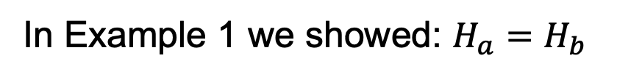
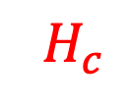



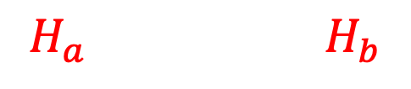

Serializability
A history $H$ is said to be (conflict) serializable if there exists some serial history $H′$ that is conflict equivalent to $H$.
$T_{1}$ $T_{2}$
w1(x)
r2(x)
w1(y)
r2(y)
c1
c2
$T_{1}$ $T_{2}$
w1(x)
w1(y)
c1
r2(x)
r2(y)
c2
$T_{1}$ $T_{2}$
w1(x)
r2(x)
r2(y)
w1(y)
c1
c2
$$H_{a} { H}_{b}$$
$$H_{c}$$
In Example 1 we showed: $H_{a}=H_{b}$

Slide 22
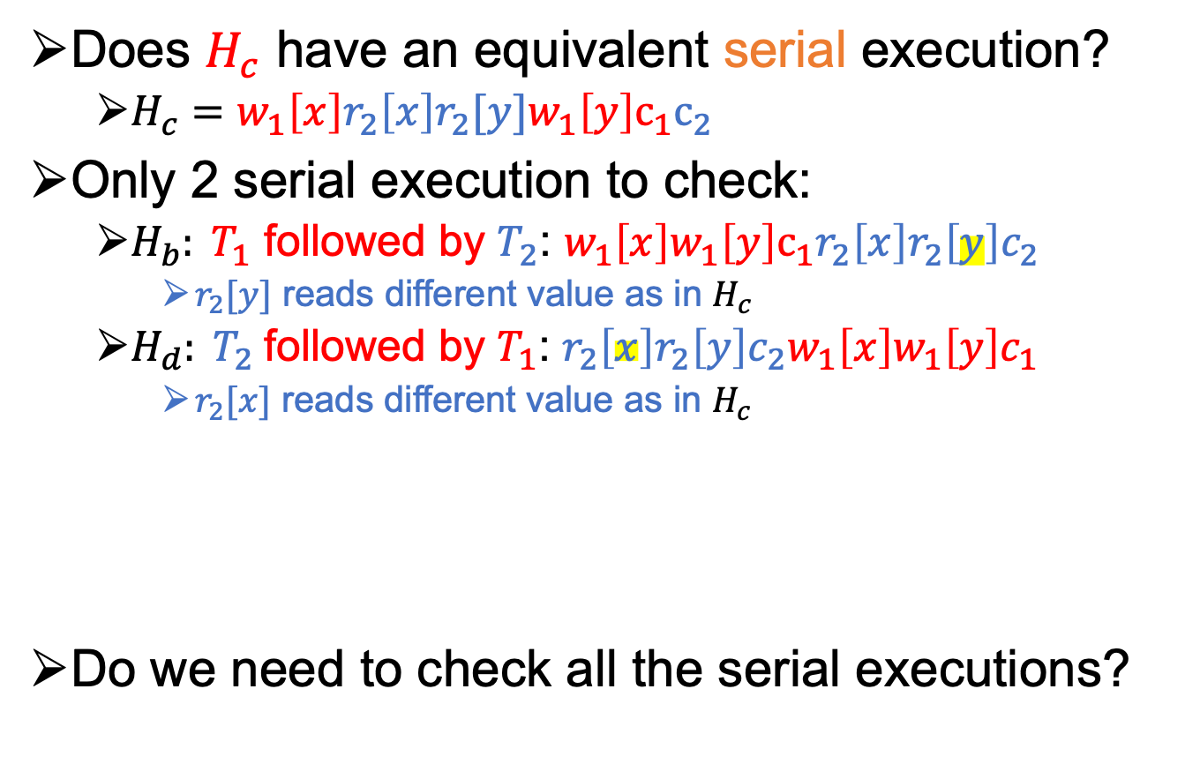
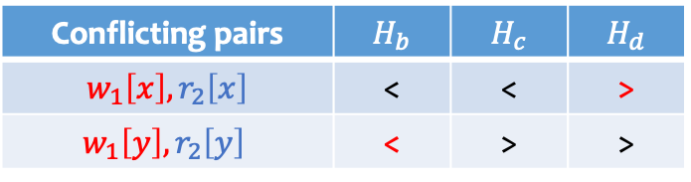
Serializability
Does $H_{c}$ have an equivalent serial execution?
  $H_{c}=w_{1}\left[x\right]r_{2}\left[x\right]r_{2}[y]w_{1}\left[y\right]c_{1}c_{2}$
Only 2 serial execution to check:
  $H_{b}: T_{1}$ followed by $T_{2}$: $w_{1}\left[x\right]w_{1}\left[y\right]{c_{1}r_{2}\left[x\right]r}_{2}\left[y\right]c_{2}$
    $r_{2}[y]$ reads different value as in $H_{c}$
  $H_{d}: T_{2}$followed by $T_{1}$: ${{r_{2}\left[x\right]r}_{2}\left[y\right]c_{2}w}_{1}\left[x\right]w_{1}\left[y\right]c_{1}$
    $r_{2}[x]$ reads different value as in $H_{c}$
Do we need to check all the serial executions?
Conflicting pairs | $$H_{b}$$ | $$H_{c}$$ | $$H_{d}$$
$$w_{1}\left[x\right],r_{2}\left[x\right]$$ | < | < | >
$$w_{1}\left[y\right],r_{2}\left[y\right]$$ | < | > | >

Slide 23
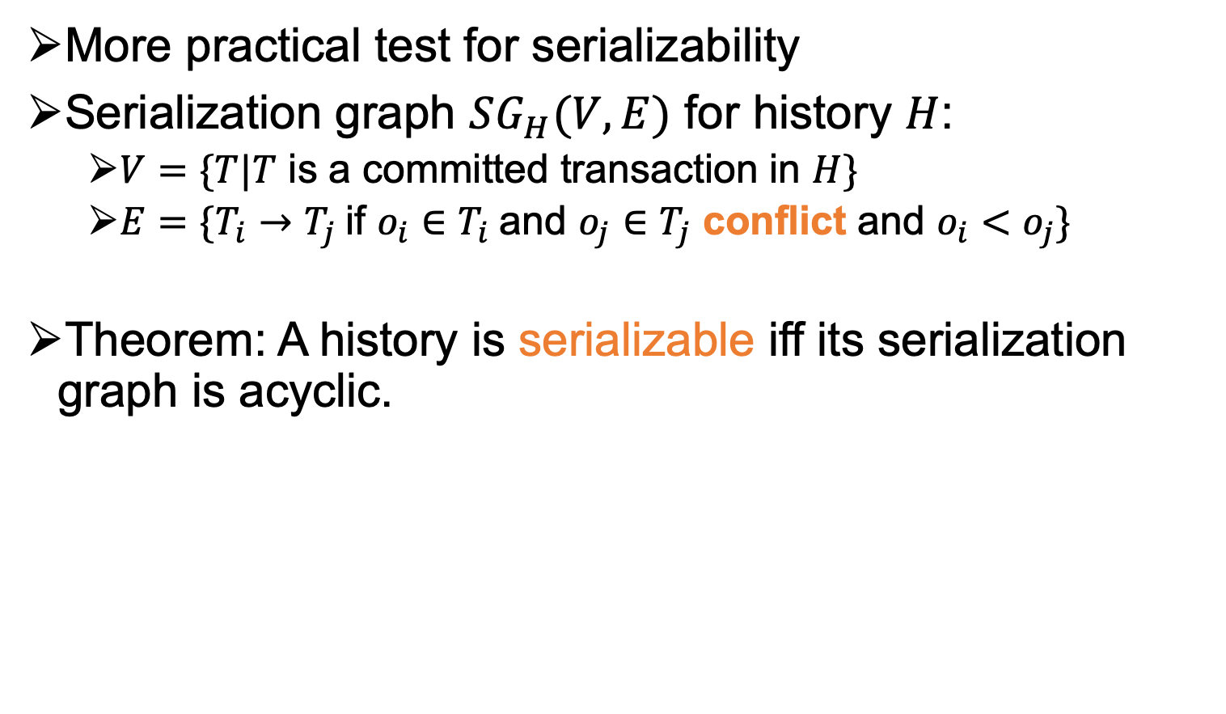
Serialization Graph
More practical test for serializability
Serialization graph $SG_{H}(V,E)$ for history $H$:
  $V=\{T|T$ is a committed transaction in $H\}$
  $E=\{T_{i}→T_{j}$if $o_{i}∈T_{i}$and $o_{j}∈T_{j}$ conflict and $o_{i}<o_{j}\}$
Theorem: A history is serializable iff its serialization graph is acyclic.

Slide 24



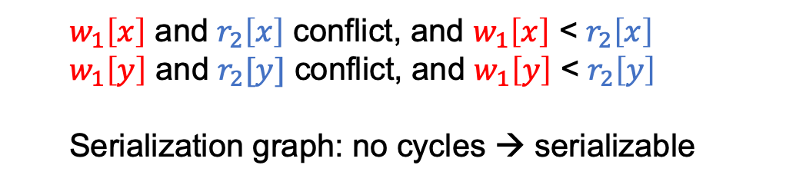
Example 1
${ H}_{a}=w_{1}\left[x\right]r_{2}\left[x\right]w_{1}\left[y\right]r_{2}[y]$ $c_{1}c_{2}$
$T_{1}$ $T_{2}$
w1(x)
r2(x)
w1(y)
r2(y)
c1
c2
  $w_{1}\left[x\right]$ and $r_{2}\left[x\right]$ conflict, and $w_{1}\left[x\right]$ < $r_{2}\left[x\right]$
  $w_{1}\left[y\right]$ and $r_{2}[y]$ conflict, and $w_{1}\left[y\right]$ < $r_{2}\left[y\right]$
  Serialization graph: no cycles → serializable
$$T_{1}$$
$$T_{2}$$
$$H_{a}$$

Slide 25




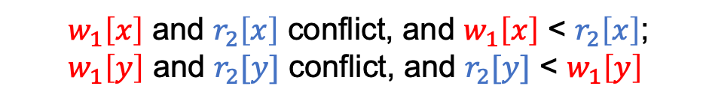

Example 2
Example: $H_{c}=w_{1}\left[x\right]r_{2}\left[x\right]r_{2}[y]w_{1}\left[y\right]c_{1}c_{2}$
$T_{1}$ $T_{2}$
w1(x)
r2(x)
r2(y)
w1(y)
c1
c2
  $w_{1}\left[x\right]$ and $r_{2}\left[x\right]$ conflict, and $w_{1}\left[x\right]$ < $r_{2}\left[x\right]$;
  $w_{1}\left[y\right]$ and $r_{2}[y]$ conflict, and $r_{2}[y]$ < $w_{1}\left[y\right]$
$H_{c}$
Not serializable
$$T_{1}$$
$$T_{2}$$

Slide 26

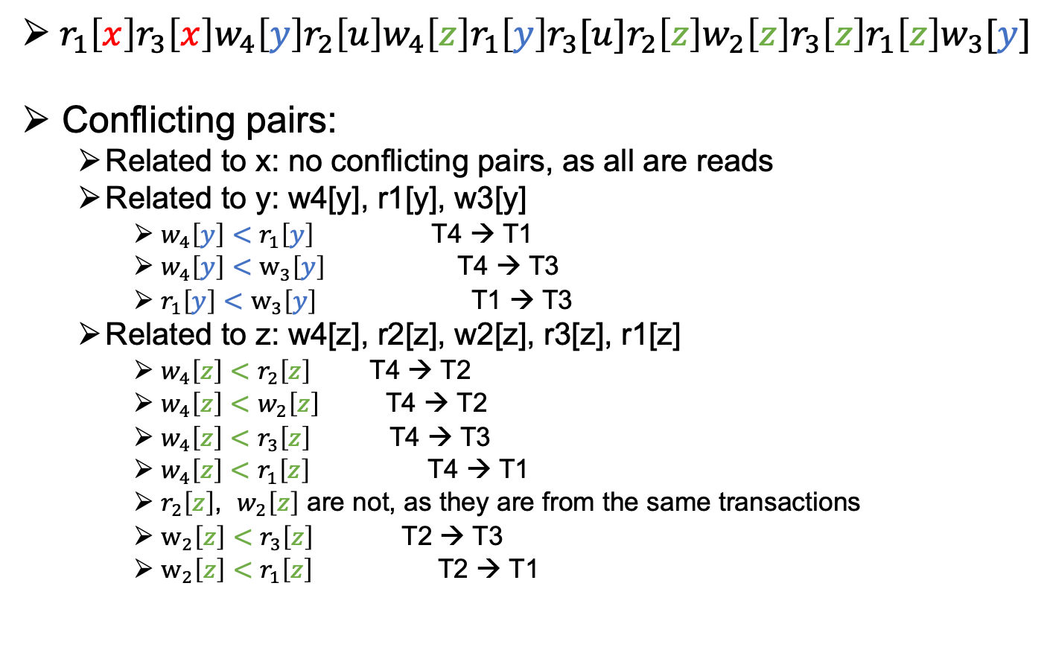



Example 3
${ r}_{1}\left[x\right]r_{3}\left[x\right]w_{4}\left[y\right]r_{2}\left[u\right]w_{4}\left[z\right]r_{1}\left[y\right]r_{3}[u]r_{2}\left[z\right]w_{2}\left[z\right]r_{3}\left[z\right]r_{1}\left[z\right]w_{3}[y]$
Conflicting pairs:
  Related to x: no conflicting pairs, as all are reads
  Related to y: w4[y], r1[y], w3[y]
    $w_{4}\left[y\right]<$ $r_{1}\left[y\right]$ T4 → T1
    $w_{4}\left[y\right]<$ $w_{3}\left[y\right]$ T4 → T3
    $r_{1}\left[y\right]$ $<$ $w_{3}\left[y\right]$ T1 → T3
  Related to z: w4[z], r2[z], w2[z], r3[z], r1[z]
    $w_{4}\left[z\right]$ $<$ $r_{2}\left[z\right]$ T4 → T2
    $w_{4}\left[z\right]$ $<$ $w_{2}\left[z\right]$ T4 → T2
    $w_{4}\left[z\right]$ $<$ $r_{3}\left[z\right]$ T4 → T3
    $w_{4}\left[z\right]$ $<$ $r_{1}\left[z\right]$ T4 → T1
    $r_{2}\left[z\right]$, $w_{2}\left[z\right]$ are not, as they are from the same transactions
    $w_{2}\left[z\right]$ $<$ $r_{3}\left[z\right]$ T2 → T3
    $w_{2}\left[z\right]$ $<$ $r_{1}\left[z\right]$ T2 → T1
$$T_{1}$$
$$T_{2}$$
$$T_{3}$$
$$T_{4}$$

Slide 27


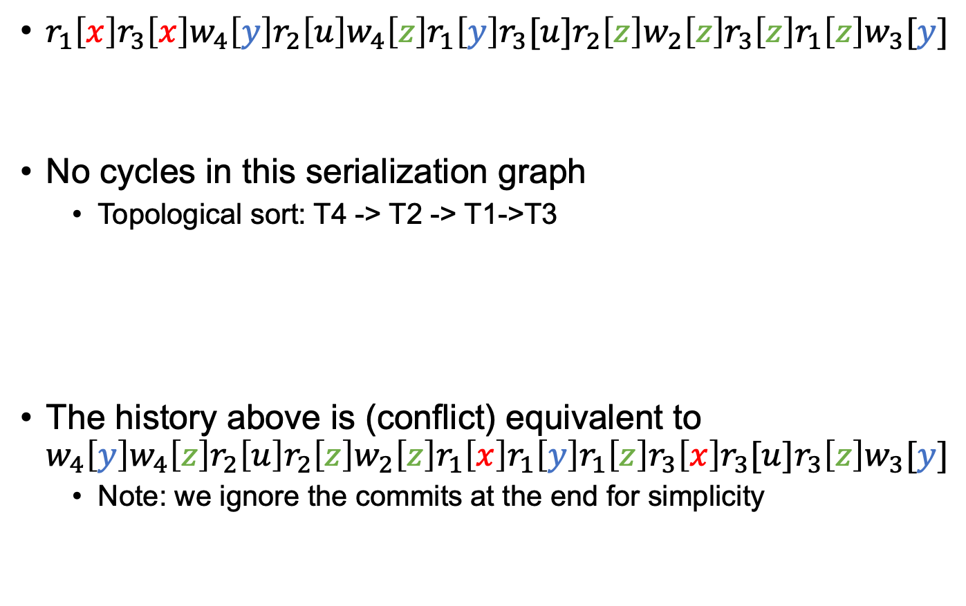


Example 3
$r_{1}\left[x\right]r_{3}\left[x\right]w_{4}\left[y\right]r_{2}\left[u\right]w_{4}\left[z\right]r_{1}\left[y\right]r_{3}[u]r_{2}\left[z\right]w_{2}\left[z\right]r_{3}\left[z\right]r_{1}\left[z\right]w_{3}[y]$
No cycles in this serialization graph
  Topological sort: T4 -> T2 -> T1->T3
The history above is (conflict) equivalent to
$w_{4}\left[y\right]w_{4}\left[z\right]r_{2}\left[u\right]r_{2}\left[z\right]w_{2}\left[z\right]r_{1}\left[x\right]r_{1}\left[y\right]r_{1}\left[z\right]r_{3}\left[x\right]r_{3}[u]r_{3}\left[z\right]w_{3}[y]$
  Note: we ignore the commits at the end for simplicity
$$T_{1}$$
$$T_{2}$$
$$T_{3}$$
$$T_{4}$$

Slide 28
Next Lecture: 2 Phase-Locking Protocol That Guarantees Conflict Serializability
(And Logging-based Recovery)

