Slide 1
Concurrency control & recovery system Transaction Processing
Introduction to Database Management
CS348 Spring 2021

Slide 2
Review
ACID
  Atomicity: TX’s are either completely done or not done at all
  Consistency: TX’s should leave the database in a consistent state
  Isolation: TX’s must behave as if they are executed in isolation
  Durability: Effects of committed TX’s are resilient against failures
SQL transactions
  -- Begins implicitly
  SELECT …;
  UPDATE …;
  ROLLBACK | COMMIT;

Slide 3
Outline
Concurrency control -- isolation
  Review serializable execution histories
  Locking-based concurrency control
Recovery – atomicity and durability
  Naïve approaches
  Logging for undo and redo

Slide 4
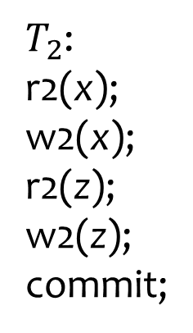
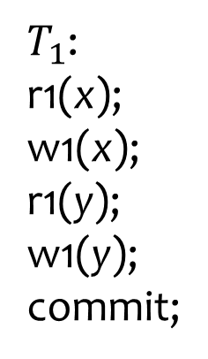
Concurrency control
Goal: ensure the “I” (isolation) in ACID
$T_{1}$:
r1(x);
w1(x);
r1(y);
w1(y);
commit;
$T_{2}$:
r2(x);
w2(x);
r2(z);
w2(z);
commit;
x y z

Slide 5
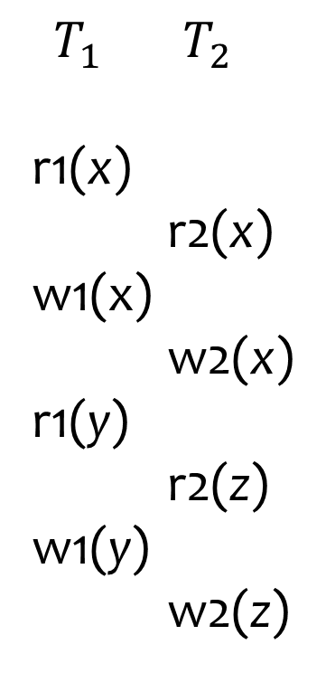
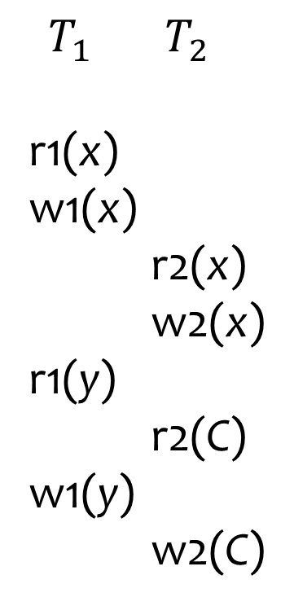
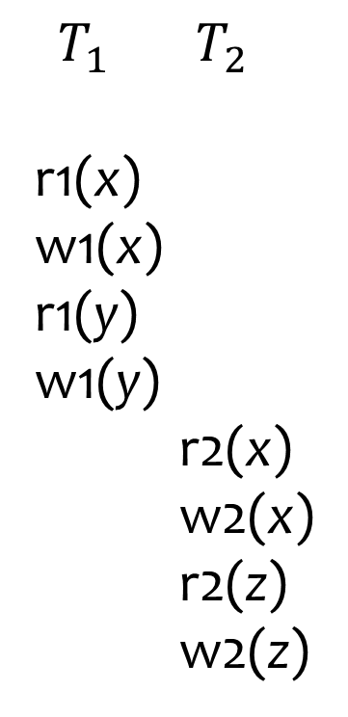
Good versus bad execution histories
Serial
Good!
Bad!
Good! Why?
$T_{1}$ $T_{2}$
r1(x)
w1(x)
r1(y)
w1(y)
r2(x)
w2(x)
r2(z)
w2(z)
$T_{1}$ $T_{2}$
r1(x)
r2(x)
w1(x)
w2(x)
r1(y)
r2(z)
w1(y)
w2(z)
$T_{1}$ $T_{2}$
r1(x)
w1(x)
r2(x)
w2(x)
r1(y)
r2(C)
w1(y)
w2(C)
Read 400
Write
400 – 100
Read 400
Write
400 – 50
$H_{a} { H}_{b}$ $H_{c}$

Slide 6



Good versus bad execution histories
Serializable
Good!
$T_{1}$ $T_{2}$
r1(x)
w1(x)
r2(x)
w2(x)
r1(y)
r2(C)
w1(y)
w2(C)
Serialization graph (Lecture 15)
$$T_{1}$$
$$T_{2}$$
${ H}_{c}$

Slide 7


Good versus bad execution histories
Not serializable
Bad!
$T_{1}$ $T_{2}$
r1(x)
r2(x)
w1(x)
w2(x)
r1(y)
r2(z)
w1(y)
w2(z)
$$T_{1}$$
How to avoid this?
$$T_{2}$$
${ H}_{b}$

Slide 8
Concurrency control
Possible classification
Pessimistic – assume that conflicts will happen and take preventive action
  Two-phase locking (2PL)
  Timestamp ordering
Optimistic – assume that conflicts are rare and run transactions and fix if there is a problem
We will only review 2PL

Slide 9
Locking
Rules
  If a transaction wants to read an object, it must first request a shared lock (S mode) on that object
  If a transaction wants to modify an object, it must first request an exclusive lock (X mode) on that object
  Allow one exclusive lock, or multiple shared locks
Mode of the lock requested
 | S | X
S | Yes | No
X | No | No
Mode of lock(s)
currently held
by other transactions
Grant the lock?
Compatibility matrix

Slide 10
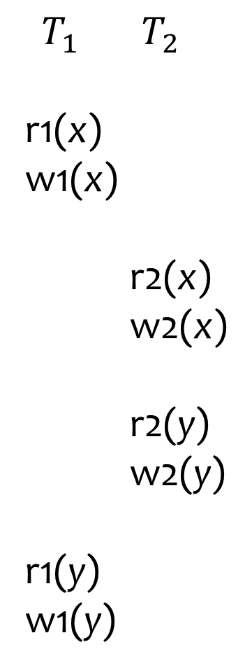
Basic locking is not enough
$T_{1}$ $T_{2}$
r1(x)
w1(x)
r2(x)
w2(x)
r2(y)
w2(y)
r1(y)
w1(y)
lock-X(x)
unlock(x)
lock-X(x)
Possible schedule
under locking
$$T_{1}$$
unlock(x)
$$T_{2}$$
But still not
conflict-serializable!
lock-X(y)
unlock(y)
lock-X(y)
unlock(y)

Slide 11

Basic locking is not enough
$T_{1}$ $T_{2}$
r1(x)
w1(x)
r2(x)
w2(x)
r2(y)
w2(y)
r1(y)
w1(y)
Add 1 to both x and y
(preserve x=y)
Multiply both x and y by 2
(preserves x=y)
lock-X(x)
Read 100
Write 100+1
unlock(x)
lock-X(x)
Possible schedule
under locking
$$T_{1}$$
Read 101
Write 101*2
unlock(x)
$$T_{2}$$
But still not
conflict-serializable!
lock-X(y)
Read 100
Write 100*2
unlock(y)
lock-X(y)
Read 200
x $≠$ y !
Write 200+1
unlock(y)

Slide 12
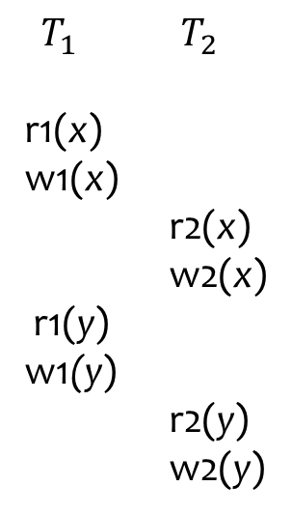

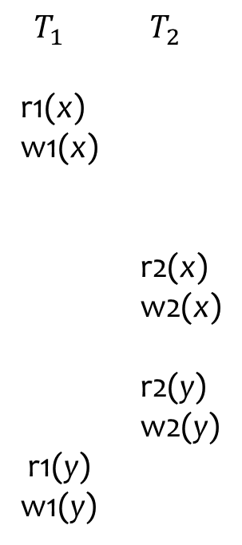
Two-phase locking (2PL)
All lock requests precede all unlock requests
  Phase 1: obtain locks, phase 2: release locks
$T_{1}$ $T_{2}$
r1(x)
w1(x)
r2(x)
w2(x)
r2(y)
w2(y)
r1(y)
w1(y)
$T_{1}$ $T_{2}$
r1(x)
w1(x)
r2(x)
w2(x)
r1(y)
w1(y)
r2(y)
w2(y)
2PL guarantees a
conflict-serializable
schedule
lock-X(x)
lock-X(y)
unlock(x)
lock-X(x)
lock-X(y)
Cannot obtain the lock on y
until $T_{1}$ unlocks
unlock(y)

Slide 13
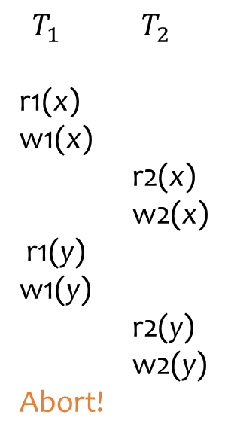
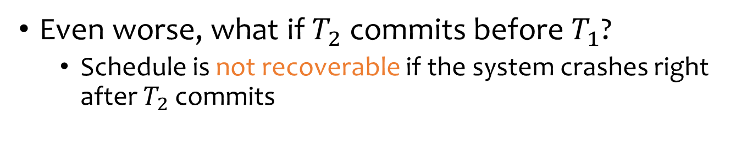
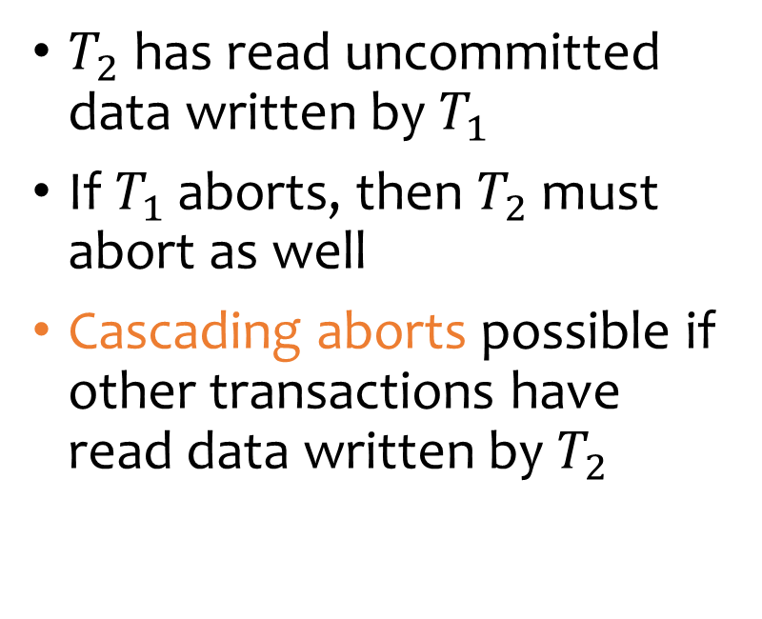
Remaining problems of 2PL
$T_{1}$ $T_{2}$
r1(x)
w1(x)
r2(x)
w2(x)
r1(y)
w1(y)
r2(y)
w2(y)
Abort!
$T_{2}$ has read uncommitted data written by $T_{1}$
If $T_{1}$ aborts, then $T_{2}$ must abort as well
Cascading aborts possible if other transactions have read data written by $T_{2}$
Even worse, what if $T_{2}$ commits before $T_{1}$?
  Schedule is not recoverable if the system crashes right after $T_{2}$ commits

Slide 14
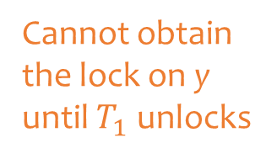
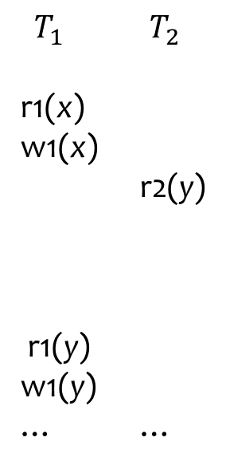
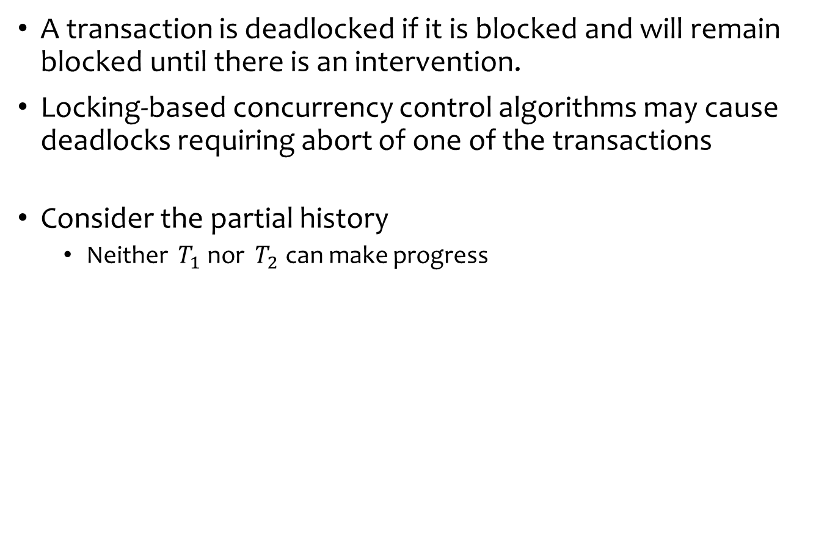
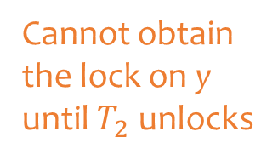
Deadlocks
A transaction is deadlocked if it is blocked and will remain blocked until there is an intervention.
Locking-based concurrency control algorithms may cause deadlocks requiring abort of one of the transactions
Consider the partial history
  Neither $T_{1}$ nor $T_{2}$ can make progress
$T_{1}$ $T_{2}$
r1(x)
w1(x)
r2(y)
r1(y)
w1(y)
… …
lock-X(x)
Cannot obtain the lock on y
until $T_{2}$unlocks
lock-S(y)
lock-S(x)
lock-X(y)
Cannot obtain the lock on y
until $T_{1}$ unlocks
unlock-X(x)
unlock-S(y)

Slide 15
Strict 2PL
Only release X-locks at commit/abort time
  A writer will block all other readers until the writer commits or aborts
Used in many commercial DBMS
  Oracle is a notable exception
Why do we use strict 2PL? (assignment question)

Slide 16
Outline
Concurrency control -- isolation
  Review serializable execution histories
  Locking-based concurrency control
Recovery – atomicity and durability
  Naïve approaches
  Logging for undo and redo

Slide 17
Execution model
To read/write X
The disk block containing X must be first brought into memory
X is read/written in memory
The memory block containing X, if modified, must be written back (flushed) to disk eventually
Disk
Memory
buffer
X
Y…
CPU
X
Y…
X
Y…
X
Y…

Slide 18

Failures
System crashes right after a transaction T1 commits; but not all effects of T1 were written to disk
  How do we complete/redo T1 (durability)?
System crashes in the middle of a transaction T2; partial effects of T2 were written to disk
  How do we undo T2 (atomicity)?
start
T1
end
start
T2
end
time

Slide 19
Naïve approach: Force -- durability
T1 (balance transfer of $100 from A to B)
Memory buffer
read(A, a); a = a – 100;
A = 800
700
write(A, a);
B = 400
500
read(B, b); b = b + 100;
write(B, b);
commit;
Disk
Force: all writes must be reflected on disk when a transaction commits
A = 800
700
B = 400
500

Slide 20
Naïve approach: Force -- durability
T1 (balance transfer of $100 from A to B)
Memory buffer
read(A, a); a = a – 100;
A = 800
700
write(A, a);
B = 400
500
read(B, b); b = b + 100;
write(B, b);
commit;
Disk
Force: all writes must be reflected on disk when a transaction commits
A = 800
B = 400
Bad!
Without force: not all writes are on disk when T1 commits
If system crashes right after T1 commits, effects of T1 will be lost

Slide 21
Naïve approach: No steal -- atomicity
T1 (balance transfer of $100 from A to B)
Memory buffer
read(A, a); a = a – 100;
A = 800
700
write(A, a);
B = 400
500
read(B, b); b = b + 100;
write(B, b);
commit;
No steal: Writes of a transaction can only be flushed to disk at commit time:
e.g. A=700 cannot be flushed to disk before commit.
Disk
A = 800
700
B = 400
Bad!
With steal: some writes are on disk before T commits
If system crashes before T1 commits, there is no way to undo the changes

Slide 22
Naïve approach
Force: When a transaction commits, all writes of this transaction must be reflected on disk
  Ensures durability
  Problem of force: Lots of random writes hurt performance
No steal: Writes of a transaction can only be flushed to disk at commit time
  Ensures atomicity
  Problem of no steal: Holding on to all dirty blocks requires lots of memory

Slide 23
Logging
Database log: sequence of log records, recording all changes made to the database, written to stable storage (e.g., disk) during normal operation
Hey, one change turns into two—bad for performance?
  But writes are sequential (append to the end of log)
Database
log
Old stable database state
Update operation
New stable database state

Slide 24
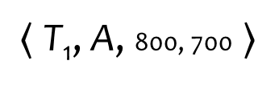
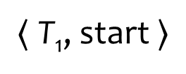
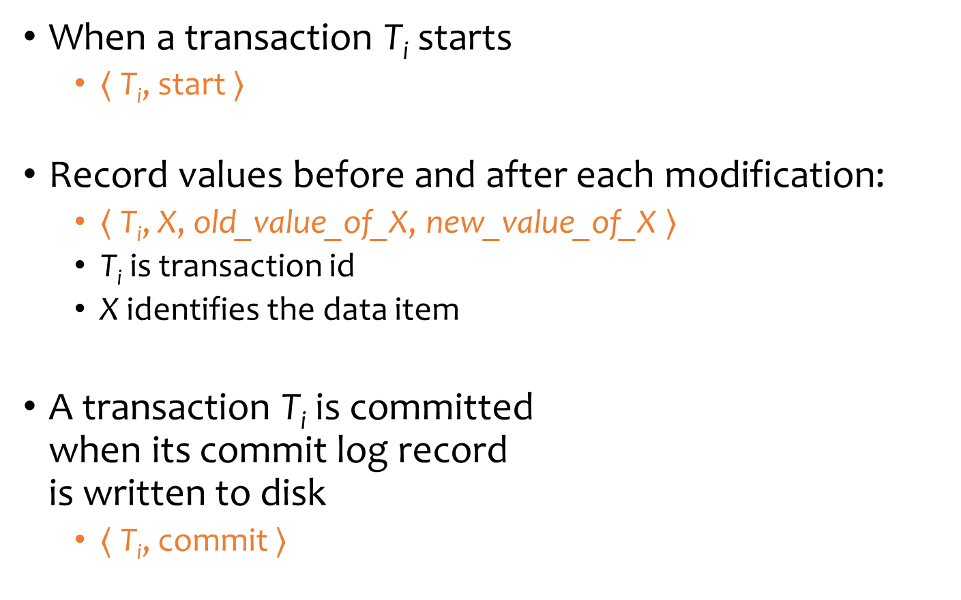
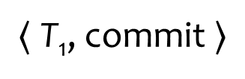
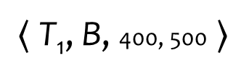
Log format
When a transaction T_{i} starts
  $〈$ T_{i}, start $〉$
Record values before and after each modification:
  $〈$ T_{i}, X, old_value_of_X, new_value_of_X $〉$
  T_{i} is transaction id
  X identifies the data item
A transaction T_{i} is committed
when its commit log record
is written to disk
  $〈$ T_{i}, commit $〉$
Log
$〈$T₁, start $〉$
$〈$T₁, A, 800, 700 $〉$
$〈$T₁, B, 400, 500 $〉$
$〈$T₁, commit $〉$

Slide 25
When to write log records into stable store?
Write-ahead logging (WAL): Before X is modified on disk, the log record pertaining to X must be flushed
Without WAL, system might crash after X is modified on disk but before its log record is written to disk—no way to undo

Slide 26
Undo/redo logging example
T1 (balance transfer of $100 from A to B)
read(A, a); a = a – 100;
Memory buffer
write(A, a);
read(B, b); b = b + 100;
A = 800
700
write(B, b);
B = 400
500
Disk
Log
$〈$T₁, start $〉$
A = 800
$〈$T₁, A, 800, 700 $〉$
B = 400
$〈$T₁, B, 400, 500 $〉$
WAL: Before A,B are modified on disk, their log info must be flushed

Slide 27
Undo/redo logging example cont.
T1 (balance transfer of $100 from A to B)
read(A, a); a = a – 100;
Memory buffer
write(A, a);
read(B, b); b = b + 100;
A = 800
700
write(B, b);
B = 400
500
Disk
Log
$〈$T₁, start $〉$
Steal: can flush
before commit
A = 800
700
$〈$T₁, A, 800, 700 $〉$
B = 400
$〈$T₁, B, 400, 500 $〉$
If system crashes before T1 commits, we have the old value of A stored on the log to undo T1

Slide 28
Undo/redo logging example cont.
T1 (balance transfer of $100 from A to B)
read(A, a); a = a – 100;
Memory buffer
write(A, a);
read(B, b); b = b + 100;
A = 800
700
write(B, b);
B = 400
500
commit;
Disk
Log
$〈$T₁, start $〉$
No force: can flush
after commit
A = 800
$〈$T₁, A, 800, 700 $〉$
B = 400
$〈$T₁, B, 400, 500 $〉$
$〈$T₁, commit $〉$
If system crashes before we flush the changes of A, B to the disk, we have their new committed values on the log to redo T1

Slide 29
Log example
Log
Redo phase:
Start of log
T1, start
T1, x, 99, 100
T2, start
T2, y, 199, 200
T3, start
T3, z, 51, 50
T2, w, 1000, 10
T2, commit
T4, start
T3, abort
T4, y, 200, 50
x: 99
y: 199
z: 51
w: 1000
redo
redo
100
redo
200
redo
50
redo
10
redo
redo
List of active transactions at crash:
T1
T2
T3
End of log

Slide 30
Log example
Log
Redo phase:
Start of log
T1, start
T1, x, 99, 100
T2, start
T2, y, 199, 200
T3, start
T3, z, 51, 50
T2, w, 1000, 10
T2, commit
T4, start
T3, abort
T4, y, 200, 50
x: 99
y: 199
z: 51
w: 1000
redo
redo
100
redo
200
redo
50
redo
10
redo
redo
redo
List of active transactions at crash:
T1
T2
T3
End of log

Slide 31
Log example
Log
Redo phase:
Start of log
T1, start
T1, x, 99, 100
T2, start
T2, y, 199, 200
T3, start
T3, z, 51, 50
T2, w, 1000, 10
T2, commit
T4, start
T3, abort
T4, y, 200, 50
x: 99
y: 199
z: 51
w: 1000
redo
redo
100
redo
200
redo
50
redo
10
redo
redo
redo
List of active transactions at crash:
redo
T1
T2
T3
T4
End of log

Slide 32
Log example
Log
Redo phase:
Start of log
T1, start
T1, x, 99, 100
T2, start
T2, y, 199, 200
T3, start
T3, z, 51, 50
T2, w, 1000, 10
T2, commit
T4, start
T3, abort
T4, y, 200, 50
x: 99
y: 199
z: 51
w: 1000
redo
redo
100
redo
200
redo
50
51
redo
10
redo
redo
redo
List of active transactions at crash:
redo
T1
T2
T3
T4
redo
End of log

Slide 33
Log example
Log
Redo phase:
Start of log
T1, start
T1, x, 99, 100
T2, start
T2, y, 199, 200
T3, start
T3, z, 51, 50
T2, w, 1000, 10
T2, commit
T4, start
T3, abort
T4, y, 200, 50
x: 99
y: 199
z: 51
w: 1000
redo
redo
100
redo
200
50
redo
50
51
redo
10
redo
redo
redo
List of active transactions at crash:
redo
T1
T2
T3
T4
redo
End of log
redo

Slide 34
Log example
Log
Undo phase: T1, T4
Start of log
T1, start
T1, x, 99, 100
T2, start
T2, y, 199, 200
T3, start
T3, z, 51, 50
T2, w, 1000, 10
T2, commit
T4, start
T3, abort
T4, y, 200, 50
x: 99
y: 199
z: 51
w: 1000
*
undo
100
99
200
50
200
50
51
10
List of active transactions at crash:
*
T1
T2
T3
T4
End of log
undo
T4, abort
T1, abort

Slide 35
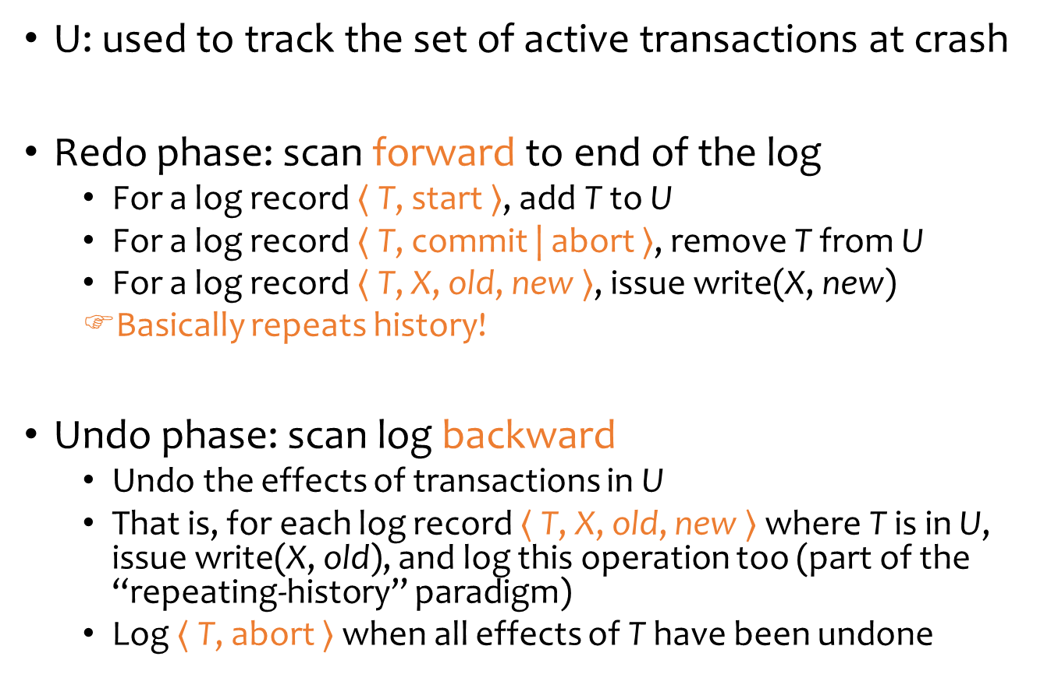
Undo/redo logging
U: used to track the set of active transactions at crash
Redo phase: scan forward to end of the log
  For a log record $〈$ T, start $〉$, add T to U
  For a log record $〈$ T, commit | abort $〉$, remove T from U
  For a log record $〈$ T, X, old, new $〉$, issue write(X, new)
  Basically repeats history!
Undo phase: scan log backward
  Undo the effects of transactions in U
  That is, for each log record $〈$ T, X, old, new $〉$ where T is in U, issue write(X, old), and log this operation too (part of the “repeating-history” paradigm)
  Log $〈$ T, abort $〉$ when all effects of T have been undone

Slide 36
Checkpointing
Shortens the amount of log that need to be undone or redone when a failure occurs
A checkpoint record contains a list of active transactions
Steps:
  Write a begin_checkpoint record into the log
  Collect the checkpoint data into the stable storage
  Write an end_checkpoint record into the log

Slide 37

Summary
Concurrency control
  2PL: guarantees a conflict-serializable schedule
  Deadlock problem
Recovery: undo/redo logging
  Normal operation: write-ahead logging, no force, steal
  Recovery: first redo (forward), and then undo (backward)

