Slide 1
SKETCHING TECHNIQUES FOR Real-time big data
Stefan Savev
Course@
Data Science Retreat, Berlin

Slide 2
OVERVIEW
Big Data.
Here Big Data == Big Matrix
Here data = interaction/co-occurrence data from e-commerce, traffic logs
Some data analysis questions
How many DISTINCT users viewed a page
Approximate trends (counts of events over time)
Fast linear regression with extremely large number of features (large number of features = all bigrams)
Fast dimensionality reduction with the SVD (detect patterns)
Main Theme
Sometimes approximate answers are good enough (When?)
We are turning the big data into small data (sketches) on which we can still compute the answers (approximately)
Suitable for real time answers and streaming application (real time streaming needs little memory)

Slide 3
When is approximate good enough?
Aggregate statistics: # users of a website, they change all the time so why focus on complete exactness
Machine Learning – it’s already an approximation
Search – it’s already based on “fuzzy matching”
Recommendation Systems – it’s a blackbox with little guarantees anyway (for example it will work for one customer very well and poorly for another one)
When is approximate NOT appropriate?
Total sales for last year in $
What about projected sales for next year?

Slide 4
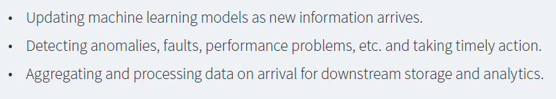
Interesting trends
Fast data (Typesafe white paper)
Turning big data into little data
For example to estimate the mean (e.g. mean latency) you don’t need to store the whole data
To estimate a histogram you may need to see all the data, but you don’t need to store it

Slide 5
Tasks
Day 1: Implement memory efficient (approximate) COUNT DISTINCT
Day 2: Implement Ted Dunning’s t-digest together with an anomaly detector
Day 3: Overview of hashing/sketching/random projection techniques

Slide 6
goals
Analysis of the approximate distinct count problem. Memory usage. What are advantages of different approaches (Hadoop, Streaming, exact vs. approximate)
Building an API for this problem
Building a small testing framework for this problem.
Testing mainstream libraries for approximate distinct count (ElasticSearch and Streamlib)
Creating your own simple solution (algorithm) for this problem and testing it.
Rough understanding the HyperLogLog algorithm.
Implementing HyperLogLog without fine tuning.
Understanding where HyperLogLog breaks and why.
Improving upon HyperLogLog with Linear Counting. HyperLog++
Understanding the fine print in HyperLogLog++. Exactly how much memory is used for exactly how much precision.

Slide 7
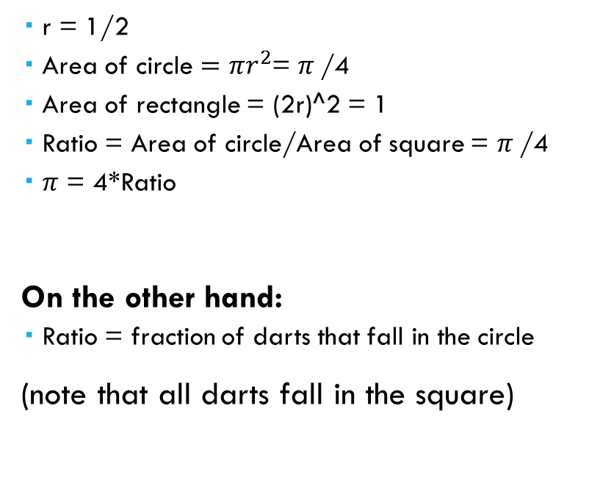

Warm up: estimate $π$ by throwing darts
r = 1/2
Area of circle $=πr^{2}$= $π$/4
Area of rectangle = (2r)^2 = 1
Ratio = Area of circle/Area of square = $π$/4
$π$ = 4*Ratio
On the other hand:
Ratio = fraction of darts that fall in the circle
(note that all darts fall in the square)
1

Slide 8

Warm up: estimate $π$ by throwing darts
val numDarts = 1000000 val rnd = new Random(4811) case class Point2D(x: Double, y: Double) val circleRadius = 0.5 def throwDart(): Point2D = Point2D(…,…) def inCircle(point: Point2D) = … //test whether the point is in the circle
val numDartsInCircle = (1 to numDarts).map(_ => throwDart()).count(inCircle) def estimate(numDartsInCircle: Int, numTotalDarts: Int): Double =… println("pi estimate: " + estimate(numDartsInCircle, numDarts))

Slide 9
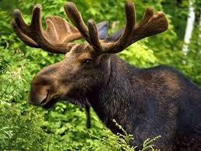
Stochastic averaging explained

Slide 10
Approximate distinct count
Use case:
An organization has many (e.g. millions) of web pages
Each page is hit by many (e.g. millions) of users.
We want to be able for each page to find the number of DISTINCT users that saw the page for a given time interval
Special case: count all unique visitors on a web site
Other use cases
Use case at Google: number of unique queries for a given time frame
Use case in database optimizers: Select good query plans
Extended use case: range queries, show trend of unique counts
Fast computation of similarity

Slide 11
Possible solutions
Naïve solution: use a hash set for each page. Next slide: compute memory
Brute force solution: store the page-visitor interactions in Hadoop and run offline jobs.
Use HyperLogLog++ algorithm: approximate solution

Slide 12
Who uses hyperloglog(++)?
Redis New Data structure: http://antirez.com/news/75
ElasticSearch: https://www.elastic.co/blog/count-elasticsearch
(according to ElasticSearch this feature has been requested by many users)
Amazon: http://www.looker.com/blog/practical-data-science-amazon-announces-hyperloglog
Facebook in Presto database

Slide 13
Distinct count: naïve solution
Uses a hash table for each page
One million web pages
How much memory is used in (GB?)
Next slide: assume Zipfean distribution.

Slide 14
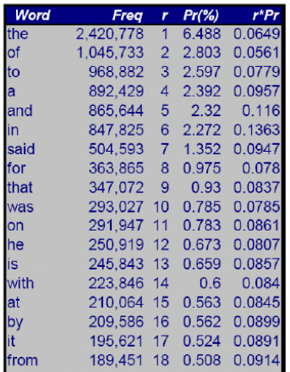

Distinct count: zipfean distribution analysis
Use case: fraction of the words that appear once
Set n = 1, then V/2 is the result,
Half of the words appear only once
Reference

Slide 15
Memory for all pages
Half (1/(1*2)) of the web pages have one unique view
(1/(2*3)) of the pages have 2 distinct users
(1/(3*4)) of the pages have 3 distinct users
And so on.
1*1/(1*2) + 2/(2*3) + … + n*1/(n*(n + 1)) = log(n)
Basically:
Most pages are viewed a few times [small memory to count]
A few pages a looked at by a lot of users [lots of memory but for a few pages]

Slide 16
Distinct count with hadoop
Input: a collection of (page_id, user_id) tuples
Goal: for each page compute number of unique user id’s
Simple solution:
Problem: page_ids with largest number of distinct users may cause out-of-memory
error in reducer or the corresponding reducer to run very long
def mapper(key=page_id, value=user_id):
emit(page_id, user_id)
def reduce(key=page_id, values_iterator=user_ids_per_page_id):
num_distinct = disctinct(user_ids_per_page)
emit(page_id, num_distinct)

Slide 17
Distinct count with hive
SELECT page_id, COUNT(DISTINCT user_id) AS num_distinct_ids FROM visits
GROUP BY page_id
Question: how many map reduce jobs does HIVE run for this?

Slide 18
Distinct count with scala
val data = Array((page_id, user_id))
data.groupBy({case (page_id, user_id) => page_id}).
map({case (page_id, user_ids) => page_ids, Array.distrinct(user_ids).length})

Slide 19
approximate counting
class ApproximateCounter (precision: PrecisionSpec){
def add(id: Long): Unit = …
def distinctCount(): (Double, StdDev) = …
}
T can be long (e.g user id), string (e.g. cookie), tuple (e.g. (user_id, page_id))
Precision: how to specify it?
ElasticSearch uses a number between 0 and 40000. Default is 40000. What does it mean?
More later
Counts are integers (or longs), but some algorithms may return double because we return an approximation. ElasticSearch and StreamLib return a Long.
Since the result is a random variable, we can return the std. deviation as well
Approximation Method = Linear Counting, HyperLogLog, HyperLogLog++, etc.

Slide 20
Task 1: design/implement the api
Suggested API:
trait ApproximateCounter{
def add(obj: T): Unit
def distinctCount(): Double
}

Slide 21
Task 2: implementation With standard hash table
Create a verifying implementation with Scala/Java HashMap
class NaiveCounter extends ApproximateCounter{
…
}

Slide 22
Task 3: create a wrapper around stream-LIB IMPLEMENTATION

Slide 23
TASK 4: CREATE A WRAPPER AROUND ELASTIC SEARCH IMPLEMENTATION

Slide 24
Task 5: Test on random data
- Create a generator class
class ItemGenerator(objectCounts: Array[Int], rnd: Random) {
def onProcessItem(processor: Int => Unit): Unit = …
}
- objectCounts is an array such that objectCount[i] = k means that object i will be generated k times
For example if objectCounts = Array(2,1,4) we can generate a sequence 0,0,1,2,2,2,2 or any permutation of this sequence. The generated items are send to onProcessItem(...) and received via the function processor
Or just a generator class that outputs 1,2,3,….
Or use an iterator

Slide 25
Task 5:
Create a Tester object. For example
class Tester(itemGenerator: ItemGenerator,
counterImplementations: Vector[ApproximateCounter]) {
val printWriter = new PrintWriter()
itemGenerator. onProcessItem(itemId => {
for(impl <- counterImplementations){
impl.add(itemId)
printWriter.printLine (impl. distinctCount().value.toString())
}
})
printWriter.close()
}

Slide 26
Task 6: evaluate the accuracy of the counters
The file created from the previous step should contain at least two columns
the first column is for the naïve (exact) distinct count.
the second count is for the approximate distinct count.
We want to plot them against each other (for example in R or Python)

Slide 27
TASK 7: OUR FIRST IMPLEMENTATION
Suppose we are working with long numbers that represent ids.
We map each id to a random number in the interval (0,1).
If k unique items are seen, they are mapped to k unique numbers in (0, 1).
Those numbers split the interval into (k + 1) parts. The expected lengths of each part are equal and since they sum to 1, the expected length of any part is 1/(k + 1)
Therefore if we know the smallest number in the interval, we can solve for k
1/(k + 1) = E[first interval length] = smallest number.
Number of distinct objects = 1/smallest number - 1
0
1

Slide 28
One algorithm
counters = Array.ofDim[Double](k).map(_=> 1.0) //initialize to 1
def add(obj): Unit = {
for(i <- 0 until k){
hash_code_i = hash(i, obj) //assume output from [0 to MAX_LONG)
rnd_number = hash_code_i.toDouble/MAX_LONG
counters(i) = Math.min(counters(i), rnd_number)
}}}
def getDistinct(): Double = {
avg = Array.average(counters)
1.0/avg - 1
}

Slide 29
improvement
Add more counters
then average

Slide 30
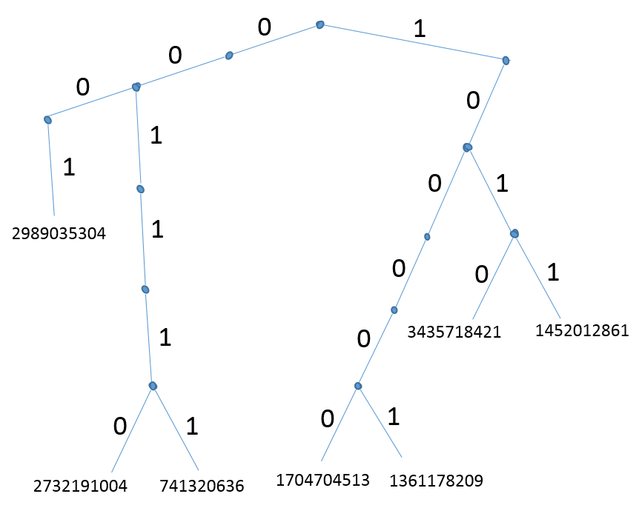
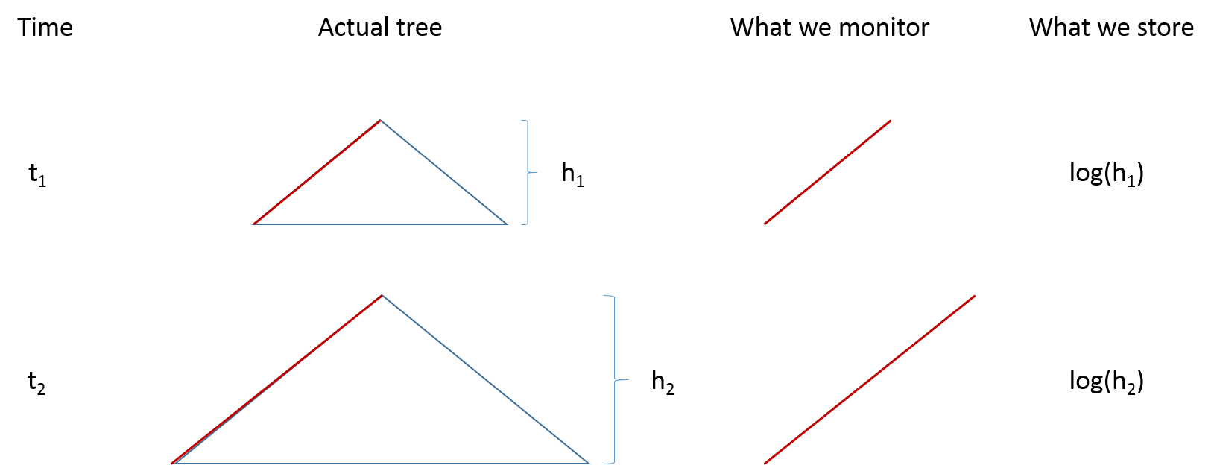
hyperloglog
17 (id) -> 2989035304 (hash code) 00010100111100001001010001001101 (hash code in binary)
2732191004 00111000101101111001101101000101
1704704513 10000000010111011101100110100110

Slide 31
Hyperloglog basic implementation
m = 2^p (for example p = 14)
counters = Array.ofDim[Double](m)
def add(obj: T): Unit ={
hash_code = hash(obj) //use 64 bit hash code
index = first p bits of hash_code
w = last (64 – p) bits of hash_code = 00…01… (the number of leading “0” can be zero)
sigma = 1 + number of leading zeros in w
counters(index) = max(counter(index), sigma)
}
def getCount(): Double= {
m*Array.average(counters.map(h=> 2^h)) //does not work well, see next slide
}

Slide 32
Hyperloglog: improved estimation
def getCount(): Double = {
correction = 0.7213/(1 + 1.079/m) //bias, computed empirically by google implementation
//not by a formula like here
correction * m * Array.harmonic_mean(counters.map(h=> 2^h))
}
For small numbers of distinct values, HyperLogLog over-estimates. Correction shrinks the estimate.
Try with and without correction on our test case.

Slide 33
Linear counting
HyperLogLog does not work very well when the number of distinct elements is small.
(absolute error vs. relative error)
Why? Given that we’ve seen k zeros at the beginning of a number, what’s the chance of seeing (k + extra) at the beginning of a number? Does not depend on k, but if k is big, the fluctuation has very small effect because it’s relative to k.
Solution: use a different algorithm (Linear Counting) for small number of distinct elements.
p = 14
m = 2^p = 16384 counters
…
Max. number of leading zeros
of bit strings
into this bucket

Slide 34
Linear counting
0
2
…
1
p = 14
m = 2^p = 16384 counters
MAIN OBSERVATION
For small number of distinct elements, most buckets are empty. Nothing is hashed to them. So, the number of buckets that have 0 is more indicative of the number of distinct elements, than the actual values in the buckets.
Distinct elements = - m * log(zeros/m)
Max. number of leading zeros
of bit strings
into this bucket

Slide 35
Linear counting formula derivation
k distinct ids
m buckets
p = prob. a values goes to a particular bucket = 1/m because each bucket is equally likely
q = out of k distinct ids, no id goes to a bucket = (1 – p)^k
Z = 1 if bucket is empty and 0 otherwise
E[Z] = 1*q + 0*(1 – q) = q
Expected number of empty buckets = m * E[Z] = m * q = m (1 – 1/m)^k = m * exp(-k/m)
Solve for k: log(zeros/m) = - k/m, k = - m * log(zeros/m)

Slide 36
Task 8: linear counting in hyperloglog
def add(): Unit //as before
def getCount(): Double= {
val zeros = counters.filter(_== 0).length //how many counters are zero
- m log(m.toDouble/zeros)
}
What happens if zeros = 0 (i.e. we have no empty buckets)

Slide 37
Improving the memory usage of hll
The data that HLL++ keeps is just the counters
Observation 1: For small distinct counts, most of the counters are zero. So we don’t need to materialize them
Observation 2: Even when the counters are not zero, they store the height of the binary tree. Since we are considering 2^(64 – 14) max. distinct elements, this means the counters will store max (64 – 14). This number is represented in less than log(64 – 14) = 6 bits.

Slide 38
Task 9: Use elastic search aggregation

Slide 39
About hash functions
https://code.google.com/p/smhasher/
Each bit of the output has to have a prob. ½ of being 0 or 1
We have to see all 256 values of a byte roughly the same number of times

Slide 40
References
https://highlyscalable.wordpress.com/2012/05/01/probabilistic-structures-web-analytics-data-mining/
Elastic Search Implementation https://github.com/elastic/elasticsearch/blob/6e3a4e21a118b73be2dfd5dfc2c787df5b950253/core/src/main/java/org/elasticsearch/search/aggregations/metrics/cardinality/HyperLogLogPlusPlus.java

