Slide 1
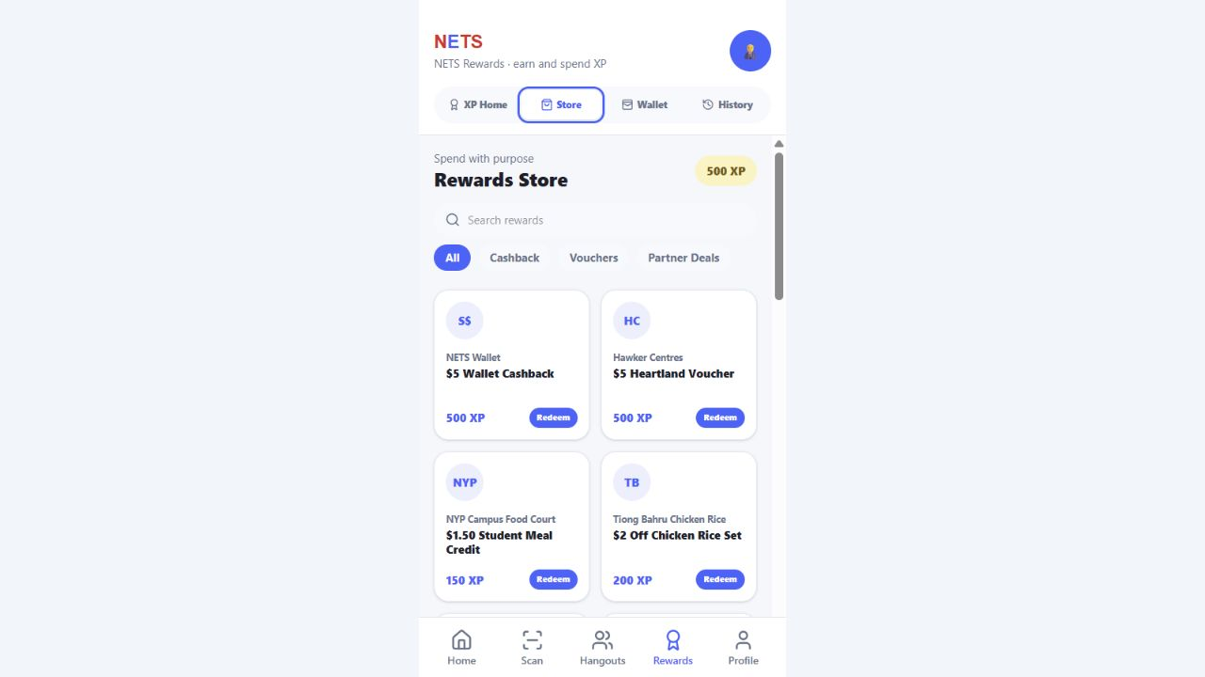
HADI'S INDIVIDUAL SOLUTION
XP Rewards
Store
Turning every NETS payment into
a reason to return.
Purchase-linked XP • instant cashback • local merchant value • traceable redemption
IT3852 · FINAL SOLUTION
Notes:
Open with the promise: this is not only a catalogue. It is a payment-linked loyalty engine designed to make NETS useful after every ordinary transaction. State ownership clearly: the XP Rewards Store is Hadi's individual component.
[Sources]
- Hadi Part New.pdf, page 1 — refined solution framing.
- Local prototype screenshot: app_assets/rewards-store.png — captured 16 Aug 2026.

Slide 2
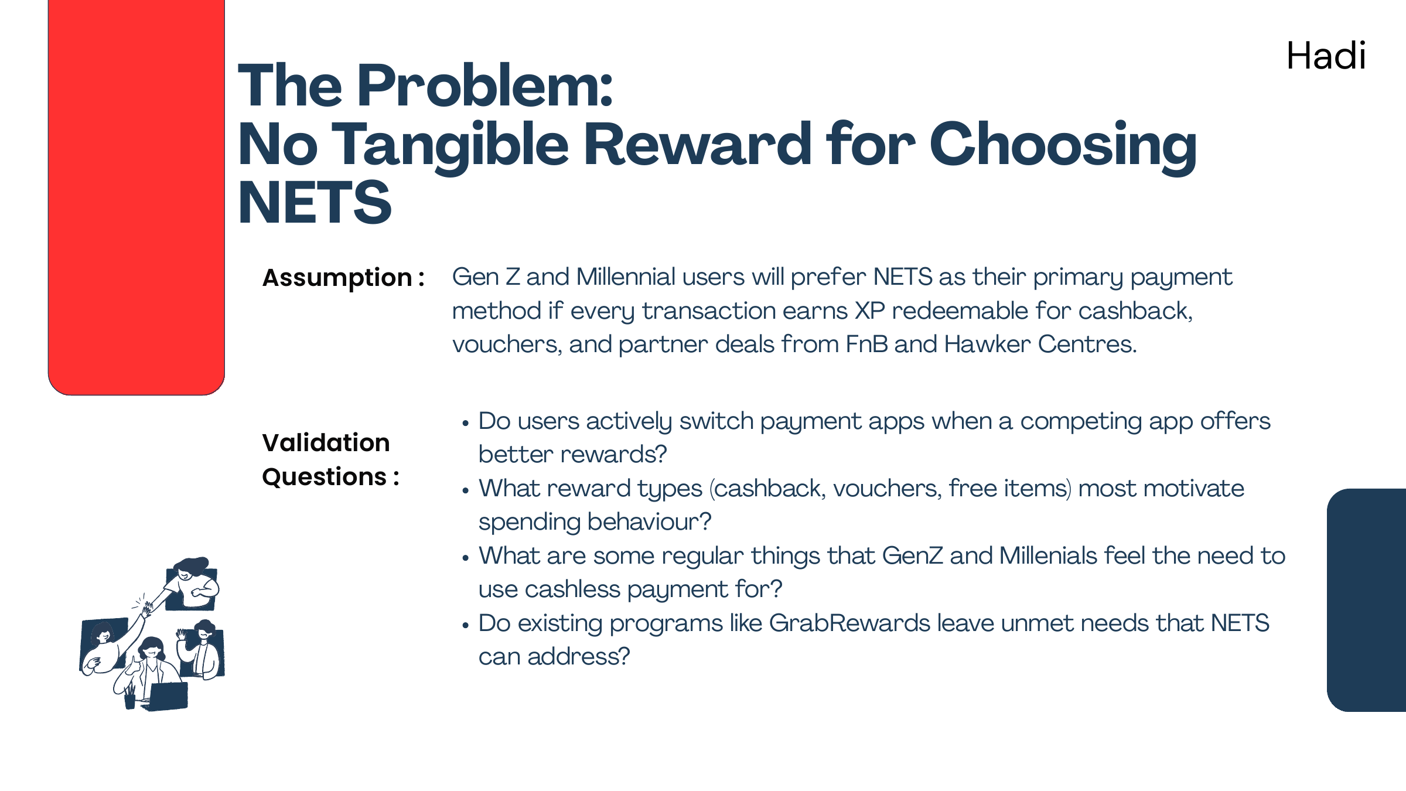
VALIDATED OPPORTUNITY
02
The problem was not acceptance. It was preference.
NETS was already present at everyday merchants — but users still needed a tangible reason to choose it repeatedly.
25 / 48
45,000
survey respondents selected
promotions & discounts
merchant touchpoints
reported in project research
Insight
ORIGINAL HYPOTHESIS
Rewards can turn reach into habit — especially when the value is immediate and local.
“Every transaction earns XP redeemable for cashback, vouchers and partner deals.”
XP REWARDS STORE
HADI
Notes:
Connect validation to the feature decision. The team's survey gave promotions and discounts 25 of 48 selections. Pair that with the project research on merchant reach: the strategic gap is not where NETS is accepted, but why a user would prefer it again tomorrow.
[Sources]
- docs/presentation-revisions.md — 25 of 48 respondents selected promotions and discounts.
- Hadi Part Old.pdf, pages 1-2 — original assumption, questions, insight, and decision.
- Hadi Part New.pdf, page 3 — project-reported merchant reach and strategic gap.

Slide 3
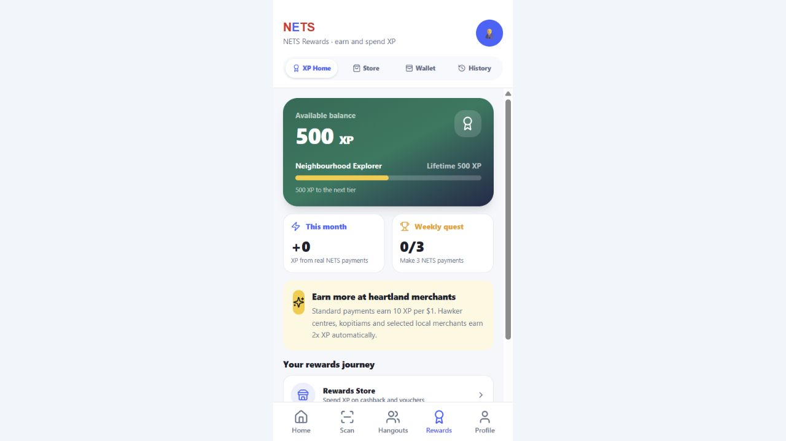
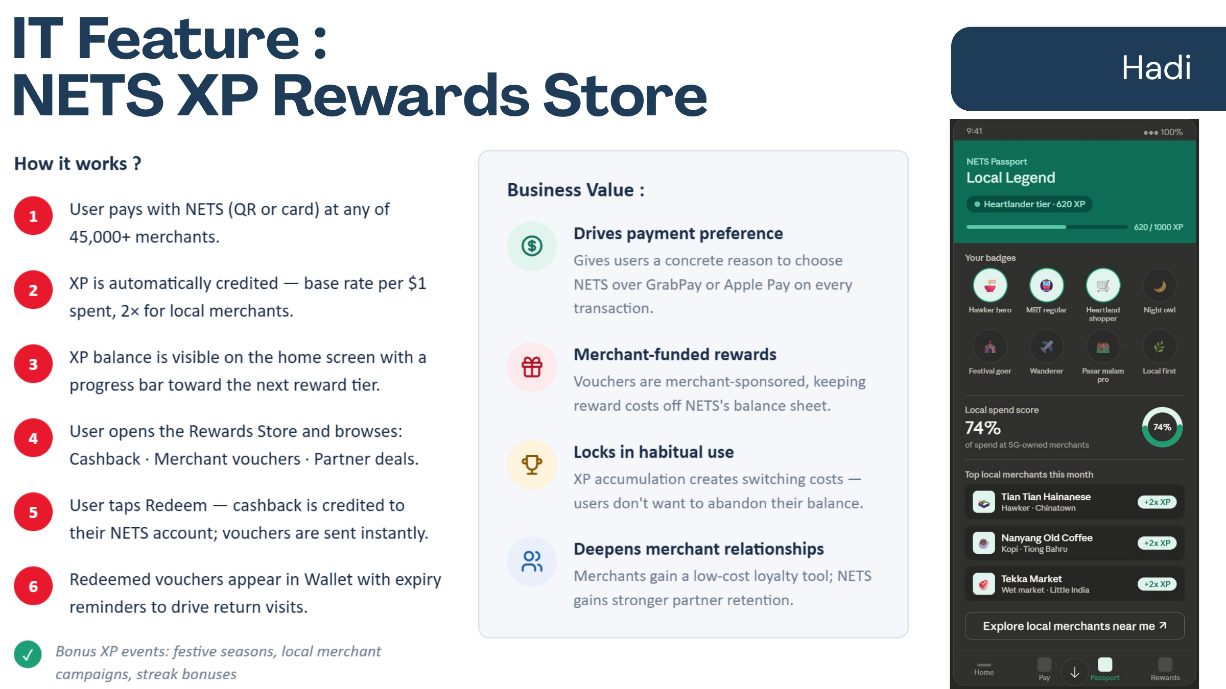
EVOLUTION
03
A catalogue idea became a loyalty engine.
The biggest iteration was behind the screens: the prototype now decides what qualifies, prevents duplicate earning, and makes redemption change real balances.
BEFORE · CONCEPT
NOW · IMPLEMENTED
01 Only purchase transactions earn
02 10 XP per $1 + heartland 2x
03 Cashback posts into the wallet
04 History makes every movement traceable
Browse rewards • Redeem rewards
Earn XP everywhere
Significant iteration = fewer loopholes + clearer value + stronger ownership
XP REWARDS STORE
HADI
Notes:
Use the before-and-after contrast to prove iteration. The original deck mostly described what a store could contain. The final prototype implements the loyalty logic: eligibility, rates, balance-safe redemption, transaction effects, and history.
[Sources]
- Hadi Part Old.pdf, page 4 — original store concept.
- Hadi Part New.pdf, page 2 — original-versus-implemented comparison.
- src/app/utils/rewardStorage.ts — implemented XP and redemption logic.
- Local prototype screenshot: app_assets/rewards-overview.png.

Slide 4
PRODUCT LOOP
04
Verified payment behaviour drives the loop.
Each stage keeps the same user, transaction type, XP balance and reward record — so the experience feels instant while the ledger remains explainable.
01
02
03
04
05
PAY
CLASSIFY
EARN
REDEEM
APPLY
NETS QR / card
purchase vs transfer
10 XP per $1
balance checked first
cashback or code
Payment ID
Transaction kind
XP balance
Reward status
blocks duplicates
controls eligibility
never drops below zero
keeps outcomes honest
XP REWARDS STORE
HADI
Notes:
Walk left to right. The reward engine begins only after a payment is classified as a purchase. XP is derived from that ledger entry. Redemption checks the current balance before writing a redemption. Cashback becomes a separate money-in transaction; vouchers become codes with lifecycle states.
[Sources]
- Hadi Part New.pdf, page 4 — five-stage product loop.
- src/app/pages/PaymentSuccessPage.tsx — purchase transaction and payment ID.
- src/app/utils/rewardStorage.ts — XP calculation, stats, and redemption.
- src/app/utils/transactionModel.ts — canonical transaction types.

Slide 5
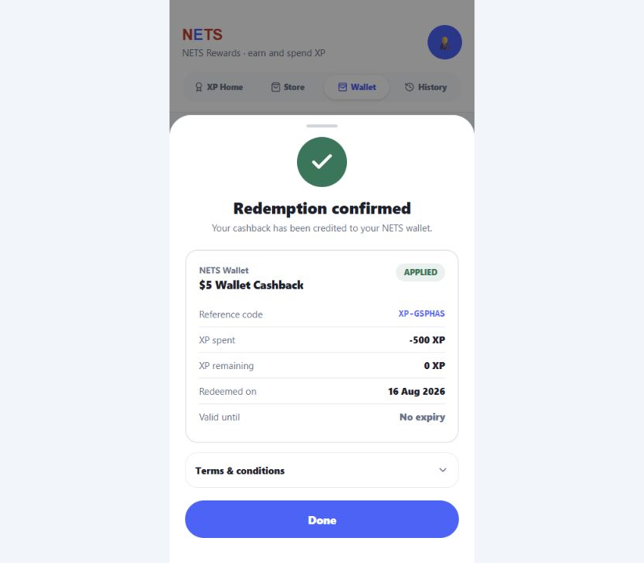
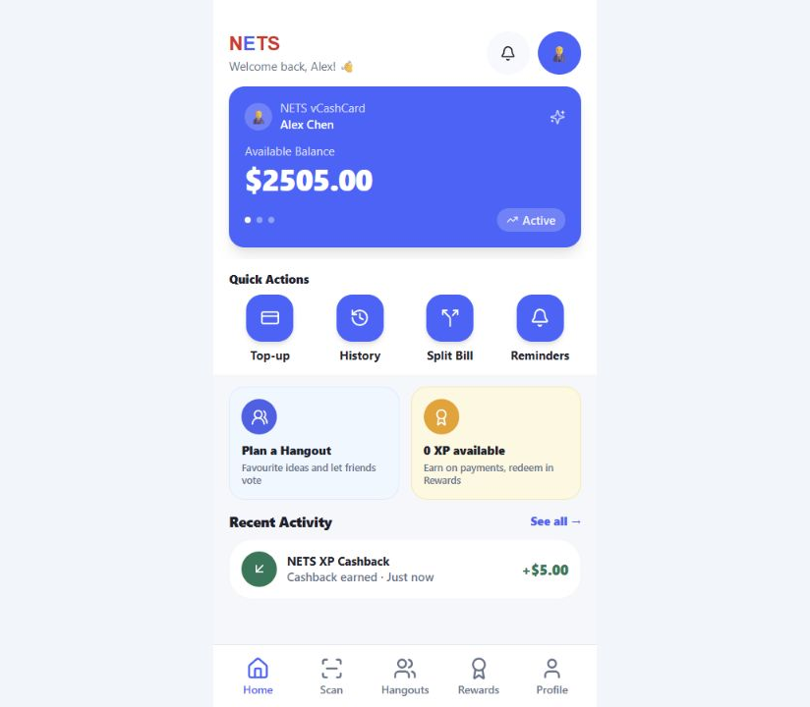
WORKING PROTOTYPE
05
The reward becomes real in under a minute.
A complete loop is visible to the user: choose value, confirm the trade-off, then see the money and history update.
1 · CHOOSE
2 · CONFIRM
3 · USE
Cashback, local vouchers and partner deals
Reference, XP spent and remaining balance
$5 appears in the wallet as real cashback
LIVE DEMO ROUTE
Store → $5 Cashback → Confirm → Done → Home
XP REWARDS STORE
HADI
Notes:
Demo this exact route if time allows. Point out that the screen shows the cost and the post-redemption XP balance before confirmation. After redemption, the receipt gives a reference and status. The home screen then shows the wallet balance rising from $2,500 to $2,505 and records NETS XP Cashback as recent activity.
[Sources]
- Local prototype screenshots: rewards-store.png, redemption-receipt.png, home-after-cashback.png — captured 16 Aug 2026.
- src/app/pages/RewardsPage.tsx — redemption detail, receipt, wallet, and history views.
- src/app/utils/rewardStorage.ts — cashback transaction write.

Slide 6
EVERYDAY EXPERIENCE
06
Useful because it fits ordinary spending.
The user does not manage a separate points system. Rewards are calculated from payments they already make, then surfaced at the moment they can use them.
01
LUNCH
Hawker & campus meals
Automatic 2x heartland XP makes low-value, frequent spending feel worthwhile.
02
CASH FLOW
Instant wallet cashback
A reward becomes spendable money immediately — no coupon hunting or waiting.
03
CONFIDENCE
Clear states and history
Users see affordability, expiry, Applied / Active / Used status, and every XP movement.
Day-to-day value = low effort + visible progress + usable outcomes
XP REWARDS STORE
HADI
Notes:
Explain usefulness through normal behaviour. A student buying lunch earns without opening the rewards page. The overview gives progress and a reason to return. Cashback is immediately useful. Voucher states, expiry dates, terms, directions, and a permanent history reduce uncertainty.
[Sources]
- src/app/pages/RewardsPage.tsx — overview, store, voucher details, expiry warning, directions, wallet, and history.
- src/app/utils/rewardStorage.ts — heartland multiplier and reward catalogue.
- Local prototype screenshot: app_assets/rewards-overview.png.

Slide 7
TECHNICAL INTEGRITY
07
Trust is designed into the XP ledger.
Four safeguards stop the prototype from rewarding the wrong behaviour or displaying a state the ledger cannot support.
01
PURCHASE ONLY
02
IDEMPOTENT WRITE
XP query accepts kind = purchase; transfers, top-ups, income and cashback do not earn.
A unique payment ID plus processed-payment marker blocks accidental duplicates.
03
BALANCE SAFE
04
HONEST STATUS
Current XP = earned − redeemed; insufficient balances are refused before the write.
Cashback is Applied; vouchers stay Active, Used or Expired — never ambiguous.
XP REWARDS STORE
HADI
Notes:
This is the technical-ownership slide. Explain the exact failure each decision prevents: false XP from transfers, duplicate rows after revisiting a success screen, negative balances, and misleading cashback or voucher states. These are not decorative controls; they protect customer trust.
[Sources]
- Hadi Part New.pdf, page 5 — four safeguards.
- src/app/utils/rewardStorage.ts — purchase-only history query, balance math, status model, and redemption guard.
- src/app/pages/PaymentSuccessPage.tsx — processed-payment check.
- src/app/utils/transactionStorage.ts and database/sql/17_processed_payments.sql — idempotency marker.

Slide 8
SYSTEM INTEGRATION
08
One ledger connects rewards to the whole product.
The feature is not isolated: it reads the shared transaction table and writes outcomes that the home wallet, history, and management portal immediately understand.
CUSTOMER
PURCHASE
XP ENGINE
REDEMPTION
Wallet cashback + voucher states
Shared transaction
kind + payment ID
Rate, multiplier
and balance
Cost check +
persistent record
MANAGEMENT
Live redemption count + partner catalogue
Seamless integration means one action produces consistent state everywhere — without copying or faking the result.
XP REWARDS STORE
HADI
Notes:
Follow the shared state. A purchase enters the same transaction ledger used by Home and analytics. The XP engine derives the balance. Redemption writes a reward record. Cashback also writes a canonical cashback transaction, which instantly updates Home. Admin statistics count those same redemptions, and admin-managed partner deals enter the store catalogue.
[Sources]
- README.md — integrated NETS lifestyle prototype and shared persistence.
- src/app/utils/rewardStorage.ts — shared transaction query, partner catalogue, redemption, and cashback write.
- src/app/utils/adminStats.ts — reward-redemption management count.
- src/app/pages/HomePage.tsx — wallet reads shared transactions.

Slide 9
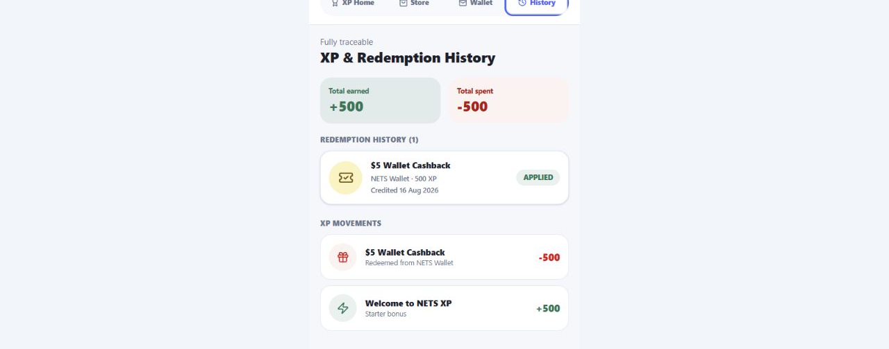
EVIDENCE OF QUALITY
09
The implementation is demonstrably robust.
Quality is shown through build evidence, authored user-journey tests, and a browser-verified end-to-end redemption — not only through screenshots.
✓
19
✓
0
TYPECHECK
REGRESSION TESTS
PRODUCTION BUILD
BROWSER ERRORS
passed
passed
passed
during reward journey
Focused end-to-end scenarios authored
01
Cashback → receipt → Applied wallet state → transaction history
02
Voucher → expiry + terms → single-use state → permanent history
03
Insufficient XP → locked action → no negative balance
Browser-verified ledger outcome
XP REWARDS STORE
HADI
Notes:
Be precise about verification. The full project verification command passed TypeScript, 19 Vitest tests, and the production build. In the connected browser, the reward flow completed with no error overlay or console errors. Three focused Playwright scenarios are authored; the local runner itself was not counted as passing because its exact Chromium executable was unavailable.
[Sources]
- npm run verify output, 16 Aug 2026 — typecheck, 19 tests, and Vite build passed.
- tests/e2e/rewards.spec.ts — three authored rewards journeys.
- Local browser verification, 16 Aug 2026 — no overlay or console errors; cashback, wallet, history, and balance update confirmed.
- Local prototype screenshot: app_assets/rewards-history.png.

Slide 10
A-BAND SYNTHESIS
10
The feature earns trust before it earns loyalty.
XP Rewards is credible because relevance, usability, technical integrity and integration reinforce one another.
01
RELEVANT
Validated preference problem → tangible everyday value
02
REFINED
Complete earn, redeem, receipt, wallet and history journey
03
INNOVATIVE
Heartland multiplier + instant wallet cashback
04
INTEGRATED
Shared transaction ledger updates customer and admin views
05
OWNED
Rules, trade-offs, safeguards and limits are explainable
Next proof: refund reversals · micro-payment caps · account-farming controls · funded reward economics
XP REWARDS STORE
HADI
Notes:
Close on the A-band criteria rather than a generic thank-you. The solution is relevant to a validated insight, complete enough to demonstrate, innovative in how it connects heartland rewards to wallet value, seamless across the system, and explainable in technical detail. Critical evaluation matters too: name the next safeguards and economics that would be required before production.
[Sources]
- IT3852 2026S1 Project Guide (1).pdf, pages 15-17 — Final Presentation and Final Solution Proficient (A) descriptors.
- docs/presentation-revisions.md — reward economics and abuse-control refinement requirements.
- Hadi Part New.pdf, pages 2-5 — iteration, loop, and safeguards.

