Slide 1
FINN Deep Dive: HW Scheduling & Folding
Giulio Gambardella, Yaman Umuroglu
Last updated 2020-06-05

Slide 2
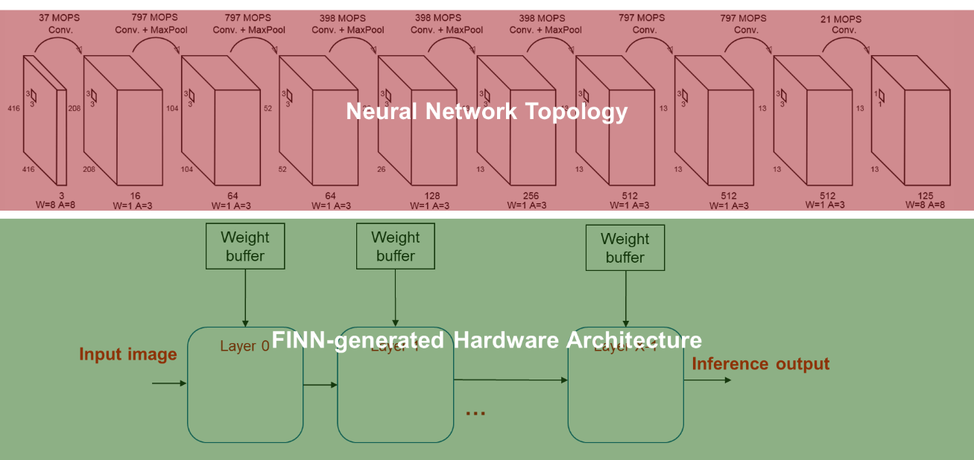
Previously on FINN
Hardware architecture is dataflow with streaming
HLS streams (FIFOs) are used to communicate among layers
Each layer is always running, starts computing as soon as it can
Each layer has internal parallelism s.t. pipeline is approximately balanced

Slide 3
Data Layout & Scheduling Preliminaries
Carefully select folded (time-multiplexed) data layout
Match producer and consumer order to minimize buffering + latency
Carry everything between layers using hls::stream< >
Stream width depends on precision and degree of parallelization
Use data width converters to up/downscale where needed
Specify parallelism (P) instead of folding (or reuse) factor (F)
Amount of work (W) = parallelism (P) * folding factor (F)

Slide 4
FINN Tensor Layout: NHWFP
Variant of NHWC = ( N (batch), H (height), W (width), C (channels) )
Channels from same pixel ‘next to’ each other, simplifies e.g. sliding window
C is dot product axis, may contain more than just channels (e.g. lowered convolution)
Almost all hlslib layer implementations assume this layout, but there are exceptions
N is 1 from the perspective of our hardware
H and W can be omitted for FC layers (equal to 1)
Add time-multiplexing axis on top of NHWC
Let C = F * P where F (folding) and P (parallelism) are integers
Layout becomes (N, H, W, F, P)
This decides the stream width: P elements every cycle
Elements may be e.g 2-bit, will be packed tightly together

Slide 5
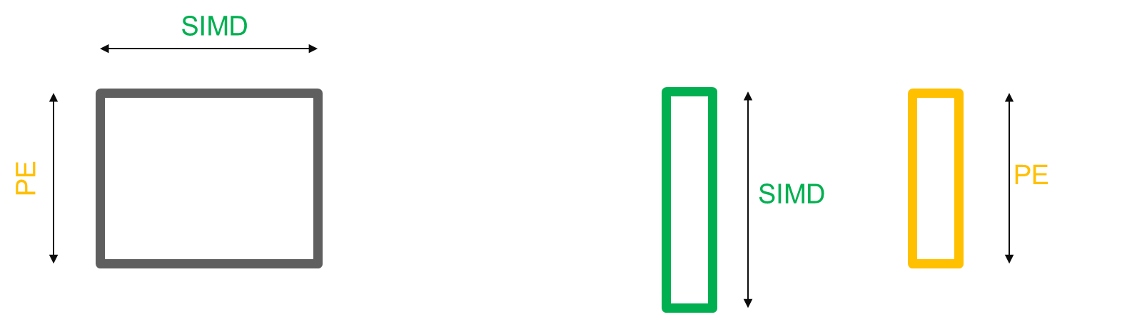
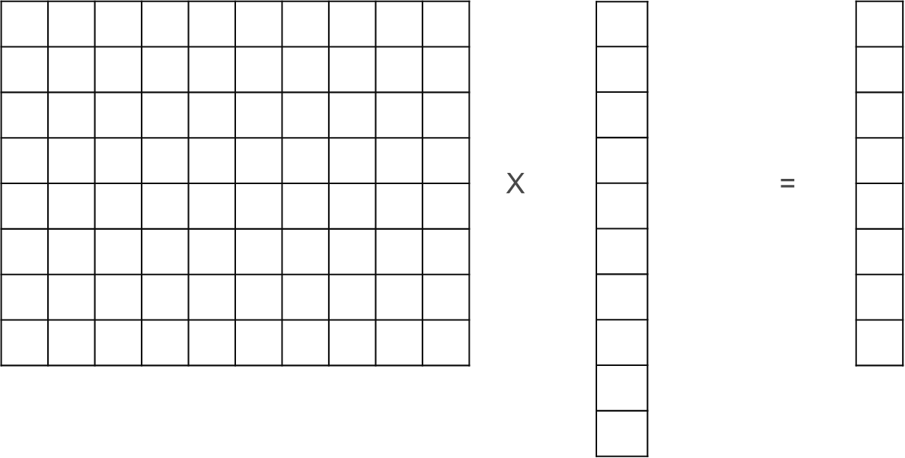
The Basics: Matrix-Vector Folding for a FC Layer
Assume these dimension sizes:
W = number of input features
H = number of output features
Two controllable degrees of parallelism:
MACs inside a single inner product: SIMD
Inner products in parallel: PE
H % PE == 0, W % SIMD == 0
H (output features)
W (input features)

Slide 6
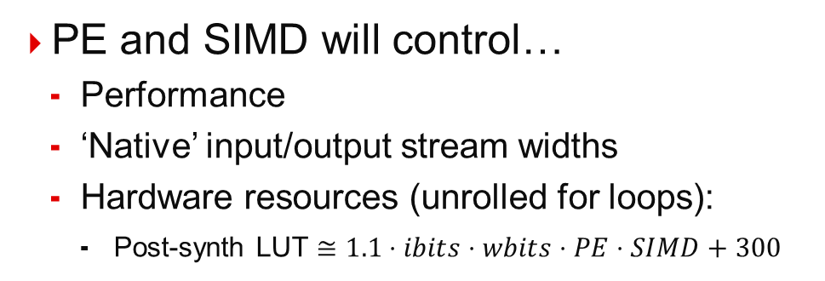
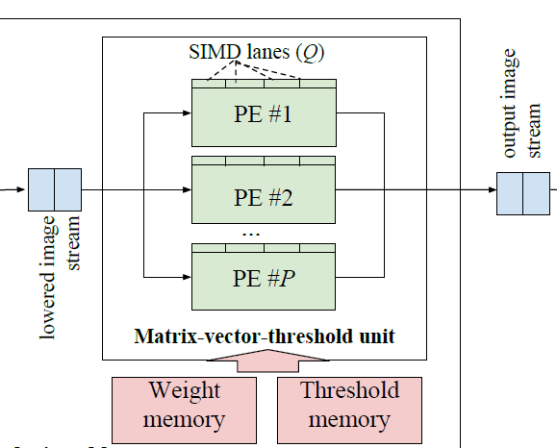
The Basics: Matrix-Vector Folding in Hardware
PE and SIMD will control…
Performance
‘Native’ input/output stream widths
Hardware resources (unrolled for loops):
Post-synth LUT $≅1.1⋅ibits⋅wbits⋅PE⋅SIMD+300$
‘native’ input stream width:
SIMD * input precision
Original tensor shape:
(1, W)
Folded tensor shape:
(1, W/SIMD, SIMD)
‘native’ output stream width:
PE * output precision
Original tensor shape:
(1, H)
Folded tensor shape:
(1, H/PE, PE)

Slide 7
The Basics: Matrix-Vector Folding, Cycle 1
Assume PE = H / 2, SIMD = W / 2
SIMD
PE
SIMD
PE
(partial result in accumulators)
X
=
Read from input stream
Save in OCM buffer

Slide 8
The Basics: Matrix-Vector Folding, Cycle 2
SIMD
PE
PE
X
=
SIMD
Write result to output stream
Read from input stream
Save in OCM buffer

Slide 9
The Basics: Matrix-Vector Folding, Cycle 3
SIMD
(reused from OCM buffer)
SIMD
X
=
PE
PE
(partial result in accumulators)

Slide 10
The Basics: Matrix-Vector Folding, Cycle 4
Finished!
Took 4 cycles
SIMD
X
=
PE
PE
SIMD
(reused from OCM buffer)
Write result to output stream

Slide 11
FINN I/O – main ideas
All layers consumes input in the same order
All channels for 1 pixel, pixels in raster order
All layers generates output in the same order used to consume from next layer
In order to decrease buffering requirements among layers (FIFOs)
No need of data restructuring among layers (im2col performed inside the layer with line buffering)

Slide 12
FINN – I/O order
Weight buffer
Weight buffer
Conv Layer 0
Conv Layer 1
IFM
OFM
Height
Channels
Width

Slide 13
FINN – I/O order
Weight buffer
Weight buffer
Conv Layer 0
Conv Layer 1
IFM
OFM
Height
Channels
Width

Slide 14
FINN – I/O order
Weight buffer
Weight buffer
Conv Layer 0
Conv Layer 1
IFM
OFM
Height
Channels
Width

Slide 15
FINN – I/O order
Weight buffer
Weight buffer
Conv Layer 0
Conv Layer 1
IFM
OFM
Height
Channels
Width

Slide 16
Folding compute on fixed PE array

Slide 17
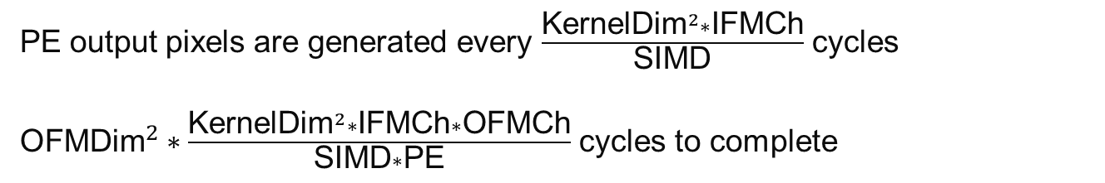
Convolutional layer – folding
PE
SIMD
SIMD
PE
.
.
.
PE output pixels are generated every $\frac{{\text{KernelDim}}^{2}∗\text{IFMCh}}{\text{SIMD}}$ cycles
${\text{OFM}\text{Dim}}^{2}∗\frac{{\text{KernelDim}}^{2}∗\text{IFMCh}∗\text{OFMCh}}{\text{SIMD}∗\text{PE}}$ cycles to complete
Height
Channels
Width

Slide 18
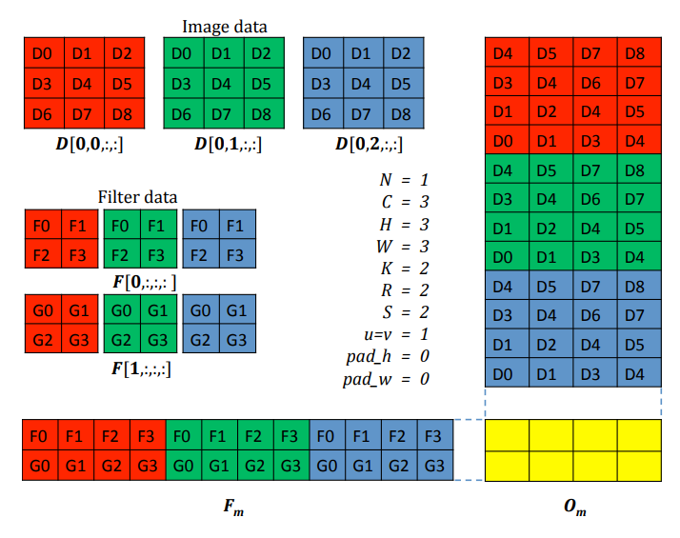
Im2col + matrix vector = convolution
Lowering convolution to im2col + matrix multiplication
Performed in a streaming function without buffering of the whole feature map
Produces input for matrix operation as soon as data is available

Slide 19
Animation of folding in a Conv2D

Slide 20
Matrix Vector streaming execution in a Matrix Matrix (rpt)
Execution matrix-matrix:
For (OFDim*OFMDim)
Execute Matrix-Vector
IFM0
IFM1
IFM2
IFM3
OFM0
OFM1
OFM2
OFM3

Slide 21
Neuron1 Synapse1
Execution matrix-vector:
First neuron
For (SynapseFolding)
Read SIMD Input pixels
Compute matrix Vector in each PE
IFM0
IFM1
IFM2
IFM3
OFM0
OFM1
OFM2
OFM3

Slide 22
Neuron1 Synapse2
Execution matrix-vector:
First neuron
For (SynapseFolding)
Read SIMD Input pixels
Compute matrix Vector in each PE
IFM0
IFM1
IFM2
IFM3
OFM0
OFM1
OFM2
OFM3

Slide 23
Neuron1 Synapse3
Execution matrix-vector:
First neuron
For (SynapseFolding)
Read SIMD Input pixels
Compute matrix Vector in each PE
IFM0
IFM1
IFM2
IFM3
OFM0
OFM1
OFM2
OFM3

Slide 24
Neuron1 Synapse4
Execution matrix-vector:
First neuron
For (SynapseFolding)
Read SIMD Input pixels
Compute matrix Vector in each PE
IFM0
IFM1
IFM2
IFM3
OFM0
OFM1
OFM2
OFM3

Slide 25
Neuron1 Synapse5
Execution matrix-vector:
First neuron
For (SynapseFolding)
Read SIMD Input pixels
Compute matrix Vector in each PE
IFM0
IFM1
IFM2
IFM3
OFM0
OFM1
OFM2
OFM3

Slide 26
Neuron1 Synapse6
Execution matrix-vector:
First neuron
For (SynapseFolding)
Read SIMD Input pixels
Compute matrix Vector in each PE
IFM0
IFM1
IFM2
IFM3
OFM0
OFM1
OFM2
OFM3

Slide 27
Neuron1 Synapse7
Execution matrix-vector:
First neuron
For (SynapseFolding)
Read SIMD Input pixels
Compute matrix Vector in each PE
IFM0
IFM1
IFM2
IFM3
OFM0
OFM1
OFM2
OFM3

Slide 28
Neuron1 Synapse8
Execution matrix-vector:
First neuron
For (SynapseFolding)
Read SIMD Input pixels
Compute matrix Vector in each PE
IFM0
IFM1
IFM2
IFM3
OFM0
OFM1
OFM2
OFM3

Slide 29
PE Pixels output
Execution matrix-vector:
First neuron
For (SynapseFolding)
Read SIMD Input pixels
Compute matrix Vector in each PE
Threshold comparison
Output PE Pixels
IFM0
IFM1
IFM2
IFM3
OFM0
OFM1
OFM2
OFM3

Slide 30
Neuron2 Synapse1
Execution matrix-vector:
First neuron
For (SynapseFolding)
Read SIMD Input pixels
Compute matrix Vector in each PE
Threshold comparison
Output PE Pixels
Other neurons
For (SynapseFolding)
Read buffered SIMD pixels
Compute matrix Vector in each PE
IFM0
IFM1
IFM2
IFM3
OFM0
OFM1
OFM2
OFM3

Slide 31
Neuron2 Synapse2
Execution matrix-vector:
First neuron
For (SynapseFolding)
Read SIMD Input pixels
Compute matrix Vector in each PE
Threshold comparison
Output PE Pixels
Other neurons
For (SynapseFolding)
Read buffered SIMD pixels
Compute matrix Vector in each PE
IFM0
IFM1
IFM2
IFM3
OFM0
OFM1
OFM2
OFM3

Slide 32
Neuron2 Synapse3
Execution matrix-vector:
First neuron
For (SynapseFolding)
Read SIMD Input pixels
Compute matrix Vector in each PE
Threshold comparison
Output PE Pixels
Other neurons
For (SynapseFolding)
Read buffered SIMD pixels
Compute matrix Vector in each PE
IFM0
IFM1
IFM2
IFM3
OFM0
OFM1
OFM2
OFM3

Slide 33
Neuron2 Synapse4
Execution matrix-vector:
First neuron
For (SynapseFolding)
Read SIMD Input pixels
Compute matrix Vector in each PE
Threshold comparison
Output PE Pixels
Other neurons
For (SynapseFolding)
Read buffered SIMD pixels
Compute matrix Vector in each PE
IFM0
IFM1
IFM2
IFM3
OFM0
OFM1
OFM2
OFM3

Slide 34
Neuron2 Synapse5
Execution matrix-vector:
First neuron
For (SynapseFolding)
Read SIMD Input pixels
Compute matrix Vector in each PE
Threshold comparison
Output PE Pixels
Other neurons
For (SynapseFolding)
Read buffered SIMD pixels
Compute matrix Vector in each PE
IFM0
IFM1
IFM2
IFM3
OFM0
OFM1
OFM2
OFM3

Slide 35
Neuron2 Synapse6
Execution matrix-vector:
First neuron
For (SynapseFolding)
Read SIMD Input pixels
Compute matrix Vector in each PE
Threshold comparison
Output PE Pixels
Other neurons
For (SynapseFolding)
Read buffered SIMD pixels
Compute matrix Vector in each PE
IFM0
IFM1
IFM2
IFM3
OFM0
OFM1
OFM2
OFM3

Slide 36
Neuron2 Synapse7
Execution matrix-vector:
First neuron
For (SynapseFolding)
Read SIMD Input pixels
Compute matrix Vector in each PE
Threshold comparison
Output PE Pixels
Other neurons
For (SynapseFolding)
Read buffered SIMD pixels
Compute matrix Vector in each PE
IFM0
IFM1
IFM2
IFM3
OFM0
OFM1
OFM2
OFM3

Slide 37
Neuron2 Synapse8
Execution matrix-vector:
First neuron
For (SynapseFolding)
Read SIMD Input pixels
Compute matrix Vector in each PE
Threshold comparison
Output PE Pixels
Other neurons
For (SynapseFolding)
Read buffered SIMD pixels
Compute matrix Vector in each PE
IFM0
IFM1
IFM2
IFM3
OFM0
OFM1
OFM2
OFM3

Slide 38
PE Pixels output
Execution matrix-vector:
First neuron
For (SynapseFolding)
Read SIMD Input pixels
Compute matrix Vector in each PE
Threshold comparison
Output PE Pixels
Other neurons
For (SynapseFolding)
Read buffered SIMD pixels
Compute matrix Vector in each PE
Threshold comparison
Output PE Pixels
IFM0
IFM1
IFM2
IFM3
OFM0
OFM1
OFM2
OFM3

