Slide 1
Employee Attrition
Project Report

Slide 2
Project Background
The project is for company X which is trying to control attrition.
Employee attrition is the loss of employees through any method such as resignation, retirement, personal health, elimination of position, or other similar reasons.
The dataset provided contains information about the current employees and ex-employees of company X.
The aim of this project is to ultimately find insights as to why employees are leaving the company and to predict those who are likely to leave among the current employees.

Slide 3
Project Methodology
Explorative analysis of the dataset to expose the key factors that contribute to employee attrition in this particular firm.
Regression model to predict the future employee that will leave the company

Slide 4
EXPLORATIVE DATA ANALYSIS
EDA

Slide 5
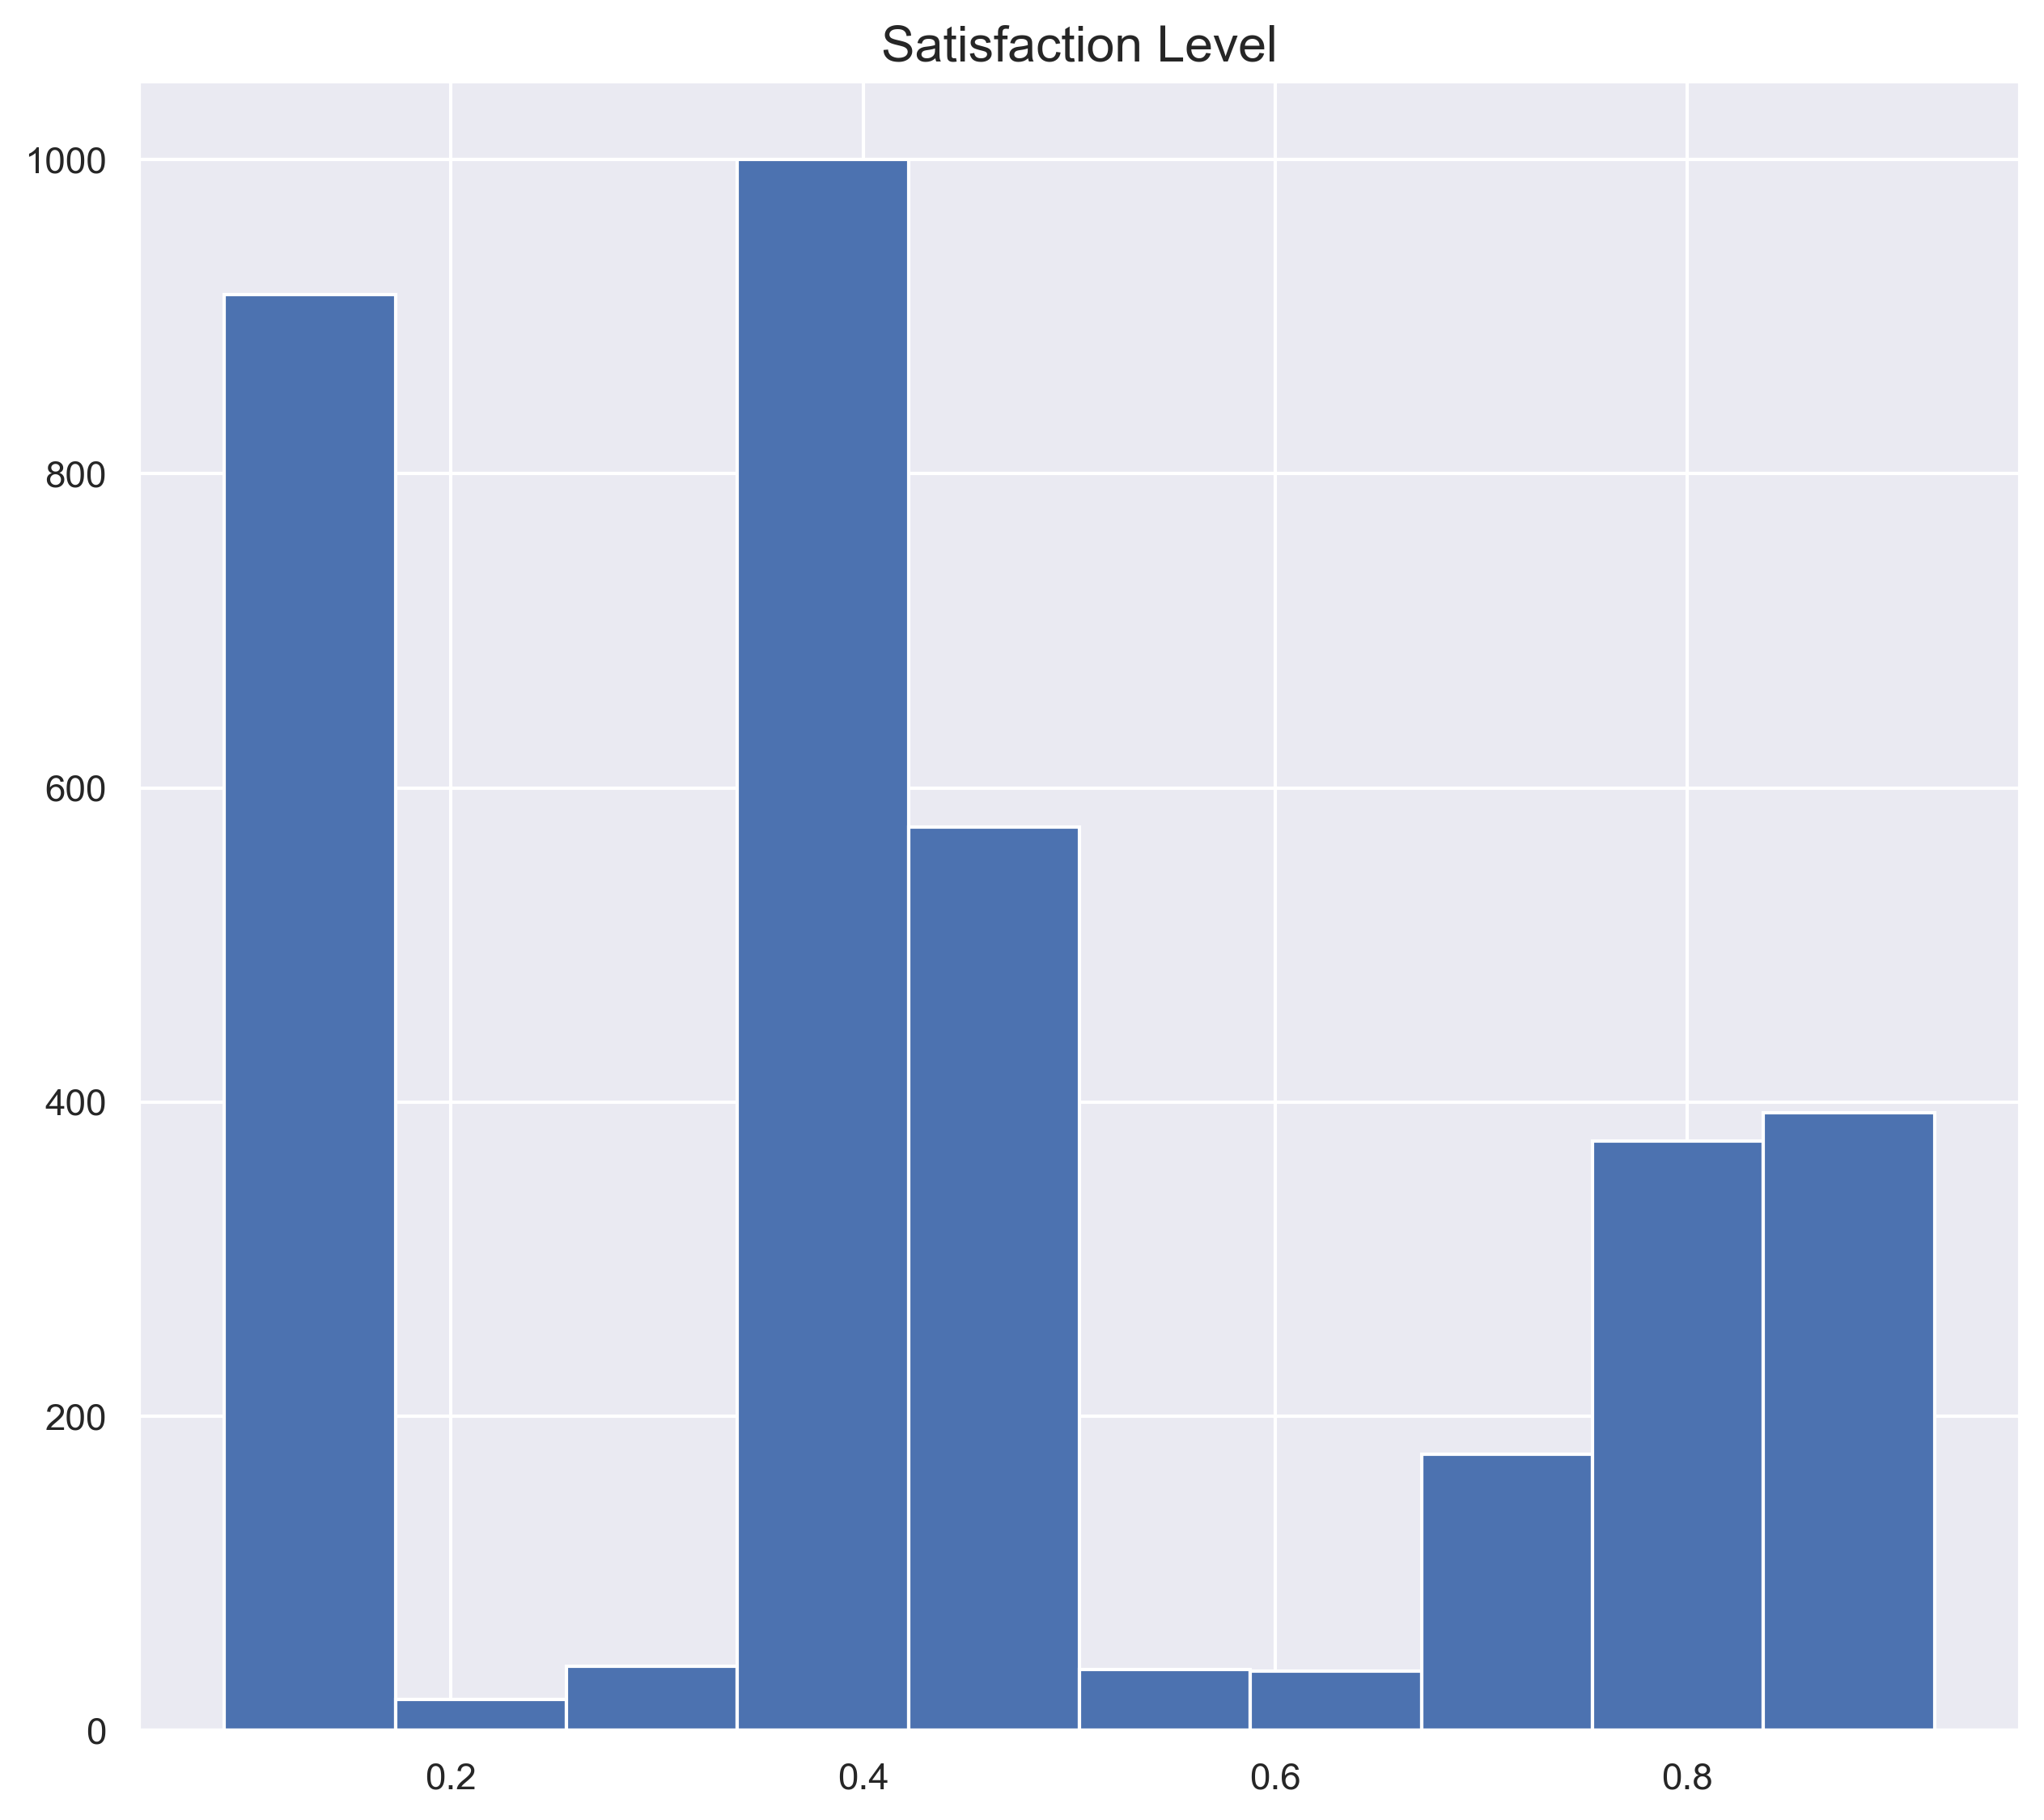
From the histogram, we can deduce that people with lower satisfaction level are more likely to leave the company.

Slide 6
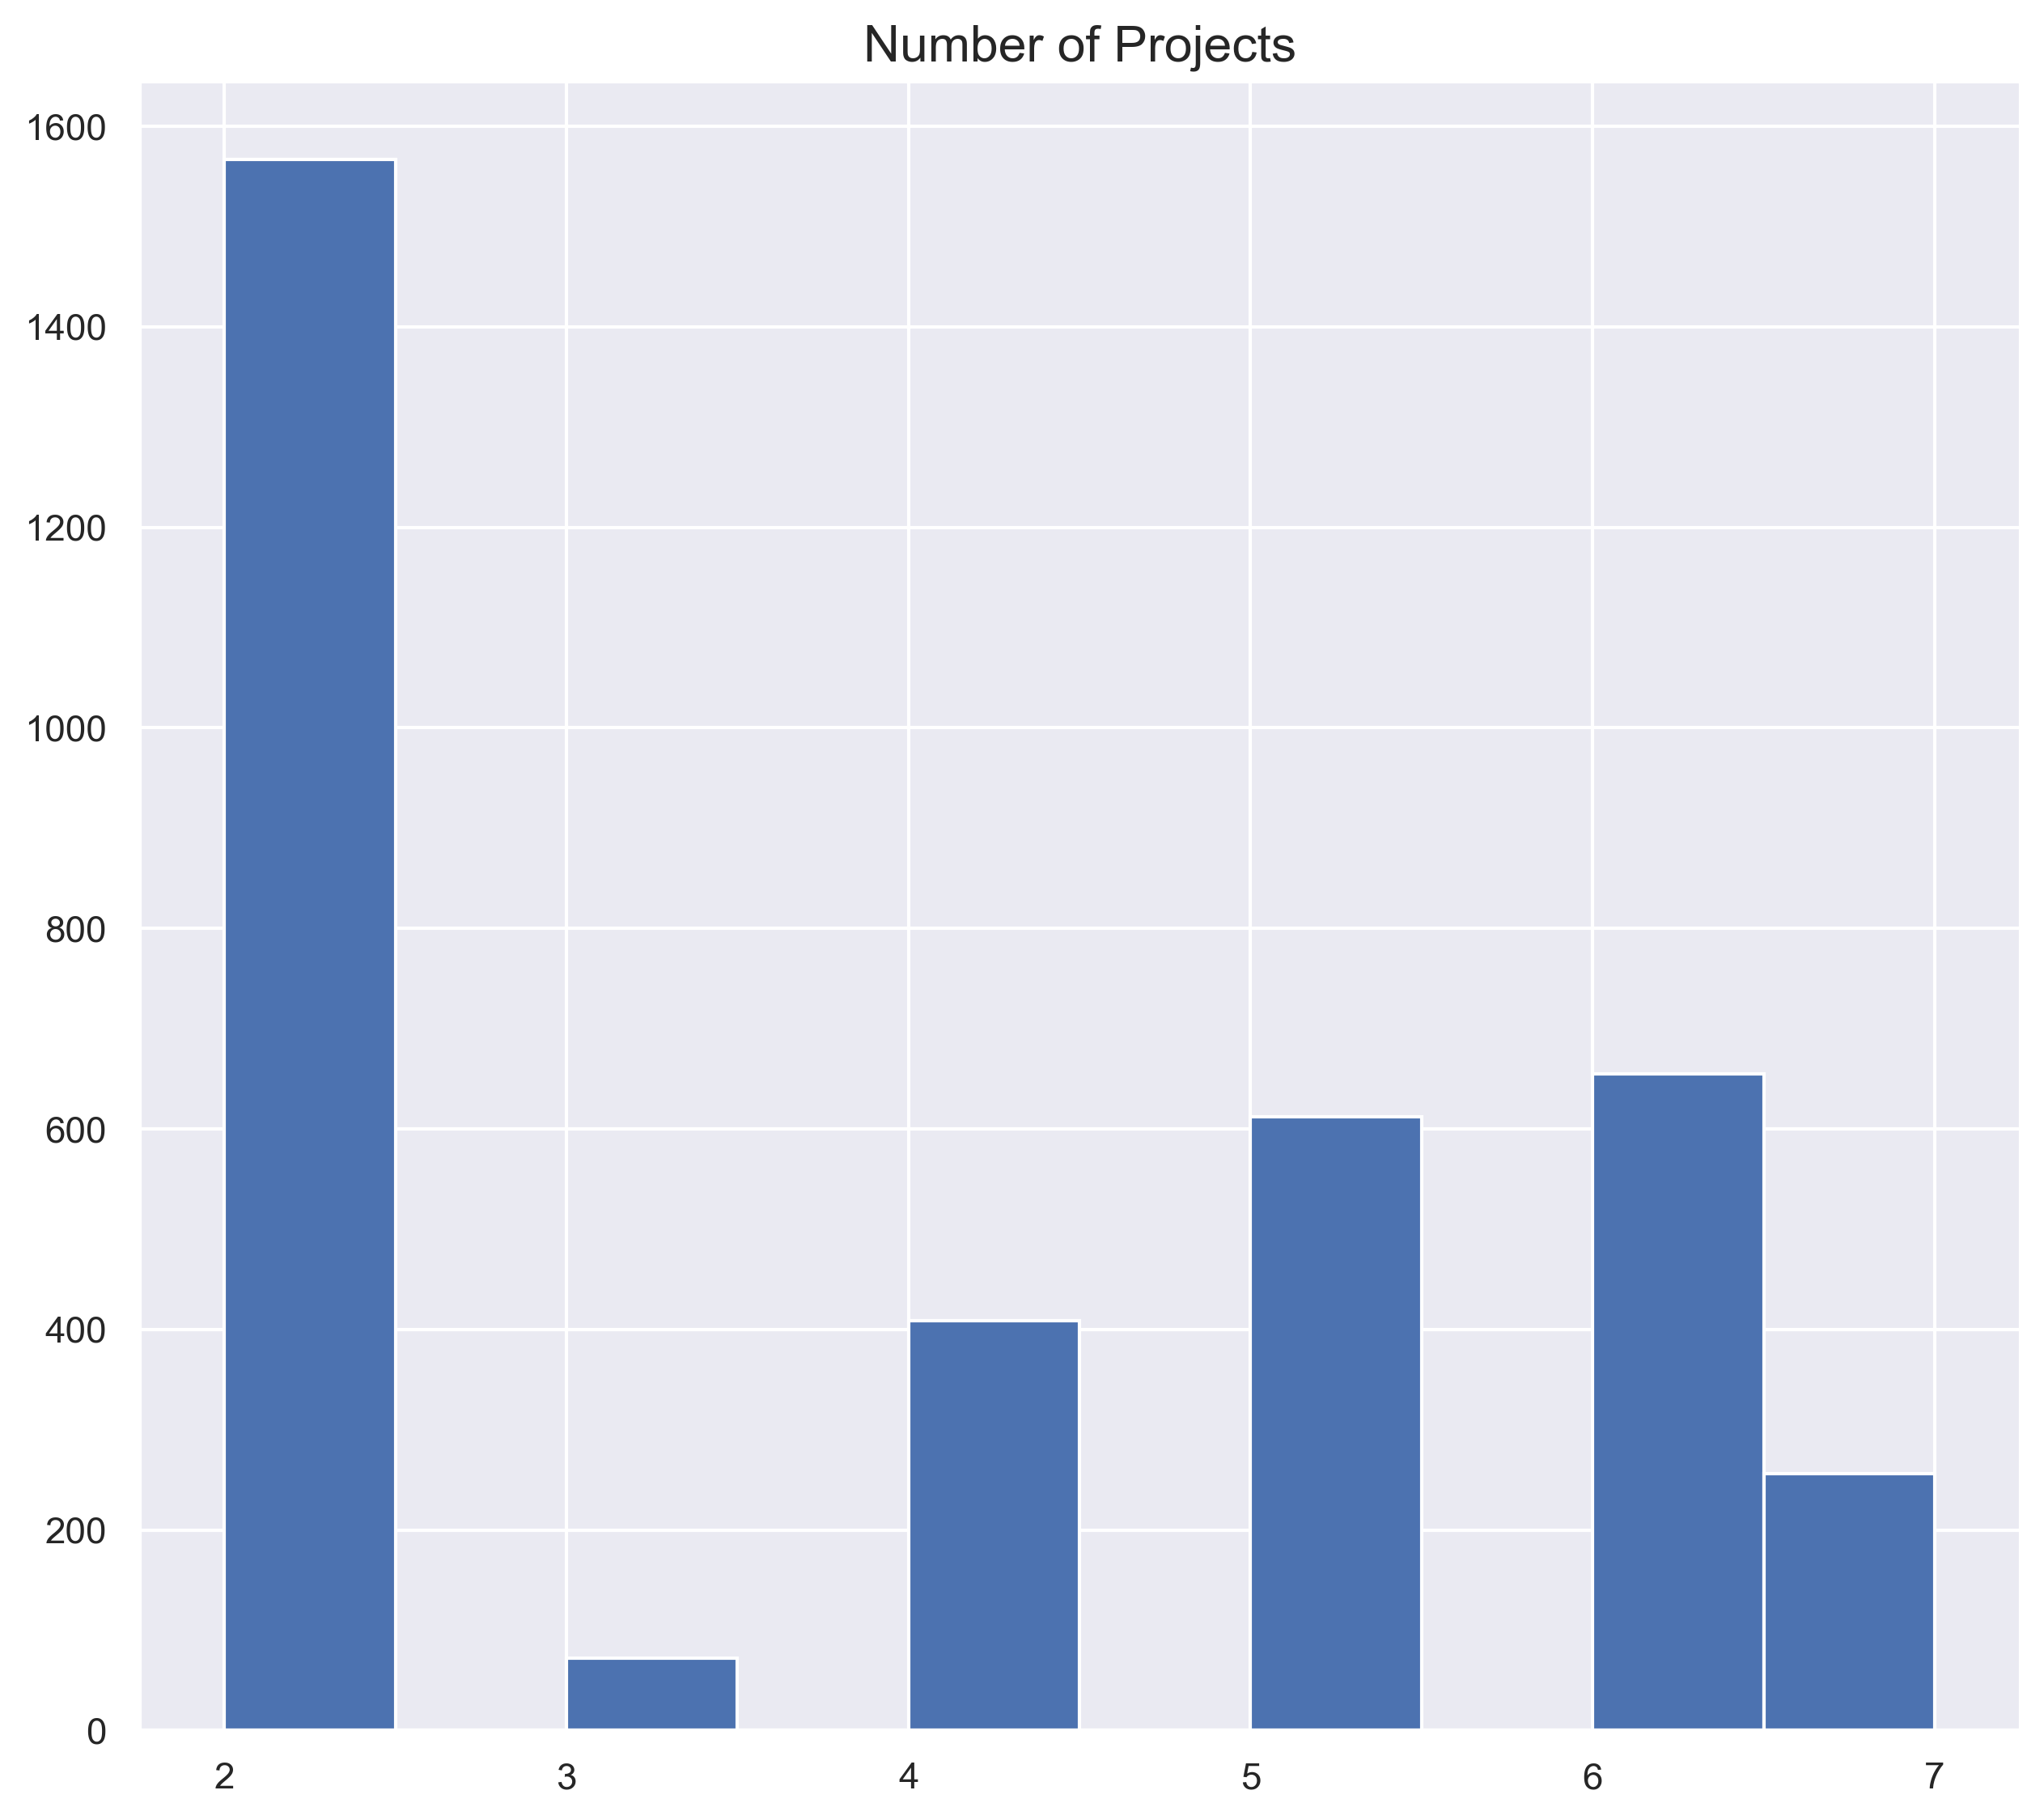
The histogram shows that people with small and big number of projects are leaving the company however, people with 2 or less projects are more likely to leave.

Slide 7
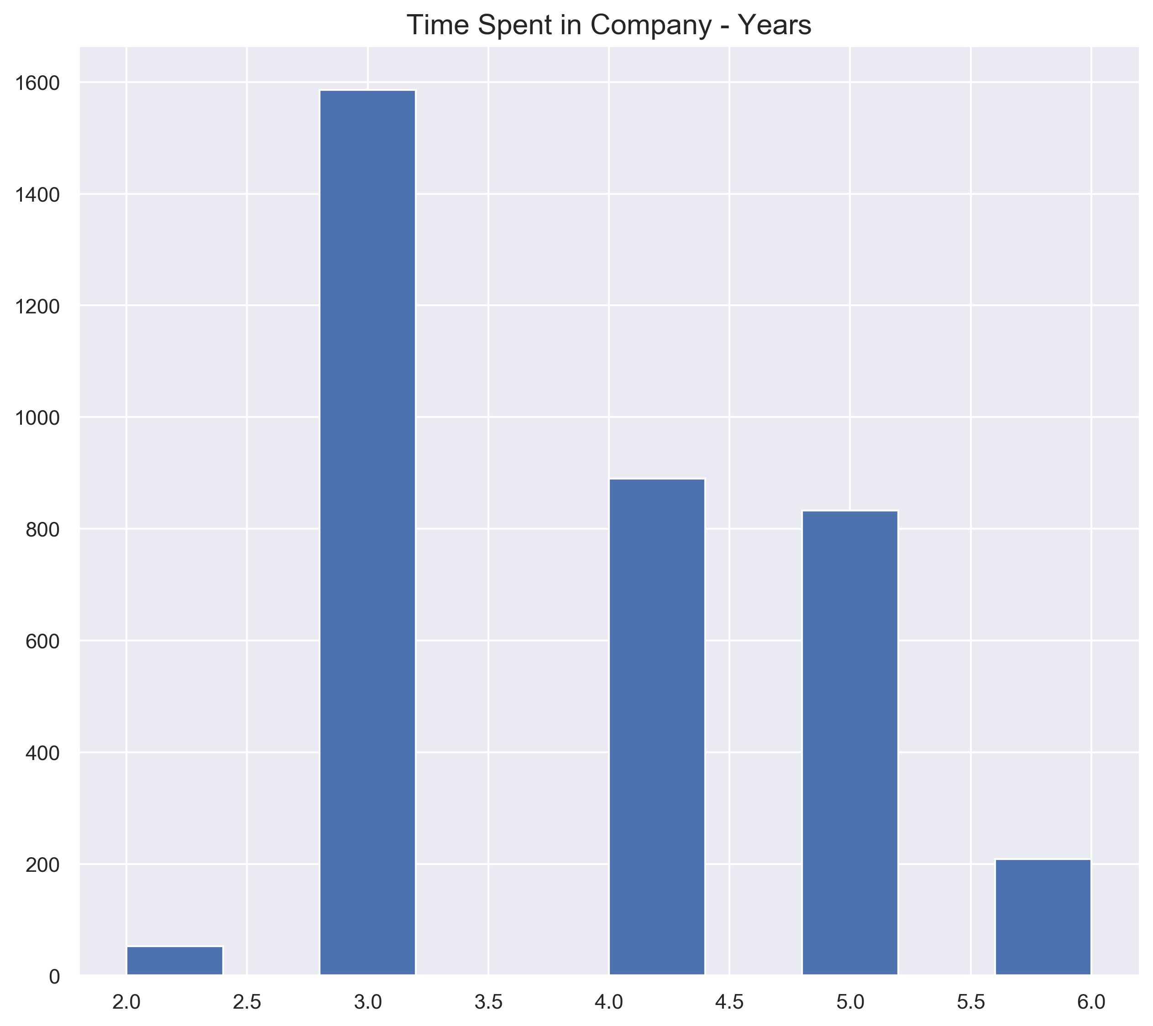
From the chart , we can see that new entrants into the company are less likely to leave, however a lot of people starts leaving the company after 3 years. Most people leaving have spent between 3-5 years at the company. The rate however goes lower as they spend more years in the company.

Slide 8
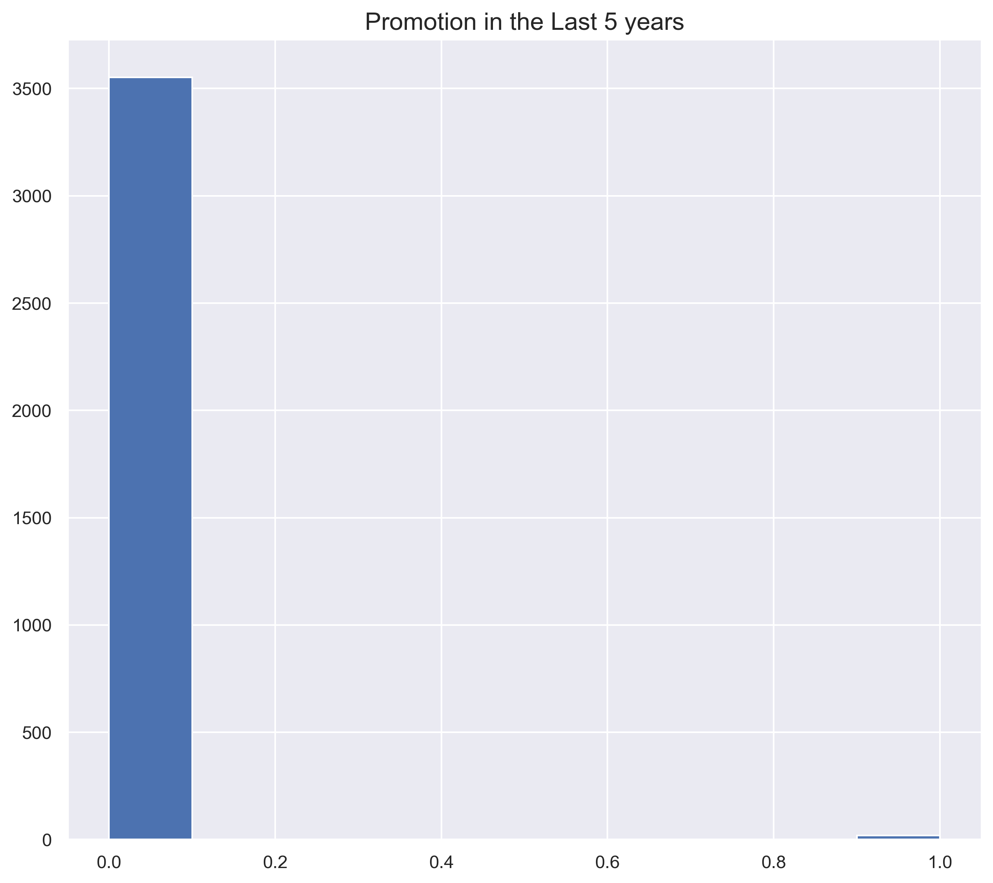
Everyone who left the company had no promotion in the last 5 years. This is a strong indication as to why people are leaving the company. Employees are likely leave a company if there's no chance for growth and advancement to seek it elsewhere.

Slide 9
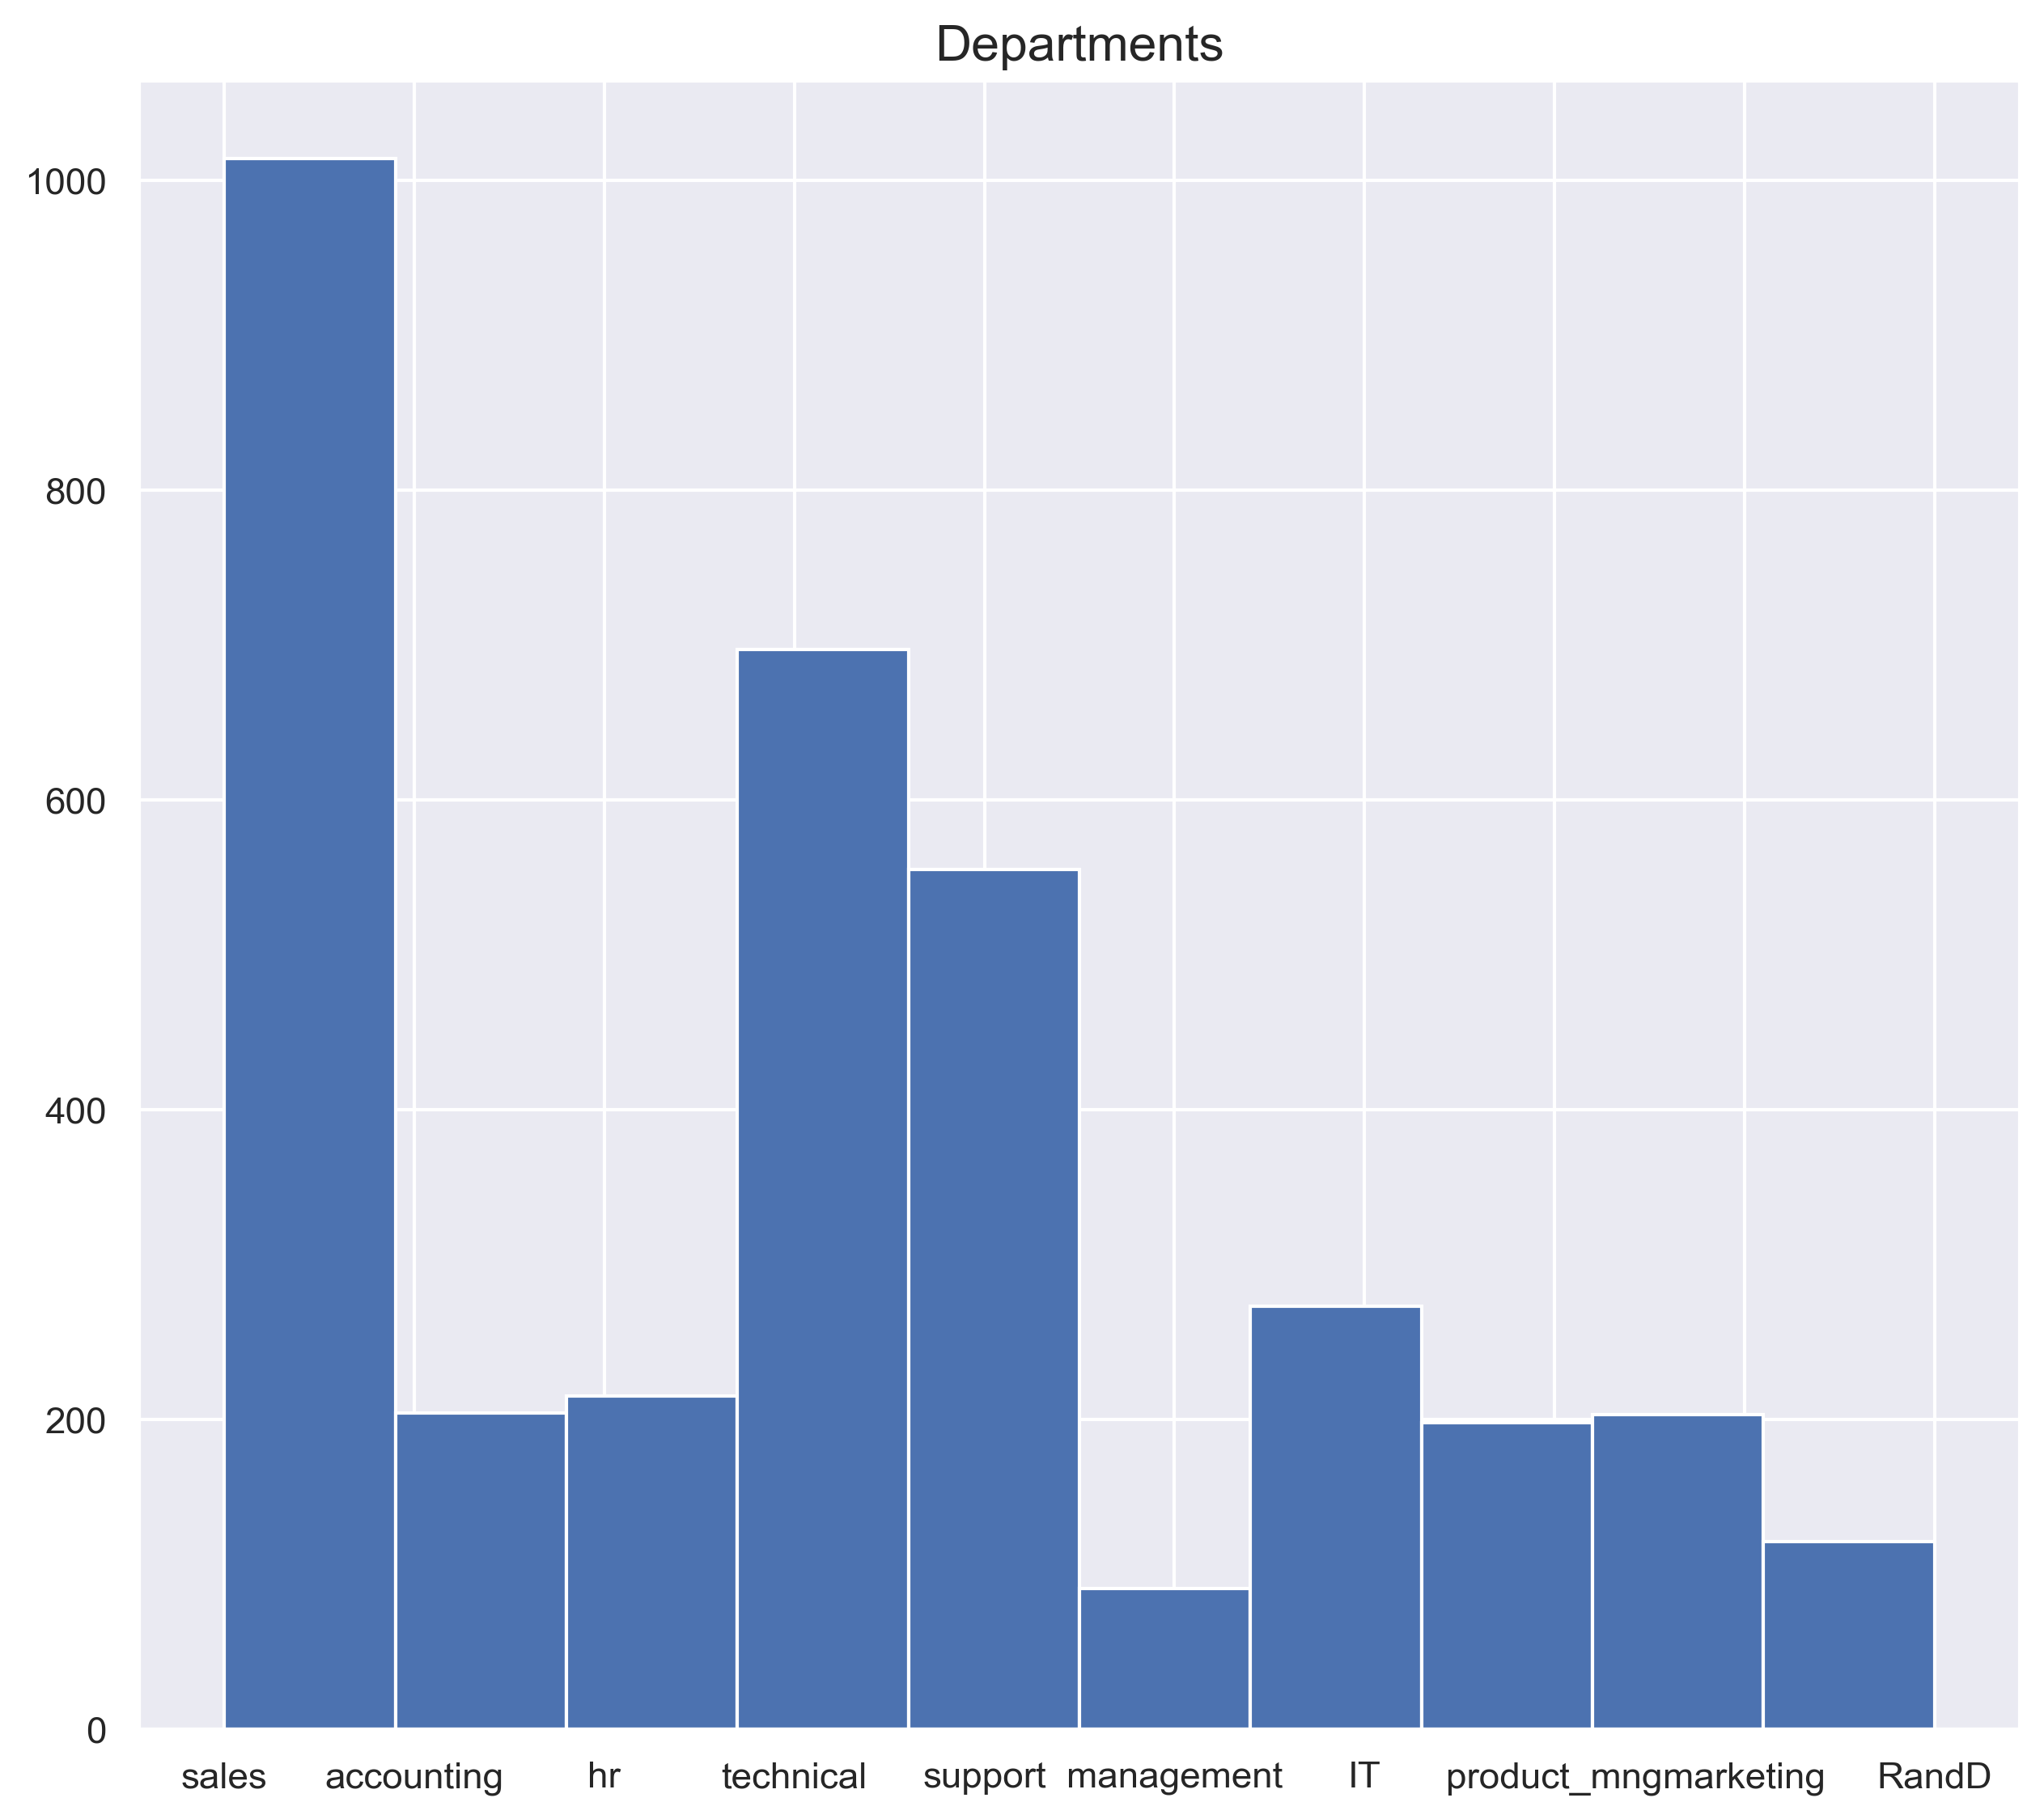
Employees are leaving from all departments however, the rate at which they leave from the various departments differs from one another. Sales has the highest rate among employees leaving while management has the lowest.

Slide 10
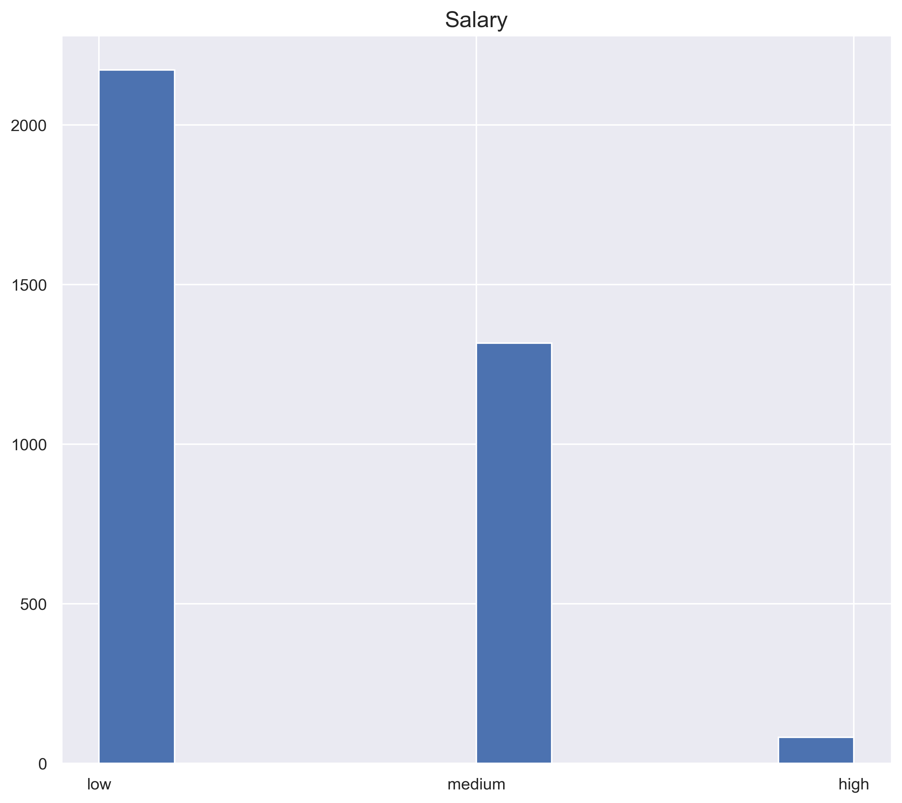
Salary seems to be another strong indication as to why people are leaving. Majority of those who left the company are being paid low salaries. The rate of people leaving diminishes as their salary increases. People with high salaries seems less likely to leave the company.

Slide 11
PREDICTING EMPlOYEES
that would leave the company

Slide 12
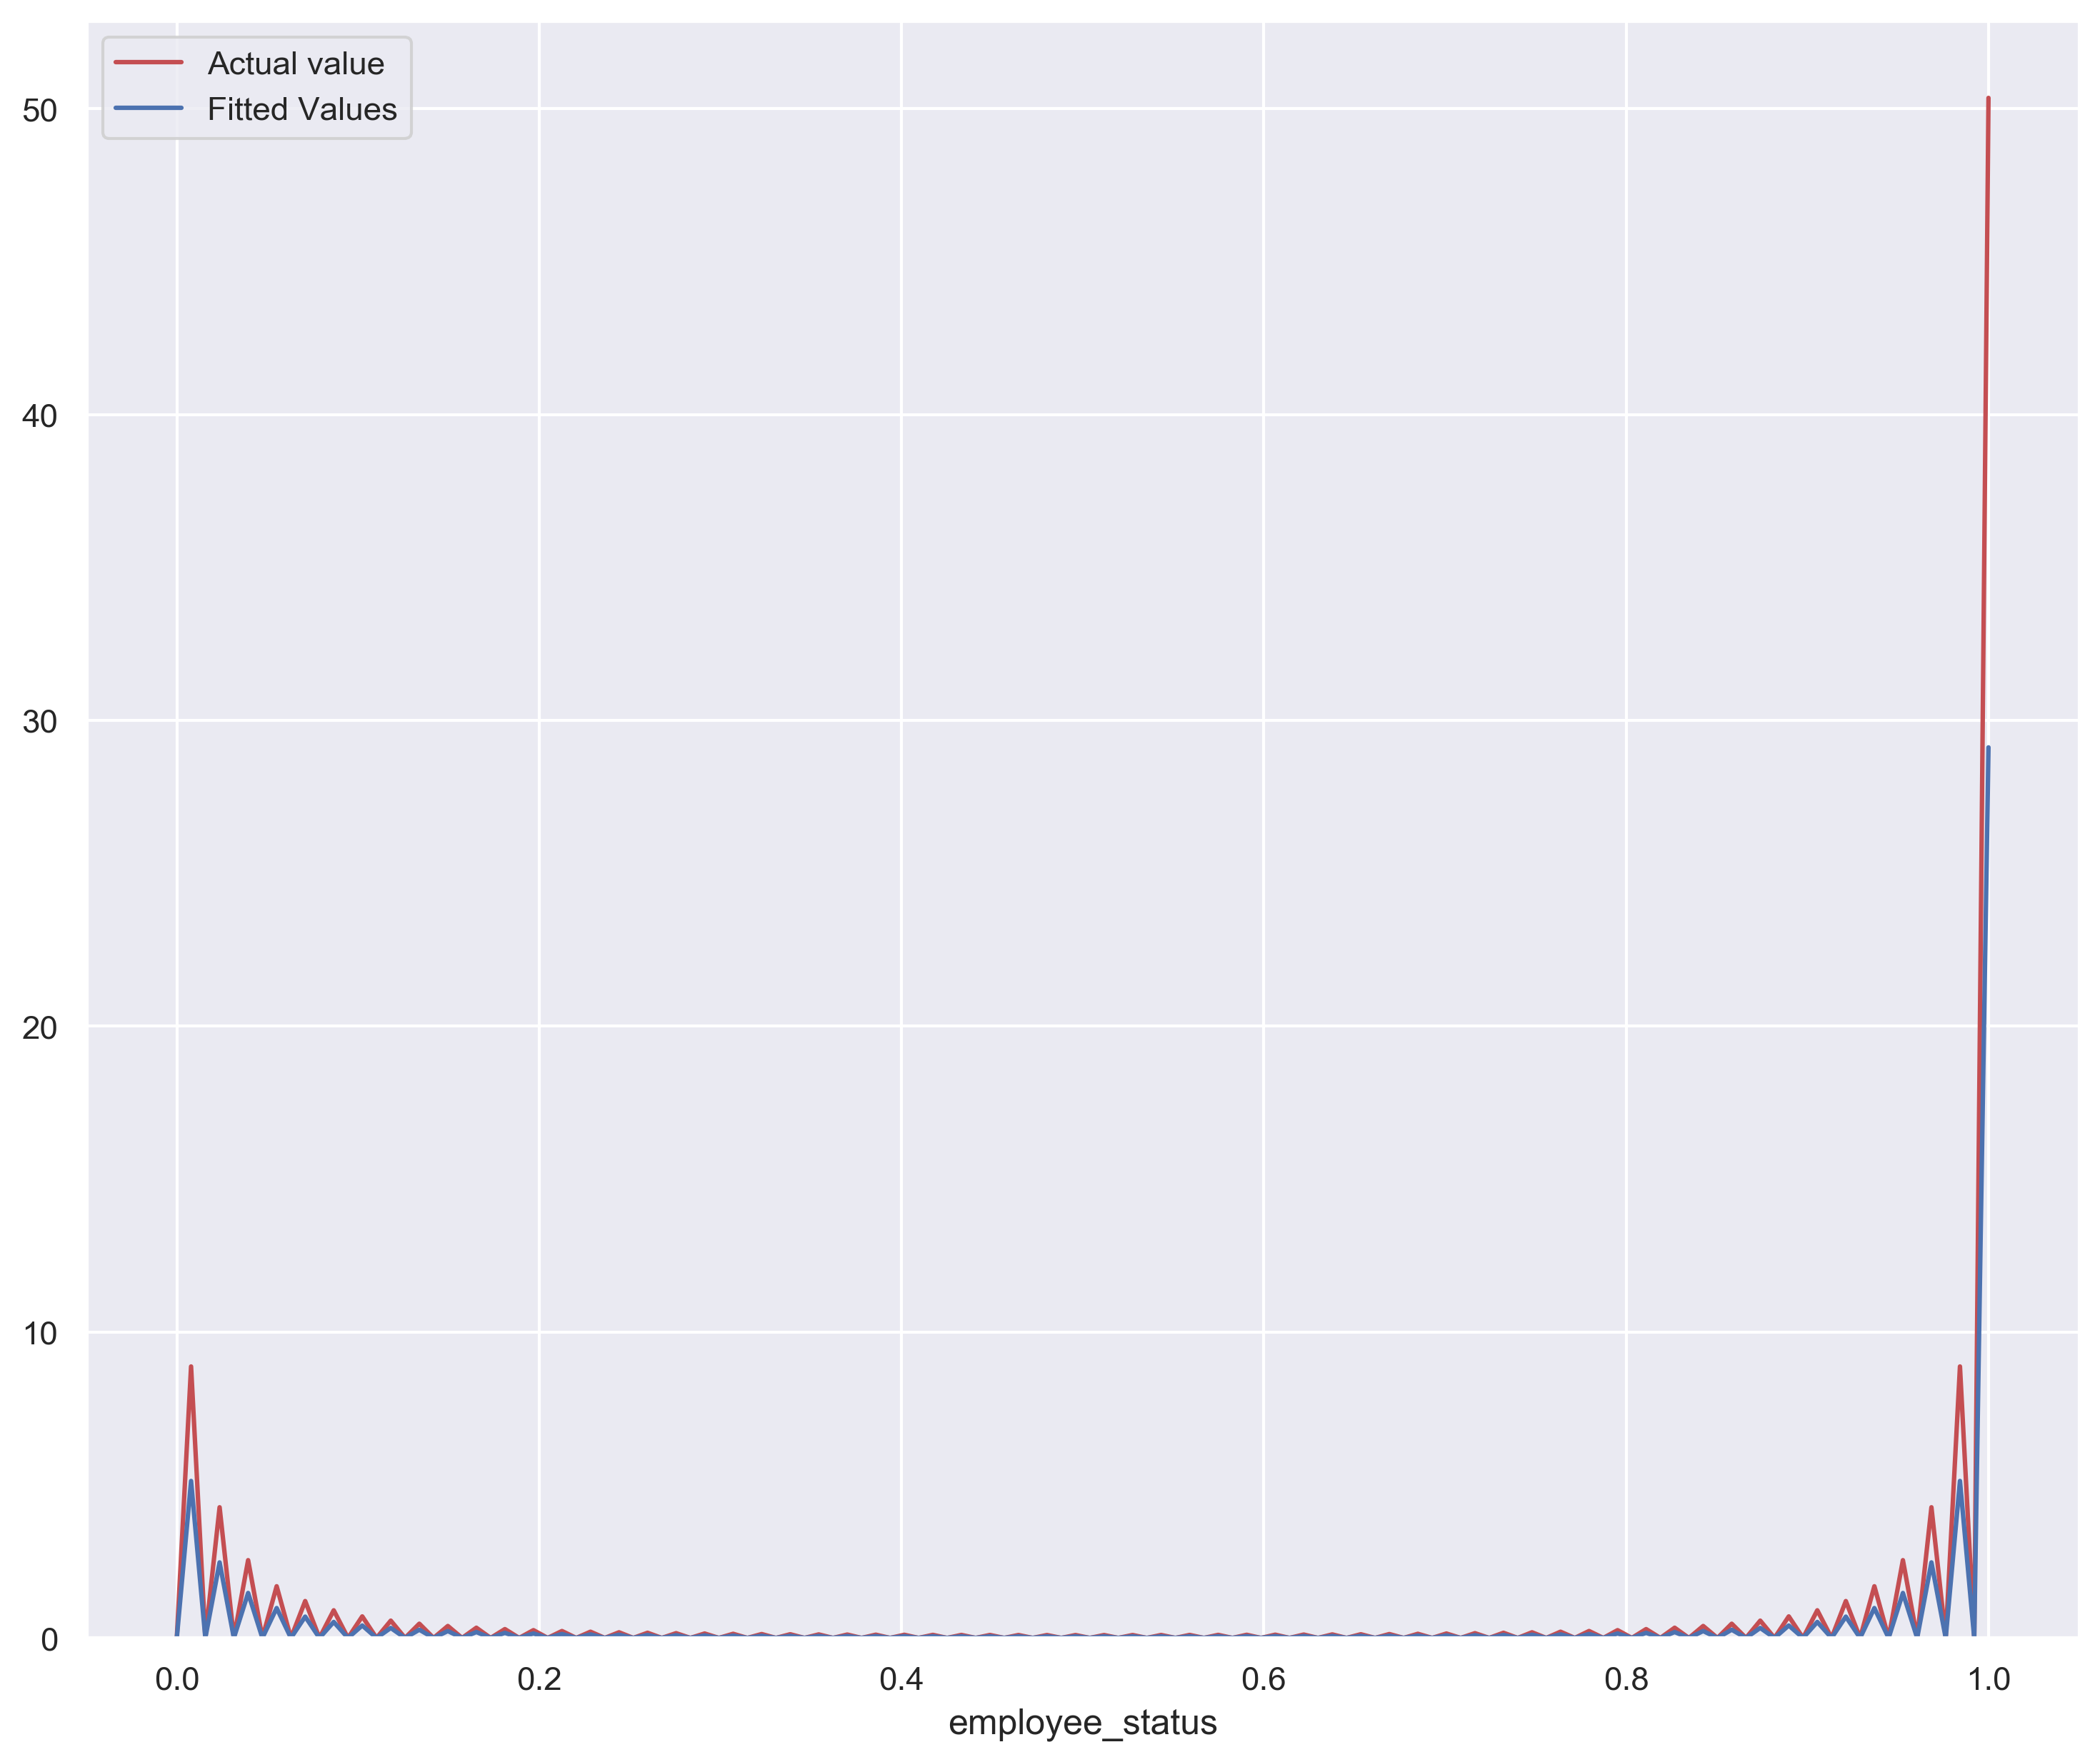
A logistic regression was used on the dataset to create a model for prediction. The model achieved an accuracy of about 80%. The input used for the model was a combination of current and ex-employess data, in order to provide the model with training data in identifying the two instances. Through this model, an output was derived that shows employees and their likelihood to leave the company.

Slide 13
Conclusion
The explorative data analysis revealed some interesting insights:
Employees with low satisfaction are more likely to leave the company
People with 2 or less projects are more likely to leave than people with higher number of projects.
Most people leaving have spent between 3-5 years at the company.
Everyone who left the company had no promotion in the last 5 years.
Sales has the highest rate among employees leaving while management has the lowest.
Majority of those who left the company are being paid low salaries. The rate of people leaving diminishes as their salary increases.

Slide 14
Recommendations
The company has to interact with employees with low satisfaction level to find out their pain points and how to make it better.
The company needs to engage their workers with more project, employees that perform the same tasks constantly will be bored and might seek excitement elsewhere.
Everyone leaving have not been promoted in the last 5 years. This could also explain why employees leave after 3 – 5 years. Employees come in with hope for growth and advancement, if they don't get it, the will seek it elsewhere. The company therefore has to promote staffs and create opportunities for growth.
The company also has to review its salaries as most employees who left were getting a low salary.

Slide 15
End of Project
Employee Attrition

