Slide 1
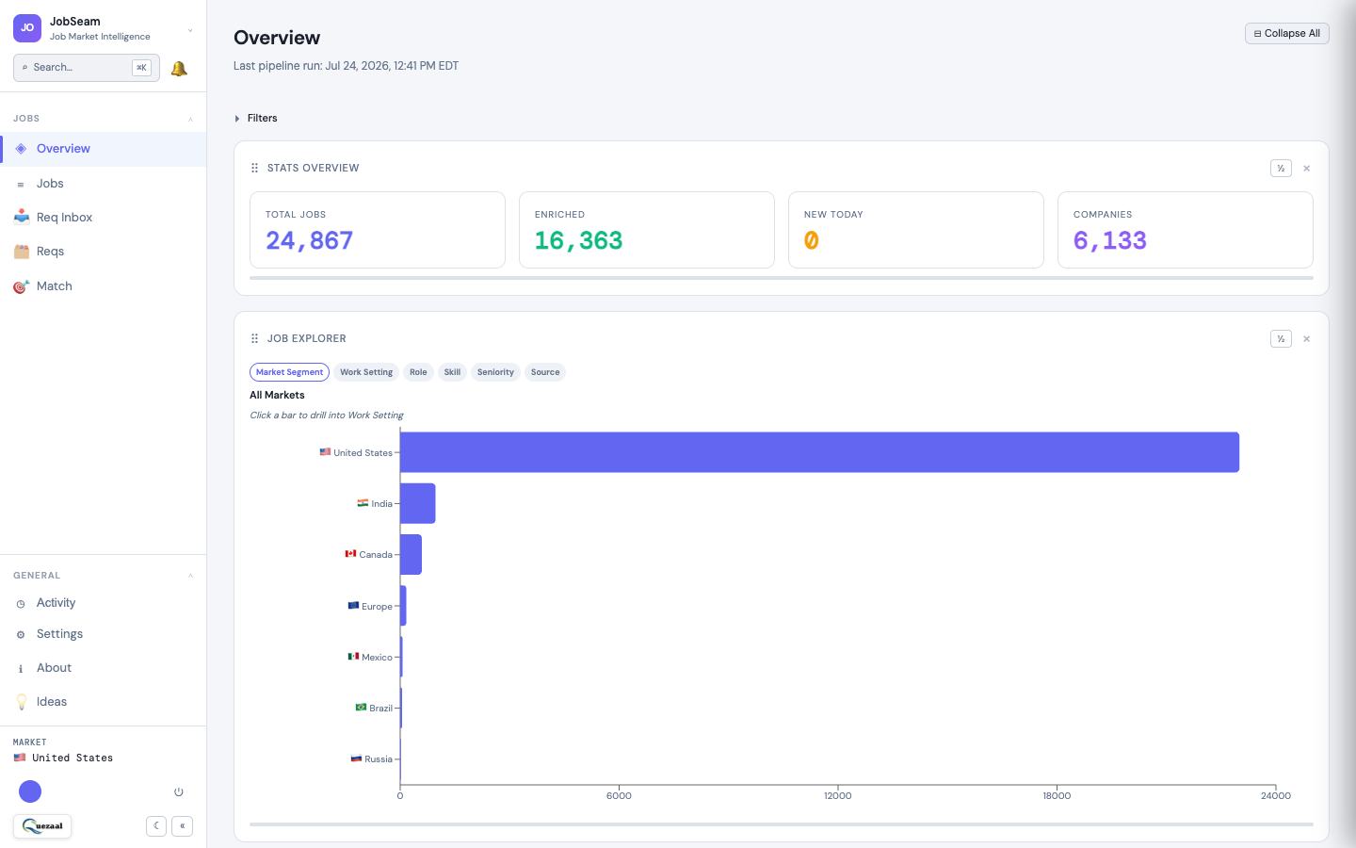
JOBSEAM · AI TALENT MATCHING PLATFORM · 2026
Match every talent to their best opportunity.
For IT staffing firms, universities placing graduates, and individuals running their own job search. One platform. Every workflow.
94%
3×
$2B+
Faster matching
More RTRs per day
Addressable market

Slide 2
THE PROBLEM
Bench sales is still running on email and spreadsheets.
THE SCALE
12,000+
IT staffing firms in North America
50
✗ 4+ hours per rep per day reading vendor email blasts
✗ Manual matching — wrong consultants sent on wrong reqs
✗ Duplicate RTRs sent to the same vendor, no record kept
✗ Zero audit trail — no compliance, no activity visibility
✗ No data on which markets, rates, or roles are performing
Vendor emails per rep per day — mostly unread
$18K
Average revenue per missed placement

Slide 3
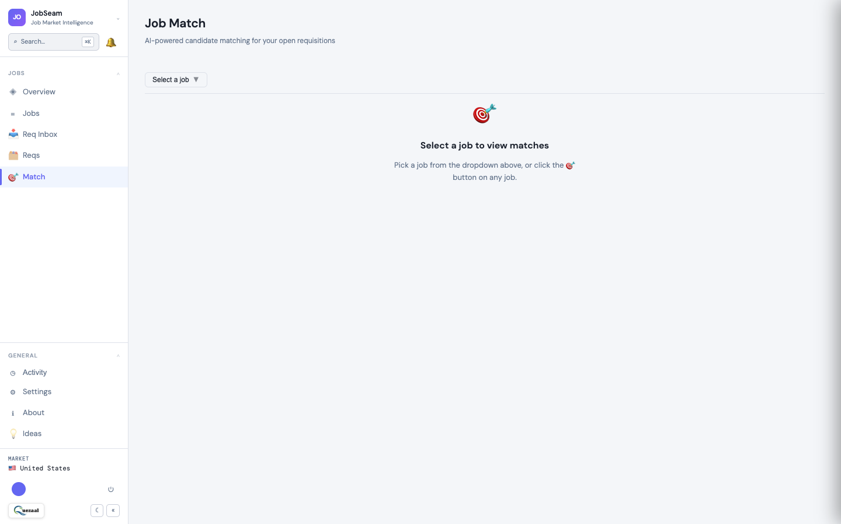
THE SOLUTION
AI scores every consultant against every req — automatically.
Exact skill matching plus semantic equivalence. Spring Boot maps to Spring Framework. Java covers J2EE. Match scores in under a second.
✓ Every consultant on your bench scored instantly
✓ Skill gaps identified before submission
✓ Visa, rate, and seniority filters applied automatically
✓ One-click RTR from the match panel, auto-logged

Slide 4
WORKFLOW
From vendor email to sent RTR in one unified flow.
📬
🤖
✅
⚡
📧
Req Arrives
AI Extracts
You Approve
Match Runs
RTR Sent
Vendor email lands in a dedicated mailbox you configure. No browser tabs, no forwarding rules.
LLM reads each email, pulls out title, skills, rate, visa. Multi-req emails split automatically.
Review in minutes. Set rules to auto-approve trusted vendors — they flow through instantly.
Every consultant on your bench scored against the req. Semantic matching, not keyword search.
One click from the match panel. Logged with timestamp, actor, and job. Full audit record.
Average time from email arrival to RTR sent: under 90 minutes (vs. 1–2 days manually)

Slide 5
PLATFORM
A complete bench sales operating system.
🤖
📬
📊
AI Job Matching
Email Req Ingestion
13-Panel Dashboard
Exact + semantic skill scoring. Seniority, rate, and visa filters built in. Works for consultants, students, and individuals alike.
Configure a mailbox. AI reads every vendor blast, extracts reqs, deduplicates. Or add jobs manually for self-service use.
Interactive drill-through panels: market, skills, seniority, source, job velocity. Click any bar to land in filtered Jobs.
🔄
📋
🎓
Talent Match Loop
Full Audit Trail
Multi-Context Platform
Advisor sees match score + gaps, flags skills to improve, talent re-uploads resume, score recalculates. Closed feedback loop.
Every scan, match, approval, and RTR logged. Timestamped, attributed, immutable. Compliance-ready.
Staffing firm, university, or solo user — same AI engine. Labels (Student, Consultant, Trainee) configurable per group.

Slide 6
WHO IT IS FOR
Three deployment contexts. One AI matching platform.
🏢 Staffing & C2C Firms
🎓 Universities & Training
🔍 Individual Job Seekers
Bench sales teams match consultants to vendor reqs. Email ingestion, AI scoring, one-click RTR, full audit trail.
Placement advisors match student cohorts to live jobs. Cohort dashboard, skill gap analysis, application tracking.
Self-service. Add target jobs, see AI match %, identify skill gaps, track every application without a spreadsheet.
📞 Bench Sales / Placement Teams
📊 Managers, Owners & Directors
✦ Talent (Any Type)
Walk in to ranked talent already scored. No inbox triage. Focus on closing.
Real-time dashboard. Full audit log. Team activity visible. Decisions backed by data.
See your AI match score. Get gap feedback from your advisor. Re-upload resume, watch score improve.

Slide 7
TRACTION
Built on real workflows. Validated by the market.
MVP
4+
10K+
94%
Full-featured v1 live in production
Cohort management phases shipped
Jobs tracked across active markets
Match speed improvement vs manual
MODULES LIVE
WHY NOW
✓ AI matching engine — exact and semantic
✓ Resume AI parsing pipeline
✓ Market job crawler across 10+ sources
✓ Consultant profiles and cohort management
✓ RTR workflow with audit logging
✓ Multi-team groups with role-based access
JobSeam was designed by people who have worked inside IT staffing firms. Every feature traces to a specific workflow pain point — not a guess about what the market needs. The product is live. We're raising to put fuel on a fire that is already lit.

Slide 8
MARKET OPPORTUNITY
Three markets. One platform with no AI-native competitor.
Bullhorn / Ceipal / JobDiva
Enterprise ATS. Expensive. No AI matching. Built for inbound hiring, not outbound bench sales.
LinkedIn Recruiter
✓ Staffing TAM: $85B — IT staffing in North America
✓ SAM: $4.2B — mid-market staffing firms (10–500 employees)
✓ Education TAM: $8B+ — training, bootcamp & university placement
✓ 15,000+ coding bootcamps, IT training institutes & university programs
✓ 12,000+ target staffing companies in North America alone
✓ No direct competitor purpose-built for AI talent matching across all three contexts
Candidate discovery, not bench matching. No vendor email integration. $12K+ per seat per year.
Spreadsheets and Email
Still the dominant system for 70% of mid-market bench sales teams. Our primary replacement.
JobSeam
AI-native. Built for bench sales. Email ingestion plus matching plus RTR plus audit. Priced for mid-market.

Slide 9
BUSINESS MODEL
Predictable SaaS. Team-level pricing, not per-seat.
Most Popular
Starter
Growth
Agency
$299/mo
$699/mo
Custom
Up to 5 sales reps · 200 consultants
Up to 15 sales reps · 1,000 consultants
Unlimited reps and consultants
· AI Job Matching
· Market Intelligence (2 markets)
· Consultant Profiles + Resume Parsing
· RTR Workflow + Audit Log
· Email Req Ingestion (1 mailbox)
· Everything in Starter
· 5 markets + custom market requests
· Email Ingestion (5 mailboxes)
· Cohort management + onboarding
· Consultant Match reverse matching
· Priority support
· Everything in Growth
· Unlimited markets + dedicated crawling
· Unlimited email mailboxes
· White-label option
· Dedicated onboarding + CSM
· SSO and API access

Slide 10
GO-TO-MARKET
Three channels. Community-led. Compounding flywheel.
📱
📧
🤝
LinkedIn and Community
LinkedIn DM Outbound
Partner and Referral
3 posts per week. Mix of pain insight, product demo clip, and use case. Engage in bench sales LinkedIn and WhatsApp groups daily.
Sales Navigator targeting: Owners and VPs at IT staffing firms, 11–200 employees. 5-message sequence. No pitch in message one.
Immigration attorneys, C2C facilitators, staffing consultants serve the same customers. 20% MRR revenue share for 12 months.
50 warm leads per month
20 demos per month
Compounding CAC reduction
M1–3
10 pilot customers · Free · Feedback loop
M4–6
30 paying customers · $30K ARR
M7–12
100 customers · $120K ARR · Growth hire
Y2
500 customers · $750K ARR · Series A

Slide 11
THE ASK
$500K seed round to reach 100 paying customers in 12 months.
WHY NOW
Macro Tailwind
H1B visa filings at record highs. C2C staffing market growing 18% year over year. Bench sizes growing faster than sales team capacity.
We have the product, the market knowledge, and the technical foundation. We need capital to move from MVP-complete to market-proven.
AI Unit Economics
LLM cost per token dropped 90% in 18 months. The unit economics for AI at scale only just became viable.
40%
30%
Sales and marketing
Engineering
Foundation Ready
The product is live. We are not raising to build an MVP. We are raising to put fuel on a fire that is already lit.
20%
10%
Customer success
Operations and reserve

Slide 12
JobSeam
The bench sales revolution starts here.
60-second demo. No setup. We show you live matches on your own consultant data.
Book a Demo
hello@jobseam.quezaal.com
A Quezaal Product

