Slide 1
K-means聚类与学习向量量化与密度聚类与层次聚类
汇报人：金益淼（32309255）

Slide 2
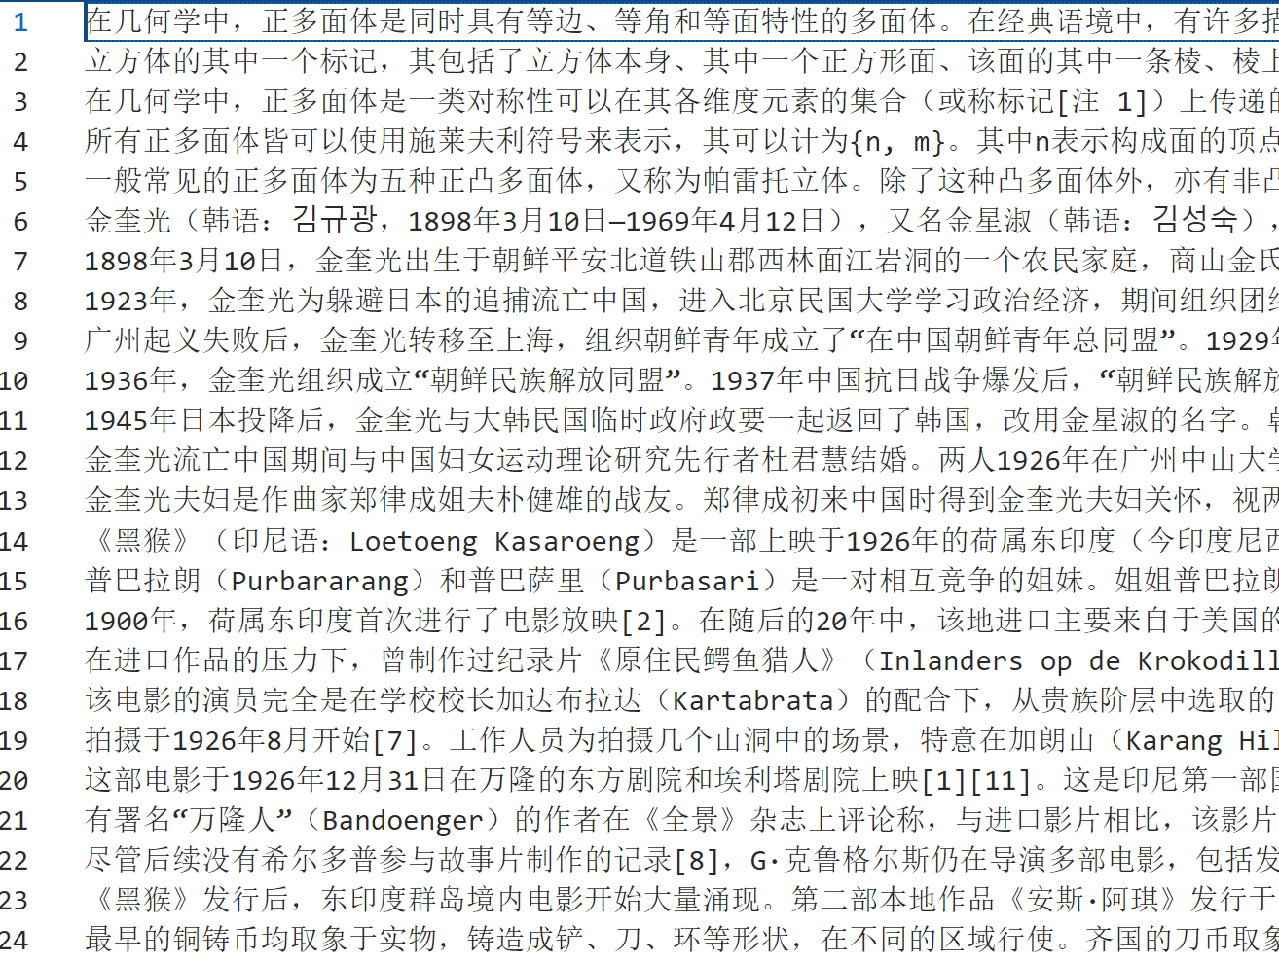
实验流程
24条由维基百科三个页面提取的段落，经由句子向量化得到384维向量
得到embeddings(24, 384)
之后所有计算均在384维度上计算，在每次可视化的时候使用UMAP算法进行降低维度。

Slide 3
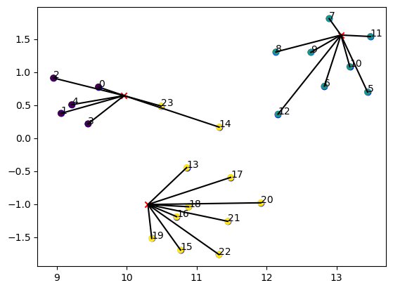
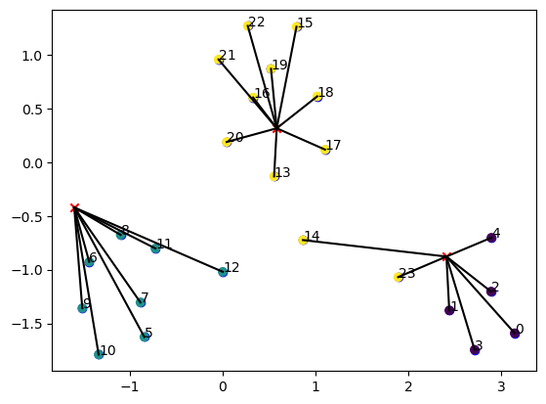
实验流程
由于UMAP每次结果是随机的，而且每次计算时处理固有24个点，还有其他的权值点需要一同计算。所有每次降维后可视化结果均不同。

Slide 4
K-means聚类
def kmeans(X, K, max_iters=100):
# 1. 随机初始化质心 centroids = X[np.random.choice(range(X.shape[0]), size=K, replace=False)] for _ in range(max_iters): # 2. 计算每个样本到每个质心的距离
distances = np.sqrt(((X - centroids[:, np.newaxis])**2).sum(axis=2))
# 3. 将每个样本分配到最近的质心
labels = np.argmin(distances, axis=0)
# 可视化 plot_clusters(np.vstack([X, centroids]), labels)
# 4. 计算新的质心
new_centroids = np.array([X[labels==k].mean(axis=0) for k in range(K)])
# 5. 检查质心是否改变
if np.all(centroids == new_centroids):
break centroids = new_centroids return labels, centroids

Slide 5
K-means聚类
def plot_clusters(embedd, label):
# 使用UMAP进行降维
reducer = umap.UMAP()
embeddings_2d = reducer.fit_transform(embedd)
# embeddings_2d = embedd
# 绘制节点 并显示ID
for i in range(LEN):
plt.scatter(embeddings_2d[i, 0], embeddings_2d[i, 1], c='blue')
plt.text(embeddings_2d[i, 0], embeddings_2d[i, 1], i)
plt.scatter(embeddings_2d[:LEN, 0], embeddings_2d[:LEN, 1], c=gualist)
# 绘制质心
plt.scatter(embeddings_2d[LEN:, 0], embeddings_2d[LEN:, 1], c='red', marker='x')
# 连接节点和质心
for i in range(LEN):
a = embeddings_2d[i]
b = embeddings_2d[LEN+int(label[i])]
plt.plot([a[0], b[0]], [a[1], b[1]], 'k-') plt.show()

Slide 6
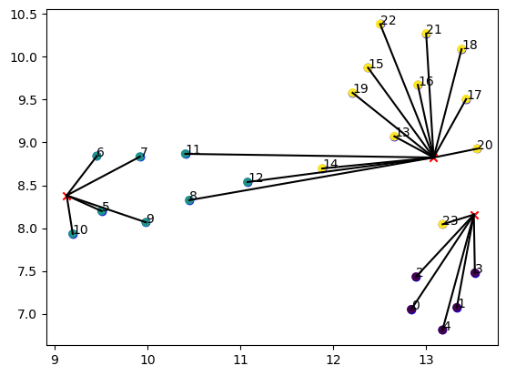
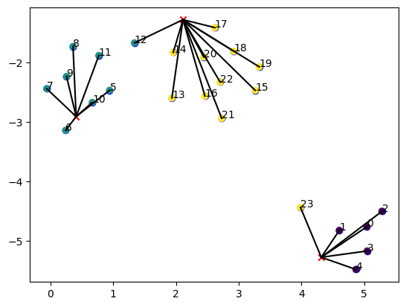
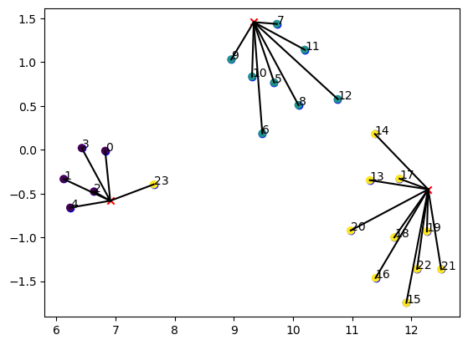
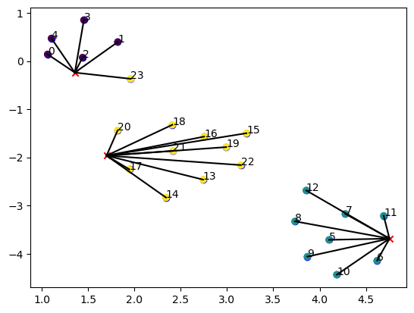

Slide 7
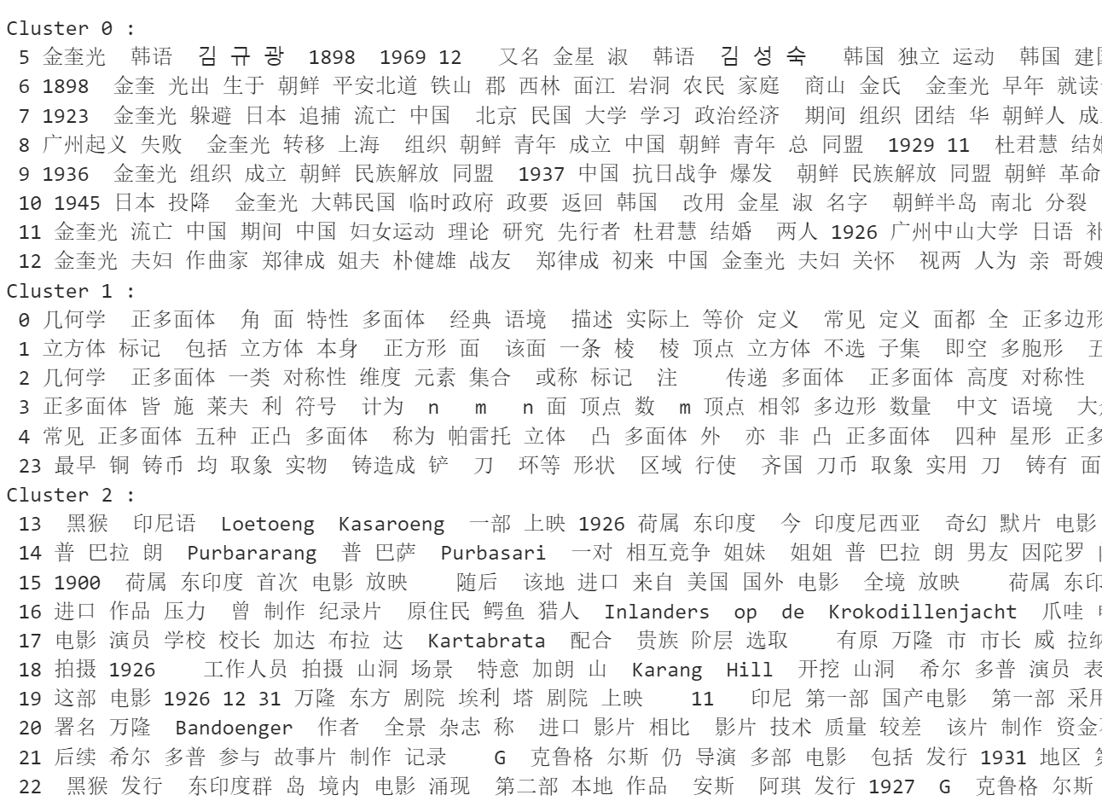

Slide 8
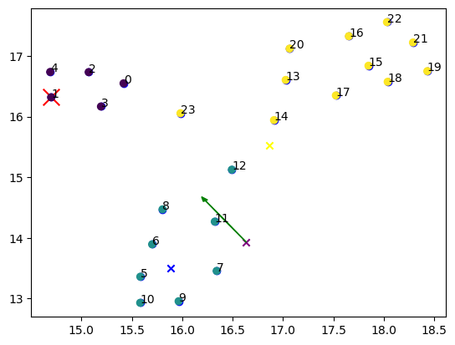
学习向量量化

Slide 9
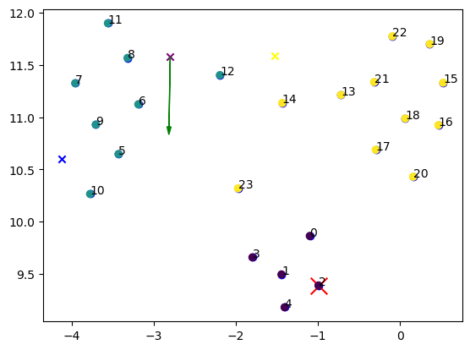

Slide 10
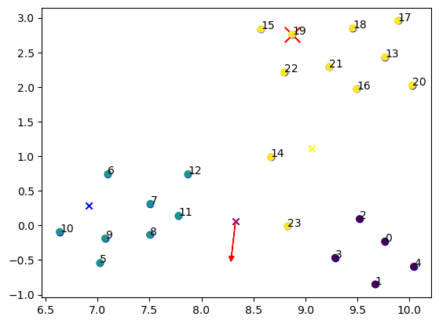
学习向量量化

Slide 11
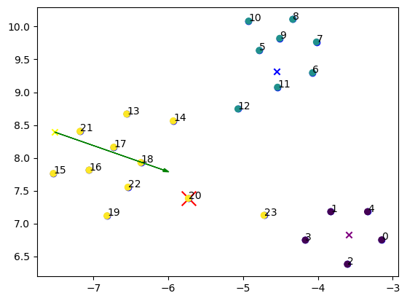
学习向量量化

Slide 12
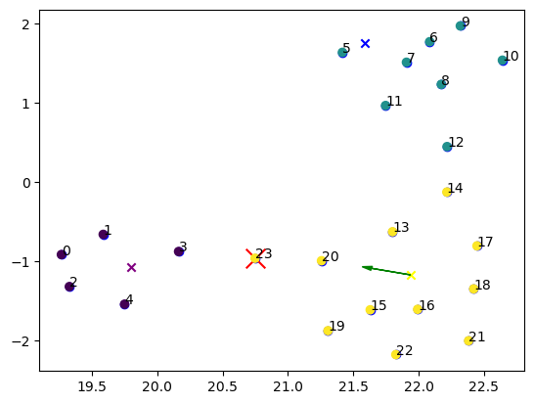
学习向量量化
10轮结果

Slide 13
def lvq_fit(embedd, label,prem_embeddings, prem_labels, n_prototypes,n_epochs, learning_rate):
prototypes = prem_embeddings
prototype_labels = prem_labels for _ in range(n_epochs):
redBot = 0
for x, l in zip(embedd, label): # 使用不同的变量名
redBot = redBot + 1
# 计算输入向量到所有原型向量的距离
distances = np.linalg.norm(prototypes - x, axis=1)
# 找到最近的原型向量
nearest_index = np.argmin(distances) temp = prototypes[nearest_index]
polarity = 0 # 如果类别相同，将原型向量向输入向量的方向调整 if l == prototype_labels[nearest_index]: # 使用新的变量名
polarity = 0
prototypes[nearest_index] += learning_rate * (x - prototypes[nearest_index])
else:
polarity = 1
prototypes[nearest_index] -= learning_rate * (x - prototypes[nearest_index])
plot_clusters(np.vstack([embedd,prototypes,prototypes[nearest_index]]), label, nearest_index, polarity,redBot) return prototypes, prototype_labels

Slide 14
# 可视化函数，对输入的LEN+4的向量进行降维，前LEN个视为节点，之后三个是向量原型，后一个是调整后的向量原型，prot表示第几个向量被调整，polarity表示调整方向。并输入一个label，是长度三十的数组，包含元素{0，1，2}表示节标签，
def plot_clusters(embedd, label, prot, polarity,redBot):
reducer = umap.UMAP()
embeddings_2d = reducer.fit_transform(embedd)
for i in range(LEN):
plt.scatter(embeddings_2d[i, 0], embeddings_2d[i, 1], c='blue')
plt.text(embeddings_2d[i, 0], embeddings_2d[i, 1], i)
if i == redBot:
plt.scatter(embeddings_2d[i, 0], embeddings_2d[i, 1], c='red',marker='x',s=200)
plt.scatter(embeddings_2d[:LEN, 0], embeddings_2d[:LEN, 1], c=gualist) # embedd第25个绘制为紫色
plt.scatter(embeddings_2d[LEN, 0], embeddings_2d[LEN, 1], c='purple',marker='x')
# embedd第26个绘制为蓝色
plt.scatter(embeddings_2d[LEN+1, 0], embeddings_2d[LEN+1, 1], c='blue',marker='x')
# embedd第27个绘制为黄色
plt.scatter(embeddings_2d[LEN+2, 0], embeddings_2d[LEN+2, 1], c='yellow',marker='x') a_protem = embeddings_2d[LEN+prot]
b_protem = embeddings_2d[-1]
plt.arrow(a_protem[0], a_protem[1], b_protem[0] - a_protem[0], b_protem[1] - a_protem[1], head_width=.05,shape='full', length_includes_head=True,color='red')

Slide 15

内蒙古大学第十次代表大会
层次聚类
层次聚类（英语：Hierarchical clustering）是一种旨在建立聚类的层次结构的聚类分析方法。层次聚类的策略通常有两种：
凝聚（Agglomerative clustering）：一种自底向上方法，从小集群开始，逐渐将其合并，形成更大的集群；
分裂（Divisive clustering）：一种自顶向下方法，从单个集群开始，递归地将其拆分成更小的集群。
凝聚和分离的操作通常用贪心算法实现，结果通常用树状图展示。

Slide 16
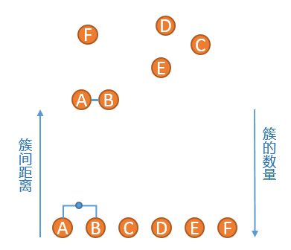
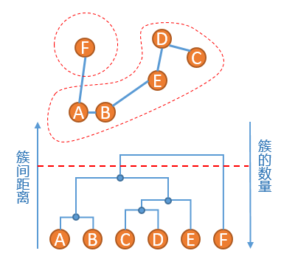
举例
对于如下数据：
1、 将A到F六个点，分别生成6个簇
2、 找到当前簇中距离最短的两个点，这里我们使用单连锁的方式来计算距离，发现A点和B点距离最短，将A和B组成一个新的簇，此时簇列表中包含五个簇，分别是{A，B}，{C}，{D}，{E}，{F}。
3、重复步骤2、发现{C}和{D}的距离最短，连接之，然后是簇{C,D}和簇{E}距离最短，依次类推，直到最后只剩下一个簇。
4、此时原始数据的聚类关系是按照层次来组织的，选取一个簇间距离的阈值，可以得到一个聚类结果。

Slide 17
# 计算所有数据点之间的距离。 # 找到距离最近的两个数据点或者数据点群。
# 合并最近的两个数据点或者数据点群。 # 重复步骤2和3，直到所有数据点都被合并到一个群中。
def compute_distances(data):
# 计算所有数据点之间的欧氏距离
distances = np.sqrt(((data[:, np.newaxis] - data)**2).sum(axis=2))
return distances def find_closest(distances):
# 找到距离最近的两个数据点
min_dist = np.inf
x, y = -1, -1
for i in range(distances.shape[0]):
for j in range(i+1, distances.shape[1]):
if distances[i][j] < min_dist:
min_dist = distances[i][j]
x, y = i, j
return x, y def plot_clusters(data, clusters, merged_cluster):
colors = ['b', 'g', 'r', 'c', 'm', 'y', 'k']
for i, cluster in enumerate(clusters):
centroid = np.mean(data[cluster], axis=0)
# 将每个点连接到质心
for point in data[cluster]:
plt.arrow(centroid[0], centroid[1], point[0]-centroid[0], point[1]-centroid[1], head_width=0.05, head_length=0.1, fc='blue', ec='blue') points = data[cluster]
plt.scatter(points[:, 0], points[:, 1], c=colors[i%len(colors)])
plt.show()

Slide 18
def hierarchical_clustering(data):
out = {}
i = 0
clusters = [[i] for i in range(data.shape[0])]
centers = [] # 初始化中心点列表
distances = compute_distances(data)
while len(clusters) > 1:
print(clusters)
out[i] = str(clusters)
out[i] = json.dumps(out[i], ensure_ascii=False)
i += 1
x, y = find_closest(distances)
distances[x] = (distances[x] + distances[y]) / 2
distances[:, x] = (distances[:, x] + distances[:, y]) / 2
distances = np.delete(distances, y, axis=0)
distances = np.delete(distances, y, axis=1)
clusters[x].extend(clusters[y])
merged_cluster = clusters[y]
center = np.mean(data[merged_cluster], axis=0) # 计算新的群集中心
centers.append(center) # 将新的群集中心添加到中心点列表中
del clusters[y]
plot_clusters(data, clusters, merged_cluster) # 绘制群集和连线
centers = np.array(centers)
return out
内蒙古大学第十次代表大会

Slide 19
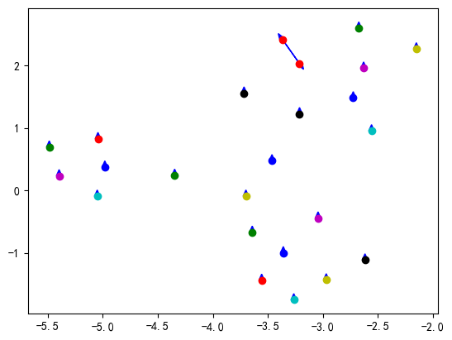
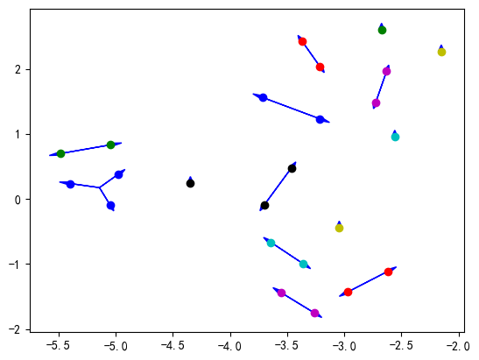
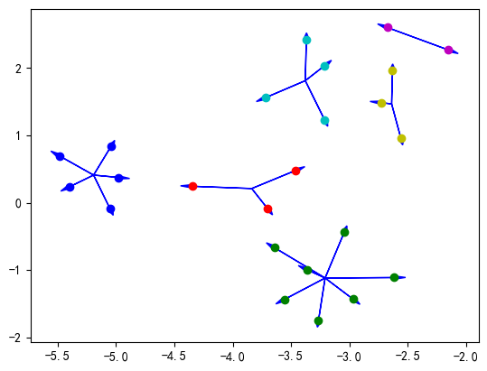
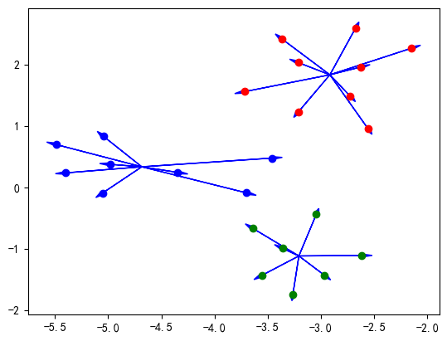

Slide 20
def plot_dendrogram(data, labels):
plt.figure(figsize=(10, 7)) # 设置图的大小
linked = linkage(data, 'single')
dendrogram(linked, orientation='top', distance_sort='descending', show_leaf_counts=True, labels=labels)
plt.xticks(rotation=90) # 旋转标签
plt.rcParams['axes.unicode_minus'] = False
plt.show()
内蒙古大学第十次代表大会

Slide 21
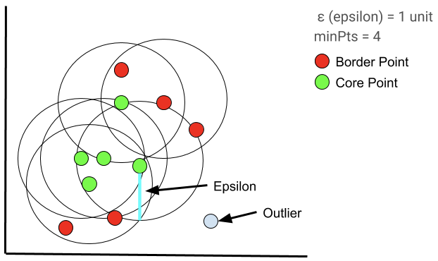

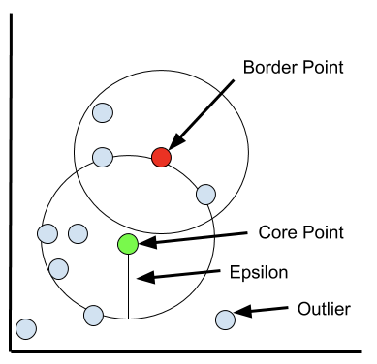
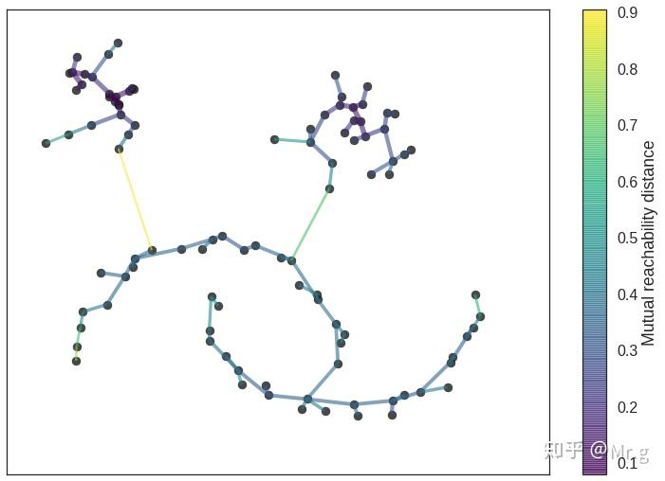
DBSCAN
Epsilon (ɛ)：DBSCAN用来确定两个点是否相似和属于同一类的距离。更大的epsilon将产生更大的簇(包含更多的数据点)，更小的epsilon将构建更小的簇。
最小点(minPts)：在一个邻域的半径内至少包含minPts数的邻域被认为是一个簇。一个较低的minPts帮助算法建立更多的集群与更多的噪声。
核心点：如果一个对象在其半径Eps内含有超过MmPts数目的点。
边界点：如果一个对象在其半径 Eps 内含有点的数量小于 MinPts，但是该对象落在核心点的邻域内。
噪音点：如果一个对象既不是核心点也不是边界点。

Slide 22
def dbscan(X, eps, minPts):
labels = [0] * len(X)
cluster = []
for i in range(len(X)):
if labels[i] != 0:
continue
neighbors = range_query(X, i, eps)
if len(neighbors) > minPts:
cluster.append(grow_cluster(X, labels, i, neighbors, len(cluster) + 1, eps, minPts,cluster))
return cluster,labels
def grow_cluster(X, labels, i, neighbors, C, eps, minPts,cluster):
out = {'core':[], 'border':[]}
labels[i] = C
out_copy = [1]
neighbors_copy = [1]
labels_copy = [1]
while out != out_copy or neighbors != neighbors_copy or labels != labels_copy:
labels_copy = labels.copy()
out_copy = out.copy()
neighbors_copy = neighbors.copy()
for i in neighbors_copy:
if labels[i] == 0:
labels[i] = C
temp = range_query(X, i, eps)
if len(temp) >= minPts:
out['core'].append(i)
neighbors += temp
# 去重并排序
neighbors = list(set(neighbors))
else:
out['border'].append(i)
return out

Slide 23
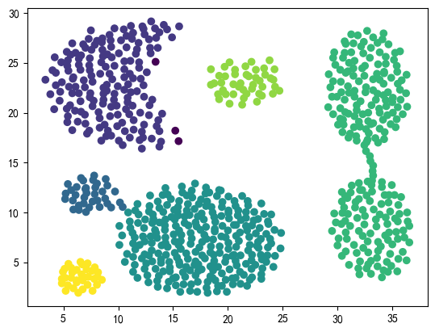

Slide 24
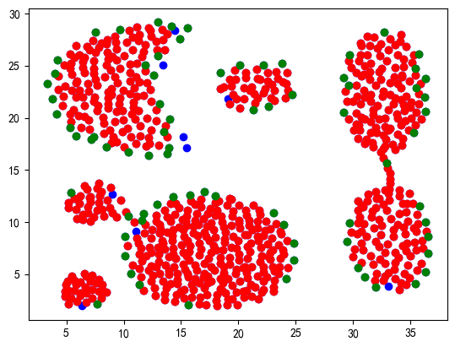

Slide 25
def plt_dbscan(X, cluster,out):
for i in range(len(X)):
if i in out['core']:
plt.scatter(X[i, 0], X[i, 1], c='red')
elif i in out['border']:
plt.scatter(X[i, 0], X[i, 1], c='green')
else:
plt.scatter(X[i, 0], X[i, 1], c='blue')
for i in range(len(cluster)):
for j in cluster[i]['core']:
plt.scatter(X[j, 0], X[j, 1], color='red')
for j in cluster[i]['border']:
plt.scatter(X[j, 0], X[j, 1], color='green')
plt.show()

Slide 26
{'core': [], 'border': [0]}
{'core': [], 'border': [0, 1]}
{'core': [], 'border': [0, 1]}
{'core': [], 'border': [0, 1, 3]}
{'core': [4], 'border': [0, 1, 3]}
{'core': [4, 5], 'border': [0, 1, 3]}
{'core': [4, 5], 'border': [0, 1, 3]}
{'core': [4, 5], 'border': [0, 1, 3]}
{'core': [4, 5], 'border': [0, 1, 3]}
{'core': [4, 5], 'border': [0, 1, 3]}
{'core': [4, 5], 'border': [0, 1, 3]}
{'core': [4, 5], 'border': [0, 1, 3]}
{'core': [4, 5], 'border': [0, 1, 3, 6]}
{'core': [4, 5, 7], 'border': [0, 1, 3, 6]}
{'core': [4, 5, 7, 9], 'border': [0, 1, 3, 6]}
{'core': [4, 5, 7, 9, 10], 'border': [0, 1, 3, 6]}
{'core': [4, 5, 7, 9, 10, 11], 'border': [0, 1, 3, 6]}
{'core': [4, 5, 7, 9, 10, 11, 12], 'border': [0, 1, 3, 6]}
{'core': [4, 5, 7, 9, 10, 11, 12], 'border': [0, 1, 3, 6]}
{'core': [4, 5, 7, 9, 10, 11, 12], 'border': [0, 1, 3, 6]}
{'core': [4, 5, 7, 9, 10, 11, 12], 'border': [0, 1, 3, 6]}
{'core': [4, 5, 7, 9, 10, 11, 12], 'border': [0, 1, 3, 6]}
{'core': [4, 5, 7, 9, 10, 11, 12], 'border': [0, 1, 3, 6]}
{'core': [4, 5, 7, 9, 10, 11, 12], 'border': [0, 1, 3, 6]}
{'core': [4, 5, 7, 9, 10, 11, 12], 'border': [0, 1, 3, 6]}
{'core': [4, 5, 7, 9, 10, 11, 12], 'border': [0, 1, 3, 6]}
{'core': [4, 5, 7, 9, 10, 11, 12, 8], 'border': [0, 1, 3, 6]}
{'core': [4, 5, 7, 9, 10, 11, 12, 8], 'border': [0, 1, 3, 6]}
{'core': [4, 5, 7, 9, 10, 11, 12, 8], 'border': [0, 1, 3, 6]}
{'core': [4, 5, 7, 9, 10, 11, 12, 8], 'border': [0, 1, 3, 6]}
{'core': [4, 5, 7, 9, 10, 11, 12, 8], 'border': [0, 1, 3, 6]}
{'core': [4, 5, 7, 9, 10, 11, 12, 8, 15], 'border': [0, 1, 3, 6]}
{'core': [4, 5, 7, 9, 10, 11, 12, 8, 15, 16], 'border': [0, 1, 3, 6]}
{'core': [4, 5, 7, 9, 10, 11, 12, 8, 15, 16, 17], 'border': [0, 1, 3, 6]}
{'core': [4, 5, 7, 9, 10, 11, 12, 8, 15, 16, 17, 18], 'border': [0, 1, 3, 6]}
{'core': [4, 5, 7, 9, 10, 11, 12, 8, 15, 16, 17, 18], 'border': [0, 1, 3, 6]}
{'core': [4, 5, 7, 9, 10, 11, 12, 8, 15, 16, 17, 18], 'border': [0, 1, 3, 6]}
{'core': [4, 5, 7, 9, 10, 11, 12, 8, 15, 16, 17, 18], 'border': [0, 1, 3, 6]}
{'core': [4, 5, 7, 9, 10, 11, 12, 8, 15, 16, 17, 18], 'border': [0, 1, 3, 6]}
{'core': [4, 5, 7, 9, 10, 11, 12, 8, 15, 16, 17, 18], 'border': [0, 1, 3, 6]}
{'core': [4, 5, 7, 9, 10, 11, 12, 8, 15, 16, 17, 18], 'border': [0, 1, 3, 6]}
{'core': [4, 5, 7, 9, 10, 11, 12, 8, 15, 16, 17, 18], 'border': [0, 1, 3, 6]}
{'core': [4, 5, 7, 9, 10, 11, 12, 8, 15, 16, 17, 18], 'border': [0, 1, 3, 6]}
{'core': [4, 5, 7, 9, 10, 11, 12, 8, 15, 16, 17, 18], 'border': [0, 1, 3, 6]}
{'core': [4, 5, 7, 9, 10, 11, 12, 8, 15, 16, 17, 18], 'border': [0, 1, 3, 6]}
{'core': [4, 5, 7, 9, 10, 11, 12, 8, 15, 16, 17, 18], 'border': [0, 1, 3, 6]}
{'core': [4, 5, 7, 9, 10, 11, 12, 8, 15, 16, 17, 18], 'border': [0, 1, 3, 6]}
{'core': [4, 5, 7, 9, 10, 11, 12, 8, 15, 16, 17, 18], 'border': [0, 1, 3, 6]}
{'core': [4, 5, 7, 9, 10, 11, 12, 8, 15, 16, 17, 18], 'border': [0, 1, 3, 6, 14]}
{'core': [4, 5, 7, 9, 10, 11, 12, 8, 15, 16, 17, 18], 'border': [0, 1, 3, 6, 14]}
{'core': [4, 5, 7, 9, 10, 11, 12, 8, 15, 16, 17, 18], 'border': [0, 1, 3, 6, 14]}
{'core': [4, 5, 7, 9, 10, 11, 12, 8, 15, 16, 17, 18], 'border': [0, 1, 3, 6, 14]}
{'core': [4, 5, 7, 9, 10, 11, 12, 8, 15, 16, 17, 18], 'border': [0, 1, 3, 6, 14]}
{'core': [4, 5, 7, 9, 10, 11, 12, 8, 15, 16, 17, 18, 19], 'border': [0, 1, 3, 6, 14]}
{'core': [4, 5, 7, 9, 10, 11, 12, 8, 15, 16, 17, 18, 19, 20], 'border': [0, 1, 3, 6, 14]}
{'core': [4, 5, 7, 9, 10, 11, 12, 8, 15, 16, 17, 18, 19, 20, 21], 'border': [0, 1, 3, 6, 14]}
{'core': [4, 5, 7, 9, 10, 11, 12, 8, 15, 16, 17, 18, 19, 20, 21, 24], 'border': [0, 1, 3, 6, 14]}
{'core': [4, 5, 7, 9, 10, 11, 12, 8, 15, 16, 17, 18, 19, 20, 21, 24, 25], 'border': [0, 1, 3, 6, 14]}
{'core': [4, 5, 7, 9, 10, 11, 12, 8, 15, 16, 17, 18, 19, 20, 21, 24, 25, 26], 'border': [0, 1, 3, 6, 14]}
{'core': [4, 5, 7, 9, 10, 11, 12, 8, 15, 16, 17, 18, 19, 20, 21, 24, 25, 26], 'border': [0, 1, 3, 6, 14]}
{'core': [4, 5, 7, 9, 10, 11, 12, 8, 15, 16, 17, 18, 19, 20, 21, 24, 25, 26], 'border': [0, 1, 3, 6, 14]}
{'core': [4, 5, 7, 9, 10, 11, 12, 8, 15, 16, 17, 18, 19, 20, 21, 24, 25, 26], 'border': [0, 1, 3, 6, 14]}
{'core': [4, 5, 7, 9, 10, 11, 12, 8, 15, 16, 17, 18, 19, 20, 21, 24, 25, 26], 'border': [0, 1, 3, 6, 14]}
{'core': [4, 5, 7, 9, 10, 11, 12, 8, 15, 16, 17, 18, 19, 20, 21, 24, 25, 26], 'border': [0, 1, 3, 6, 14]}
{'core': [4, 5, 7, 9, 10, 11, 12, 8, 15, 16, 17, 18, 19, 20, 21, 24, 25, 26], 'border': [0, 1, 3, 6, 14]}
{'core': [4, 5, 7, 9, 10, 11, 12, 8, 15, 16, 17, 18, 19, 20, 21, 24, 25, 26], 'border': [0, 1, 3, 6, 14]}
{'core': [4, 5, 7, 9, 10, 11, 12, 8, 15, 16, 17, 18, 19, 20, 21, 24, 25, 26], 'border': [0, 1, 3, 6, 14]}
{'core': [4, 5, 7, 9, 10, 11, 12, 8, 15, 16, 17, 18, 19, 20, 21, 24, 25, 26], 'border': [0, 1, 3, 6, 14]}
{'core': [4, 5, 7, 9, 10, 11, 12, 8, 15, 16, 17, 18, 19, 20, 21, 24, 25, 26], 'border': [0, 1, 3, 6, 14]}
{'core': [4, 5, 7, 9, 10, 11, 12, 8, 15, 16, 17, 18, 19, 20, 21, 24, 25, 26], 'border': [0, 1, 3, 6, 14]}
{'core': [4, 5, 7, 9, 10, 11, 12, 8, 15, 16, 17, 18, 19, 20, 21, 24, 25, 26], 'border': [0, 1, 3, 6, 14]}
{'core': [4, 5, 7, 9, 10, 11, 12, 8, 15, 16, 17, 18, 19, 20, 21, 24, 25, 26], 'border': [0, 1, 3, 6, 14]}
{'core': [4, 5, 7, 9, 10, 11, 12, 8, 15, 16, 17, 18, 19, 20, 21, 24, 25, 26], 'border': [0, 1, 3, 6, 14]}
{'core': [4, 5, 7, 9, 10, 11, 12, 8, 15, 16, 17, 18, 19, 20, 21, 24, 25, 26], 'border': [0, 1, 3, 6, 14]}
{'core': [4, 5, 7, 9, 10, 11, 12, 8, 15, 16, 17, 18, 19, 20, 21, 24, 25, 26], 'border': [0, 1, 3, 6, 14]}
{'core': [4, 5, 7, 9, 10, 11, 12, 8, 15, 16, 17, 18, 19, 20, 21, 24, 25, 26], 'border': [0, 1, 3, 6, 14]}
{'core': [4, 5, 7, 9, 10, 11, 12, 8, 15, 16, 17, 18, 19, 20, 21, 24, 25, 26], 'border': [0, 1, 3, 6, 14]}
{'core': [4, 5, 7, 9, 10, 11, 12, 8, 15, 16, 17, 18, 19, 20, 21, 24, 25, 26], 'border': [0, 1, 3, 6, 14]}
{'core': [4, 5, 7, 9, 10, 11, 12, 8, 15, 16, 17, 18, 19, 20, 21, 24, 25, 26], 'border': [0, 1, 3, 6, 14]}
{'core': [4, 5, 7, 9, 10, 11, 12, 8, 15, 16, 17, 18, 19, 20, 21, 24, 25, 26], 'border': [0, 1, 3, 6, 14]}
{'core': [4, 5, 7, 9, 10, 11, 12, 8, 15, 16, 17, 18, 19, 20, 21, 24, 25, 26], 'border': [0, 1, 3, 6, 14, 22]}
{'core': [4, 5, 7, 9, 10, 11, 12, 8, 15, 16, 17, 18, 19, 20, 21, 24, 25, 26, 23], 'border': [0, 1, 3, 6, 14, 22]}
{'core': [4, 5, 7, 9, 10, 11, 12, 8, 15, 16, 17, 18, 19, 20, 21, 24, 25, 26, 23], 'border': [0, 1, 3, 6, 14, 22]}
{'core': [4, 5, 7, 9, 10, 11, 12, 8, 15, 16, 17, 18, 19, 20, 21, 24, 25, 26, 23], 'border': [0, 1, 3, 6, 14, 22]}

Slide 27
感谢聆听

