Slide 1
[UNPROMPTED] · MARCH 2026
Why Most ML Vulnerability Detection Fails
(And What Actually Worked for Kernel Bugs)
Jenny Guanni Qu · AI Researcher, Pebblebed Ventures
125,183
20 yrs
@GuanniQu
pebblebed.com/blog/kernel-bugs
bug-fix pairs
of kernel history
pebblebed.com
1 / 10

Slide 2
THE DATASET
The largest labeled vulnerability dataset. Built for free.
The kernel community's Fixes: tag convention created 125K labeled bug-fix pairs with perfect temporal provenance — and zero annotation cost.
125,183
labeled bug-fix pairs
commit de788b2e6227
Author: Florian Westphal <fw@strlen.de>
netfilter: ctnetlink: fix refcount leak
Fixes: d205dc40798d ("netfilter: ctnetlink: ...")
^^^^^^^^^^^^
Bug-introducing commit (Aug 2006)
0
human annotation cost
28%
Temporal split: Train ≤2022 · Val 2023 · Test 2024
No data leakage. Model must predict the future.
of fix commits have Fixes: tags
The other 72% are unlabeled
Jenny Guanni Qu · Pebblebed Ventures
2 / 10

Slide 3
EMPIRICAL FINDINGS
What 125,000 bugs reveal about kernel security
5.0 yr
Race conditions hide 2x longer than deadlocks
Non-deterministic. Don't crash — silently corrupt state. Even KCSAN can only flag races it observes.
3x
CI infrastructure > code quality
gpu/i915: 1.4yr avg (dedicated fuzzing, super-reviewers). drivers/can: 4.2yr avg (niche, few eyes). Same kernel.
6x
5AM commits: 32% vuln rate vs 5.1% at 11AM
Saturday is riskiest day (9.55%). Sunday safest (6.99%). Process around the code matters as much as the code.
"The bugs that survive longest are the ones that don't crash."
Jenny Guanni Qu · Pebblebed Ventures
3 / 10

Slide 4
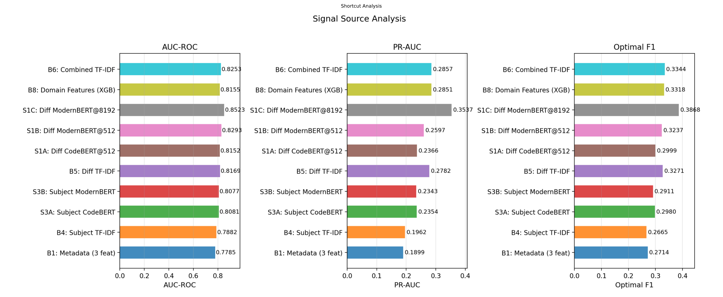
METHODOLOGY
Before training any neural model, I built 9 ways to cheat.
The bar: B6 Combined TF-IDF = 0.825 AUC. Bag of words. No neural network. If your model can't beat this, it's a fancy tokenizer.
Jenny Guanni Qu · Pebblebed Ventures
4 / 10

Slide 5
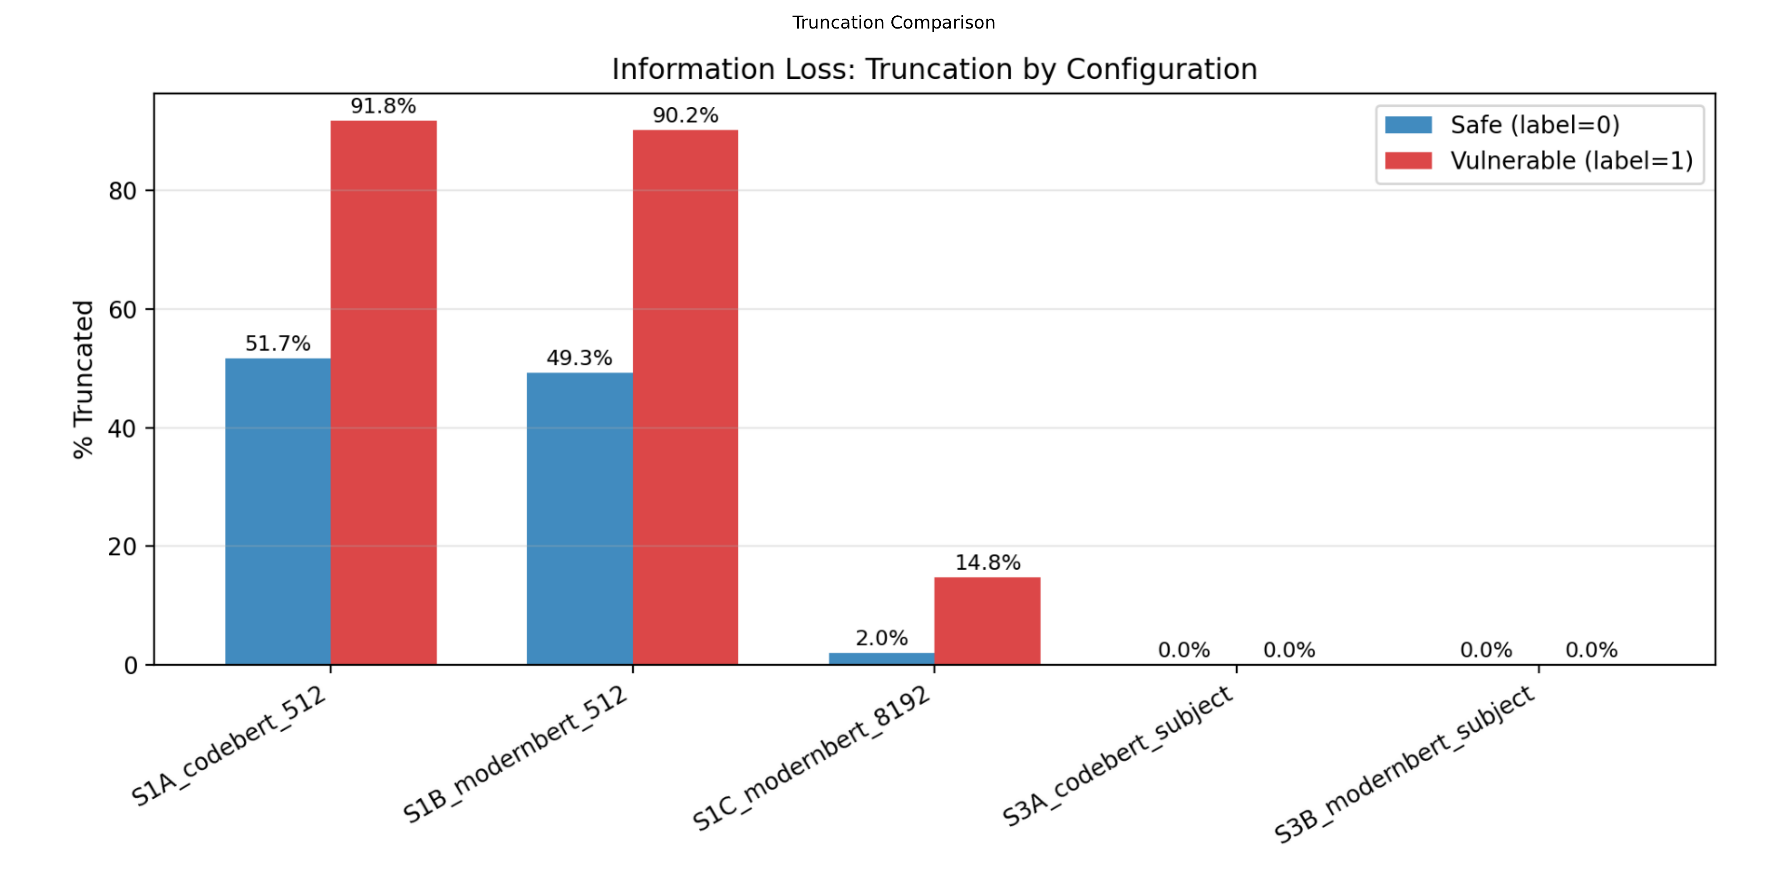
CONTROL EXPERIMENT
At 512 tokens, transformers read messages — not code.
THE S3A CONTROL
S1A: CodeBERT on diffs @512
AUC: 0.815
S3A: CodeBERT on subjects only
AUC: 0.808
Delta: 0.007
The code added almost nothing.
But at 8,192 tokens: ModernBERT achieves 0.852 AUC. Truncation drops from 91.8% → 14.8% for vulnerable commits.
Context length — not architecture — unlocks code understanding.
Jenny Guanni Qu · Pebblebed Ventures
5 / 10

Slide 6
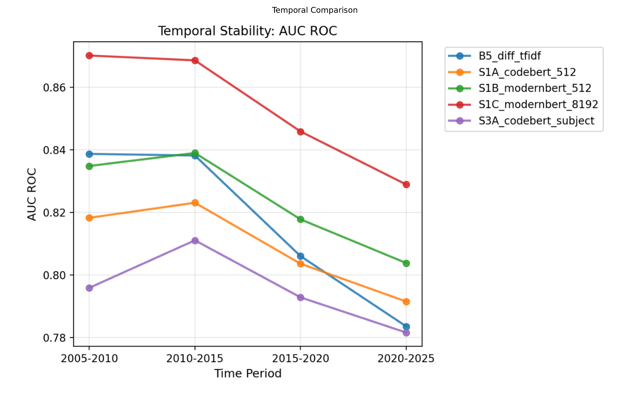
NOVEL FINDING
Vulnerability patterns have a shelf life.
EVERY MODEL DEGRADES
XGBoost (hand-engineered):
0.874 → 0.809 (old → recent)
ModernBERT (neural):
0.870 → 0.829 (degrades less)
IMPLICATION
Every detection approach — ML classifier, LLM agent, static analysis rule — has a shelf life. Vulnerability patterns evolve. If you're not retraining on recent data, your detector is degrading right now.
Jenny Guanni Qu · Pebblebed Ventures
6 / 10

Slide 7
THE CEILING
What diff-level classification fundamentally can't see.
COMMIT d205dc40798d · Aug 2006 · netfilter
MODEL SCORE
// Fix deadlock: remove put() call
- nf_conntrack_put(&last->ct_general);
+ last = NULL;
continue;
// But this get() still exists:
nf_conntrack_get(&ct->ct_general);
// get() without matching put()
// → refcount leak → memory never freed
// → discovered 19 years later (Aug 2025)
0.51
Coin flip.
The vulnerability is what's MISSING
A removed put() with no replacement. Every feature says 'fine.'
Requires whole-program reasoning
Need to trace refcount state across the entire function call graph.
This is information-theoretic, not a model problem
No amount of architecture will detect absent operations from a diff alone.
Jenny Guanni Qu · Pebblebed Ventures
7 / 10

Slide 8
TAKEAWAYS
Three things to take home.
1
Build adversarial baselines before you build models.
Diff size alone = 0.779 AUC. Bag of words = 0.825. If your neural model can't substantially beat these, you've learned commit size, not vulnerability patterns. This applies to every paper and product in this space.
2
Where you look matters more than how you look.
drivers/can: 4.2yr average bug lifetime. gpu/i915: 1.4yr. Same kernel, same language. The difference is fuzzing infrastructure and reviewer coverage. Point your tools at the subsystems nobody is watching.
3
The hardest bugs don't crash.
Race conditions hide 5 years. Refcount leaks persist for decades. LLM-based crash-finding is exciting — but the bugs that survive longest silently corrupt state. That's a different problem requiring a different approach.
Jenny Guanni Qu · Pebblebed Ventures
8 / 10

Slide 9
WHAT'S NEXT
Classification on diffs has a ceiling. What comes next?
WHAT WE HAVE
WHAT WE NEED
Classify commits as security-relevant
Recognize patterns in fix commits
Triage existing changes
0.860 AUC on temporal test set
→
Find unknown vulnerabilities before anyone
Reason about absent operations
Understand code across function boundaries
Active exploration, not passive classification
The next step: incorporating the context that exists around commits.
Review discussions on LKML. Related changes across the codebase. The temporal graph of how code evolves. Commits don't exist in isolation — and neither should our analysis of them.
That's what we're building at Pebblebed.
Jenny Guanni Qu · Pebblebed Ventures
9 / 10

Slide 10
"The hard problem is detecting what isn't there."
125K bugs · 20 years
0.860 AUC overall
Every model degrades on recent code
Dataset huggingface.co/datasets/pebblebed/kernel-vuln-dataset
Code github.com/quguanni/kernel-archaeology
Blog pebblebed.com/blog/kernel-bugs
Blog Pt2 pebblebed.com/blog/kernel-bugs-part2
Jenny Guanni Qu
@GuanniQu · quguanni.com
Talk to me about: the benchmark problem · cross-project generalization · ML-guided fuzzing
pebblebed.com
10 / 10

