Slide 1
Basics of Options Pricing & Valuation
Notes:
Hypothesis Test:
1.先猜后证：小概率事件发生的概率很低！
假设检验： 检验总体！

Slide 2
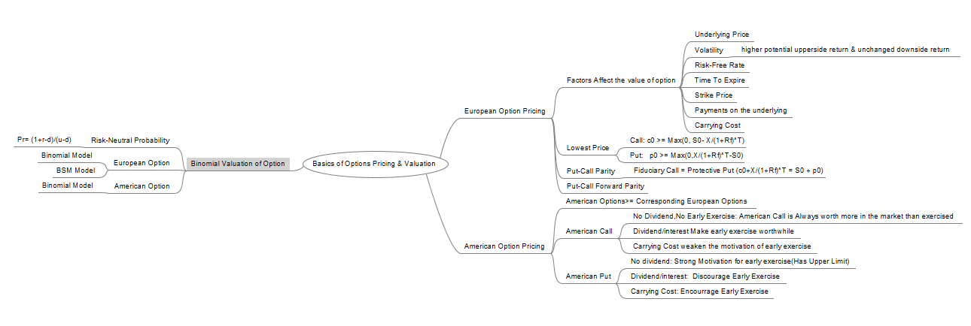
MindMap

Slide 3


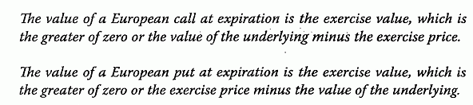
Value of European Option at Exp
Value(call option at expiration) = Exercise Value/Intrinsic Value
Value (put option at expiration) = Exercise Value/Intrinsic Value

Slide 4
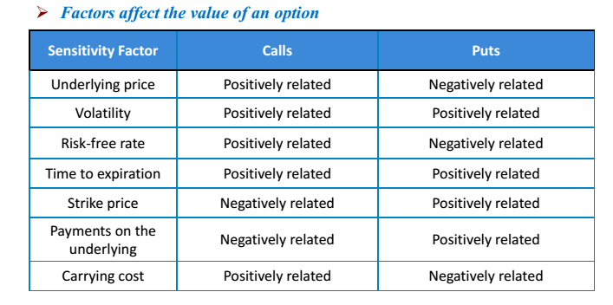
Factors Affect Option Price

Slide 5
Factors - Volatility
Higher Volatility => More Extreme Value of the Underlying
Case 1: Higher Value of Underlying at Expiration, Higher Payoff of call option at Expiration
Expiring more in the money is better than less in the money. (>)
Case 2: Lower Value of Underlying at Expiration, Remain 0 payoff of call option at Expiration
Expiring more out of money is not worse than less out of money.(=) => Higher Volatility => Better Payoff at expiration

Slide 6


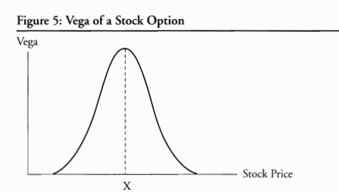
Factors – Volatility(2)
Greek Letters Of Option (FRM)

Slide 7



Factors – Risk Free Rate
Opportunity Cost:
When interest rates are higher call options prices are higher
A call option can be looked at as the right to delay a purchase.
when IR (interest rates) are higher opportunity costs of holding money is higher. By using call options investors save more money by not paying for the underlying until later date and earn higher interest meanwhile.
When interest rates are higher put options prices are lower
A put option can be looked at as the right to delay a sale.
when IR are higher opportunity costs of waiting is higher because investors lose more interest while waiting to sell the underlying when using puts.
BSM Formula:

Slide 8
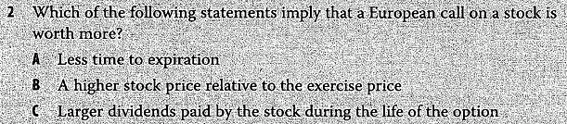
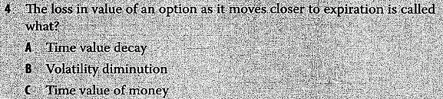
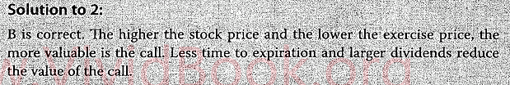
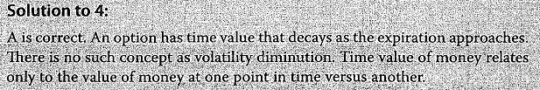
Example

Slide 9
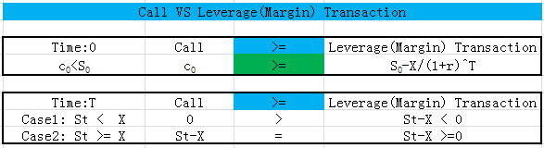
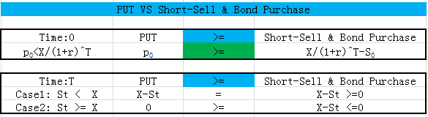
Lower & Upper Bound of Option(1)
Lower & Upper Bound of Call Option
Lower Bound of European Put Option

Slide 10
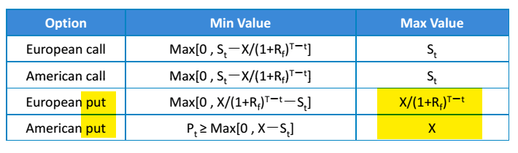
Lower & Upper Bound of Option(2)
Lower & Upper Bound of Option Value

Slide 11
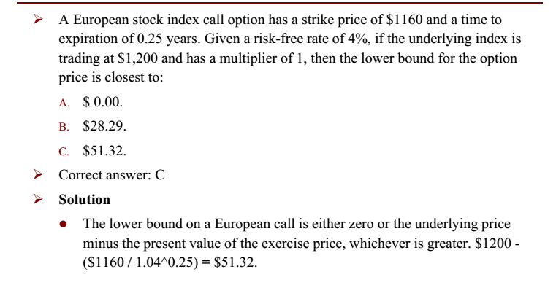
Example

Slide 12
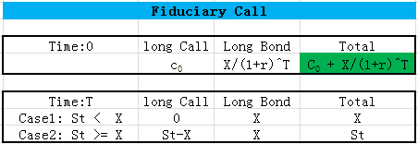
Put-Call Parity-Fiduciary Call
Fiduciary Call is a portfolio consisting of:
A long position in a European call option with an exercise price of X that maturities in T years on a stock.
A long position in a pure‐discount risk less bond that pays X in T years

Slide 13
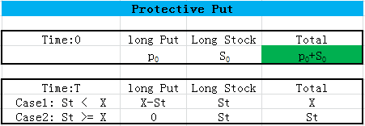
Put-Call Parity- Protective Put
Protective Put is a portfolio consisting of:
A long position in a European put option with an exercise price of X that maturities in T years on a stock.
A long position in the underlying stock

Slide 14
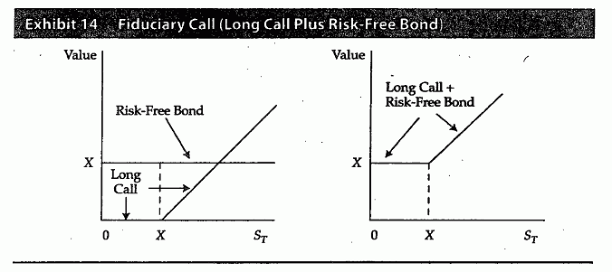
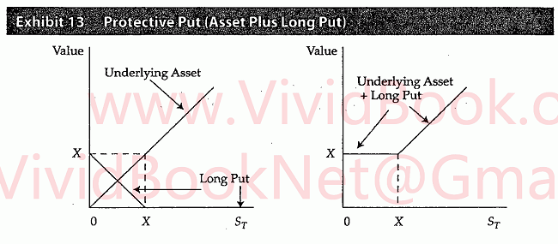
Put-Call Parity- Graph

Slide 15
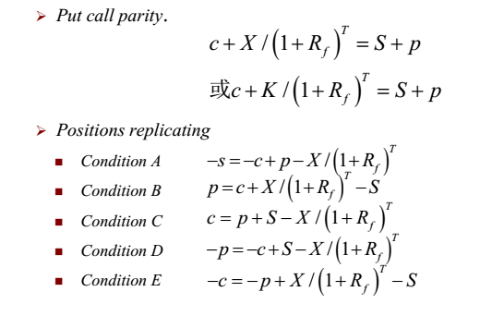
Put-Call Parity Formula
Put-Call Parity : Not Applicable to American Options (unless they are held to expiration)
American Options allow early exercise, Early exercise will result in a departure in the present values of the two portfolios.)

Slide 16
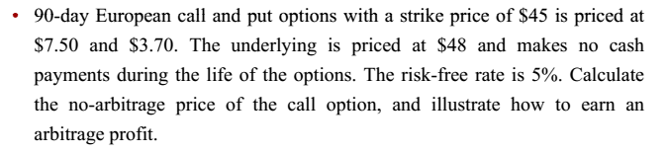
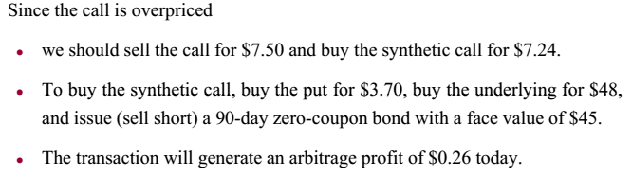
Example: Exploit violations of parity
Example: Exploit violations of put-call parity
Answer:

Slide 17
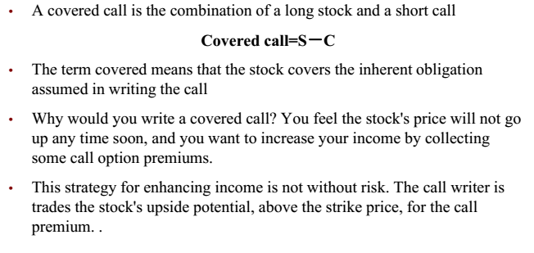
Fiduciary Call VS Covered Call
Covered Call

Slide 18
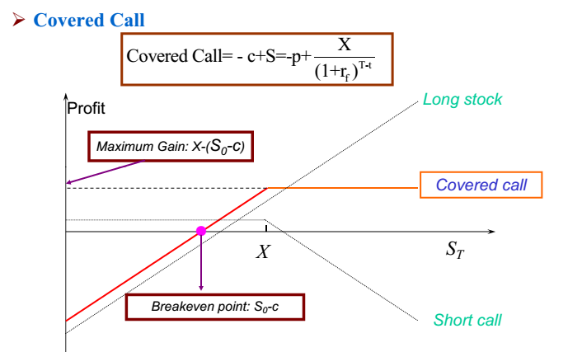
Fiduciary Call VS Covered Call(2)

Slide 19
Warrant Buffet’s Exlample
Coca-Cola: Lower Purchase Price
April 1993, Sold 5 million shares out-of-the-money Coca-Cola put options(X=$35)
Received Premium: 1.5 * 5M => 7.5M$
Berkshire's 2008 Letter to shareholders
Our put contracts total $37.1 billion: S&P 500, FTSE 100, Euro Stoxx 50, and Nikkei 225. Our first contract comes due on September 9, 2019 and our last on January 24, 2028. We have received premiums of $4.9 billion, money we have invested.
Notes:
http://www.nasdaq.com/article/warren-buffett-converts-crisisera-warrants-for-28-of-goldman-sachs-cm285398

Slide 20
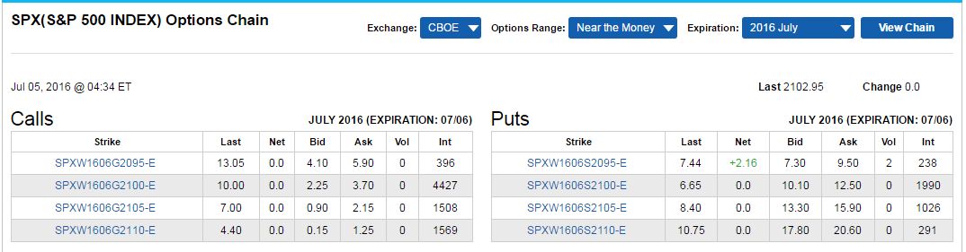
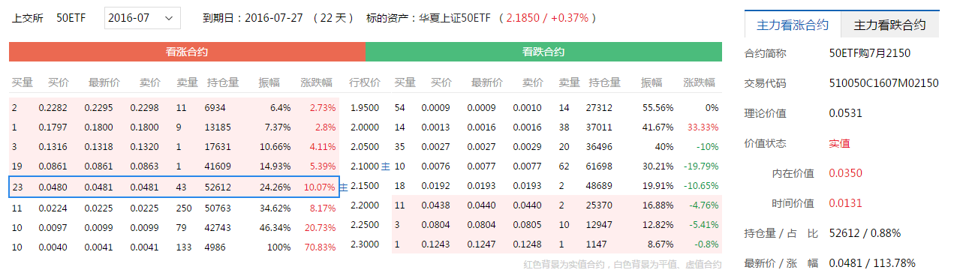
Quotes
CBOE: https://www.cboe.com/delayedquote/quotetable.aspx?ticker=SPX
SSE: http://stock.finance.sina.com.cn/option/quotes.html
Notes:
CBOE: https://www.cboe.com/DelayedQuote/quotetable.aspx
http://stock.finance.sina.com.cn/option/quotes.html
SSE: http://edu.sse.com.cn/col/option/home/

